Slide 1
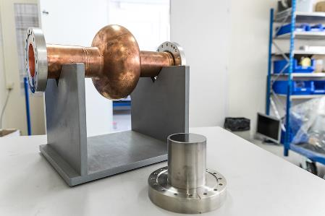
RF characterization of superconducting samples- REF264H
Lorena VEGA CID
Section: SY/RF/SRF
Supervisors: G. Vandoni, W. Venturini

Slide 2
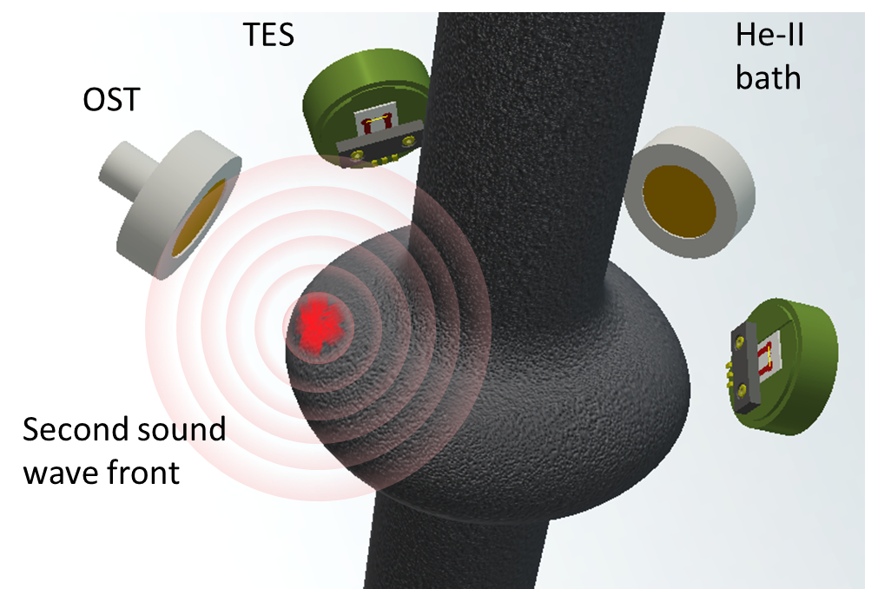
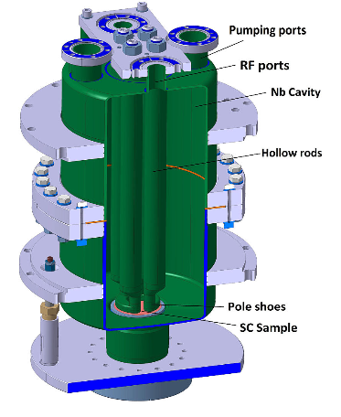
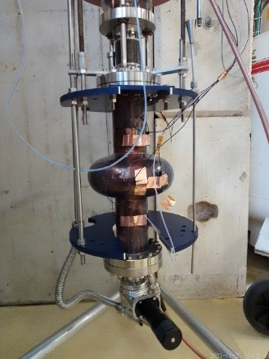
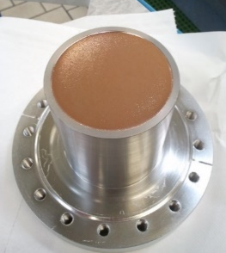
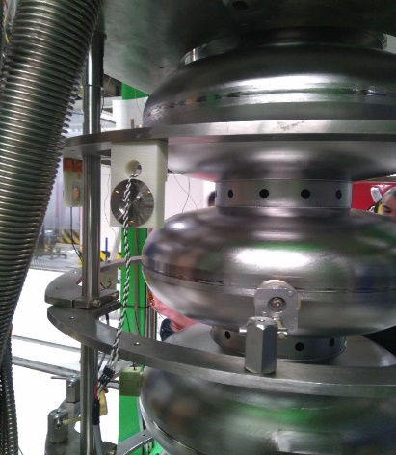
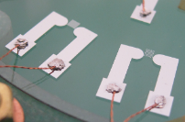
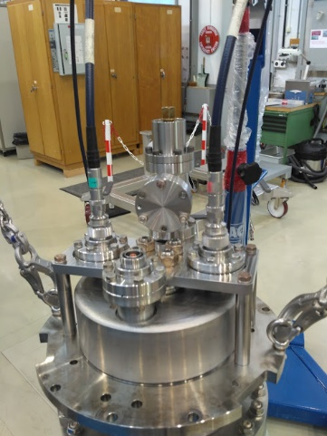
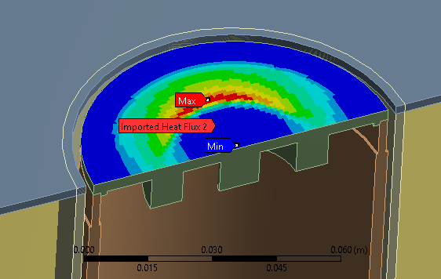
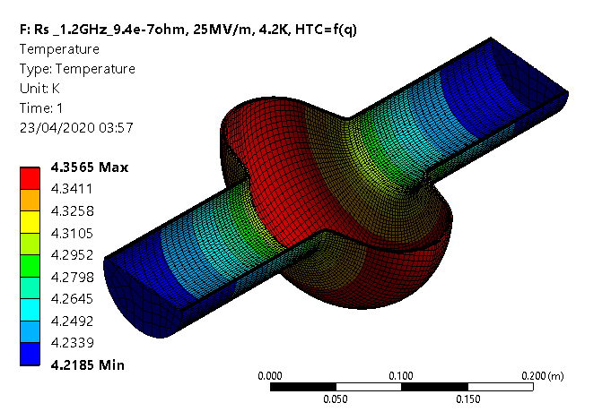
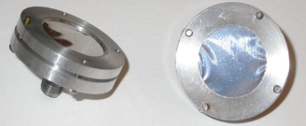
Performed activities
Thermal mapping of SRF cavities for quench localization
RF characterization of superconducting thin films
Measurements of flat samples in QPR
Measurement of 1.3 GHz cavity
Quench initiation
New QPR commissioning
Coupled RF-thermal simulations
TES
OST

Slide 3
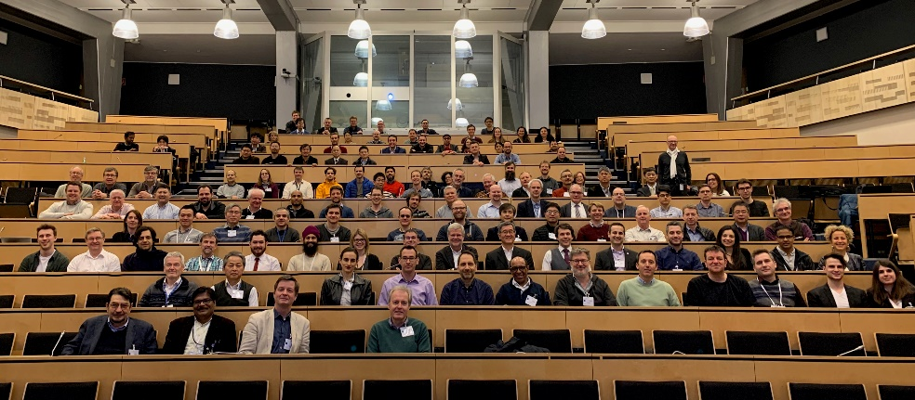

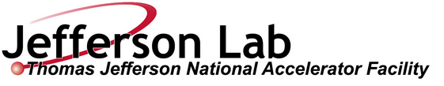
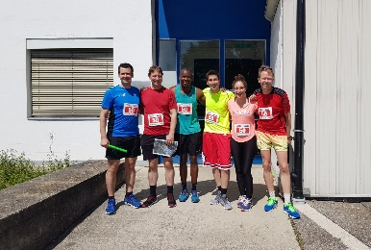
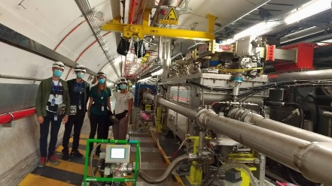
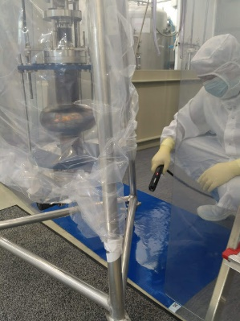
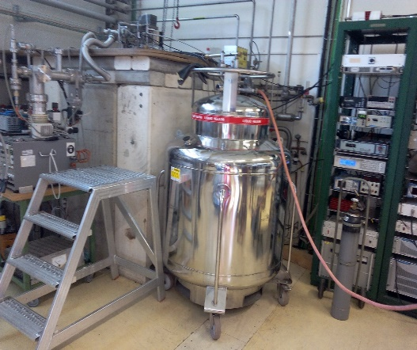
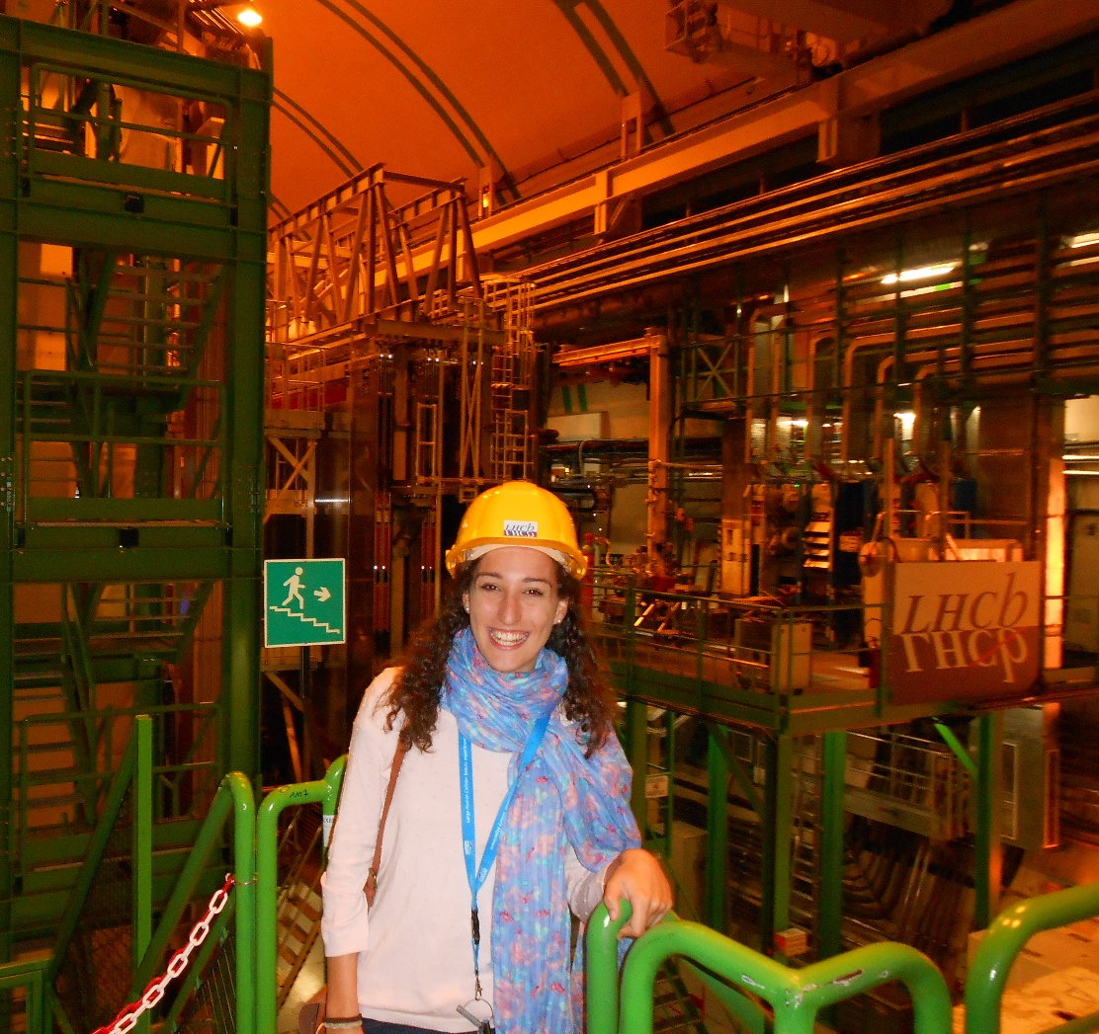
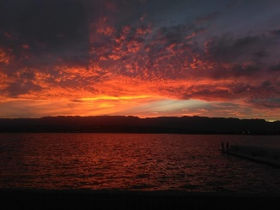
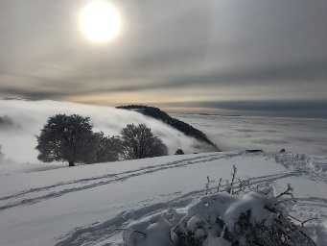

The FTEC position has been a great opportunity to…
Learn new skills by attending courses
French course
Octave course
CERN Accelerator School: RF for accelerators: CANCELLED
EASISchool 3: School on applied superconductivity
Participate in international workshops and conferences
-Invited talk at Tesla Technology Collaboration TTC 2020
-Presentation at Workshop during School on applied superconductivity
Get involved in an international community
Periodic collaboration meetings with colleagues from other institutions
Social events.
Gain knowledge in particle accelerators’ technologies
Future steps
Fellow in SY-RF

Slide 4
Many thanks

