Slide 1
HL-LHC IT String
Project follow–up
Nicolás Heredia García
Team: M. Bajko (supervisor), M. Pojer, N. Heredia, A. Kosmicki, E. Vergara, M. Rodriguez
11th FTEC Workshop, CERN, 10th December 2020
https://indico.cern.ch/category/7257/

Slide 2
Table of contents
Introduction
Overview of the project: HL-LHC IT String
Activities performed in Q3 & Q4 2020
Achievements
Upcoming activities and milestones
Conclusions

Slide 3
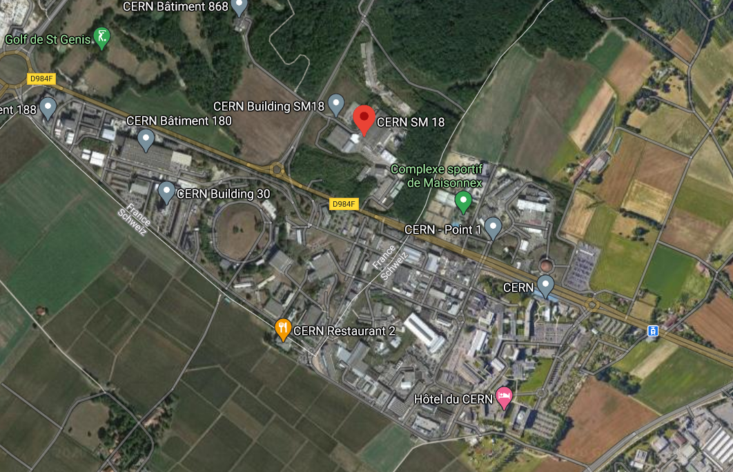
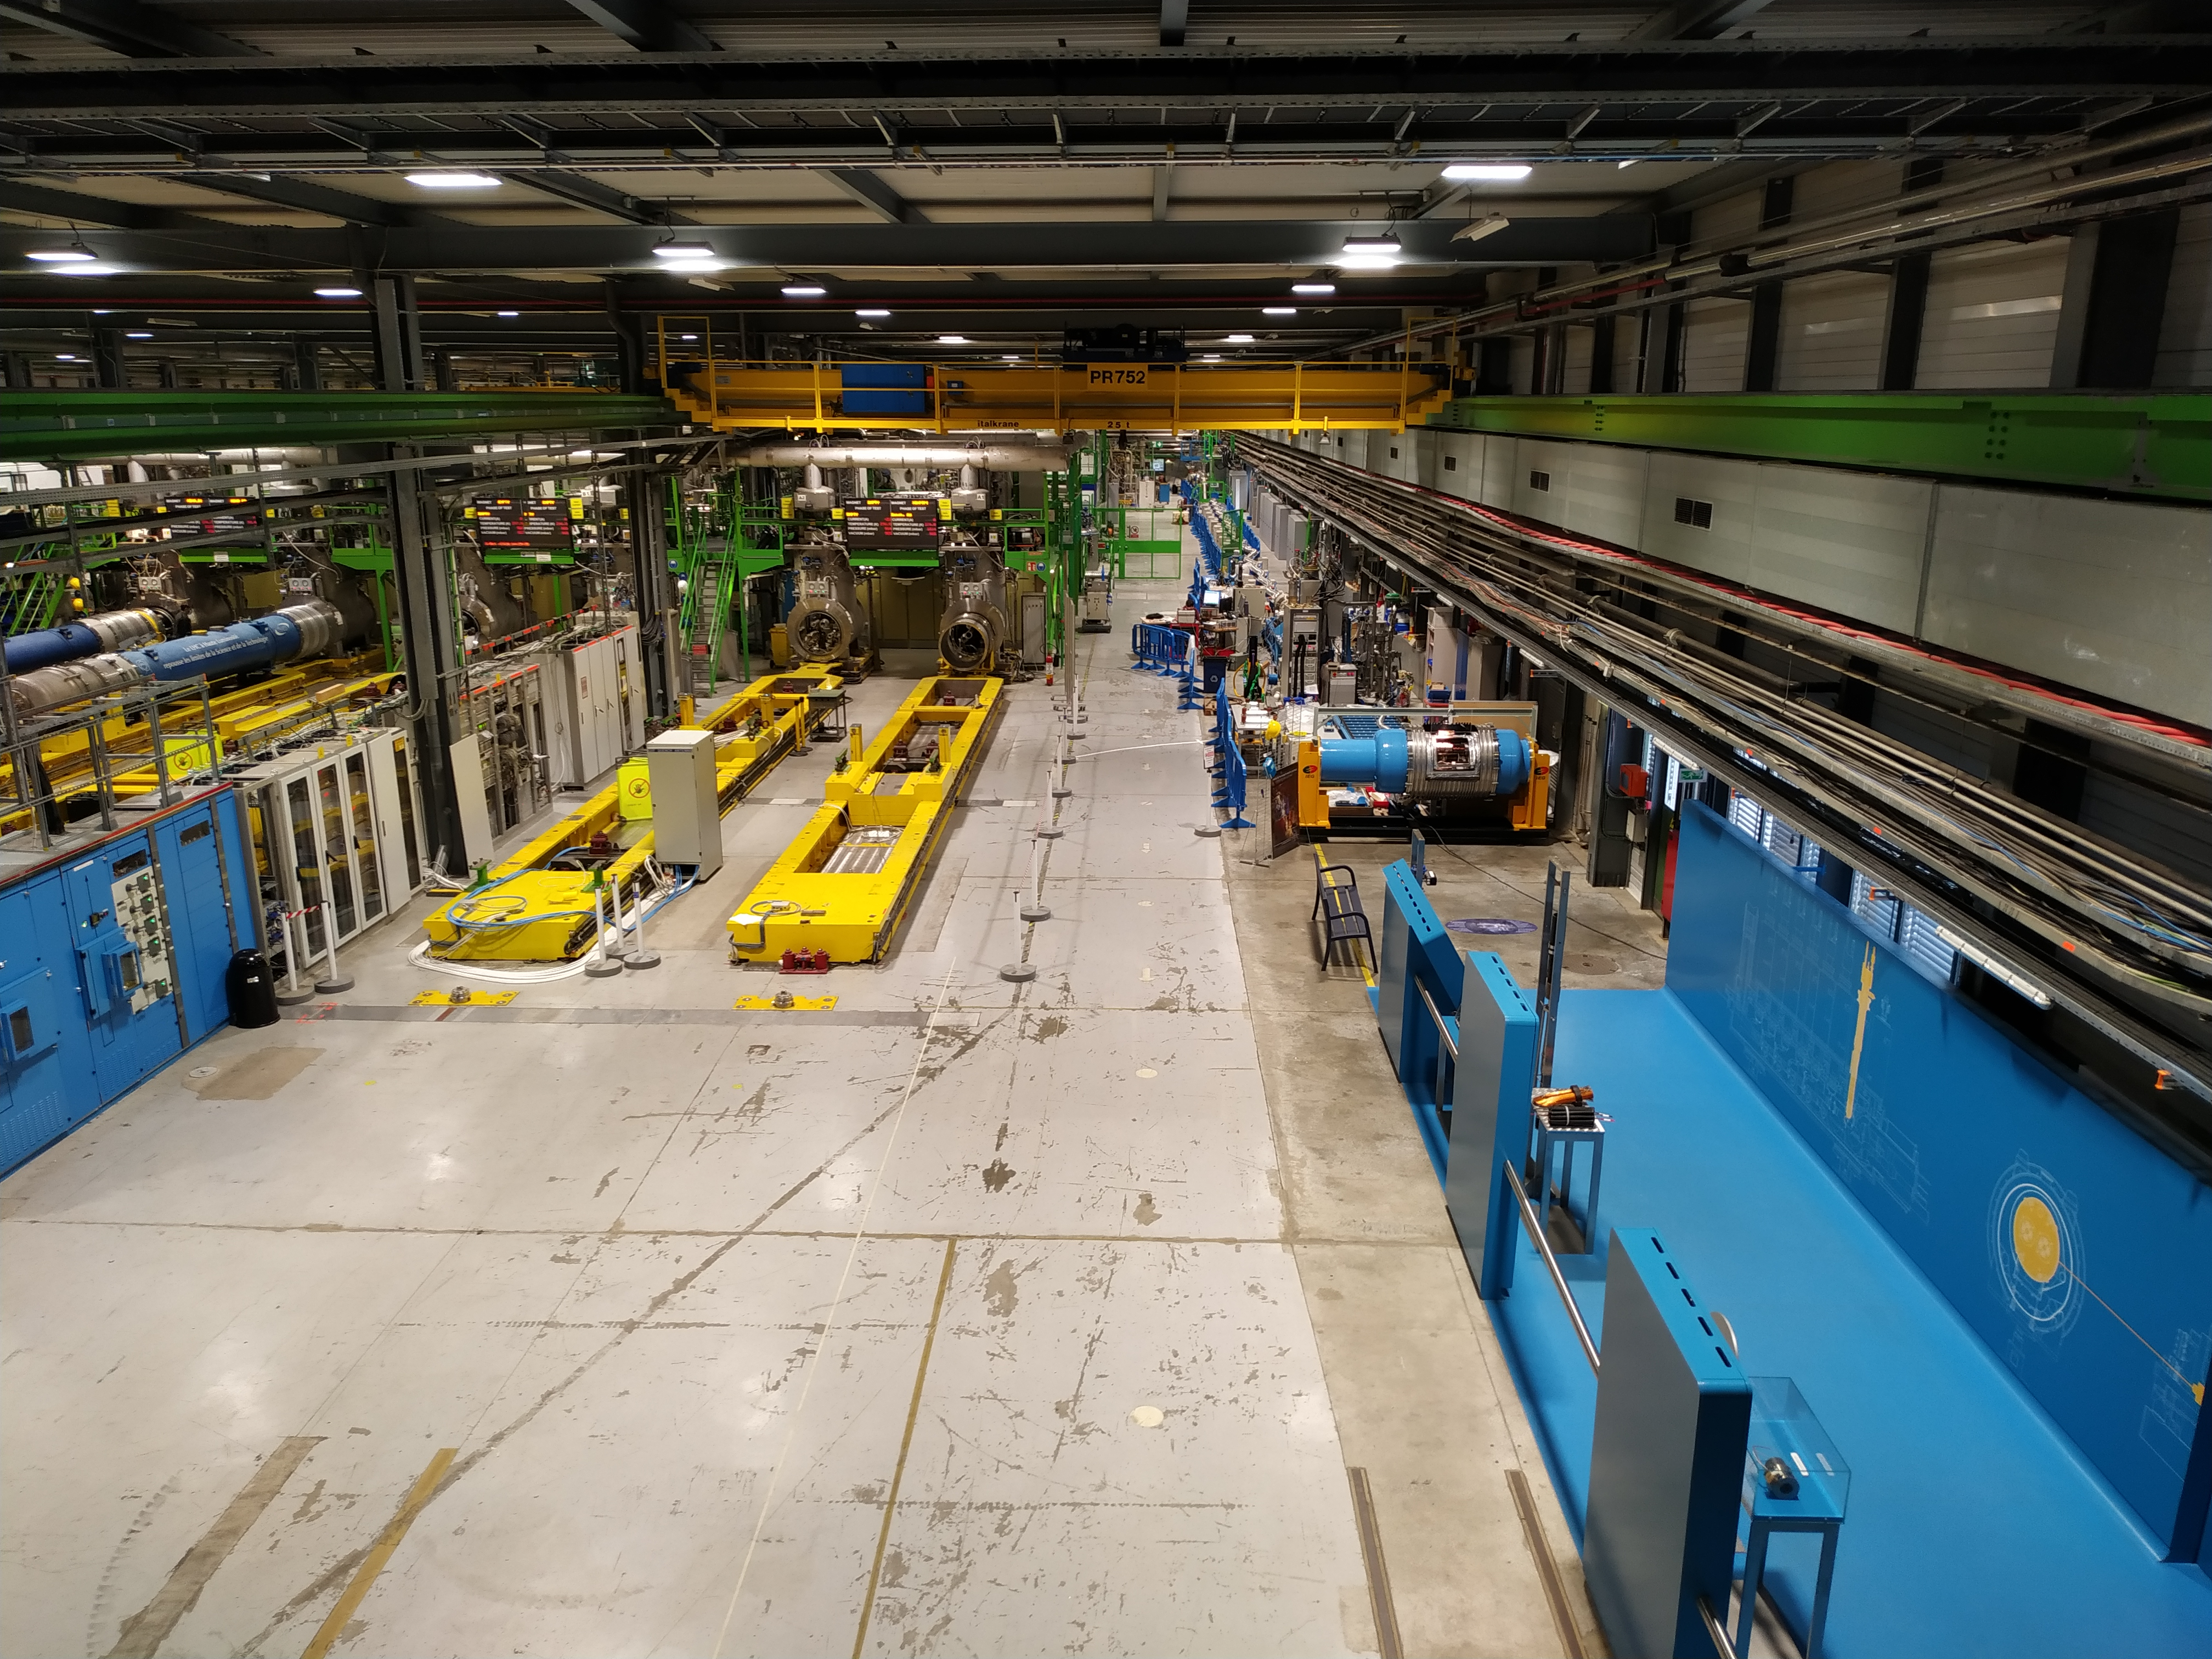
Introduction
TE
ABT
CRG
EPC
MPE
MSC
VSC
PPR
CMI
LMF
MDT
MM
MNC
SCD
TF
…
SM18

Slide 4
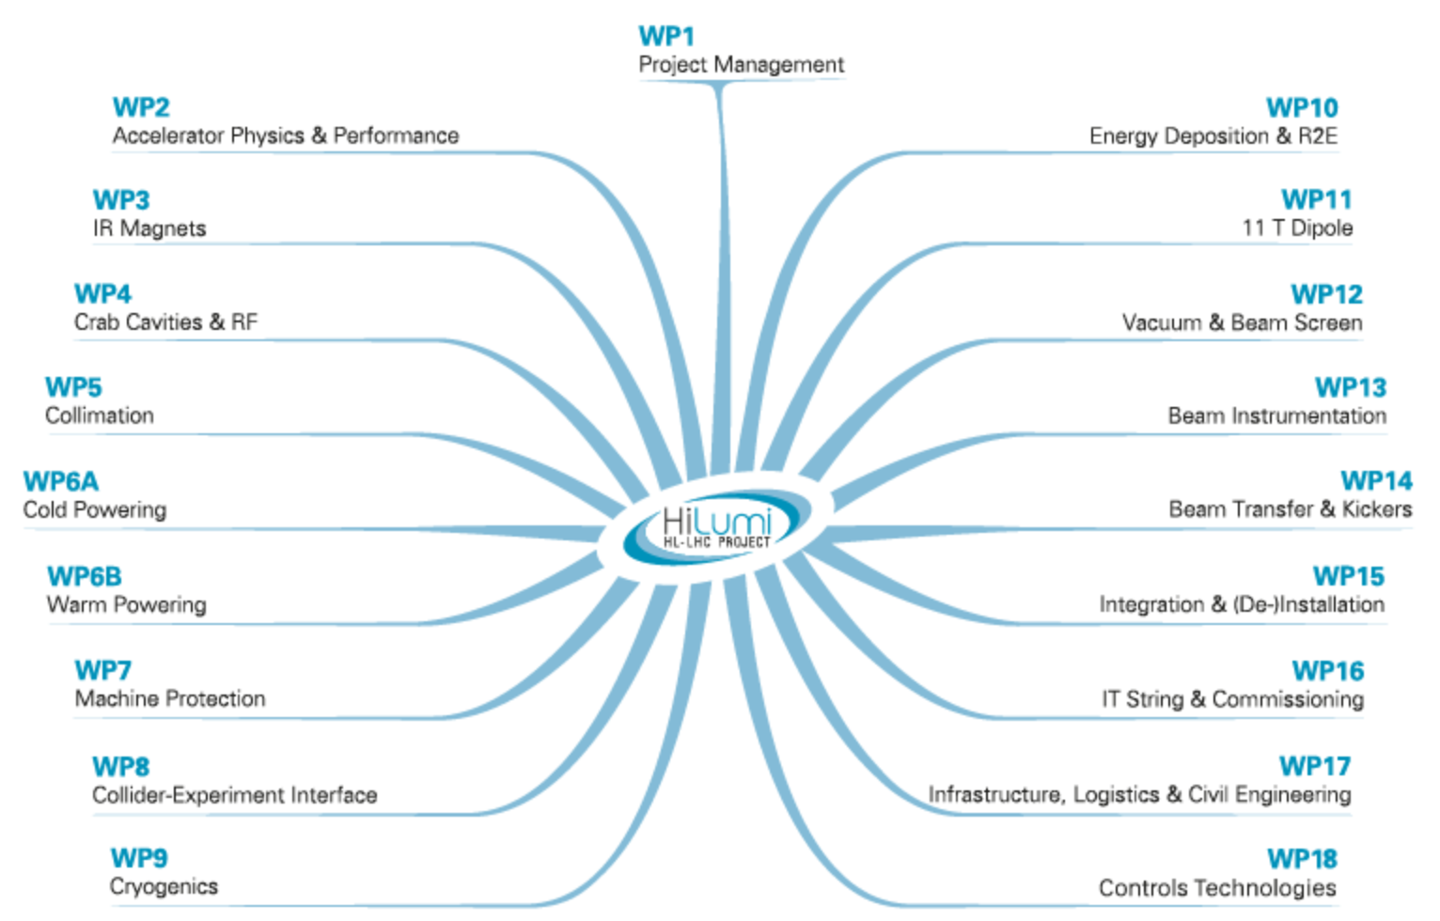
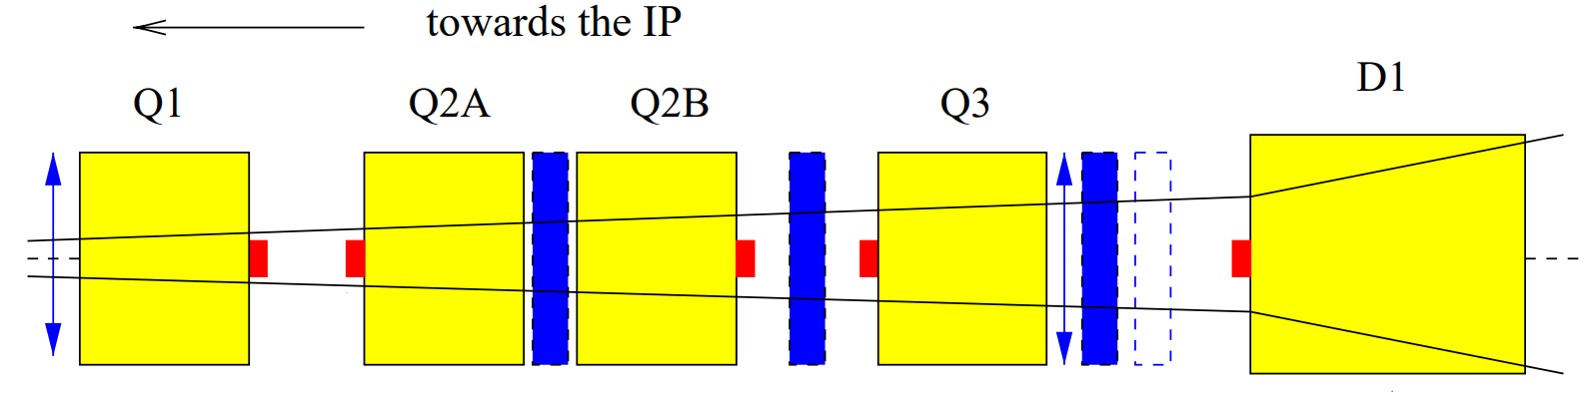
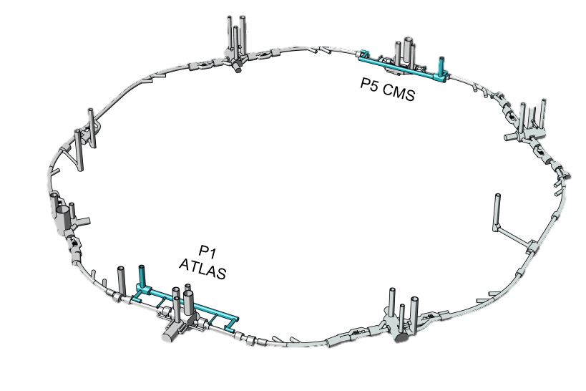
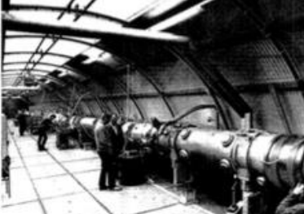
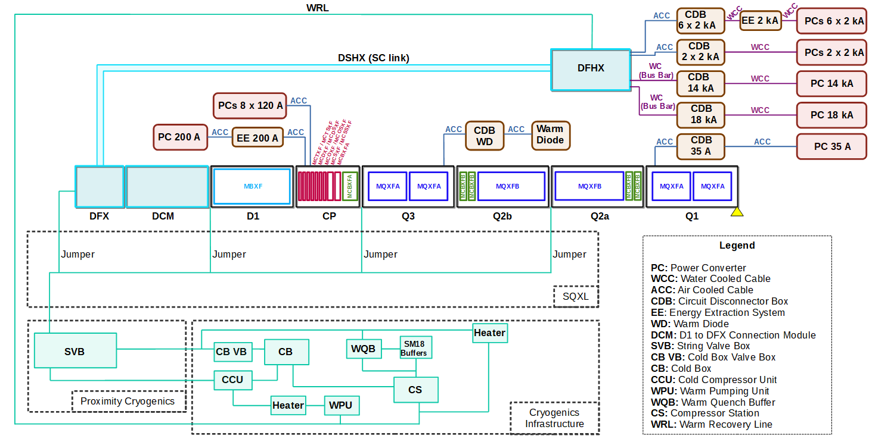
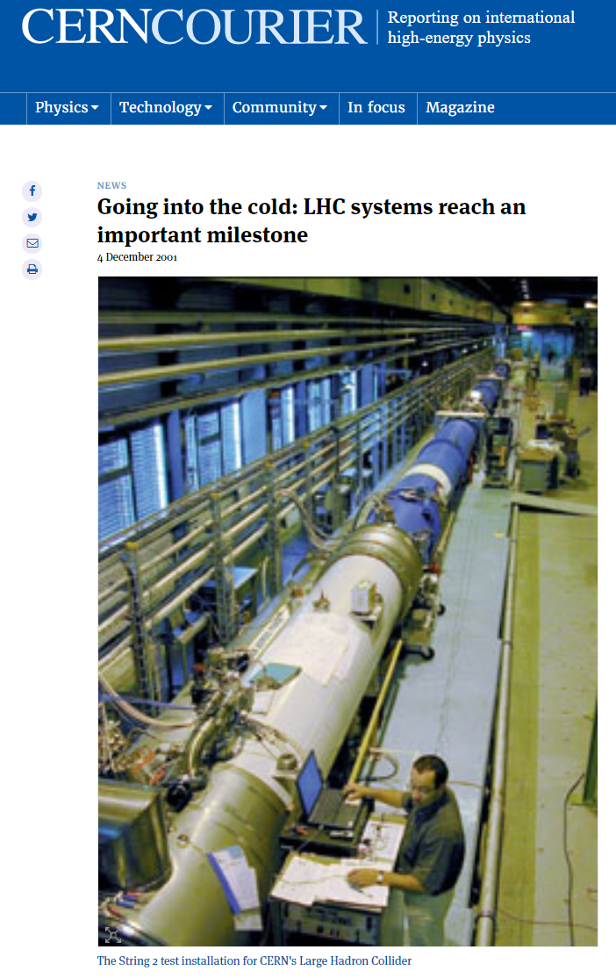

Overview of the project: HL-LHC IT String
Insertion region ATLAS and CMS
Test to validate the collective behaviour of a complete set of new technologies
String III
Set-up
Definition
Integration
Design
Installation
Transport and handling
Cool down
Operation
Budget Allocation
Planning
Coordination
Procurement strategy
Systems Interconnection
Placement
Safety and Operation Procedures
Approval
Check Readiness
Tests and studies
Warm up

Slide 5
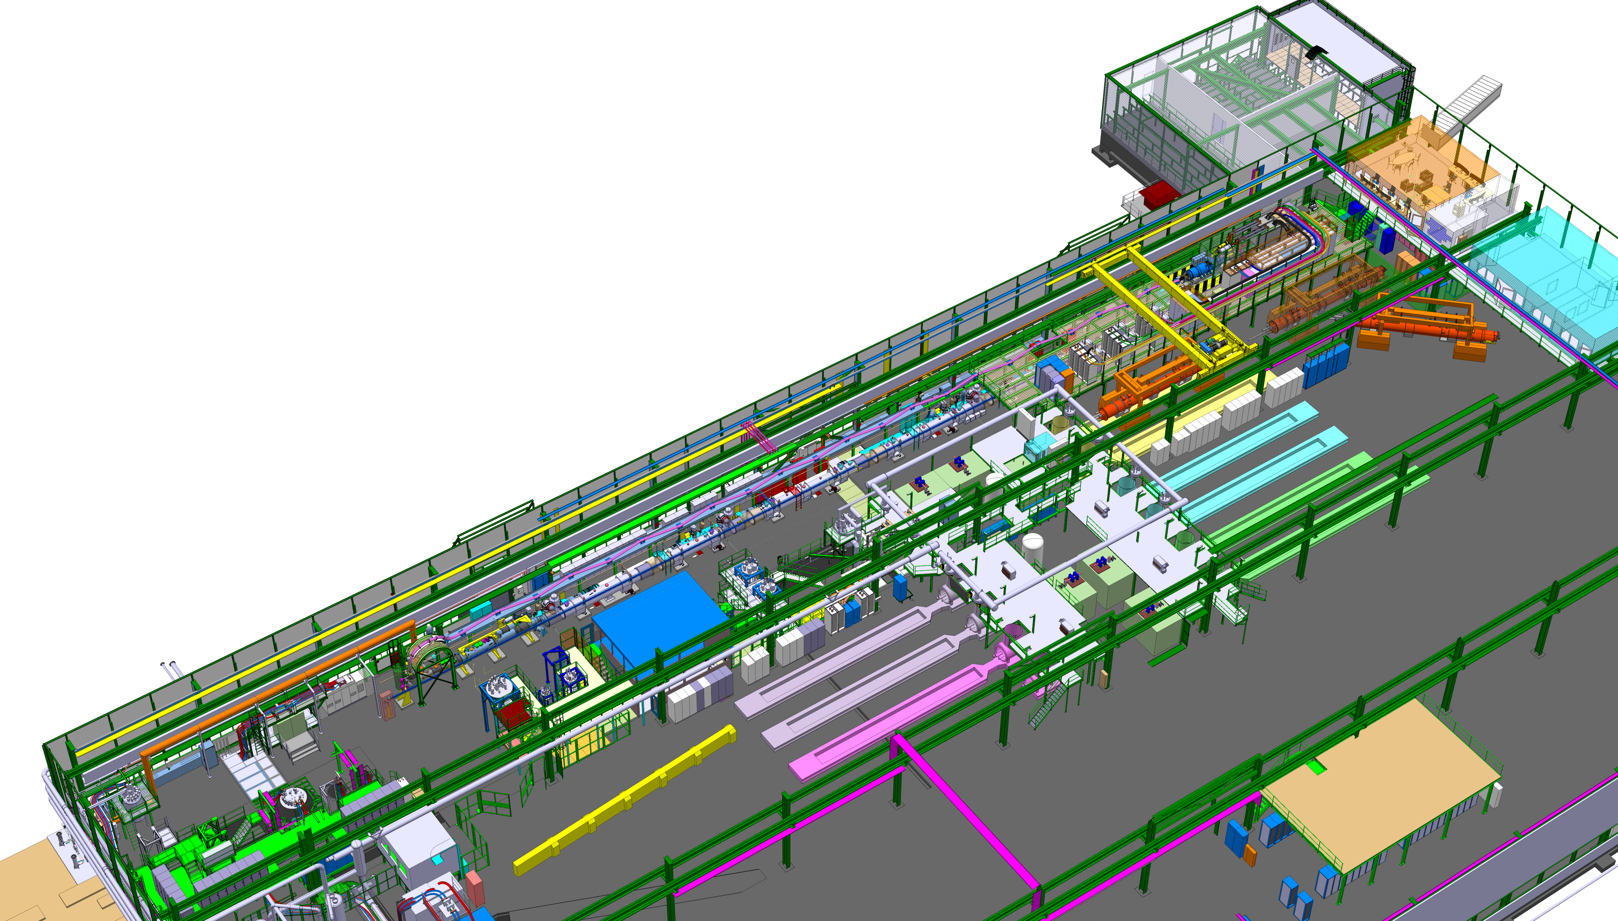
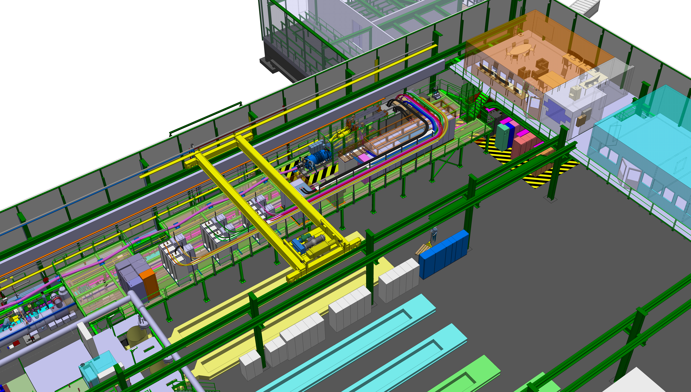
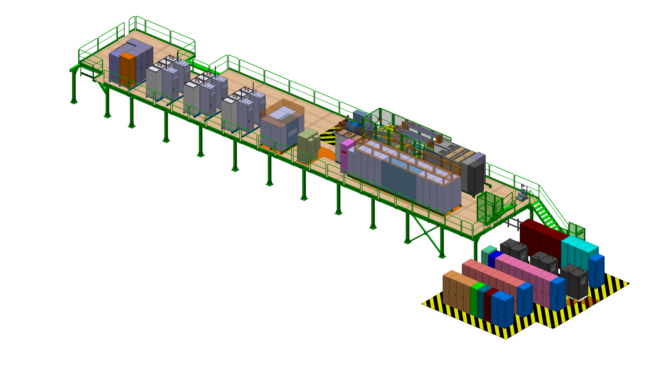
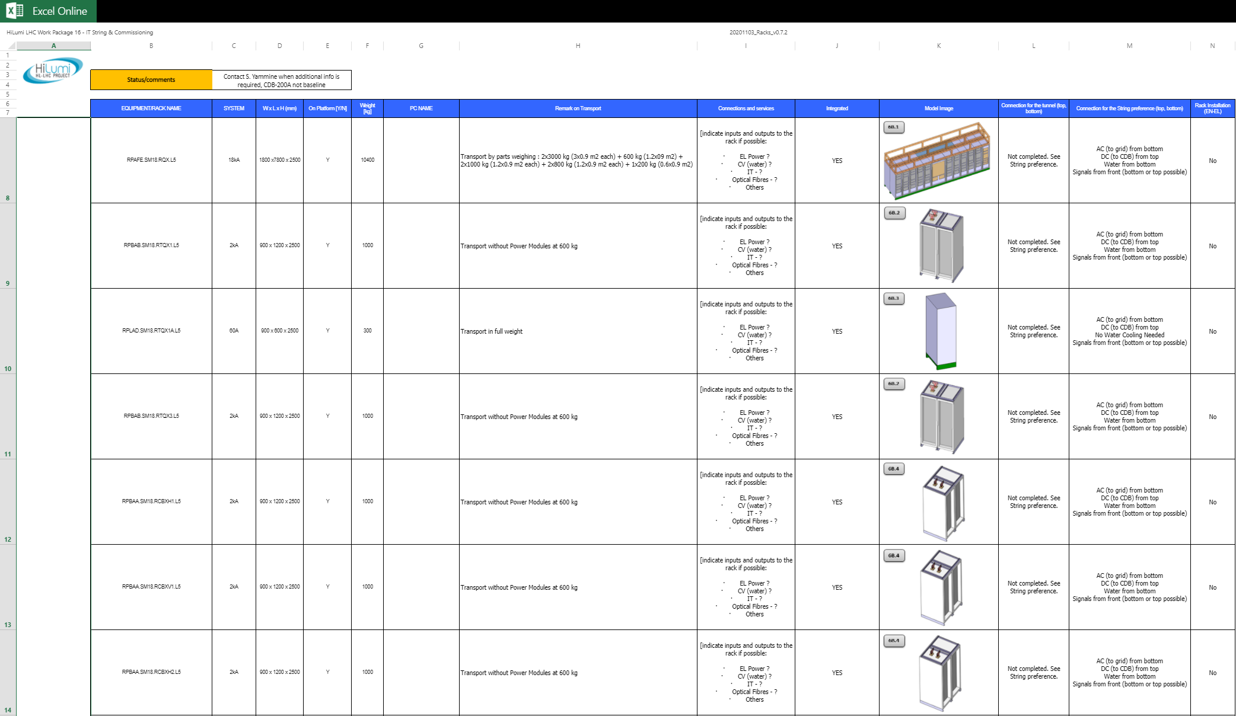
Activities performed in Q3 & Q4 2020
Design
Organise meetings
Discuss users needs
Check equipment changes
Update and improve documentation
Inform of changes in the IT String Meeting

Slide 6
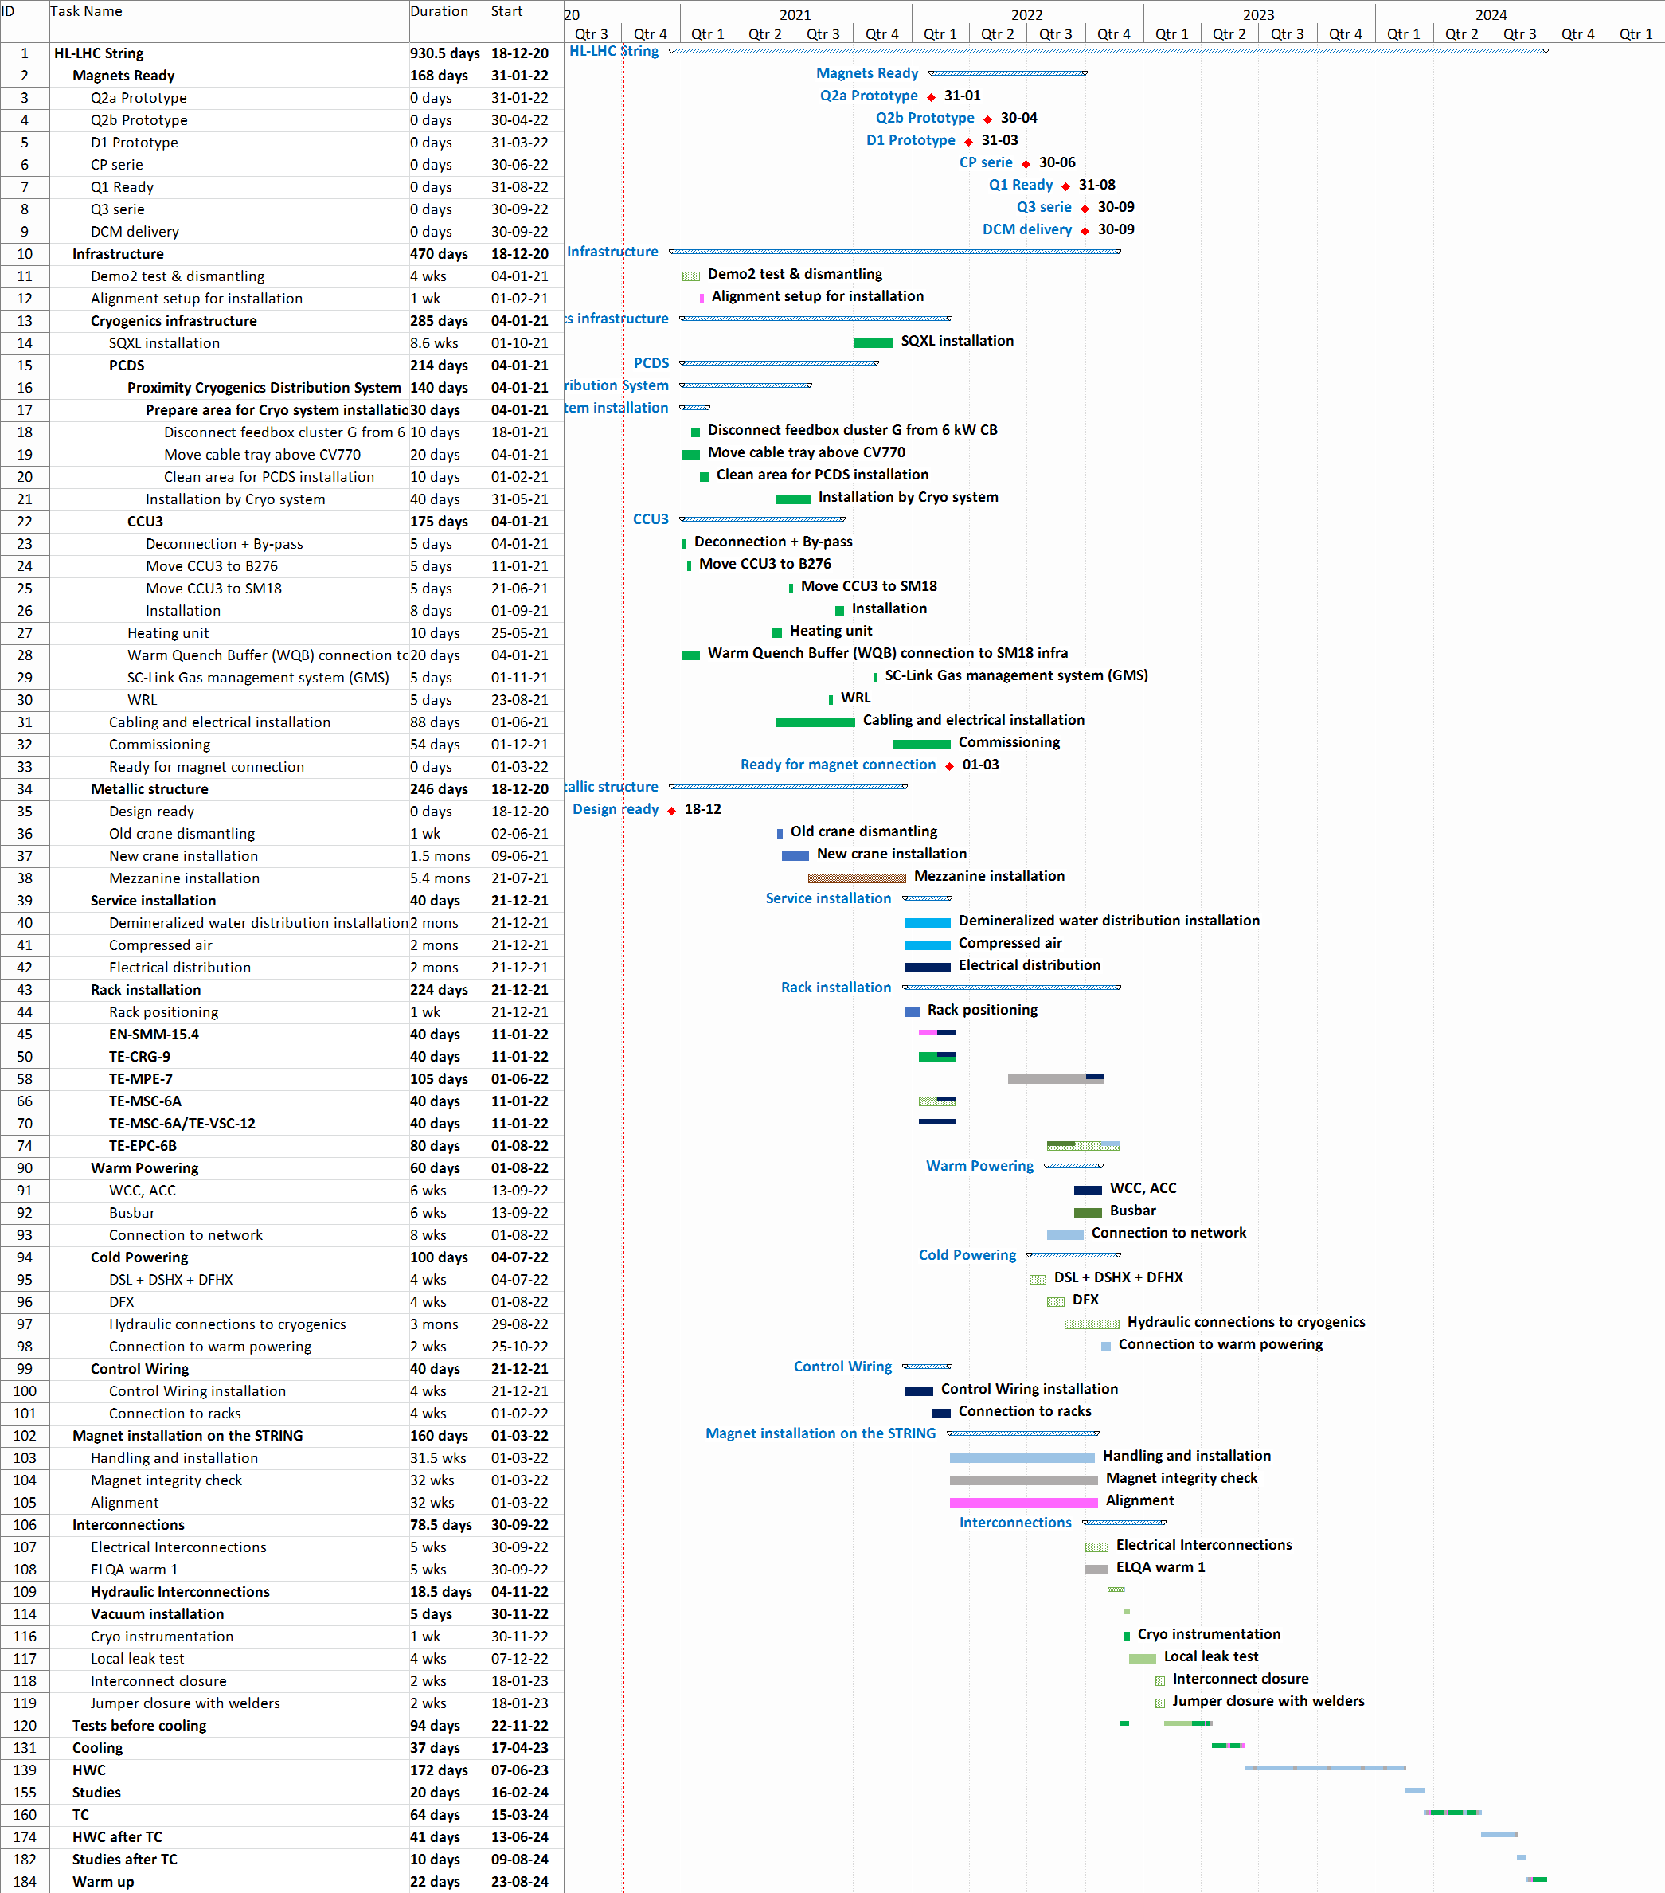
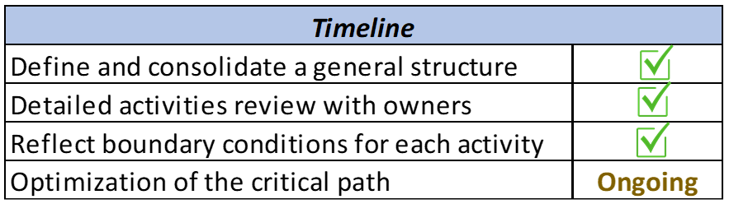
Activities performed in Q3 & Q4 2020
Installation Planning
https://oss-coordination.web.cern.ch/gantt/latest?facilities=SM18&scale=week&worktypeproject=
Installation Start
Q2 2021
Organise meetings
Follow open points
Sequence of installation and granularity
Figure out and collect relations between activities and coordinate with the planner
Inform in the IT String Meeting

Slide 7
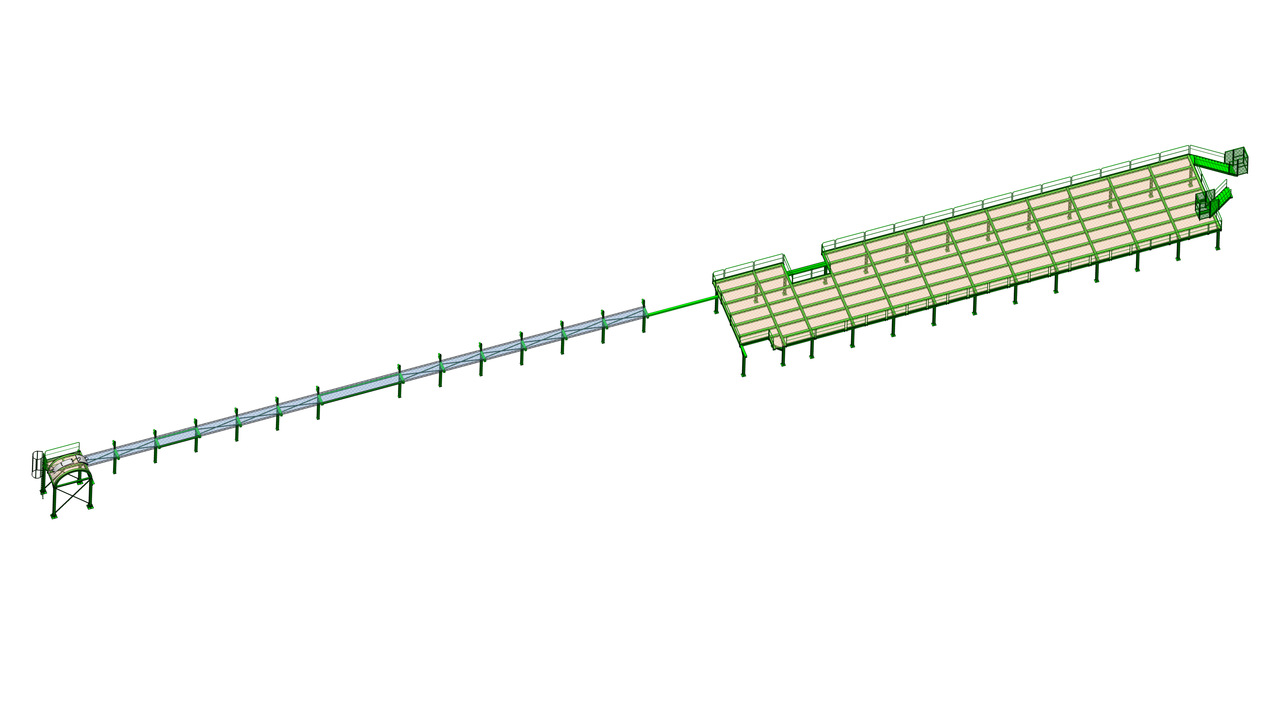
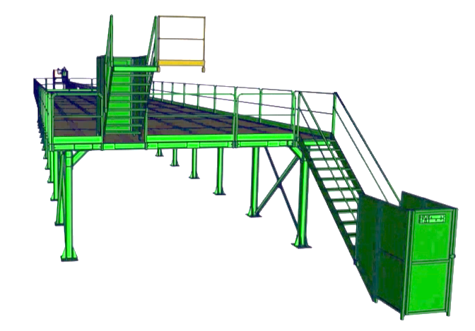
Activities performed in Q3 & Q4 2020
Metallic structure procurement
Platform Equipment | Units | kg/Unit | Total Weight (kg) | Surface (m2) | Pressure (Pa)
DFHX | 1 | 6100 | 6100 | 8.4 | 7124
Sc Link | 76 | 35 | 2660 | 15.2 | 1717
18 kA Power Converter | 1 | 10400 | 10400 | 14.04 | 7267
14 kA Power Converter | 1 | 3600 | 3600 | 4.32 | 8175
2 kA Power Converter | 8 | 1000 | 8000 | 1.08 | 9083
0,6 kA Power Converter | 1 | 300 | 300 | 0.54 | 5450
0,12 kA Power Converter | 2 | 300 | 600 | 0.54 | 5450
Rack Circuit 35 A | 1 | 300 | 300 | 0.54 | 5450
CDB 18 kA | 1 | 1600 | 1600 | 1.44 | 10900
CDB 14 kA | 1 | 1600 | 1600 | 1.44 | 10900
CDB 2 kA | 4 | 500 | 2000 | 0.72 | 6813
CDB 200 A | 1 | 500 | 500 | 0.54 | 9083
CDB Earth | 1 | 500 | 500 | 0.54 | 9083
CDB Ctrl | 1 | 300 | 300 | 0.54 | 5450
DCCT | 2 | 300 | 600 | 0.54 | 5450
Warm Diode Rack | 1 | 250 | 250 | 0.54 | 4542
Energy Extraction 2 kA | 6 | 250 | 1500 | 0.54 | 4542
Energy Extraction 0,6 kA | 1 | 500 | 500 | 0.54 | 9083
 |  | SUM | 41310
Preliminary definition of materials, profiles...
Calculation pressure on the structure
Preparation document for procurement

Slide 8

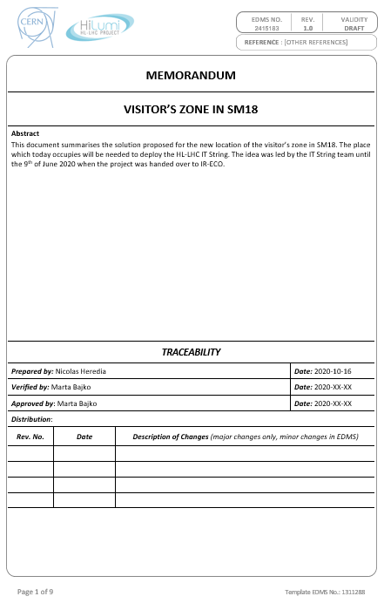

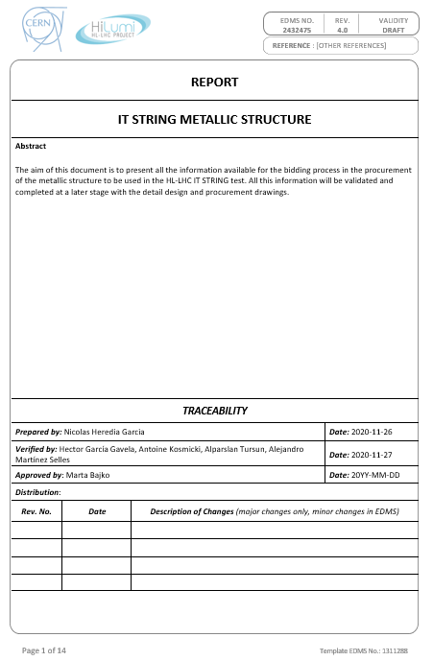

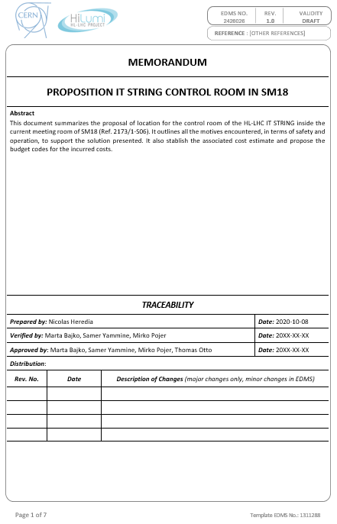
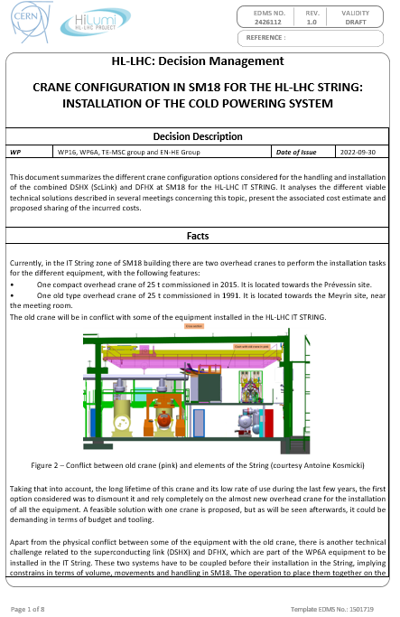
Activities performed in Q3 & Q4 2020
Repository management
Technical Documents
SharePoint
EDMS
Indico
Others
Attending meetings: TCCs, WP15 Integration meetings
Helping with reporting
Link with the users
Drawing schematics
Training: French Course, AXEL

Slide 9
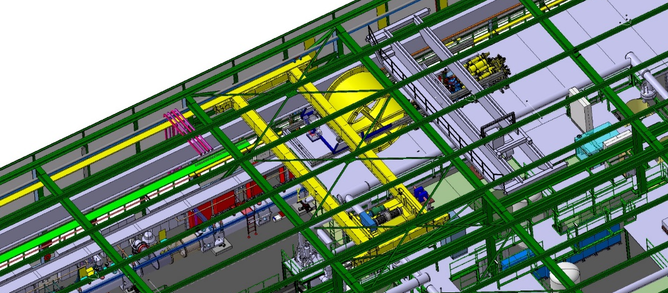
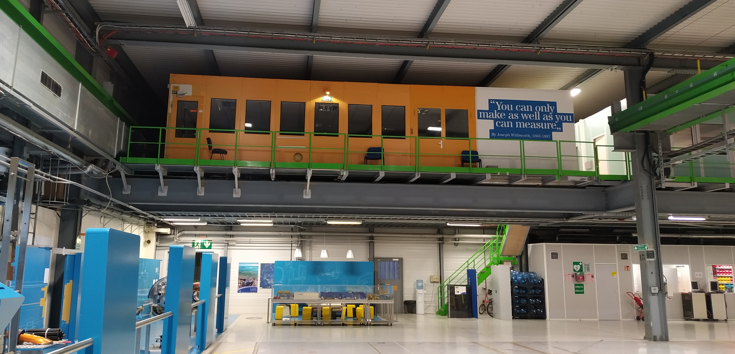
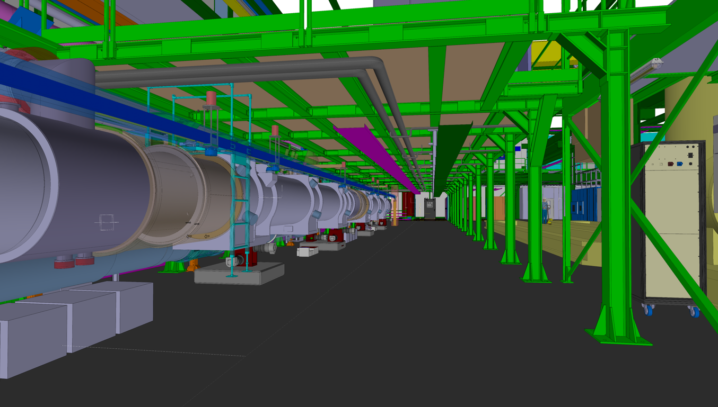
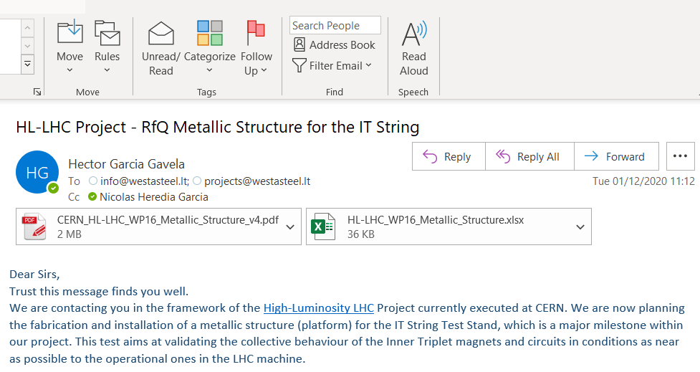
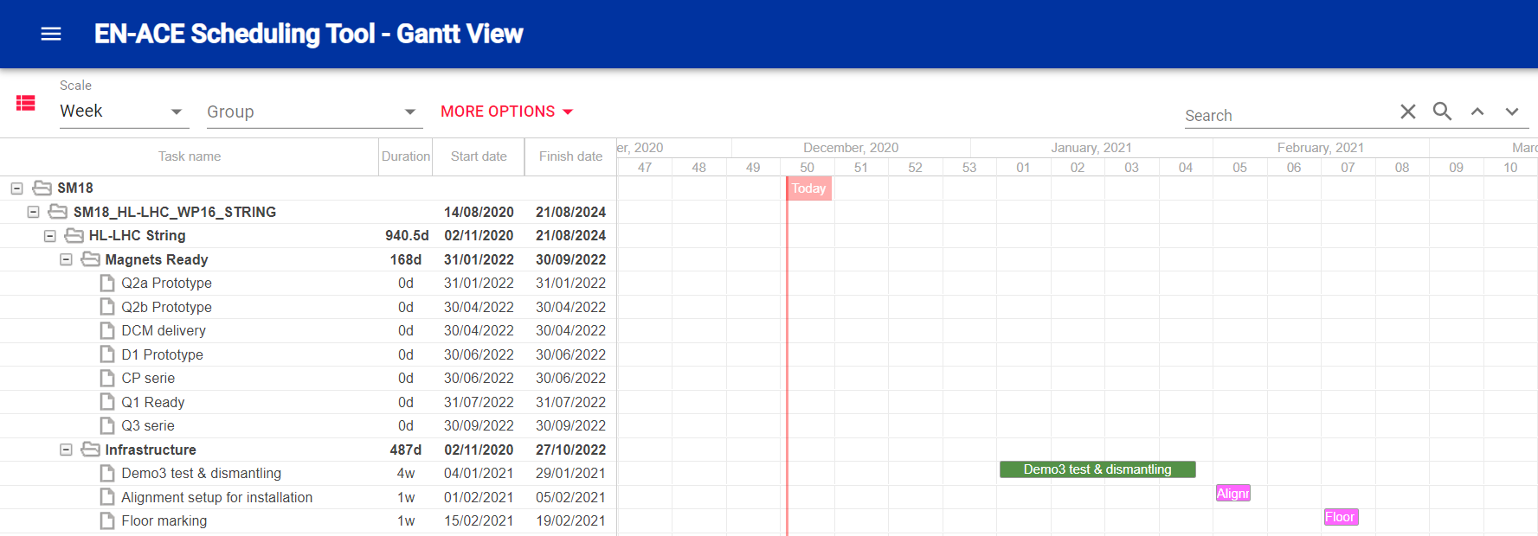
Achievements
1
Approval of the overhead crane change in SM18
2
Approval of the control room location
3
Important advance in the integration and planning
4
Start of procurement process for the metallic structure

Slide 10

Upcoming activities
To be continued
Work on the installation planning and integration
New
Define handling and transport to the String
Manage info repositories
Documents, drawings, meetings, reporting.
Collect DICs users
Work on safety and operation procedures
2021 Milestones
Clean Area Demo 3 & Visitors Zone - March
Proximity Cryo Installation - April
Metallic Platform Installation - August
Installation New Crane SM18 - March

Slide 11

Conclusions
The project is moving forward as planned
Expecting new members to join to the team
Many challenges ahead for 2021 and 2022
Great personal and professional experience so far

Slide 12
Thank you for your attention
Questions, remarks…

