Slide 2

TE-CRG-CE
Controls and Electrical Support for cryogenics
SPS BA6
Cryoplant Refurbishment
for CPC6-UNICOS process control system
Sergio VILLANUEVA
Supervisor: Marco PEZZETTI
11th FTEC Workshop

Slide 3
Summary
Introduction
Control Architecture
Software refurbishment methodology
  Turbine control
  Compressor protection: Sigma Control
Conclusion
Planning

Slide 4
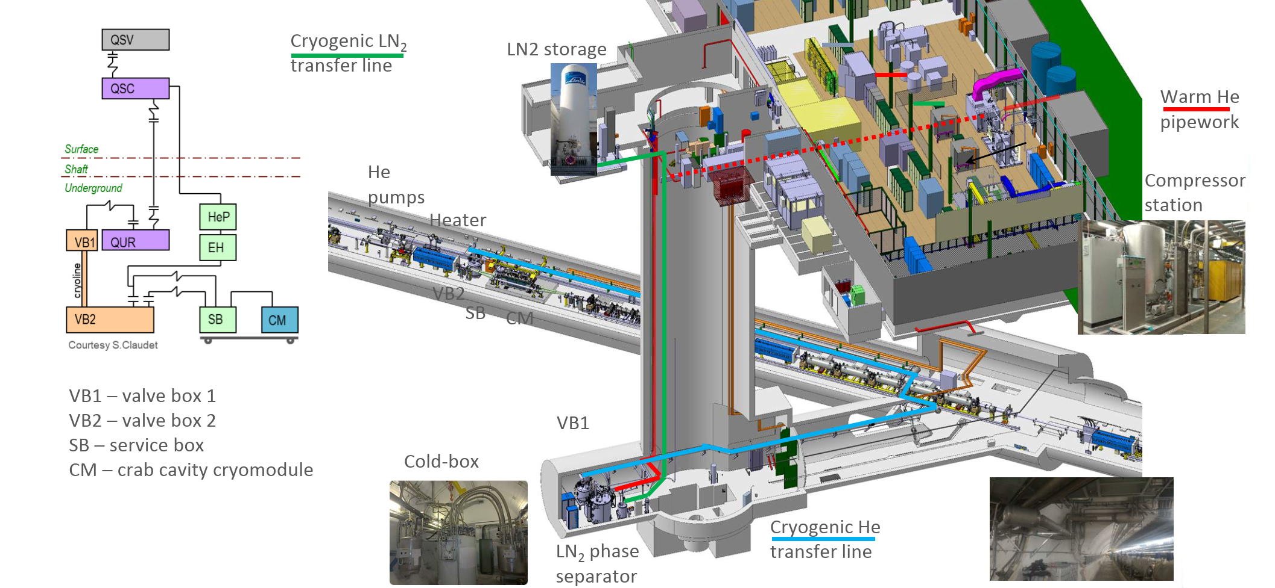

Introduction: SPS BA6 Layout
Refurbishment of the CFB_BA6_QACR Cryoplant
(HW + SW) to be integrated in UNICOS
Warm He

Slide 5

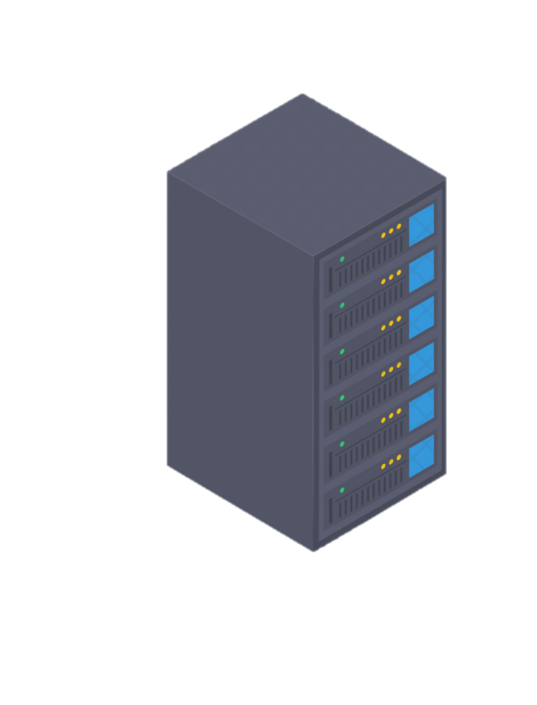
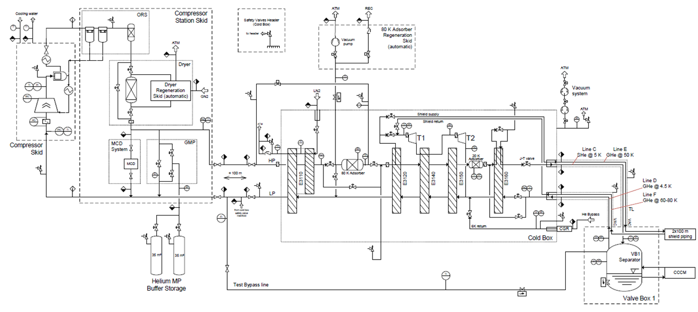
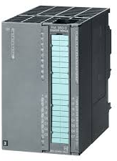

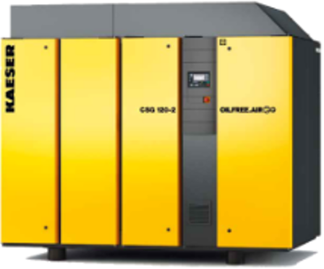
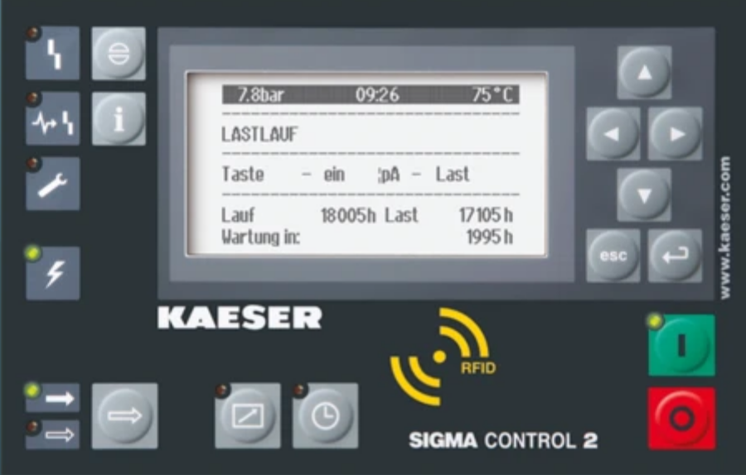

SPS BA6 Control Architecture
Linde PLC and the Kaeser compressor are currently black boxes.
CS-CCR-COCA
Hard to operate, maintain and diagnose
Limited supervision
Data Server
Communication
CFP-BA6_QAICC
PLC
Kaeser Compressor
+
Sigma Control
non-UNICOS
LINDE PLC
Linde PLC is not UNICOS CERN like.
(Compressor
Protection)

Slide 6

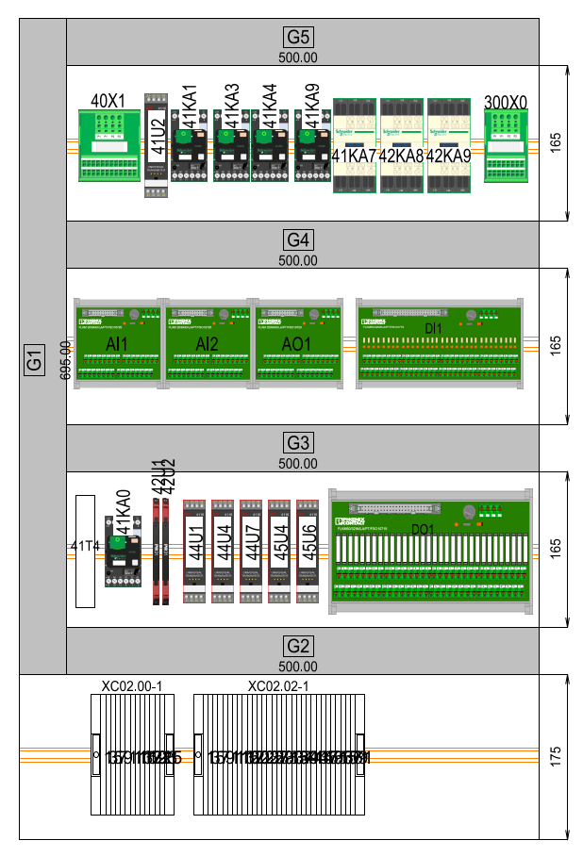
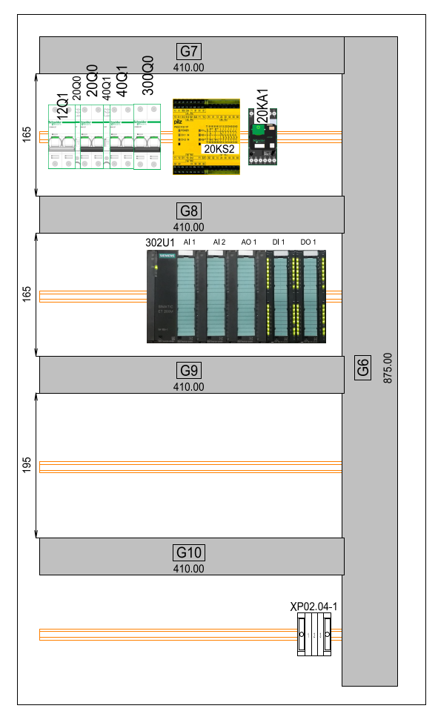
SPS BA6 Control Architecture
After the integration, an UNICOS PLC software will control the cryoplant
CS-CCR-COCA
Full control/diagnose of all equipments
New supervision
Data Server
Communication
CFP-BA6_QAICC
PLC
CFP-BA6-QACR
PLC
New Safety Chain
+ Compressor I/O

Slide 7
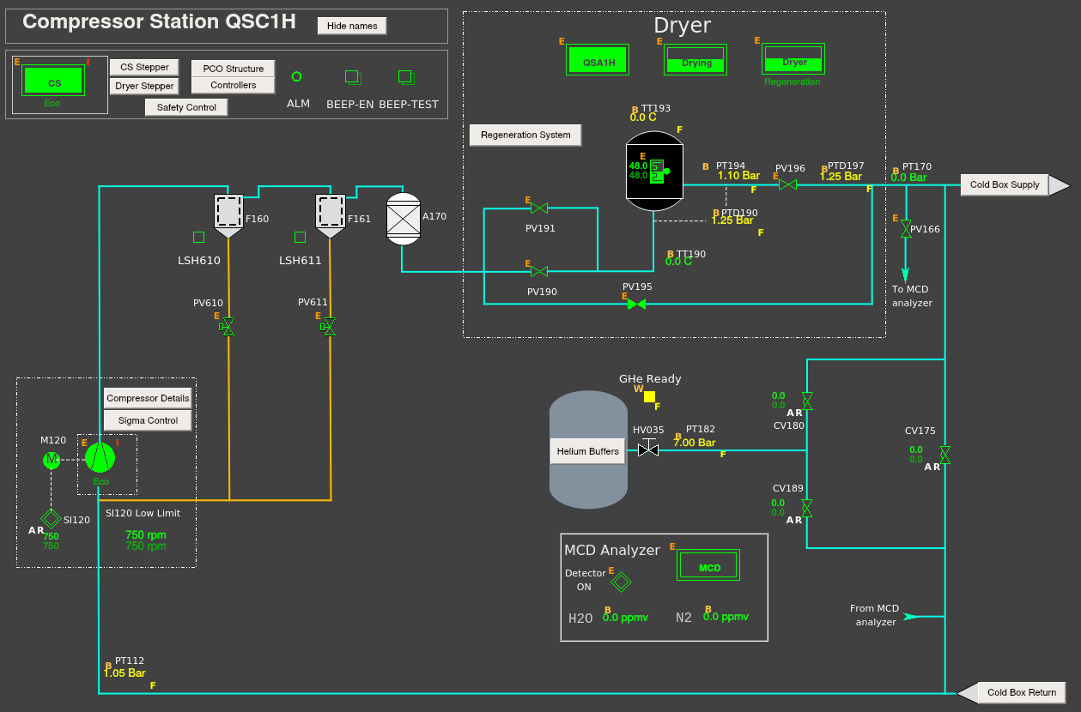
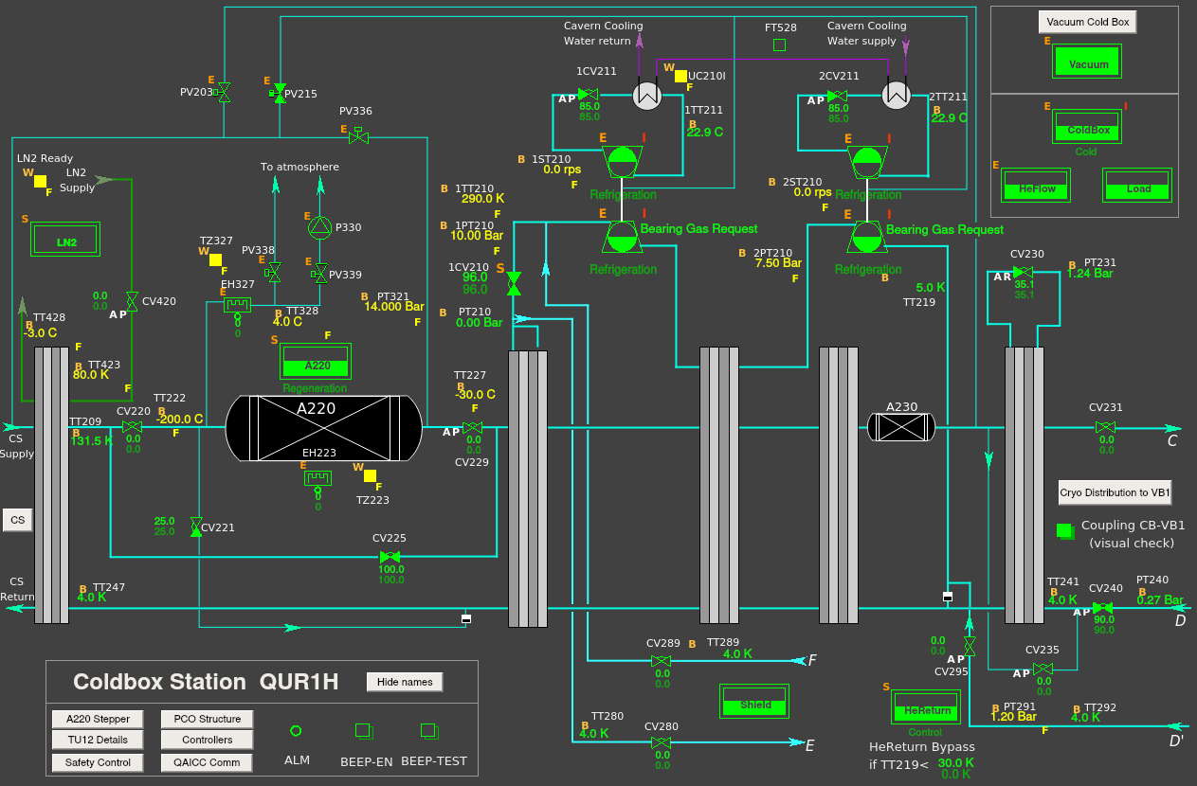
SPS BA6 Control Architecture
Updated SCADAs for Compressor and Cold Box.

Slide 8
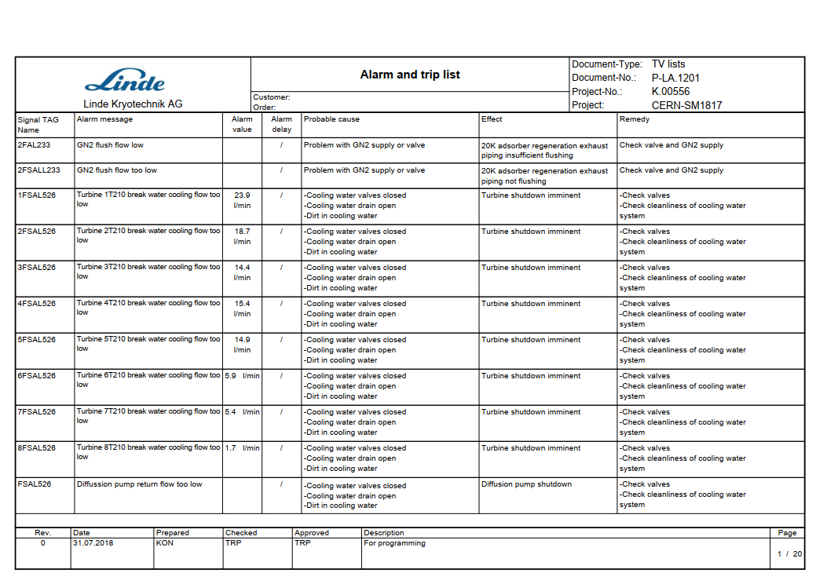
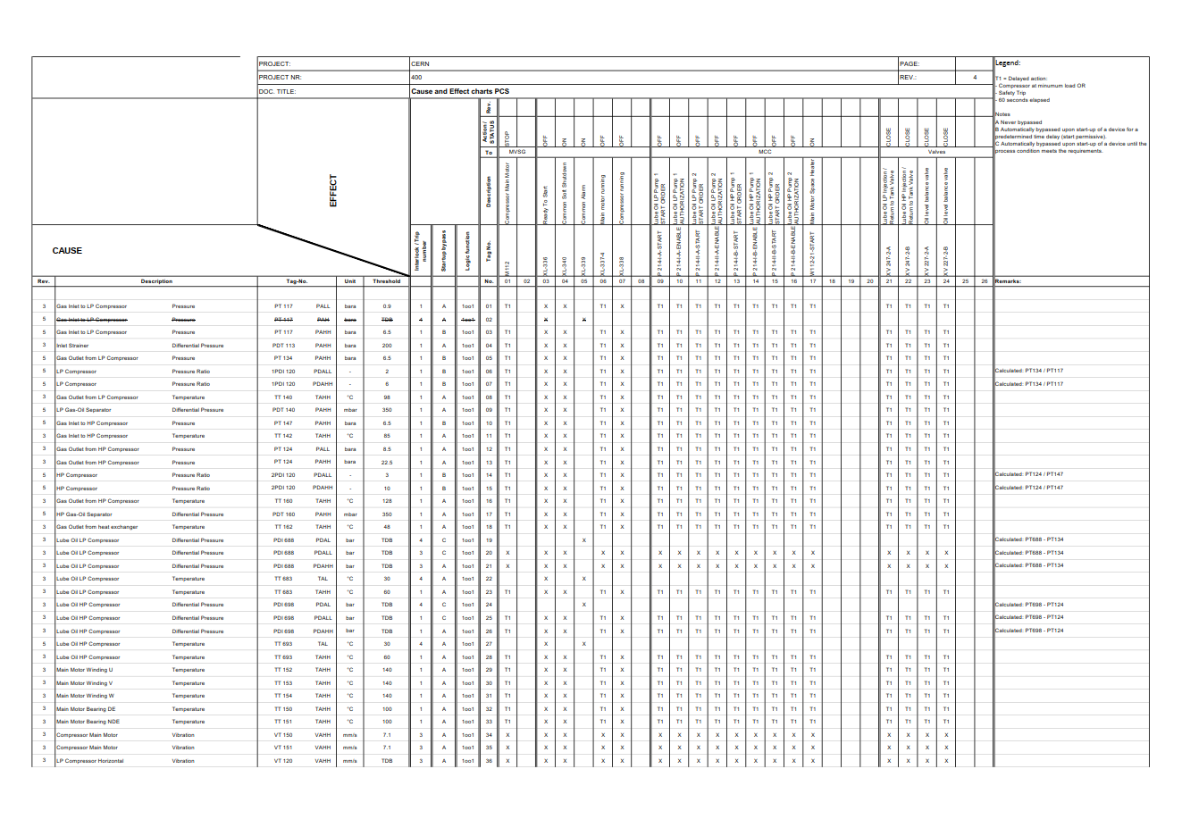
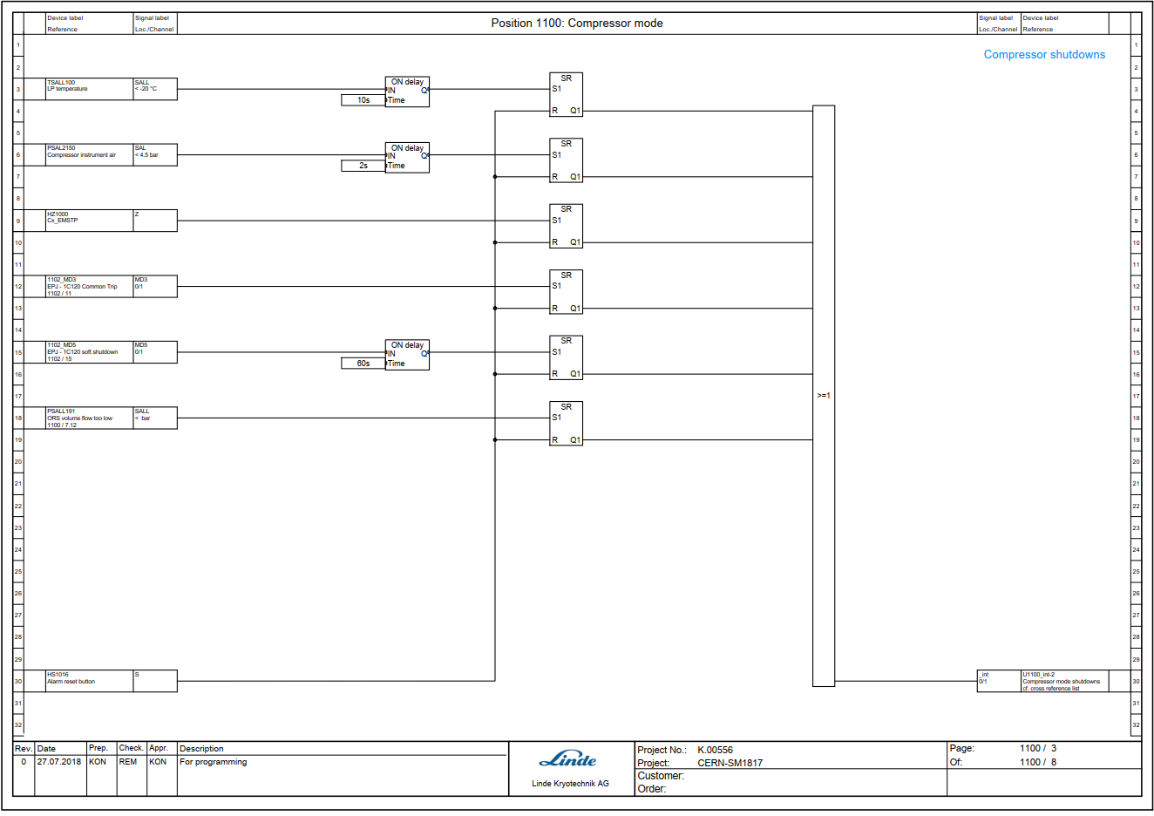
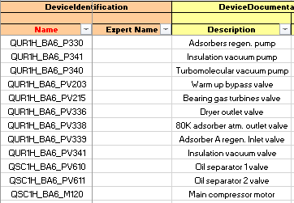
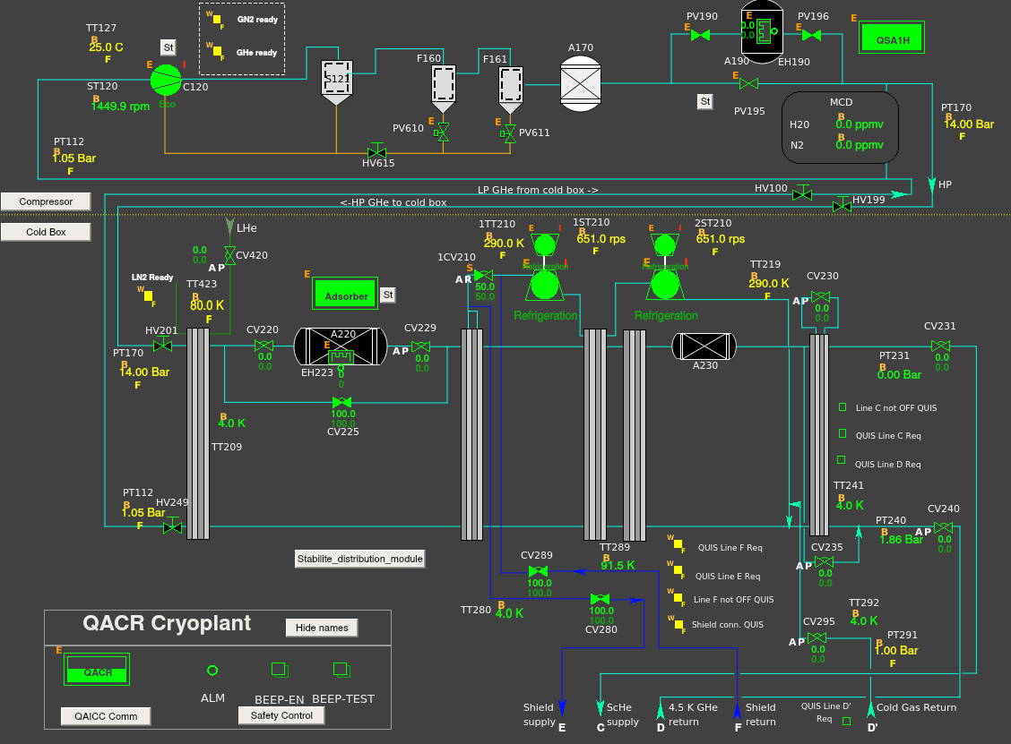

Methodology to upgrade to UNICOS
The following procedure has been followed during the development
Database + Logic definition
Unicos
generation
Mirror tests
WinCC OA / SW Ready to download
- LINDE documentation
  Alarm list
  Functional Plan
  Siemens Software
  P&ID
  Electrical drawing
Logic Spec.
SPS BA6 Compressor station
+
Cold Box
Logic Spec. Draft
(TE-CRG-OP)
SW validated after mirror test
    (TE-CRG-ML)
    (TE-CRG-OP)
- SM18 35 g/s experience
- TE-CRG-CE standards
-TE-CRG-OP / TE-CRG-ML process expertise

Slide 9
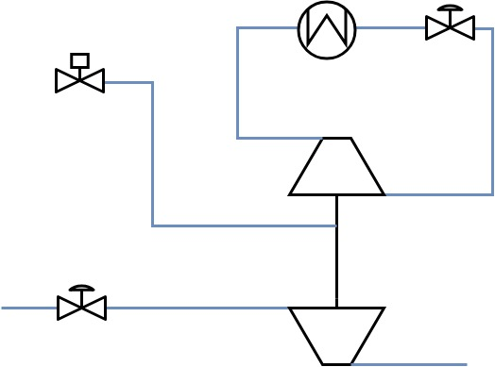
Integrating 35g/s Turbines
https://edms.cern.ch/document/2337647/1
A new PLC Function Block has been created to manage all turbine signals / valves
Thermodynamic calculations implemented with Turbine Operational Parameters (TOP)
TC
Geometry
Helium property
Thrust calculation
MAX
SC
Brake Valve
CV211
Bearing Valve
PV215
Turbine block
Setpoint
Brake Temperature
Speed Sp
Bearing Control
Command
Inlet Valve
CV210
Turbine Speed
Inlet Increment
Increment
Turbine Speed
Inlet Pressure
Inlet Temperature
Outlet Pressure
Outlet Temperature
Turbine Signals
SM18 35 g/s turbine control taken as a reference

Slide 10
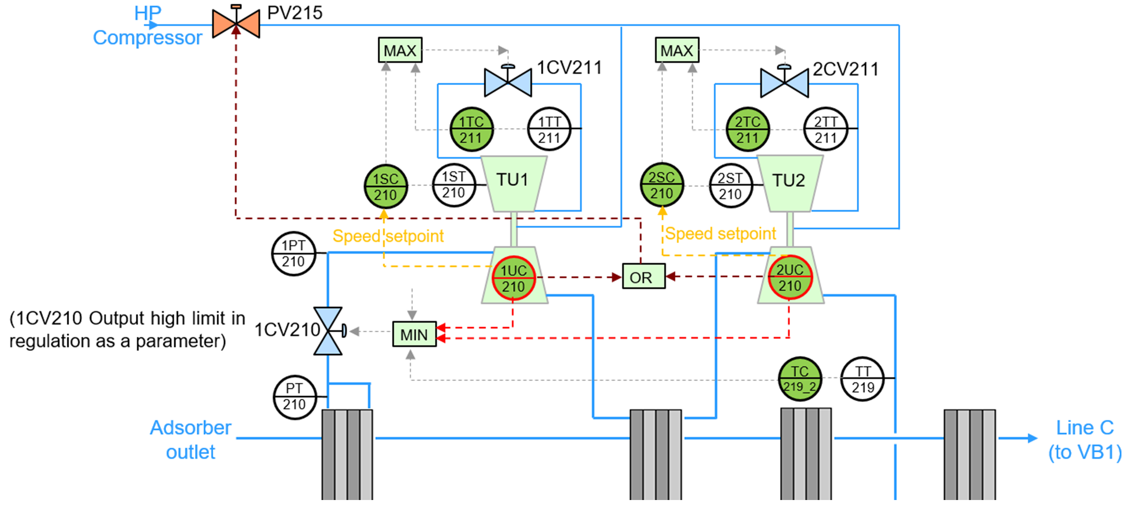
Implementation in BA6 turbine string
- Turbines TU1,TU2 in series. 2 turbine blocks:
- Inlet valve 1CV210 output (%) limited by:
1UC
210
2UC
210
○ calculated increments
○ TT219 cooldown limitation
○ Out high limit parameter
HP He
LP He

Slide 11
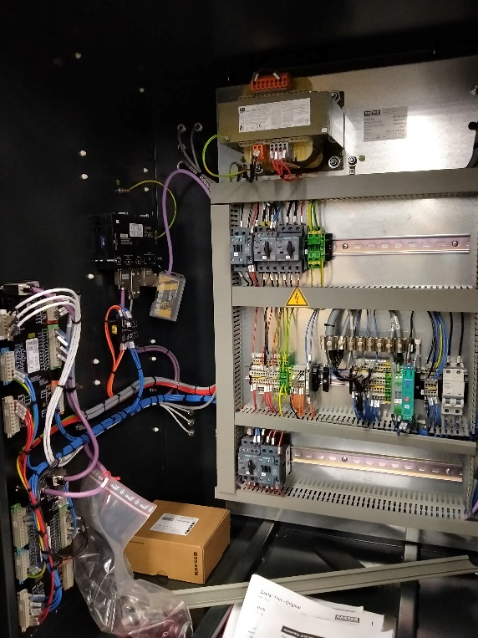
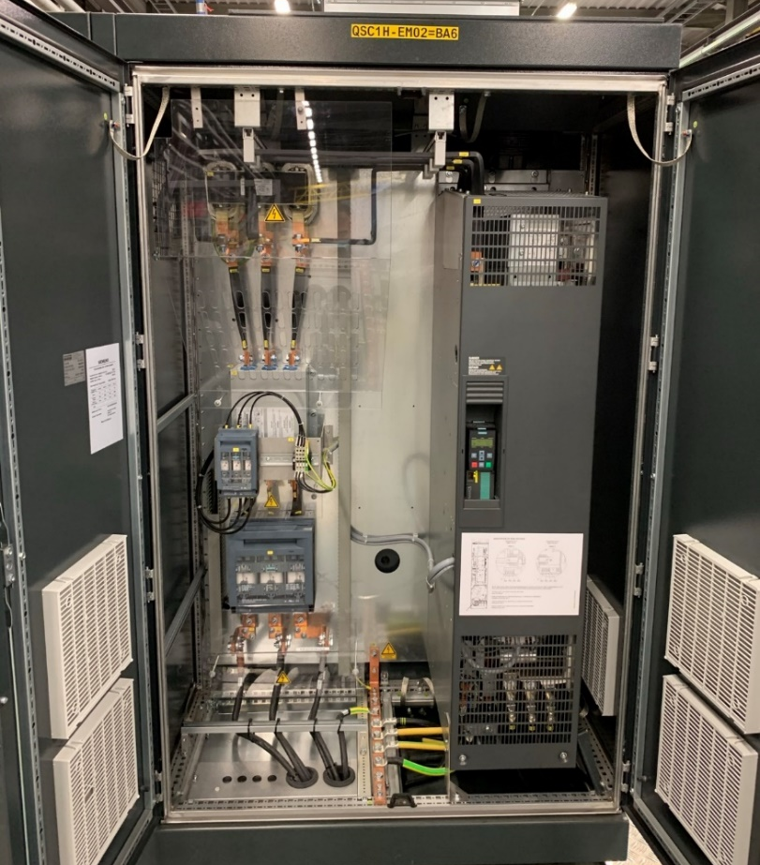
Integrating Compressor protection
Kaeser Compressor requires special and dedicated protection
Currently protected by an external equipment, Sigma Control (SC)
+100 alarms/warnings Hard to diagnose
2 proposed solutions : - Keep SC: fastest solution, limited for operation - Remove SC: full integration, electrical modification required
I/O Signals
to the PLC
by Profibus
Sigma Control display
Compressor protection instrumentation
Compressor motor VFD

Slide 12
Conclusion
SPS-BA6 cryoplant will be ready for commissioning at the beginning of January 2021.
Turbine control will be implemented relying on the experience in SM18 35g/s turbines.
We can easily switch the software to communicate with Sigma control or read instrumentation from the CP and control to VFD.
After several mirror tests, it has been obtained a PLC software that guarantees the most efficient quality control system.

Slide 13
Thank you for your attention!

