Slide 1
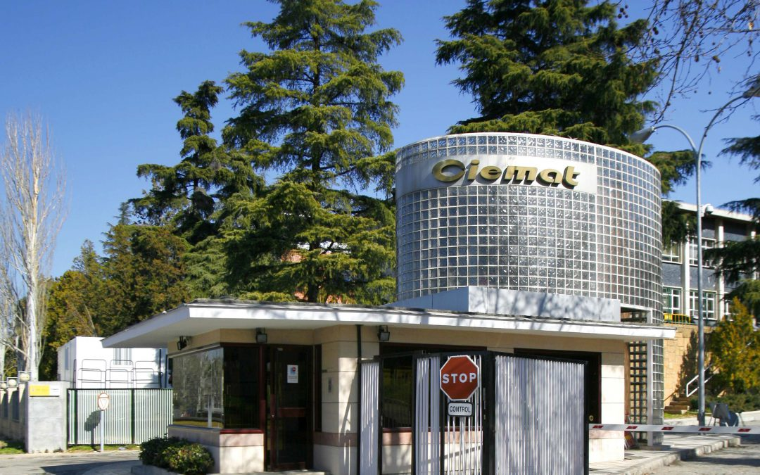

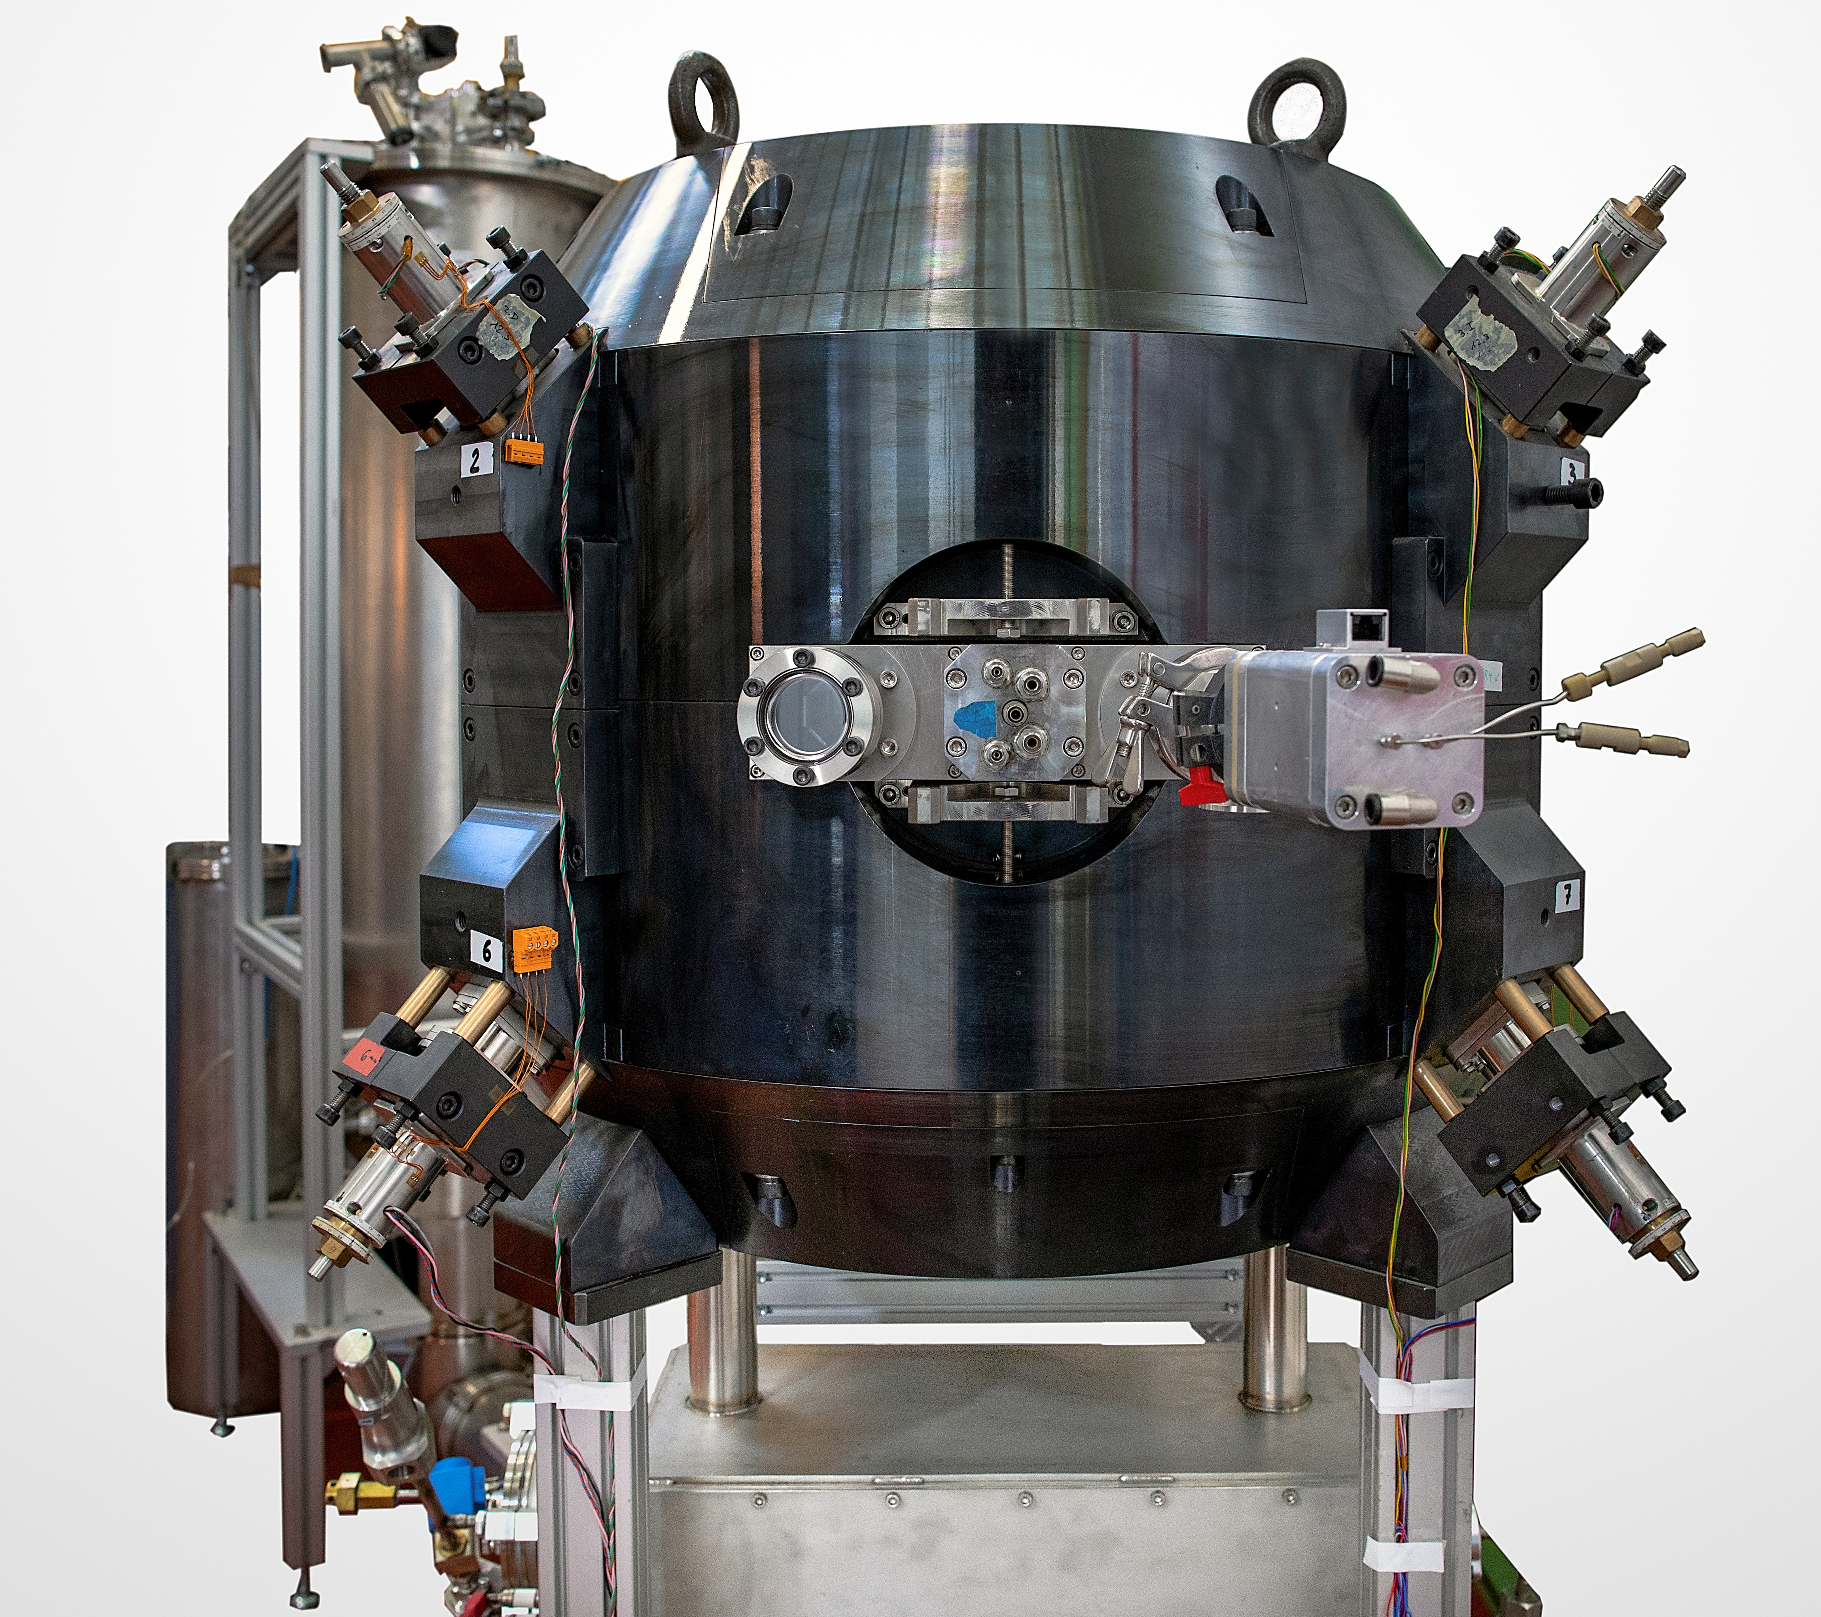



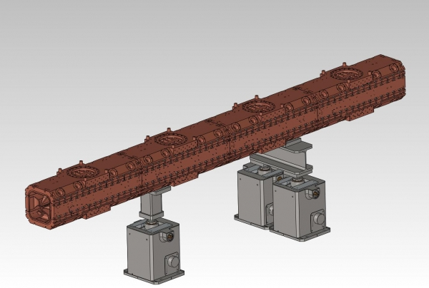
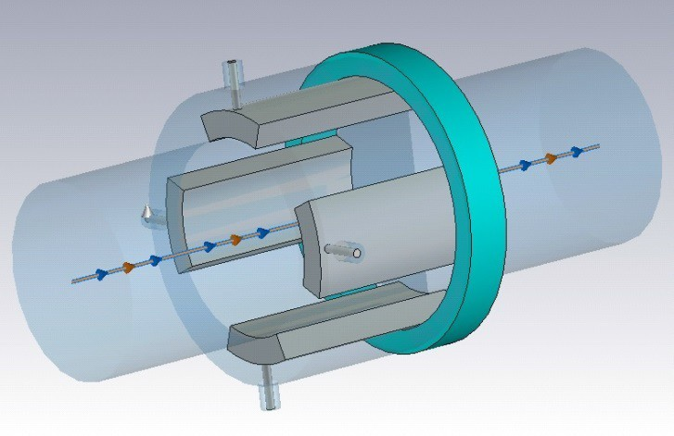
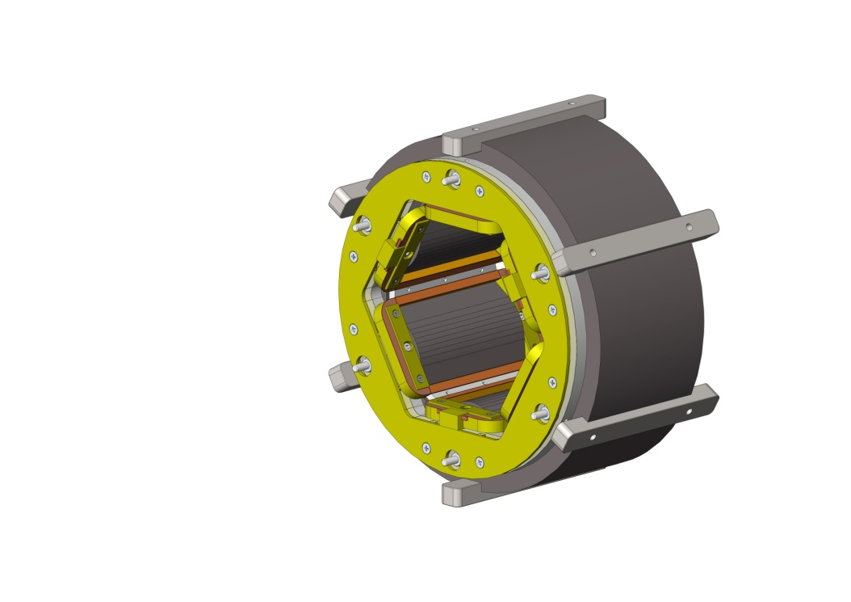
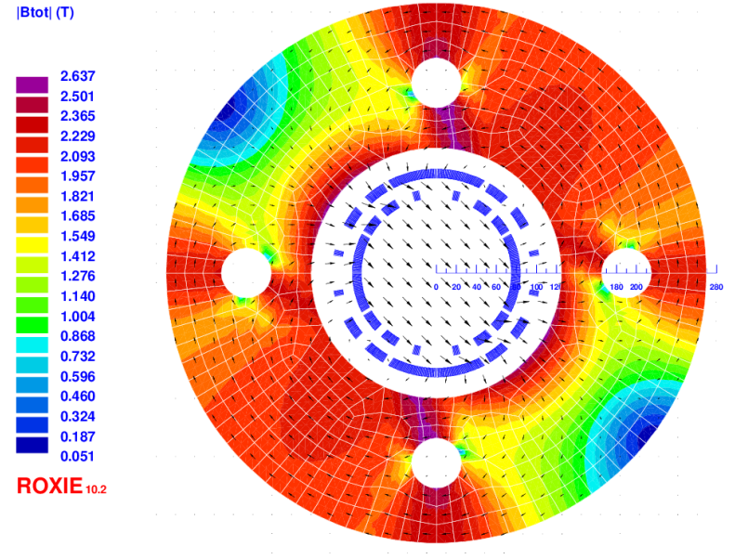
STATUS OF CIEMAT ACTIVITIES IN THE FIELD OF ACCELERATOR TECHNOLOGIES
Luis García-Tabarés
on behalf of the Electrical Engineering Division
CIEMAT
Presentación CIEMAT en el evento de seguimiento del programa FTEC. 10 de Diciembre de 2020

Slide 2

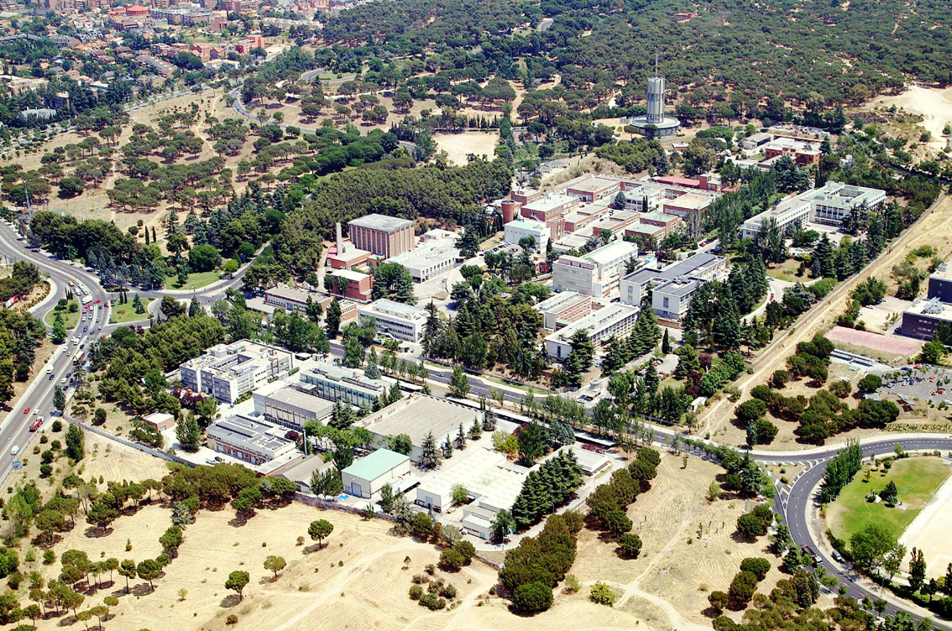
What is CIEMAT ?
CIEMAT is a Governmental Laboratory (Research Public Institution of the Ministry of Science & Innovation). 1300 engineers, researchers and staff &100 M€ annual budget
5 Scientific Departments
Energy Department
Environment Department
Basic Research Department
National Fusion Laboratory
Technology Department
3 Management Departments
Secretary-General
Institutional Relations&Knowledge Transfer
Safety and the Facility Improvement Department
Sites
CEDER (Soria)
CENER (Navarra)
CETA (Trujillo)
CISOT (Barcelona)
MONCLOA (Madrid)
PLATAFORMA SOLAR DE ALMERIA
Presentación CIEMAT en el evento de seguimiento del programa FTEC. 10 de Diciembre de 2020
Notes:
2

Slide 3
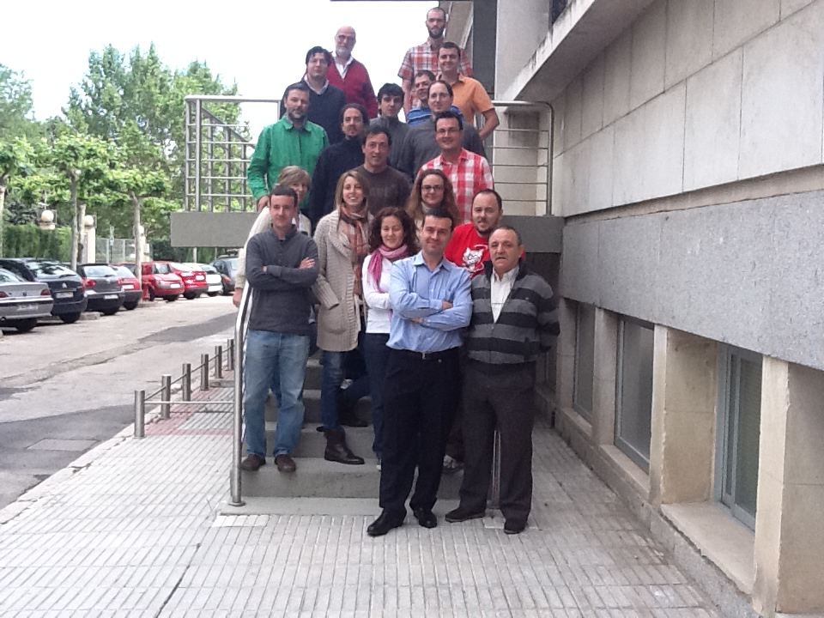
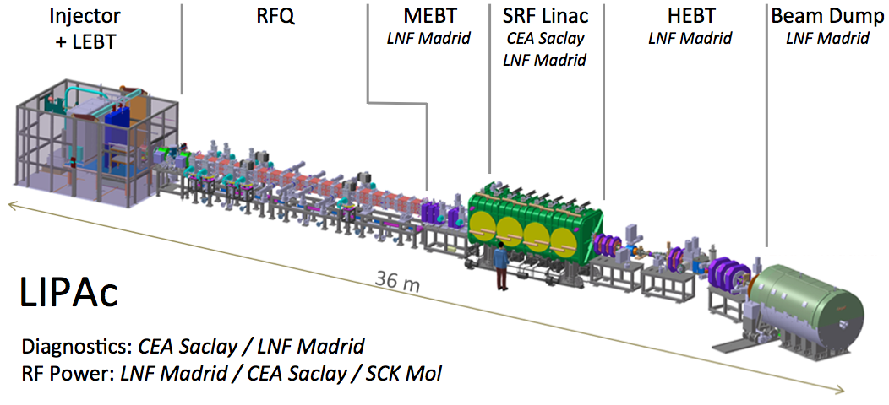
The CIEMAT Accelerator Groups
Within the Electrical Engineering Division (ascribed to the Technology Department), the Accelerator Technology Unit develops different activities related to accelerator components (basically superconducting, conventional and special magnets and RF components) as well as complete small accelerators.
Also in the National Fusion Laboratory there is a group devoted to the development of accelerator RF, Systems, Beam Dumps, Beam Diagnostics, Ancillary Systems and Safety Issues.
Presentación CIEMAT en el evento de seguimiento del programa FTEC. 10 de Diciembre de 2020
Notes:
3

Slide 4
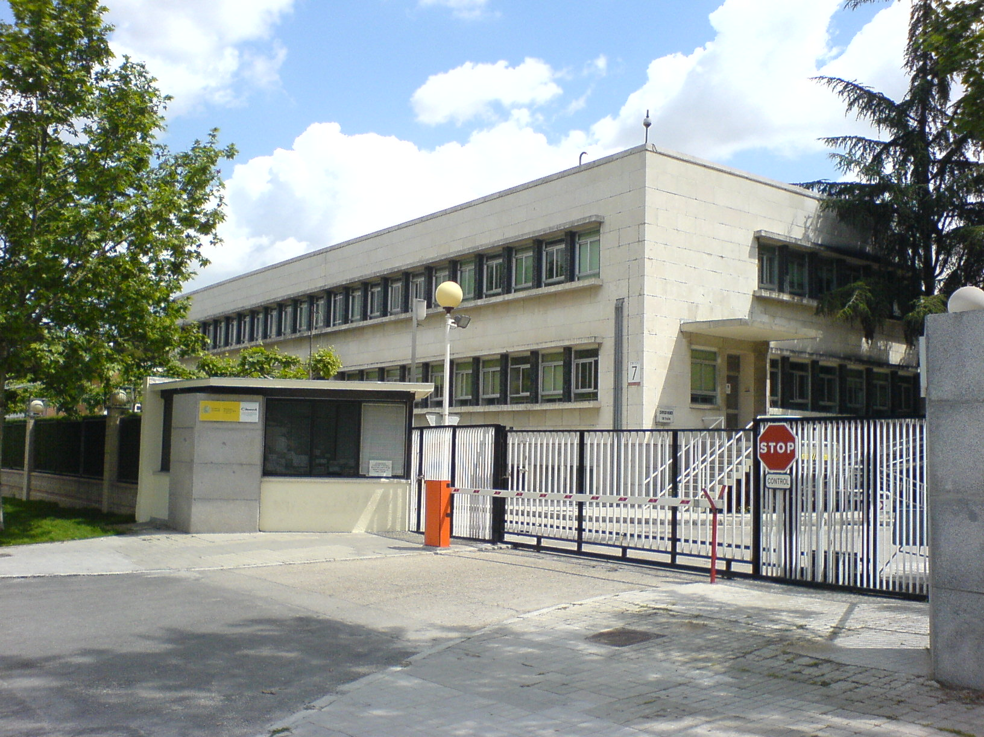
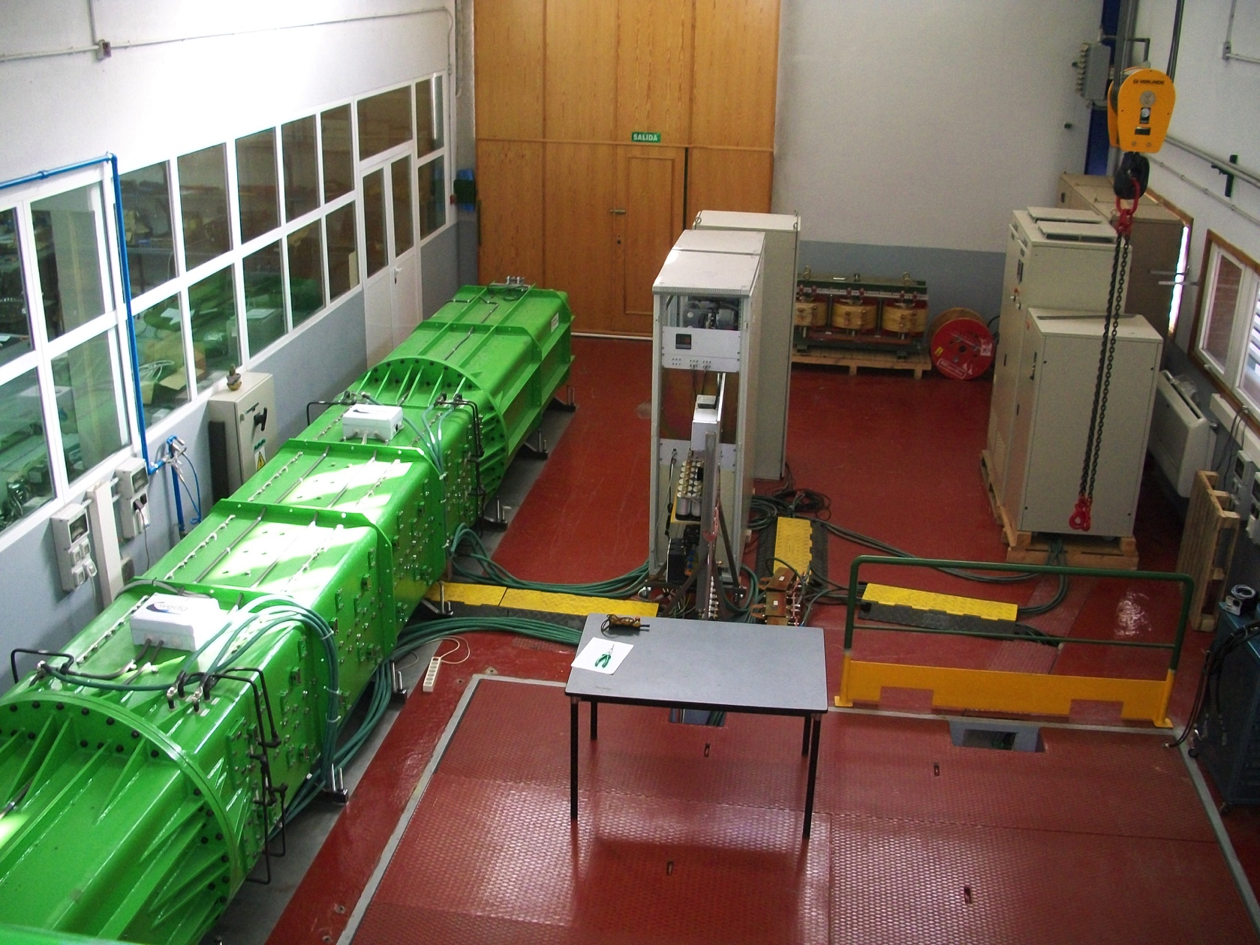
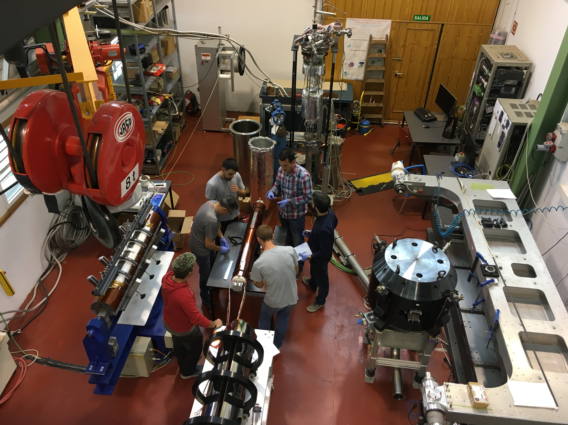
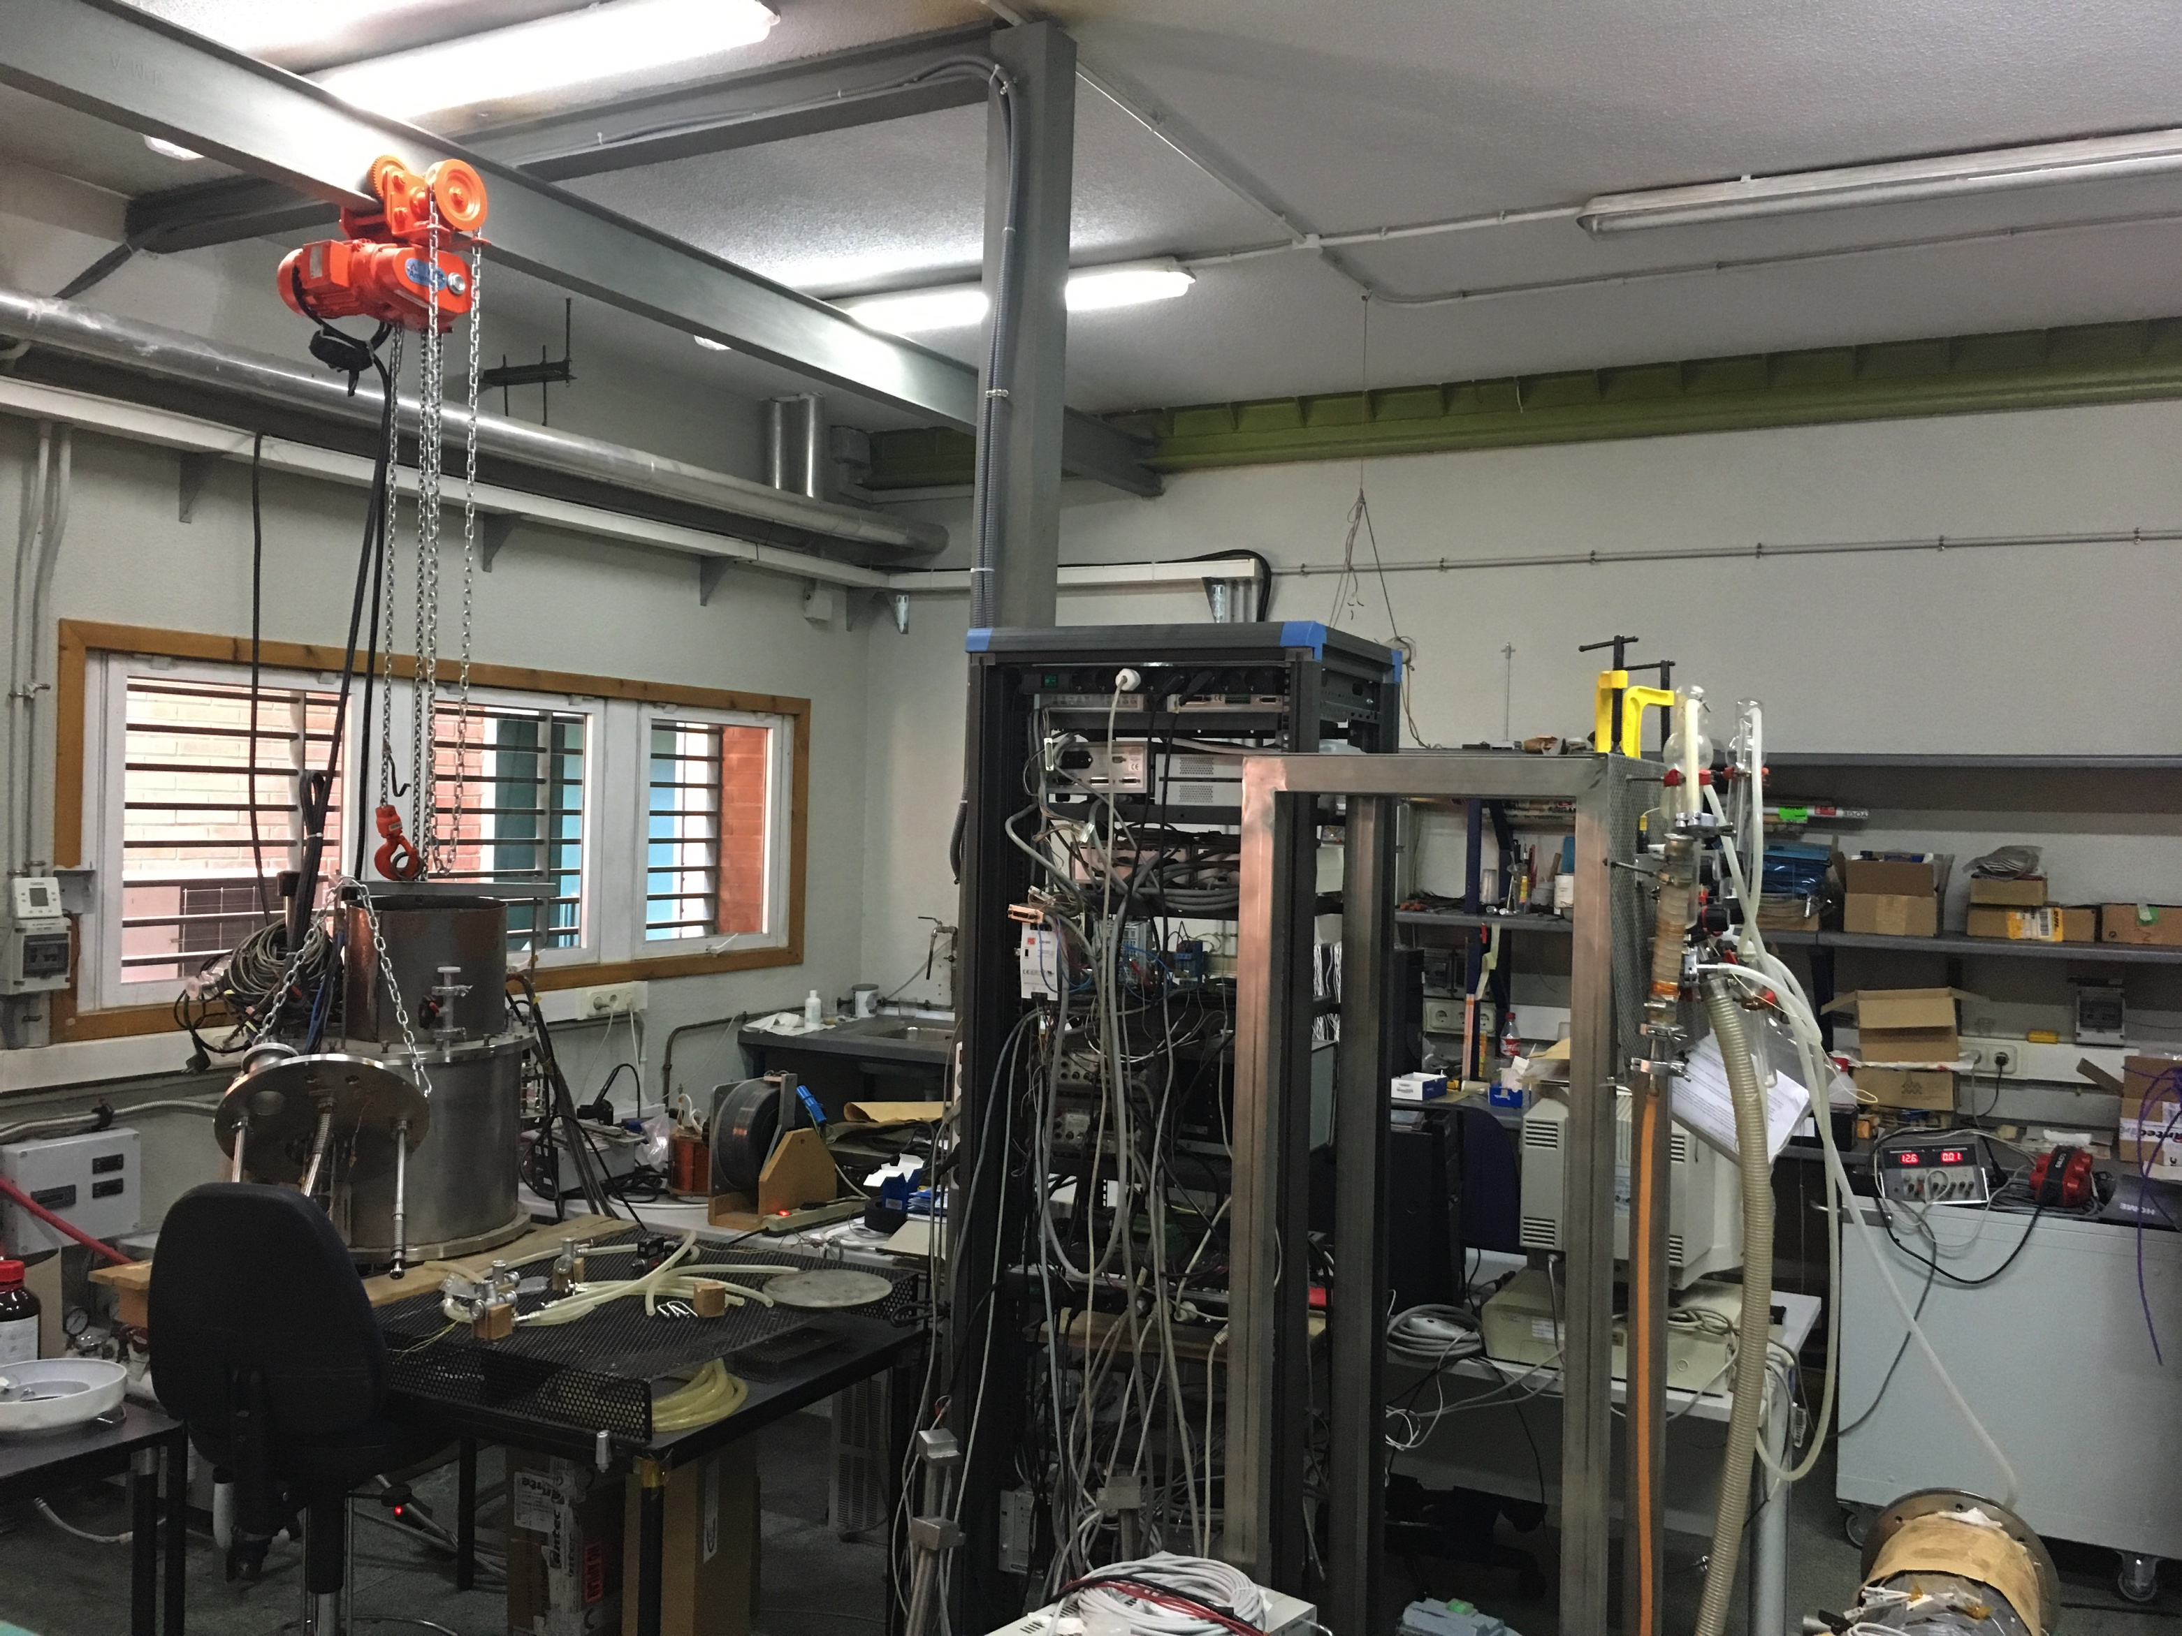
Existing Facilities & Resources
STRUCTURE
ELECTRIC ENGINEERING DIVISION (33 people)
ACCELERATOR
TECHNOLOGY UNIT (16 people)
ELECTROMECHANICAL TECHNOLOGY
UNIT (9 people)
POWER SYSTEMS
UNIT (6 people)
PRESENT FACILITIES
Main Offices
(Moncloa)
Power Systems Lab
(Julian Camarillo)
Accelerator Integration Hall
(Julian Camarillo)
Superconductivity Lab
(Julian Camarillo)
Presentación CIEMAT en el evento de seguimiento del programa FTEC. 10 de Diciembre de 2020
Notes:
4

Slide 5
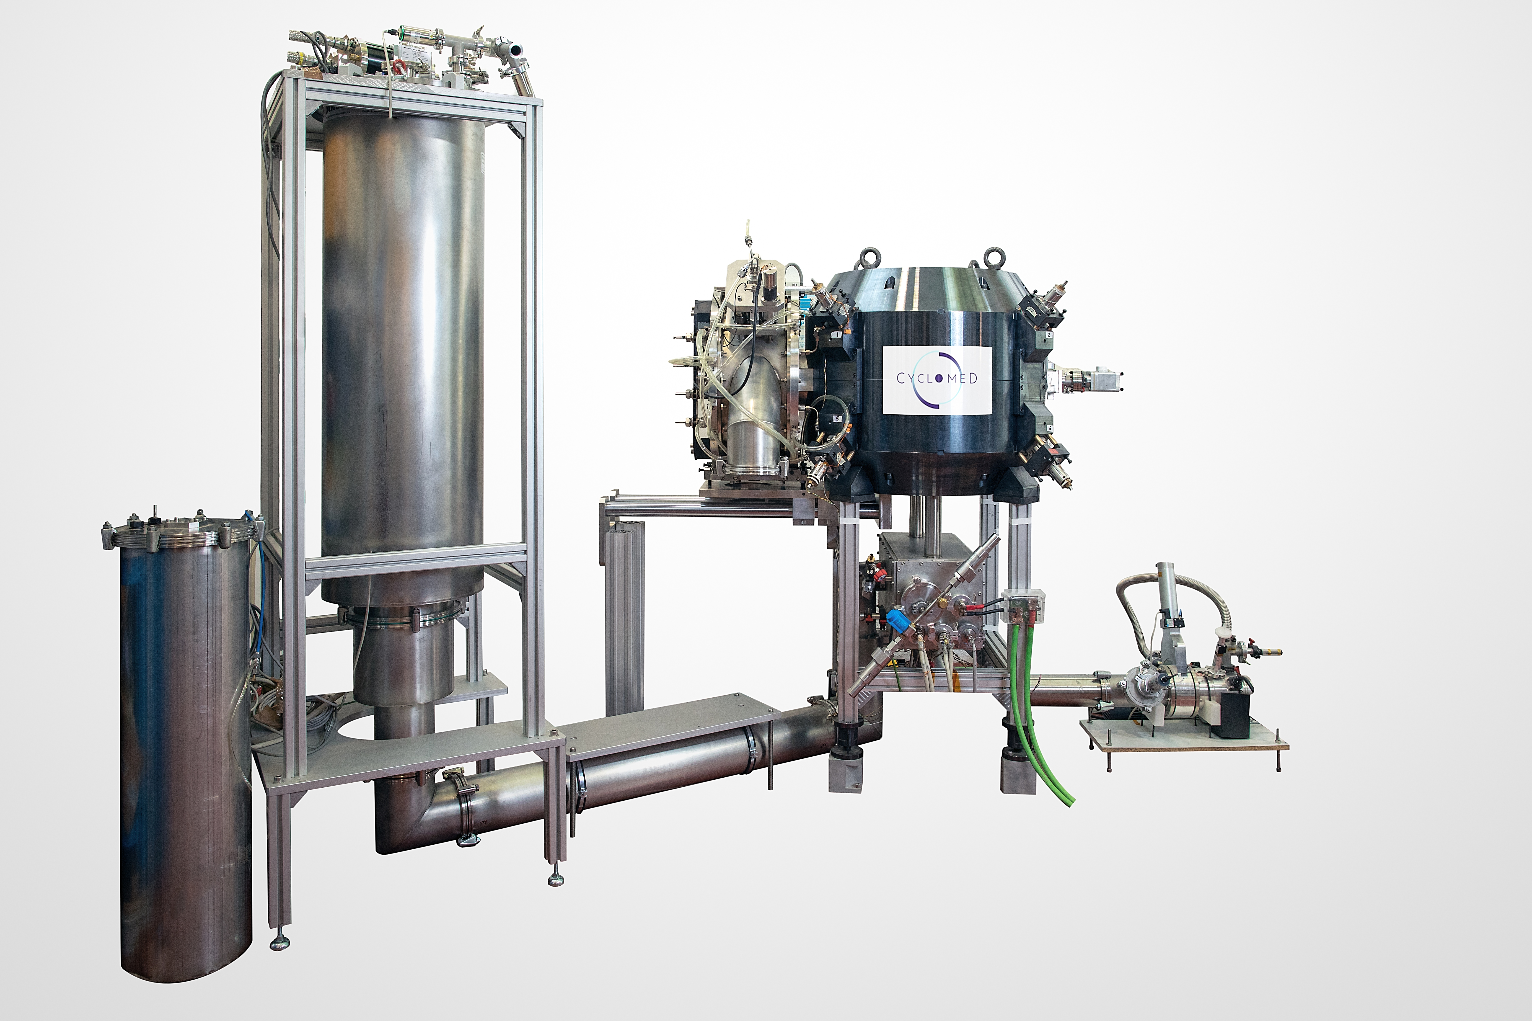
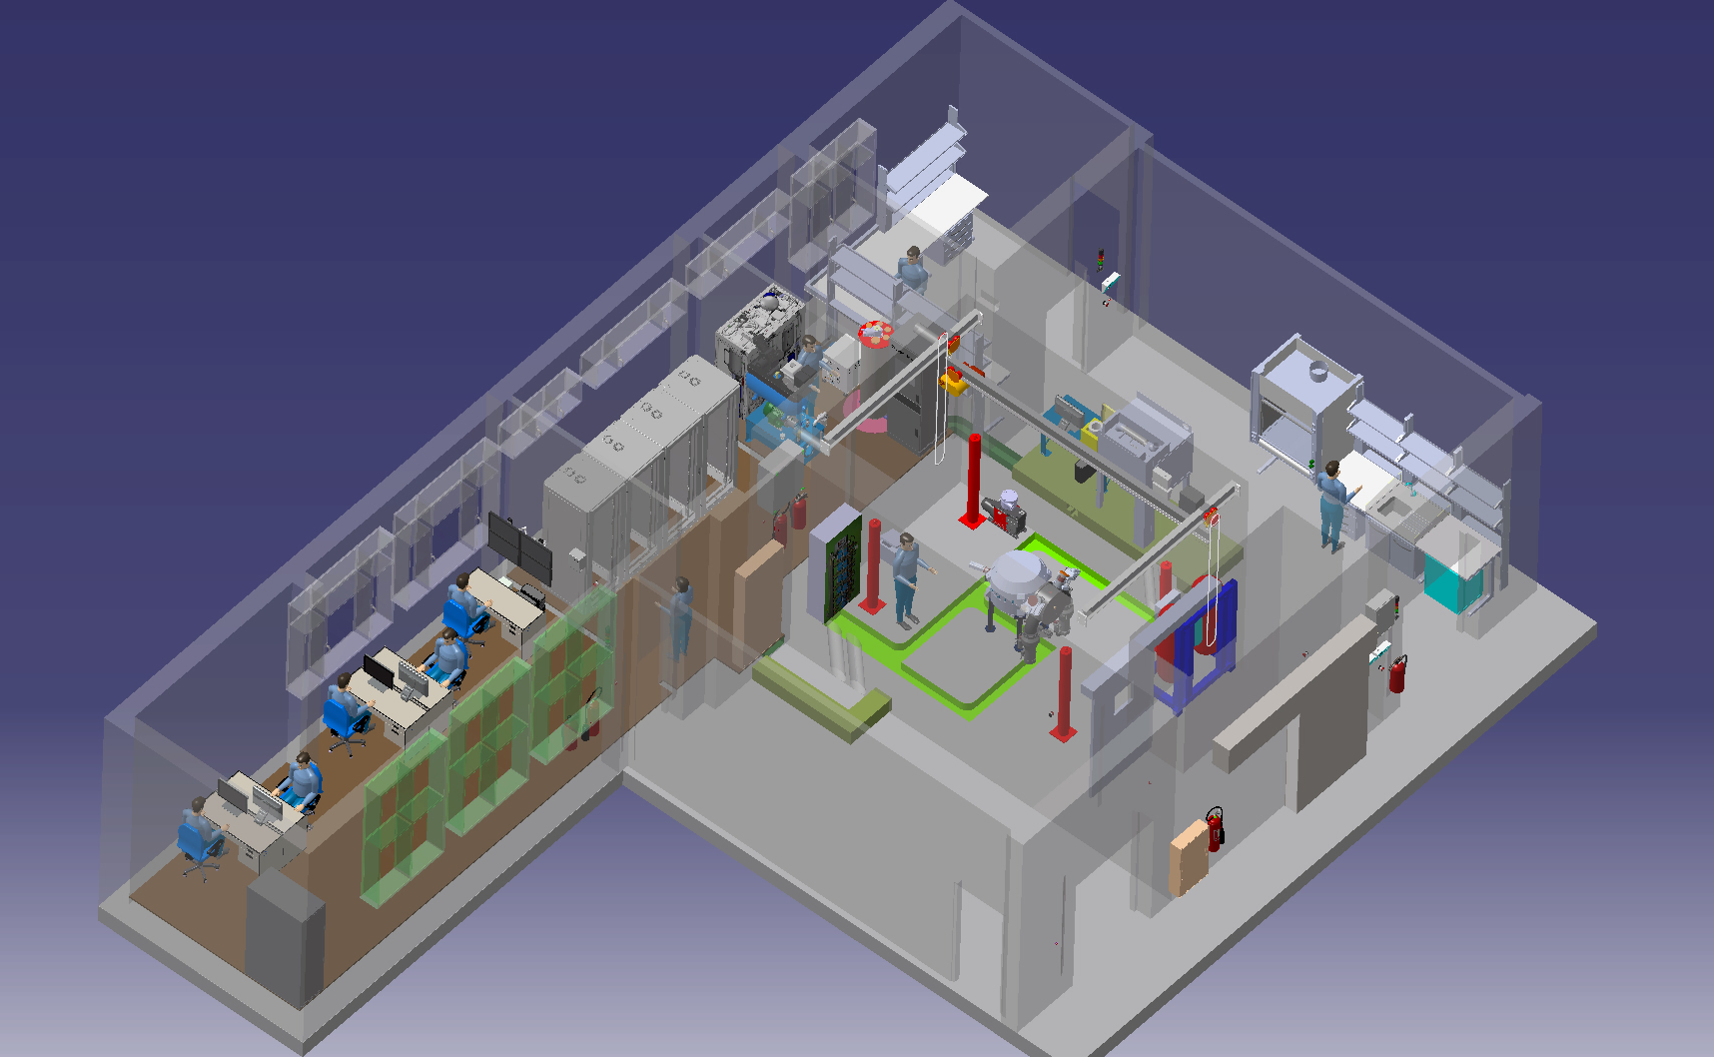
On-Going Facilities the AMIT Cyclotron
He RECONDENSER
RF
RESONATOR
SUPERCONDUCTING MAGNET
CIEMAT is involved in the development of a facility for producing radioisotopes and radiotracers which is based on the use of a compact 8.5 MeV Superconducting Cyclotron (The AMIT Project). All the main components of the facility have being designed and manufactured by CIEMAT.
Presentación CIEMAT en el evento de seguimiento del programa FTEC. 10 de Diciembre de 2020
Notes:
5

Slide 6
THE PAST
Presentación CIEMAT en el evento de seguimiento del programa FTEC. 10 de Diciembre de 2020

Slide 7
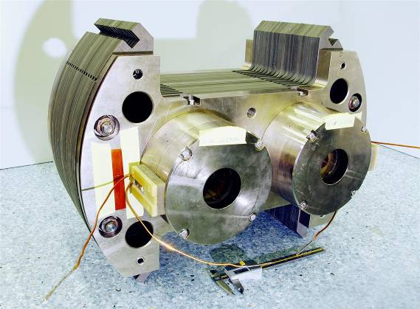
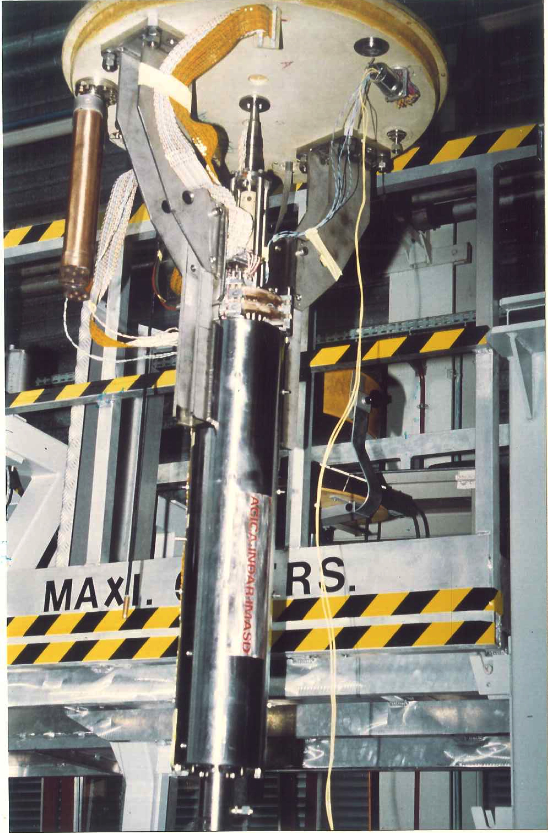
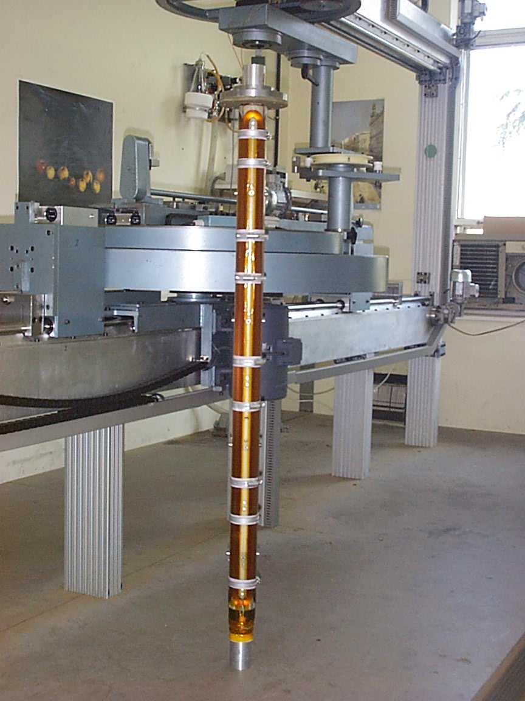
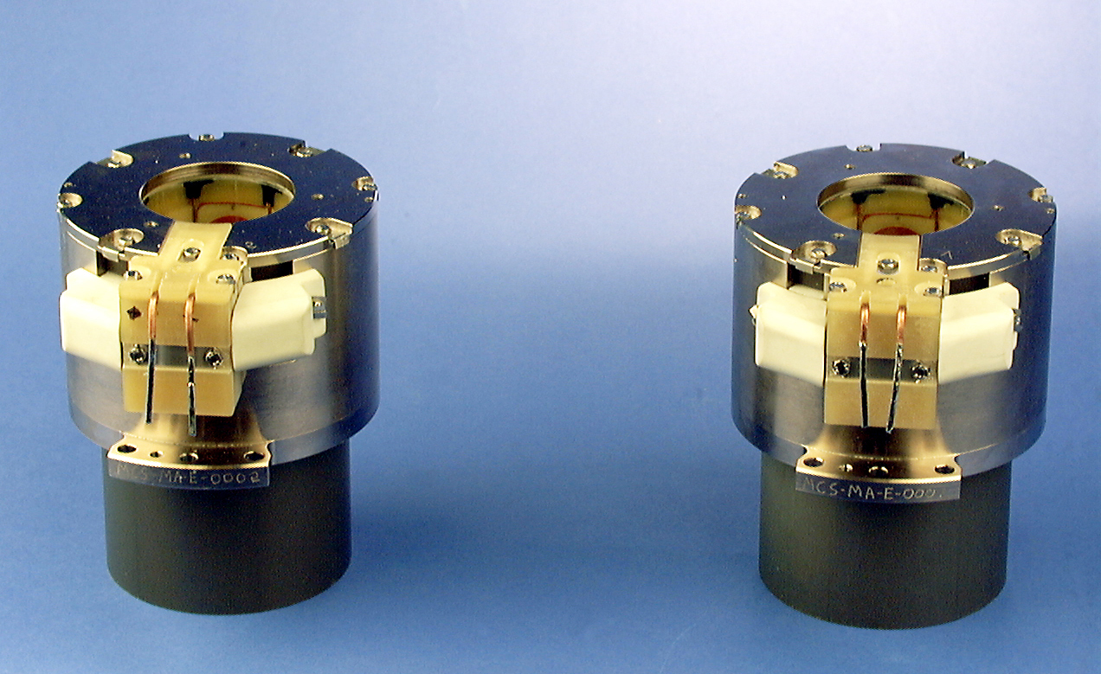
CIEMAT Previous Contributions to the LHC
CIEMAT has participated intensively in the design, construction and testing of several superconducting magnets for the LHC Project. In most cases with a significant industrial participation.
Twin Octupoles
The Tuning Quadrupole
The MQTL Trim Quadrupole
Sextupole Correctors
Presentación CIEMAT en el evento de seguimiento del programa FTEC. 10 de Diciembre de 2020
Notes:
7

Slide 8
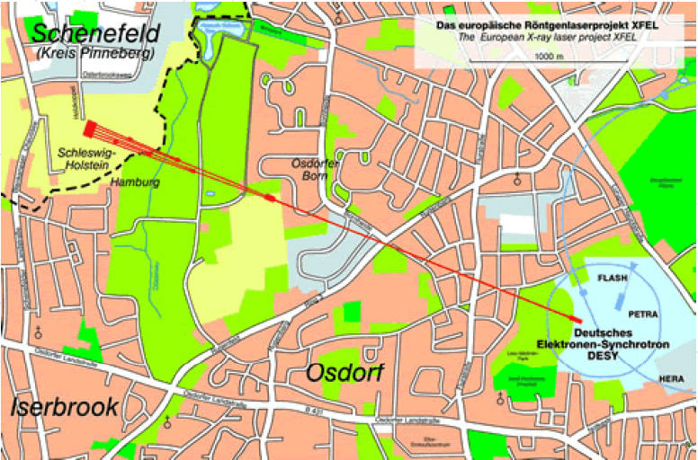
CIEMAT Previous Contributions to the E-XFEL (1)
E-XFEL (European X-Ray Free Electron Laser) is a 100 ns pulse laser source working in the band from 0.085 to 6 nm. It will be located inside DESY facilities in Hamburg.
It consists of a Superconducting LINAC up to 17GeV and an array of undulators based on permanent magnets.
Spanish Contributions to E-XFEL
COMPONENT | TYPE | QUANTITY | CONTRIBUTOR
Superconducting Combined Magnets | SC Magnet | 103 | CIEMAT
Moving Tables (Movers) | Mechanics | 101 | CIEMAT
Electronic Control Racks | Electronics & Instrum. | 101 | CIEMAT
Phase Shifter Magnets | Special Magnet | Contrib. Failed | CIEMAT
Superconducting Magnets Power Supplies | Electronics & Instrum | 240 | CEI/UPM
Presentación CIEMAT en el evento de seguimiento del programa FTEC. 10 de Diciembre de 2020
Notes:
8

Slide 9
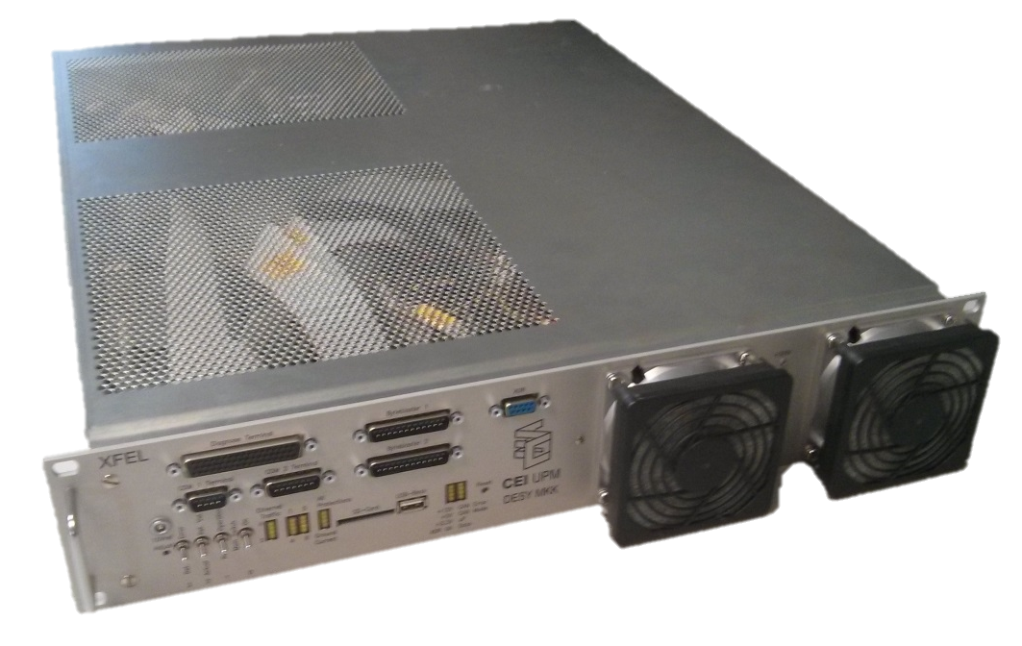
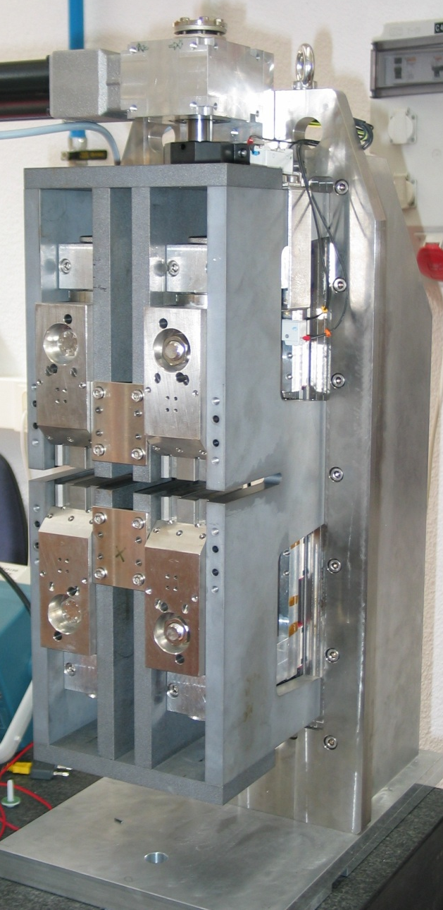
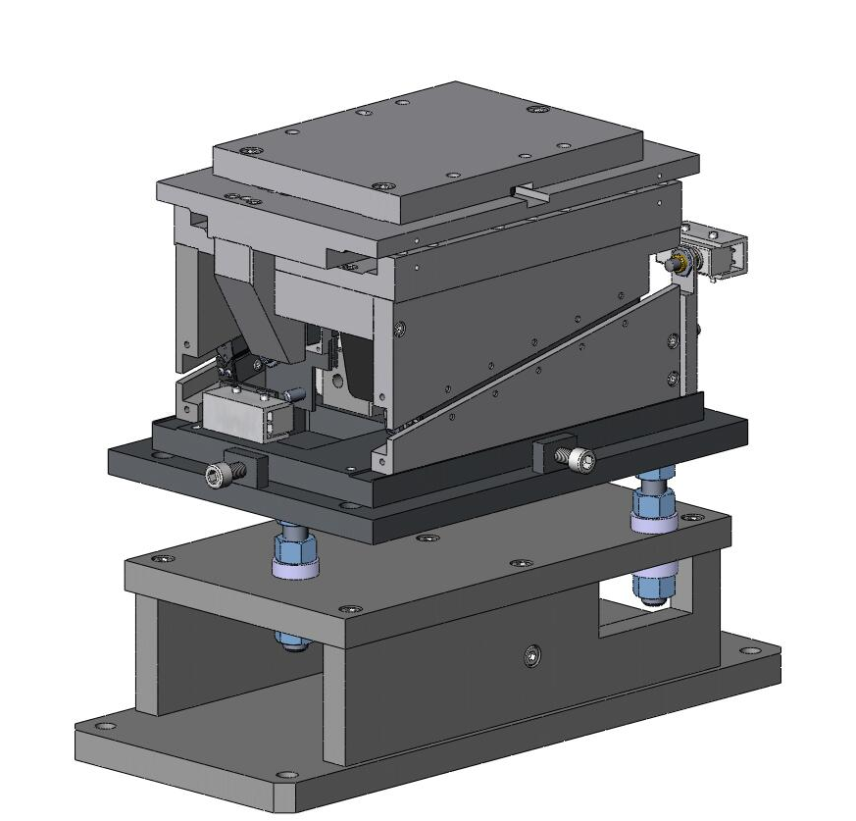
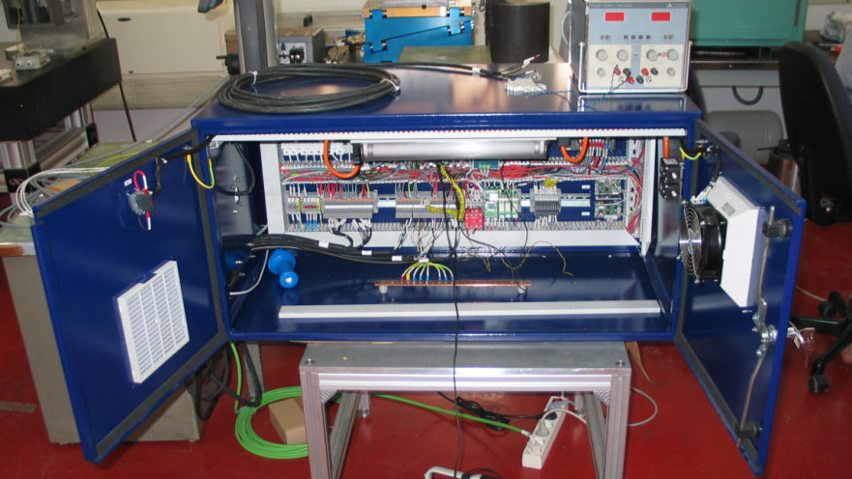
CIEMAT Previous Contributions to the E-XFEL (2)
Superconducting Combined Magnets
Power Supplies for Superconducting Combined Magnets
Moving Tables
Control Electronics Racks
Phase Shifters
Presentación CIEMAT en el evento de seguimiento del programa FTEC. 10 de Diciembre de 2020
Notes:
9

Slide 10
THE PRESENT
Presentación CIEMAT en el evento de seguimiento del programa FTEC. 10 de Diciembre de 2020

Slide 11
The CLIC Project
Presentación CIEMAT en el evento de seguimiento del programa FTEC. 10 de Diciembre de 2020

Slide 12
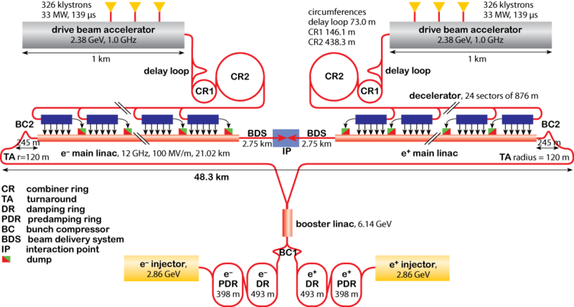
CIEMAT Contribution to CLIC (1)
CLIC is a proposal for an up to 3TeV Linear Collider, which is based on a two beam scheme to achieve the required accelerating gradients. It uses non superconducting radiofrequency components which are called PETS for the drive beam and Accelerating Structures for the main beam. A validating test facility called CTF3 has already been successfully operated for which contribution from CIEMAT and IFIC has been very significant.
Spanish contribution to CLIC
COMPONENT/CONTRIBUTION | TYPE | QUANTITY | CONTRIBUTOR
Power Extraction Transfer Structures (PETS) | RF | 12 (Partial) | CIEMAT
Double Length PETS for CLIC | RF | 1 | CIEMAT
Accelerating Structures | RF |  | CIEMAT
Longitudinally Variable Field Dipole | PM Magnet | TBD | CIEMAT
Kicker for CLIC Damping Ring | Special Magnet | 1 | IFIC & CIEMAT
BPM for CLIC Drive Beam | RF, Instrumentation | 1 | IFIC
Accelerating Structure Test Bench | RF, Instrumentation | 1 | IFIC
ALBA Contribution to CLIC Study | Several |  | ALBA
Presentación CIEMAT en el evento de seguimiento del programa FTEC. 10 de Diciembre de 2020
Notes:
12

Slide 13
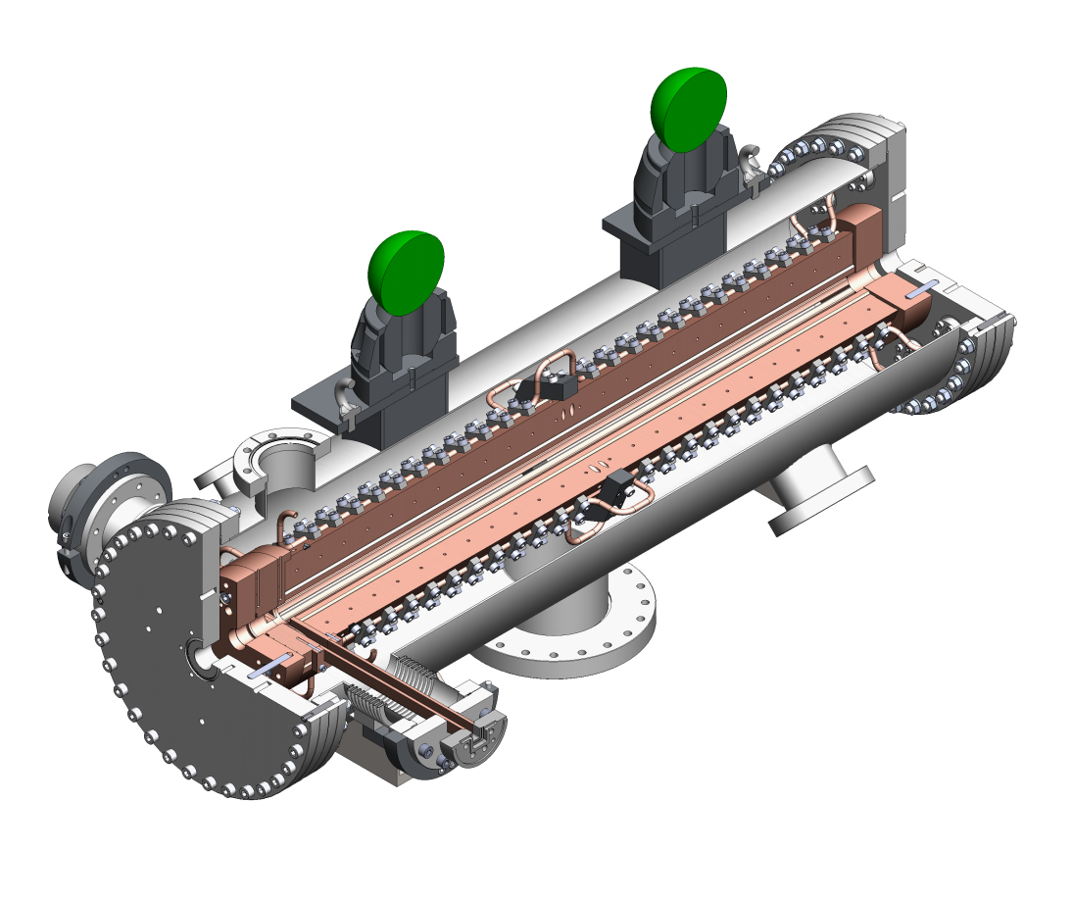
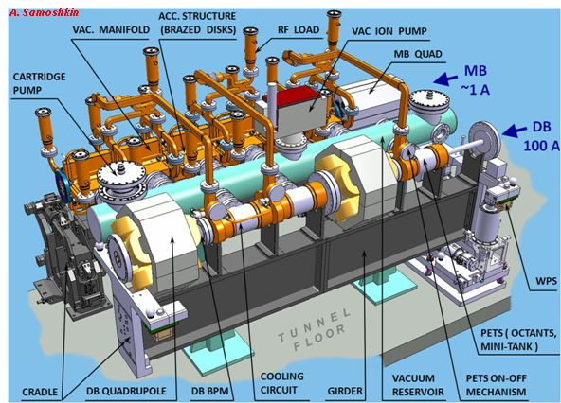
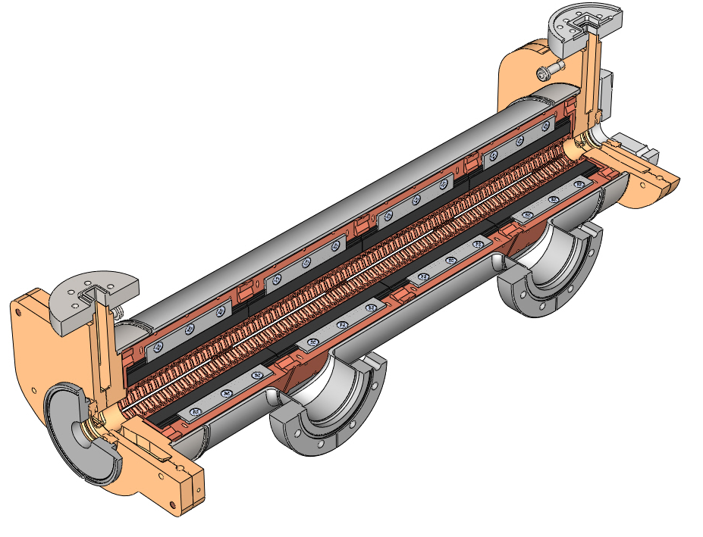
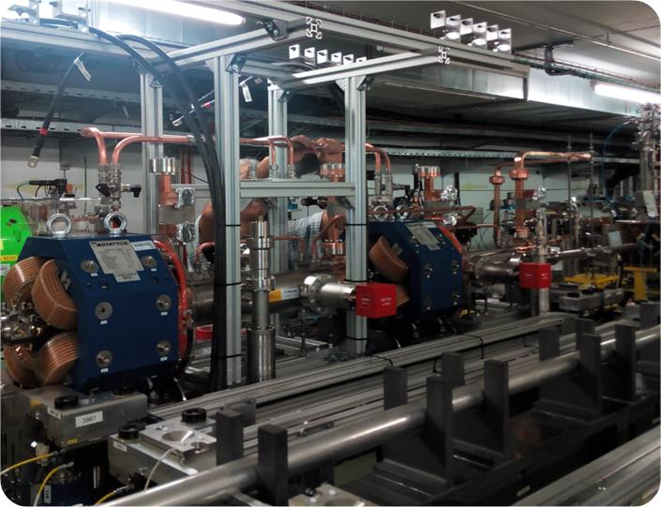
CIEMAT Contribution to CLIC (2)
Power Extraction Transfer Structures (PETS) for CLIC
TBL PETS
Double Length PETS
Type | TBL PET | Double Length PET
Op. Frequency | 12 GHz | 12 GHz
Length | 4 x CLIC | 2 x CLIC
Technology | Warm in Octants | Warm in Octants: Minitank, Integrated Couplers
Industrialization | YES: Partial Supplies by Industry
Presentación CIEMAT en el evento de seguimiento del programa FTEC. 10 de Diciembre de 2020

Slide 14
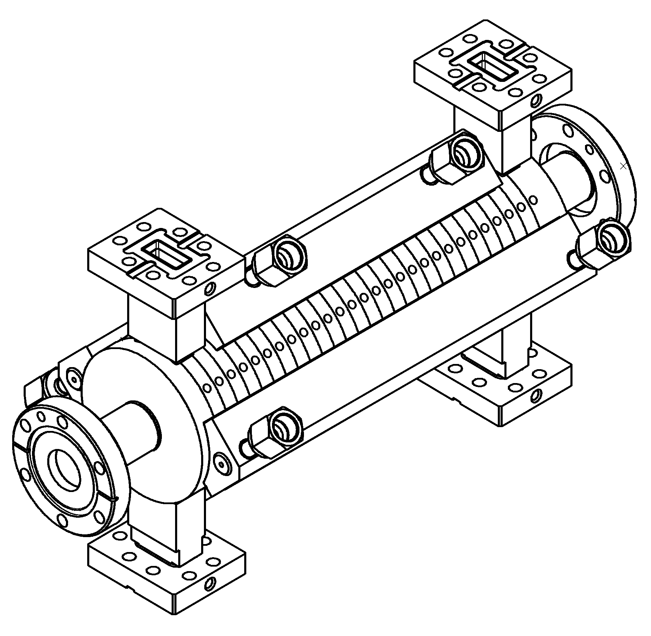
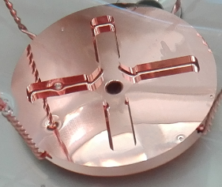
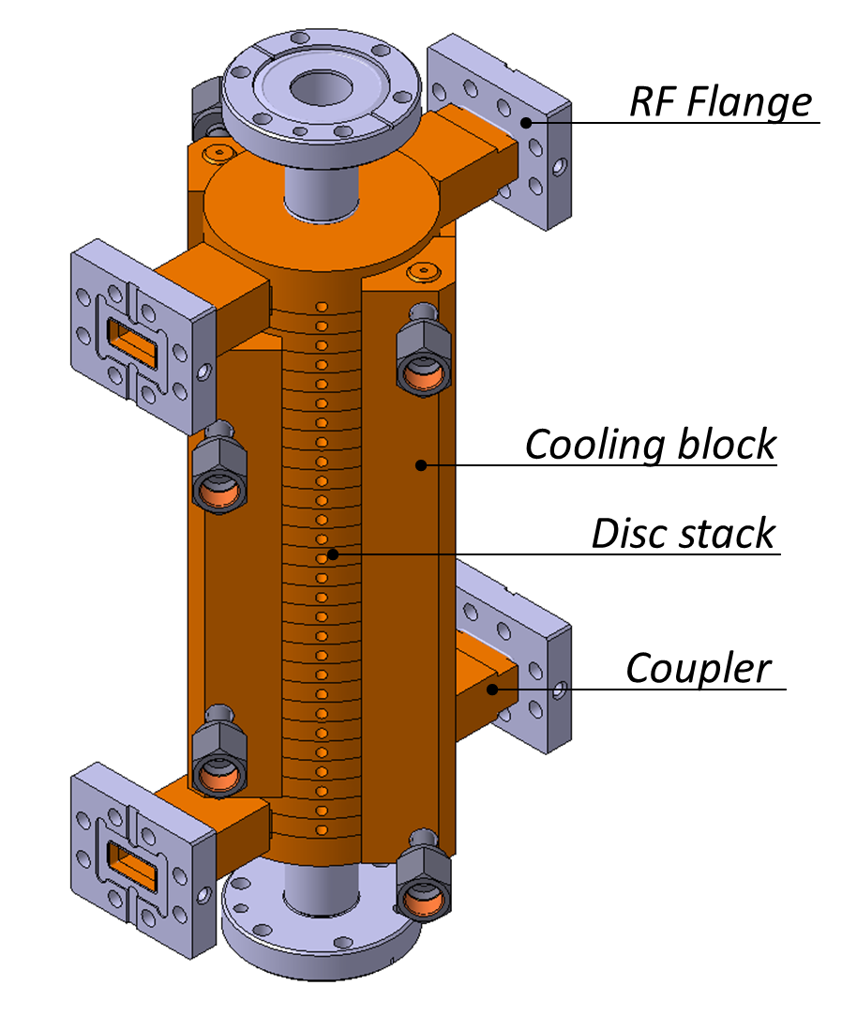
CIEMAT Contribution to CLIC (3)
Accelerating Structure for CLIC
Type | Travelling Wave
Op. Frequency | 12 GHz
Length | 230 mm
Aperture | 4.8-6.2 mm
Technology | 26 Warm Discs
Peak Input Power | 61,3 MW
Industrialization | YES: Partial Supplies by Industry
Presentación CIEMAT en el evento de seguimiento del programa FTEC. 10 de Diciembre de 2020

Slide 15
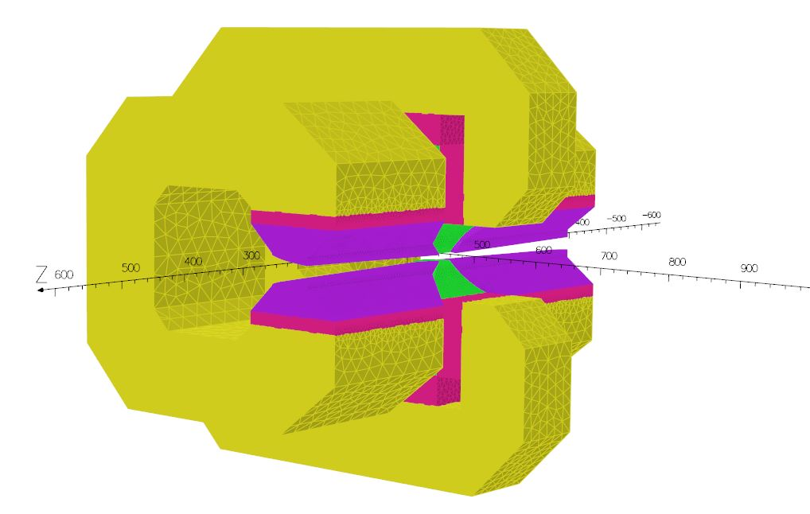
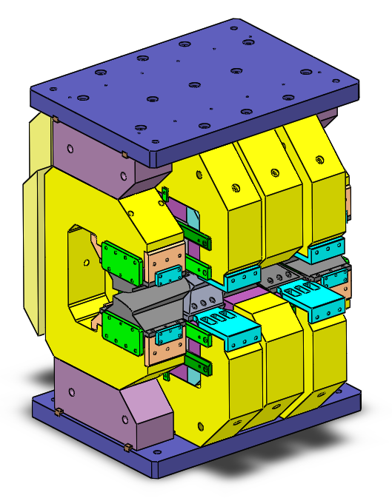
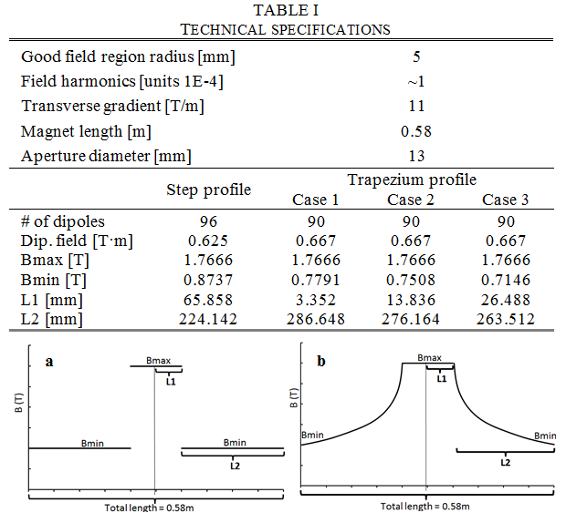
CIEMAT Contribution to CLIC (4)
CLIC Damping Ring Gradient Dipole
Type | Longitudinal & Transverse Gradient Magnet
Length | 0.58 m
Good Field Region | 5 mm
ΔB/B | 1·10⁻⁴
Transverse Gradient | 11 T/m
Technology | SmCo // NeFeB Permanenent Magnets
Industrialization | NO
Presentación CIEMAT en el evento de seguimiento del programa FTEC. 10 de Diciembre de 2020
Notes:
15

Slide 16
The LHC Hi-Lumi
Presentación CIEMAT en el evento de seguimiento del programa FTEC. 10 de Diciembre de 2020

Slide 17

The LHC Hi Lumi
In a first phase, LHC has been working at 8 TeV and 75% of its nominal luminosity. After a 2 year shutdown, luminosity will be increased to 100% and energy to 14 Tev. From 2018 to 2021 it is foreseen to increase the luminosity to 200% and after 2023, it should be increased again by a factor of 5 to 10, after significant changes in the machine.
Spanish Contribution to LHC-Hi Lumi
COMPONENT | TYPE | QUANTITY | CONTRIBUTOR
Radiation Resistant SC Sextupole Corrector Magnet | SC Magnet | 1 | CIEMAT
Radiation Resistant SC Octupole Corrector Magnet | SC Magnet | 1 | CIEMAT
Participation in the LHC Long Shutdown | Manpower | 8 man-year | CIEMAT
Development of a Nested Dipole | SC Magnet | 1+2 Prototypes | CIEMAT
Participation in the QUAQO Project | SC Magnets | 2 Prototypes | CIEMAT
Participation in the development of SC Links | SC Power Line | 2 man-year | CIEMAT
Participation in the development of a VAR Compensator | Power Converters | 2 man-year | CIEMAT
Participation in programs for SEY reduction | Materials | 3 man-year | CIEMAT
FINISHED
Presentación CIEMAT en el evento de seguimiento del programa FTEC. 10 de Diciembre de 2020
Notes:
17

Slide 18
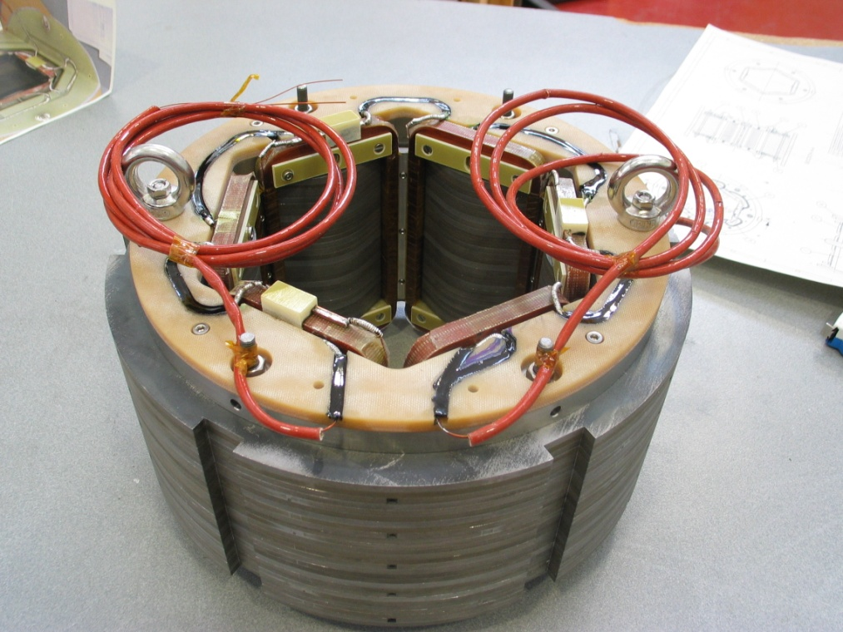
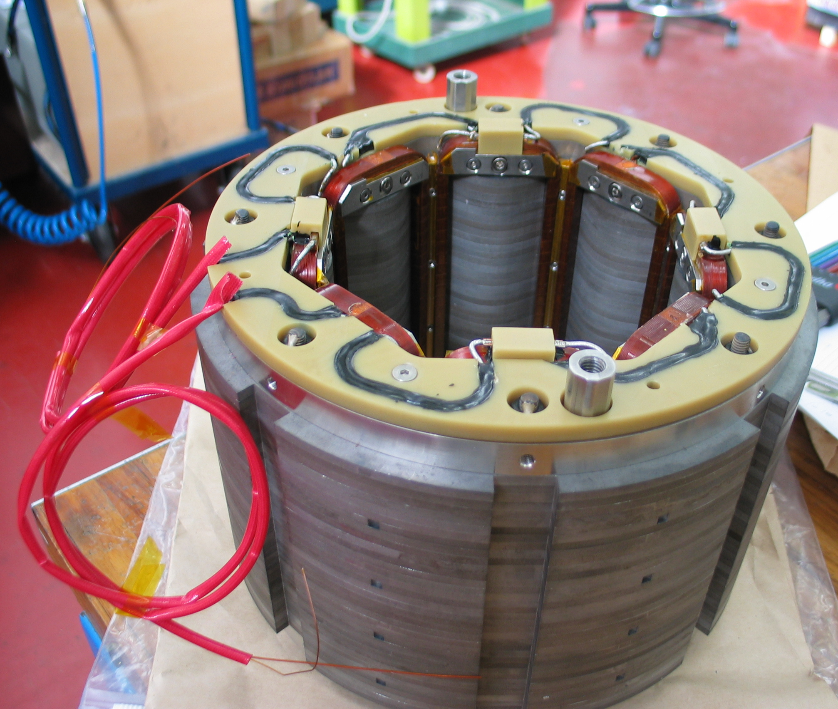
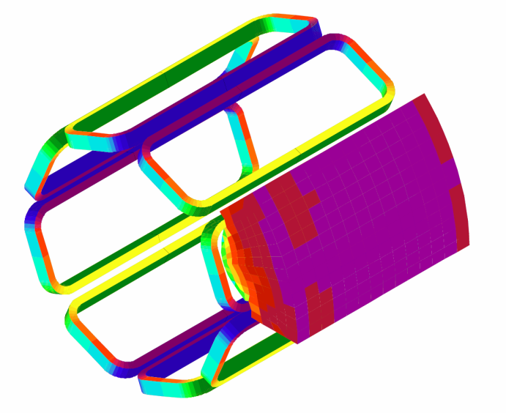
CIEMAT Contribution to LHC-HL (1)
Superconducting Magnets for LHC-HL (Superferric Correctors)
Sextupole
Octupole
Type | Sextupole | Octupole
Integrated Field | 0.055 Tm | 0.035 Tm
Physical Length | 160 mm | 160 mm
Op. Current | 100 A | 100 A
Technology | NbTi Superferric | NbTi Superferric Rad. Resistant
Industrialization | HI Lumi LHC Magnets will be based on this development
Presentación CIEMAT en el evento de seguimiento del programa FTEC. 10 de Diciembre de 2020

Slide 19
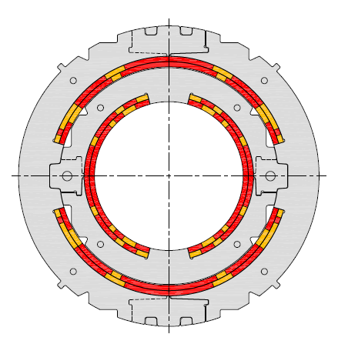
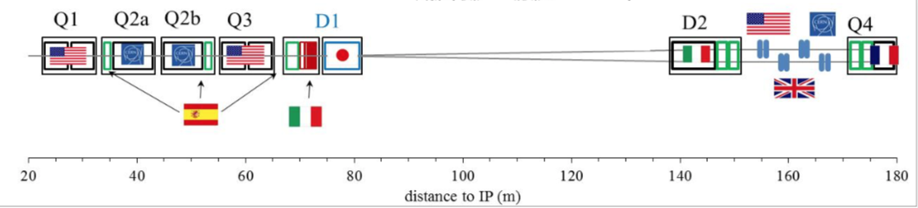
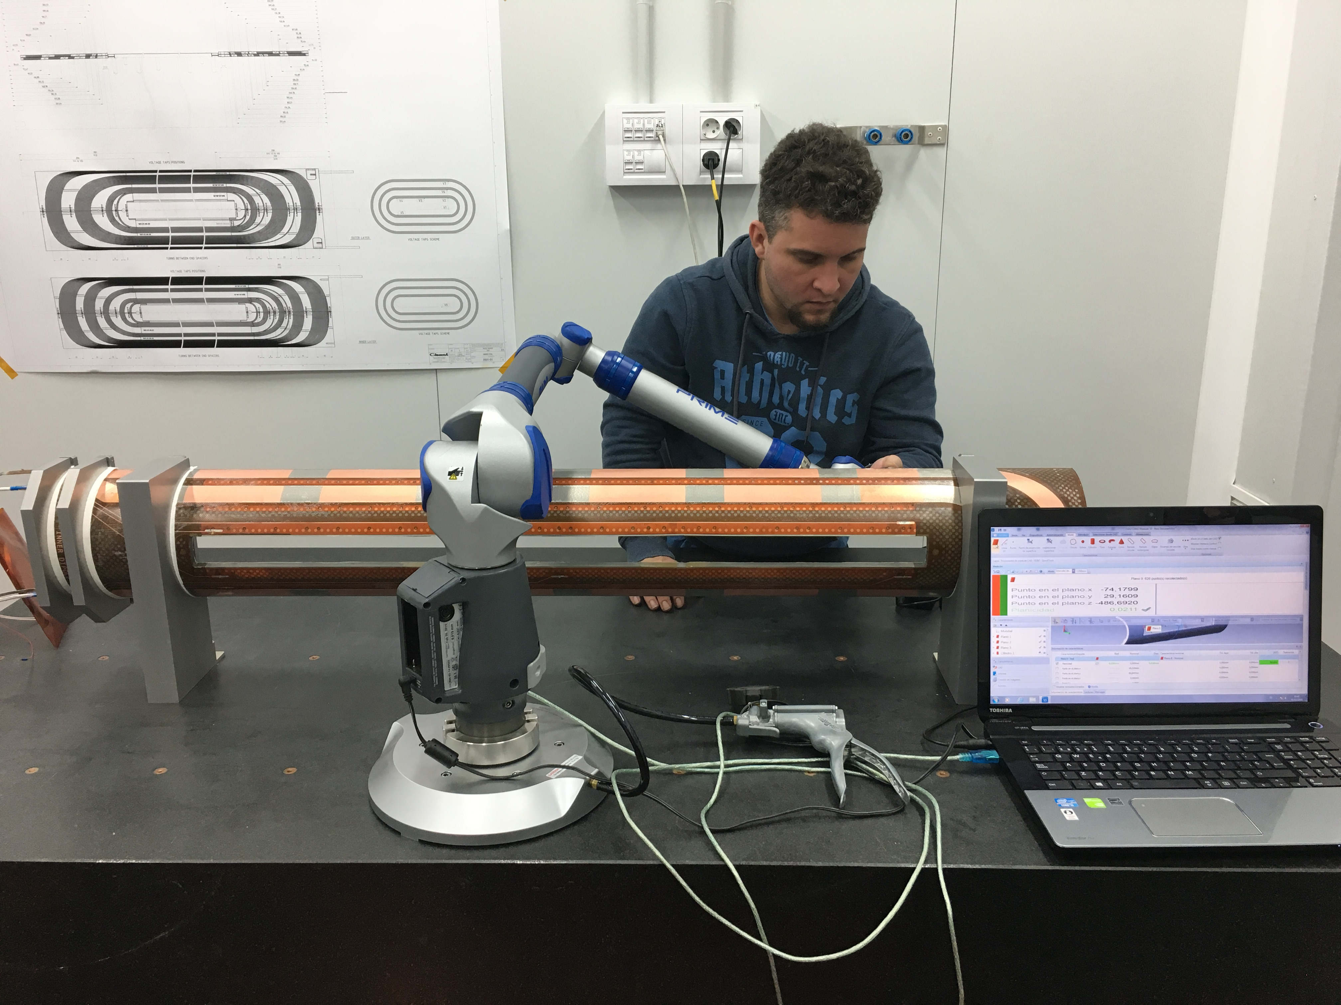
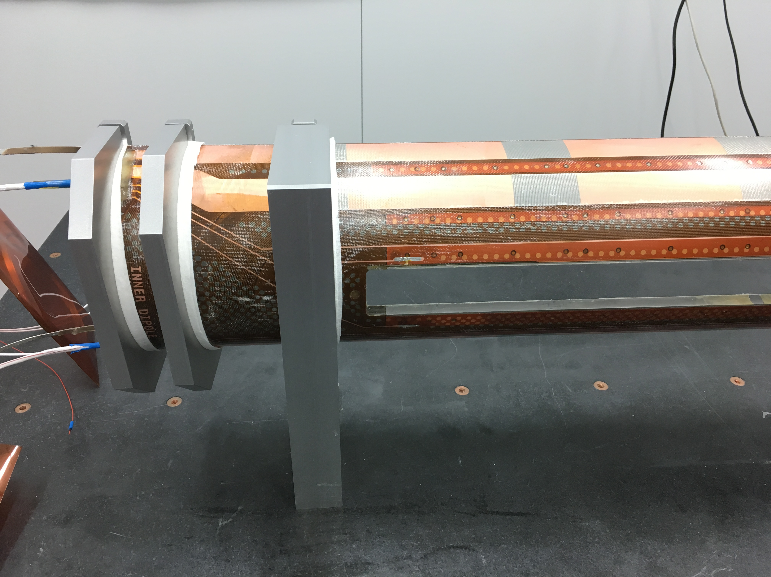
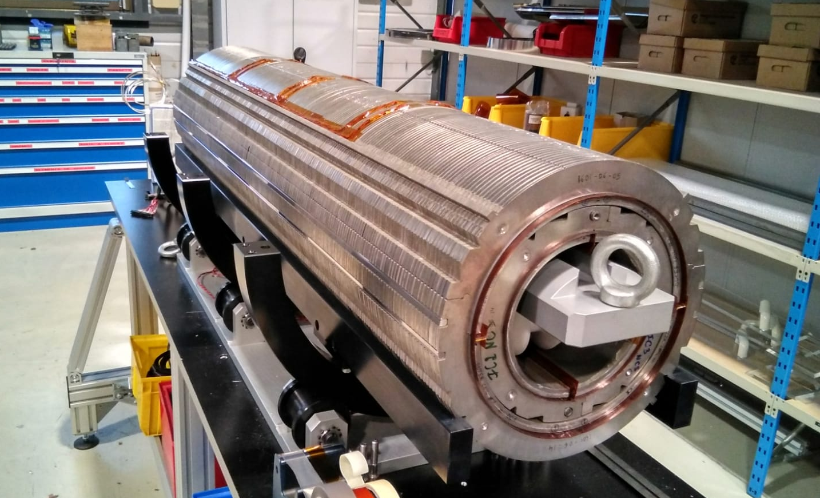
CIEMAT Contribution to LHC-HL (2)
Superconducting Magnets for LHC HL (Nested Dipoles)
MCBX H&V Combined Corrector Dipole for the Inner Triplets
Type | Combined Corrector Dipole
Integrated Field | 2.5 Tm
Physical Length | 1200 mm
Aperture | 150 mm
Technology | Nested NbTi Coils @ 1.9K
Industrialization | Yes (TBD)

Slide 20
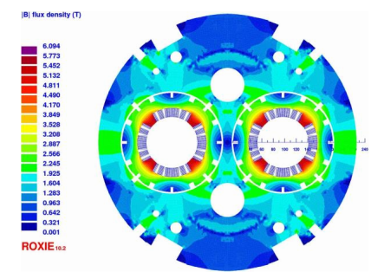
CIEMAT Contribution to LHC-HL (3)
The QUACO Project
The QUACO project draws together several research infrastructures with similar technical requirements in magnet development, which will allow the avoidance of unnecessary duplication of design effort and reduce overall cost through economies of scale using a joint procurement process. By pooling efforts, the partners in QUACO will act as a single buyer group with sufficient momentum for potential suppliers to consider the phased development of the requested magnets. QUACO’s goal is to create a paradigm shift in the industrialization of the new generation of superconducting magnets.
QUACO Project is a self-contained and consistent part of the High Luminosity LHC Project, focusing on the design, development and procurement of superconducting magnets.
The final result of the project will be 2 pilot magnets necessary for HI-LUMI LHC.
Participants:
1) The European Organization for Nuclear Research (CERN),
2) Commissariat A L’Energie Atomique Et Aux Energies Alternatives (CEA),
3) Centro de Investigaciones Energéticas, Medioambientales Y Tecnológicas (CIEMAT),
4) Narodowe Centrum Badan Jadrowych (NCBJ).
Funding:
Total cost in the proposal 6,647,895.00 €
Maximum grant amount 4,653,523.88 €
Presentación CIEMAT en el evento de seguimiento del programa FTEC. 10 de Diciembre de 2020

Slide 21
The EuroCirCol Project
Presentación CIEMAT en el evento de seguimiento del programa FTEC. 10 de Diciembre de 2020

Slide 22
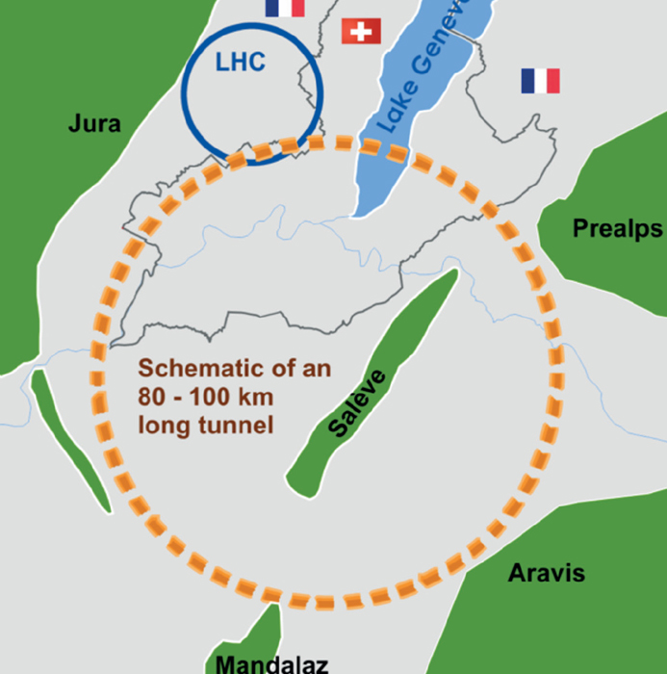
The FCC Project
CERN has recently launched a feasibility conceptual study for post-LHC particle accelerator options, considering the technology research and development programs that would be required to build a future circular collider in the range of 100 TeV. Among other initiatives, an international collaboration called EuroCirCol has been awarded with a H2020 grant to address the main issues of the future machine.
Spanish Contribution to the EuroCirCol Project (FCC)
WorK Package | WP Description | CONTRIBUTORS
WP1 | Management, Coordination and Implementation | --
WP2 | Arc Design: Conceptual design of the largest fraction of the collider ring | --
WP3 | Design of the experimental insertion regions | --
WP4 | Design of the cryogenic beam vacuum system considering the enormous synchrotron radiation level | ALBA CIEMAT
WP5 | High-Field superconducting magnet design for fields up to 16T | CIEMAT
Presentación CIEMAT en el evento de seguimiento del programa FTEC. 10 de Diciembre de 2020
Notes:
22

Slide 23
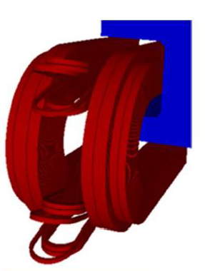
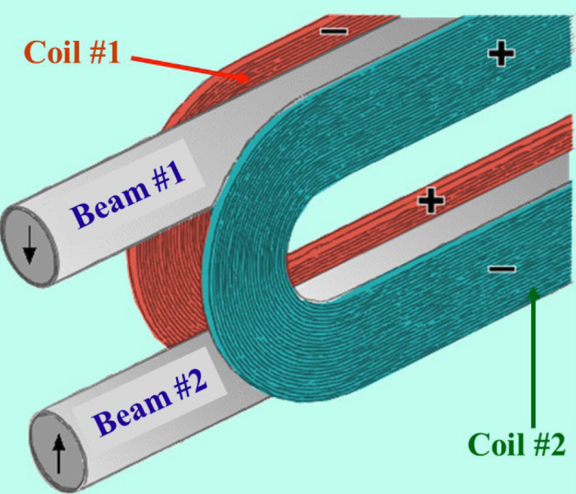
CIEMAT Contribution to EuroCirCol
Main Dipoles Conceptual Design
3D Concept of the Common Coil Solution
Analysis of the Common Coil Option
Type | Common Coil Main Dipole
Field in the aperture | 16 T
Aperture diameter | 50 mm
Outer diameter | 800 mm
Nominal current | <20kA
Magnet length | 14.3 m
Technology | Nb₃Sn Coils @ 1.9K
Industrialization | Yes (TBD)
Presentación CIEMAT en el evento de seguimiento del programa FTEC. 10 de Diciembre de 2020

Slide 24

The FTECs Program
This programme is aimed at recent graduates seeking further training in a wide area of projects. Selected trainees will have the opportunity to enlarge their knowledge through participation in Hi-Tech activities at CERN, in fields such superconducting and resistive magnets, power converters and their associated electronics, cryogenics and vacuum technologies and electronics for detectors, with a potential industrial return.
Presentación CIEMAT en el evento de seguimiento del programa FTEC. 10 de Diciembre de 2020

Slide 25
The IFMIF Contribution
Presentación CIEMAT en el evento de seguimiento del programa FTEC. 10 de Diciembre de 2020

Slide 26
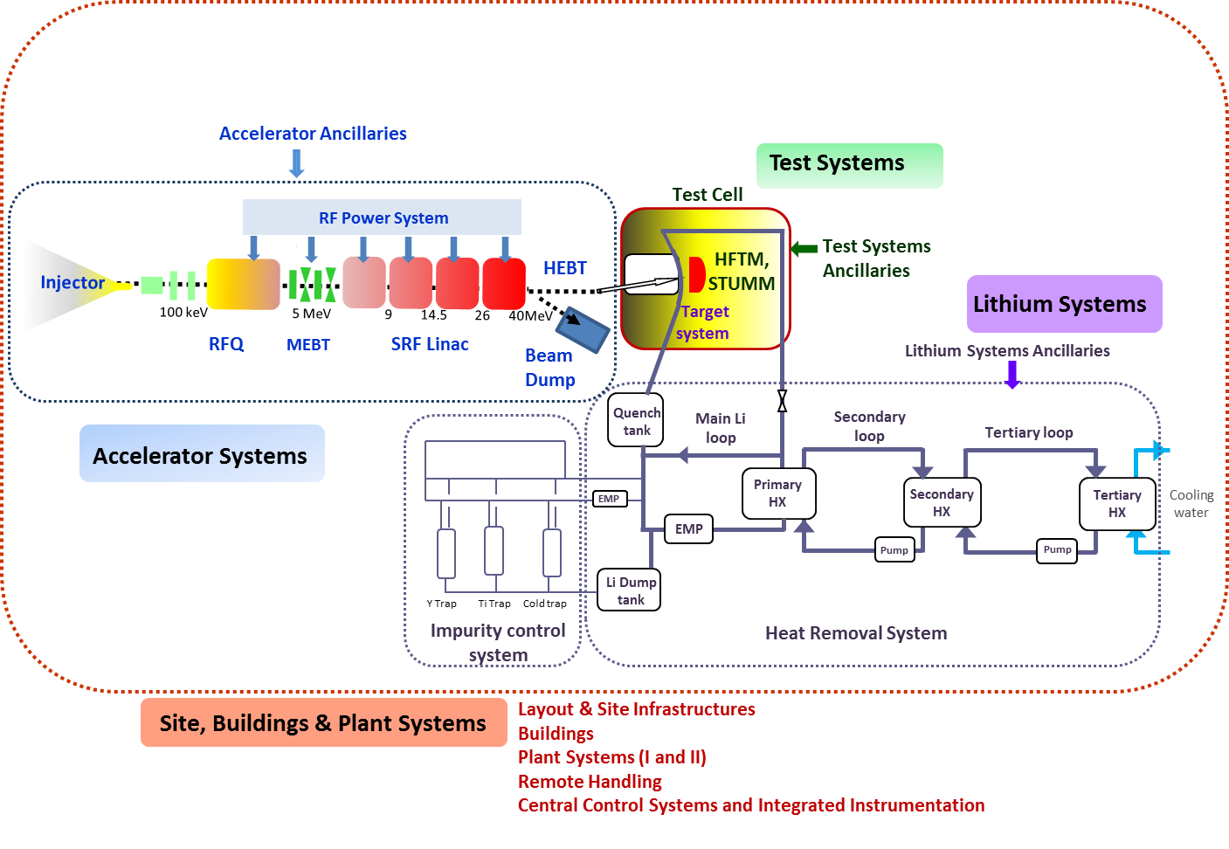
The IFMIF & DONES Projects
The IFMIF project: a 40 MeV, 125 mA deuteron accelerator acting on a lithium target to generate neutrons to test materials for the first commercial fusion reactor : the DEMO. To validate the IFMIF concept, the so called EVEDA phase has been launched, including a Linear Accelerator (LIPAc) with a current of 125 mA and an energy of 9 MeV.
The early construction of an 'Early DEMO' requires a neutron irradiation plant with reduced specifications in terms of accumulated damage of the irradiated materials, thus it was decided to design and build a facility capable of producing the specified amount of damage as soon as possible: The ENS. The design adopted is DONES (DEMO-Oriented Neutron Source), which basically consists of a simplification of IFMIF, with only one accelerator for which CIEMAT is also collaborating.
Presentación CIEMAT en el evento de seguimiento del programa FTEC. 10 de Diciembre de 2020
Notes:
26

Slide 27
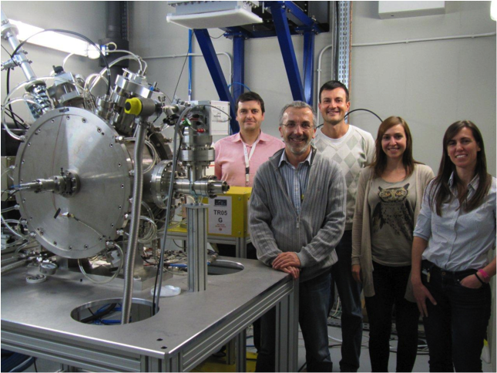
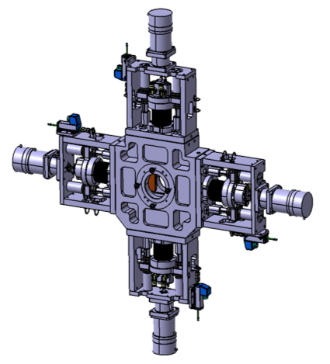


CIEMAT Contribution to IFMIF (1)
DEVICE | DESCRIPTION/TECHNOLOGY
RESISTIVE MAGNET | 13 Combined Magnets (1 Quadrupole + 1 Dipole) to be made at industry (ANTEC). Water cooled magnet, radiation resistant.
SUPERCONDUCTING MAGNET | 8 Combined superconducting magnets (2 Solenoids + 2 Dipoles). NbTi wet impregnated magnets to be manufactured at industry.
SCRAPER | 2 Collimation Scrapers fabricated at industry (AVS). Water cooled. Driven by step motors in close loop.
BUNCHER CAVITY | 2 RF Buncher cavities @175 MHz made at industry (DPM). IH resonator with 4 acceleration gaps. Resistive Type. Water cooled.
Presentación CIEMAT en el evento de seguimiento del programa FTEC. 10 de Diciembre de 2020
Notes:
27

Slide 28





Integration Activities
CIEMAT Contribution to LHC-HL (2)
  Medium Energy Beam Transport Line (MEBT):
  Compact transport line between RFQ and cryomodules
  Main components: Five combined magnets, two bunchers, beam scrapers and beam diagnostics.
  Fully designed by CIEMAT; manufactured by Spanish industry
  MEBT sent to Rokkasho
Buncher cavity
ZScrapers
MEBT
Combined magnets
Beam position monitors
Presentación CIEMAT en el evento de seguimiento del programa FTEC. 10 de Diciembre de 2020

Slide 29
THE FUTURE

Slide 30





The PRISMAC Program
PRISMAC: A CIEMAT-CDTI Collaboration Program for Research on High Field Magnets, Supported by SGI/MCI & CERN
HL-LHC MCBXF Magnets In-Kind Contribution | Training & Support on magnets and facilities Use of Facilities during the set-up of CIEMAT Laboratory Qualification of CIEMAT as a Technological Partner | Providing a team, facilities and economical resources to all the activities Prototype Development Technology Transfer to Industry Series Fabrication Follow-up Qualification of Industry as Industrial Partners Management of IK contribution to CERN | Project Funding Industrial exploitation of the associated technologies (Early Alert) Dissemination of the developed technologies to other fields (i.e. Space. Fusion, Light Sources, Energy..) | Funding the series production, components and new personnel Supporting the Spanish Traineeship Program (FTEC) Supporting the R&D Program on Key Technologies
Facility for very high field superconducting magnet prototypes
Development of FCC model magnets
SECRETARIA GENERAL DE INVESTIGACIÓN
Presentación CIEMAT en el evento de seguimiento del programa FTEC. 10 de Diciembre de 2020
Notes:
30

Slide 31
The ILC Contribution
SCOPE OF CIEMAT CONTRIBUTION
The splittable, conduction cooled superconducting magnets allocated in the Main Linac Cryomodules to focus and steer the beam.
The contribution includes the Magnet Power Supply and the Beam Position Monitor.
 | ILC Cryomodule Magnet |  | E-XFEL Cryomodule Magnet
Type: Combined | QUADRUPOLE | DIPOLE (2 H&V) | QUADRUPOLE | DIPOLE (2 H&V)
Overall Nº of Magnets | <315 | <630 | 103 | 206
Integrated Field | 36 T | 0. 075 Tm | 5.97 T | 0.00075 Tm
Peak Field | 3.3 T |  | 2,48 T | 1.59 T
Magnetic Length | 680 mm |  | 169.6 mm | 203.7 mm
Inner Diameter | 78 mm |  | 94.4 mm | 83.6 mm
Op. Current | 100 A |  | 50 A
Baseline Technology | Splittable NbTii Conduction Cooled |  | NbTi, He Bath Cooled in Vacuum Vessel
Alternative Technology | Splittable MgB₂ Conduction Cooled
Presentación CIEMAT en el evento de seguimiento del programa FTEC. 10 de Diciembre de 2020
Notes:
31

Slide 32

Medical Accelerators
iFast
CIEMAT also tries to profit from the knowledge generated in the development of High Energy Physics Accelerators and supports societal applications of accelerators such as medical accelerators for radiotherapy (hadron therapy) or diagnostics (production of radiotracers).
Presentación CIEMAT en el evento de seguimiento del programa FTEC. 10 de Diciembre de 2020
Notes:
32

Slide 33

Thank you very much for your attention
Presentación CIEMAT en el evento de seguimiento del programa FTEC. 10 de Diciembre de 2020

