Slide 1
Laser Treatment for Electron Cloud
Ana Karen Reascos Portilla TE-VSC
Supervisors:
Marcel Himmerlich TE-VSC
Mauro Taborelli TE-VSC

Slide 2
Index
End Switches and Camera
Cable Management
Control Software Development
Trainings and Volunteering
Actions Planned

Slide 3
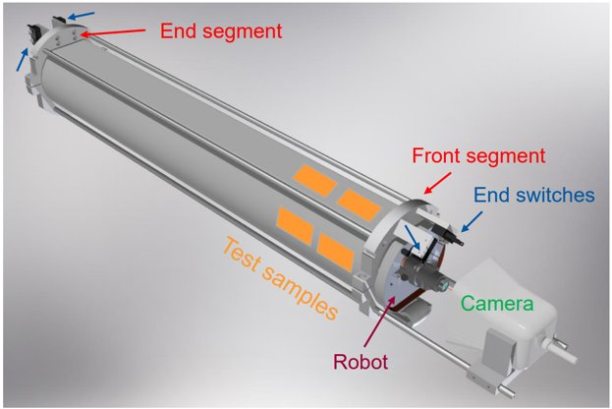
End Switches and Camera

Slide 4
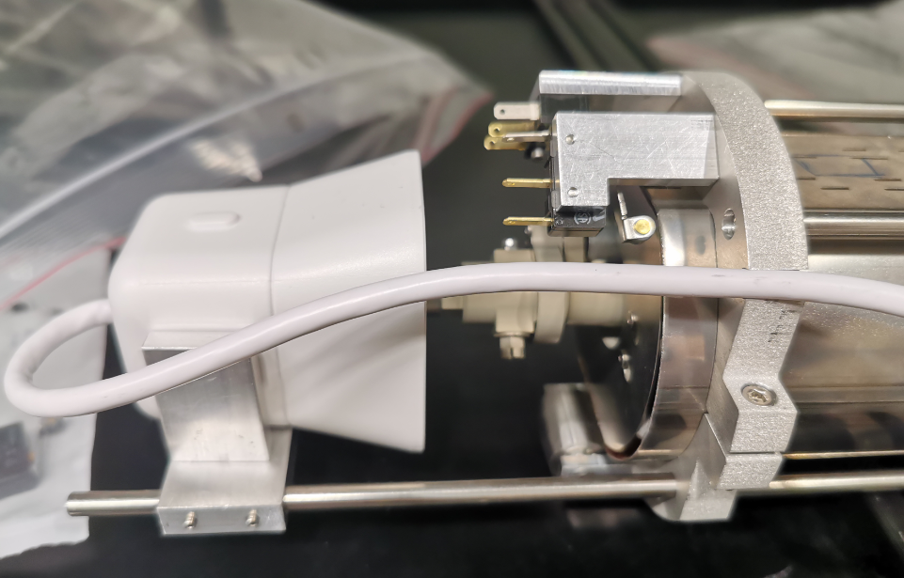
End Switches and Camera
Problem: the switches were not activated when the robot reaches the end.

Slide 5
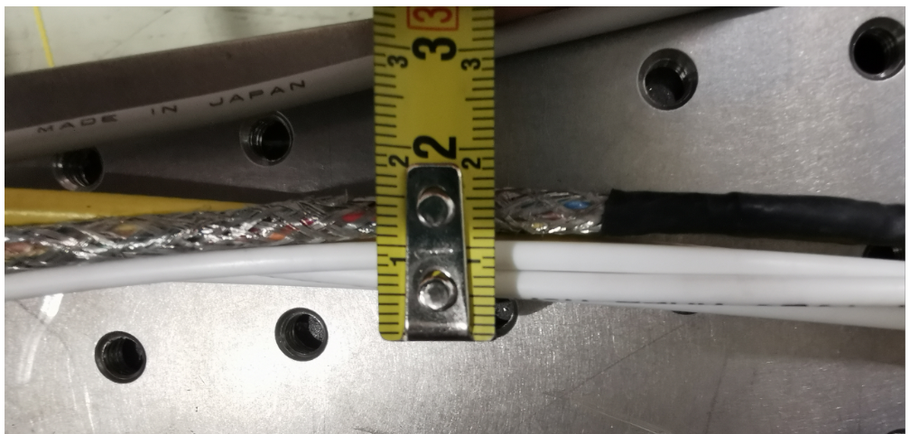
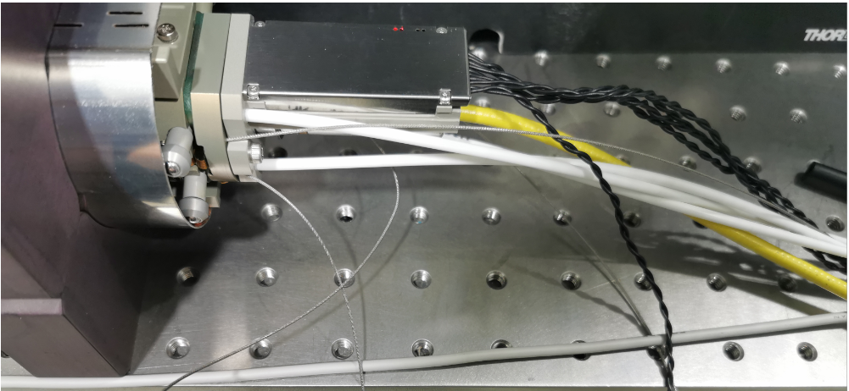
Cable Management
*hose = manguera

Slide 6
Cable Management
Material selection
Vacuum compatible to avoid contamination. Polymers containing F or Cl elements like PTFE should also be avoided.
Hard enough to avoid abrasion but not so hard that it scratches the Beam Screen surface.
Light and flexible enough for the cable management. The material must allow a minimum bending radius of 12cm.
TOO RIGID
PEEK
Polyetheretherketone
UHMWPE
Ultra high molecular weight polyethylene

Slide 7
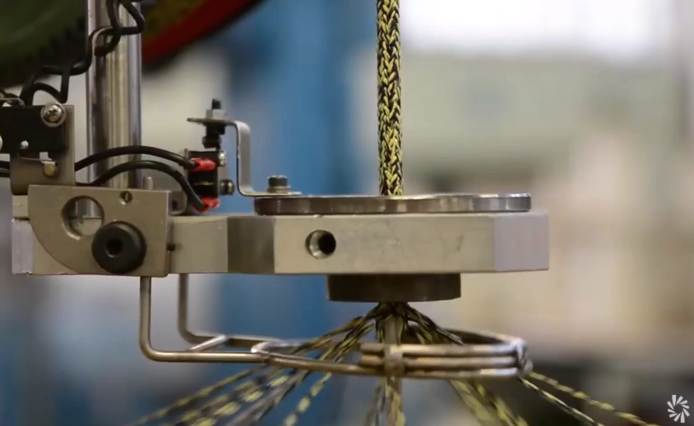
Cable Management

Slide 8
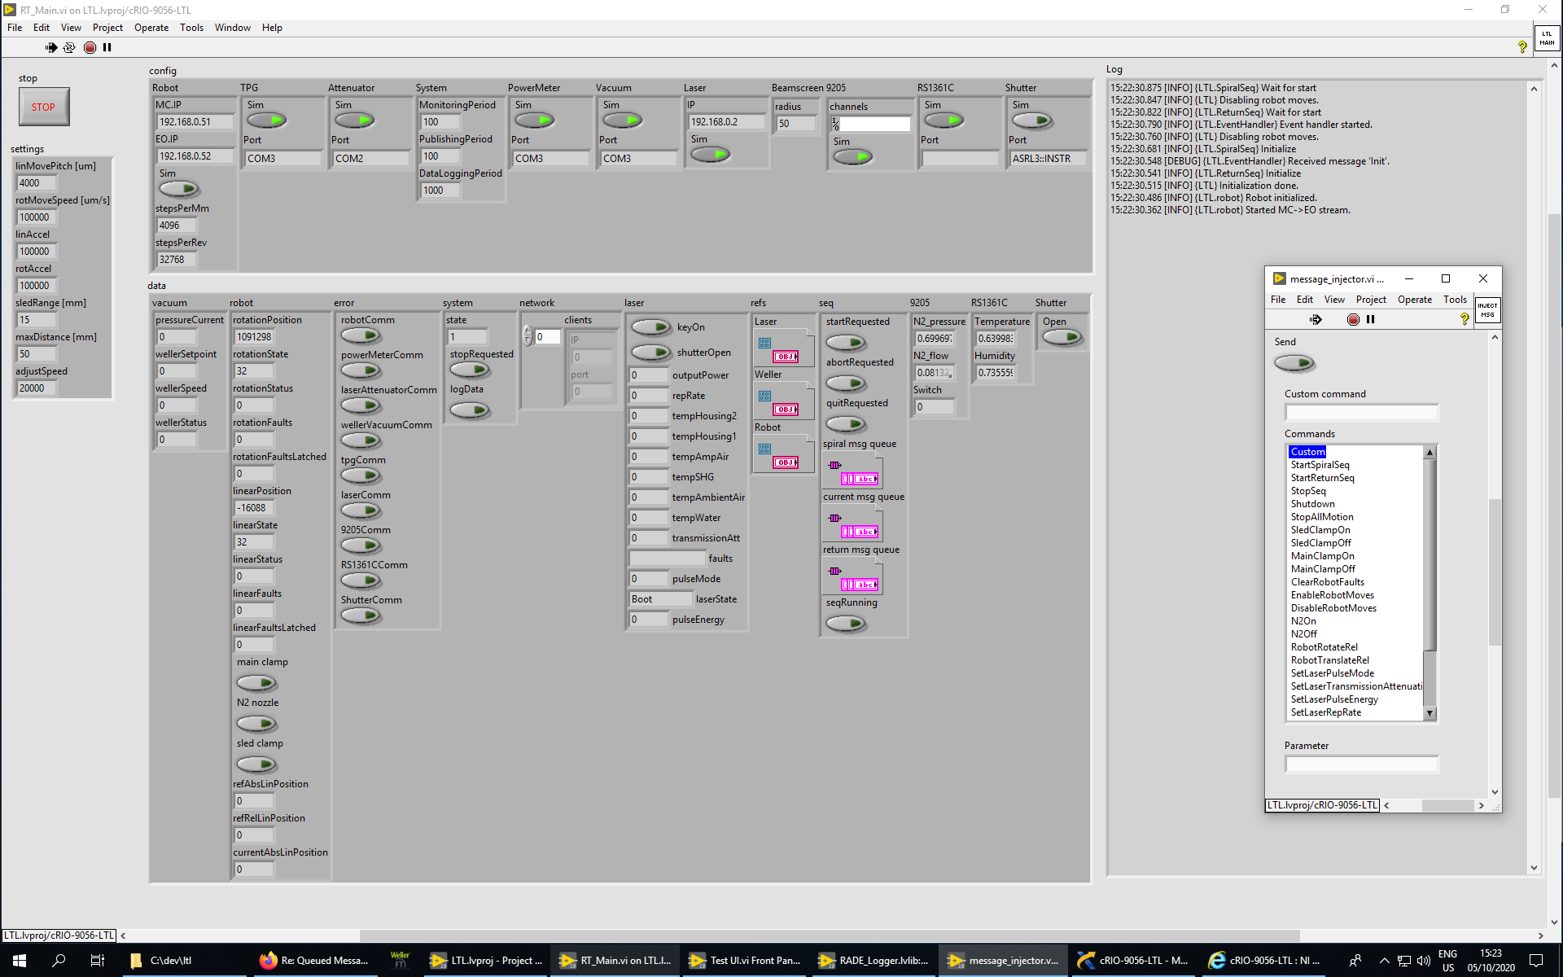
Control Software Development

Slide 9
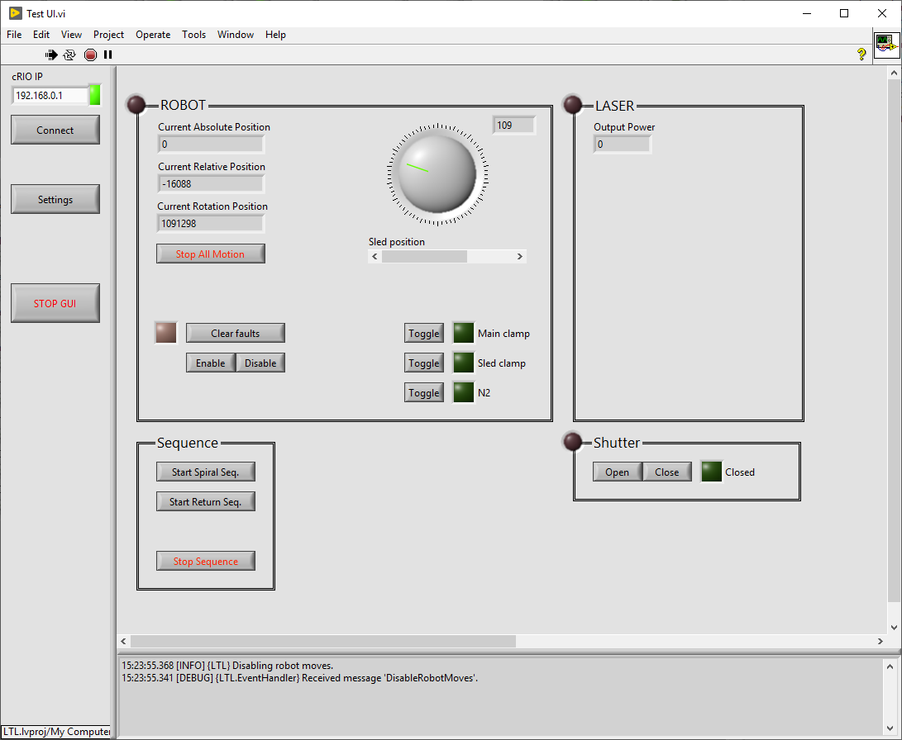
Visual information
Current State
Robot movements

Slide 10
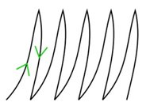

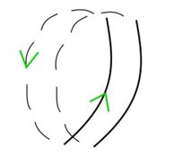
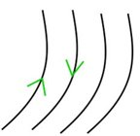
Robot movements
Spiral
Zig-zag
Partial Spiral
Lines
Spiral
Partial Spiral
Zig-zag
Lines
0m
15m

Slide 11
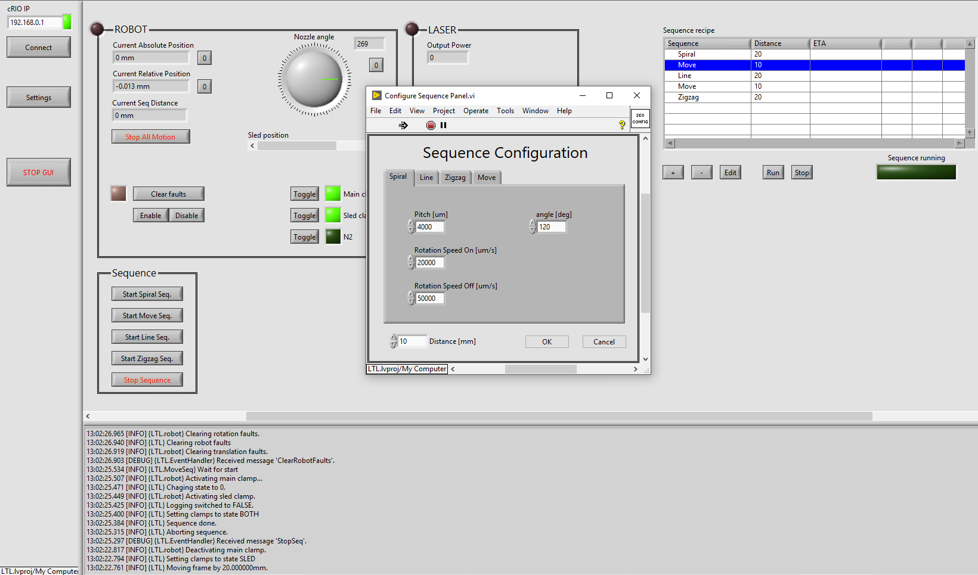
Device communication
Software Interlocks
Sequence combination

Slide 12




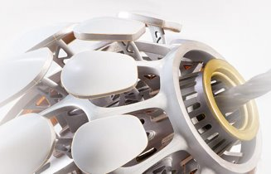
Trainings and Volunteering

Slide 13
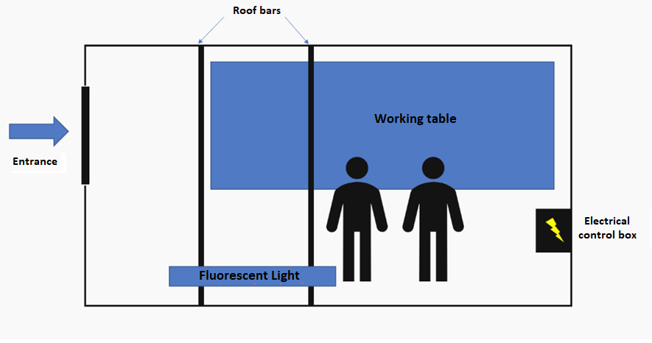
Request for electrical and lightning

Slide 14
Actions Planned
Multiple - sequence long test
Reply the Labview control system for the collaboration with the University of Dundee.
Laser installation with the Beam Delivery System
Laser Beam Stabilization Reading

Slide 15

Thank you for your attention!

