Slide 1
Supervision and trigger distribution units for magnet protection
Guzmán Martín García
10/12/2020

Slide 2
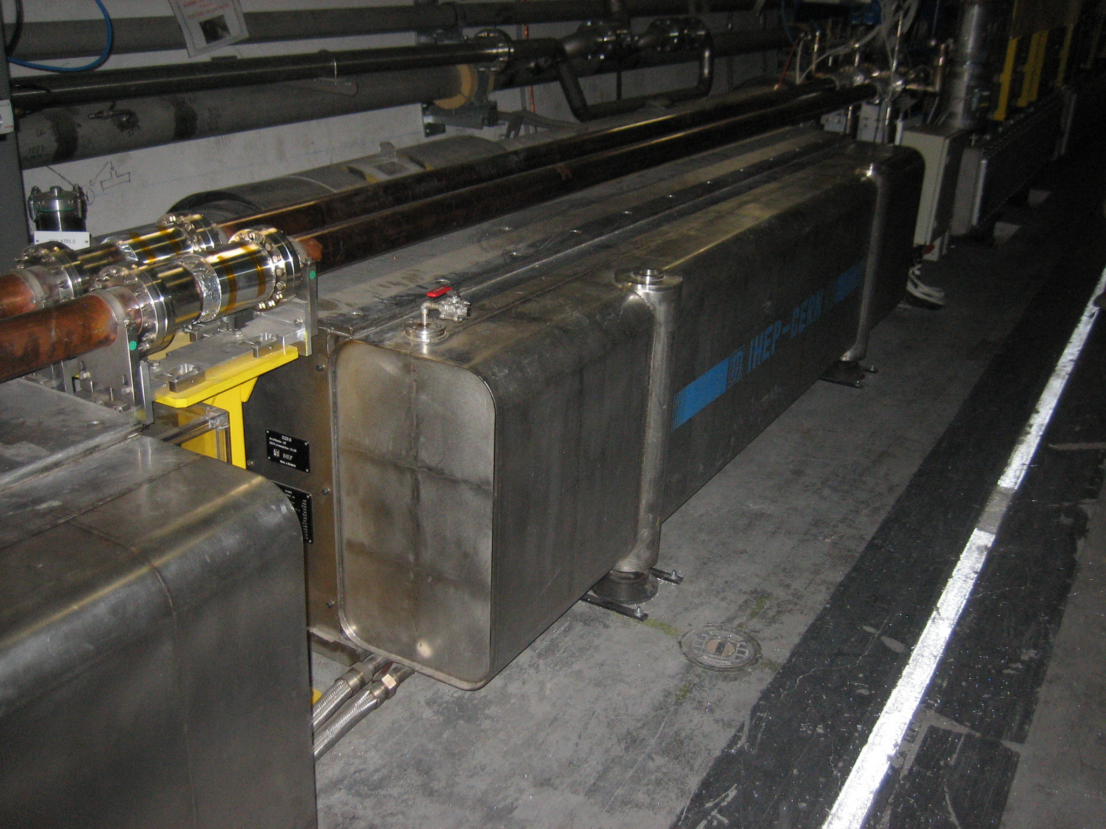
Overview
The Quench Protection System is a vital part of the superconducting magnets thorough the LHC. As the name implies, its main task is to protect the magnets against a “quench”.

Slide 3
But what is a quench?
A quench is the sudden appearance of a resistive section in a superconducting magnet that can appear spontaneously by many different reasons.
When this happens, the high currents (about 10kA) in the magnet may produce a substantial amount of heating in a really small area. This will eventually destroy the magnet, probably in a catastrophic way. For example, the energy stored in a LHC main dipole magnet circuit is of the order or 0.25kgs of TNT
To save the magnets, once a quench is detected, we dump all that energy into resistors while heating the magnet units. Heating expands the area in which the quench is happening, distributing the energy remaining in the magnet while we dump as much of it as possible into resistor banks submersed in oil.

Slide 4
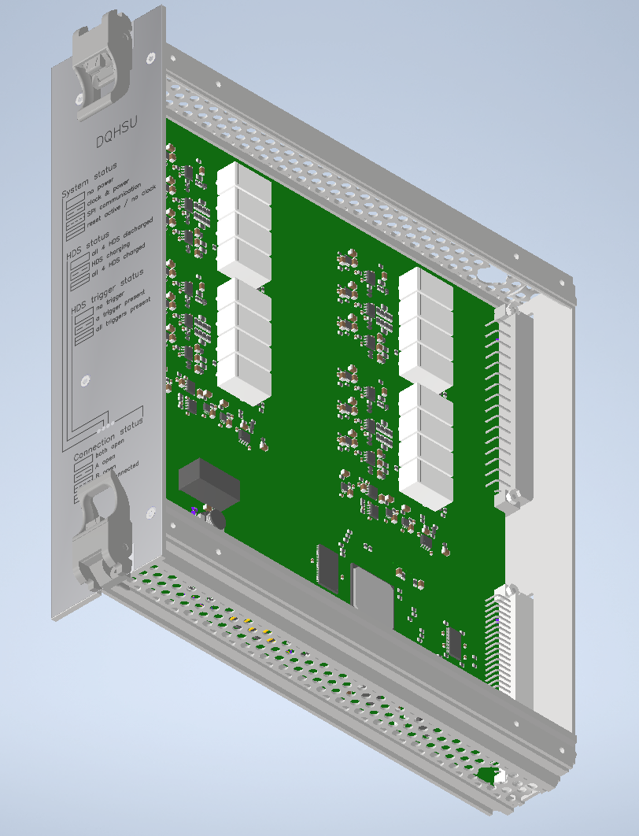
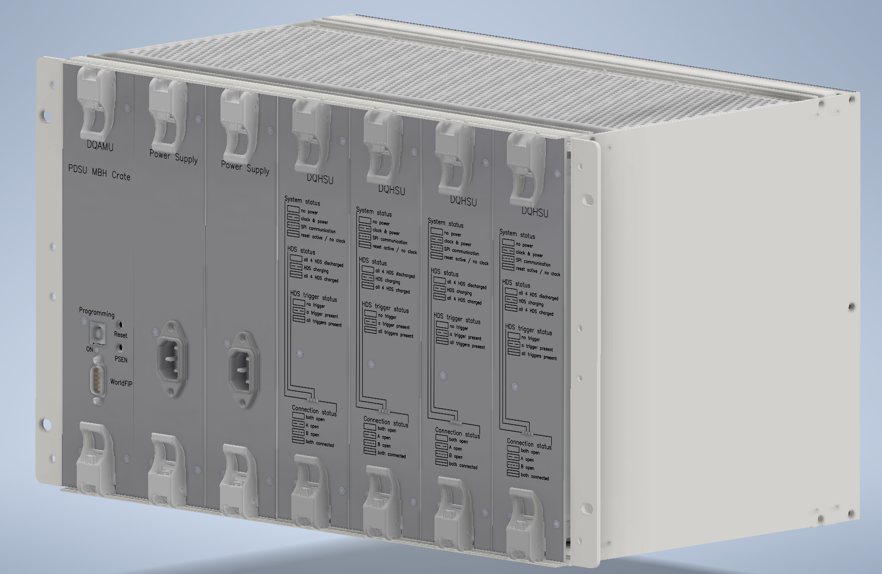
DQHSU Crate mechanical design
The integration of the DQHSU crates has been sucessful, without any major deviations from the 3D CAD other than some manufacturing issues that were easily solved.
DQHSU: Heater Supervision Unit, Will trigger and supervise the discharge in case of quench of the heater units on the future 11 Tesla magnet

Slide 5
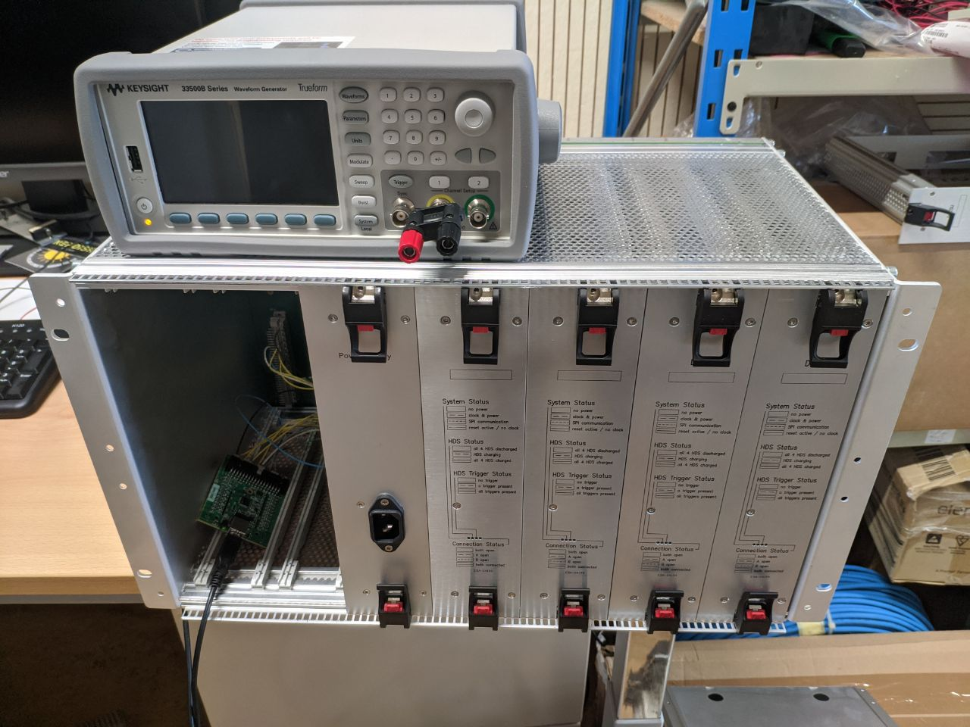
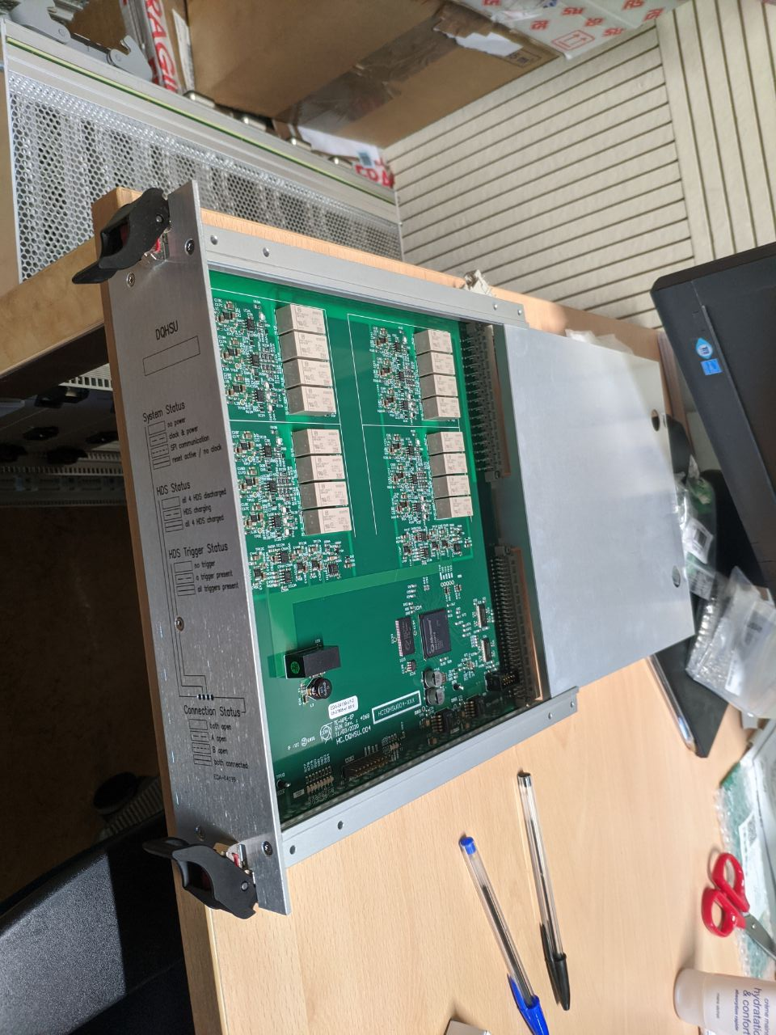
DQHSU Crate mechanical design

Slide 6
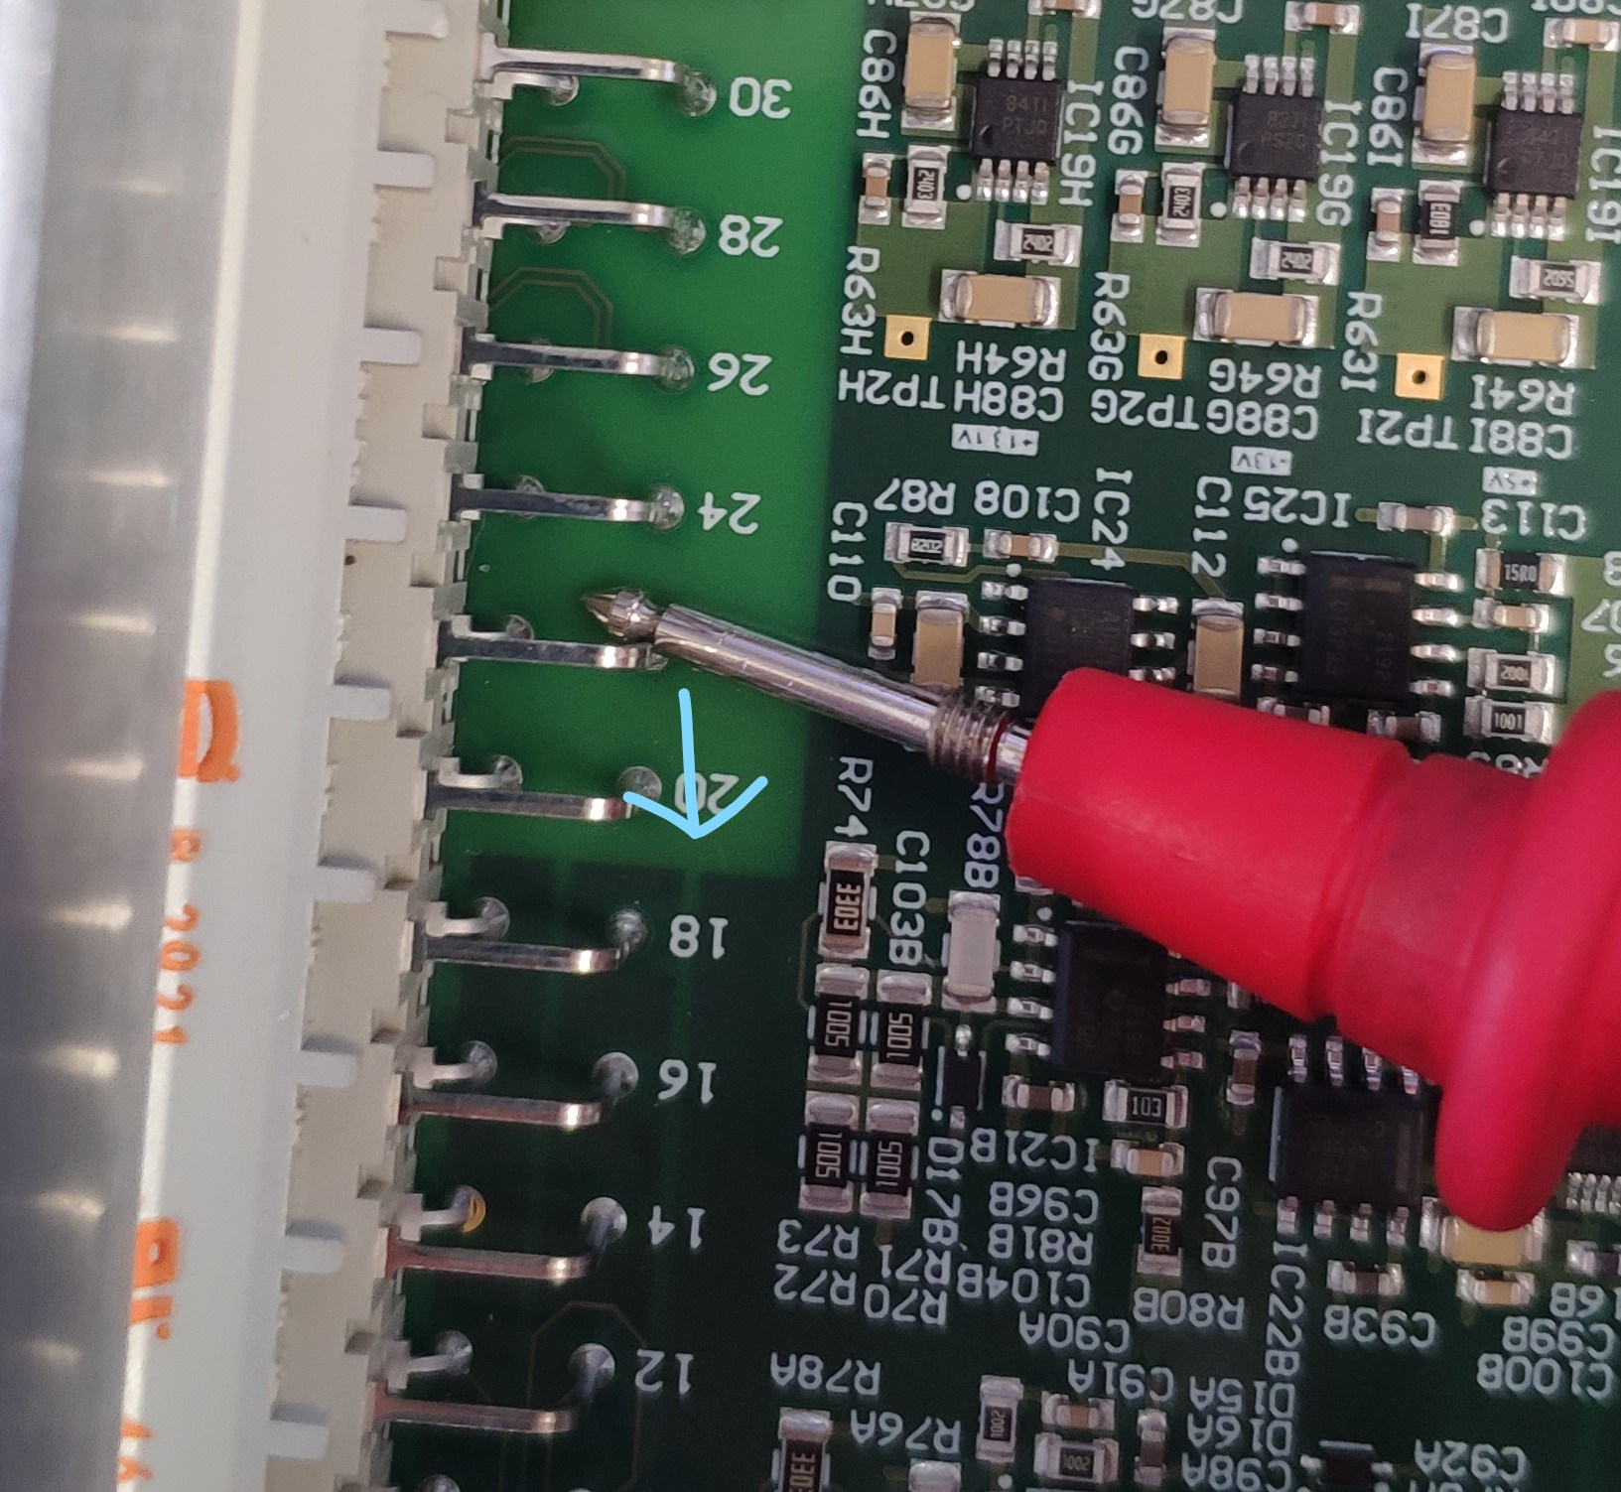
Faulty DQCSU boards diagnosis
We have finally received the results of the destructive analysis performed on the diagnosed DCQSU boards. The hypothesis was correct, and it was a mechanical problem within the board due to thermal stress during soldering
DQCSU: Crate Supervision Unit, enables power supply monitoring, remote power cycles and monitoring of the DQLPU: Local Protection Unit crates, that monitor and protect the main dipole magnets on the LHC

Slide 7
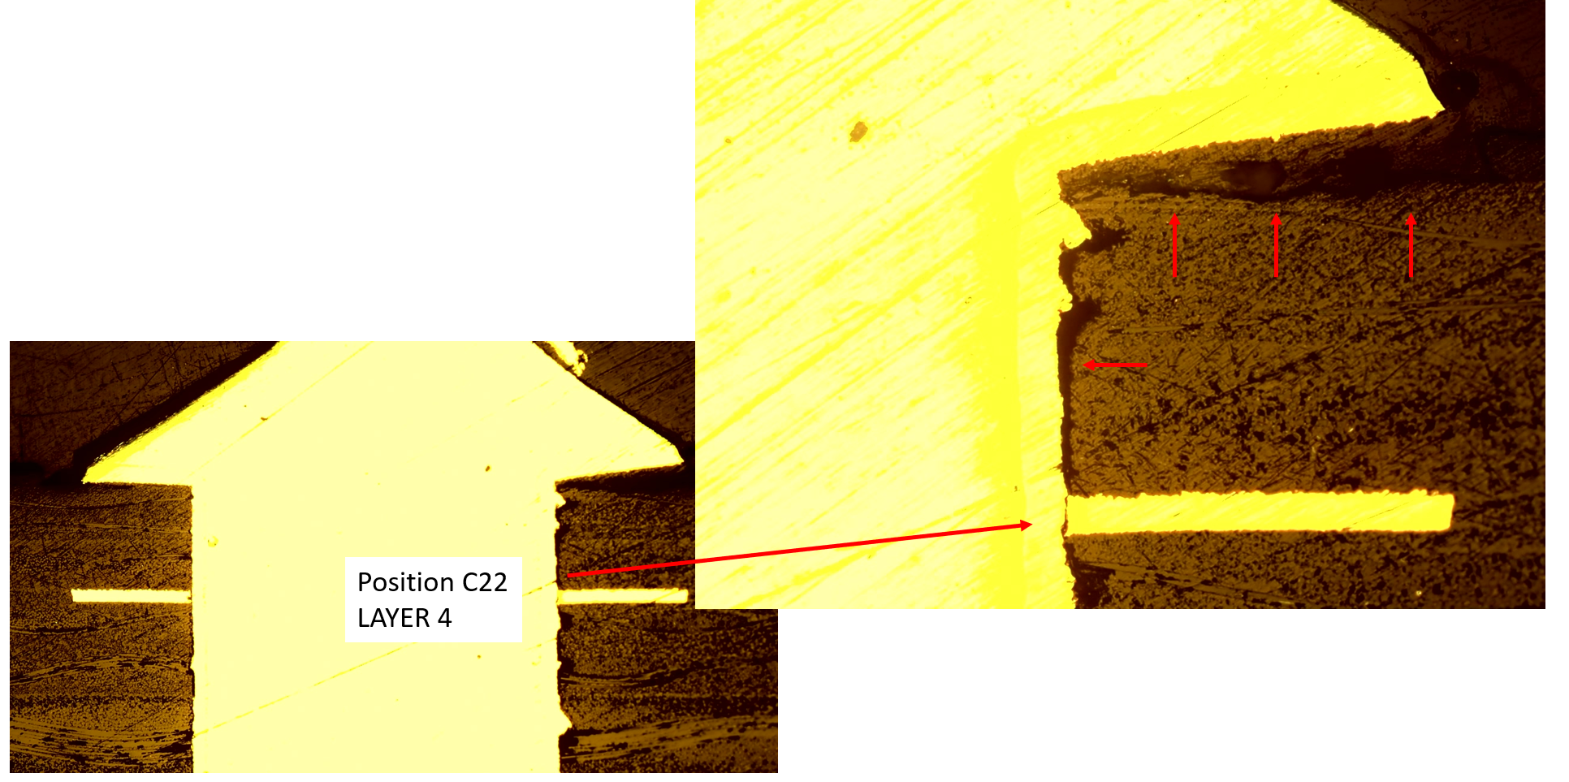
Faulty DQCSU boards diagnosis
As can be seen in the microsection, the annular ring of the via has slightly detached from the via itself. Also, it can be noted than the PCB material (the darker area) has also detached from the via.

Slide 8
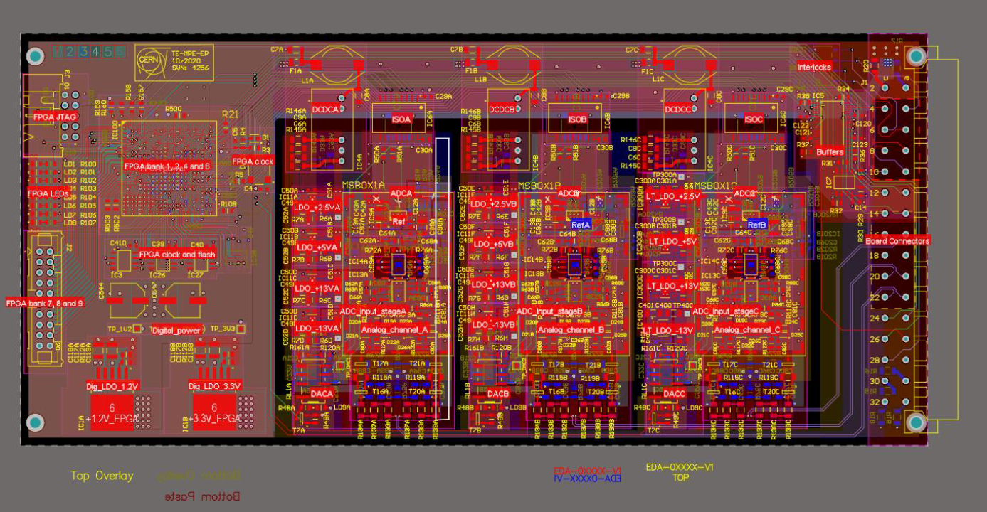
DQQDIDT PCB Design
This board is a drop-in replacement for a currently existing board detecting quenches on the Inner Triplet magnets. The main requisite was to have 3 low-noise analog input channels galvanically isolated.

Slide 9
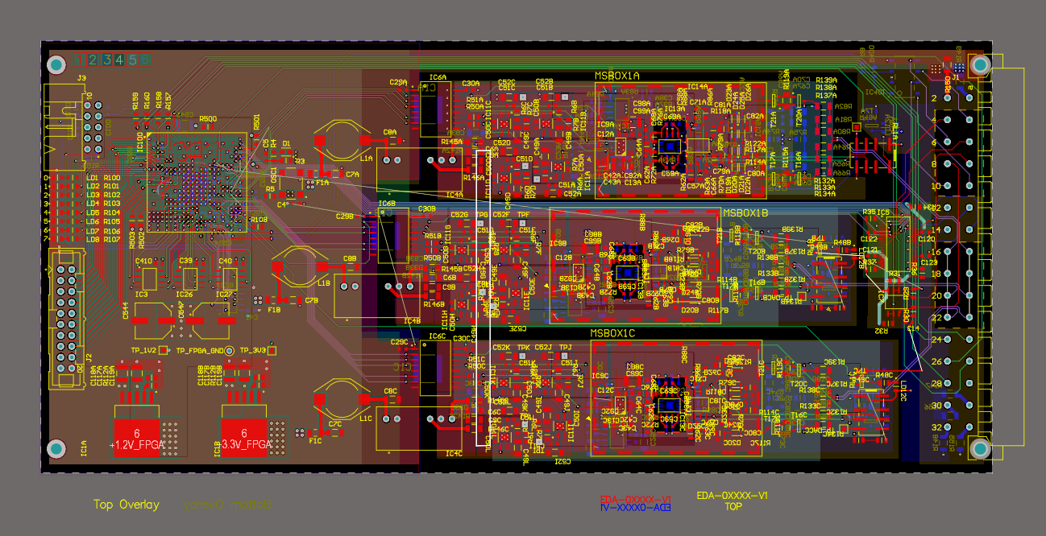
DQQDIDT PCB Design
The board went through many iterations. The first one, was based on a previous prototype that had the channels arranged horizontally. This design was deemed harder to arrange and route, and keeping the 2mm distance between the isolated channels was harder, and thus was discarded in favour of a more compact, horizontal one.

Slide 10
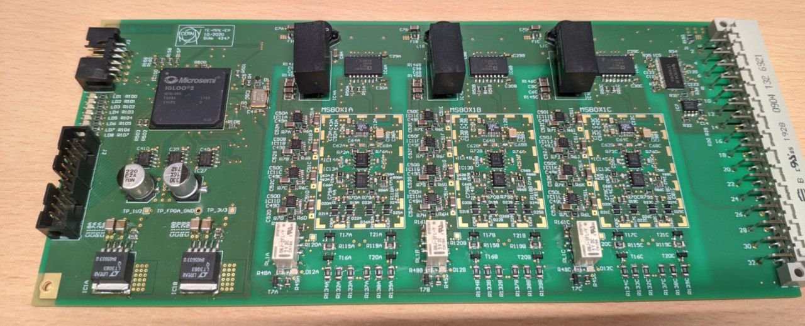
DQQDIDT PCB Design
The board performs as expected and it is currently reducing the noise at the input of the ADC of the previous design by 1.5 least significative bits, or about 20%. We have already detected a few changes that might allow for the noise to go lower and will implement them on a future prototype.

Slide 11
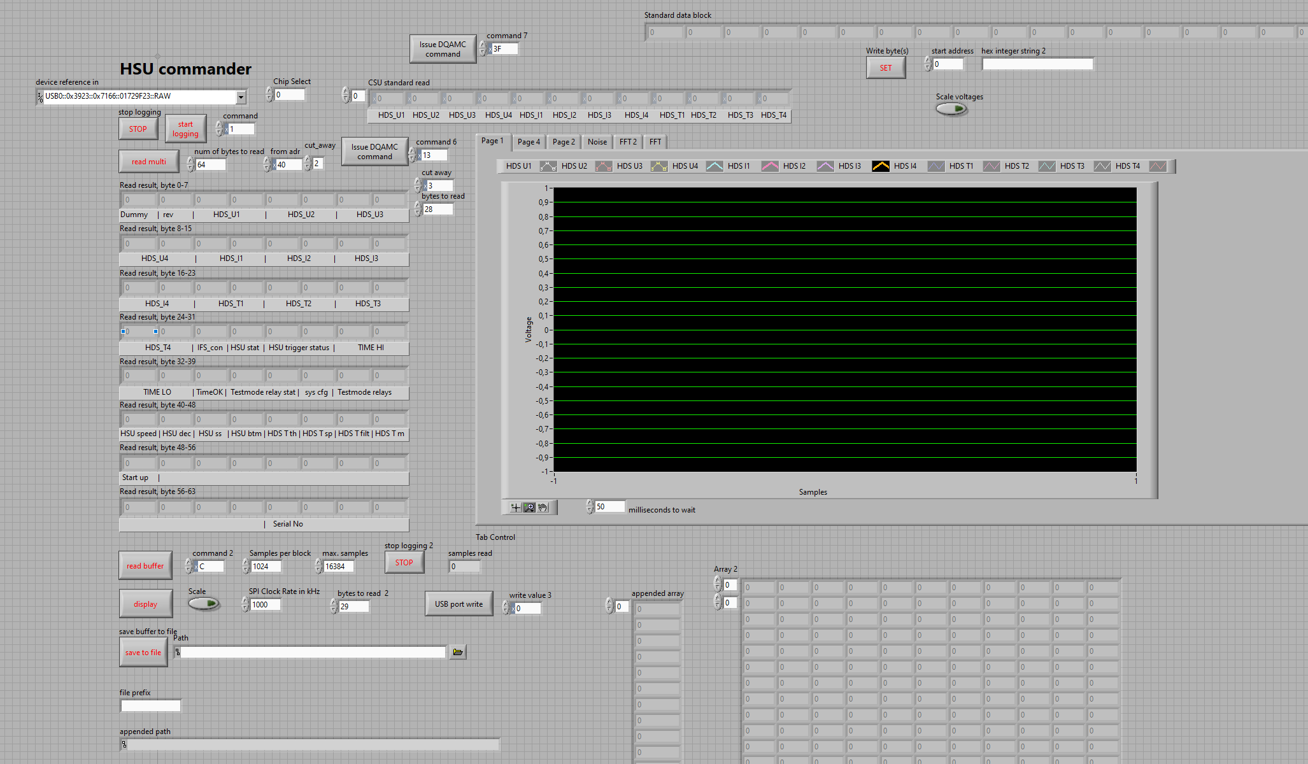
Software
Successfully ported the software that manages the DQHSU crate (seen previously) from Labview to Python. This allows for easy portability between various computer, and allows for more functionality.
The current version is a simple interface with the register map. This requires knowing the register map and the commands by heart to use it properly.

Slide 12
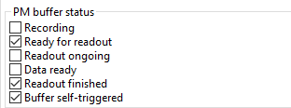

Software
The current version adds a layer in between the register map and the user, that translates the register map to a human-readable form.
Sending commands, storing settings, are also simplified greatly.

Slide 13
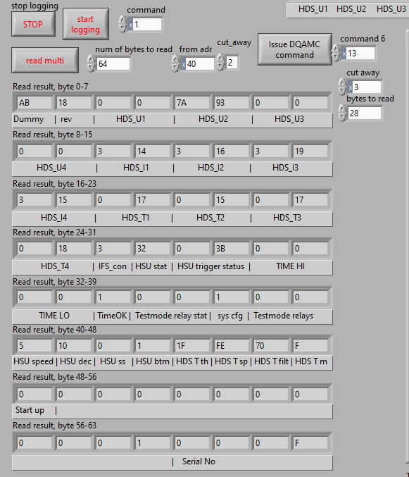
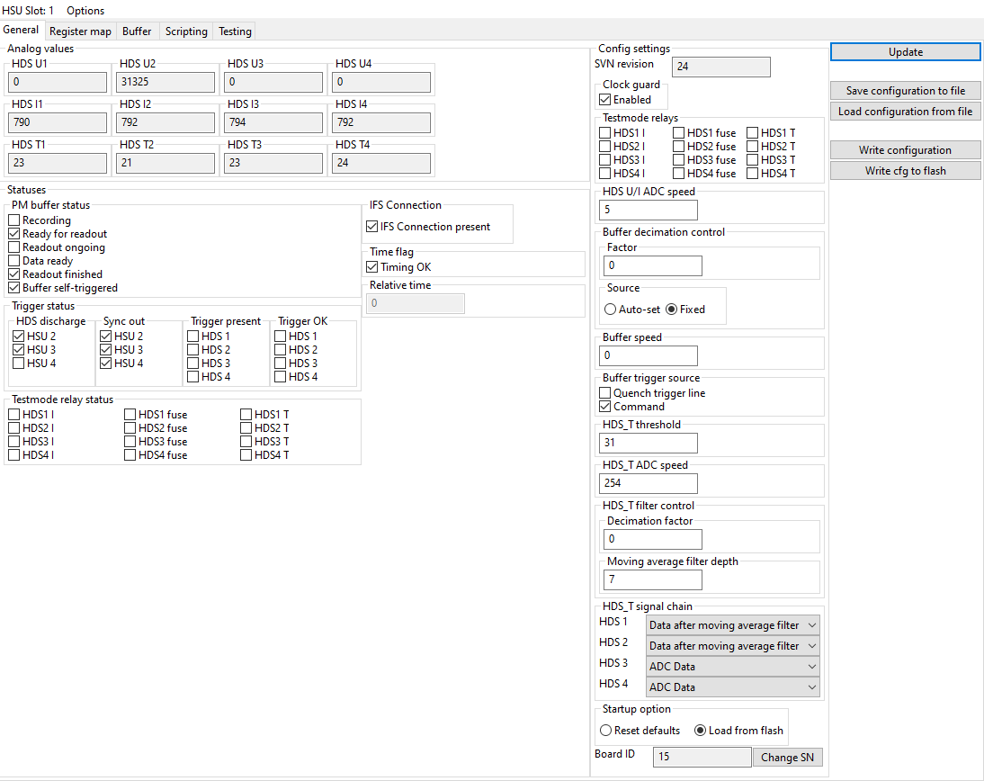
Software

Slide 14
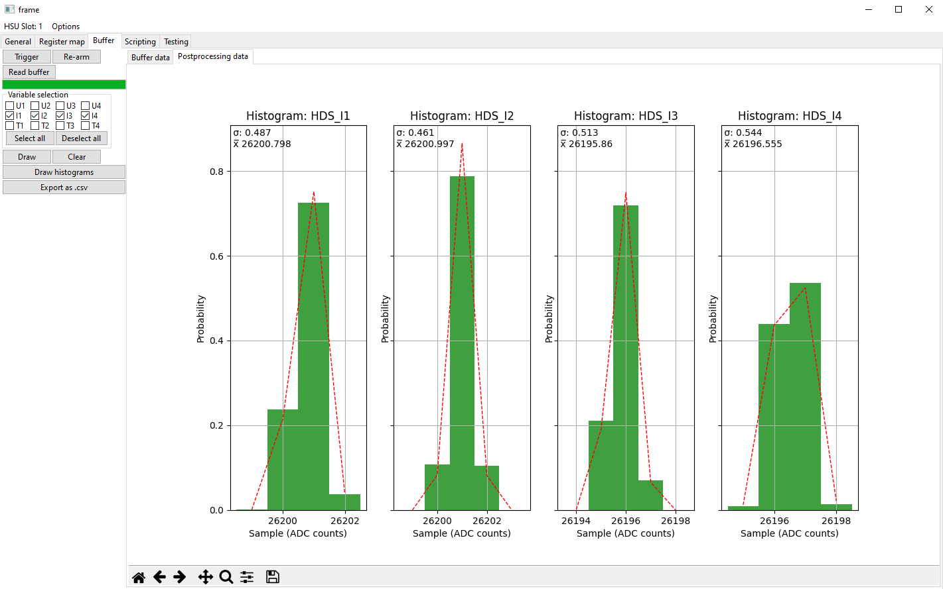
Software
There is also a testing tool that allows to perform 3 different tests to each unit to check functionality and performance.

Slide 15
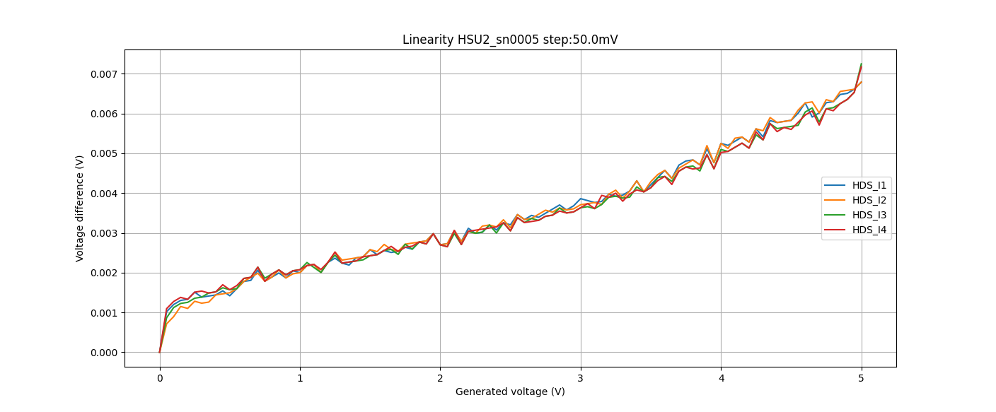
Software

Slide 16
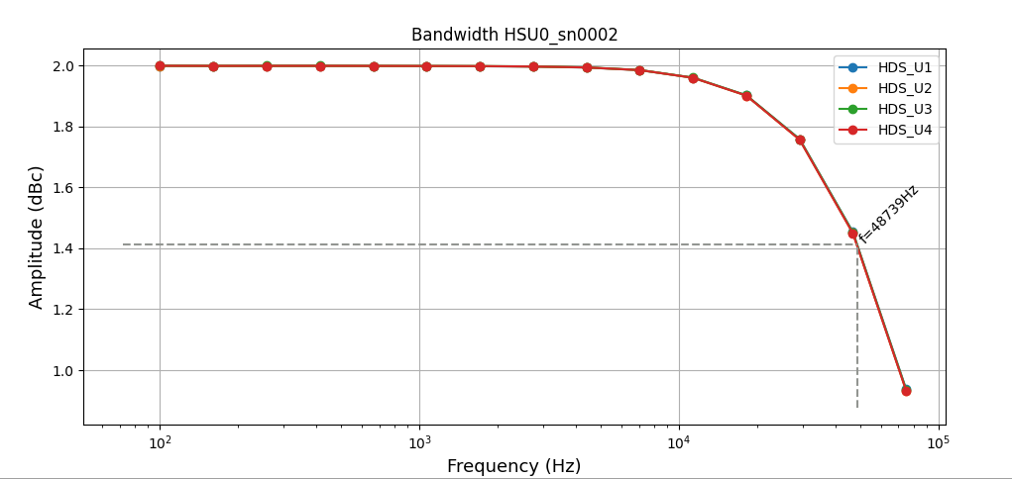
Software

Slide 17
Questions?

