Slide 1

11th FTEC Workshop
Cryogenics for the HL-LHC IT String
Óscar Durán Lucas
TE-CRG-ME - A. Perin (supervisor), G. Rolando, A. Lees, A. Wanninger, J. Mouleyre, J. Metselaar
CERN, 09th December 2020
INDICO: 981864

Slide 2
Outline
Overview of the HL-LHC IT String
Cryogenic system for HL-LHC IT String
Update on technical tasks
Heating Unit
Thermal shield circuit
Flowmeter valve box
Update on management tasks
Upcoming activities

Slide 3
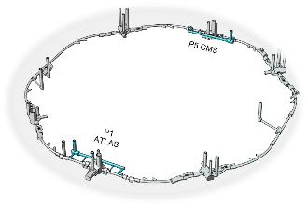
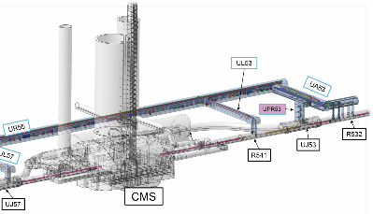
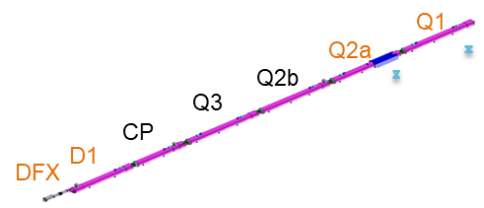
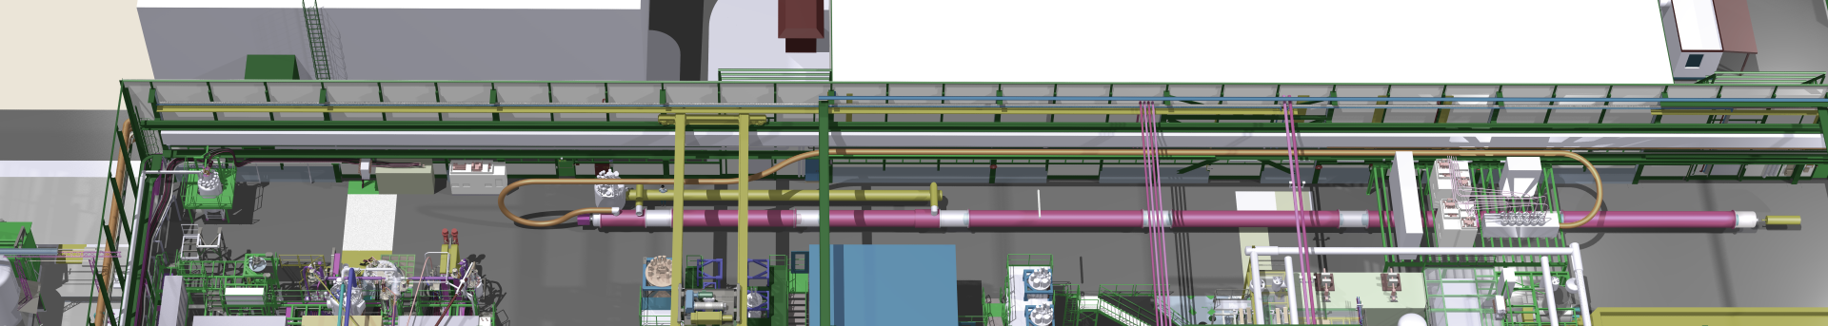
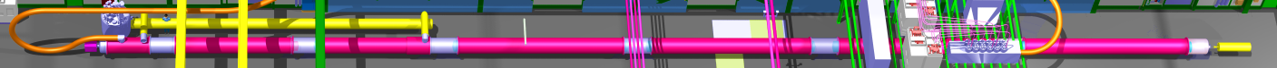
Overview of the HL-LHC IT String
The final focusing superconducting inner tripplet (IT) magnets of ATLAS and CMS of LHC will be replaced during LS3.
HL-LHC IT String will be installed in SM18 facility for testing the collective behaviour of magnets and systems, get information to speed up the commissioning in the LHC tunnel and configuration of IP5L.
View of LHC and IP5 with location of IT magnets
*Images from CRG-TM presentation,
INDICO 797080
Integration of IT String in SM18

Slide 4
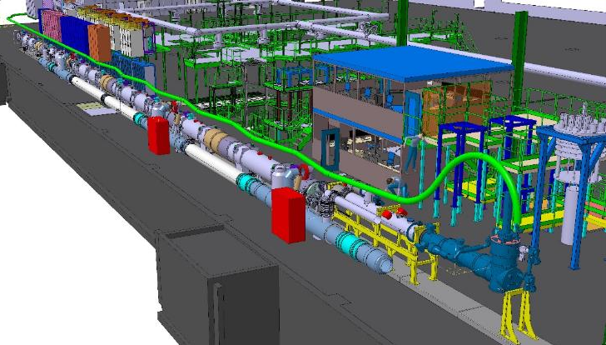
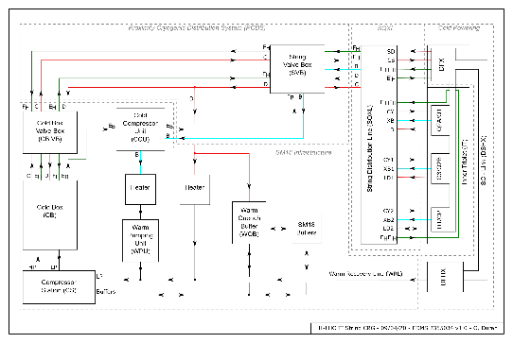
Cryogenics system for HL-LHC IT String
Layout of equipment in SM18
Cryogenic transfer lines
SQXL
Magnet cryostat
Cold Box
SQXL
Cold Compressor Unit
String Valve Box
*Images from TCC presentation,
INDICO 891644

Slide 5
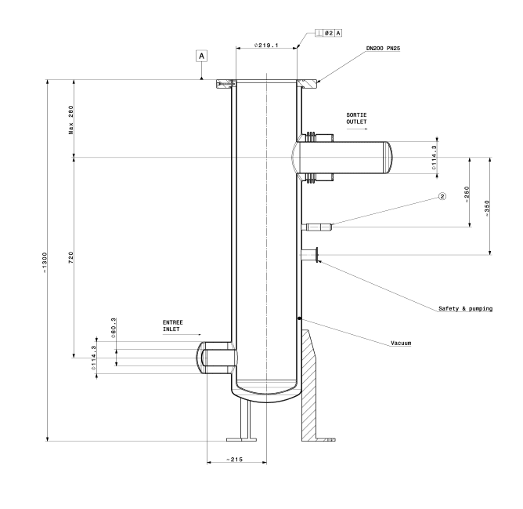
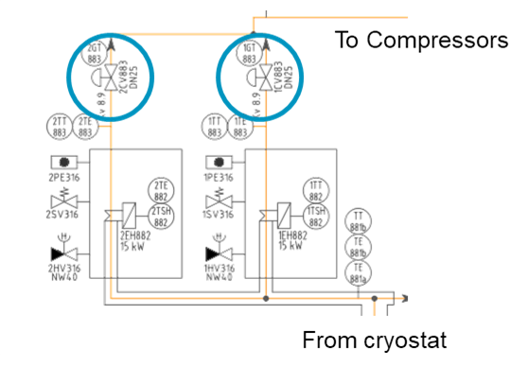
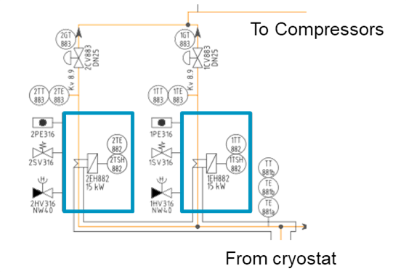
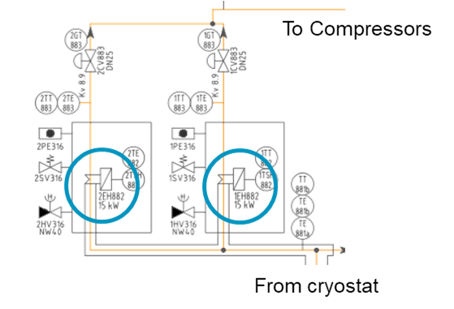
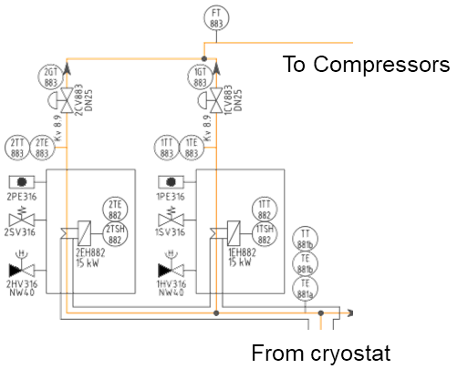
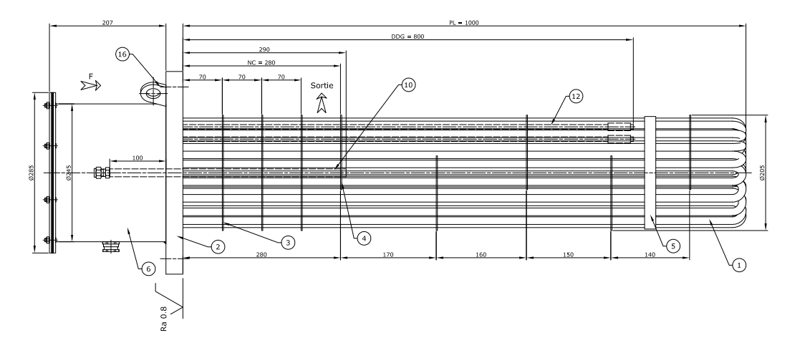
Heating unit
Why a heating unit in a cryogenic system?
1. After a quench, pressurized (up to 17 bar) and cold (10 to 30 K) He remains in transfer line D and magnet cryostat
Cold Box works at 3 bar → depressurization before restarting cool-down of magnets
Compressor station works with room temperature He
→ Heating of He needed
2. Warm Up
Technical specifications for tendering:
15 kW electrical heaters
Heater vessels
Valve sizing
Pressure model of the system to calculate the pressure drop requirements of the valve
Selection of a Kv able to regulate all operation modes
Valves, Heaters and Vessels ordered
*Images from previous procurement

Slide 6
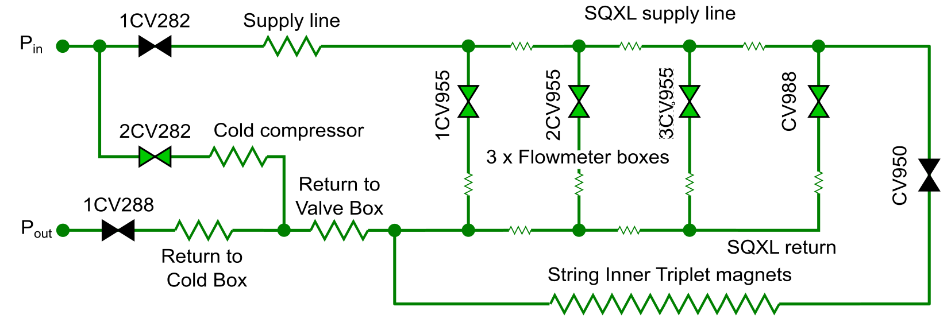
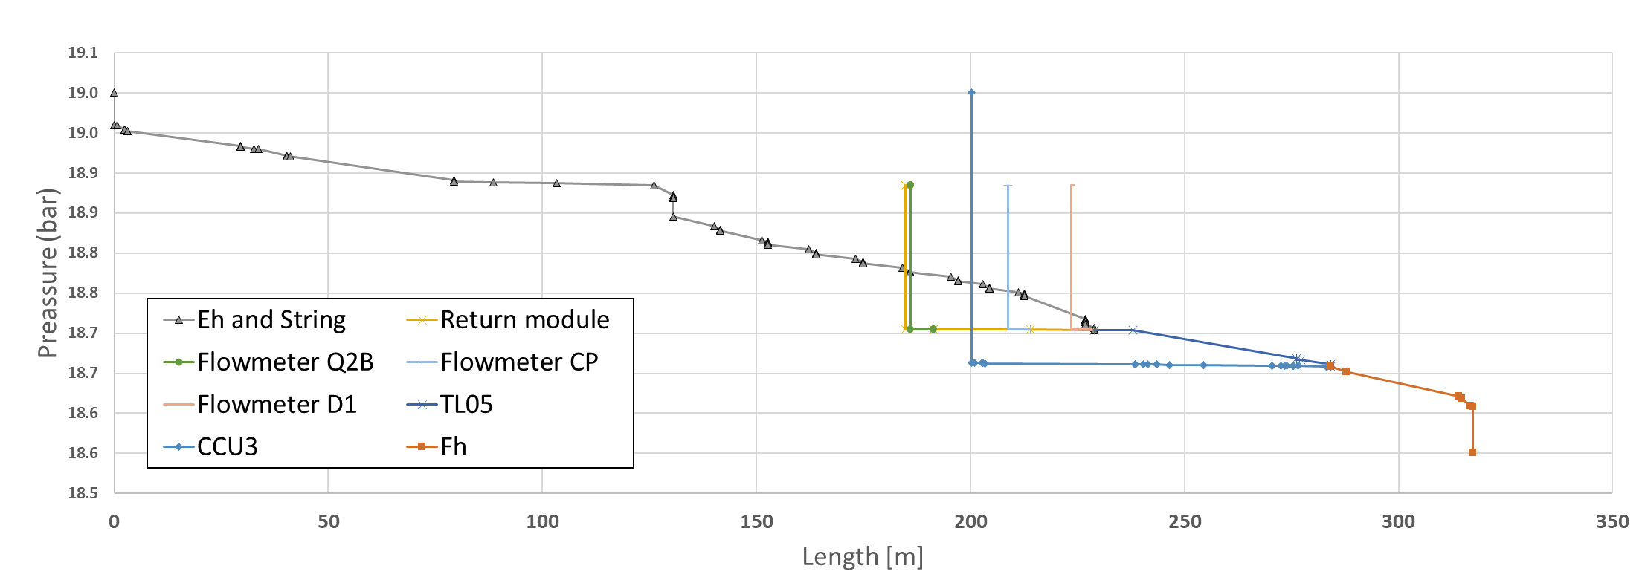
Thermal shield circuit valve sizing
Thermal shield supply is divided in 6 parallel circuits with different pressure impedances. Valves need to equilibrate the pressure in the circuit to regulate the flow in all the circuits
Parameters [min, max]: Inlet temperature, inlet pressure, mass flow at each circuit (cold compressor, flowmeter, return module, inner triplet magnets)
Valve control strategy
(x128 cases)
1CV282, CV950 and 1CV288 fully open
CV988
3CV955/2CV955/1CV955
2CV282
2CV282
1CV282
CV950
1CV955
2CV955
3CV955
All valves sized
CV988
1CV288

Slide 7
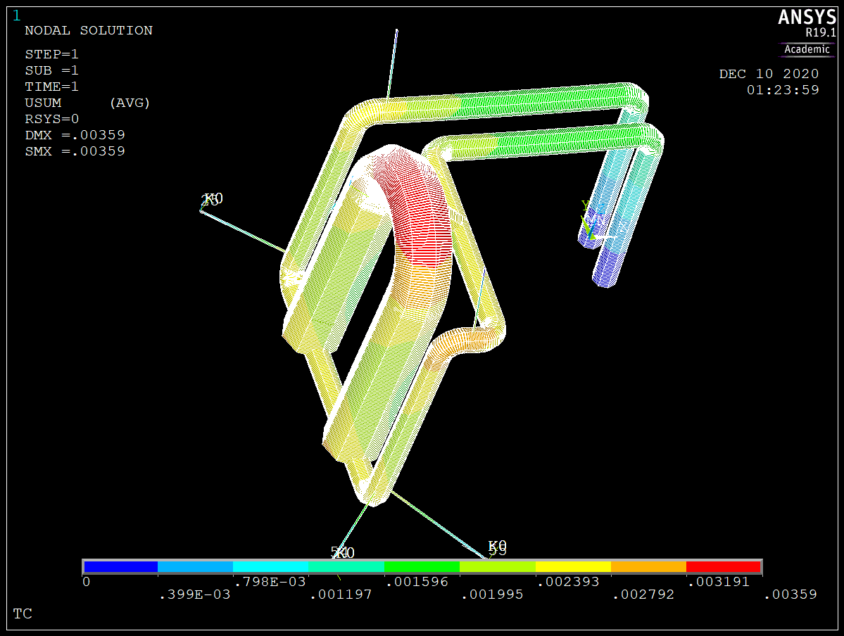
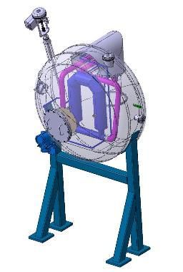
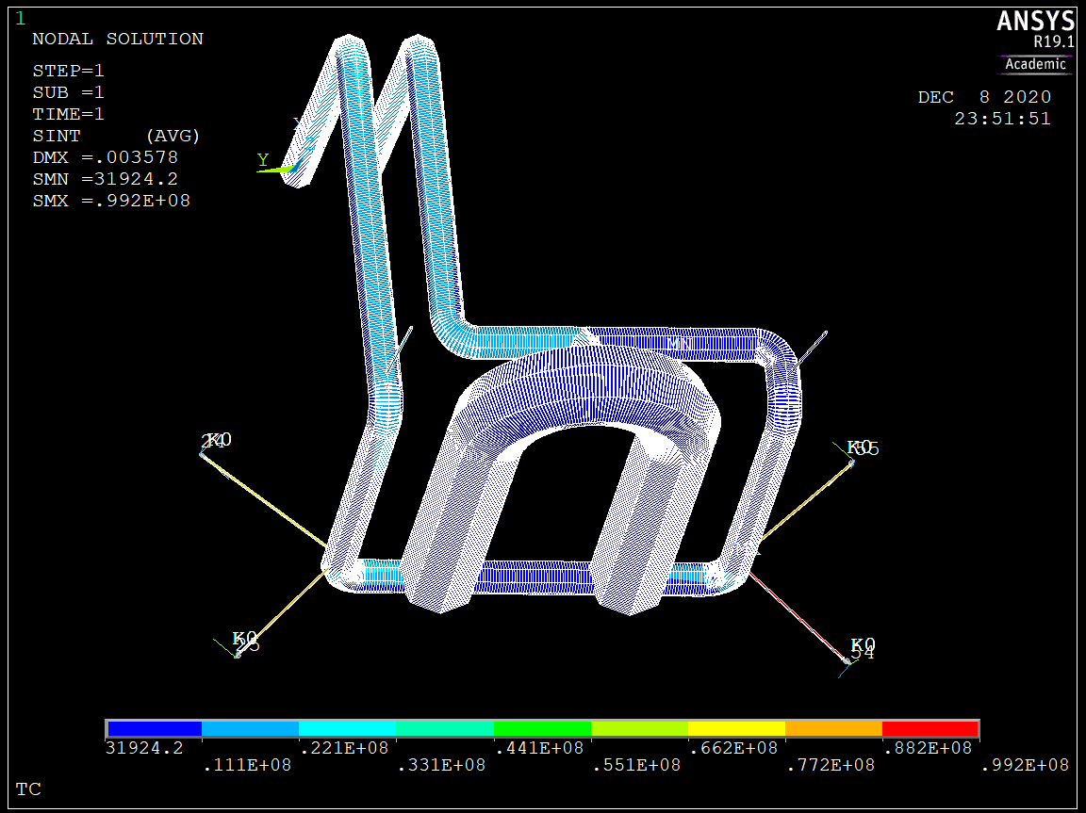
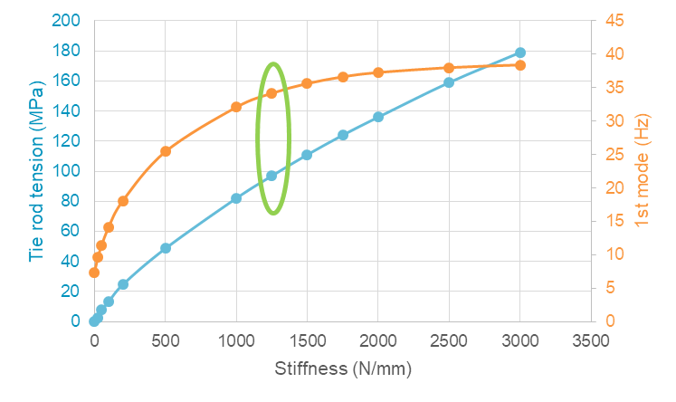
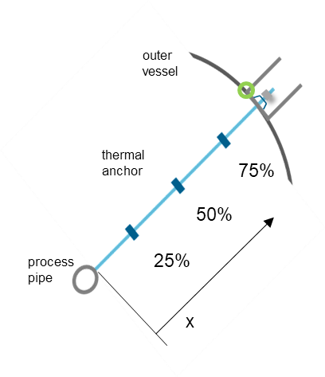
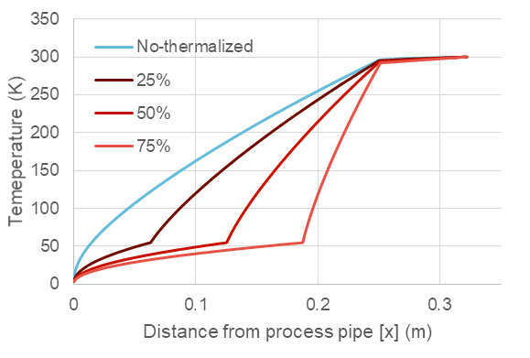
Flowmeter internal support
Mechanical study for the internal supporting of the Coriolis flowmeters inside a dedicated vacuum box
Finite Element Model (ANSYS Mechanical APDL)
Vertical tie rods holding the weight and horizontal tie rods with Belleville washers (stiff springs) to reduce the vibrations
Displacements due to cool down contraction
Stress due to cool down contraction
Belleville washer parametric study
Tie rod thermal study

Slide 8
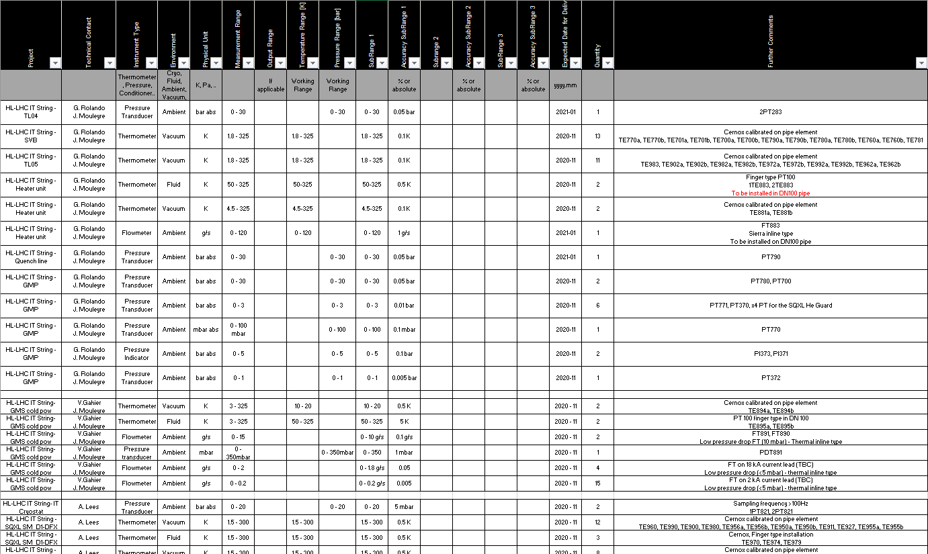
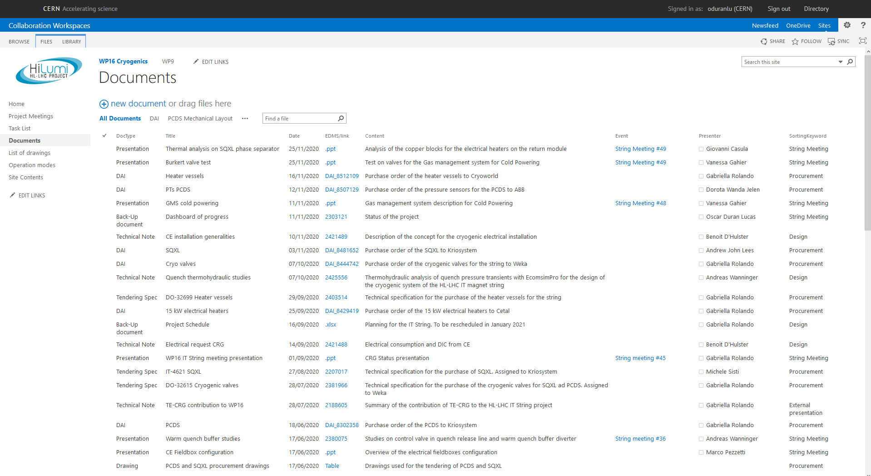
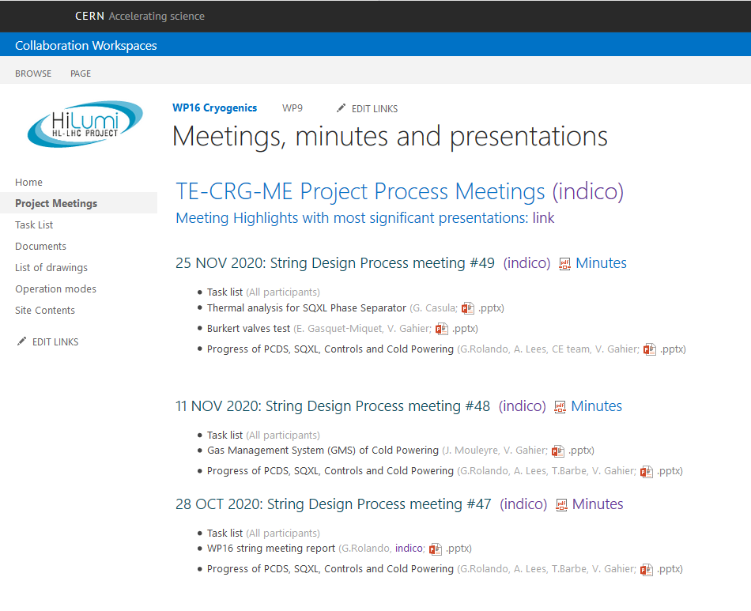
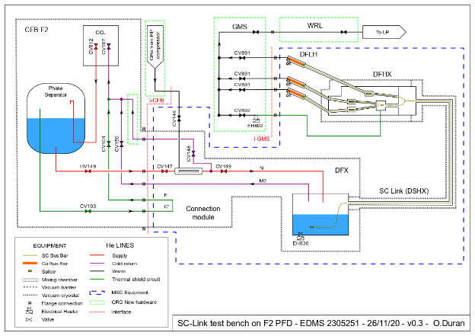
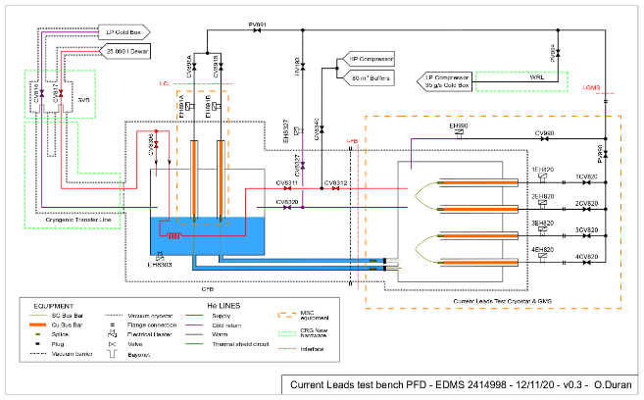
Management tasks
Instrumentation purchase request
Collection of characteristics for thermometers, pressure sensors and flowmeters
Follow Up of purchase
Documents pool
Collection of all project documents in the sharepoint webpage
Continue with other management tasks
Meeting organization and minutes
Follow Up of project documentation
Other projects Process Flow Diagrams
SC Link test bench in SM18
Current Leads test bench in SM18

Slide 9
Upcoming activities
Flowmeter box mechanical detailed design
Thermal shield
Vacuum jacket
External supports
Manufacturing details
Installation procedure
Vacuum Barrier in Warm Quench Buffer. Thermal analysis
Earned Value Management (EVM) for the track of the progress and expenses of project
Management tasks
Follow-up of the project (Dashboard, list of approvers, work breakdown structure, purchase)
Meeting organization and minutes
Update and improve project sharepoint webpage
Others

Slide 10
Thanks for your attention!
Questions?
Ó. Durán Lucas, 11th FTEC Workshop, 09.12.2020

Slide 11
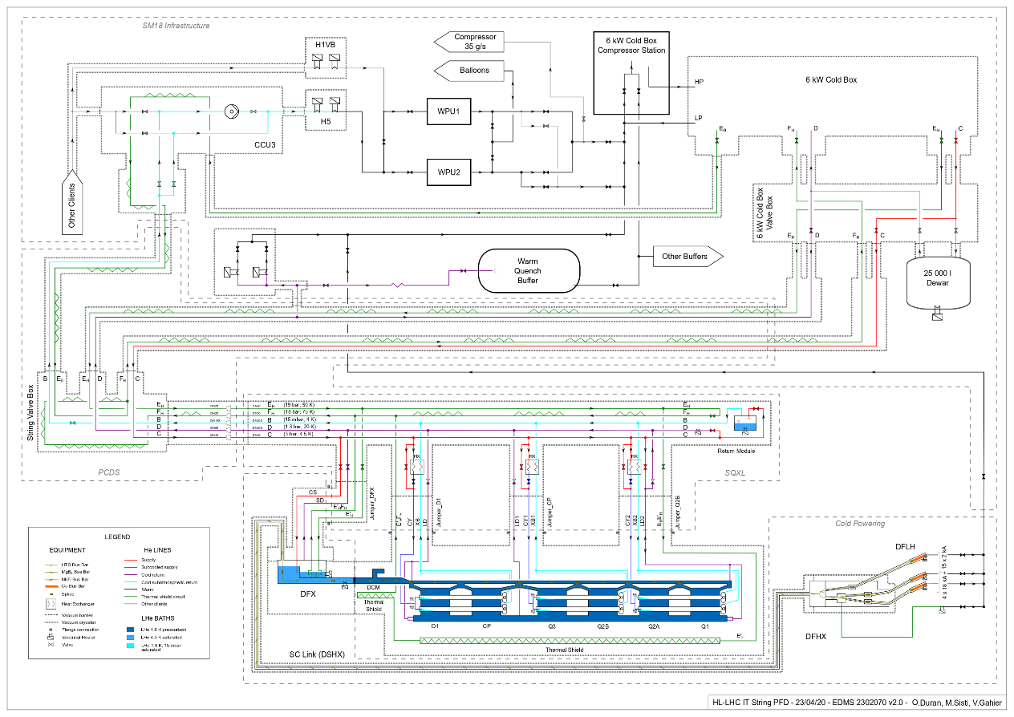
Ó. Durán Lucas, 11th FTEC Workshop, 09.12.2020

