Slide 1


FTEC Workshop December 2020
Mechanical Engineer for the design and constuction of high power
Radio Frequency devices RF
07/12/2020
sonia.garcia.scheifler@cern.ch
1/15

Slide 2
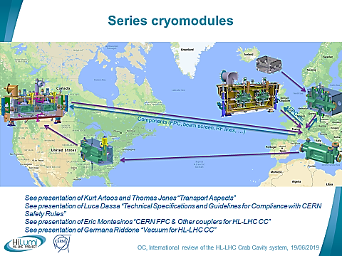
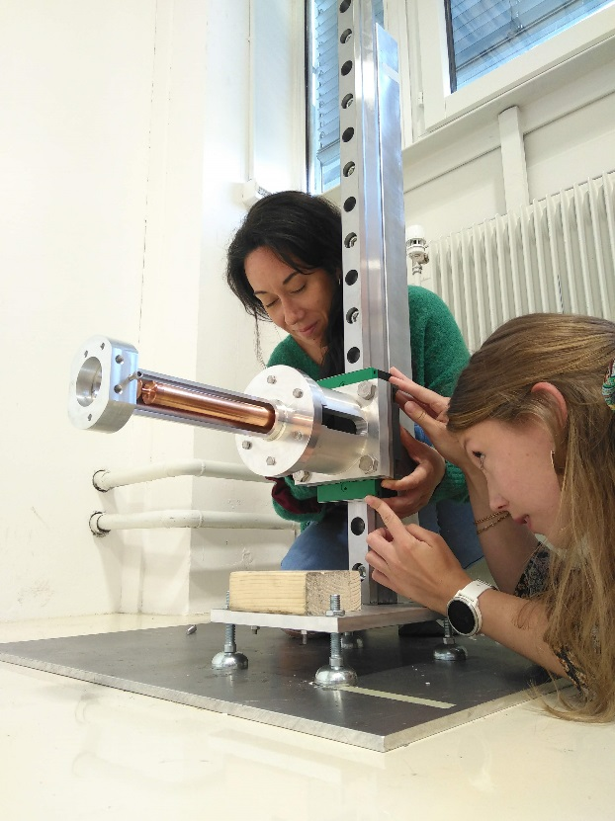



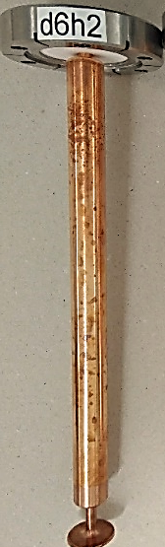

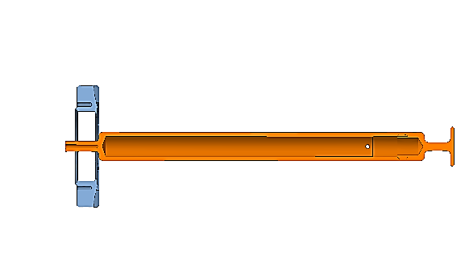
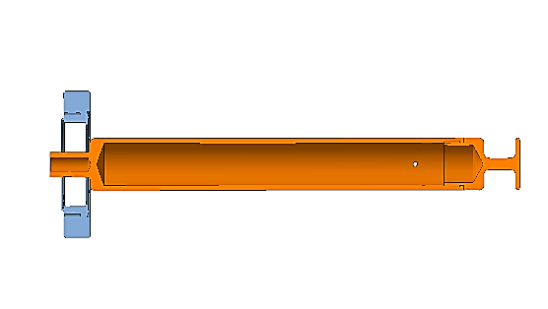



Drop test background
The main objectives are to validate:
The non-rupture of ceramic
The absence of plastic deformation
The 25 ohm-design
50Ω
✓
25Ω
·· Series Cryomodules ··
·· Frida Eriksson & Sonia García ··
07/12/2020
sonia.garcia.scheifler@cern.ch
2/15

Slide 3
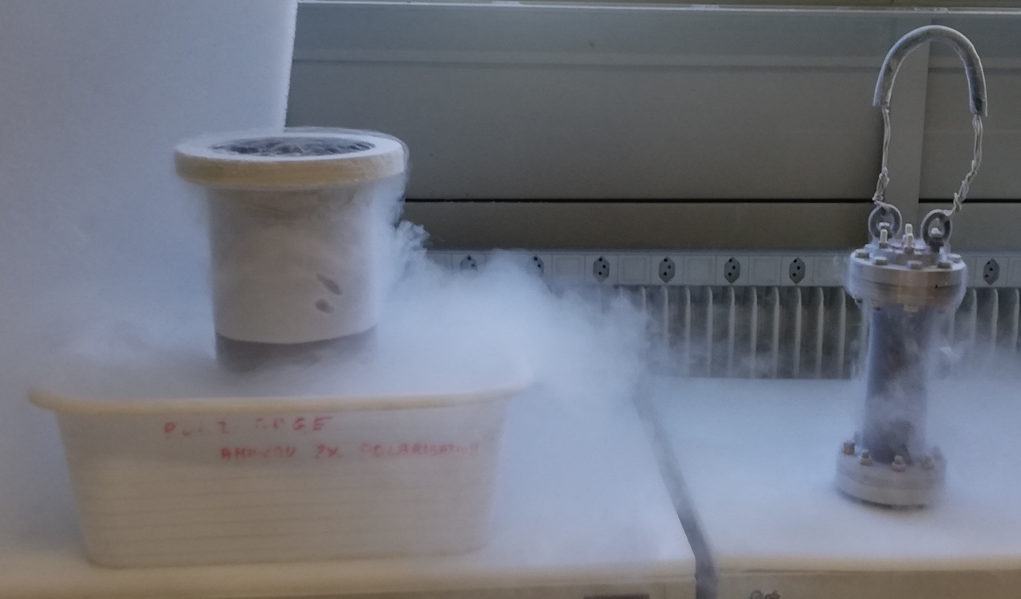
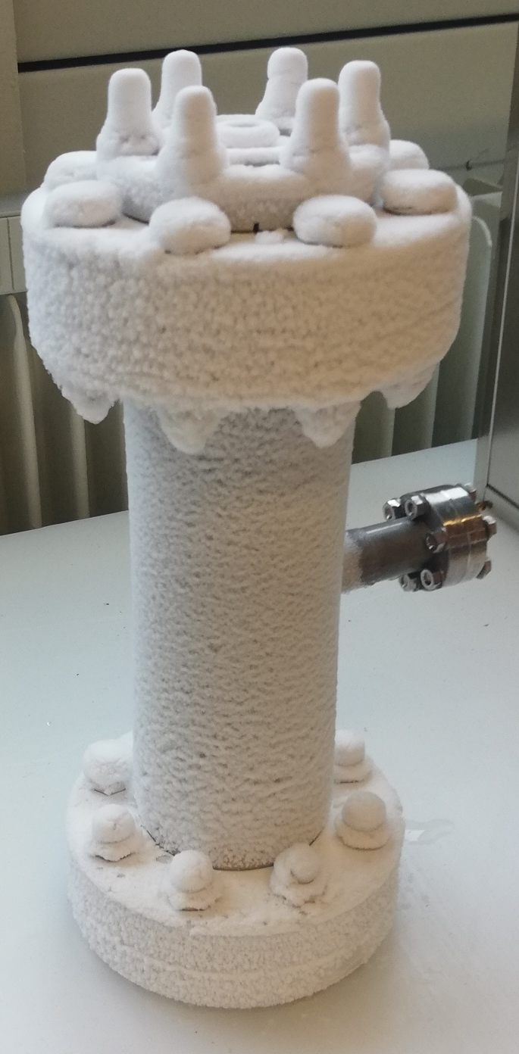
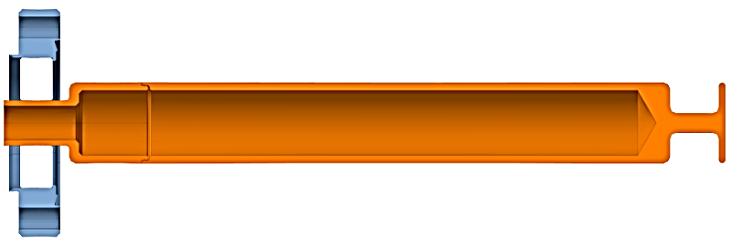
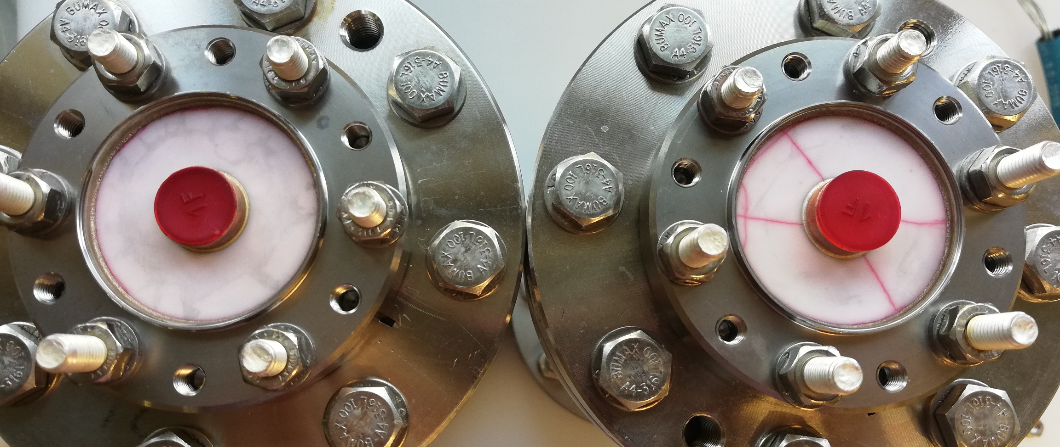
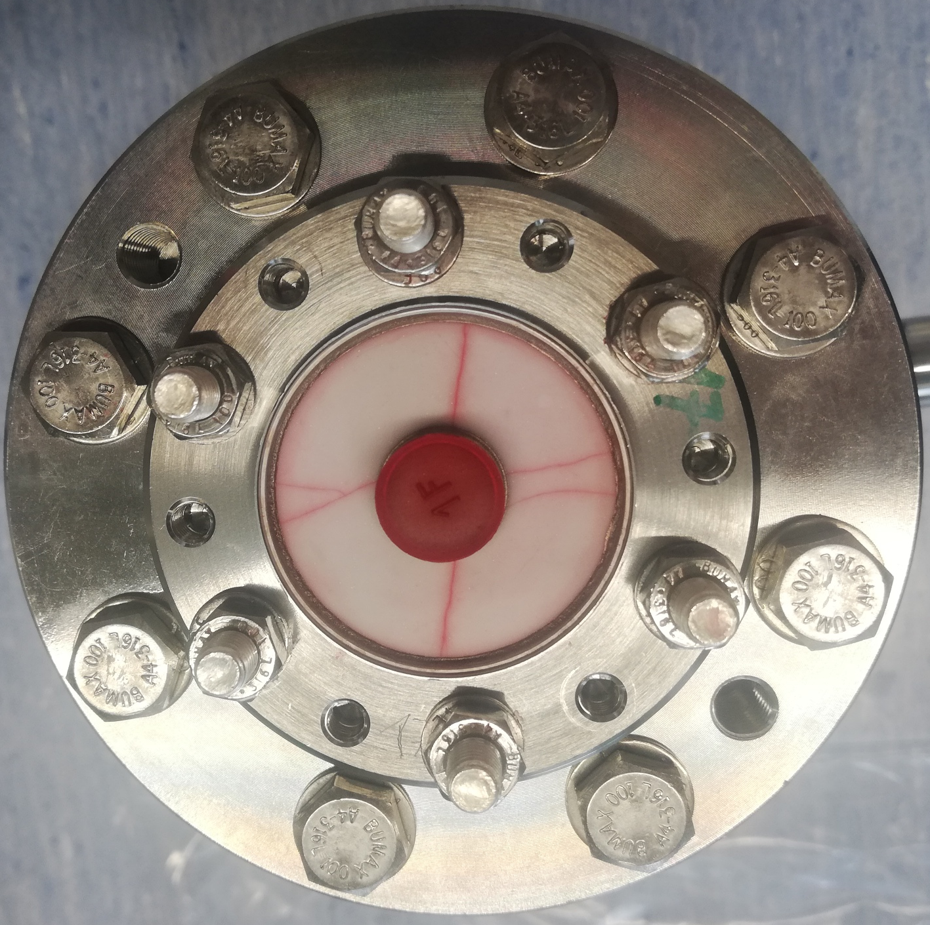
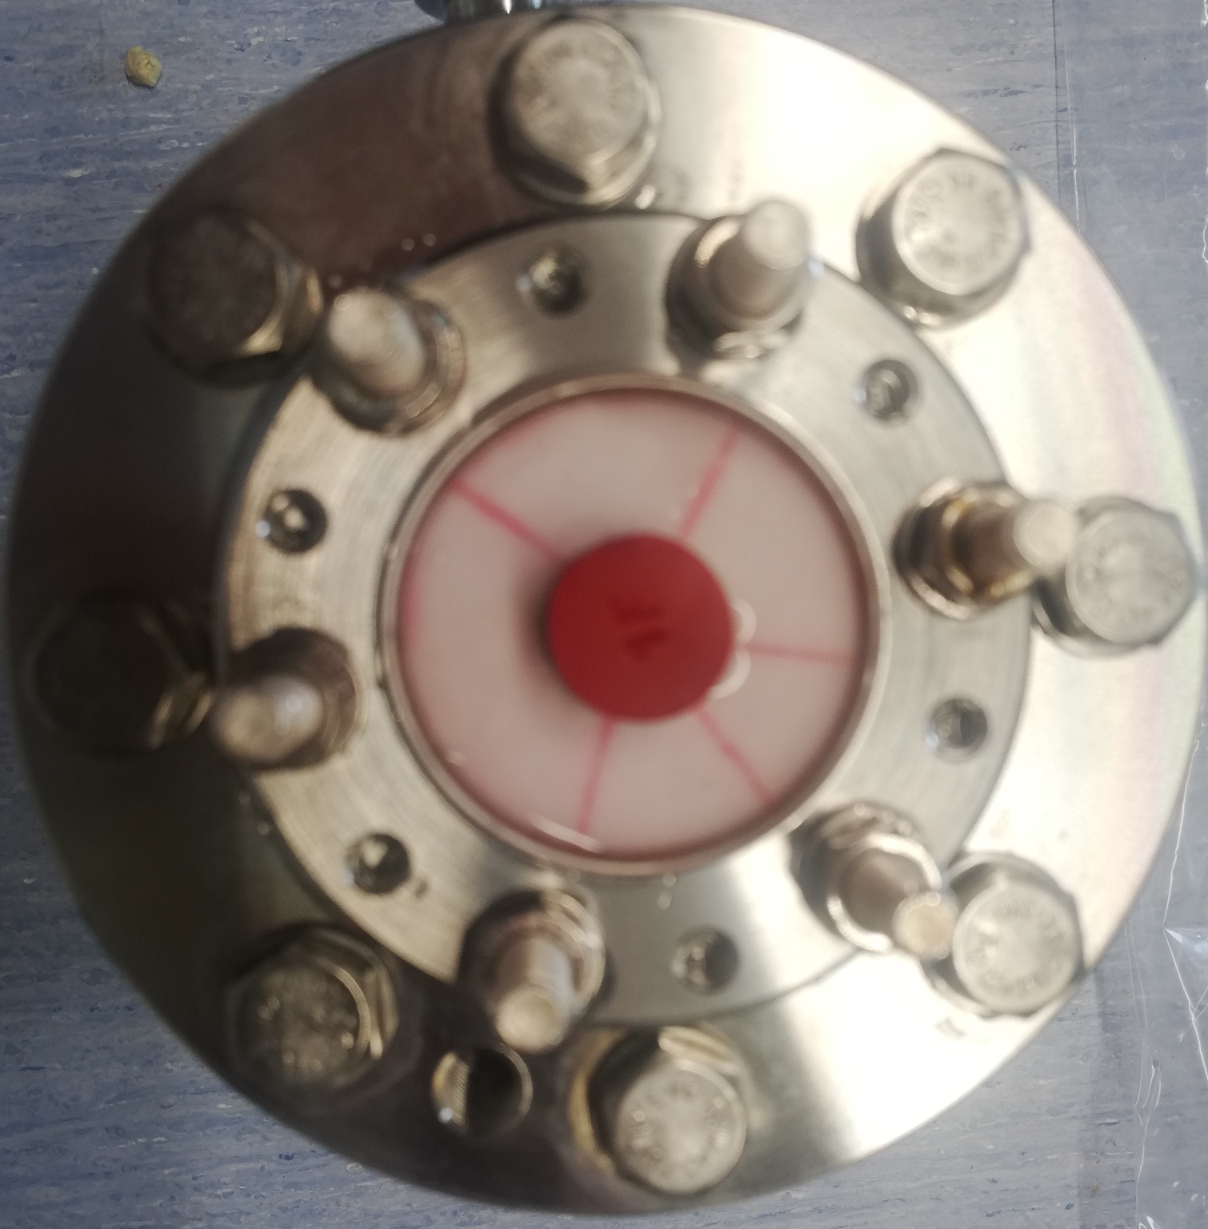
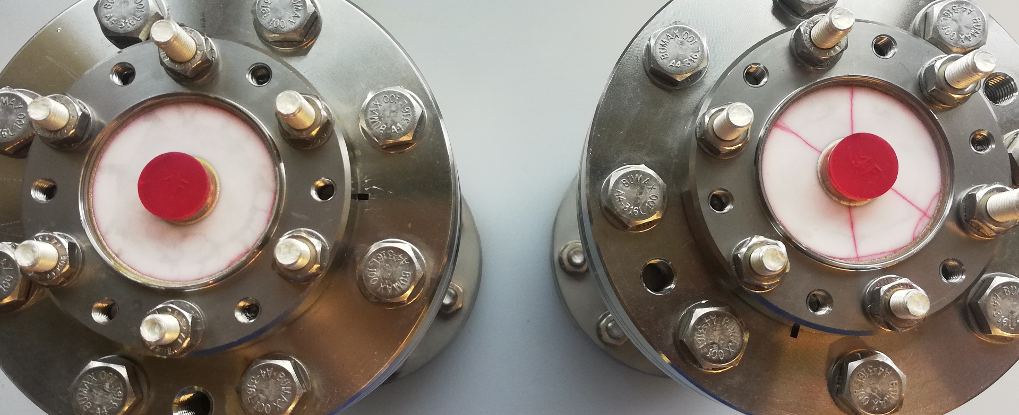
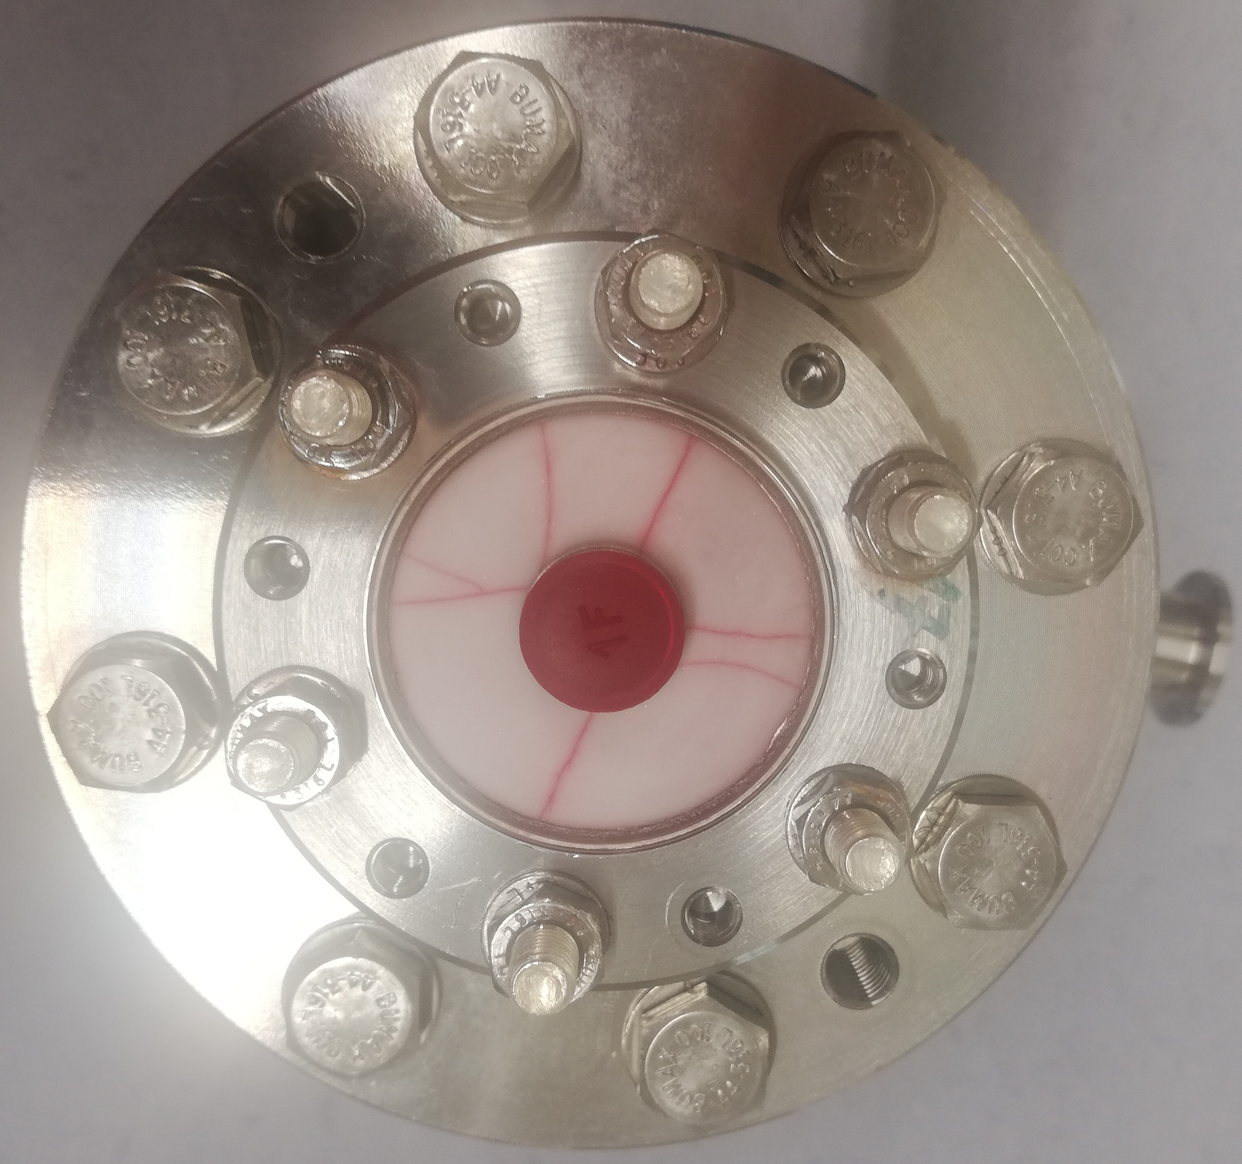
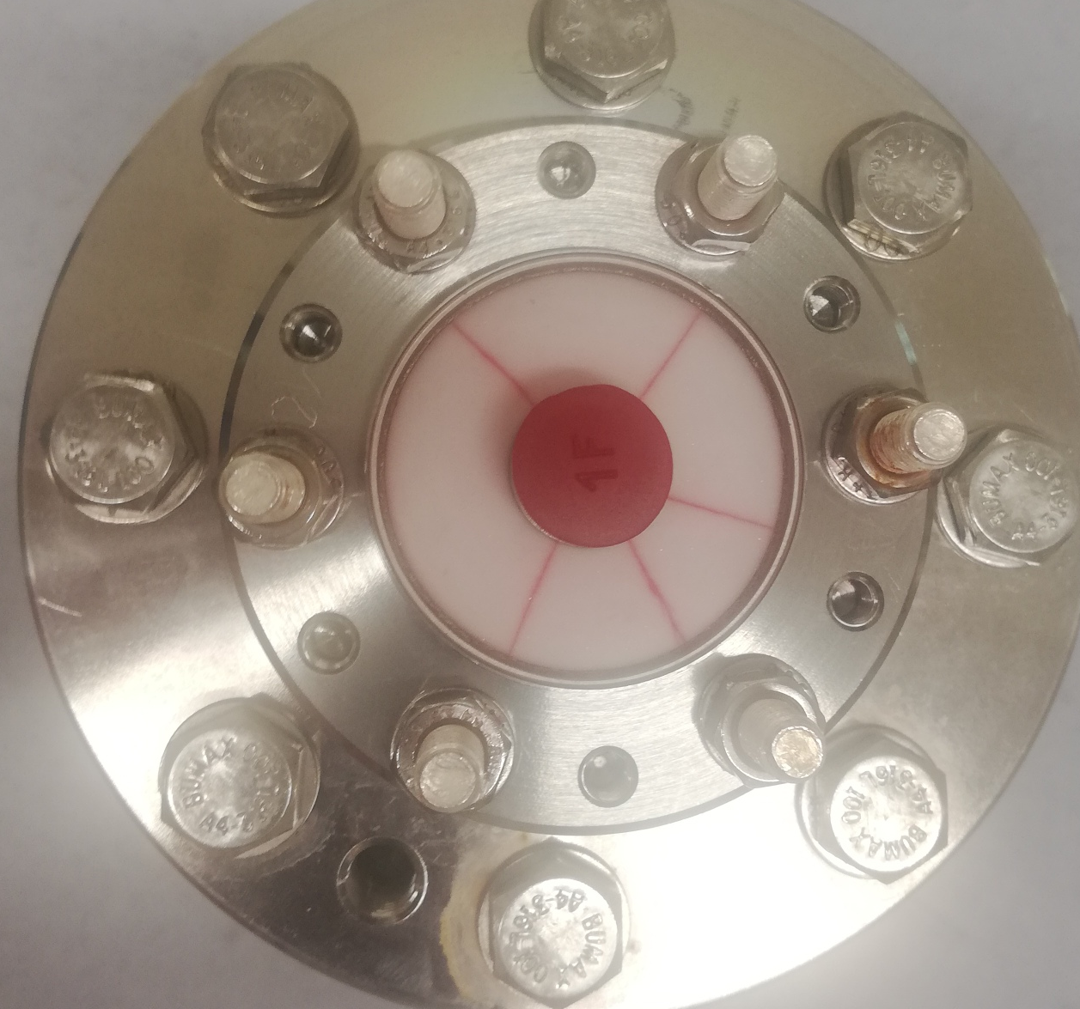

Ceramic testing
OLD design
LHCACFHC0246
·· Thermal test ··
17
18
23
21
Steps for validation
1st thermal test
Penetrant testing
2nd thermal test
Penetrant testing
Leak test
Leak test
Leak test
Cracks already appear when we closed the flange
07/12/2020
sonia.garcia.scheifler@cern.ch
3/15

Slide 4
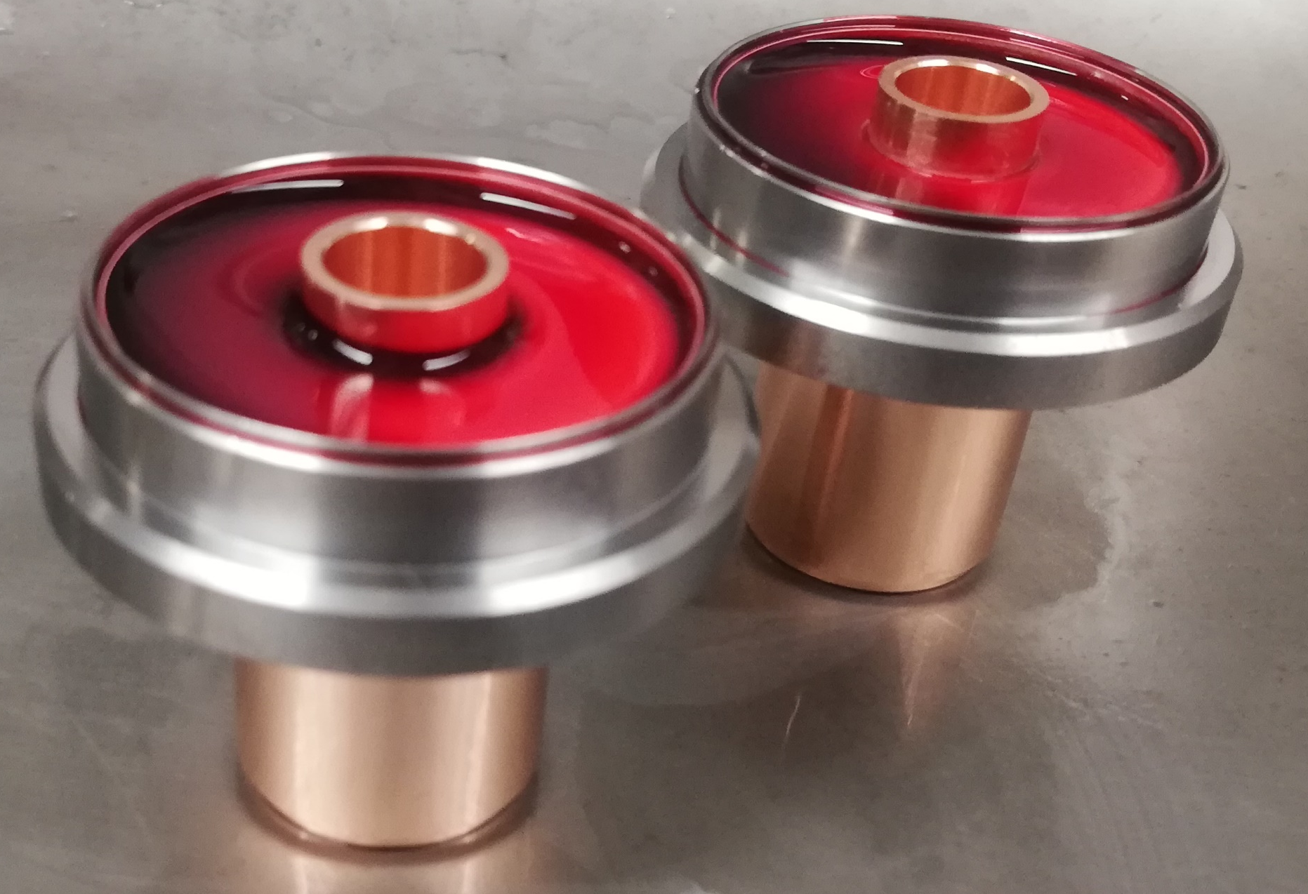
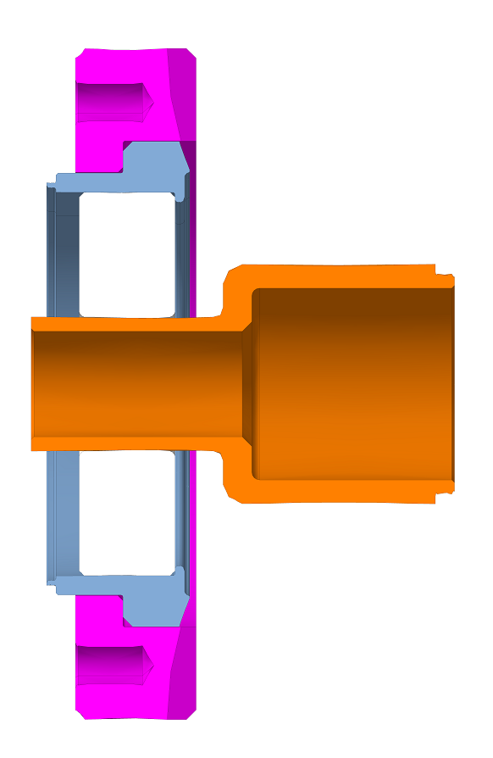
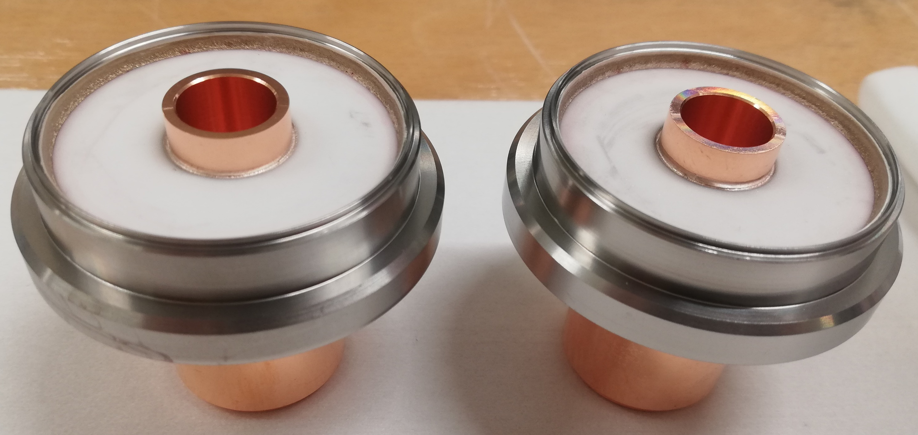
Ceramic testing
FINAL design
Final assembly for ceramic testing
We added the purple piece
When we mount the ceramic in the vacuum chamber and we tight the screws we don’t break the ceramic
No cracks!
LHCACFHC0292
We finished the tests, now we wait for the vacuum official validation.
07/12/2020
sonia.garcia.scheifler@cern.ch
4/15

Slide 5
Ceramic testing
STEPS FOR VALIDATION
Departement / groupe | EN/MME |  | BE/RF |  | EN/MME |  | BE/RF | EN/CV | BE/RF
contact | Simon | Fritz | Seb | Seb | Simon | Thomas | Seb | 40/30 | Seb | Seb
N ceramique
34 |  |  |  |  |  |  |  |  |  |  | support de ceramique collé sur brasage sortie de four
35 |  |  |  |  |  |  |  |  |  |  | les 3 passages ont été posé sur support dans le cryostat du SM18 pour test cryo des ceramiques
36
37
38
39
40
41
42
43
44
45
✓
✓
✓
Titanium flange machining
Metrology
Brazing
Visual Control
Assembly test
Leak test
Penetrant testing
Visual inspection
Vacuum chamber assembly
Clean room preparation
Cavity mounting
FE weld
Metrology
Leak test official validation
Pending
07/12/2020
sonia.garcia.scheifler@cern.ch
5/15

Slide 6
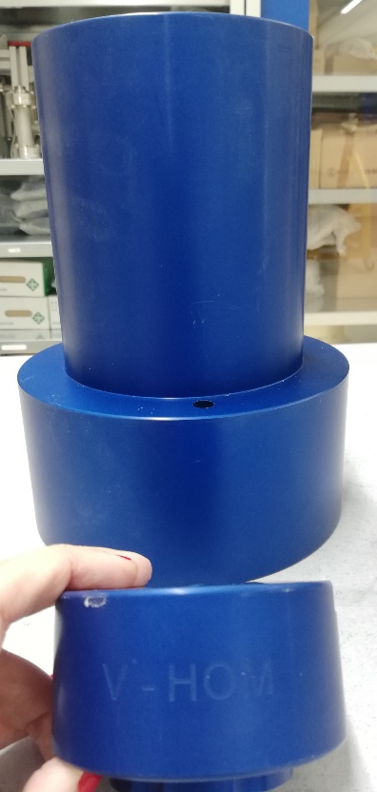
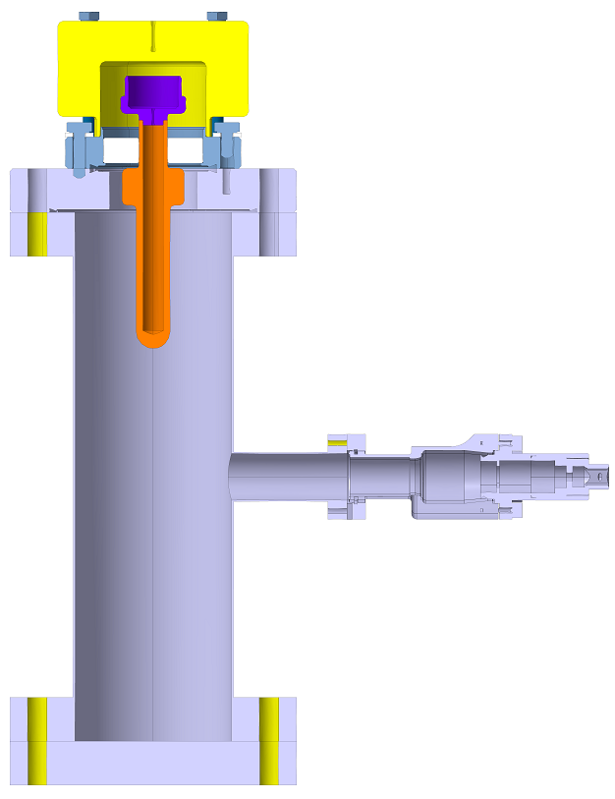
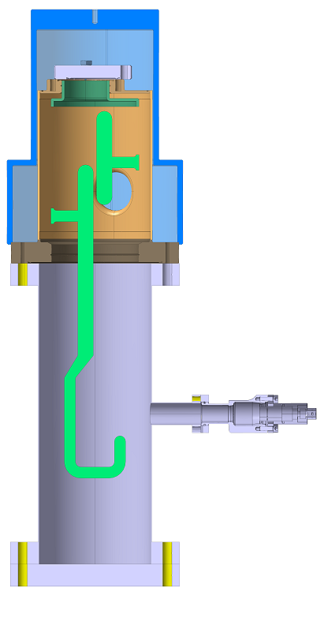
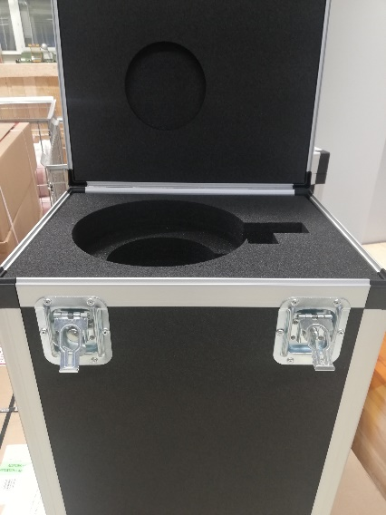
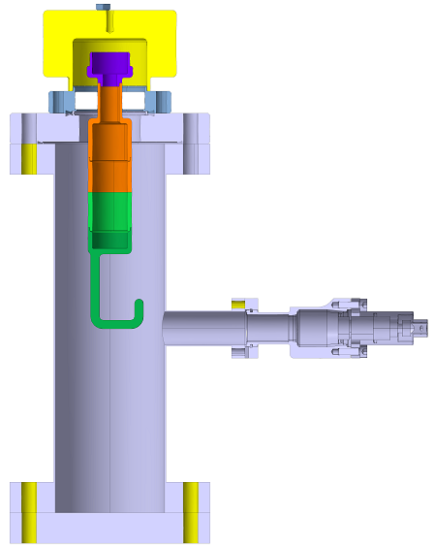
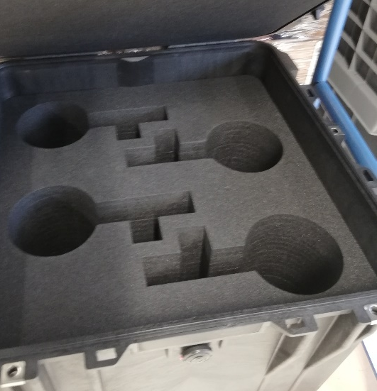
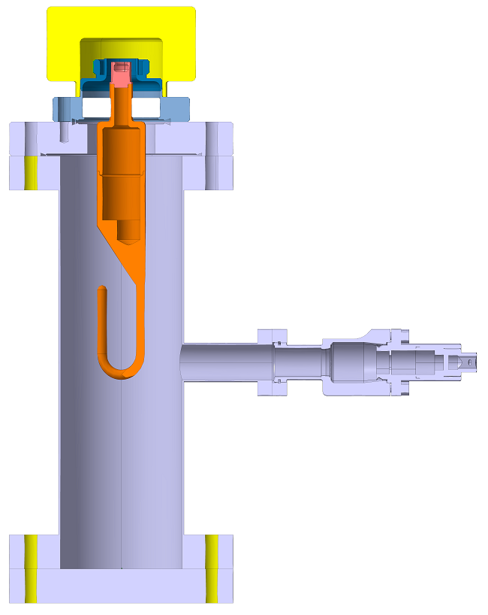
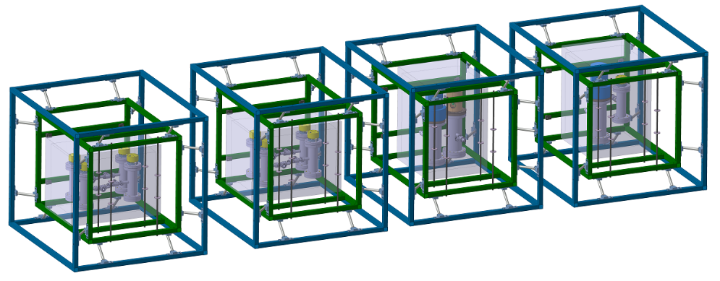
Tooling for transport under vacuum
Boxes for transport
Protection pieces
V-HOM
H-HOM Feedthrough
Field antenna
V-HOM
H-HOM Feedthrough
Field antenna
V-HOM
H-HOM Feedthrough
Field antenna
H-HOM
Chassis anti-vibration
07/12/2020
sonia.garcia.scheifler@cern.ch
6/15

Slide 7
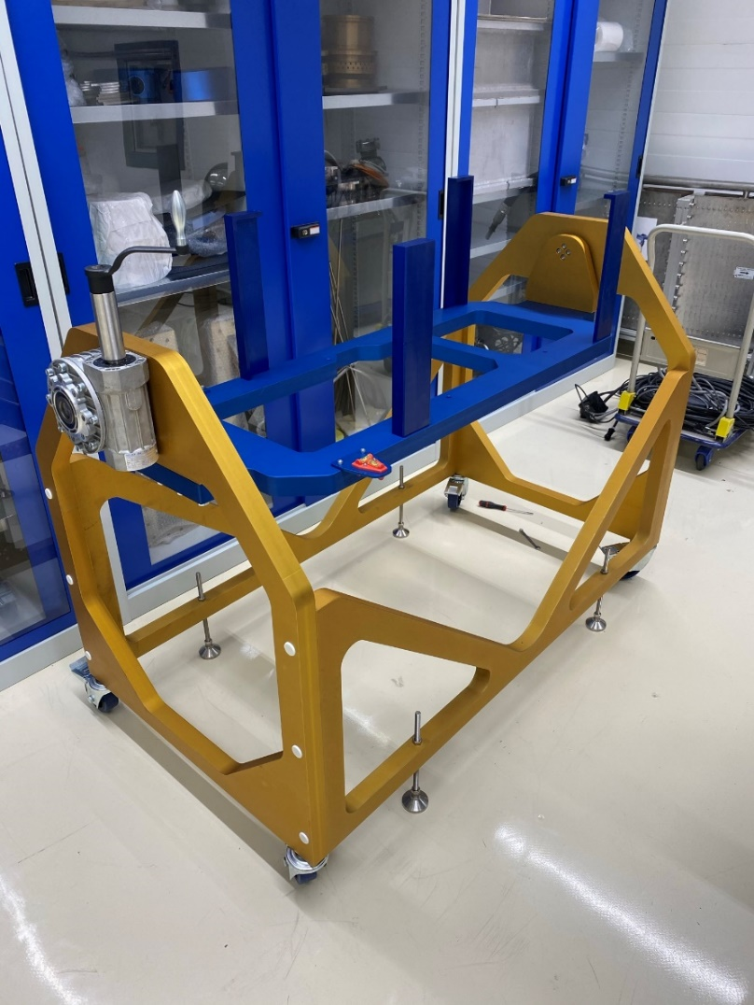
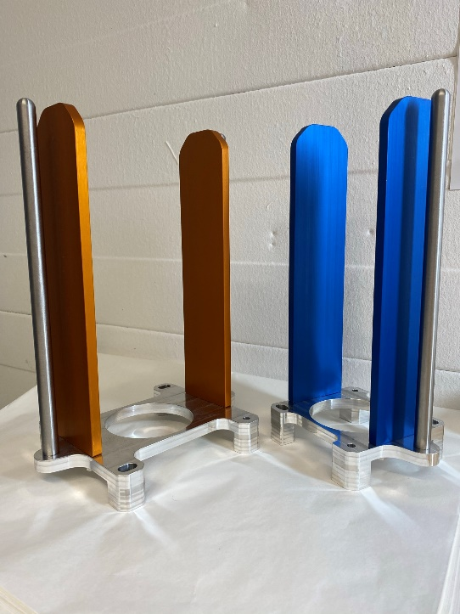
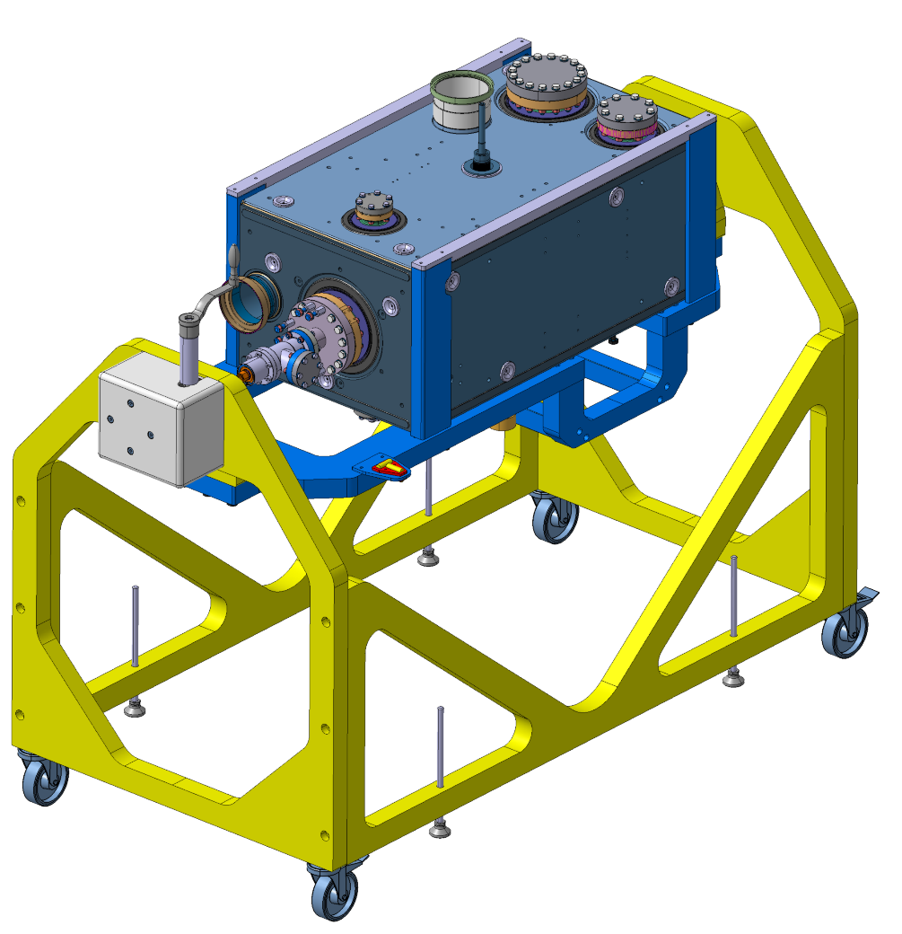
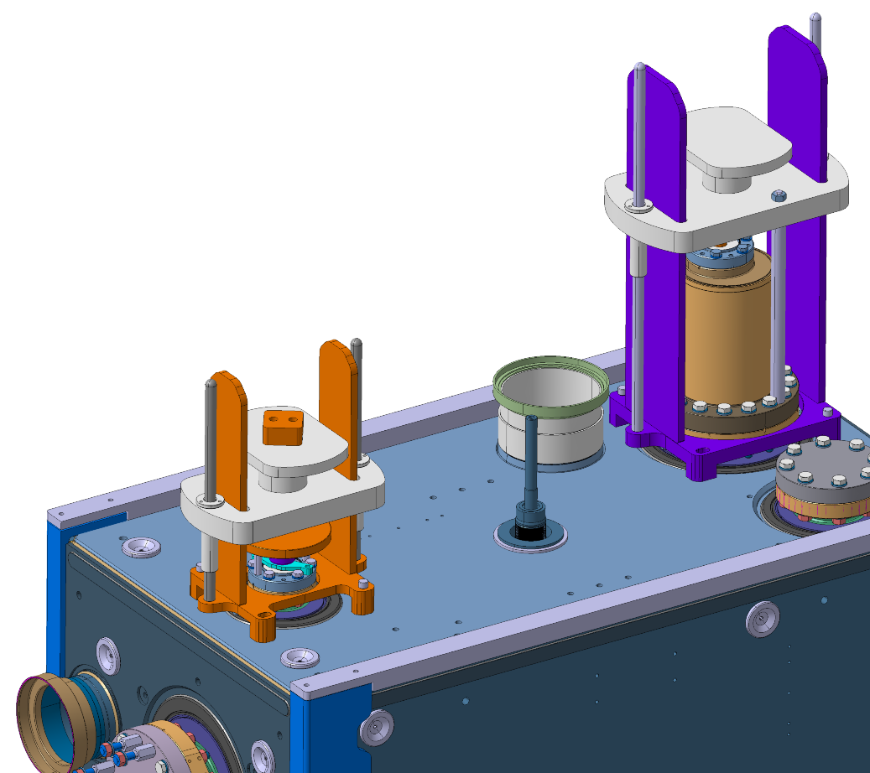
Clean room tooling
Participation in the design and mounting of the tooling for clean room
·· Courtesy of Nicolas Villanti ··
07/12/2020
sonia.garcia.scheifler@cern.ch
7/15

Slide 8
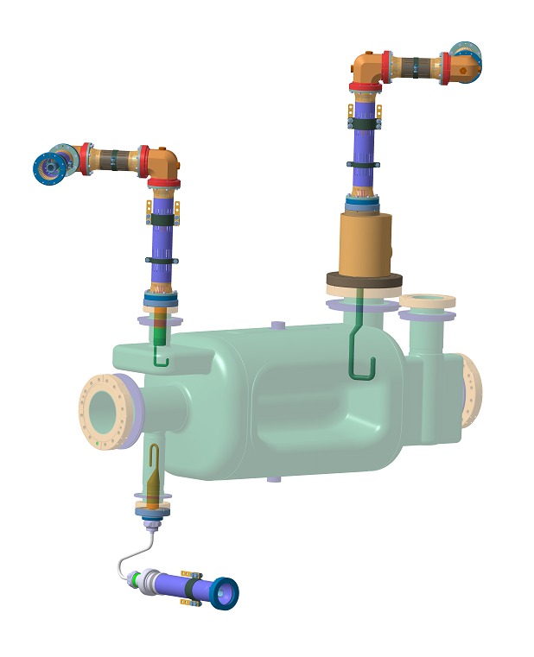
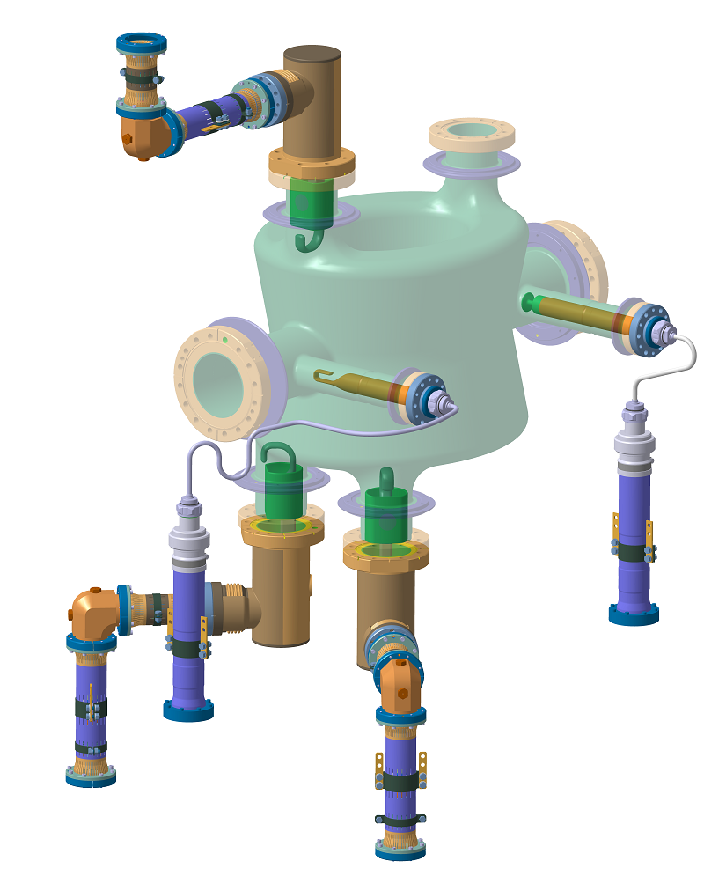
Crab cavity RFD and DQW coaxial lines
Design of the coaxial lines for DQW and RFD cryomodules:
They need to be changed because we need to pass from 50 ohm to 25 ohm
These lines extract the power from the HOMS
The lines are special because they pass from 2 K to 300 K
Difficult task has been to find a cable suppliers for 25 ohm
07/12/2020
sonia.garcia.scheifler@cern.ch
8/15

Slide 9
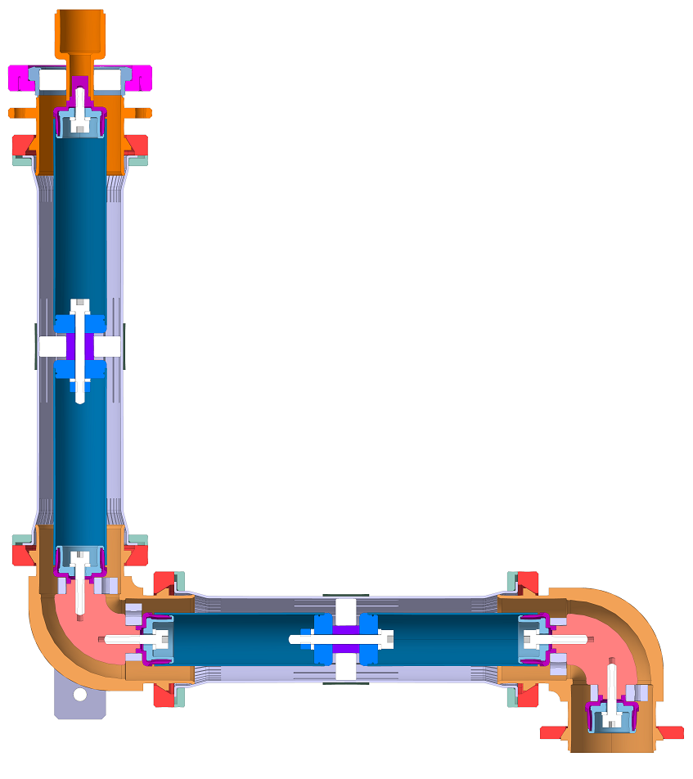
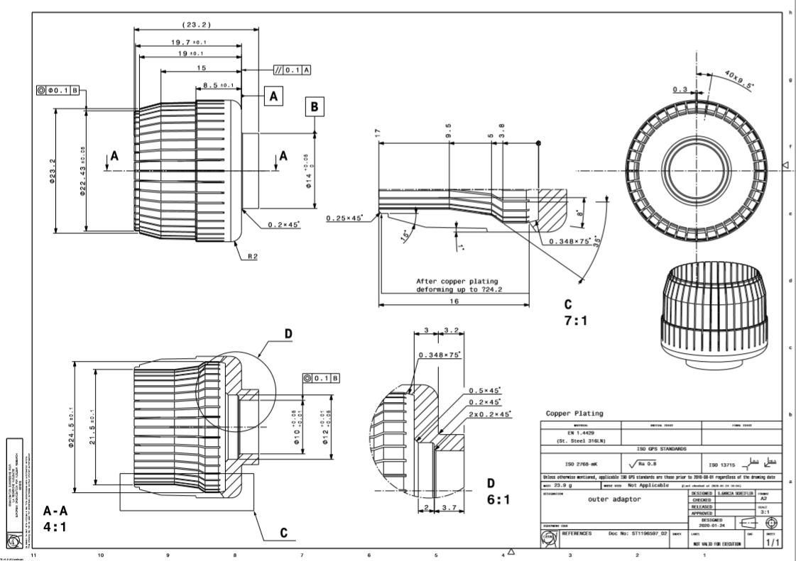
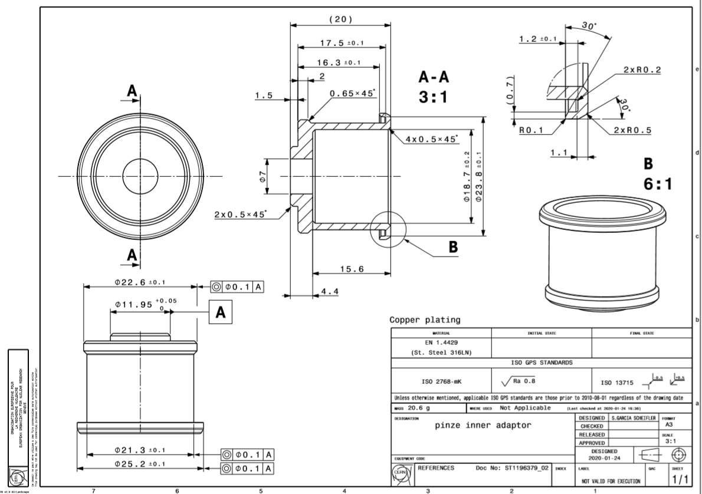
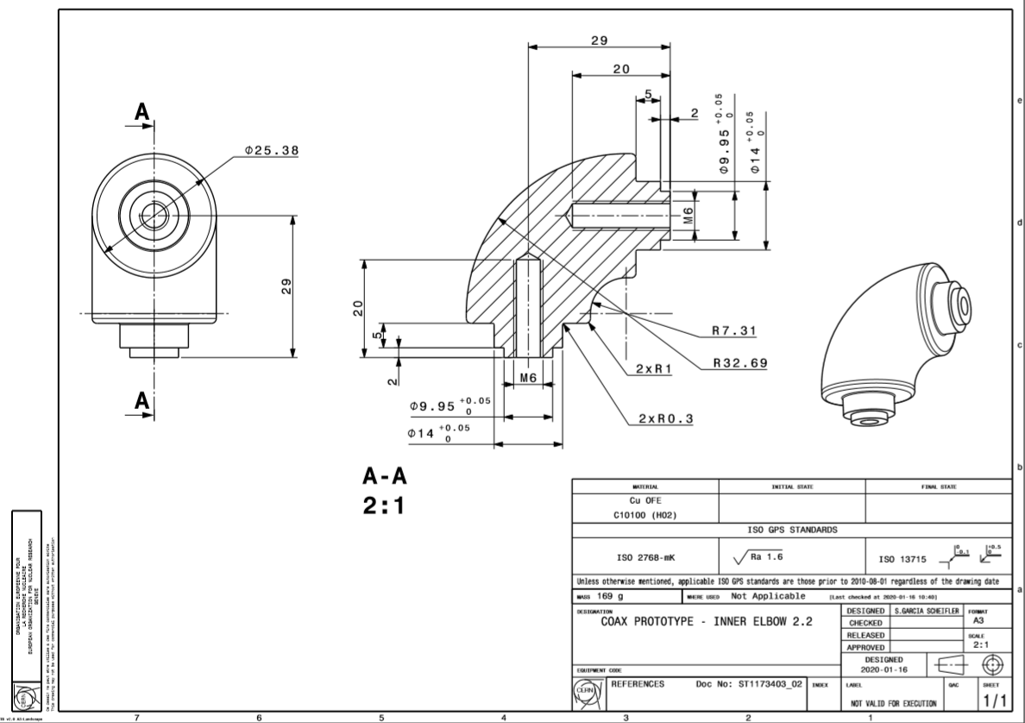
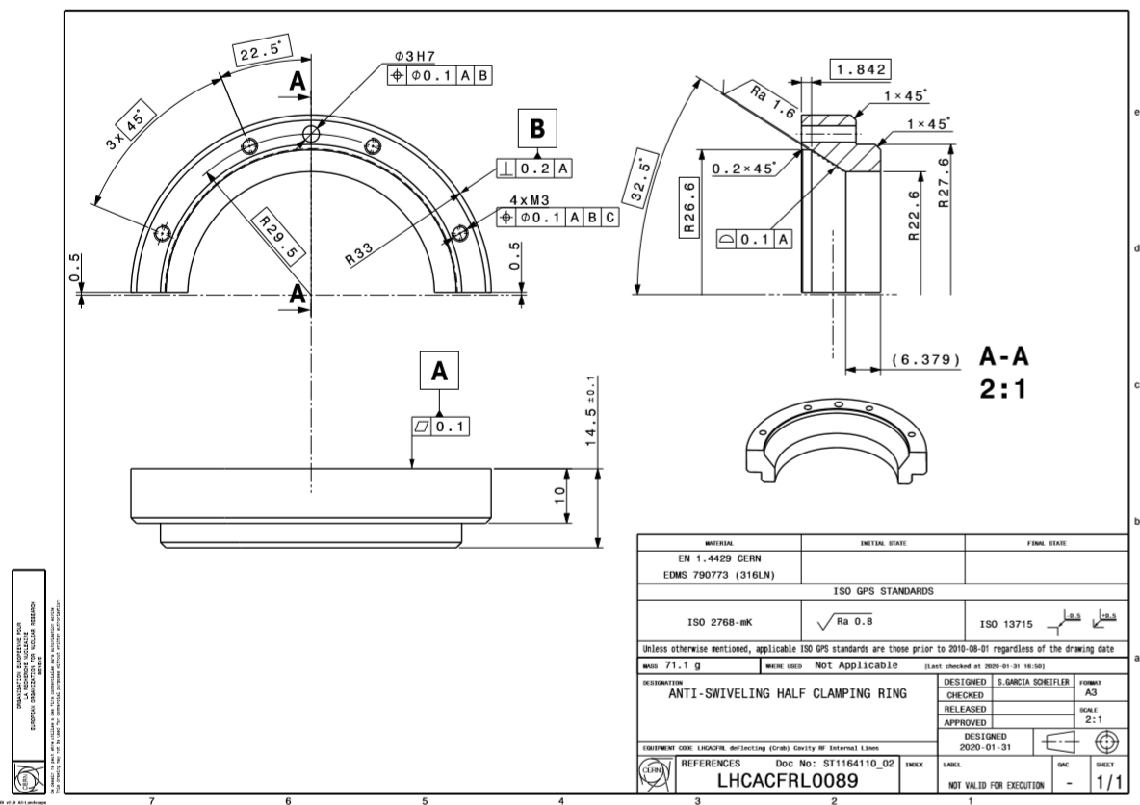
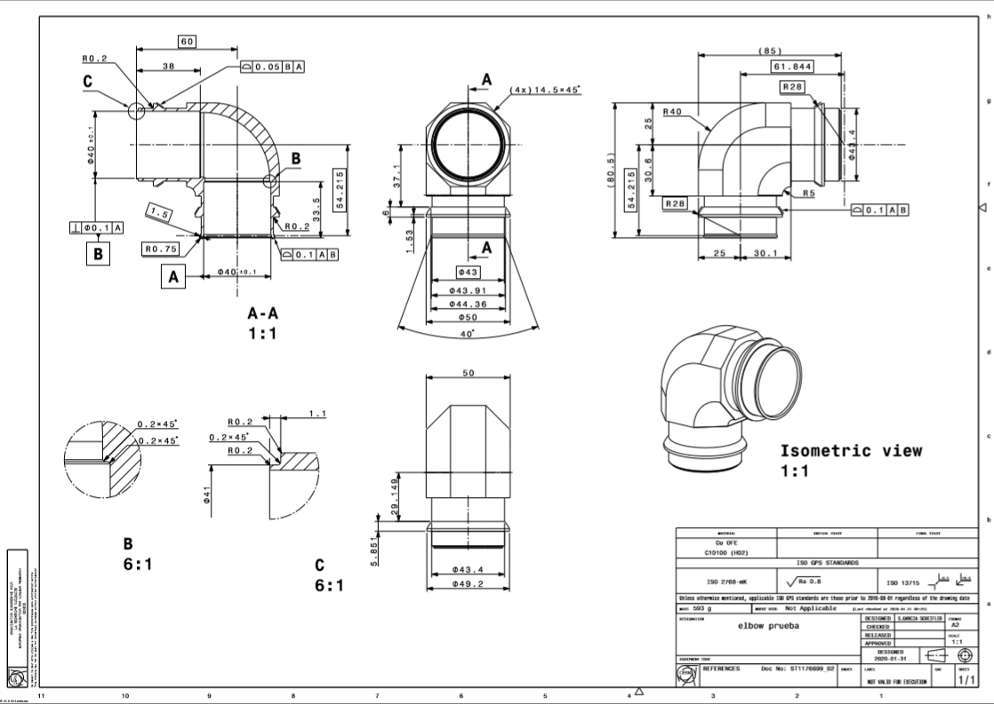
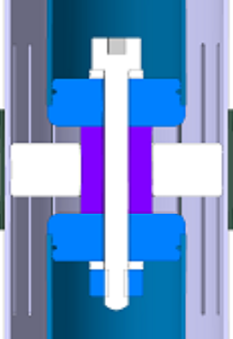
Crab cavity RFD coaxial line
Sent for study
07/12/2020
sonia.garcia.scheifler@cern.ch
9/15

Slide 10
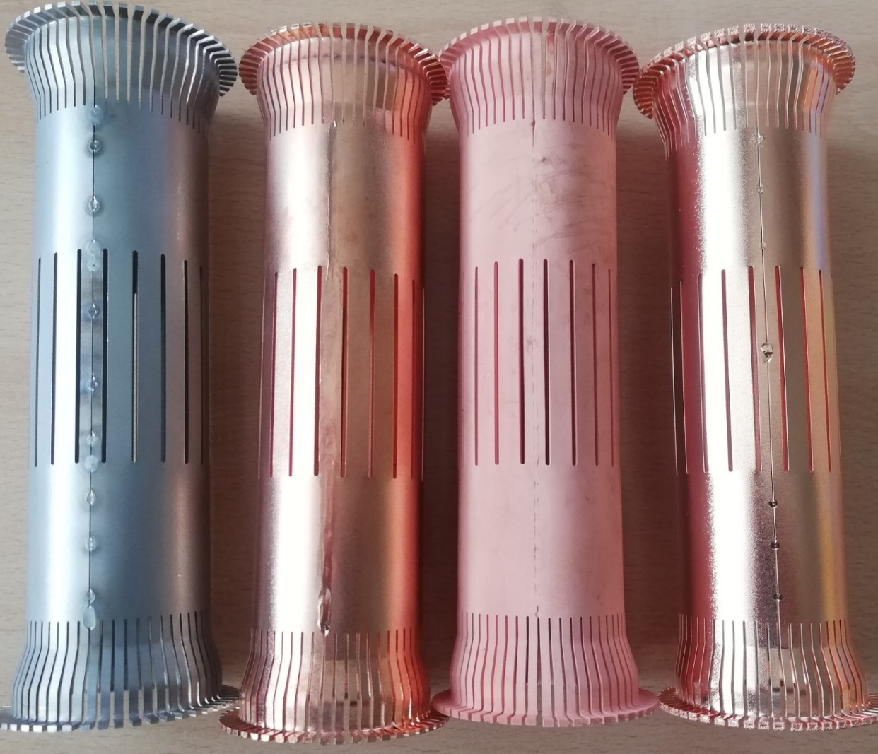
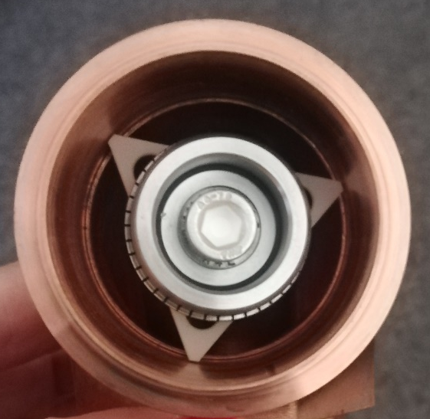
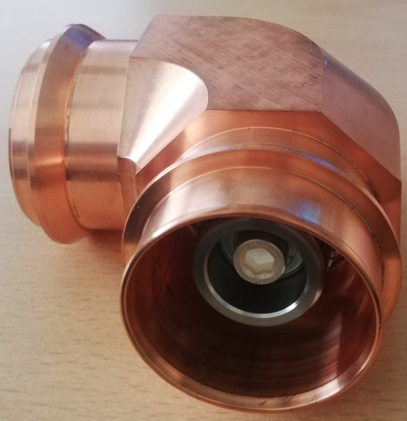

Coax line pieces for testing
We tested 5 pieces with different type of welding.
TIG Welding: good quality
EBW: deformation, expensive
Laser: deformation
Different surface treatment
(stainless steel copper plated)
LASER
TIG
TIG
EBW
✓
07/12/2020
sonia.garcia.scheifler@cern.ch
10/14

Slide 11
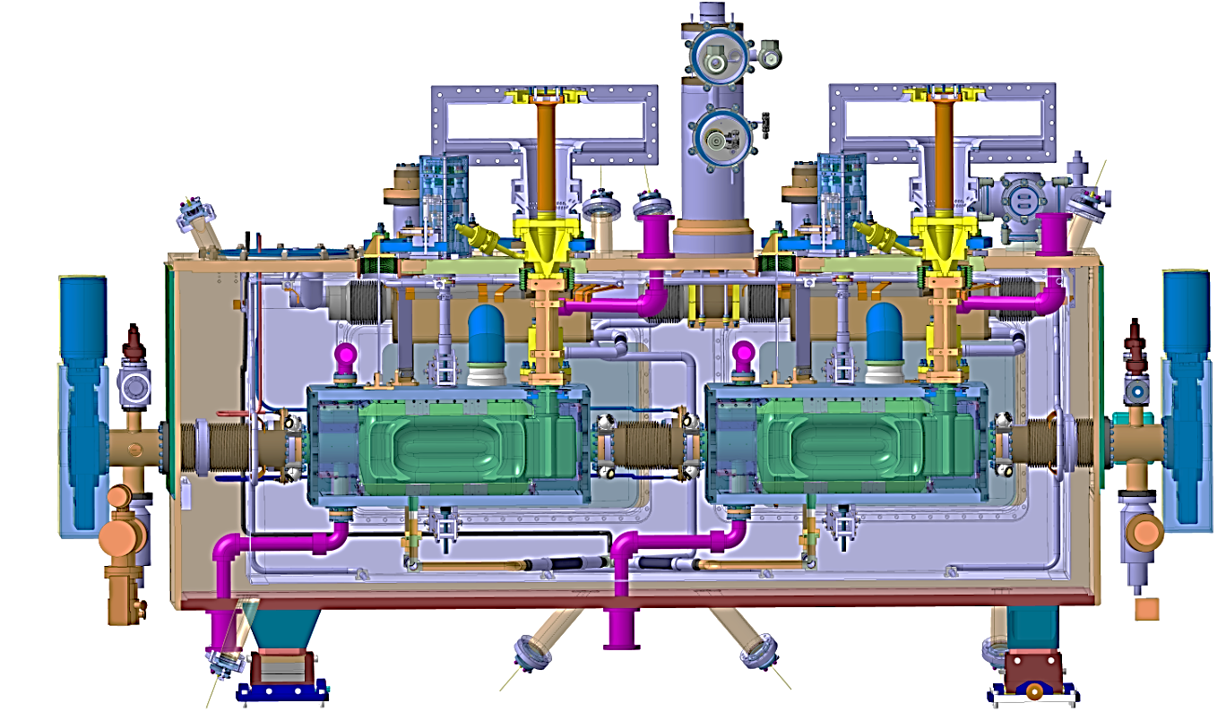
HL-HLC crab cavity Cryomodule RFD
07/12/2020
sonia.garcia.scheifler@cern.ch
11/15

Slide 12
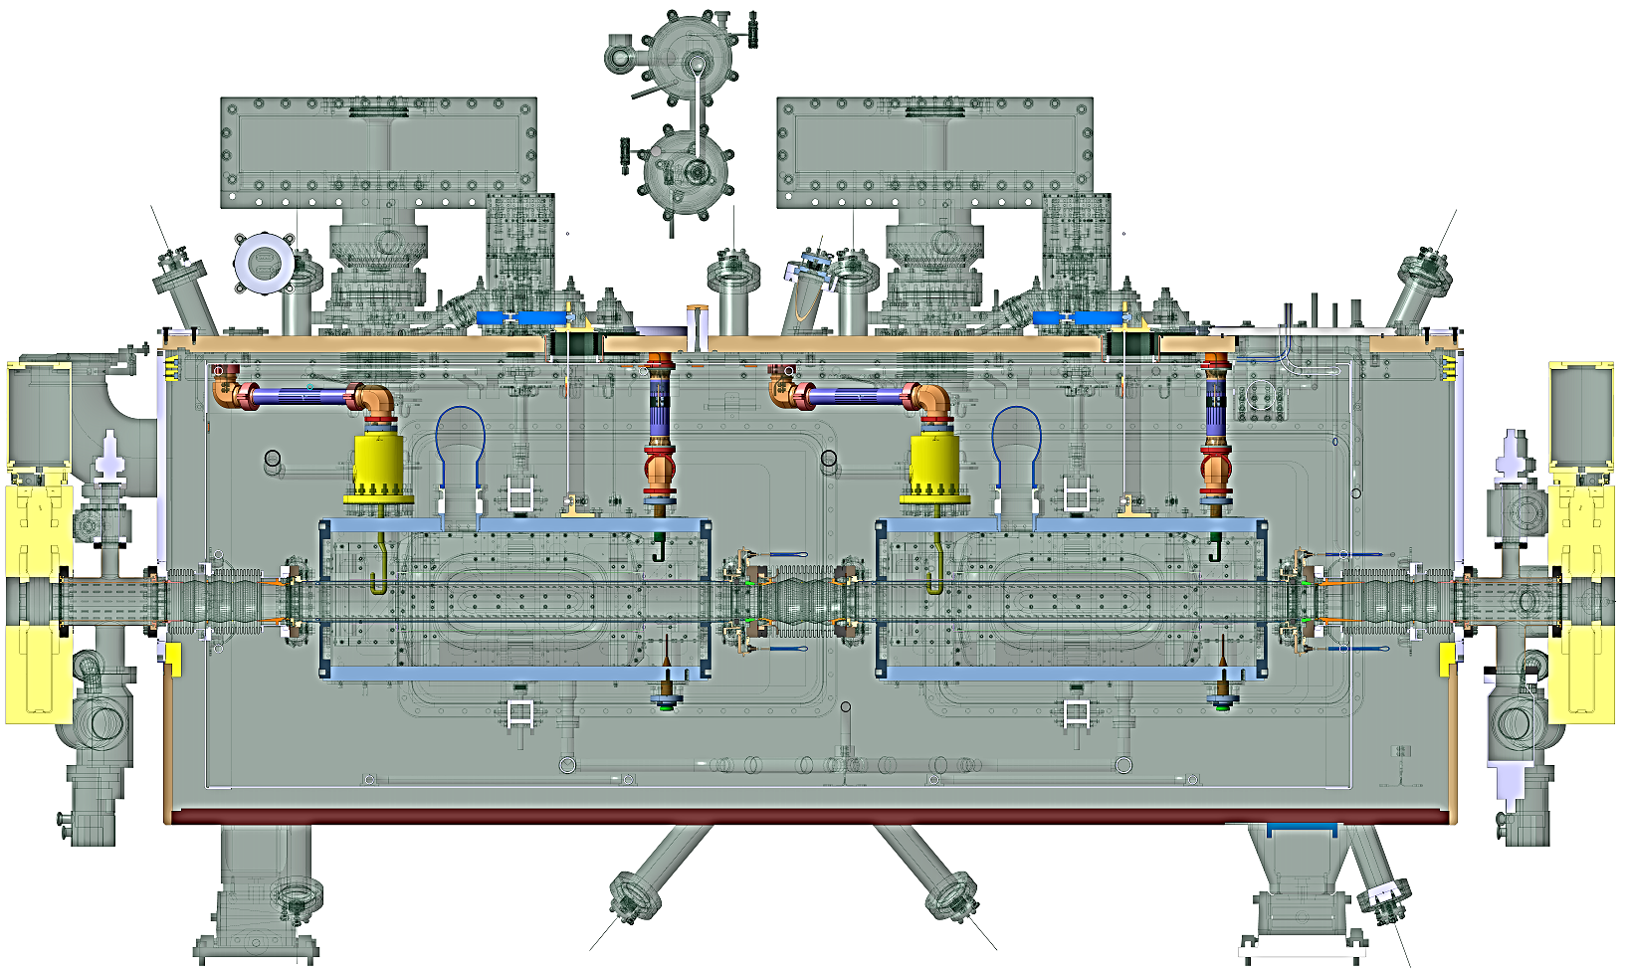
HL-HLC crab cavity Cryomodule RFD with coax lines
07/12/2020
sonia.garcia.scheifler@cern.ch
12/15

Slide 13
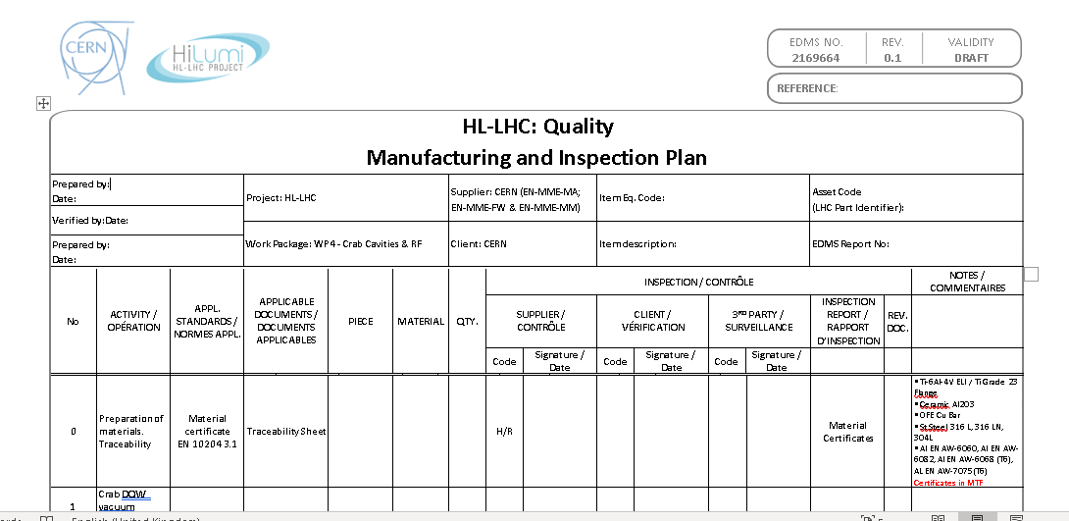
Collaboration with BE-RF-SRF in QA/QC
Steps
Manufacturing Inspection Plan (MIP)
Fundamental Power Coupler (FPC)
Material Certificates
Single Parts
Assemblies
In progress
07/12/2020
sonia.garcia.scheifler@cern.ch
13/15

Slide 14
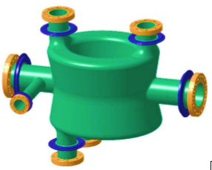
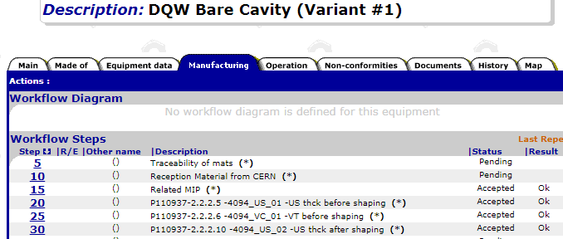
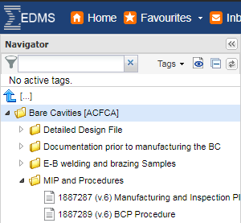

Collaboration with BE-RF-SRF in QA/QC
1. Production tracking (RI company)
3. EDMS & MTF platforms and MIP (Manufacturing Inspection Plan)
DQW cavity
2. Documentation and contract requirements
07/12/2020
sonia.garcia.scheifler@cern.ch
14/15

Slide 15
Thank you
Thanks to all colleagues from the BE-RF-PM team involved with the HOMC and Field Antenna devices, specially to Eric, Seb, Nicolas, Jamie and Frida.
Thanks to Fritz (EN-MME-FW), Nuria (BE-RF-SRF) and Teddy (EN-MME-EDM) for their help and collaboration.
Sonia Garcia
BE/RF/PM
07/12/2020
sonia.garcia.scheifler@cern.ch
15/15

