Slide 1

Development of Industrial Control Systems for Cooling and Ventilation Plants
Jonatan Alarcón Pretel,
CERN, EN-CV-CL

Slide 2
Index
Support to SAT for COOL ED BAs (1 to 6)
SAT of Demineralised Water Plant Production B176
Functional Analysis for HVAC buildings SF17 and SF57

Slide 3
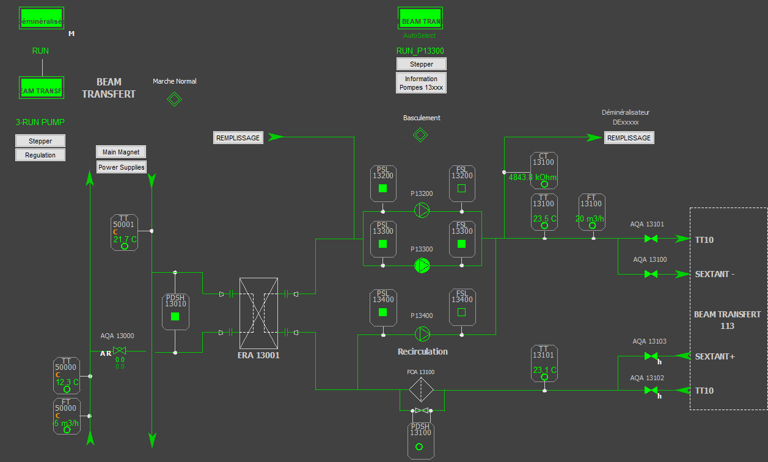
1. Support to SAT for COOL ED BAs (1 to 6)
Double distribution pumps
Users
Heat exchanger
Recirculation pump

Slide 4
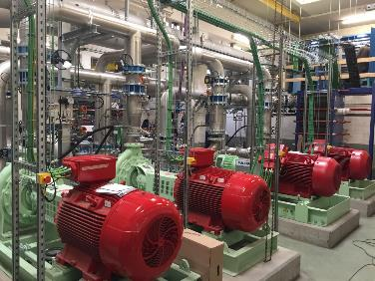
1. Support to SAT for COOL ED BAs (1 to 6)
Main problems during SAT:
Modification of the start cycle of the circuits, modification in the recirculation behaviour.
Hardware standardization for Refilling circuits and software accommodation.

Slide 5
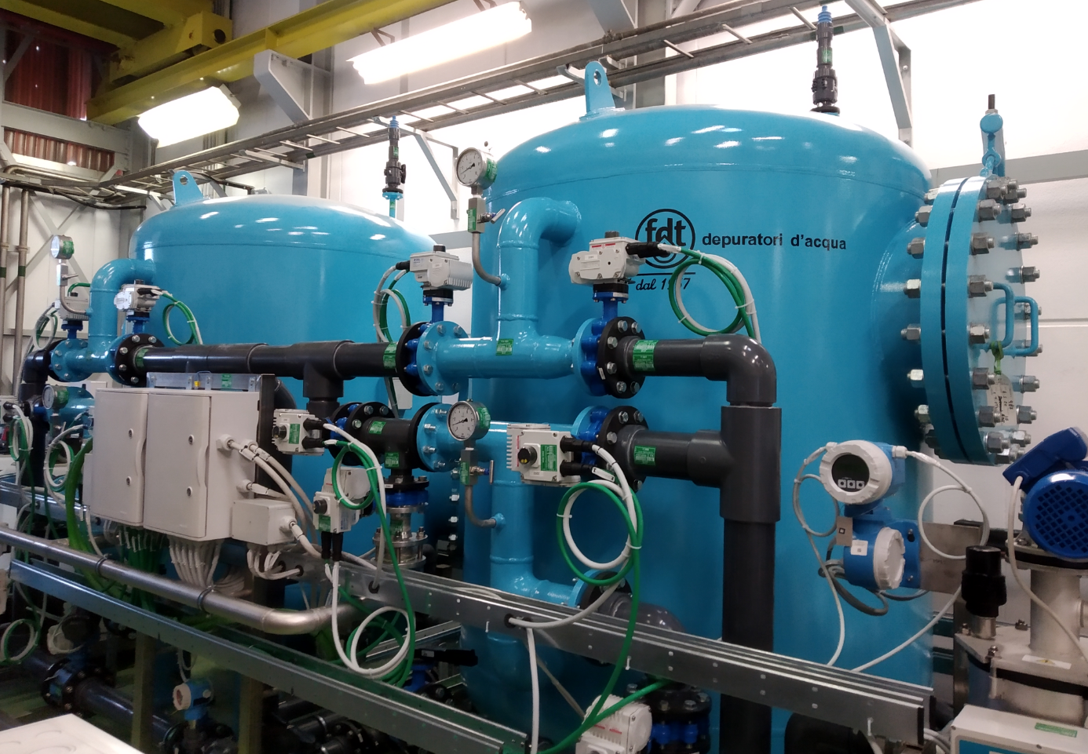
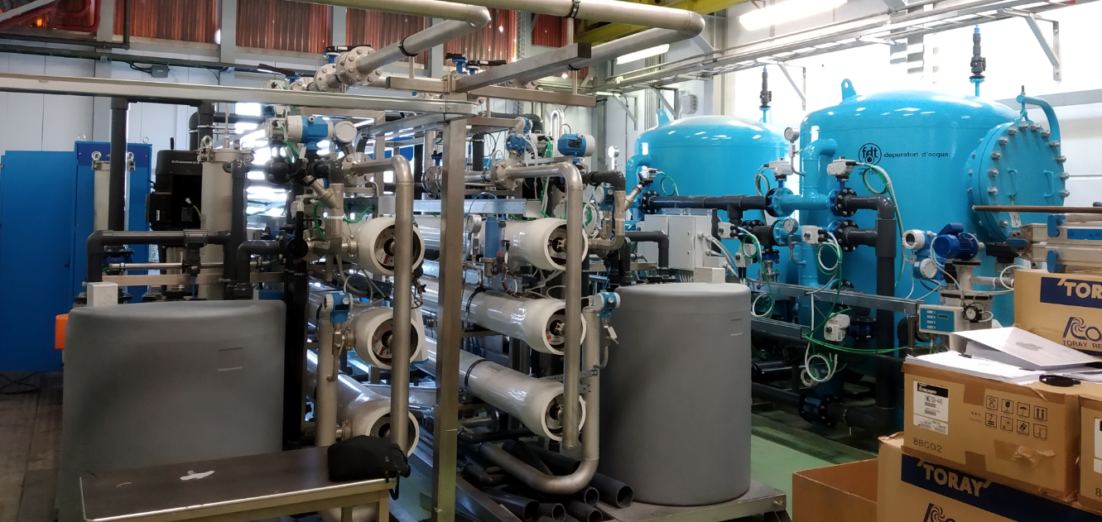
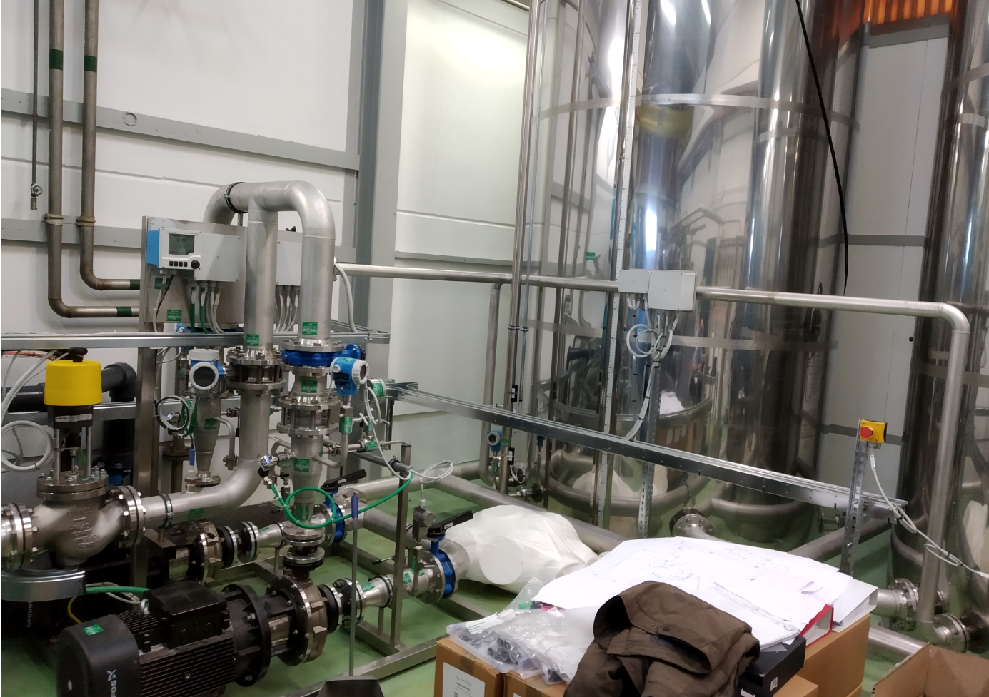
2. SAT of Demineralised Water Plant Production B176
Osmosis
Filtration
Distribution

Slide 6
2. SAT of Demineralised Water Plant Production B176
Main problems during SAT:
Low pressure in some stages of the cycle due to a flow deficit.
Design problems of the installation, overpressure in some points of the osmosis membranes.
Modification of refilling cycle of the osmosis cleaning tanks.
  Several tries with different parameters in the pumps VSD’s.
  Modifications in the installation by the contractor to reduce the filtration output pressure.

Slide 7
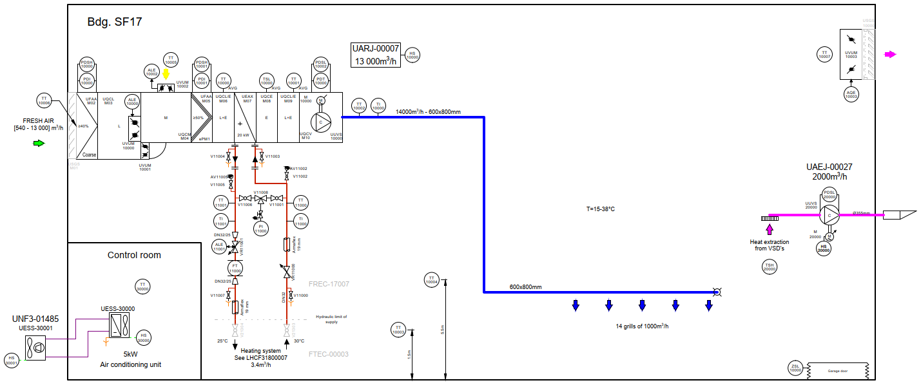
3. Functional Analysis for HVAC buildings SF17 and SF57

Slide 8
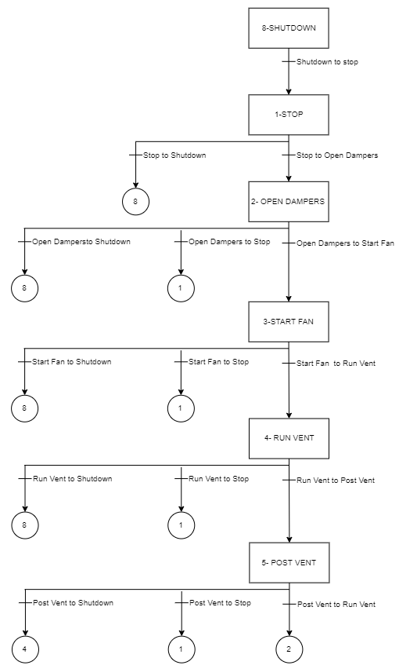
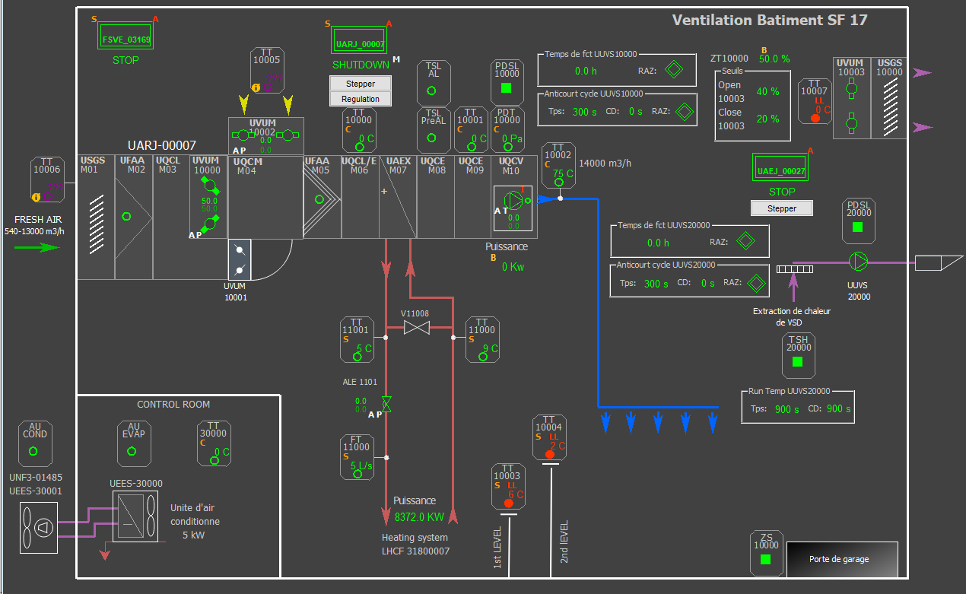
3. Functional Analysis for HVAC buildings SF17 and SF57

Slide 9
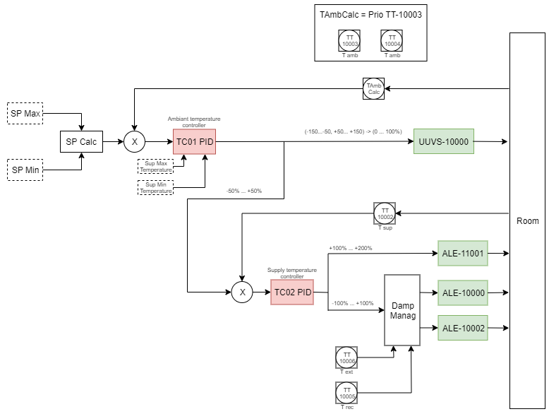
3. Functional Analysis for HVAC buildings SF17 and SF57

Slide 10
I appreciate your attention

