Slide 1
Mathematical Geodetic Observation Modelling and Testing
Monica Coppo Frias

Slide 2
FCC simulations
Alignment system simulations of the FCC
Definition of observation equations (HLS, WPS...)
Implement in LGC for the least squares compensation
Notes:
Currently we are working on the FCC alignment system simulations, more concretely in the definition of the observation equations from the survey observations, so far I have been working in the definition for the hydrostatic levelling system . This mathematical models will have to be added to the LGC software where the least square compensation for the simulations is carried out.

Slide 3
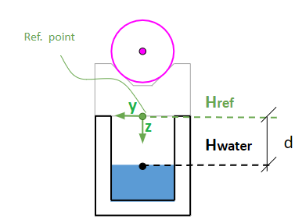
HLS mathematical model
d = Href - Hwater
d → Distances from sensor to water
HL sensor vessel system
Reference point → Top of the HL sensor vessel
Hwater is the unknown
Notes:
The HL sensor measures the distance from the sensor to the water. The sensor point is represented in green. Our model is taking into account a HL sensor vessel system, where the origin is set at the sensor in the top of the vessel. From this reference point we define our observation equation of the distance d as the difference between the height of the reference point and the height of the water surface where Height is an unkown

Slide 4
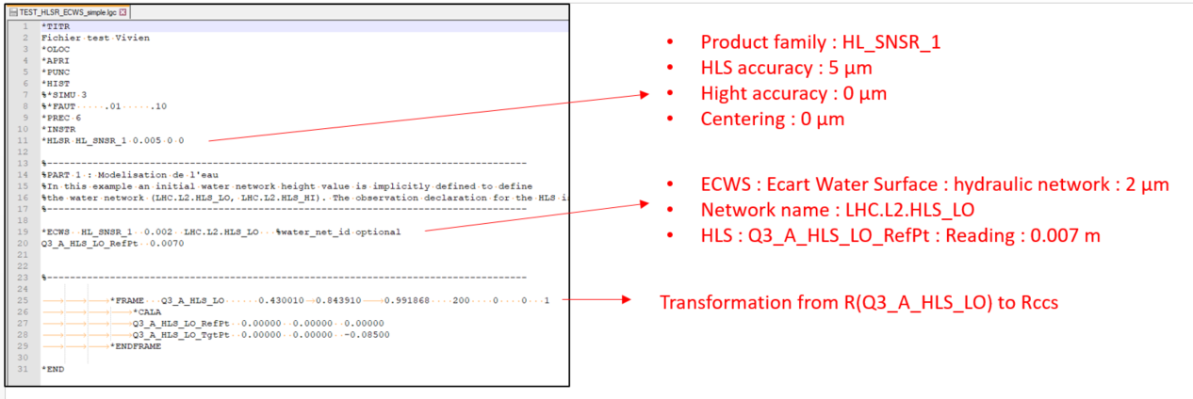
HLS on LGC
Example of ECWS input file on LGC
Notes:
When we want to add the HL sensor model into LGC, we will need first the definition of the instrument type. This is still under discussion, but the possibilities around it are, the definition of a new instrument for HL sensor with the inst_ID the standard deviation of the observed distance and the uncertainties for the height and the centering of the instrument, the other option is to use the existing EDM instrument which defines an electronic distance which is stationed in a point and its associated target, for this one the introduction of a target will be necessary (It can be the water surface, metal surface...), and the third option is to use SCALE instrument which does not require a target.
For the observation definition we introduce a Water Network and its corresponding error, which can be due to the small ripples in the water surface or a difference between the model of the equipotential surface and the true equipotential surface.

Slide 5
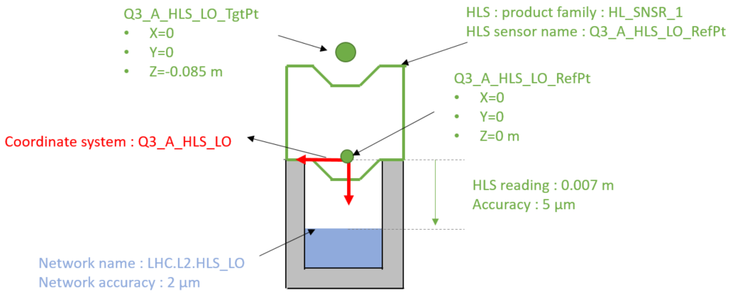
HLS on LGC
Notes:
When we want to add the HL sensor model into LGC, we will need first the definition of the instrument type. This is still under discussion, but the possibilities around it are, the definition of a new instrument for HL sensor with the inst_ID the standard deviation of the observed distance and the uncertainties for the height and the centering of the instrument, the other option is to use the existing EDM instrument which defines an electronic distance which is stationed in a point and its associated target, for this one the introduction of a target will be necessary (It can be the water surface, metal surface...), and the third option is to use SCALE instrument which does not require a target.
For the observation definition we introduce a Water Network and its corresponding error, which can be due to the small ripples in the water surface or a difference between the model of the equipotential surface and the true equipotential surface.

Slide 6
LGC development steps
Definition of the HLS instrument
Definition of the measurement associated (ECWS)
Define the contribution generators for the least squares inversion: Station point and Water surface height
Input matrices filler: Where the contributions are added to the matrices and the vector of observations is defined.
Define file writers for each instrument. New one created for HLS. This gives the format to te file.

Slide 7
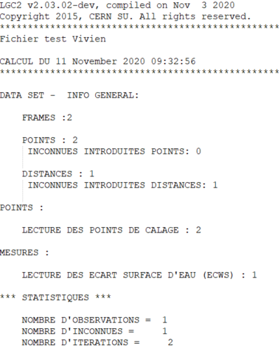
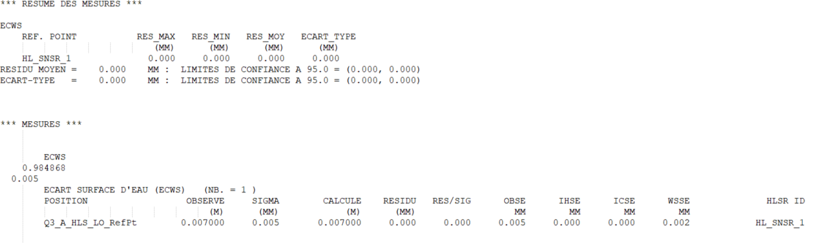
Output file
Water surface height
Calculated distance to WS
Notes:
When we want to add the HL sensor model into LGC, we will need first the definition of the instrument type. This is still under discussion, but the possibilities around it are, the definition of a new instrument for HL sensor with the inst_ID the standard deviation of the observed distance and the uncertainties for the height and the centering of the instrument, the other option is to use the existing EDM instrument which defines an electronic distance which is stationed in a point and its associated target, for this one the introduction of a target will be necessary (It can be the water surface, metal surface...), and the third option is to use SCALE instrument which does not require a target.
For the observation definition we introduce a Water Network and its corresponding error, which can be due to the small ripples in the water surface or a difference between the model of the equipotential surface and the true equipotential surface.

Slide 8
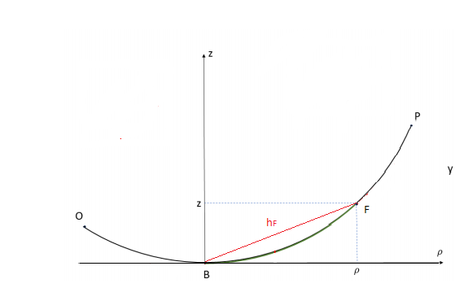
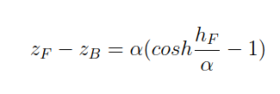
WPS catenary model
Parameters defining the points in the wire system:
Coordinates of lowest point B
Azimuth of the plane containing the wire
𝛂 -constant of the wire:
𝛂 = T/gq
The horizontal distance between F and B h_F
The Local astronomical system of point B will be taken into account

Slide 9
Questions?

Slide 10
LGC improvements for HLS
Working on a iterating model for different water surfaces
Create the output file for reliability data
Notes:
The next steps of my work need a further discussion on the definition of HL system model on LGC to be able to implement the new model in the software and do the corresponding tests. After this model the idea is to start working on the definition of the Wire Positioning System model. This system consist on a stretched wire which is the reference for the alignment of the machine components in particle accelerators

Slide 11
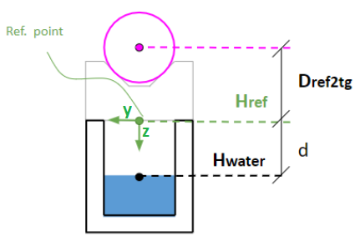
HLS mathematical model
HL sensor vessel system:
  Origin: point at the intersection of the HL sensor vessel axis and the plane defined by the top of the sensor vessel
  z-axis: Along the HL sensor vessel axis, positive towards the water surface
  y-axis: perpendicular to the z-axis, lies along the orthogonal projection of the beamline direction
  x-axis: creates a right handed Cartesian system
HL sensor reference point is defined at the origin of the HL sensor vessel system
Optical offset → distance from sensor to target, Dref2tg
  The optical offset is independent of the HL sensor measurements
HL sensor target point is defined in HL sensor vessel system, lies on the z-axis
Observations of the HL sensor target contributes to the determination of HL sensor vessel system parameters
Notes:
In the HL sensor vessel system we define the z-axis in the direction on the nominal gravity vector, the y axis is perpendicular to this one and the x axis creates a right handed system.
In the top of the HLS sensor a target point which distance to the HLS sensor vessel point is defined as the optical offset. This distance is independent of the HL sensor measurements and can be defined in the HL sensor vessel system with the appropriate uncertainty values. The measurements to the target will contribute to the determination of the HL sensor vessel system parameters.

Slide 12
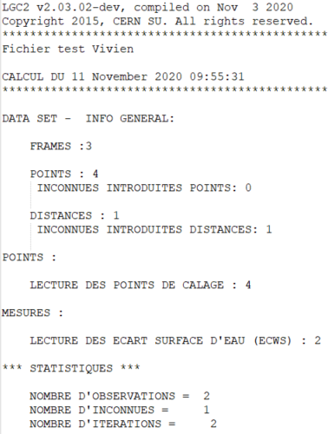
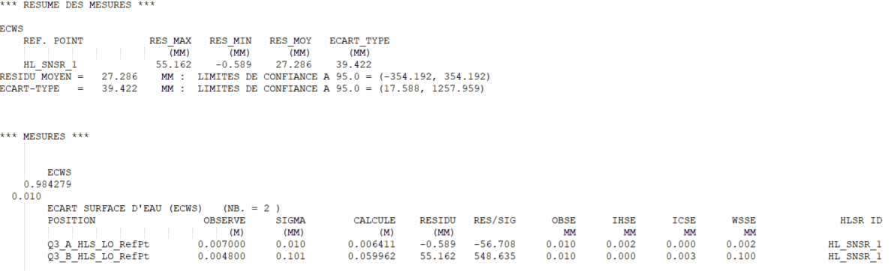
Output file
Water surface height
Calculated distance to WS

