Slide 1

Validation and verification of industrial control systems (FTEC2019-11)
Ignacio David López Miguel (BE-ICS-AP)
10/12/2020
Supervisors: Jean-Charles Tournier and Borja Fernández Adiego

Slide 2

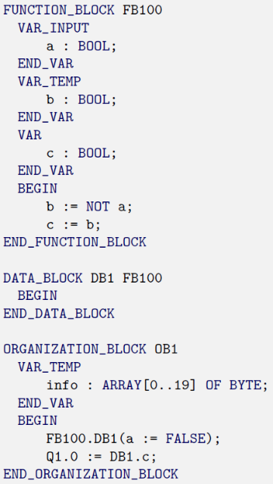
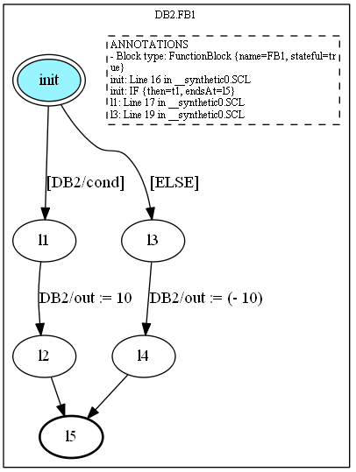

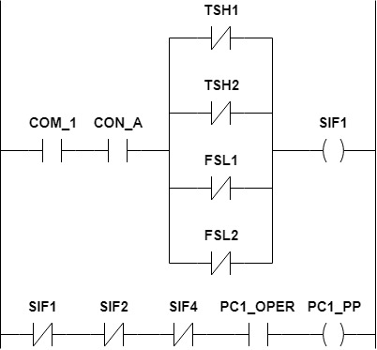


Recap: Applying model checking to PLC programs
PLCverif
PLC program
Intermediate Model
Model checking algorithms
Control Flow Automata
✗
Property failed
Trace leading to the violation
Theta
✓
Requirements
Formalized requirements
…
Property OK
If Output1 is FALSE
then Output2 is TRUE
AG (!Output1 → Output2)

Slide 3
Tasks performed
Development
Usage
R&D
Improving PLCverif
Finding new ways and projects where formal methods could be used
Using PLCverif in real CERN projects

Slide 4
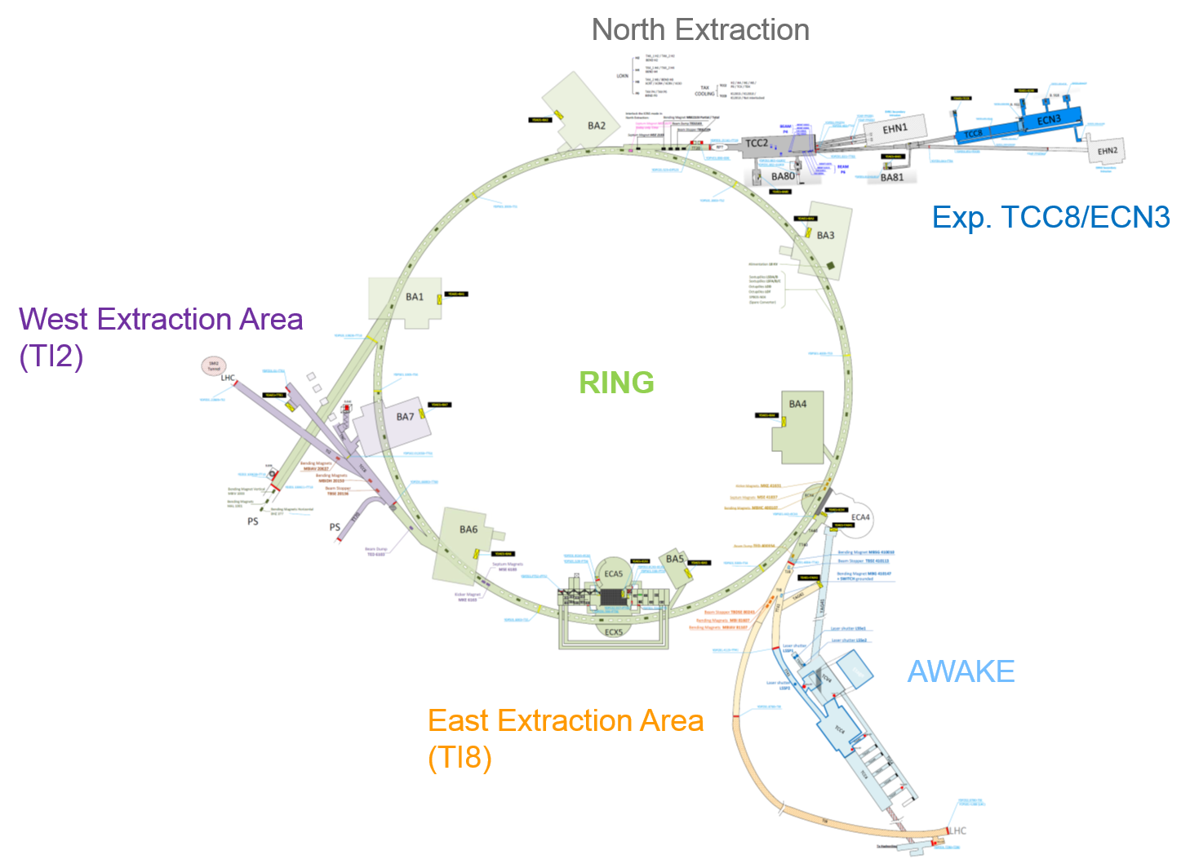
Usage
SPS Personnel Protection System
Problems found
Changed priority of the different modes
Missing/wrong conditions
Wrongly documented specification
Simultaneous active state of exclusive signals
→ Report issued and problems discussed
Difficulties during the verification
Non-implemented built-in functions
New bugs
Very complex safety functions
Powering Interlock Controllers (PIC) Machine protection → few tests performed. To be continued
Demo presented to UNICOS and external potential client to start using PLCverif

Slide 5
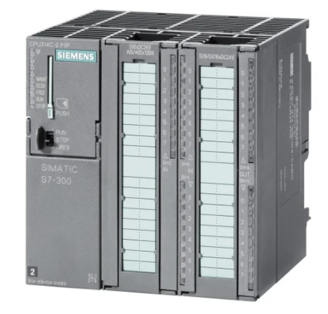
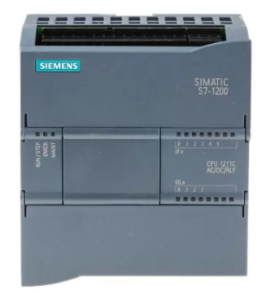


Development
Upgrade from S7-300/400 to S7-1200/1500 → been done upon necessities
Issues with different SCL instructions fixed. New features included → always ongoing
Integration with the latest release of Theta → ongoing
PLCverif is now OpenSource (https://gitlab.com/plcverif-oss)

Slide 6



R&D
Verify C++ code from other sections
Simplification of the Control Flow Automata
{
Working group about formal methods
Where to apply formal methods? Any critical function:
In house Integrated Circuits (e.g. FPGA)
Embedded Software
Safety systems
Planning/Schedule
What to do?
Sharing knowledge
Understanding the benefits of formal verification
Identifying collaboration

