Slide 1

Mechanical Engineering for beam intercepting devices
(target, collimators and dumps)
(FTEC2019-17)
Álvaro Romero Francia
STI (Sources, Targets and Interactions)
TCD (Targets Collimators Dumps)

Slide 2
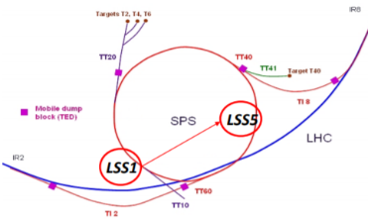
Overview
Problem Definition
The HL-LHC (High Luminosity Large Hadron Collider) and LIU (LHC Injector Upgrade) era are presenting unprecedent challenges. This includes the upgrade of the Target Internal Dump Vertical Graphite (TIDVG) located in the SPS.
TIDVG#4
TIDVG#5
Average Beam Thermal Power 60kW
Average Beam Thermal Power 235kW
LSS1
LSS5
Move from LSS1 to LSS5
Fig.1 LSS1 and LSS5 location in SPS
Alvaro Romero Francia, EN-STI-TCD
Date: 10/12/2020

Slide 3


Index
Cooling Pipes CFD/Thermal Coupling
Cooling Pipes Thermal/Structural Coupling
CFD Cooling Air around the Vacuum Chamber
Cooling TIDVG#5
Interlocks and Alarms
Cooling TIDVG#5 after Interlock
Number of Particles/Time
Interlock
TZM Fatigue Test Campaign
Fatigue
Alvaro Romero Francia, EN-STI-TCD
Date: 10/12/2020

Slide 4

Work Completed
Cooling Pipes CFD/Thermal Coupling
Cooling Pipes Thermal/Structural Coupling
CFD Cooling Air around the Vacuum Chamber
Alvaro Romero Francia, EN-STI-TCD
Date: 10/12/2020

Slide 5
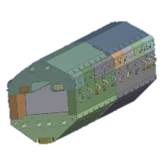
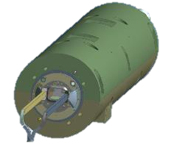


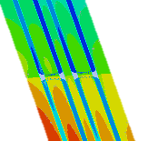
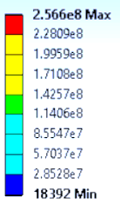
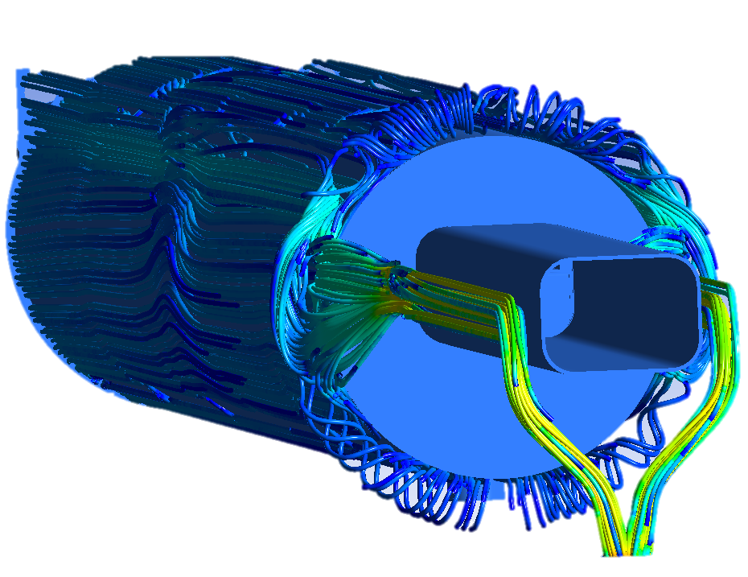
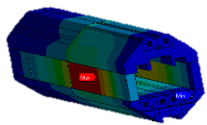
Overview
Problem Definition, Previous Work and Current Work
Vacuum Chamber
CuCr1Zr core
Beam Direction
Beam Direction
Simulations Completed:
CFD-Thermal Simulations Coupled for the cooling pipes.
Thermal-Structural Simulations Coupling for the cooling pipes.
Full CFD analysis for the Vacuum Chamber new design.
Particle Beam
Particle Beam
Cooling Pipes
Absorbing Blocks
Air Extraction
Fig.2 LSS1 a) CuCr1Zr Core. B) Vacuum Chamber
Temperature [K]
Von Mises Stress- [Pa]
Velocity [m/s]
Fig.3 a) CFD-Thermal Coupling b) Thermal-Structural Coupling. c) Cooling air behavior around Vacuum Chamber
Alvaro Romero Francia, EN-STI-TCD
Date: 10/12/2020

Slide 6

Work Completed
Interlocks and Alarms
Cooling TIDVG#5
Number of Particles/Time
Alvaro Romero Francia, EN-STI-TCD
Date: 10/12/2020

Slide 7
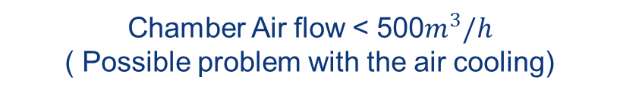
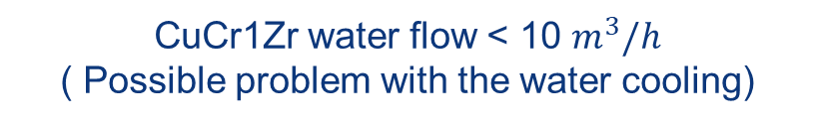
Interlocks and Alarms
CFD and FEA simulations
CuCr1Zr water flow < 10 $m^{3}/h$
( Possible problem with the water cooling)
Interlocks
Chamber Air flow < 500$m^{3}/h$
( Possible problem with the air cooling)
New: due to constrained displacements
More than 5 consecutive full SPS-FT SHiP super-cycles dumps after LHC filling steady state
(To be confirmed and defined in terms of particles/unit of time)
Alvaro Romero Francia, EN-STI-TCD
Date: 10/12/2020

Slide 8

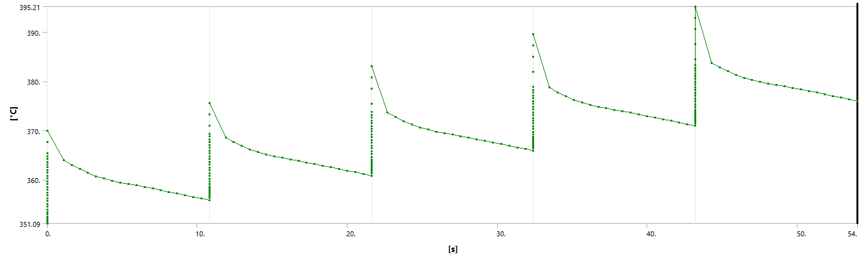
FEA Transient Thermal
BP=1.2s
7.2 s - SPS-FT SHiP pulse period
3.6 s - MD
21.6 s - LIU-SPS 80b pulse period
3.6 s - MD
LHC Filling SuperCycle
Repeated until Steady State
(C)
5 FT-SHiP Pulses
1st Pulse
2nd Pulse
3rd Pulse
4th Pulse
5th Pulse
395
390
44.12 K
Max.Difference
380
370
360
351
0
10
20
30
40
50
54
(s)
Fig.4 Temperature increase after LHC Filling Steady State and 5 FT-SHiP Pulses
Alvaro Romero Francia, EN-STI-TCD
Date: 10/12/2020

Slide 9
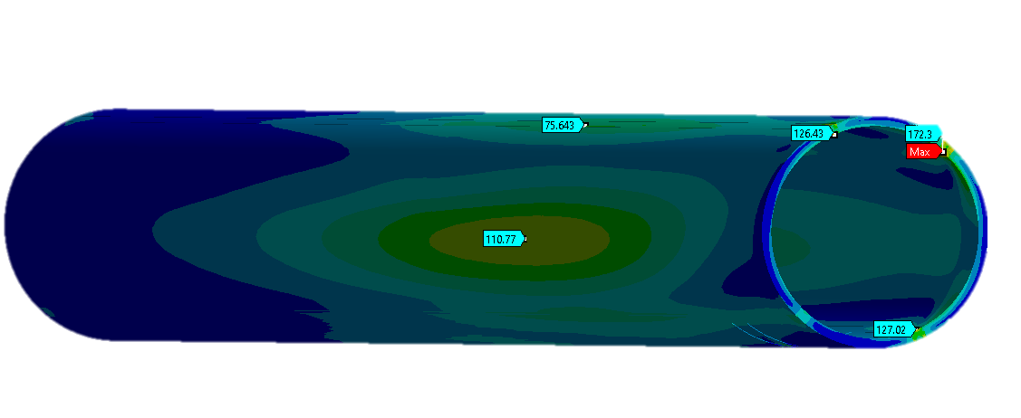
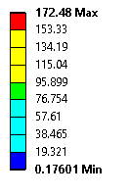
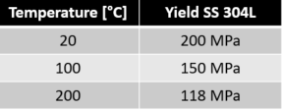
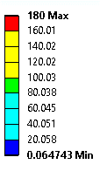
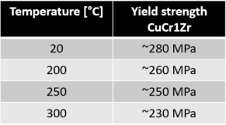
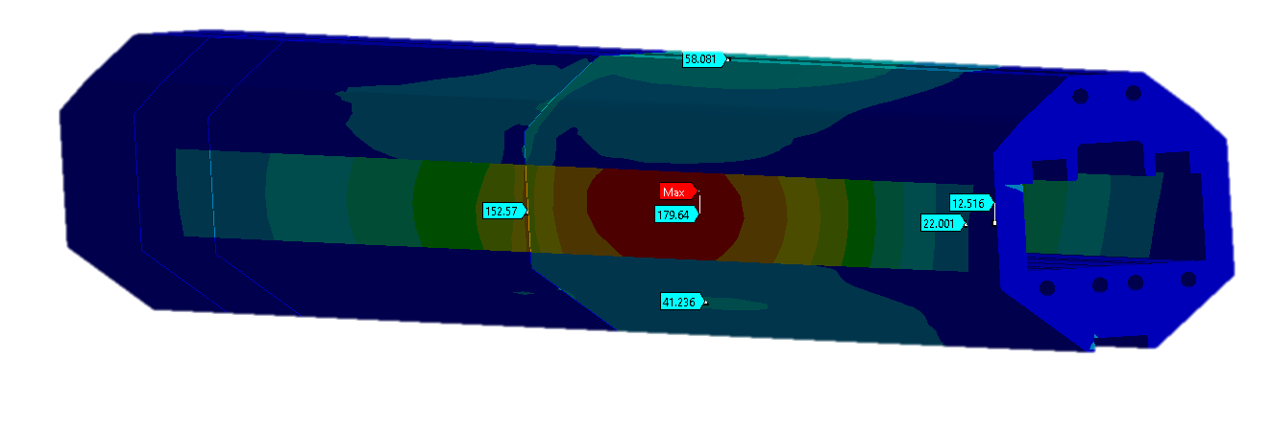
FEA Transient Structural
Fig.5 Vacuum Chamber FEA Transient Structural after LHC Filling + 5 SHiP Pulses
Fig.6 Vacuum Chamber FEA Transient Structural after LHC Filling + 5 SHiP Pulses
Stresses seem acceptable in the CuCr1Zr core and Vacuum Chamber for the normal operational scenario structural dynamic response. Both remain in the elastic domain.
Alvaro Romero Francia, EN-STI-TCD
Date: 10/12/2020

Slide 10
Number of Particles / Unit time
The Number of Particles / Unit time indicates a limiting value for operators controlling the TIDVG#5. If this value is reached or exceeded, it is a signal that the machine shall stop and the causes investigated.
The goal is to avoid dumping more than 5 Full SHiP pulses after reaching steady state with LHC filling super-cycle.
Buffer Time – 54 Seconds
Interlock Activated if… 3.1868e12 p+/s
Alvaro Romero Francia, EN-STI-TCD
Date: 10/12/2020

Slide 11
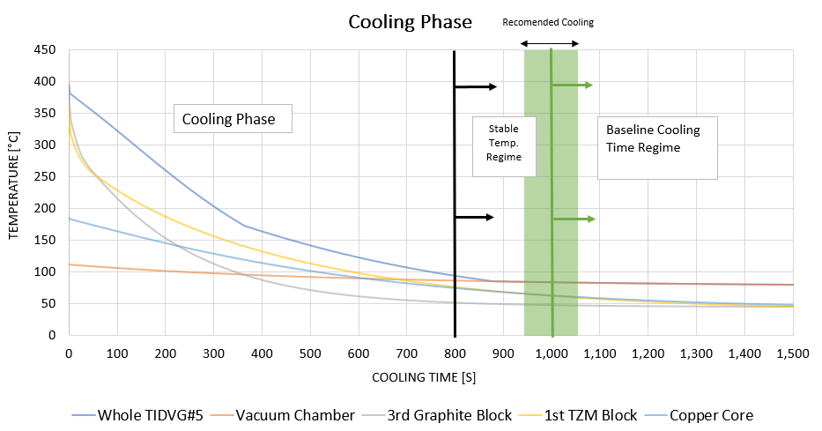
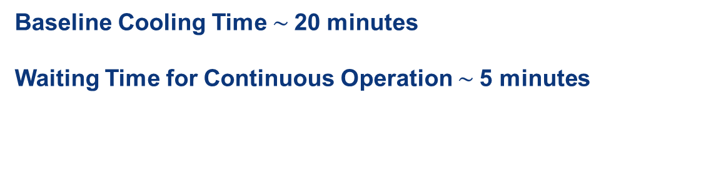
Cool Down Phase Max.Temperature
Fig.7 TIDVG#5 Cooling after LHC Filling + 5 SHiP Pulses
Baseline Cooling Time $\sim$20 minutes
Waiting Time for Continuous Operation $\sim$5 minutes
Alvaro Romero Francia, EN-STI-TCD
Date: 22/09/2020
Alvaro Romero Francia, EN-STI-TCD
Date: 10/12/2020

Slide 12

Work to be Completed
TZM Fatigue Test Campaign
Alvaro Romero Francia, EN-STI-TCD
Date: 10/12/2020

Slide 13
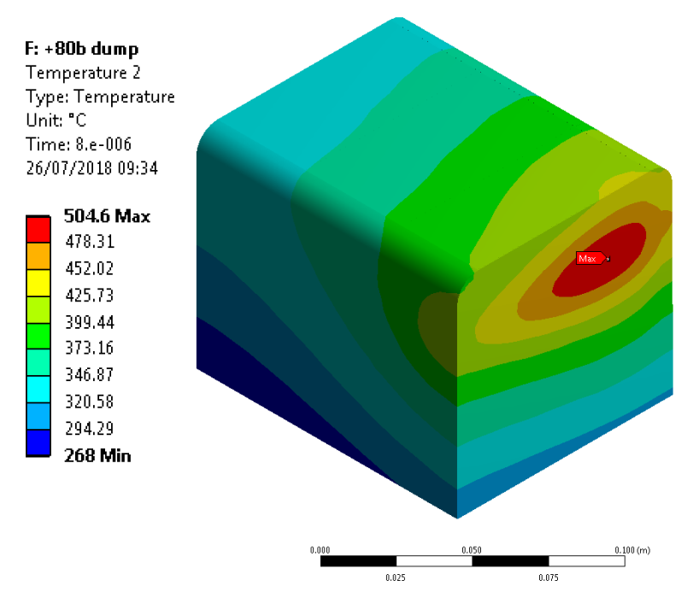
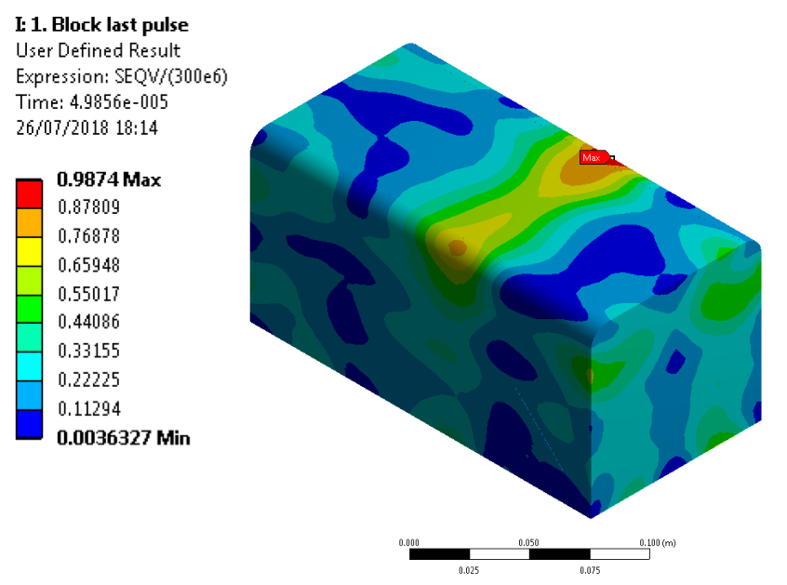
TZM Absorbing Block
Fig.8 a) TZM temperature after worst-case scenario. b) Christensen Criterion after worst-case scenario.
During Worst-Case Scenario, Christensen failure criterion demonstrated how prompt is the first TZM block to fail. A deeper study is required. This includes a fatigue analysis.
Alvaro Romero Francia, EN-STI-TCD
Date: 10/12/2020

Slide 14
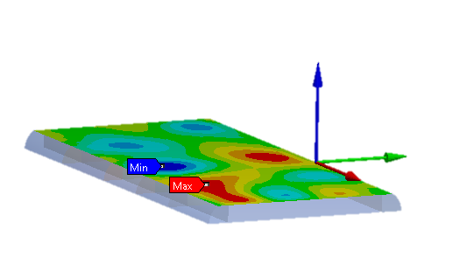
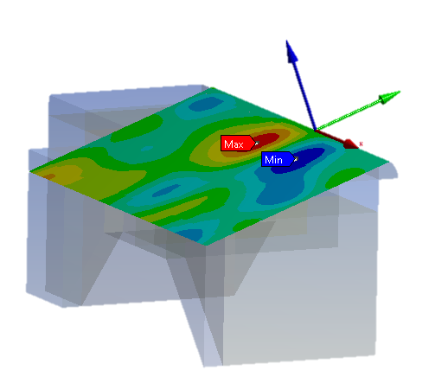
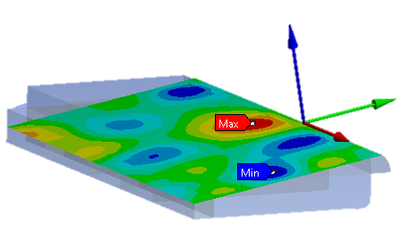
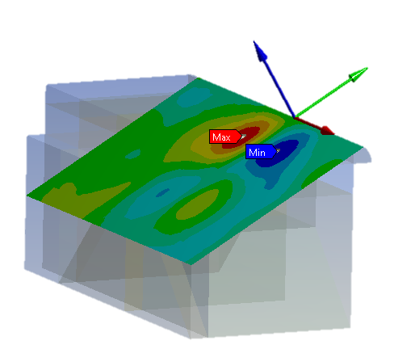
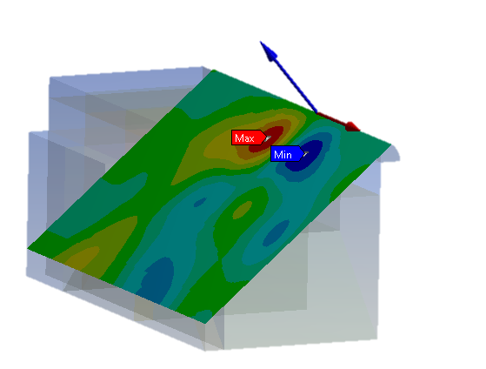
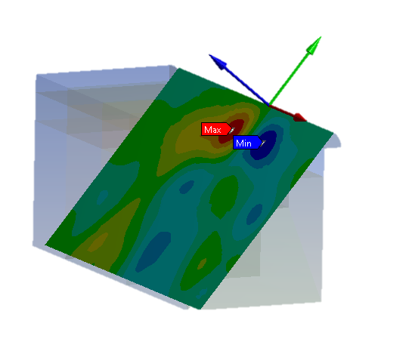
Failure Criterion
Non-Constant Amplitude, Non-Proportional Loading
Critical Plane Method
Fatemi Socie Criterion, Crossland Criterion, Sines Criterion, Dan Van Criterion
Plane at 0º X rotation
Plane at 10º X rotation
Plane at 20º X rotation
Plane at 30º X rotation
Plane at 40º X rotation
Plane at 50º X rotation
Fig.9 Critical Planes Shear Stresses
Alvaro Romero Francia, EN-STI-TCD
Date: 10/12/2020

Slide 15
TZM Fatigue Campaign
Problem
APDL command in ANSYS Records stress history during Dump.
Two Python Codes Defines Lifetime based on Criterions.
Torsion Fatigue Properties are required:
Very limited experimental data.
Most of the experimental data cover uniaxial fatigue tests.
Non experimental data relating Uniaxial and Torsion properties for Non-Ferrous alloys.
Alvaro Romero Francia, EN-STI-TCD
Date: 10/12/2020

Slide 16
Future Steps
Perform Torsion Fatigue Tests with TZM specimens.
Commissioning TIDVG#5
Torsion fatigue parameters are required to solve the failure criterions.
During Commissioning, temperature in TIDVG#5 will be recorded. Experimental results are to be compared with Numerical results.
Alvaro Romero Francia, EN-STI-TCD
Date: 10/12/2020

Slide 17
Thank you,
Questions?

