Slide 1


Validation and verification of industrial control systems (FTEC2019-11)
Ignacio David López Miguel (BE-ICS-AP)
Beams - Industrial Controls and Safety Systems – Applications
Supervisor: Jean-Charles Tournier

Slide 2
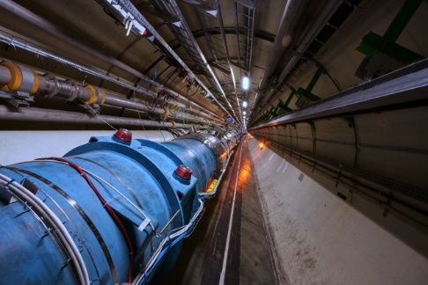
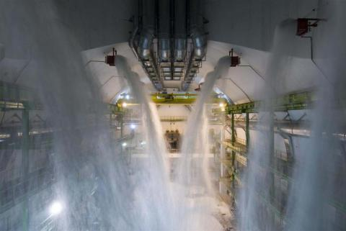
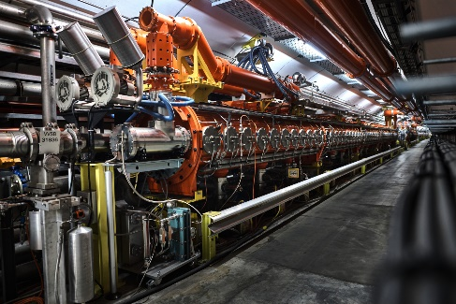
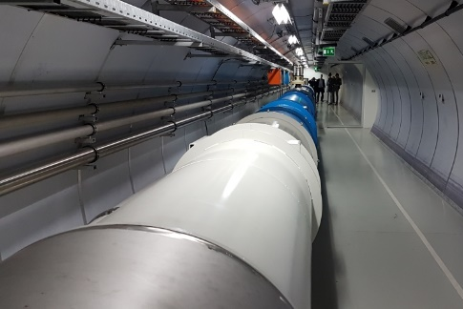
Context
BE-ICS develops Industrial Control and Safety systems.
Examples
LHC Cryogenics control systems
Cooling and ventilation control systems
LHC, SPS and PS Access control and Protection systems
Safety Instrumented Systems (SM18, FAIR)
These systems use PLCs (Programmable Logic Controllers) as a control device
Goal
How
Improve reliability and guarantee that programs are compliant with specifications
  Using formal methods (model checking)
2

Slide 3
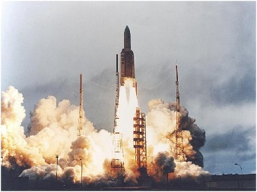
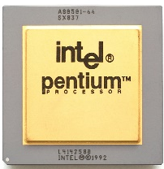

When should/could we use Formal Methods?
Safety critical systems
Ariane 5 explosion
  Damage to the environment, the installation, people
Software library used in many systems
Floating-point division error
  Damage to the reputation of the company/organization
Is it worth to use Model Checking to PLCs?
PLCverif¹
Not without tool support
  Hide complexity
  Compatibility
3
¹ B. Fernández Adiego, D. Darvas, E. Blanco Viñuela, J-C. Tournier, S. Bliudze, J. O. Blech, V. M. González Suárez: Applying model checking to industrial-sized PLC programs. IEEE Transactions on Industrial Informatics, Vol. 11, Issue 6, pp. 1400-1410, 2015. [Paper on IEEExplore]

Slide 4
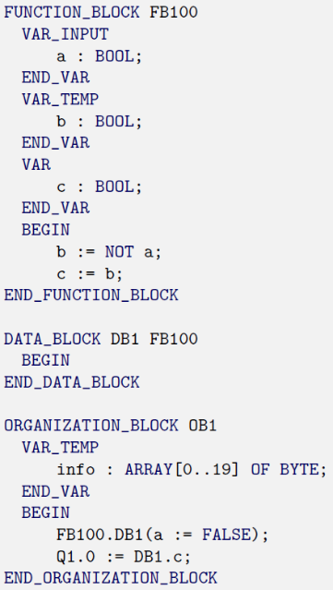
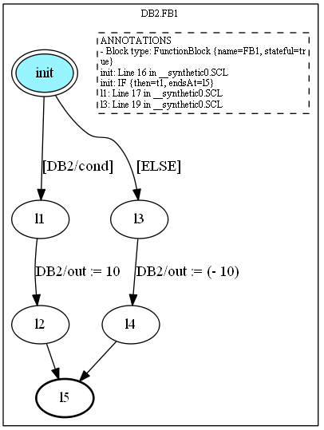

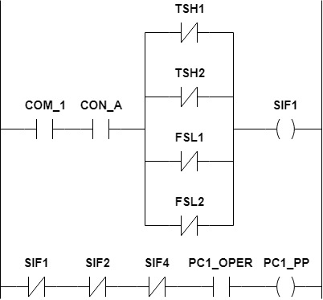

Applying model checking to PLC programs
PLC program
Intermediate Model
Model checking algorithms
Control Flow Automata
✗
Property failed
Trace leading to the violation
…
✓
Property OK
Requirements
Formalized requirements
If Output1 is FALSE
then Output2 is TRUE
AG (!Output1 → Output2)
4

Slide 5





FTEC tasks
Solving issues
SPS
Support on a real verification case
Migration to Java 11
PLCverif open source
Complete support for TIA portal
Support for other model checkers

