Slide 1

Mechanical Engineering for beam intercepting devices
(target, collimators and dumps)
(FTEC2019-17)
Alvaro Romero Francia
STI (Sources, Targets and Interactions)
TCD (Targets Collimators Dumps)

Slide 2
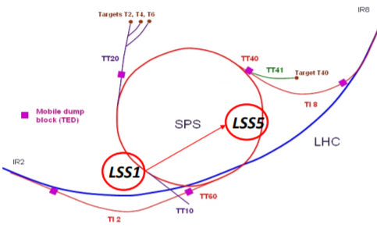
1. Overview
The HL-LHC (High Luminosity Large Hadron Collider) and LIU (LHC Injector Upgrade) era are presenting a challenging modification of several devices related. This is the case of the Target Internal Dump Vertical Graphite (TIDVG).
TIDVG#4
TIDVG#5
Beam power 60kW
Beam Power 235kW
LSS1
LSS5
Move from LSS1 to LSS5

Slide 3
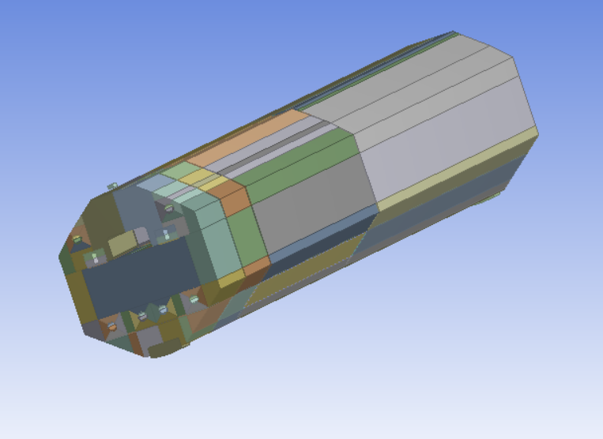
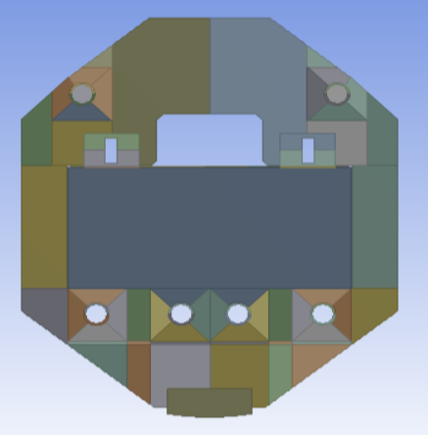
2. Current State
TIDVG5:
Intercepts beams up to 450GeV.
5m long.
Absorbing blocks made of Graphite, CuCrZr, Pure Tungsten and TZM.
Water and Air Cooling.
The system is not dynamically coupled. The thermal, mechanical and CFD simulations were performed separately.

Slide 4
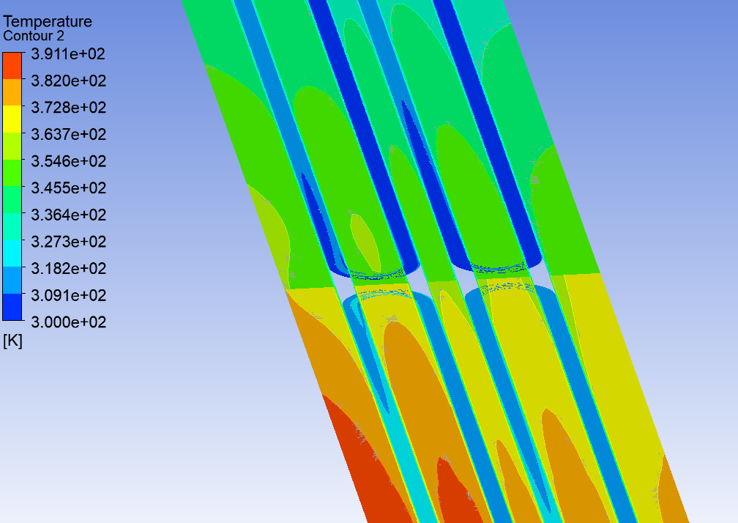
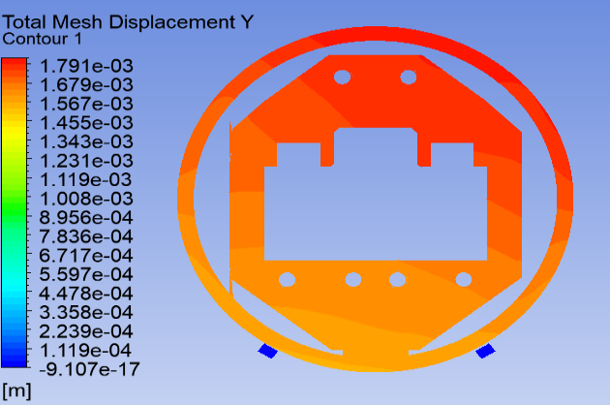
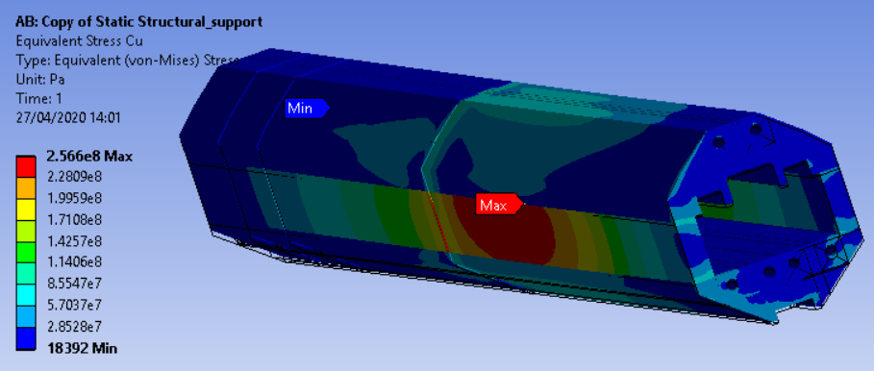
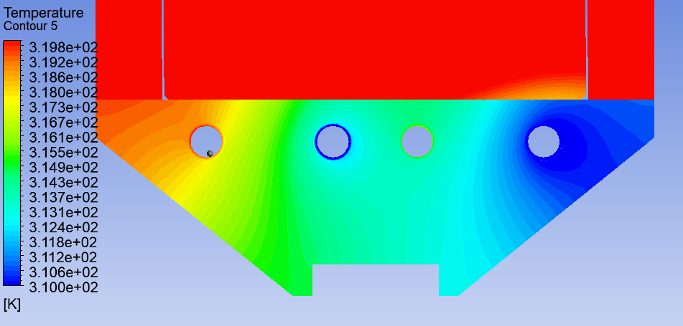
3. Progress
CFD and Thermal Simulations Coupled
Thermal and Structural Simulations Coupled

Slide 5
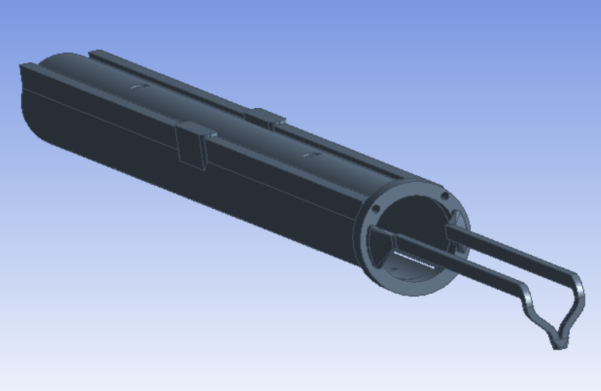
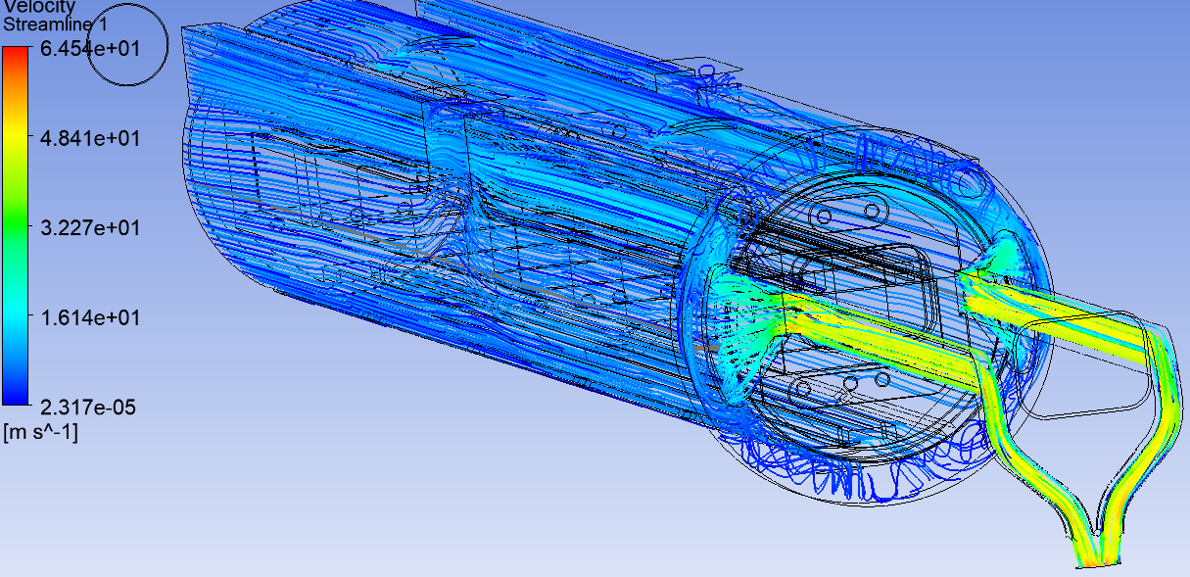
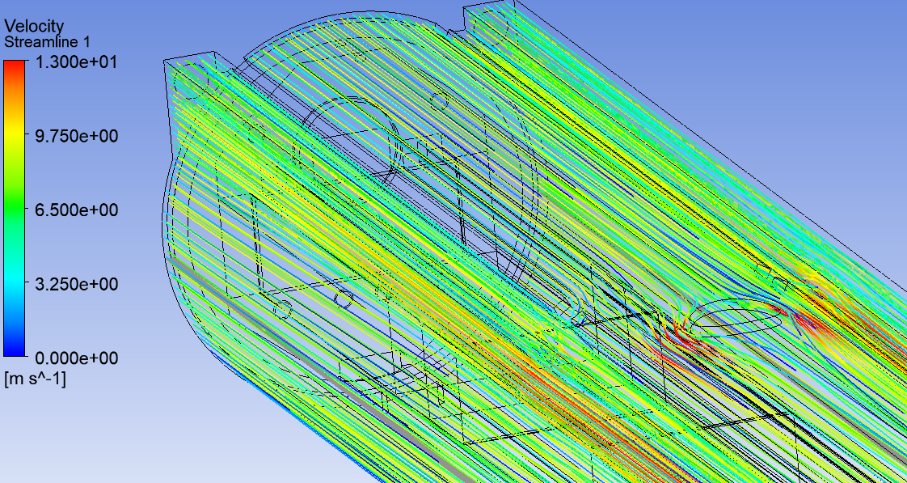
3. Progress
CFD and Thermal Coupling of the Vacuum Chamber:
Design of the Flow Domain.
CFD and Thermal Coupling.
Investigate vortices and reduce Pressure Drop.
Investigate Structural Coupling.

Slide 6
4. Future Lines of Work
Dynamic Couple between thermal, structural and CFD solutions.
Compile the entire work in one single file.
The TIDVG5 should be operating by 2021.
Thank you very much

