Slide 1
Supervision and trigger distribution units for magnet protection
Guzmán Martín García
18/05/2020

Slide 2
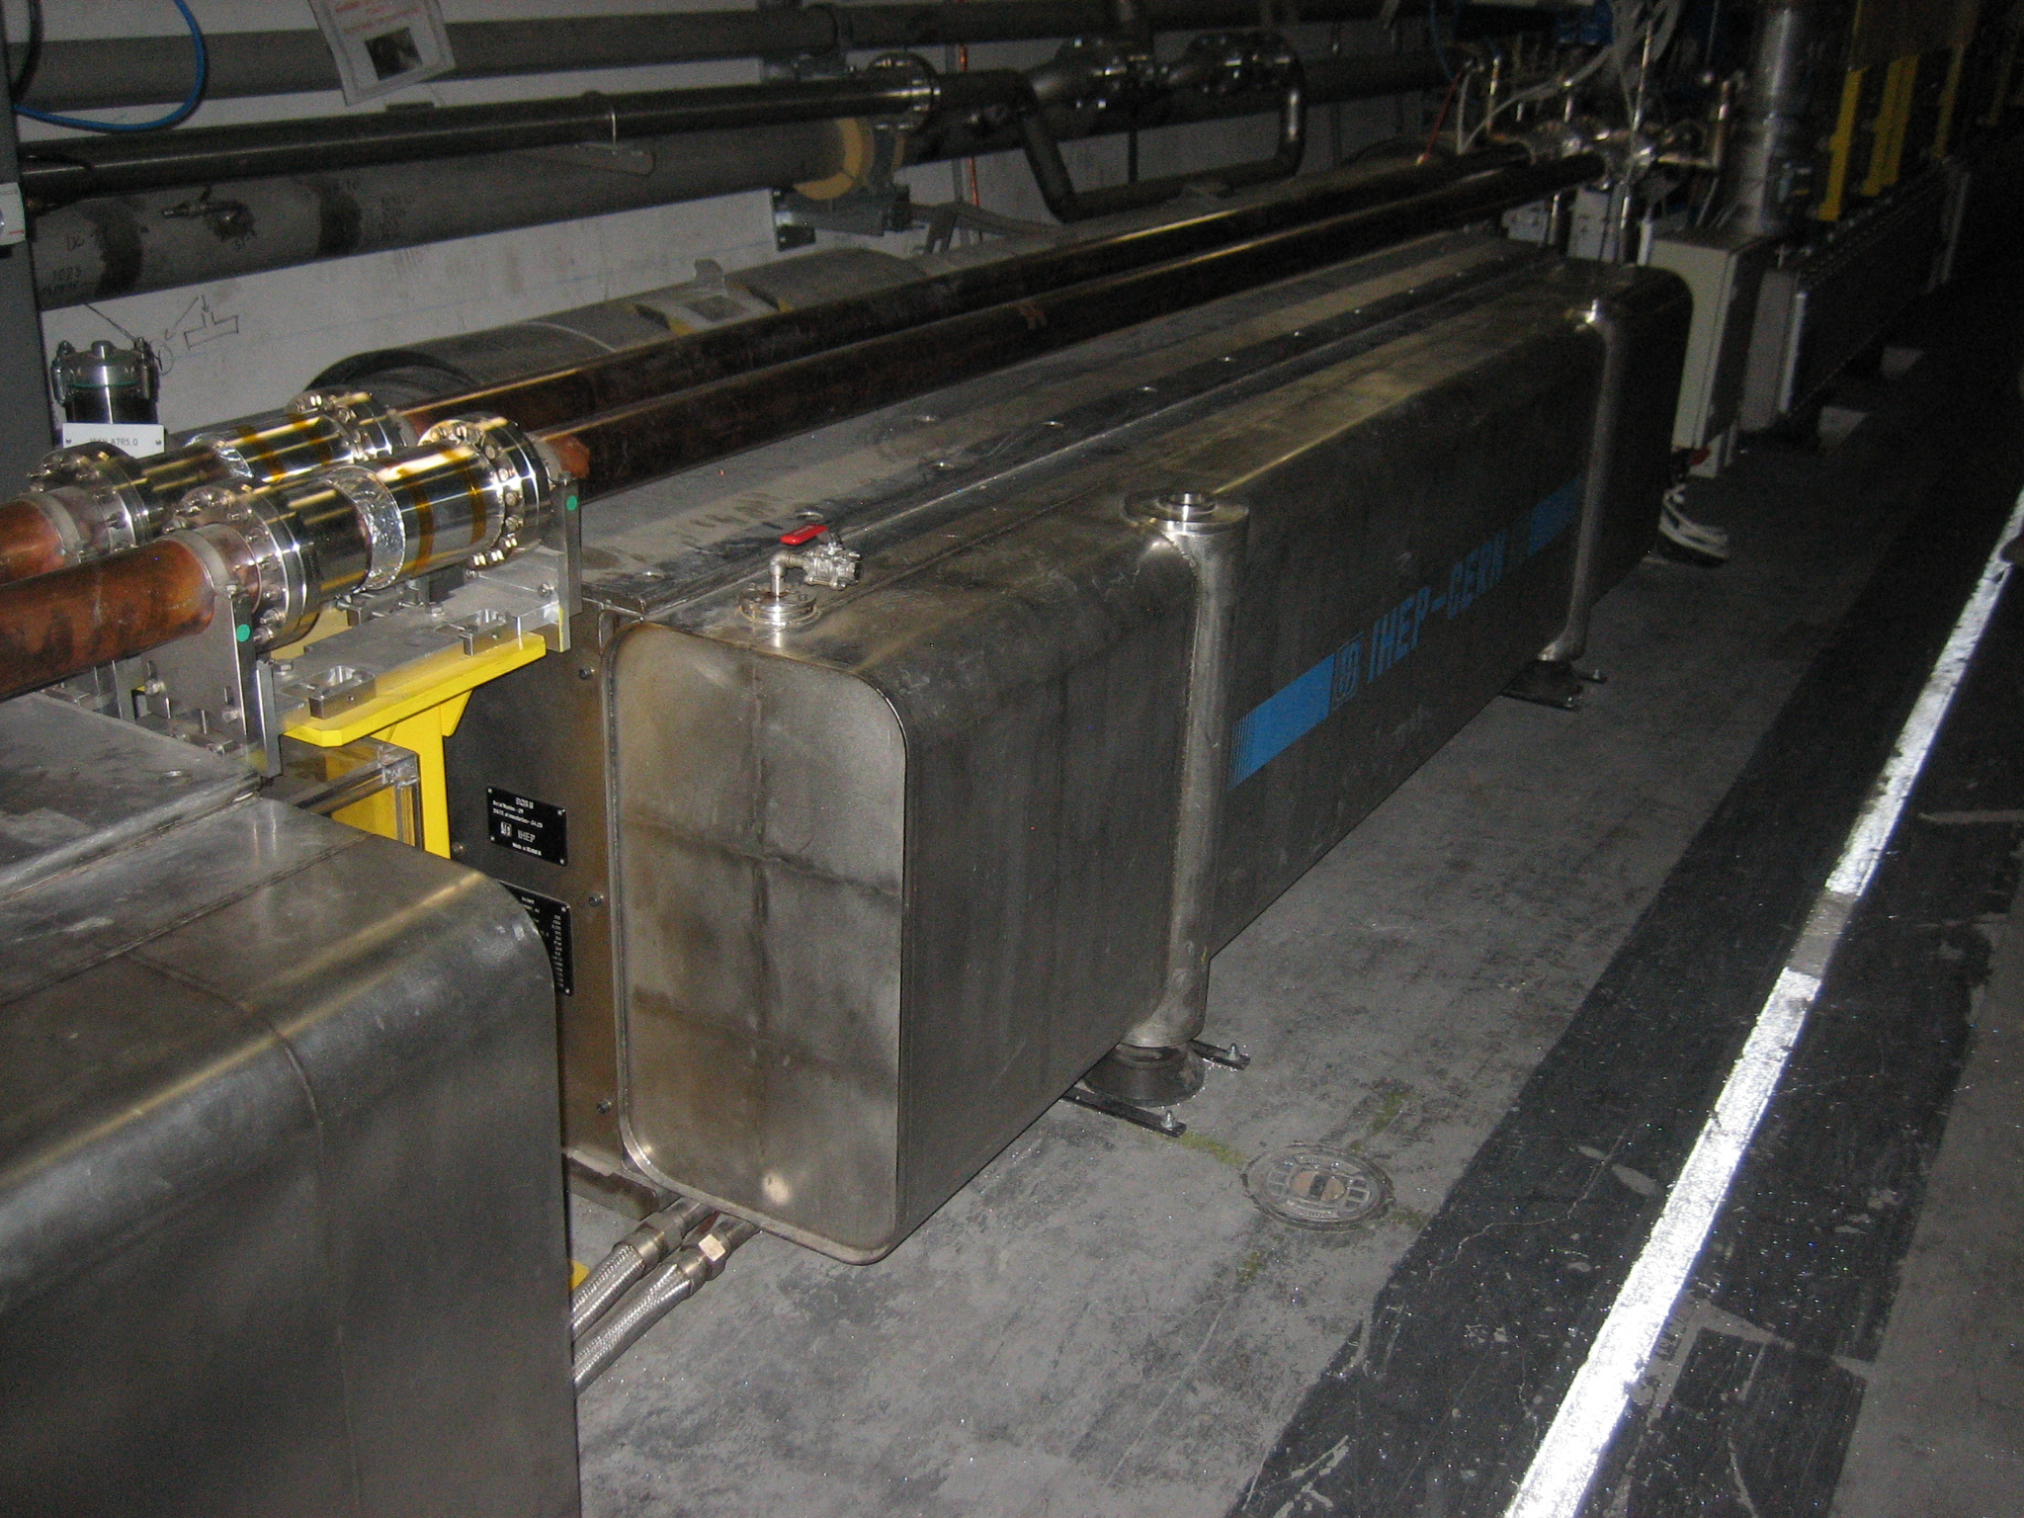
Overview
The Quench Protection System is a vital part of the superconducting magnets thorough the LHC. As the name implies, its main task is to protect the magnets against a “quench”.

Slide 3
But what is a quench?
A quench is the sudden appearance of a resistive section in a superconducting magnet that can appear spontaneously by many different reasons.
When this happens, the high currents (about 10kA) in the magnet may produce a substantial amount of heating in a really small area. This will eventually destroy the magnet, probably in a catastrophic way. For example, the energy stored in a LHC main dipole circuit is of the order or 0.25kgs of TNT
To save the magnets, once a quench is detected, we dump all that energy into resistors while heating the magnet units. Heating expands the area in which the quench is happening, distributing the heating energy.

Slide 4
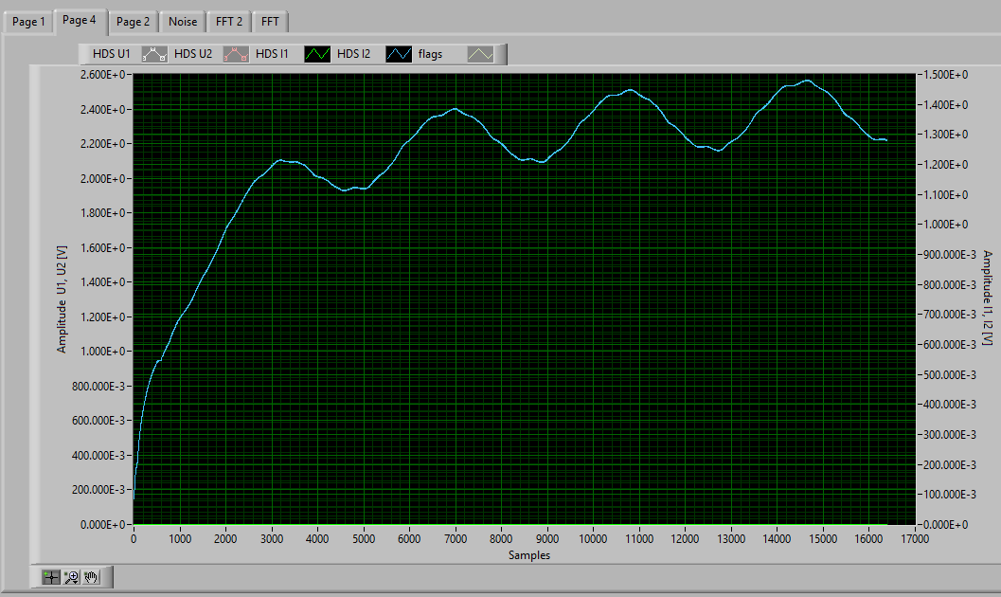
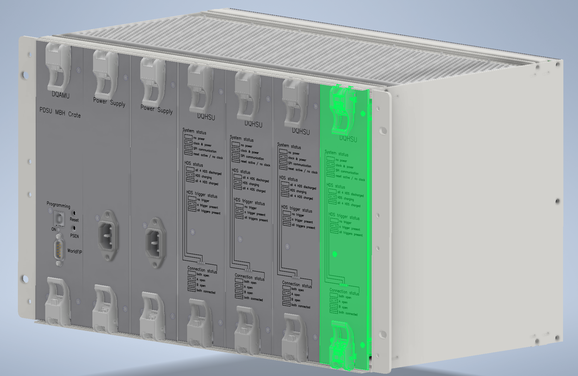
My main work at the QPS section
Debugging of misbehaving CSU PCB boards
Mechanical design / simulation of the PDSU MBH Crate
Software improvements for debugging/testing

Slide 5
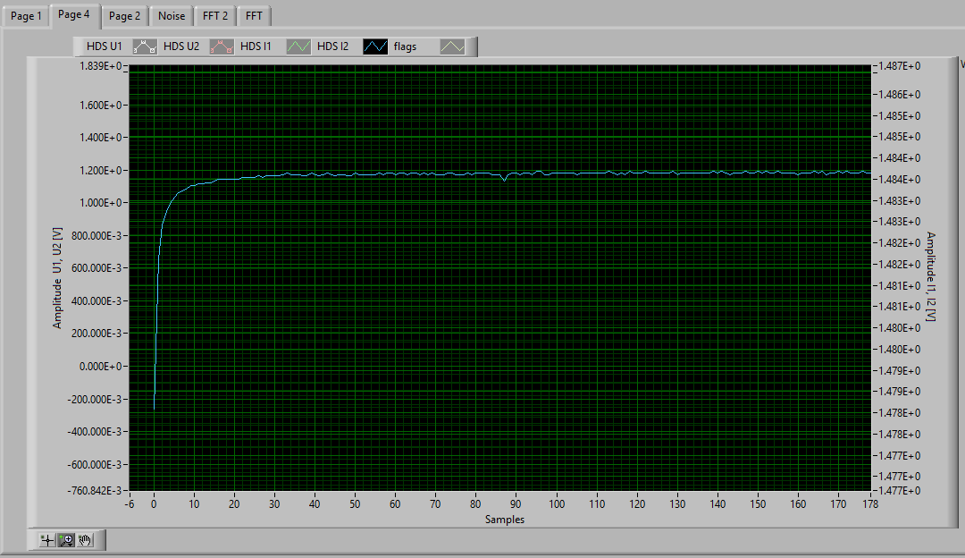
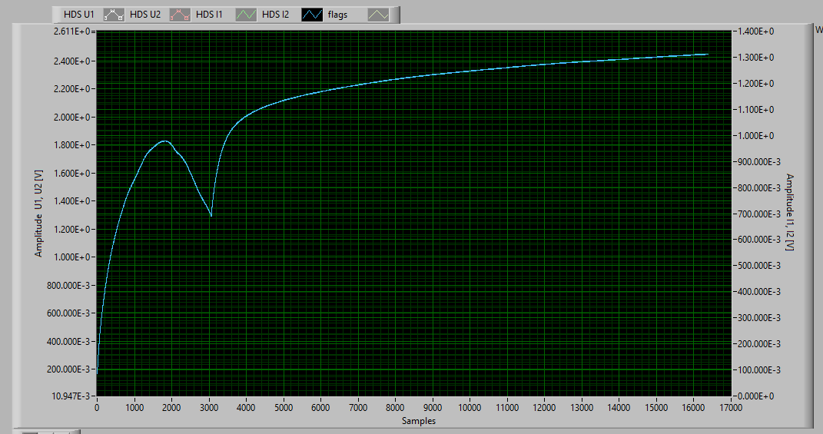
Faulty CSU PCB Boards
The CSU (Crate supervision unit) PCB boards are in charge of measuring different values (power supply voltage, interlock status, etc) and report them back or trigger if a malfunction is detected. However, during testing, some boards were found to have some of those measurement channels misbehaving.

Slide 6
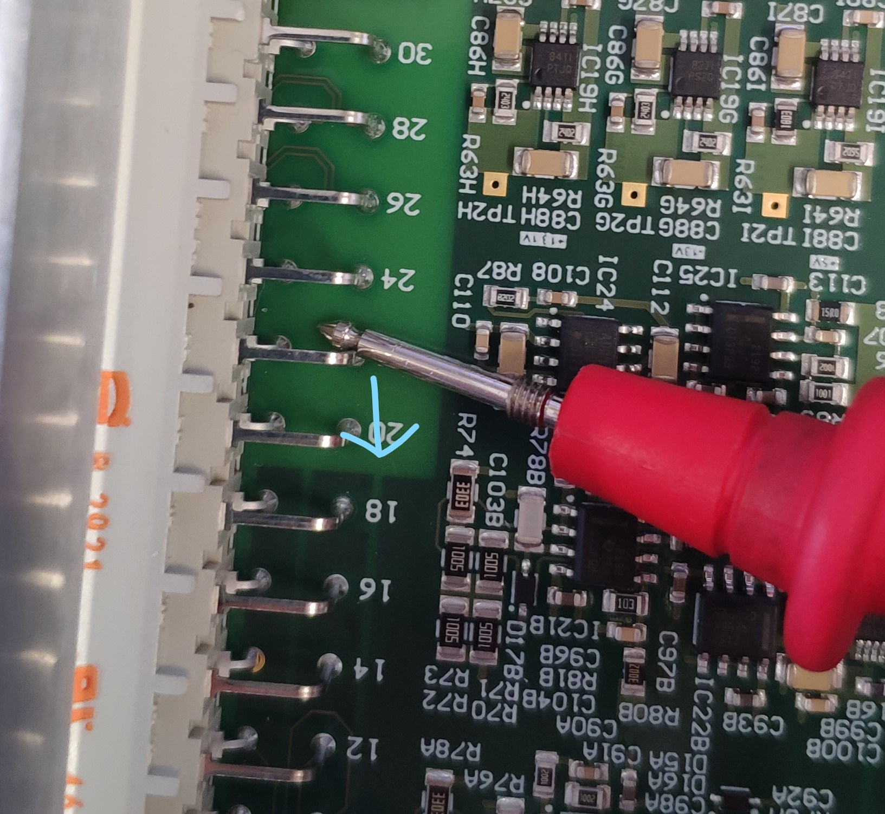
Diagnosis
Through testing on the various PCBs, a common error was detected and isolated to a specific area of the PCB: the connector soldering points. X-ray images of the area were requested, but then COVID19 happened and so far it is on hold.

Slide 7
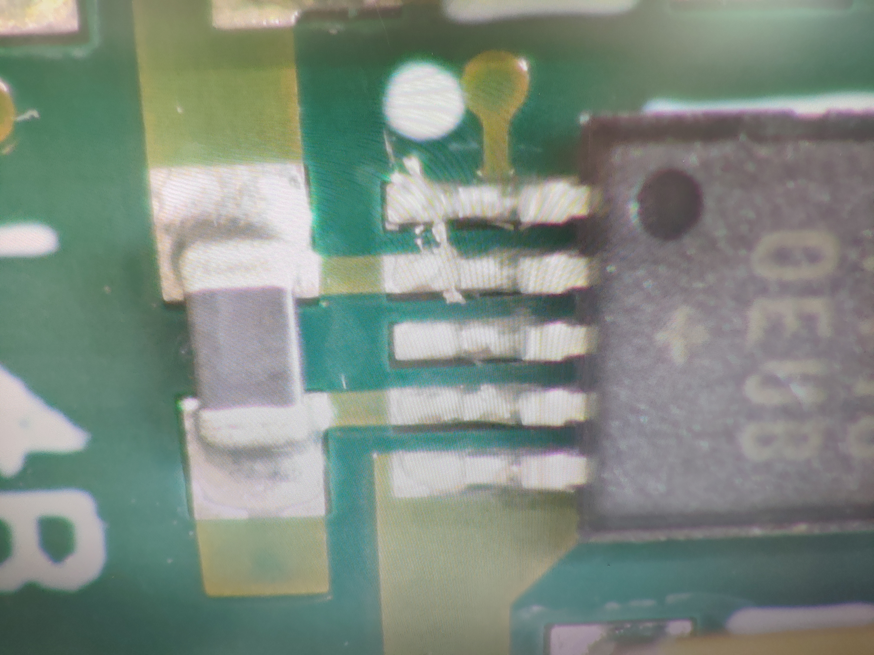
Other errors
Besides that, some common fabrication problems also were detected and fixed on the laboratory like solder bridges or faulty SMD components

Slide 8
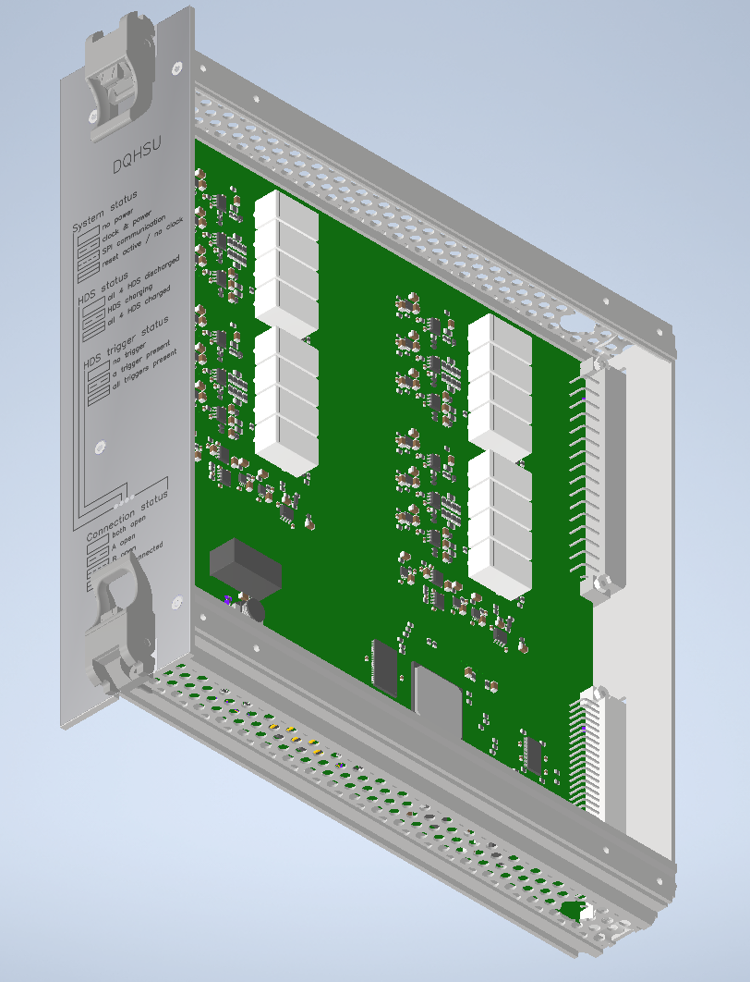
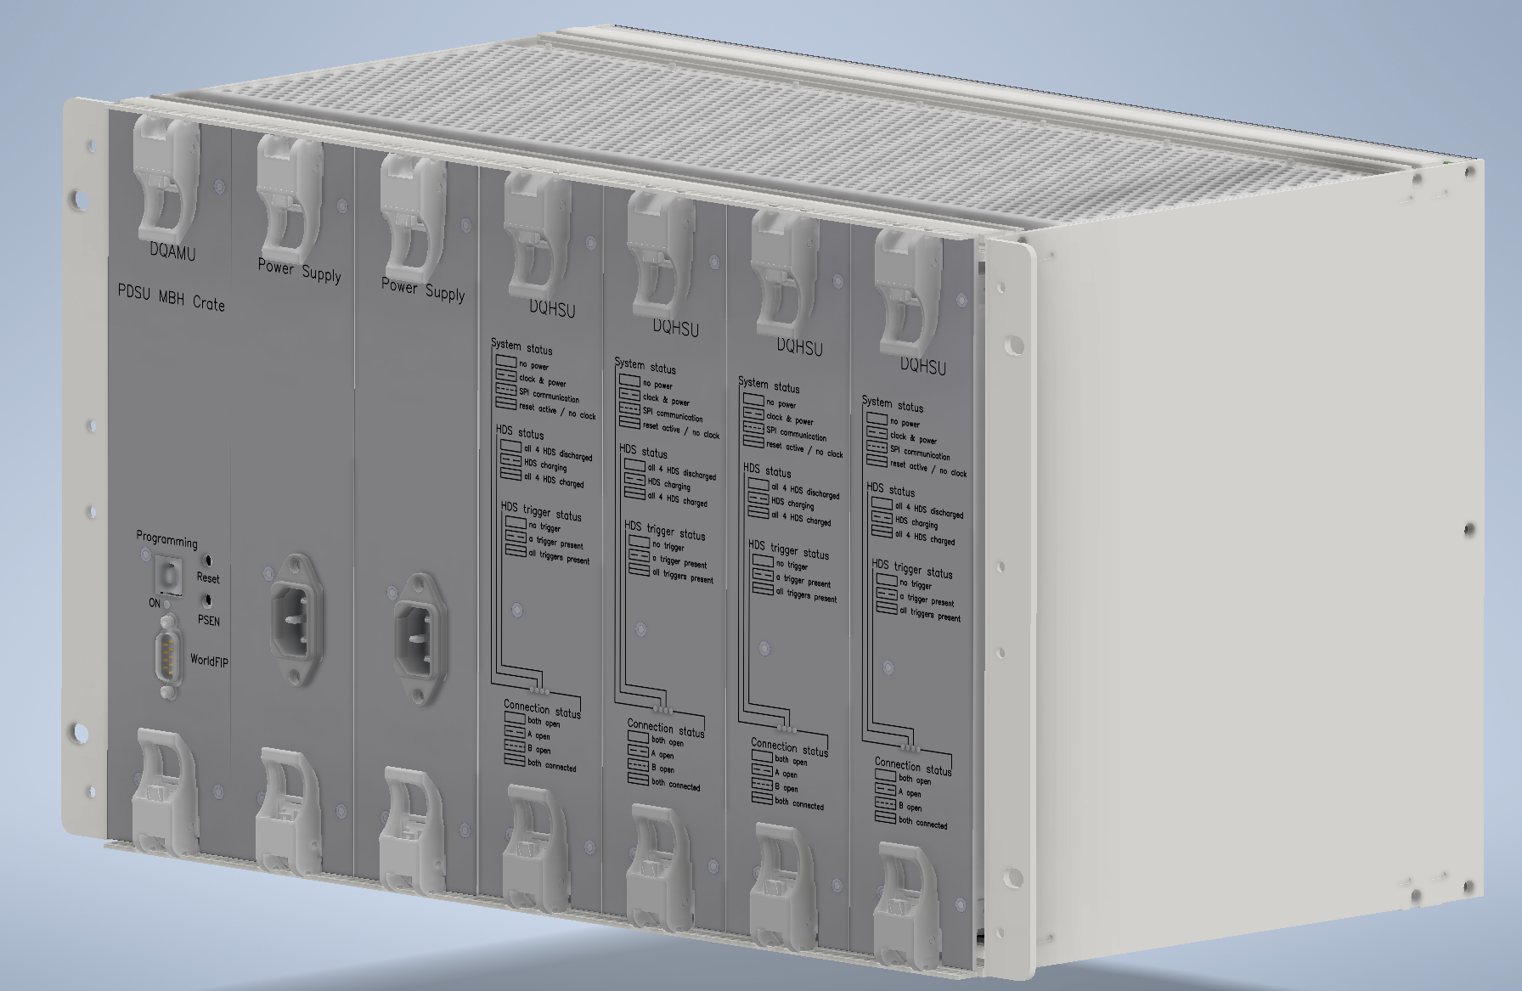
DQHSU Crate mechanical design
Other of my tasks was the design the mechanical enclosure that hosts the HSU (Heater Supervision Unit) and the cassettes that hold the PCBs.

Slide 9
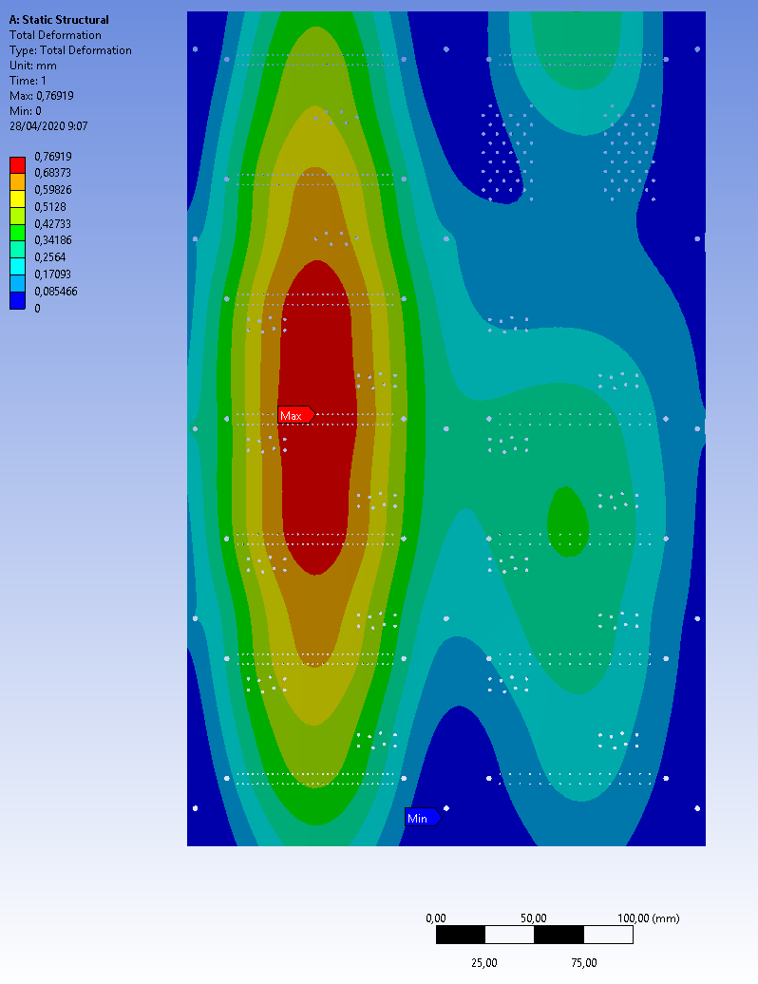
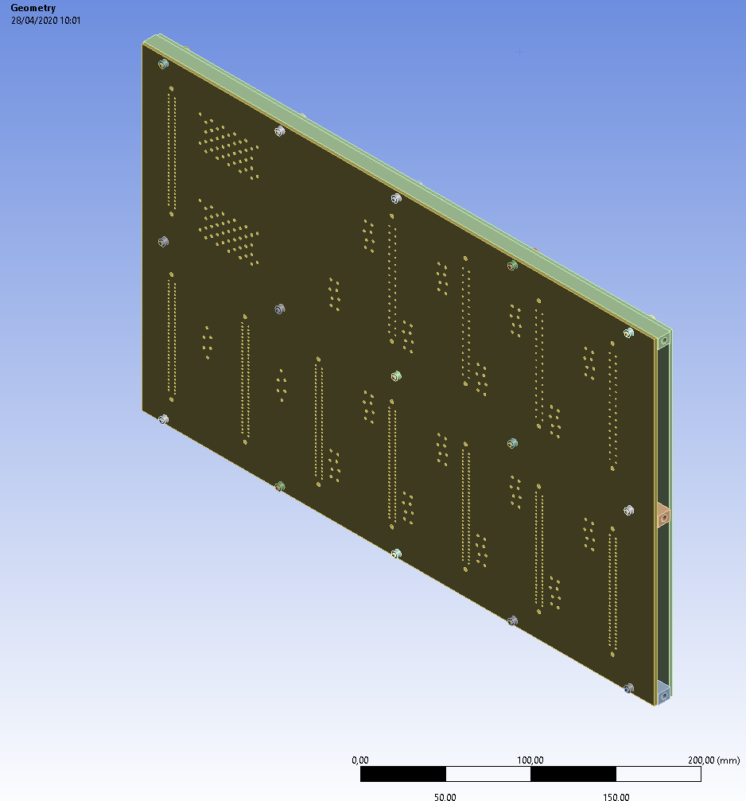
DQHSU Crate mechanical design
This design also involved some Finite Element Analysis of the Backplane PCB (the one that connects all of the cassettes between them) to check the deformation while connecting/disconnecting elements to it.

Slide 10
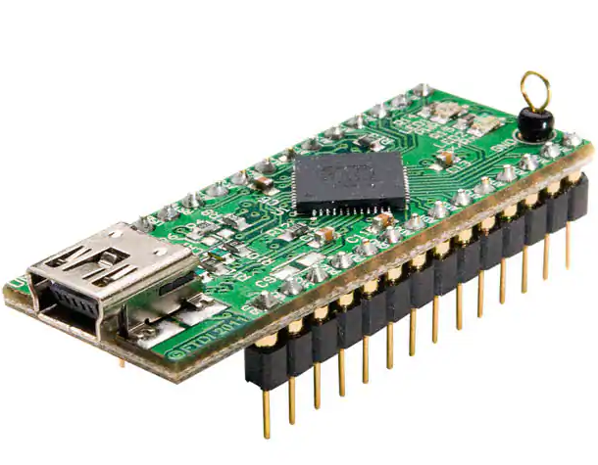
Software improvements.
And now, my main task is to learn how to use and program an FTDI UM232H to make it easier to interface with all of the hardware components of boards like the CSU using the different buses that it allows (UART, SPI, I2C) without complex driver/software changes.

Slide 11
Questions?

