Slide 1



ELECTRONICS ENGINEER IN RADIOFREQUENCY MEASUREMENT
03 FTEC WORKSHOP
Ana Dorda Martín, BE-RF-MK

Slide 2
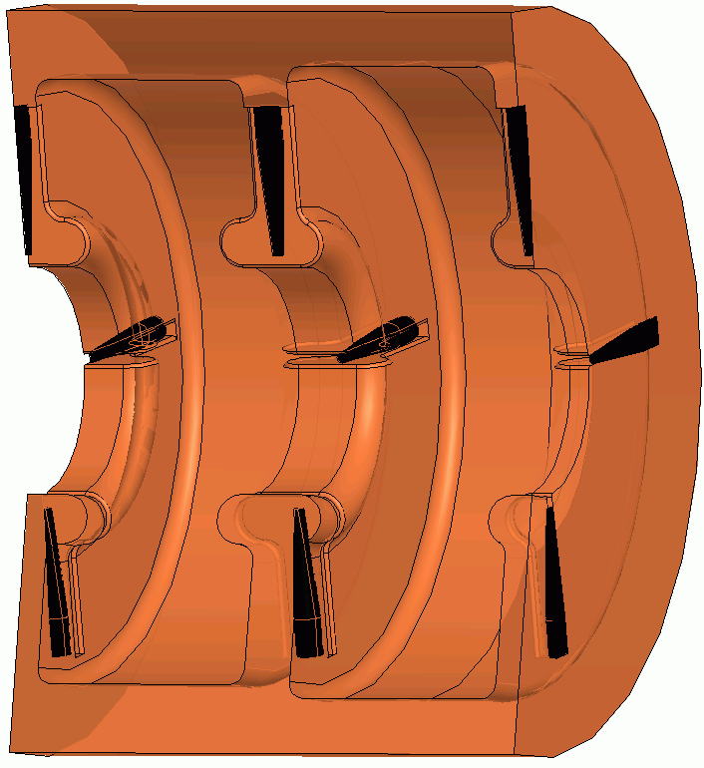
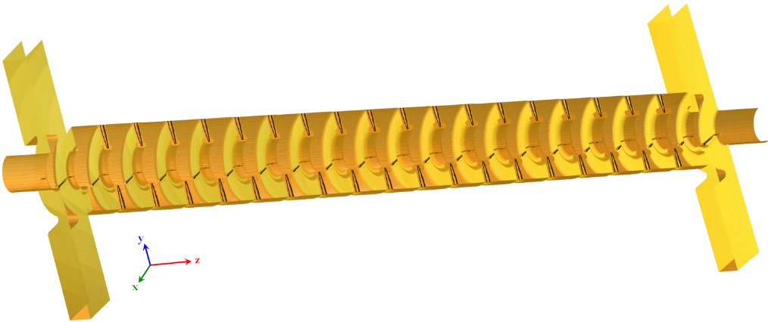


Travelling wave structure for CLIC Drive Beam Accelerator
Full beam loading (over 95%)
SICA (Slotted Iris – Constant Aperture).
Filtering of frequencies ~ 4.1 MHz (filling time around 245 ns)
Reduction of wakefields by damping and detuning.
Input power of 18MW.
2

Slide 3
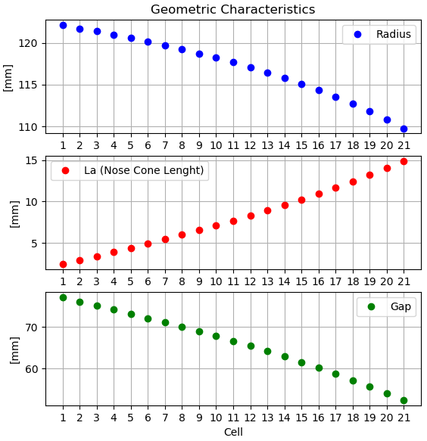
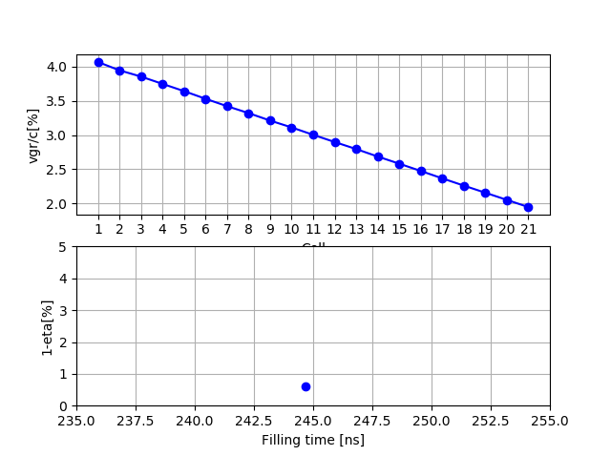
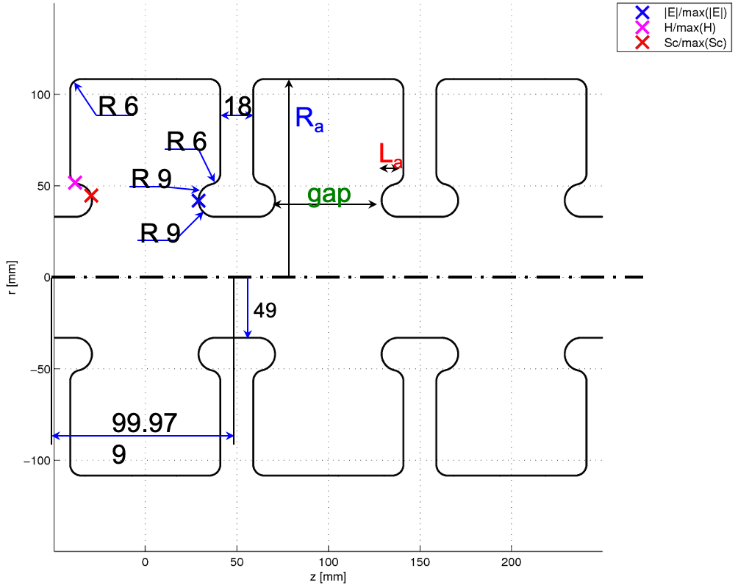
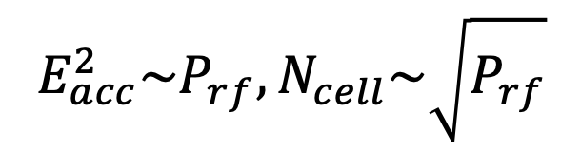
Structure re-optimization
$$E_{acc}^{2}\sim P_{rf}, N_{cell}\sim \sqrt{P_{rf}}$$

Slide 4
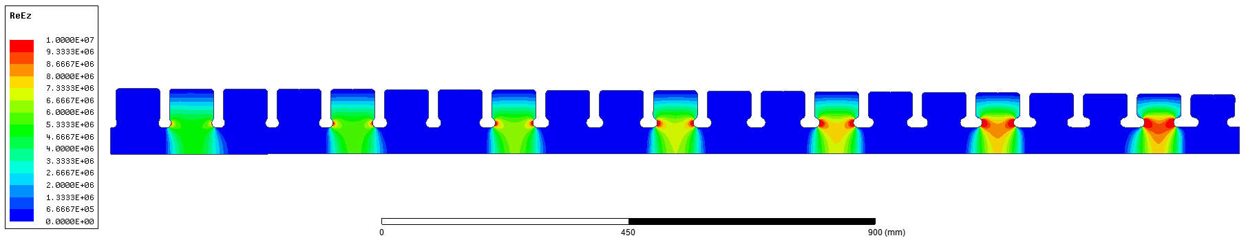
Coupler requirements
S11 lower than -30 dBs at the operating frequency of 999.55 MHz.
S11 lower than -30 dBs in a bandwith of 1 MHz.
Reduction of the dipole kick in the coupler.
Keep the phase advance per cell of 120 degrees.
Here goes the output coupler
Here goes the input coupler
21 cells
4

Slide 5
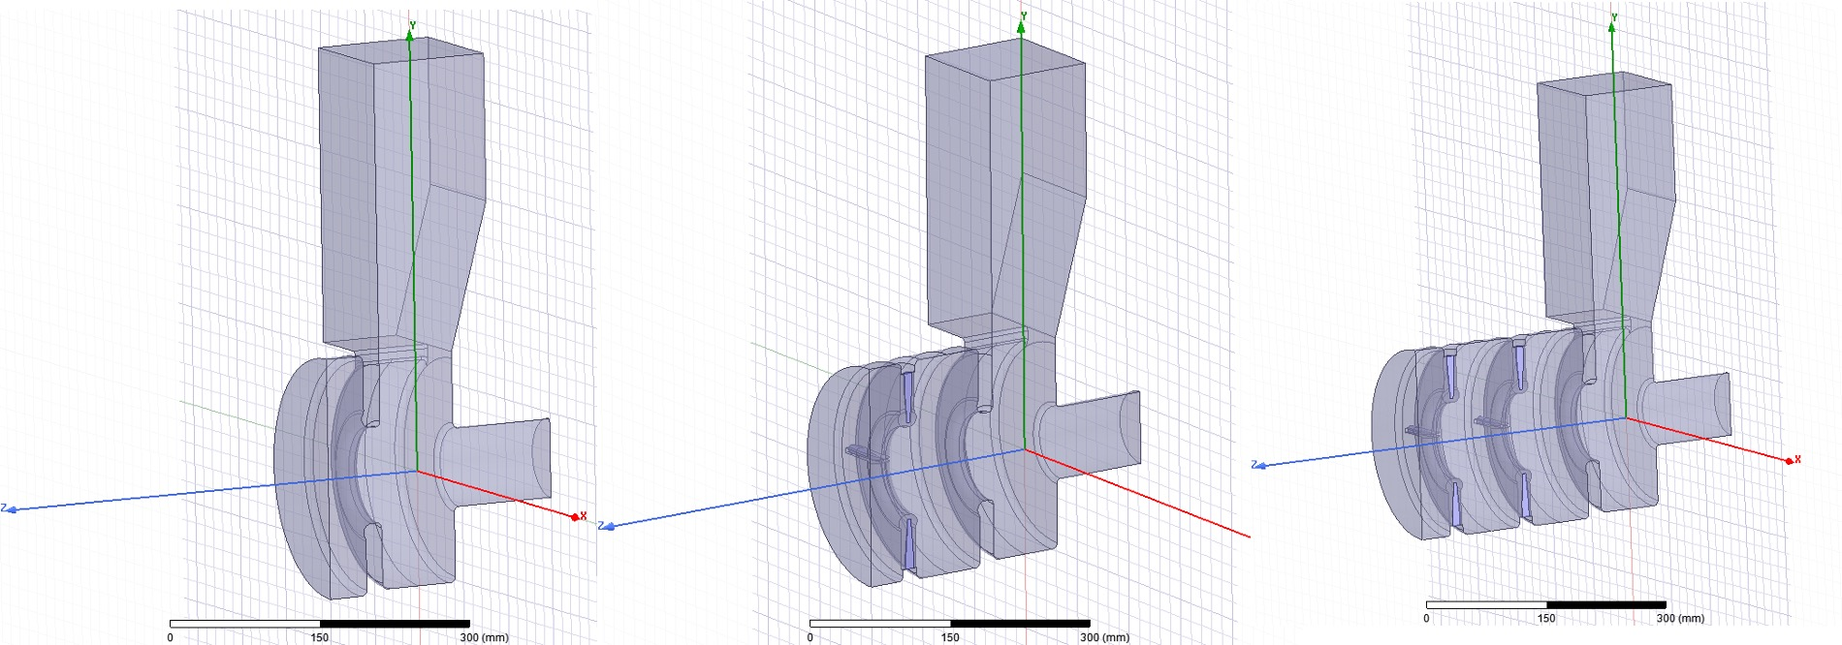

First method (I)
$$α=\left(phase_{cell0}−phase_{cell1}\right)−240$$
$$β=\left(phase_{cell1}−phase_{cell2}\right)−240$$
5

Slide 6
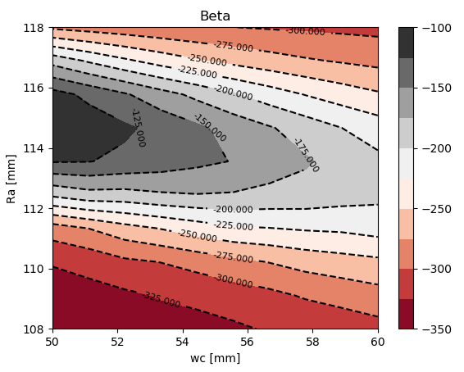
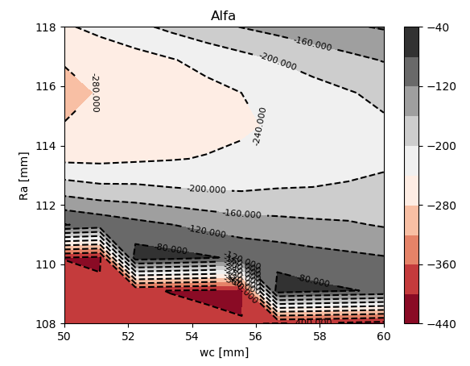
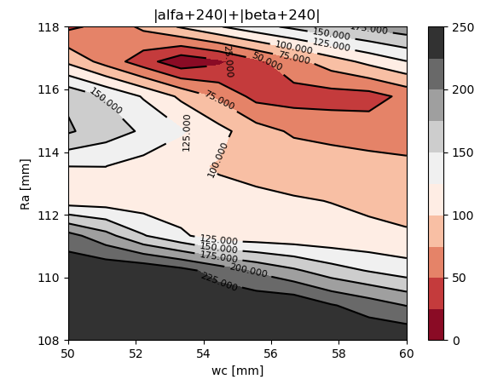
First method (II) : Newton Search
6

Slide 7
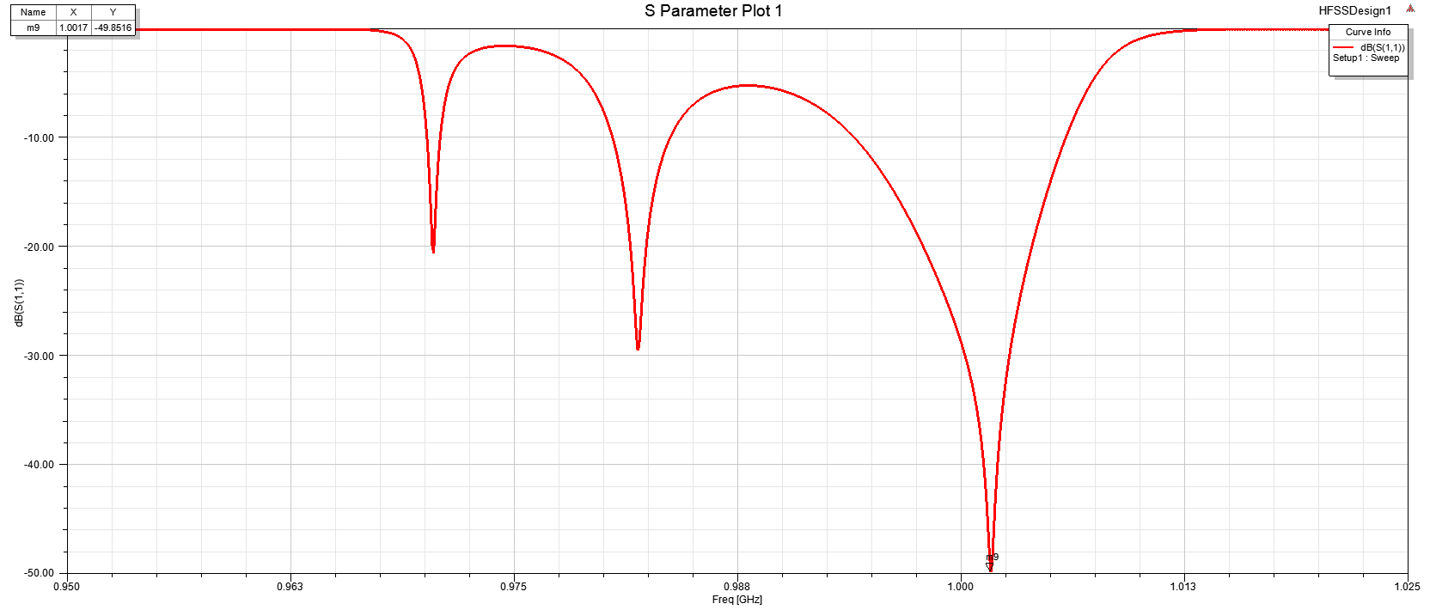
Results with first method
S11 at the bandwith of 1 MHz and the operating frequency of less than -30 dBs.
Problem: three independent simulations were performed.
7

Slide 8
Problem with dipole kick
Coupler’s profile without compensator
Coupler’s profile with compensator
RF Power goes in through here
Field corrected
Field off-centre
Compensator
8

Slide 9
Second method (I)
The new idea is to perform the whole optimization process with one simulation file.
Ra and wc tune the reflection in the coupler.
D tunes the value of the dipole kick.
9

Slide 10
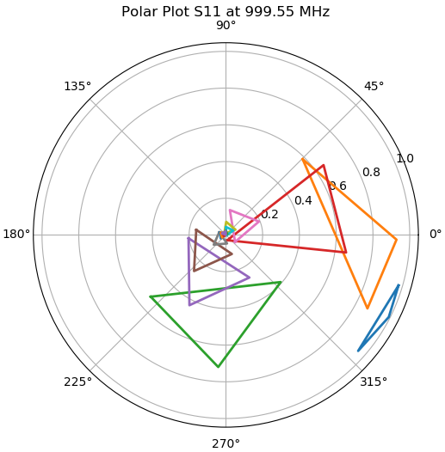
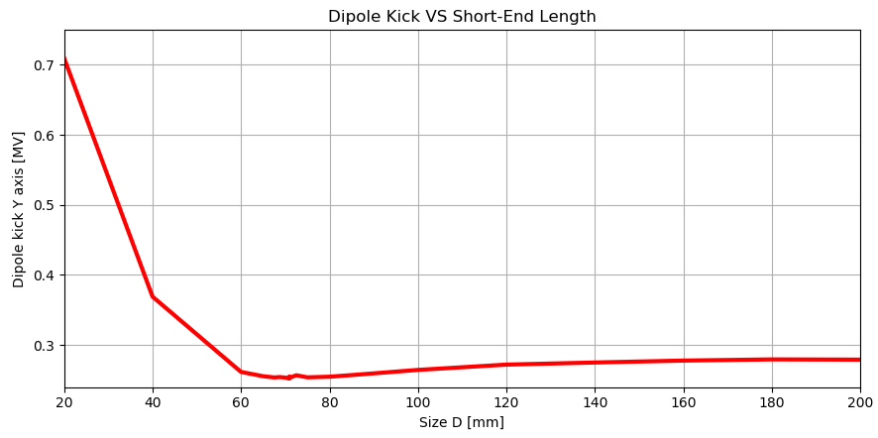
Second method (II): Iteration process
We tune D
Every vertex of a triangle corresponds to the S11 of the coupler with one, two or three cells
We tune wc and Ra

Slide 11
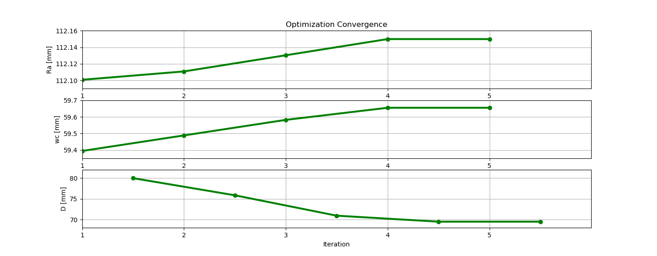
Results with second method (I): optimization convergence
11

Slide 12
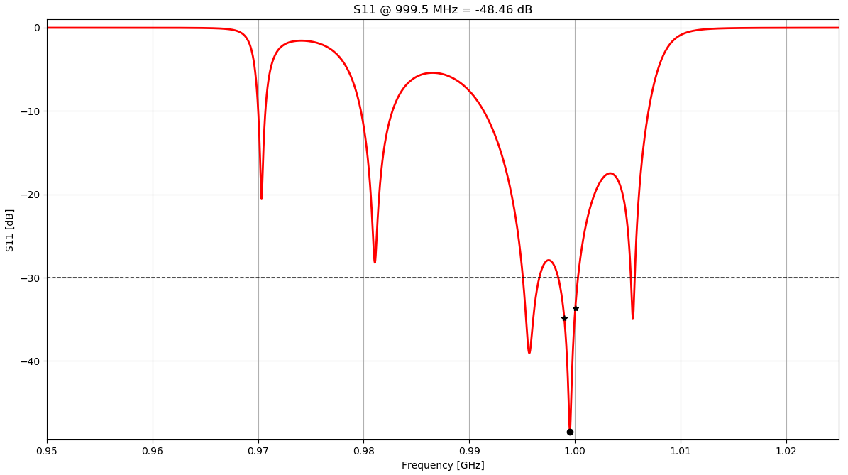
Results with second method (II): reflection
12

Slide 13
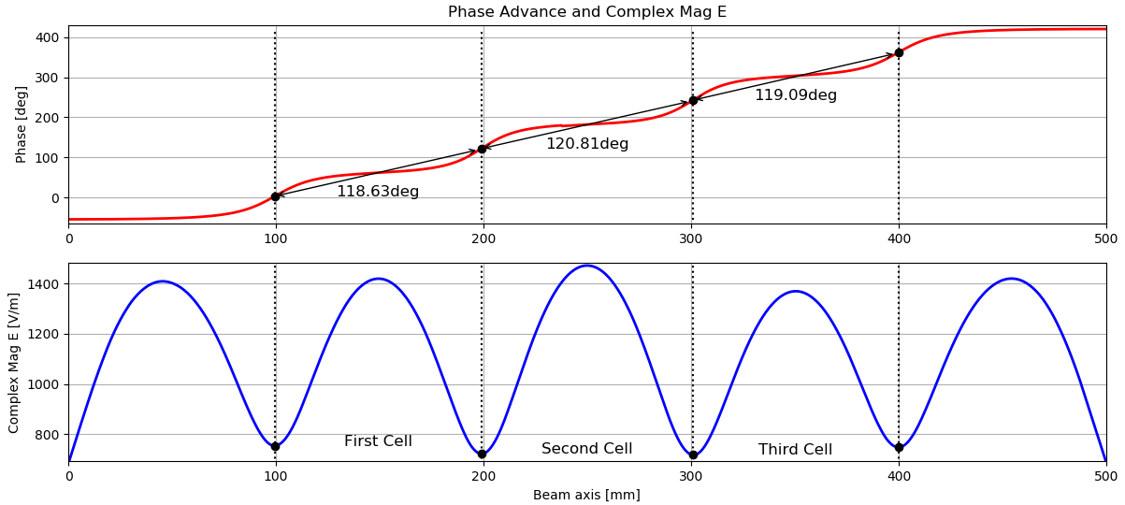
Results with second method (III): phase advance
13

Slide 14
Almost the end of the talk
Other activities during this months (cancelled)
Plan for the next months (hope that they are not also cancelled)
Participation on CERN Accelerator School about RF Basics in Lithuania.
Participation at CLIC Workshop 2020.
Design of the output coupler.
Simulate couplers behaviour with the whole structure and different number of cells.
Preparation of internal report.
Participation at LINAC 2020 in Liverpool.

Slide 15
References
[1] Marinelli, A., Palumbo, L., & Alesini, D. D. (2004). Progetto di un accoppiatore in guida d’onda per una struttura accelerante ad onda viaggiante in banda X. X-band coupler for RF gun master thesis, University of Rome “La Sapienza.
[2] Shaker, S. H., Sanaye Hajari, S., Döbert, S., Dassa, L., & Leuxe, R. (2013). Sub-harmonic buncher design for the CLIC drive beam injector.

Slide 16


Thanks! ☺
16
16
16

