Slide 1



Electronic / Electrical Engineer working on the Development of Quench Protection Systems for Superconducting Magnet Circuits (REF278W)
Miguel León López (TE-MPE-EE)
Supervisors: Félix Rodríguez Mateos, David Carrillo Barrera
10th FTEC Workshop
Monday, May 18, 2020

Slide 2
OUTLINE
  Introduction
  Project 1: DQHDS upgrade within the 11T dipole project
  Project 2: DQHDS for Inner Triplet magnets and Matching Sections
  Project 3: Coupling-Loss Induced Quench (CLIQ)

Slide 3
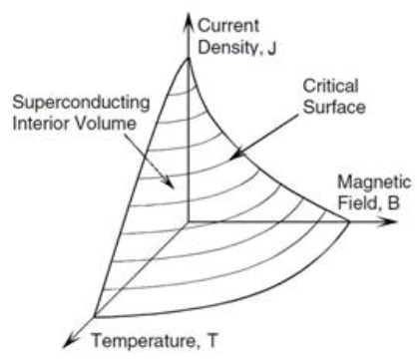
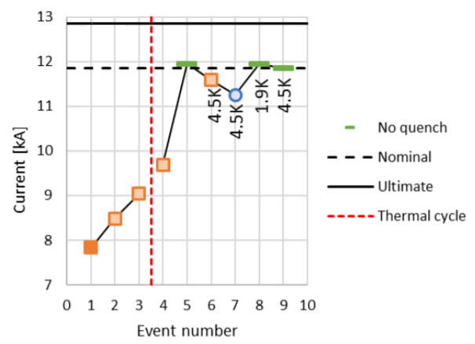
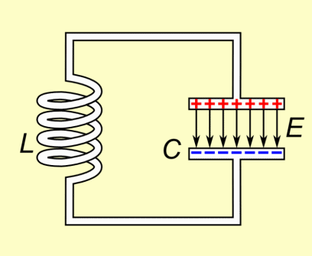
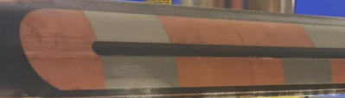
Introduction
  Quench: Transition from the superconducting state to the resistive one.
  Quenches are part of magnets’ lives.
  They are not irreversible, as long as magnets are well protected when they occur.
  Quench protection at the LHC: Bypass diodes, Energy Extraction, DQHDS, …
  For HL-LHC, we are adding CLIQ and designing new DHQDS (higher reliability)
  DQHDS & CLIQ: Capacitor banks discharging their energy into “magnets” to raise their temperature after a quench.
(if not, they can lead to something like this)

Slide 4
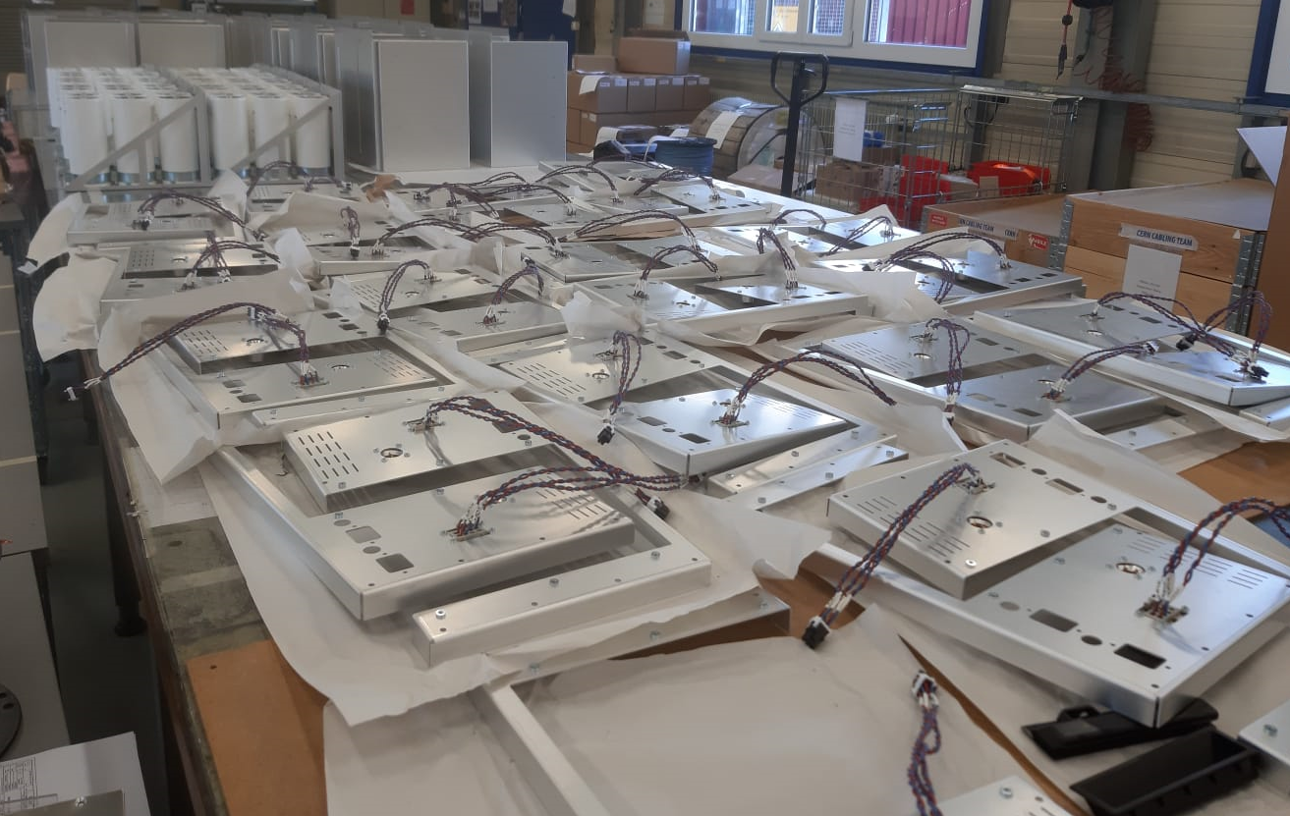
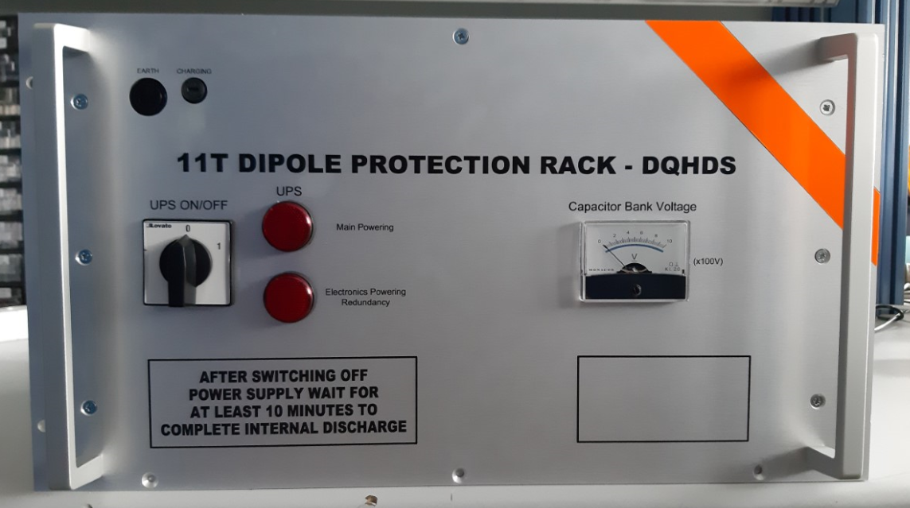
DQHDS upgrade within the 11T dipole project
FTEC 9th workshop
FTEC 10th workshop
05/2019 – 11/2019
After having qualified 2 Prototypes and 1 Pre-Series unit, we gave the green light for starting the production of the Series
Writing a Testing Procedure for these units and preparing a setup for testing them
Installation in the tunnel was planned on 06/2020
11/2019 – 03/2020
Heater strips in 11T magnets came out with lower resistance
Replacement of the step-up transformer.
First samples had some quality issues. We agreed on having the on-site acceptance at their factory.
03/2020 – 05/2020
Reception of the first unit with new transformer model mounted
Most tests have been performed. The last one is currently running.
Test Report and Green light for assembling the Series by 19/05 (tomorrow).

Slide 5
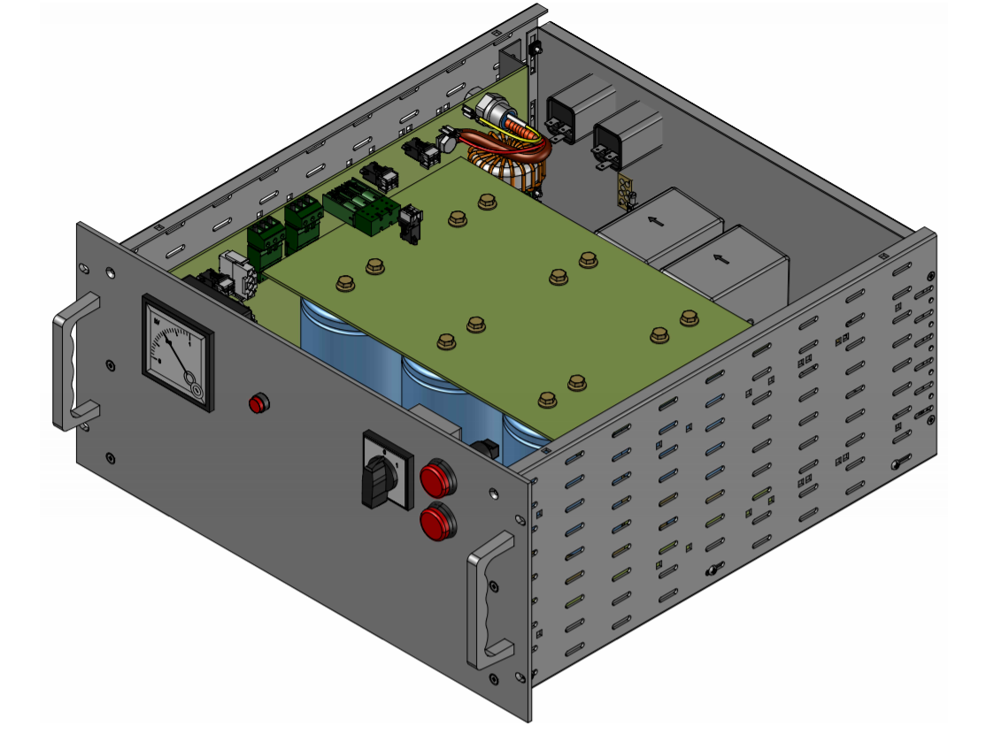
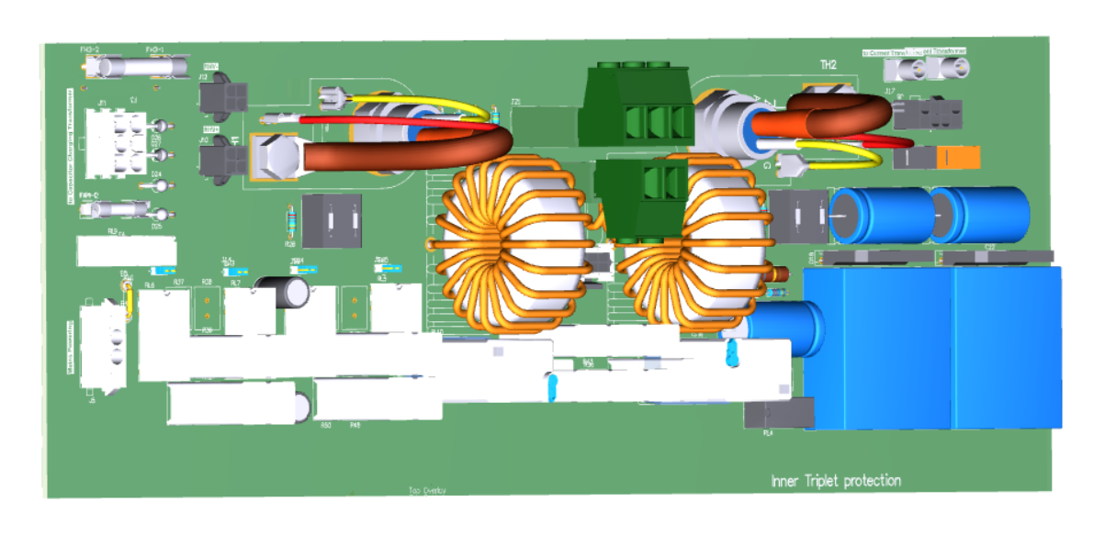
  DQHDS for Inner Triplet and Matching Sections
FTEC 9th workshop
FTEC 10th workshop
05/2019 – 11/2019
This project was at a very early stage (installation during LS3)
CERN designs the units and makes some prototypes, then Japan will build the Series.
Requirements for these units:
11/2019 – 05/2020
Review the schematics.
Documentation of all findings and modifications proposal.
Selection of components and integration in the new standard crates
Interactions with EN-EA-AS (assembly team) and TE-MPE-EM (design team).
Present the new design during the (Conceptual) Design Review (06/2020)
First prototype to be built at CERN by 07/2020
      Courtesy of Jérémy Kuhn
Equal or higher reliability & additional safety functions.
Allow for different capacitor sizes.
Cheaper, lighter, only standard components.

Slide 6
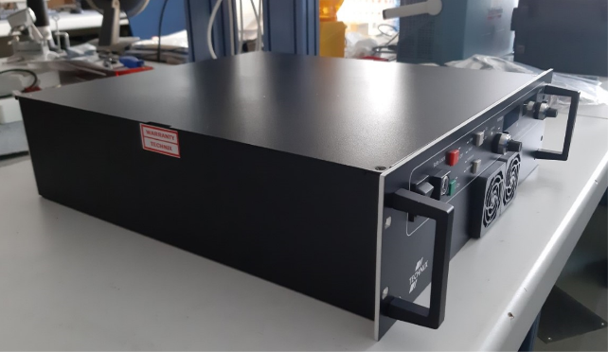
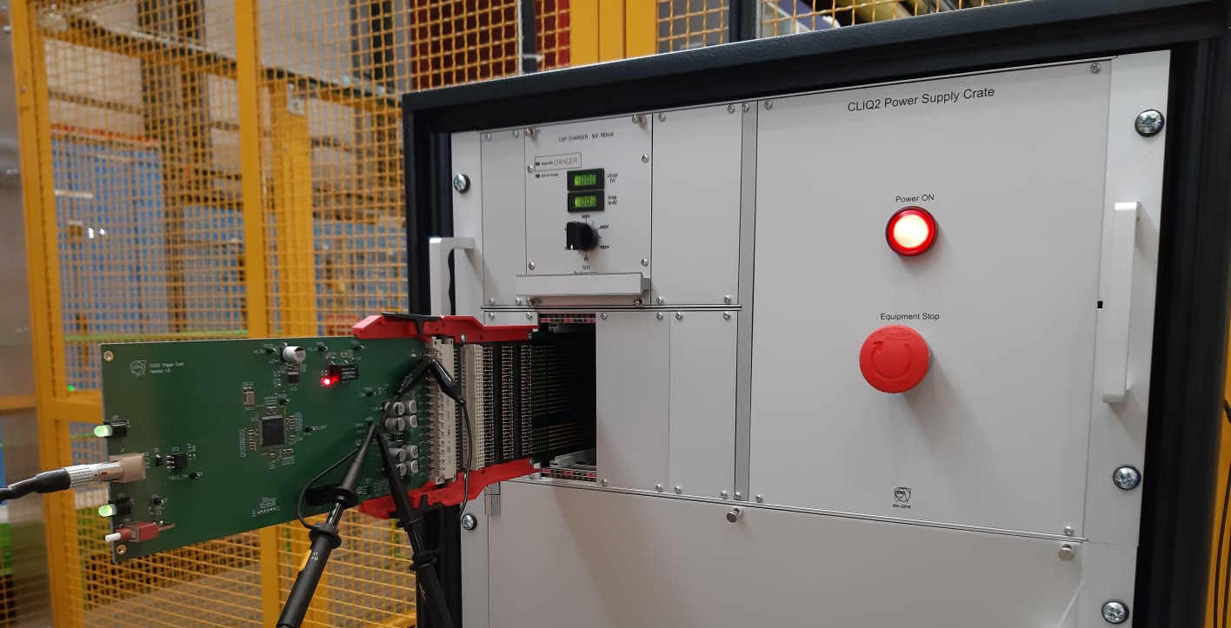
  Coupling-Loss Induced Quench (CLIQ)
FTEC 9th workshop
FTEC 10th workshop
05/2019 – 11/2019
Two different COTS capacitor chargers were selected and ordered.
The preferred one had already been fully tested and qualified.
I started working on the electronics of CLIQv3 units.
11/2019 – 05/2020
Reception, (re)calibration and qualification of the second charger.
Interacting with a firm for CE marking of CLIQ
Design of the “disconnection circuit” of CLIQv3 units
Testing of CLIQv2 Trigger and Pulse Transformer Cards
11/2019 – 05/2020
Conceptual Design Review:
Reliability Run of CLIQv2-3:
Presentation of the chargers and disconnection circuit
Technical Secretary
Documentation of the Review and Executive Summary
Definition of signals to be monitored and equipment needed.
Design of a box that enables automated testing of CLIQ (ongoing, with Josep G.)

Slide 7
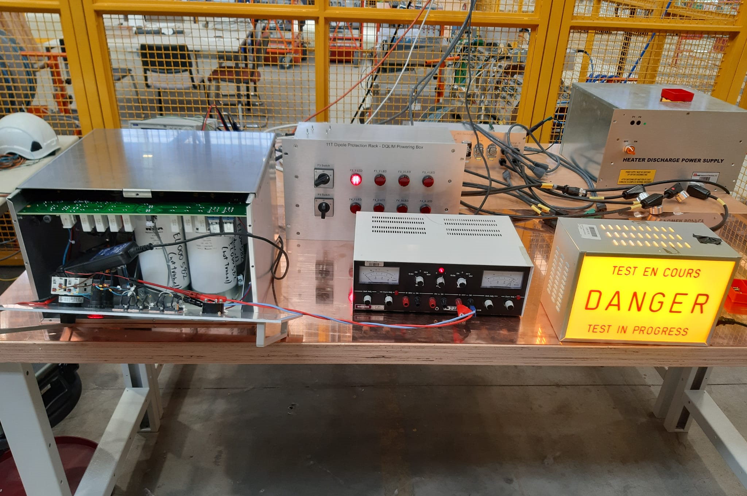
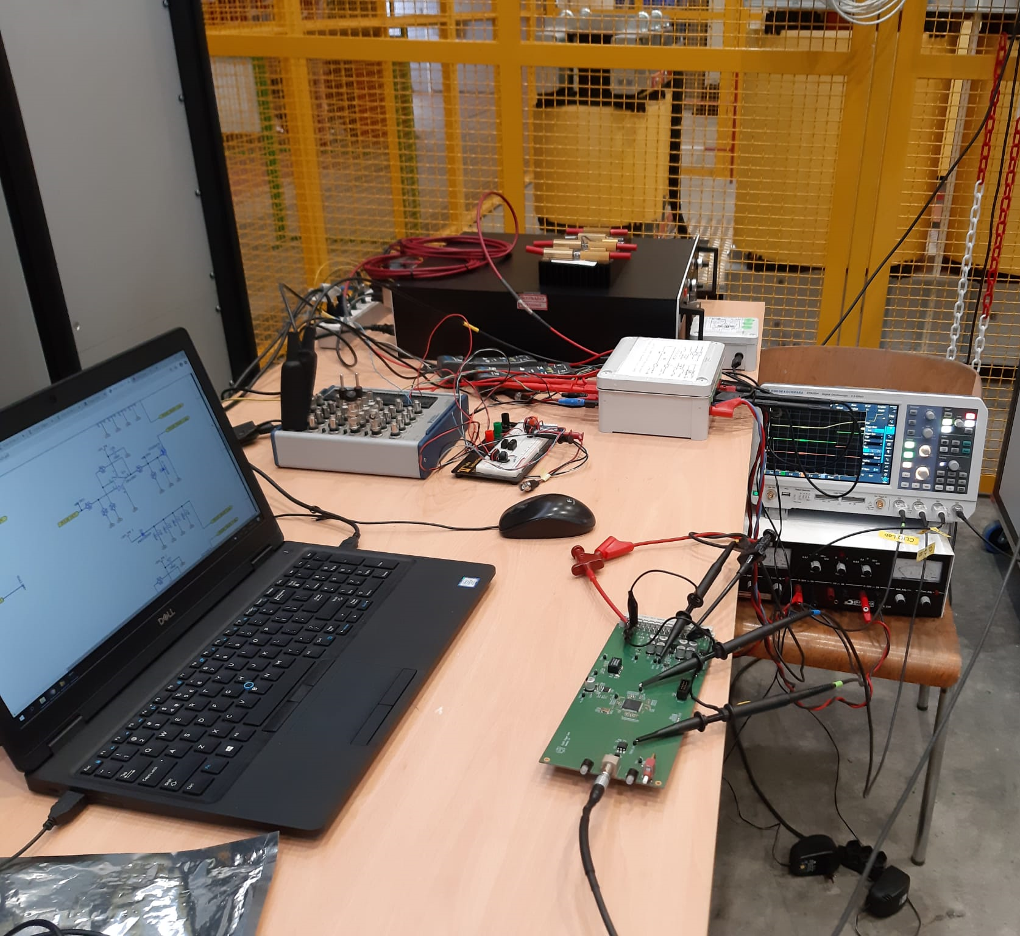
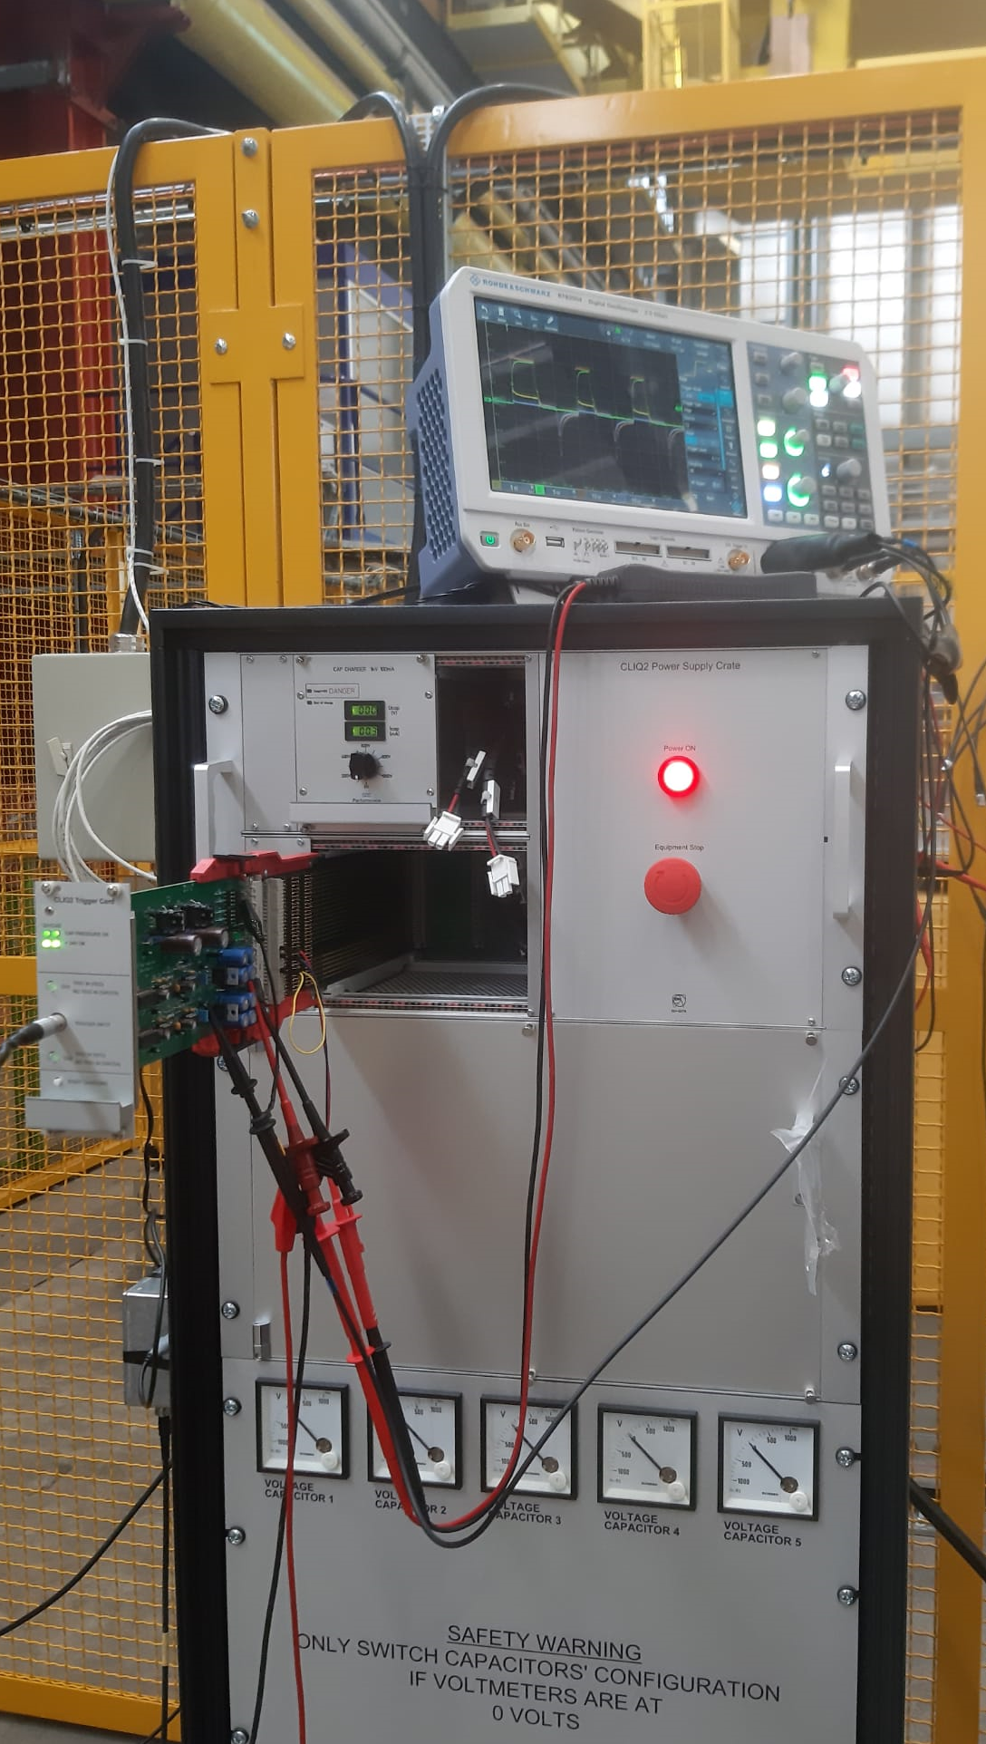
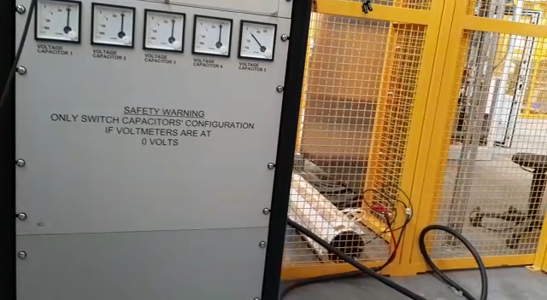
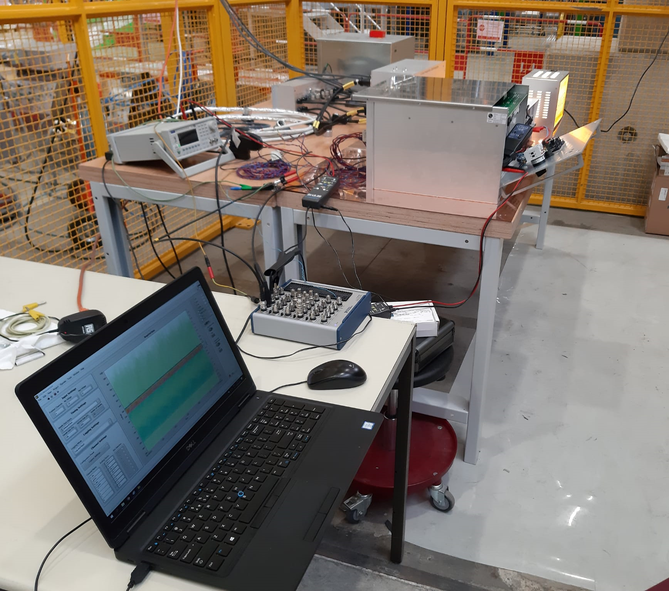
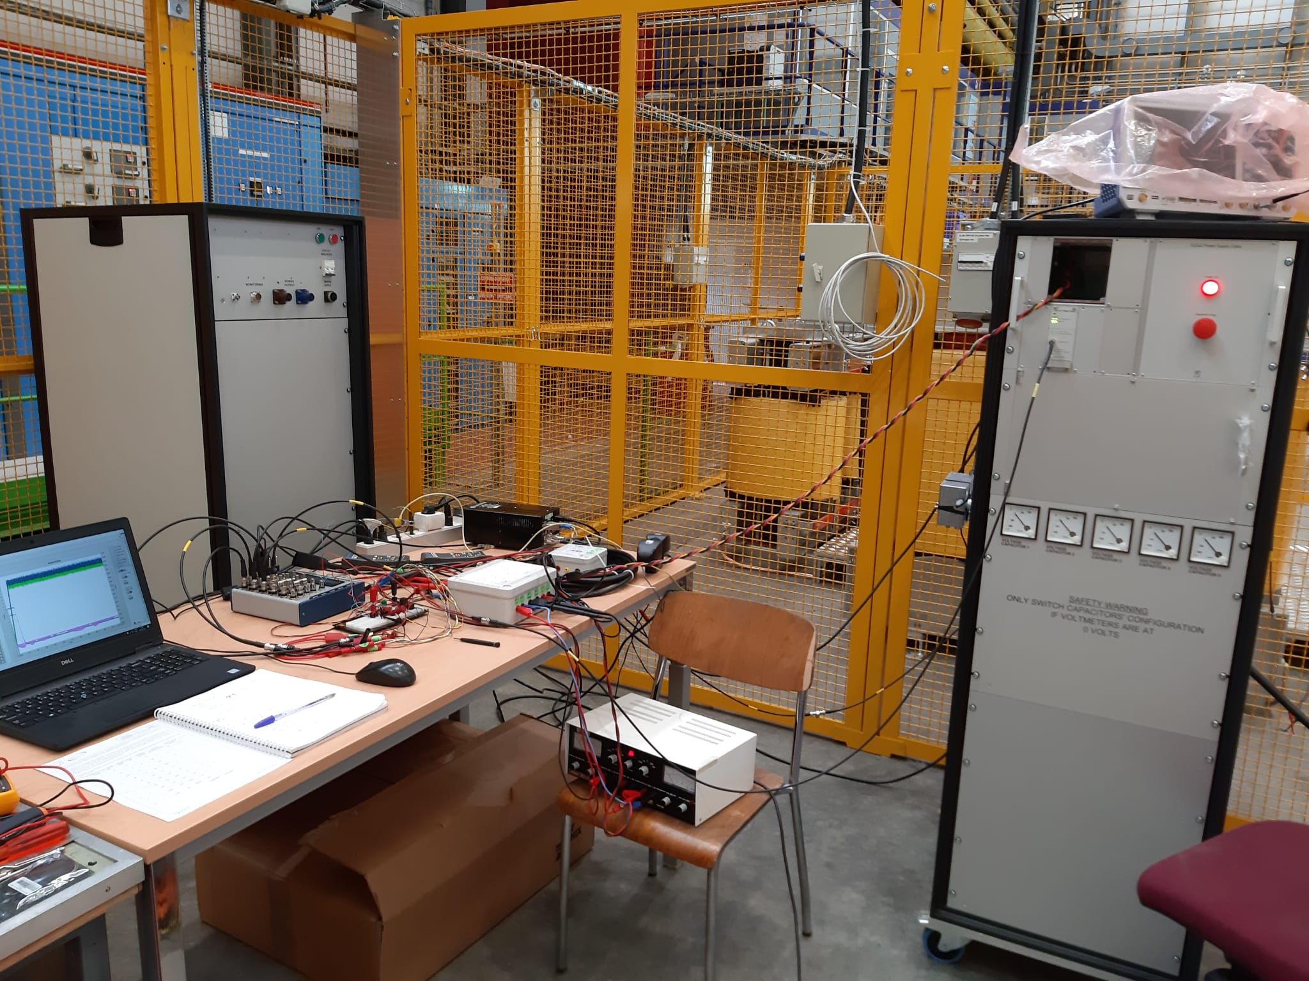

Slide 8
Thank you for your attention
Questions?

