Slide 1

10th FTEC Workshop
Cryogenics for the HL-LHC IT String
Óscar Durán Lucas
TE-CRG-ME - A. Perin (supervisor), G. Rolando, M. Sisti, A. Wanninger, J. Mouleyre, J. Metselaar
CERN, 18th May 2020
INDICO: 915648

Slide 2
Outline
Overview of the HL-LHC IT String
Cryogenic system for HL-LHC IT String
Update on technical tasks
Update on management tasks
Upcoming activities

Slide 3
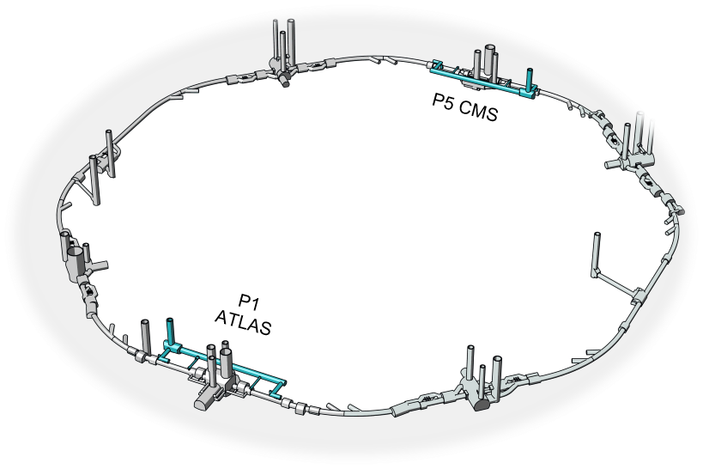
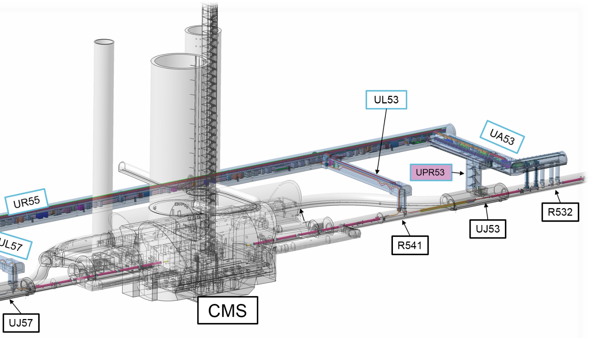
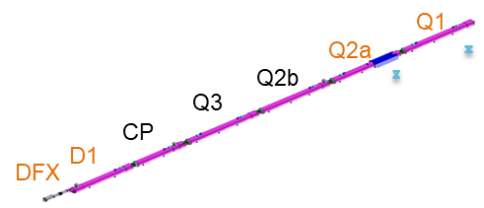
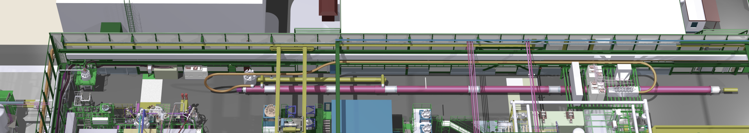
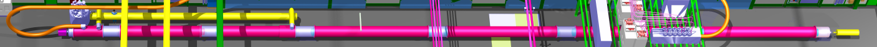
Overview of the HL-LHC IT String
The final focusing superconducting inner tripplet (IT) magnets of ATLAS and CMS of LHC will be replaced during LS3.
HL-LHC IT String will be installed in SM18 facilitiy for testing the collective behaviour of magnets and systems, get information to speed up the commissioning in the LHC tunnel and configuration of IP5L.
View of LHC and IP5 with location of IT magnets
*Images from CRG-TM presentation,
INDICO 797080
Integration of IT String in SM18

Slide 4
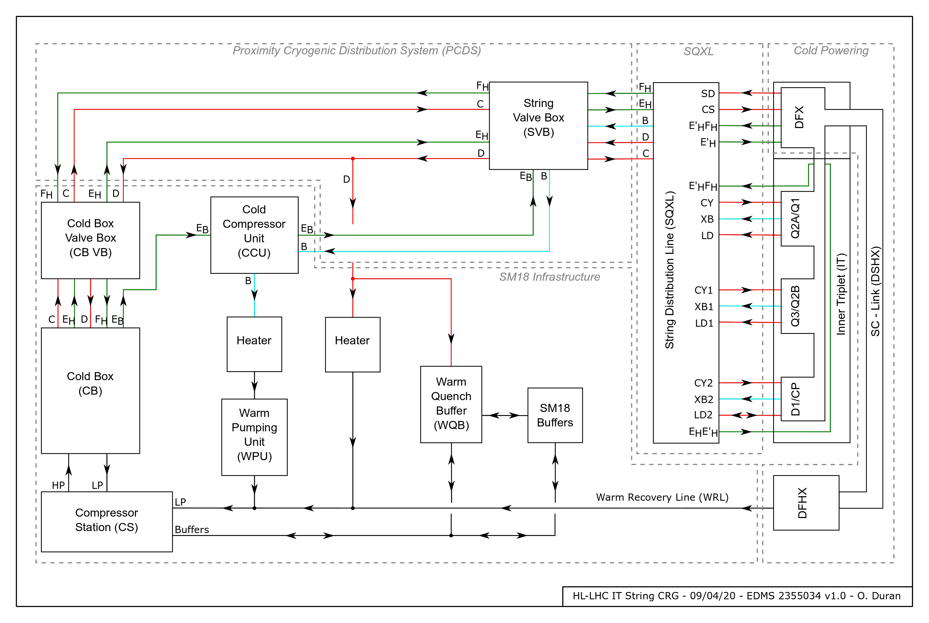
Cryogenics system for HL-LHC IT String
Main functionalities of the cryogenic system:
Representative of tunnel configuration
Controlled cool-down & warm-up
Magnet operation in He II (1.9 K)
Pressure relief during quenches
Ultimate heat load capacity of bayonet heat exchangers

Slide 5
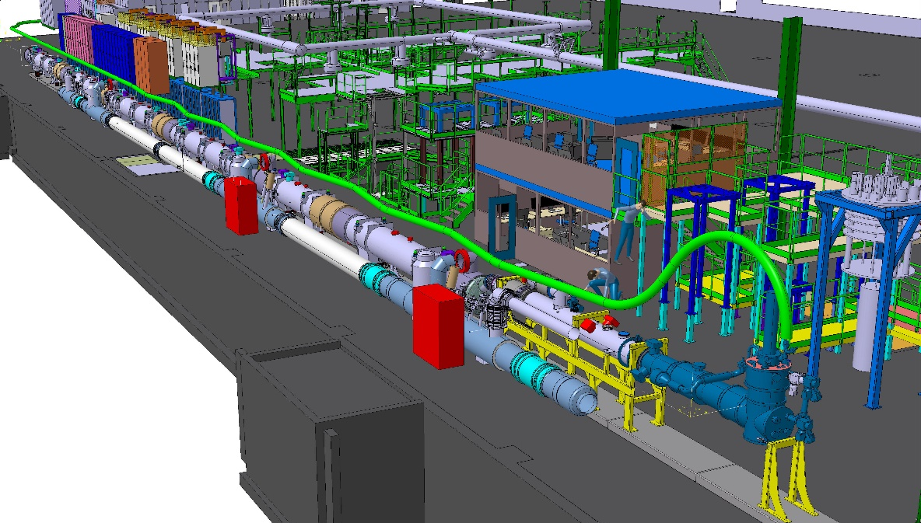
Cryogenics system for HL-LHC IT String
Layout of equipment in SM18
Cryogenic transfer lines
SQXL
Magnet cryostat
Cold Box
SQXL
Cold Compressor Unit
String Valve Box
*Images from TCC presentation,
INDICO 891644

Slide 6
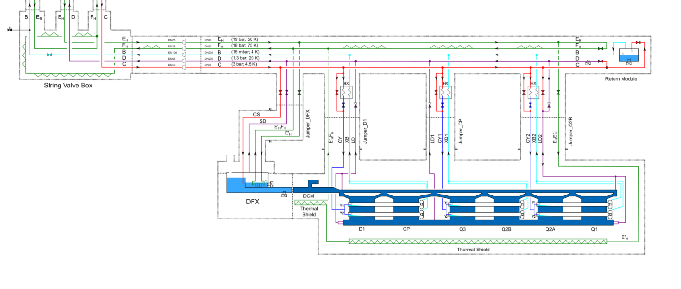
Technical tasks
Safety system dimensioning for overpressure scenarios in the 5 process lines:
Lose of insulation vacuum (LIV) → Heat load to He → Pressure increase → He release through Safety valves
Safety valves on String Valve Box → Verification of pressure upstream
Safety
Valve
Control Valve
LIV
Dimensioning of cryogenic control valve on pumping line
Pressure model of the system to calculate the pressure drop requirements of the valve
Selection of a Kv able to regulate all operation modes
Calculation of the volume of the system for purge requirements

Slide 7
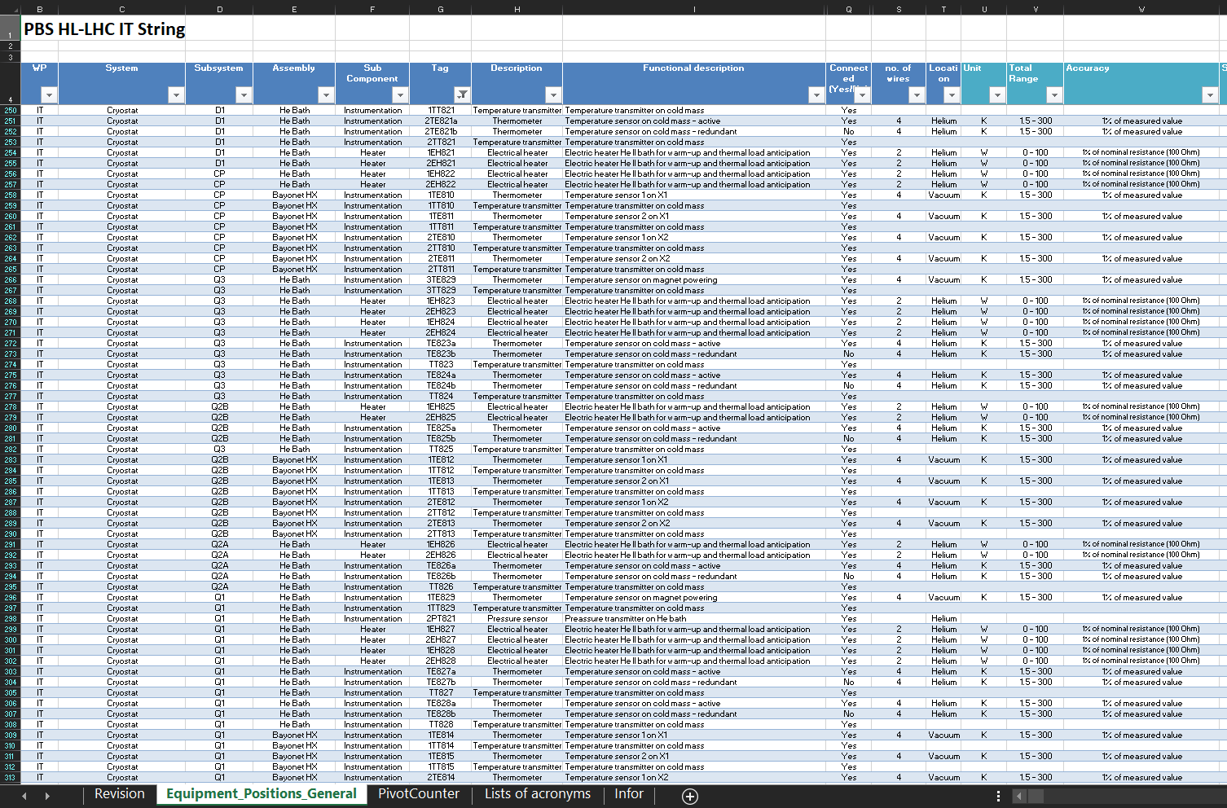
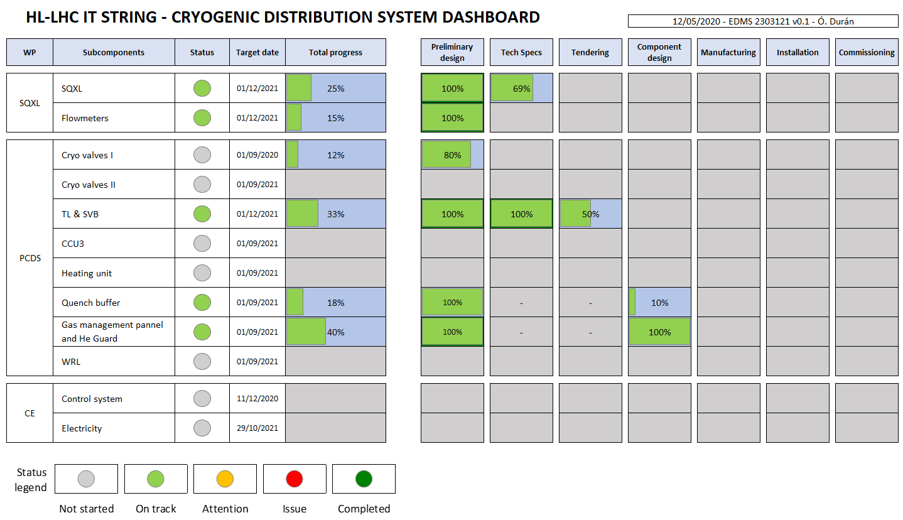
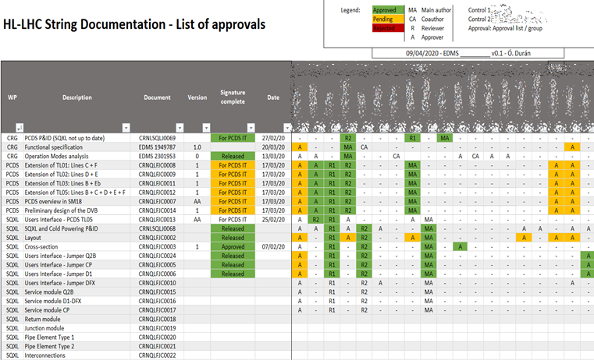
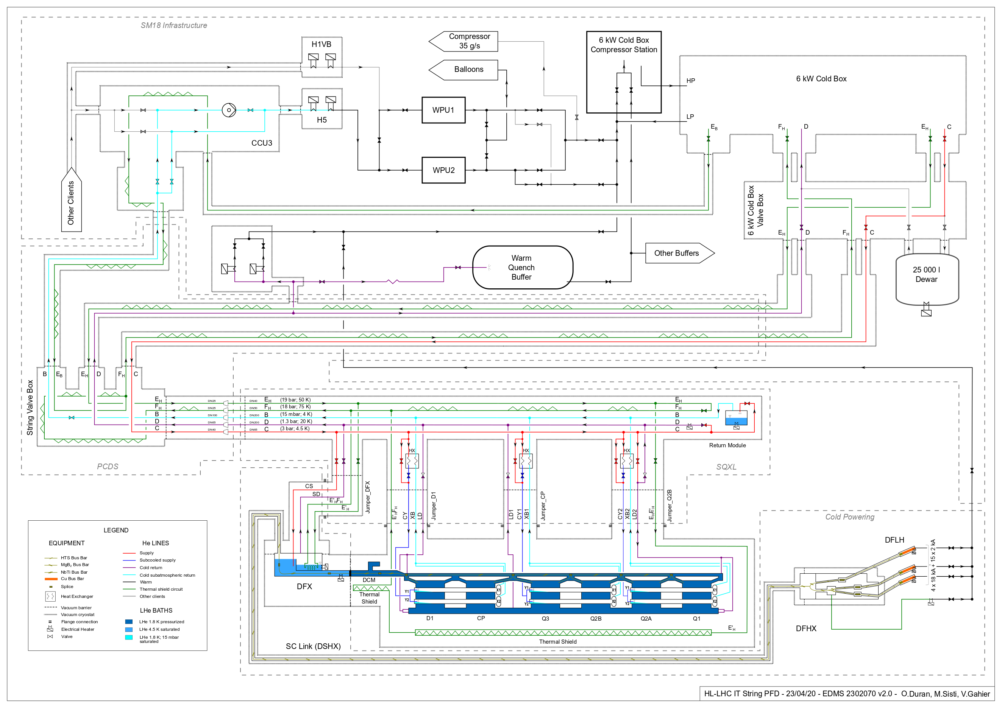
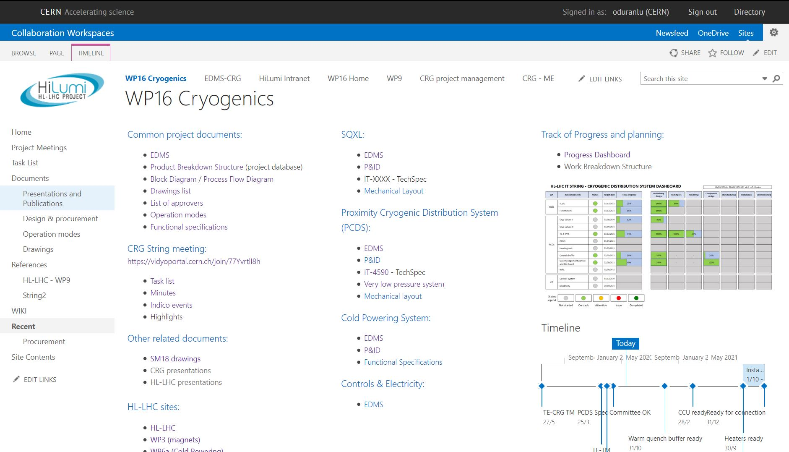
Management tasks
Completion of Product Breakdown Structure
Data base including complete cryogenic distribution of the project
~900 items, MS Excel Pivot Table
Reference document for instrumentation procurement, control architecture, naming convention
Dashboard of progress
Follow-up of the project
List of approvers
Follow-up of document approval process
Project diagrams
Block Diagram
Update of Process Flow Diagram
Continue with other management tasks
Meeting organization and minutes
Update project sharepoint webpage

Slide 8
Upcoming activities
Heaters unit
Valves dimensioning
Technical Specification for heaters and heater vessel
Risk analysis
Management tasks
Finalization of Product Breakdown Structure
Follow-up of the project (Dashboard, list of approvers, work breakdown structure, purchase)
Meeting organization and minutes
Update and improve project sharepoint webpage
Others

Slide 9
Thanks for your attention!
Questions?
Ó. Durán Lucas, 10th FTEC Workshop, 18.05.2020

