Slide 1


FTEC Workshop May 2020
Mechanical Engineer for the design and constuction of high power
Radio Frequency devices RF
15/05/2020
sonia.garcia.scheifler@cern.ch
1/15

Slide 2
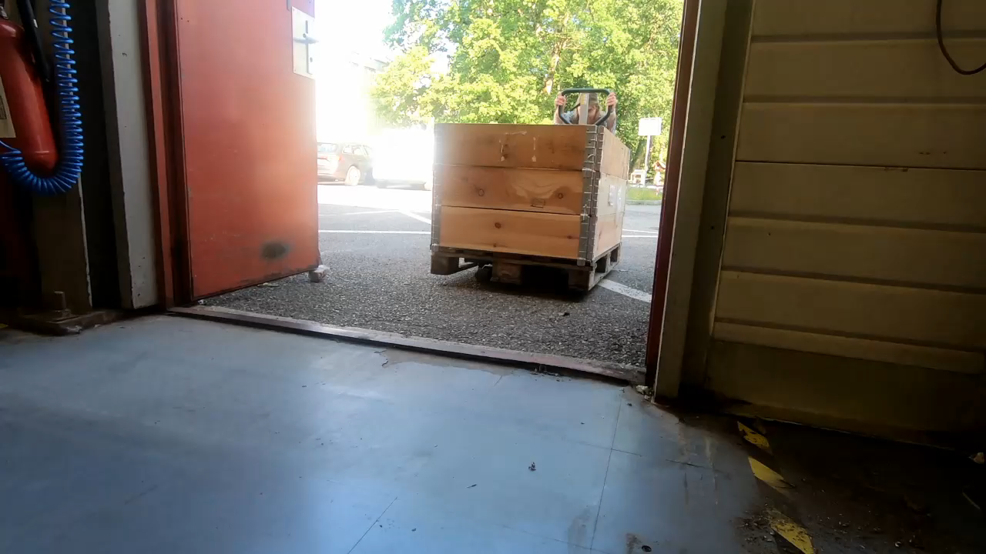
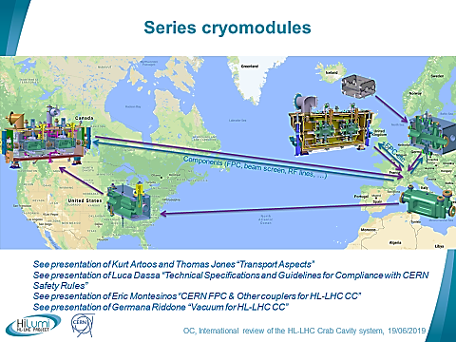


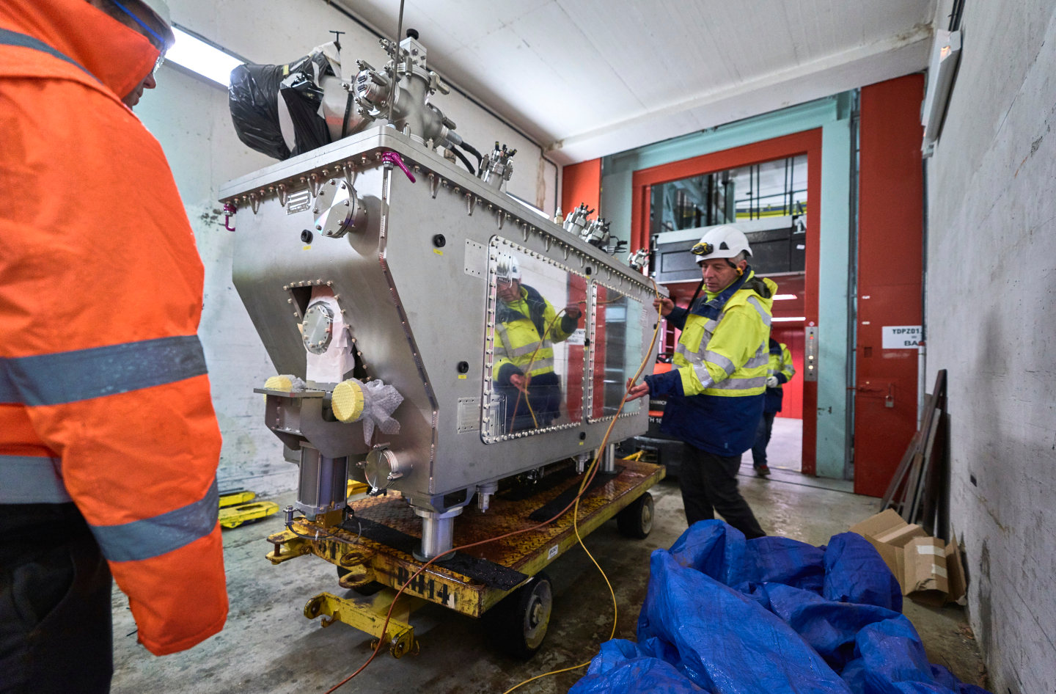

Drop test background
·· Cryomodule DQW SPS ··
·· Series Cryomodules ··
15/05/2020
sonia.garcia.scheifler@cern.ch
2/15

Slide 3
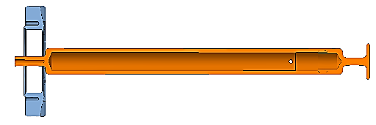
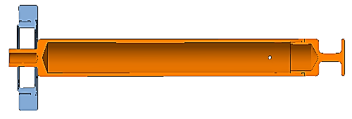
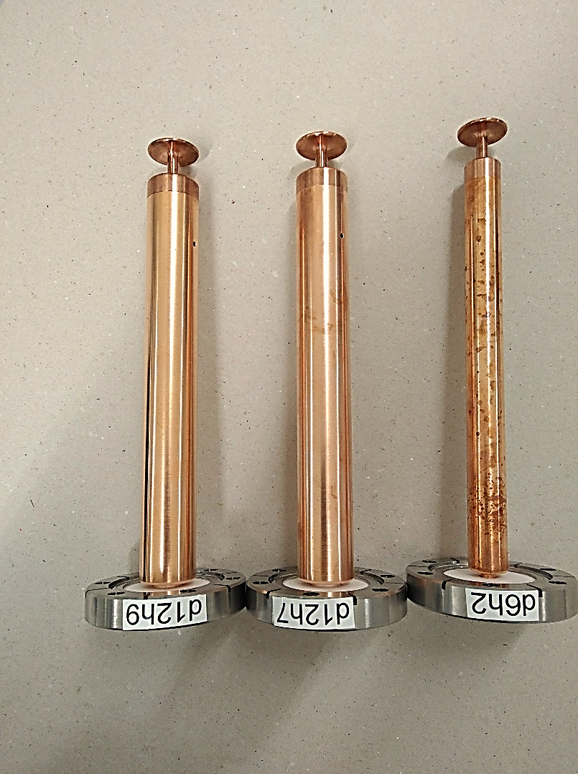

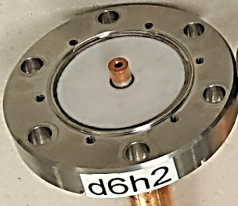




Thermal shock and drop tests of the ceramic
The main objectives are to validate:
The non-rupture of ceramic
The absence of plastic deformation
The 25 ohm-design
Design:
d6h2
d12h7
d12h9
Impedance:
50 ohm
25 ohm
Model:
The thickness of the copper tube is a key parameter :
Excessive Impossible to be brazed
Limited Feedthrough insufficiently reinforced
✓
15/05/2020
sonia.garcia.scheifler@cern.ch
3/15

Slide 4




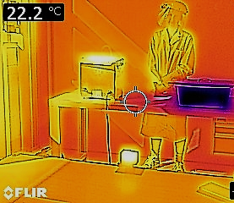
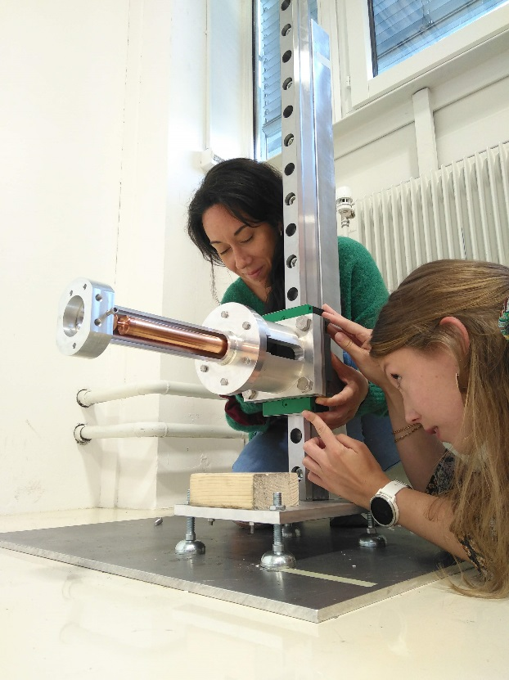
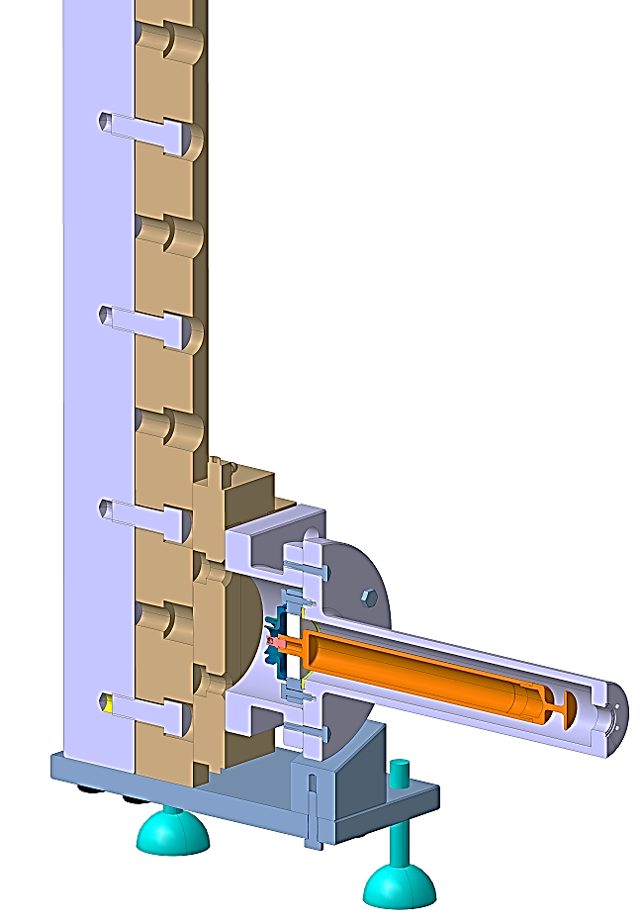
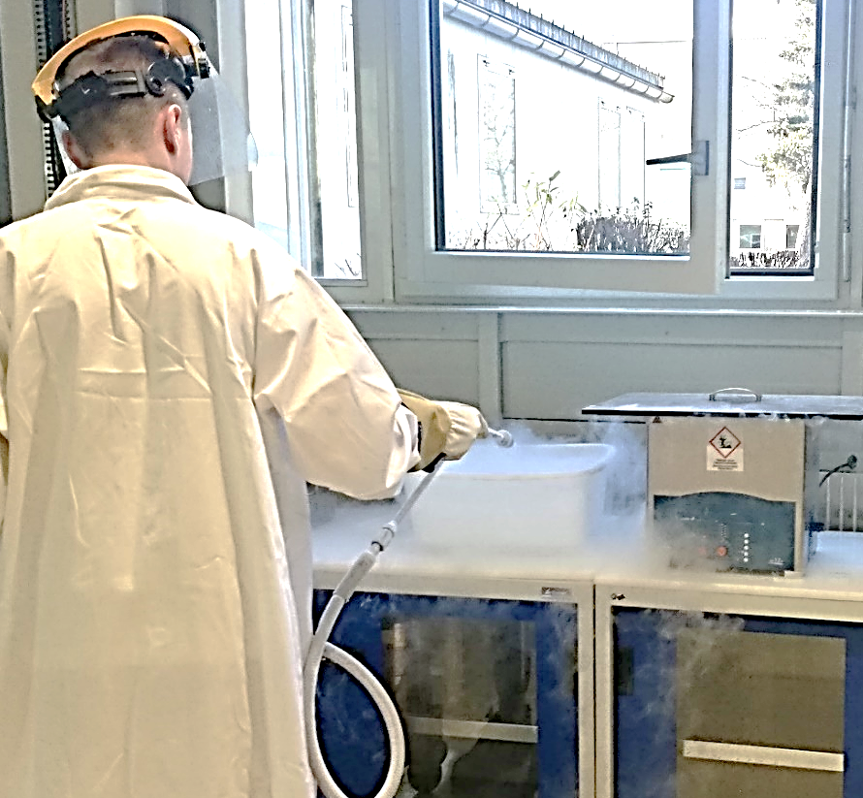
Thermal shock
drop
Thermal shock and drop tests of the ceramic
1
2
·· Nicolas Villanti ··
·· Frida Eriksson & Sonia García ··
15/05/2020
sonia.garcia.scheifler@cern.ch
4/15

Slide 5
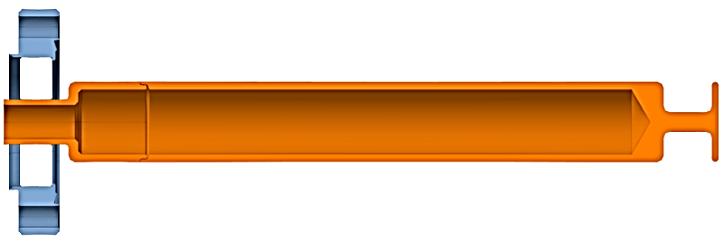
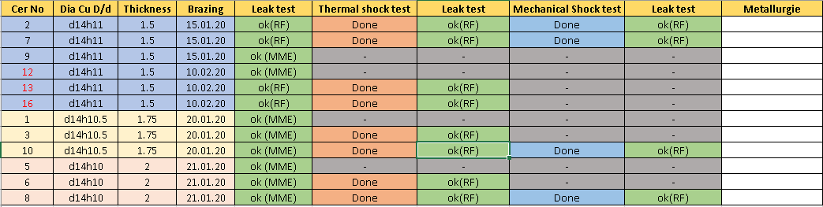
Thermal shock and drop tests of the ceramic
STEPS FOR VALIDATION
LHCACFHC0246
1
2
3
4
5
6
15/05/2020
sonia.garcia.scheifler@cern.ch
5/15

Slide 6
Mechanical
Thermal
shock test results
Design | Cr No
d14h11 | 2
d14h11 | 7
d14h10.5 | 3
d14h10.5 | 10
d14h10 | 6
d14h10 | 8
d14h11 | 13
d14h11 | 16
Leak test (date and signature) | Thermal shock test (date and signature) | Leak test (date and signature) | Comments
27/01-20 Sebastien Calvo/Sonia Garcia | 27/01-20 Nicolas Villanti/Sonia Garcia | 28/01-20 Sonia Garcia | We changed the seal after the thermal test because with the same seal there was a leak
04/02-20 Sonia Garcia | 04/02-20 Nicolas Villanti/Sonia Garcia | 04/02-20 Sonia Garcia
04/02-20 Sonia Garcia | 05/02-20 Sonia Garcia | 05/02-20 Sonia Garcia
05/02-20 Sonia Garcia | 06/02-20 Sonia Garcia | 06/02-20 Sonia Garcia
06/02-20 Sonia Garcia | 13/02-20 Flory/Sonia Garcia | 13/02-20 Sonia Garcia
13/02-20 Sonia Garcia | 13/02-20 Flory/Sonia Garcia | 13/02-20 Sonia Garcia
13/02-20 Sonia Garcia | 13/02-20 Flory/Sonia Garcia | 13/02-20 Sonia Garcia
14/02-20 Sebastien Calvo/Nicolas Villanti | 14/02-20 Nicolas Villanti/Sebastien Calvo | 14/02-20 Sebastien Calvo/Nicolas Villanti
Drop test (date and signature) | Leak test (date and signature)
17/02-20 Sebastien Calvo/Nicolas Villanti | 17/02-20 Sebastien Calvo/Nicolas Villanti
17/02-20 Sebastien Calvo/Nicolas Villanti | 17/02-20 Sebastien Calvo/Nicolas Villanti
18/02-20 Sebastien Calvo/Nicolas Villanti | 18/02-20 Sebastien Calvo/Nicolas Villanti
18/02-20 Sebastien Calvo/Nicolas Villanti | 18/02-20 Sebastien Calvo/Nicolas Villanti
2
✓
✓
✓
✓
7
✓
✓
✓
✓
✓
✓
10
✓
✓
✓
✓
✓
✓
8
✓
✓
✓
✓
✓
✓
✓
✓
·· Courtesy of Sebastien Calvo and Nicolas Villanti ··
15/05/2020
sonia.garcia.scheifler@cern.ch
6/15

Slide 7
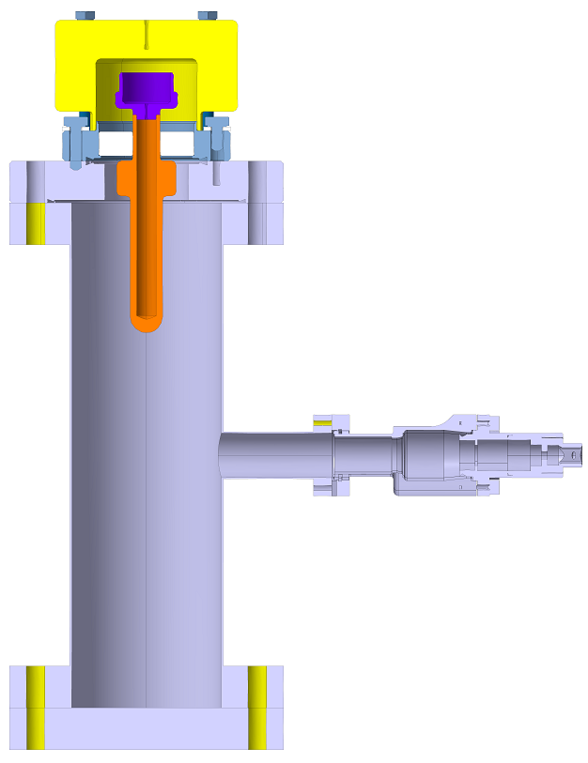
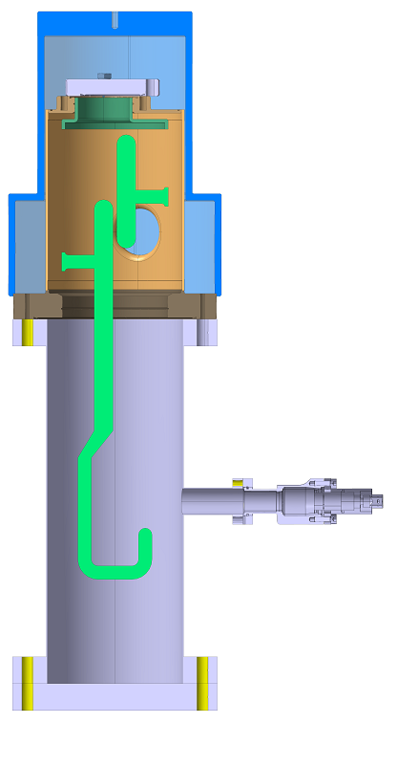
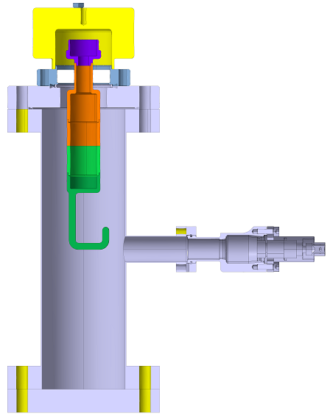
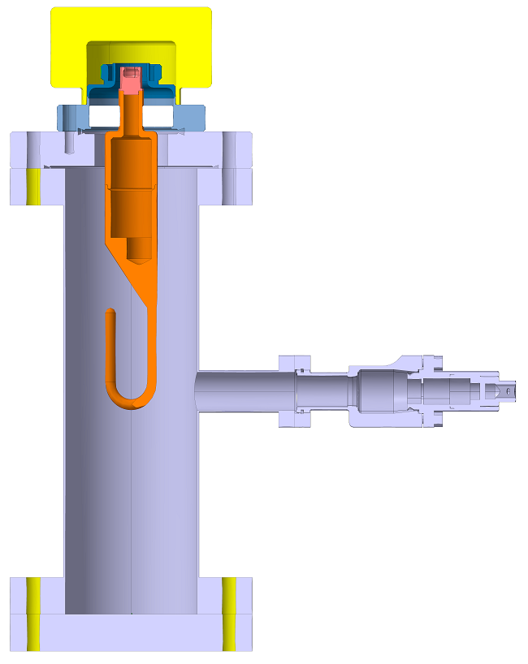
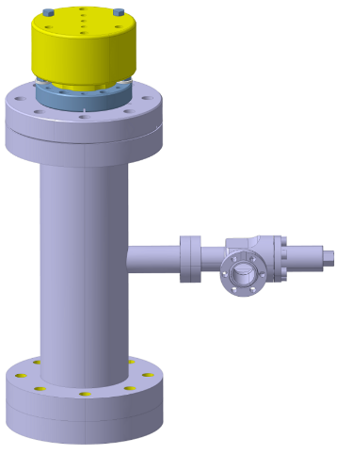
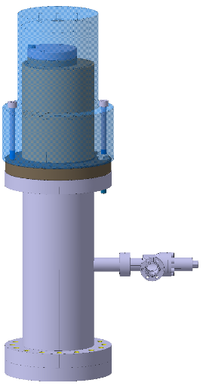
Tooling for transport under vacuum
Protection pieces for clean room
V-HOM
H-HOM Feedthrough
Field antenna
V-HOM
H-HOM Feedthrough
Field antenna
V-HOM
H-HOM Feedthrough
Field antenna
H-HOM
15/05/2020
sonia.garcia.scheifler@cern.ch
8/16

Slide 8
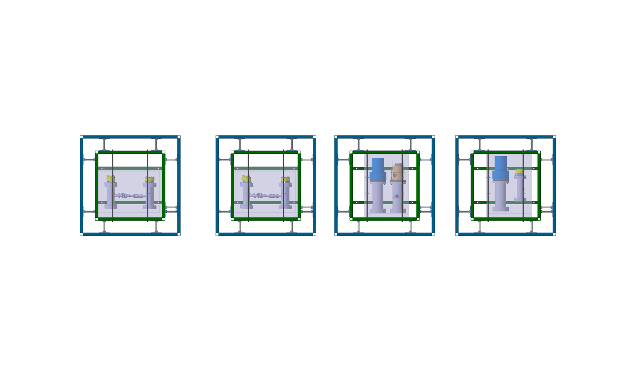
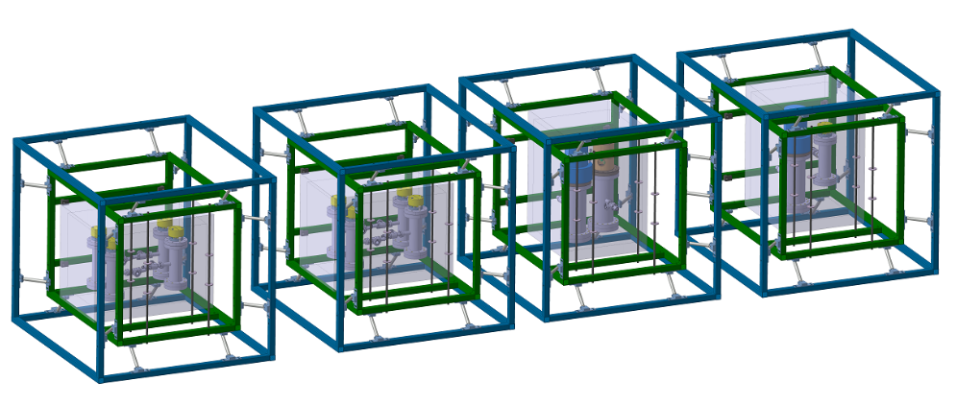
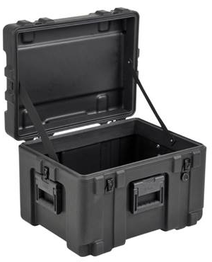
Packaging for transport anti-shock&vibrations
15/05/2020
sonia.garcia.scheifler@cern.ch
8/15

Slide 9
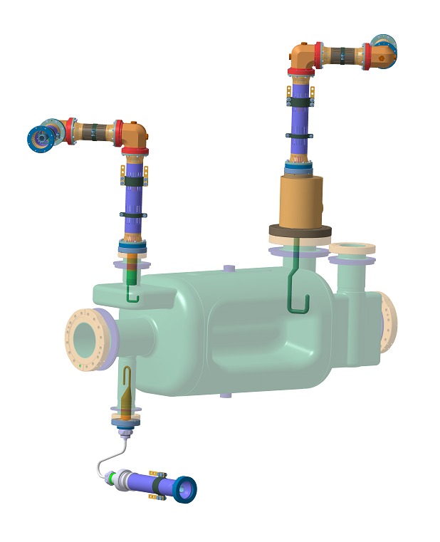
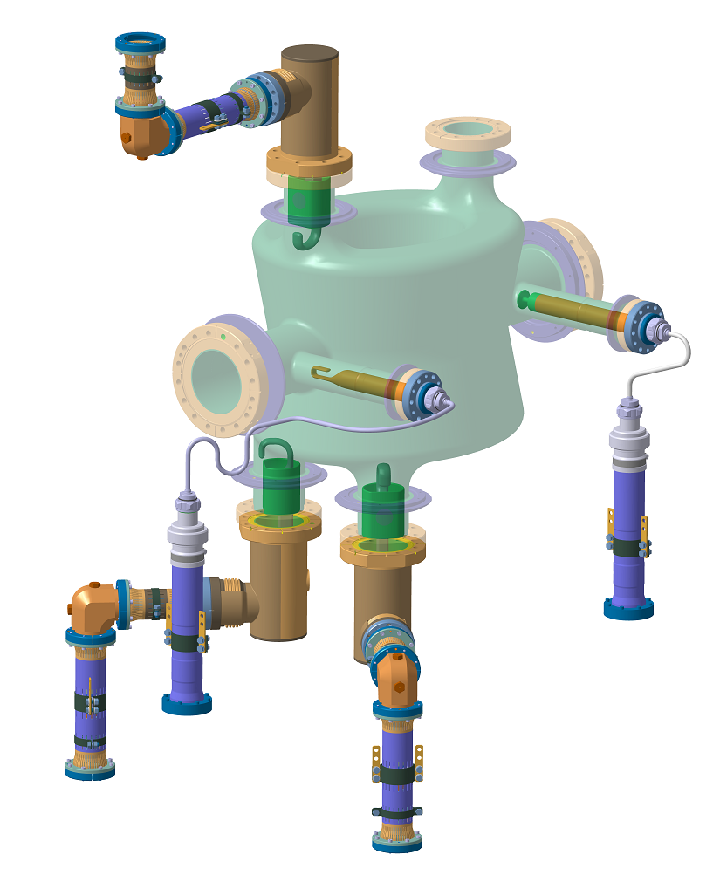
Crab cavity RFD and DQW coaxial lines
Design of the coaxial lines for DQW and RFD cryomodules:
They need to be changed because we need to pass from 50 ohm to 25 ohm
These lines extract the power from the HOMS
The lines are special because they pass from 2 K to 300 K
Difficult task has been to find a cable suppliers for 25 ohm
15/05/2020
sonia.garcia.scheifler@cern.ch
9/15

Slide 10
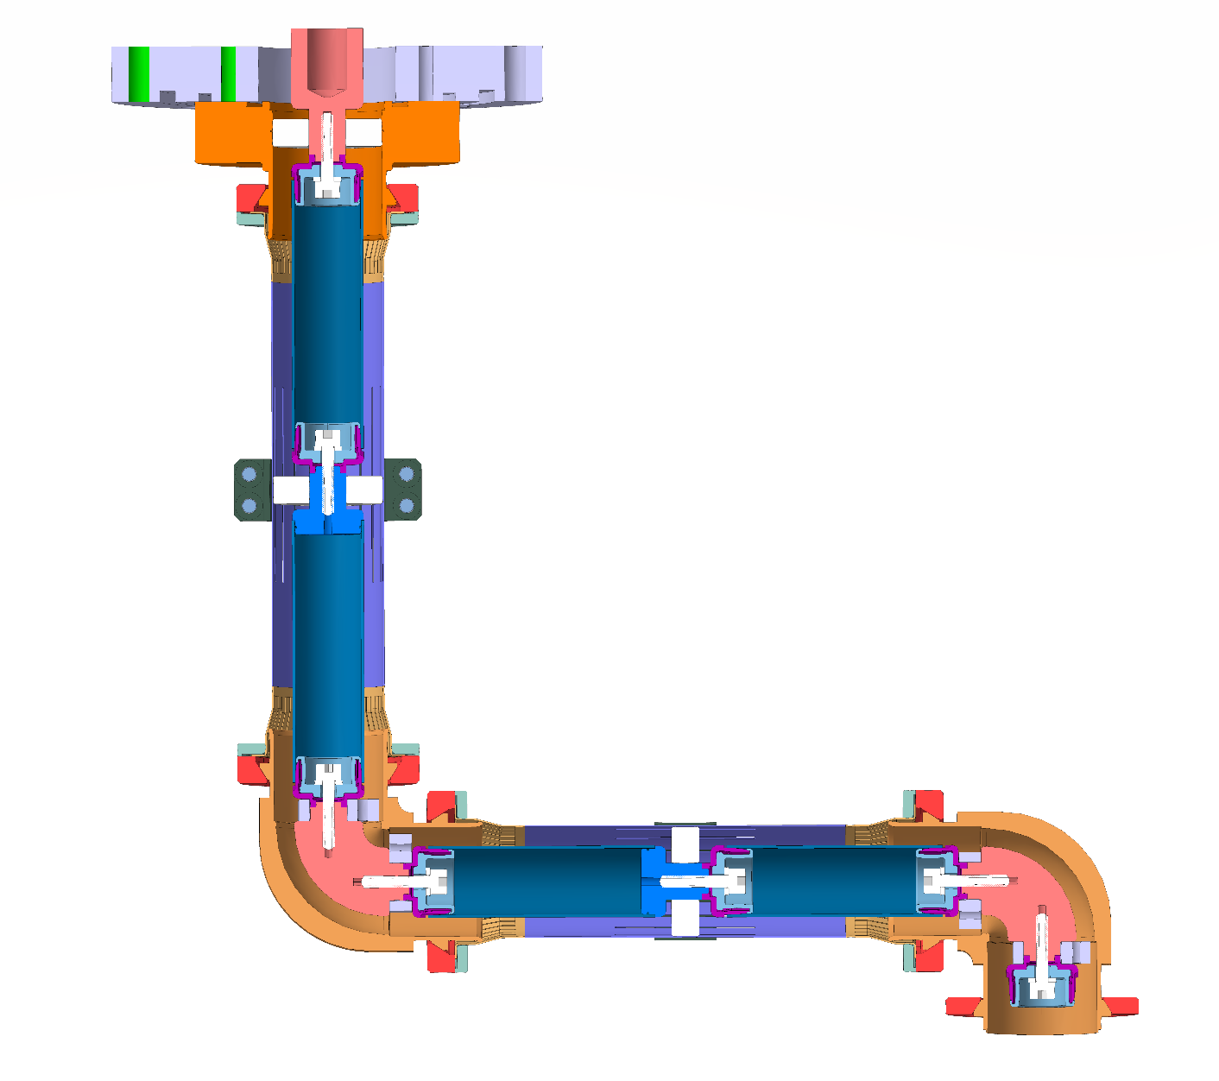
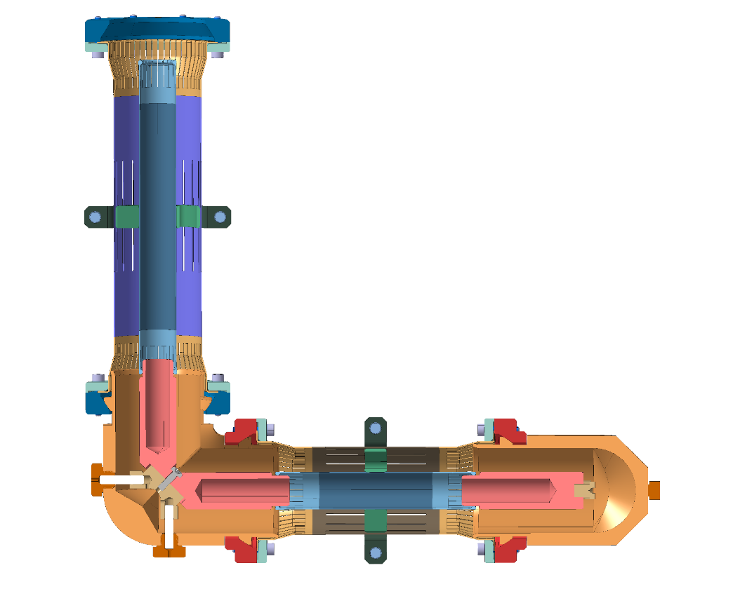
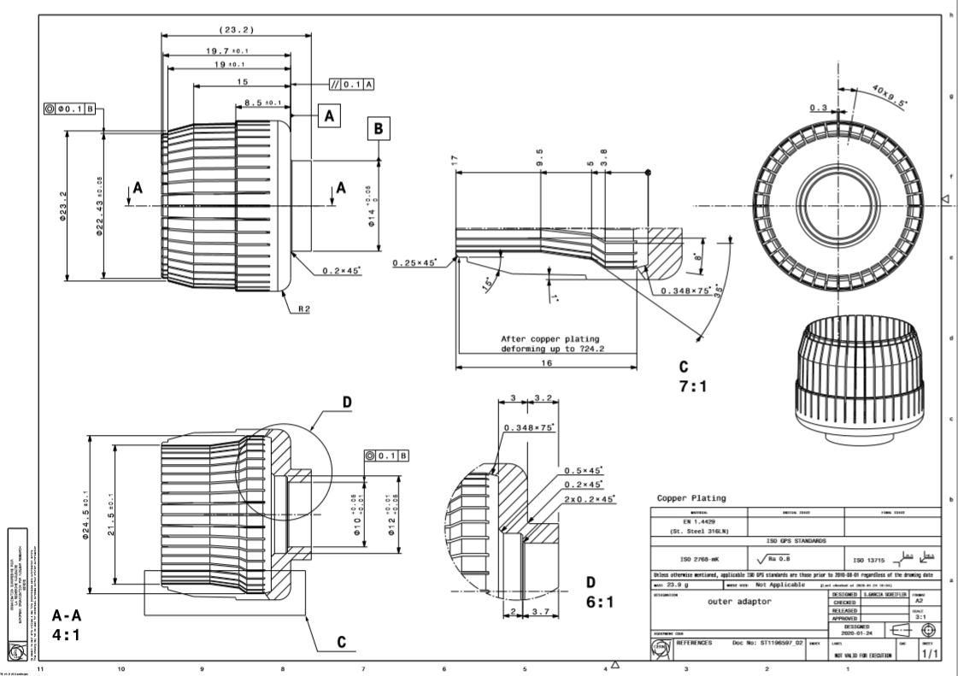
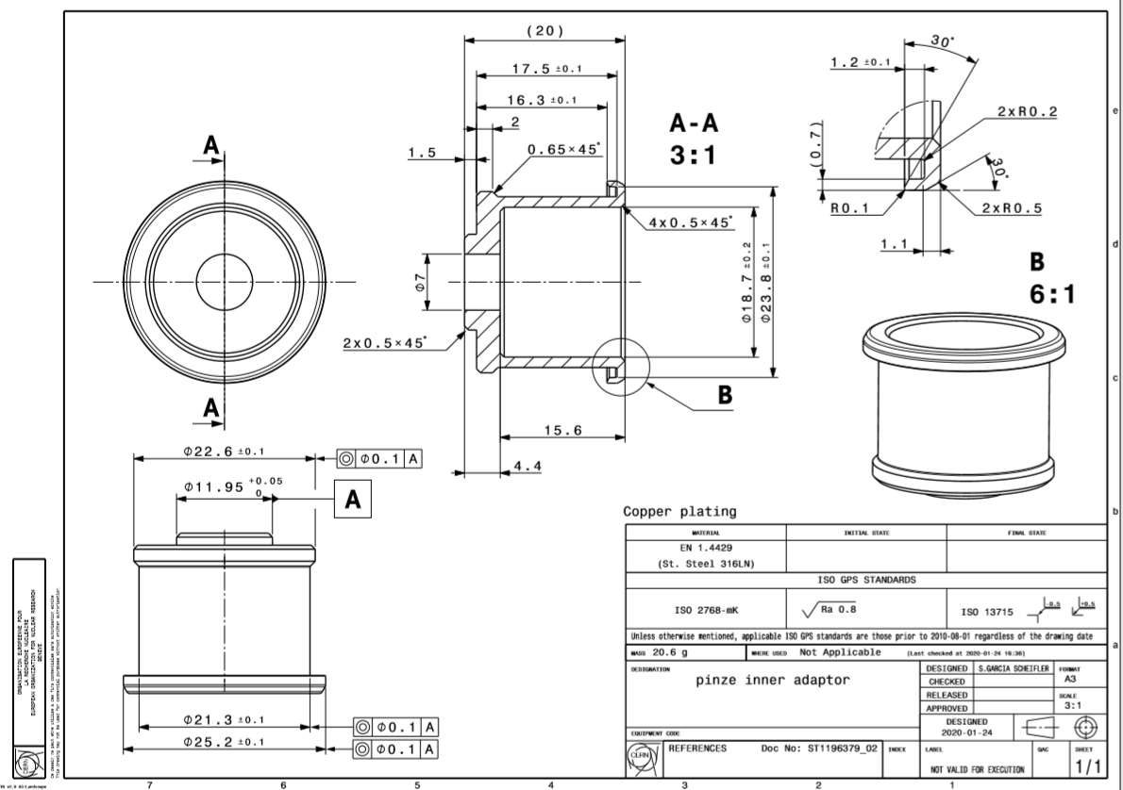
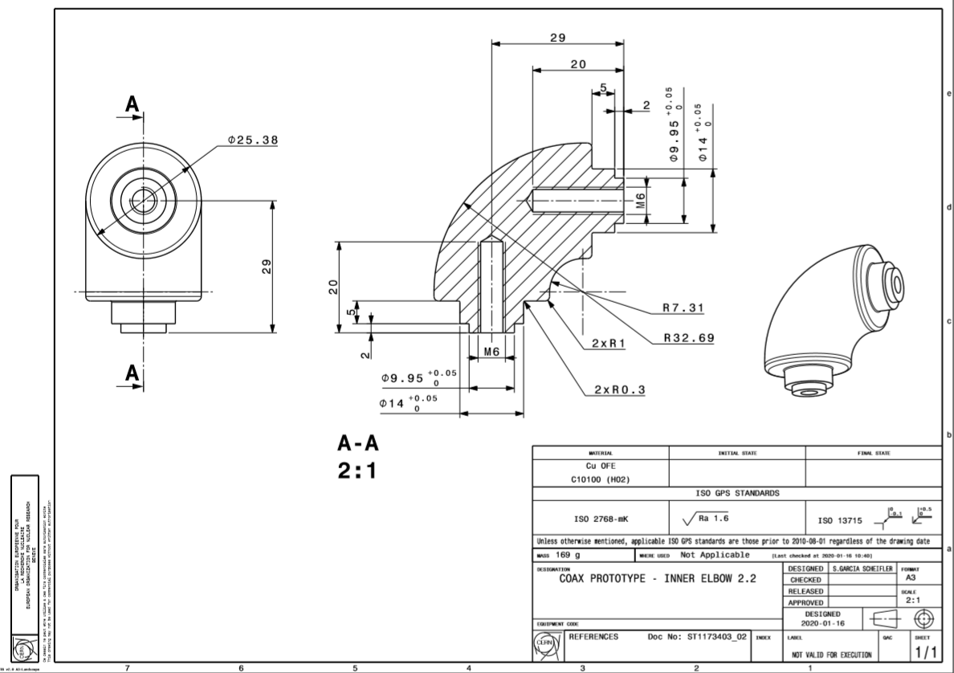
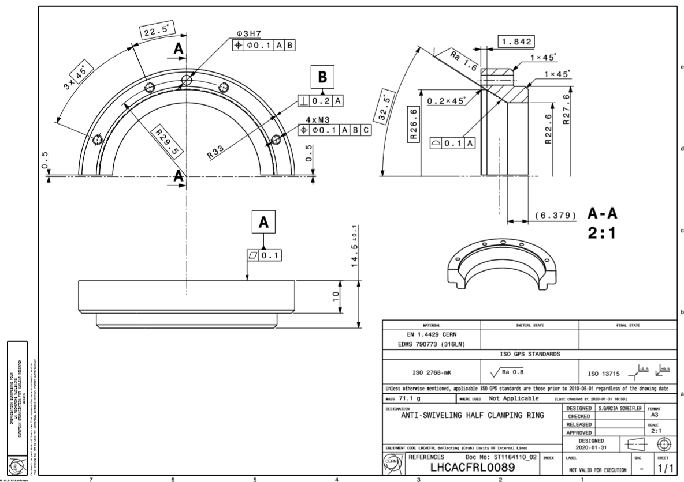
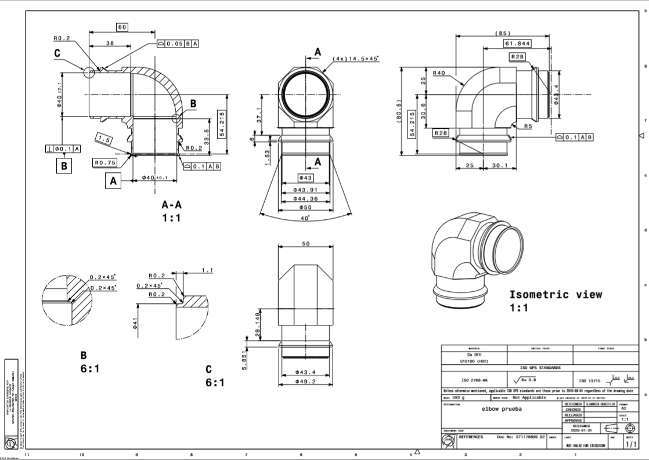

Crab cavity RFD coaxial line
15/05/2020
sonia.garcia.scheifler@cern.ch
10/15

Slide 11
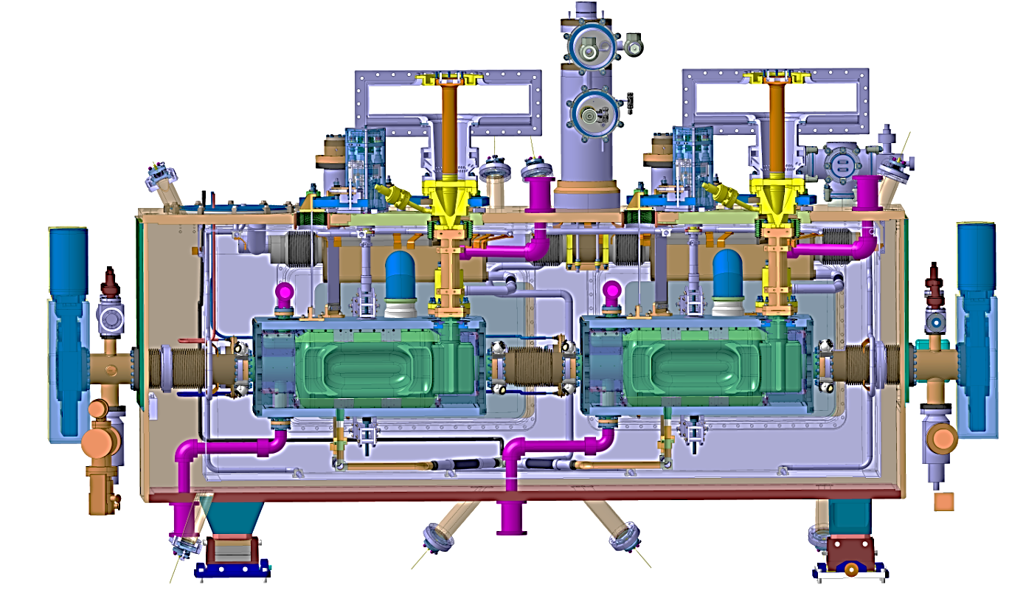
HL-HLC crab cavity Cryomodule RFD
15/05/2020
sonia.garcia.scheifler@cern.ch
11/15

Slide 12
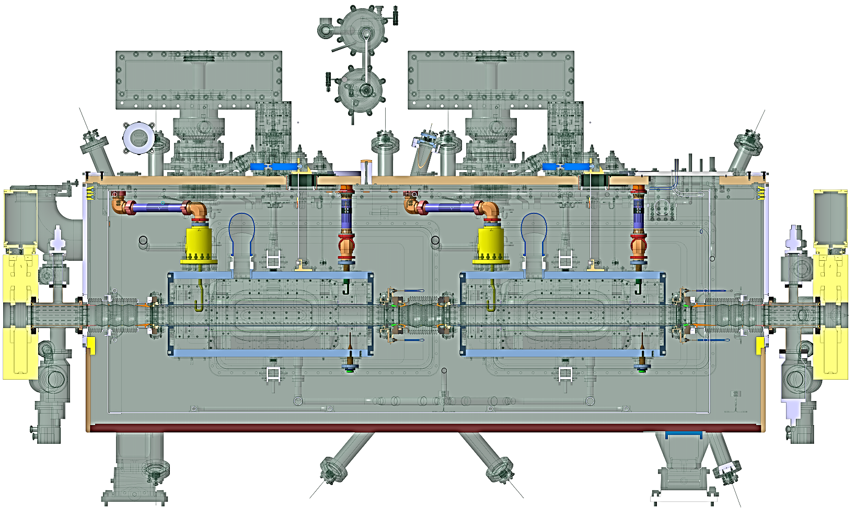
HL-HLC crab cavity Cryomodule RFD with coax lines
15/05/2020
sonia.garcia.scheifler@cern.ch
12/15

Slide 13
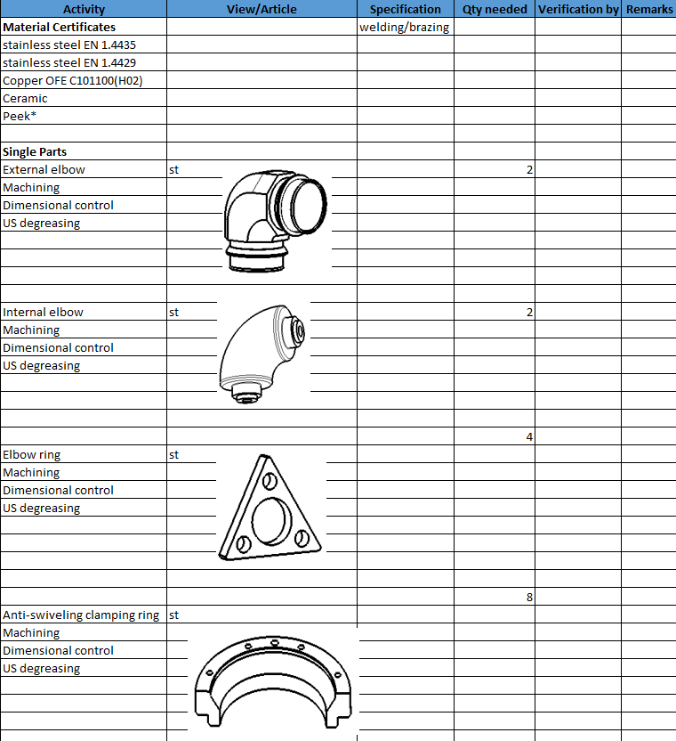
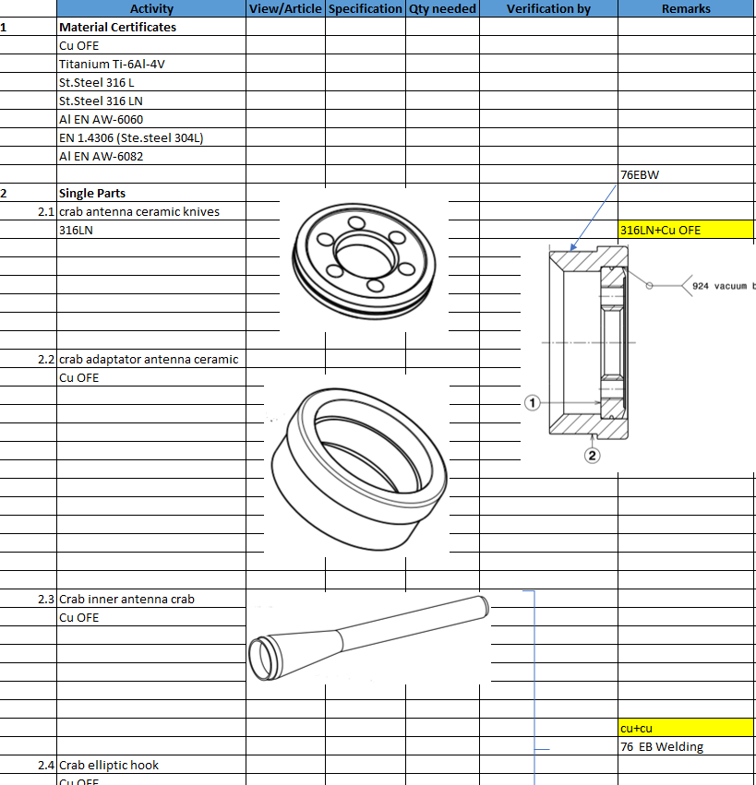
Collaboration with BE-RF-SRF in QA/QC
Steps
Manufacturing Inspection Plan (MIP)
Radio Frequency (RF) Coaxial Line
Fundamental Power Coupler (FPC)
Material Certificates
76EBW
Single Parts
Assemblies
In progress
15/05/2020
sonia.garcia.scheifler@cern.ch
13/15

Slide 14
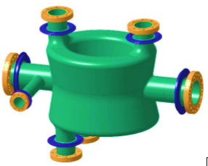
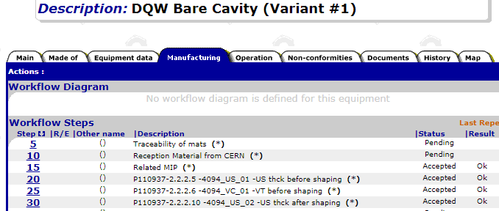
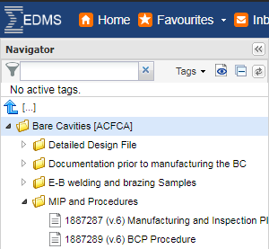

Collaboration with BE-RF-SRF in QA/QC
1. Production tracking (RI company)
3. EDMS & MTF platforms and MIP (Manufacturing Inspection Plan)
DQW cavity
2. Documentation and contract requirements
15/05/2020
sonia.garcia.scheifler@cern.ch
14/15

Slide 15
Thank you
Thanks to all colleagues from the BE-RF-PM team involved with the HOMC and Field Antenna devices, specially to Eric, Seb, Nicolas, Jamie and Frida.
Thanks to Fritz (EN-MME-FW), Nuria (BE-RF-SRF) and Teddy (EN-MME-EDM) for their help and collaboration.
Sonia Garcia
BE/RF/PM
15/05/2020
sonia.garcia.scheifler@cern.ch
15/15

