Slide 1
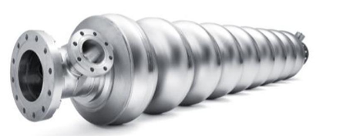
RF characterization of superconducting samples
Lorena VEGA CID
Section: BE/RF/SRF
Supervisors: G. Vandoni, W. Venturini

Slide 2
Index
General introduction
Overview of activities
  QPR measurements
  1.3 GHz cavities measurements
  New QPR commisioning
  “Teleworking” simulations

Slide 3
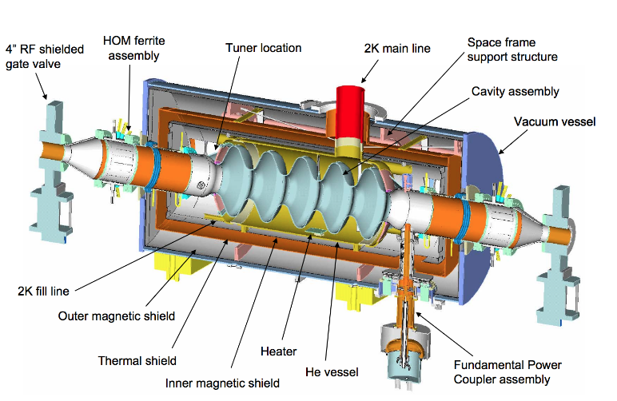
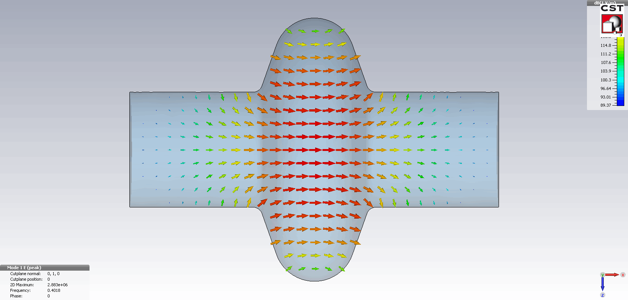
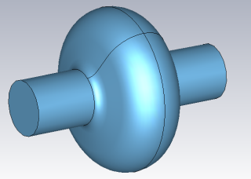
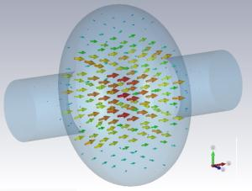
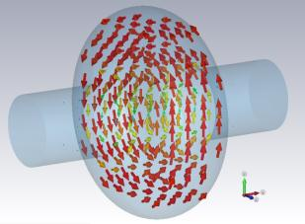
I. General introduction
p⁺
Simulation of changing E-field
Courtesy: P. Zhang simulation tesla style cavity

Slide 4

I. General introduction
Superconductivity and RF
Superconducting layer of a few micrometers should be enough!
RF
Superconducting material
Penetration
depth
Superconductors present surface resistance to RF fields
RF fields only penetrate 10s of nms
Bulk niobium cavities
Expensive
Complex manufacturing
R&D campaign to understand and improve superconducting thin film technology

Slide 5
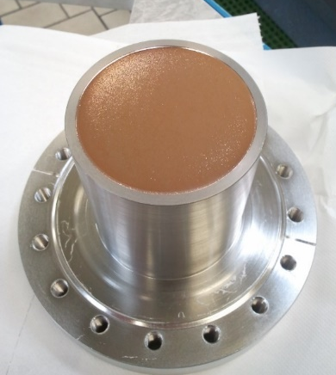
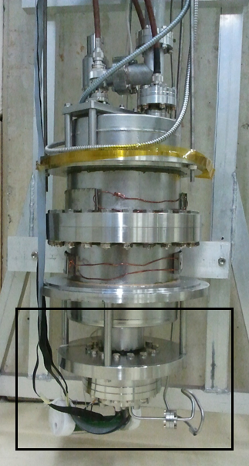
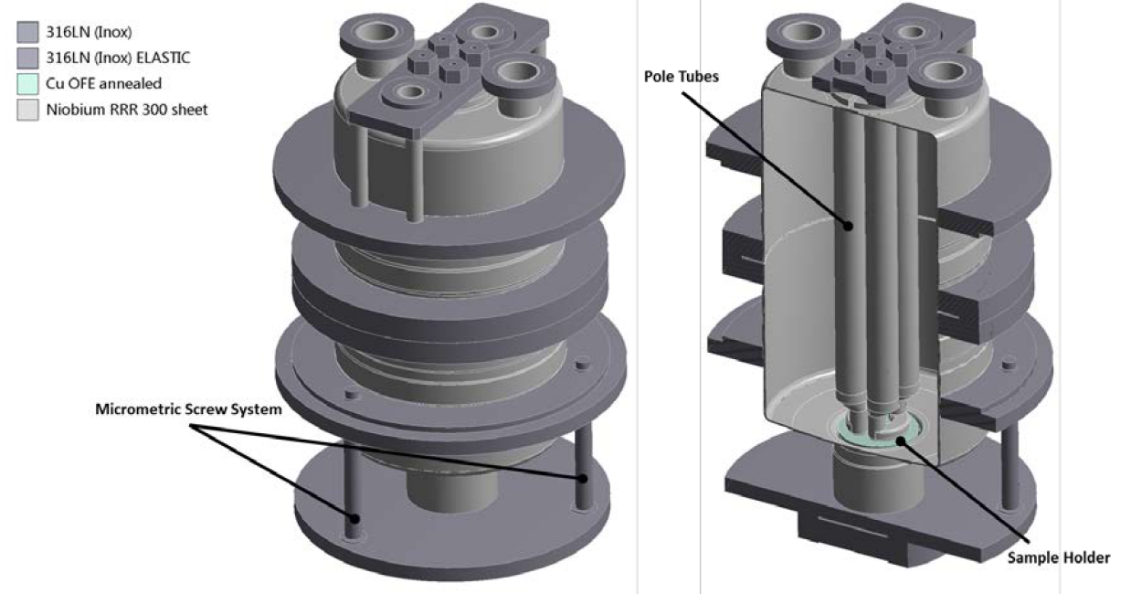
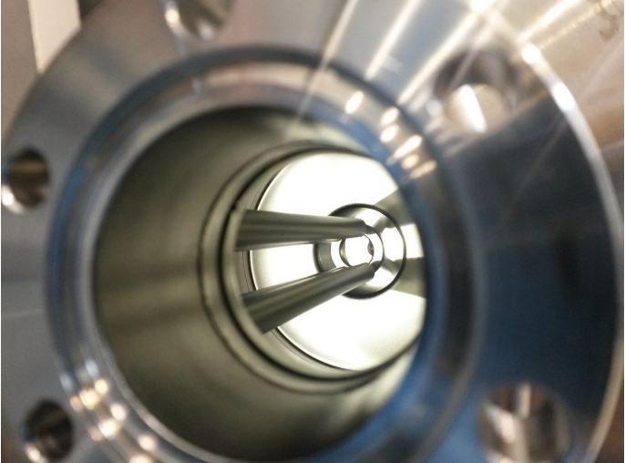
1.1) QPR measurements: Introduction
QPR sample
QPR:
Device conceived for doing RF characterization of flat superconducting samples.
Advantages:
Coating a cavity is expensive: High possibilities of failure at early stages of R&D
Alternative: Testing small samples with QPR
Copper substrate: Coating goes on top

Slide 6
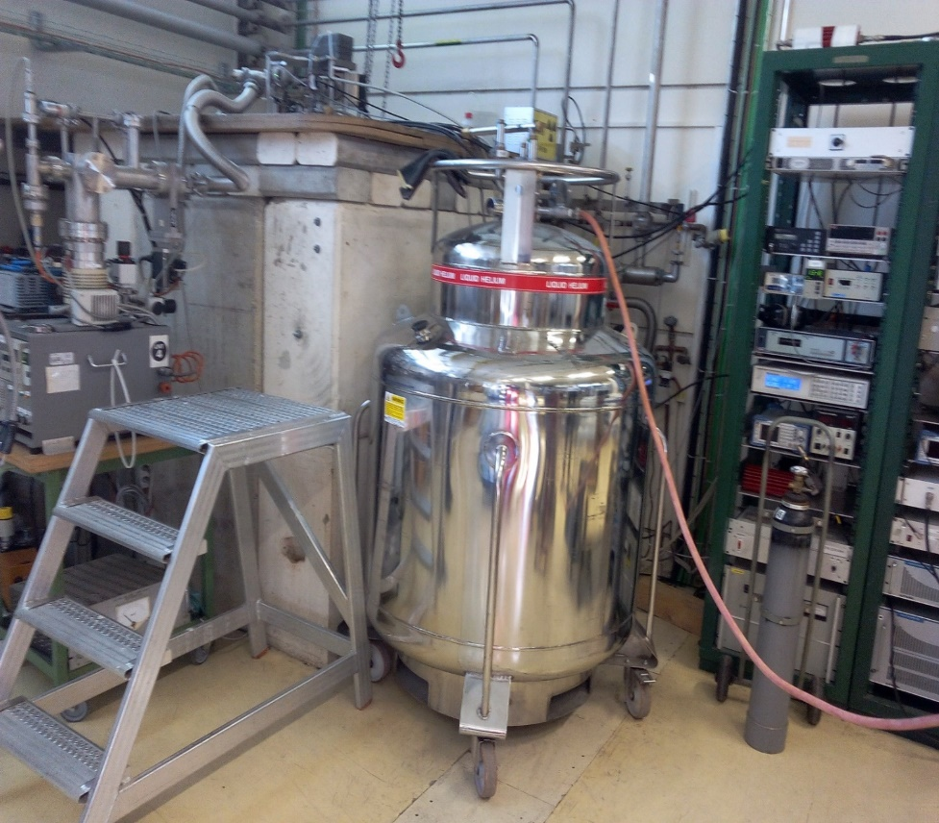
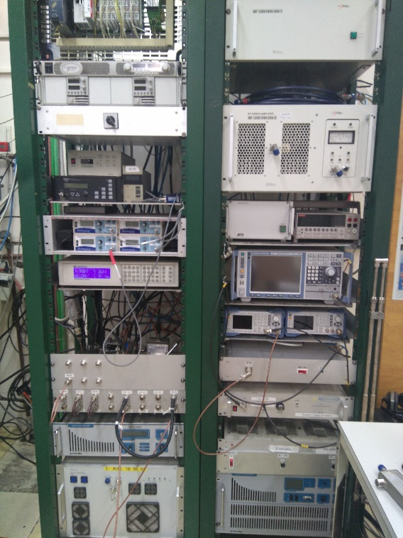
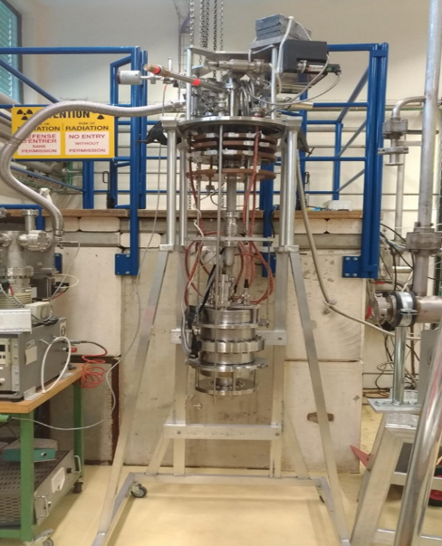
Test facility
Measurements are done in the cryolab
Only one sample can be tested at a time with the QPR.
We can also characterized 1,3GHz cavities.

Slide 7
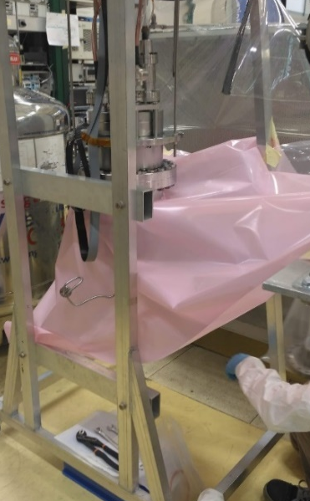
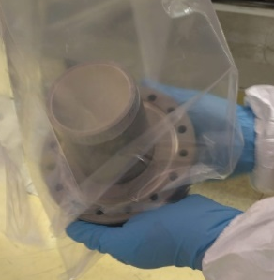
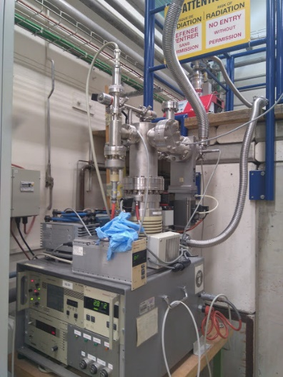
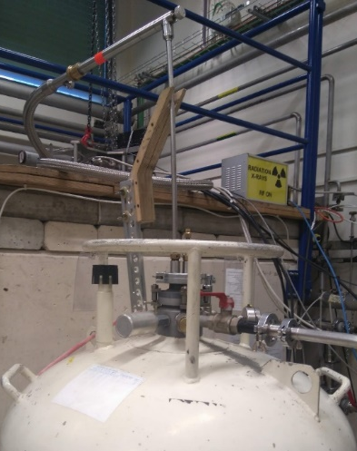

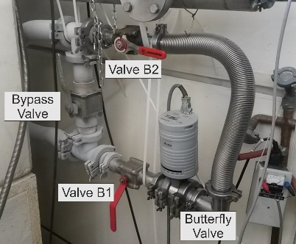
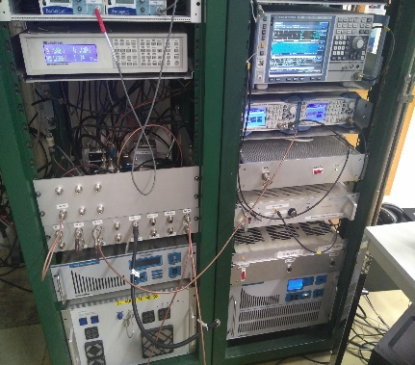
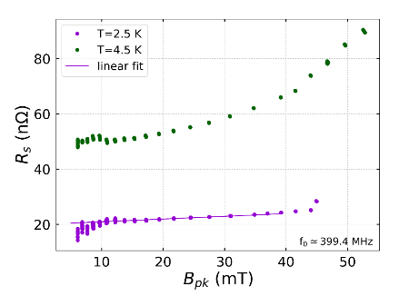
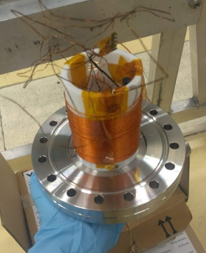
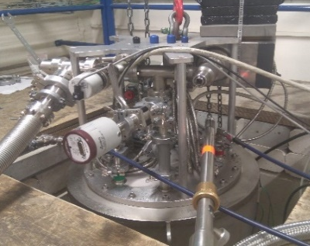
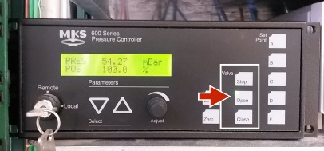
Typical day of measurements
Prepare measurements
Helium transfer to cryostat
Pump on helium bath down to 20 mbar (1.85 K)
RF system setup
Data acquisition
 | Th | Fr | Sa | Su | Mo | Tu | We | Th | Fr | Sa | Su | Mo | Tu | We | Th | Fr | Sa | Su
Prepare clean area in cryolab
Insert sample and thermometry chamber in QPR
Pump (after leak detection and venting with N2)
Insert QPR in cryostat
Fill cryostat with He
Characterization at 400 MHz
Characterization at 800 MHz
Characterization at 1.2 GHz

Slide 8
1.2) QPR measurements: Progress
Type of test
QPR
New QPR
1.3 GHz cavity
Research lines
Nb: ECR/ HiPIMS
Nb₃Sn
Bulk Nb
Institutes
CERN
JLab
HZB
Test 2019 | Starting date | Type of test | Type of coating | Fabrication
10 | 17 October | QPR | Bulk Nb | HZB
11 | 21 November | 1.3 GHz cavity | HiPIMS Nb | CERN +JLab
12 | 2 December | 1.3 GHz cavity | HiPIMS Nb | CERN +JLab
Test 2020 | Starting date | Type of test | Type of coating | Fabrication
1 | 7 January | QPR | ECR Nb | JLab
2 | 10 February | QPR | HiPIMS Nb | CERN + HZB
3 | 11 March | QPR | HiPIMS Nb | CERN + HZB

Slide 9
1.3) QPR measurements: Future work
Finish measurements of Nb coated sample from HZB (they were stopped due to covid-19 restrictions.
Measure sample from Jlab, already received at CERN.
Many others will come…

Slide 10




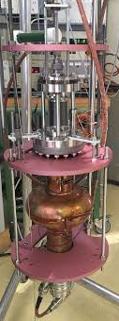



2.1) 1.3 GHz cavities measurements: Introduction
QPR sample
1.3 GHz cavity
-Bias
-Temperature
-Pressure
-Pulse parameters
-Peak power
-Bias
-Temperature
-Pressure
-Pulse parameters
-Peak power
Measure RF performance
Measure RF performance

Slide 11
2.2) 1.3 GHz cavities measurements: Progress
Type of test
QPR
New QPR
1.3 GHz cavity
Research lines
Nb: ECR/ HiPIMS
Nb₃Sn
Bulk Nb
Institutes
CERN
JLab
HZB
Test 2019 | Starting date | Type of test | Type of coating | Fabrication
10 | 17 October | QPR | Bulk Nb | HZB
11 | 21 November | 1.3 GHz cavity | HiPIMS Nb | CERN +JLab
12 | 2 December | 1.3 GHz cavity | HiPIMS Nb | CERN +JLab
Test 2020 | Starting date | Type of test | Type of coating | Fabrication
1 | 7 January | QPR | ECR Nb | JLab
2 | 10 February | QPR | HiPIMS Nb | CERN + HZB
3 | 11 March | QPR | HiPIMS Nb | CERN + HZB

Slide 12
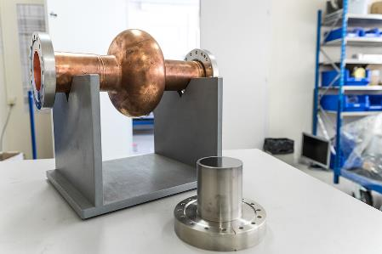
QPR and cavities: Different results with the same recipe
N2: Fully coated cavity with the same QPR recipe (HiPIMS)
Defects in substrate are propagated to the coating: Last two cavities were spun and then treated at JLab (tumbled), nonetheless some defects were still present
Results presented at Tesla Technology Collaboration Meeting (4-7 February 2020, CERN). See invited talk: “HiPIMS: From QPR to 1.3 GHz cavities”
Currently ongoing studies with RF-thermal coupled simulations.
Notes:
High Q drop of N3 was due to the coating being detached>There is a slight peel off close to the pick up flange

Slide 13
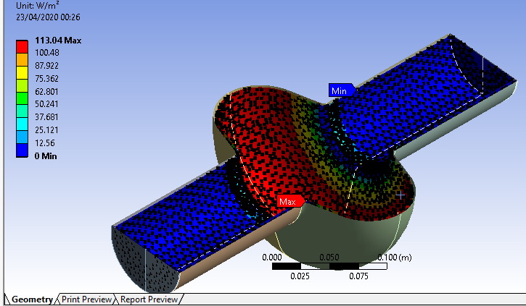
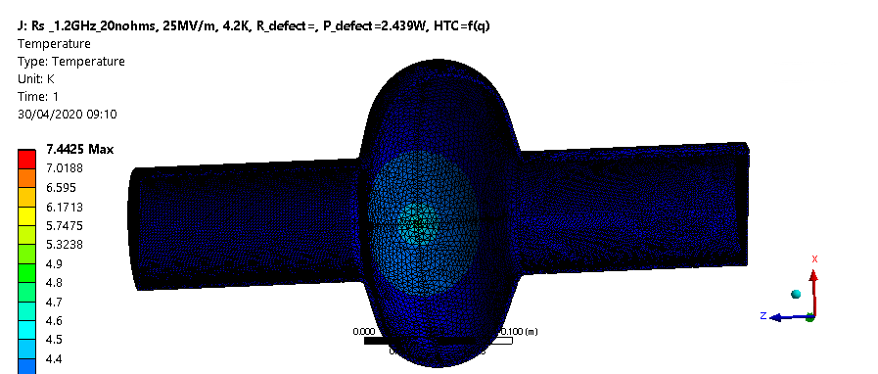
1.3 GHz RF-thermal coupled simulations
Definition of material properties
Definition of boundary conditions
Definition of RF loads
Objective: Have a better understanding of the thermal profile in the presence of a defect.
By iterating RF and thermal simulations, one can obtain the resistance expected, which is function of field and temperature.
A coupled model has been created: RF loads are obtained from CST (Pablo Vidal) and imported to ANSYS Mechanical

Slide 14
2.3) QPR measurements: Future work
New cavities will be coated once the activities are restarted after Covid-19 restrictions (high quality substrates are being prepared: electroformed substrate and machine from bulk)

Slide 15
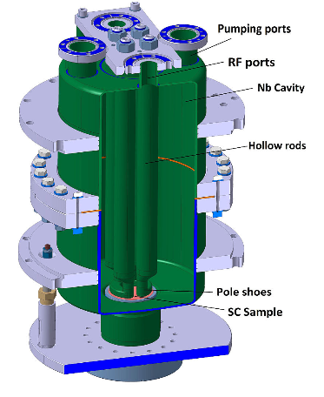
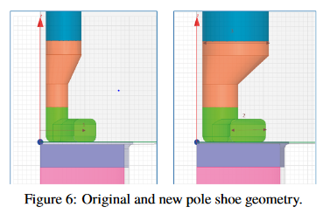
3.1) New QPR commissioning: Introduction
In 2017 a new version of the QPR was built: An electromagnetic and mechanical re-design of the existing QPR to optimize the measurement range and resolution.
Modification | Benefits
↓ gap | Higher field is illuminated in the sample: Lower the risk of quenches and field emission
↑ diameter of rods | Electric field is reduced in the rod’s surface: Lower risk field emission
↑ width of rods | More homogeneus field distribution over the sample: Better resolution
Material | Better cooling: Lower the risk of quenches

Slide 16
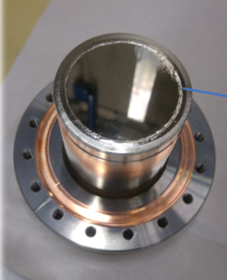
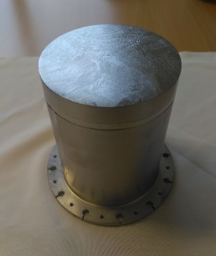
3.2) New QPR commissioning: Progress
Comparing results from old and new QPR:
Sample | Date | Results | Comments
Bulk Nb (Jlab) | April 2019 (M. Arzeo) | Overestimation of surface resistance with new QPR | The weld might have contributed to the dissipation in the new QPR as the magnetic field is more distributed in the sample surface.
Bulk Nb (HZB) | July 2019 (M. Arzeo, L. Vega) | Discrepancies in the results with old and new QPR. | The sample quality was very low. Results cannot be fully trusted as there might be heat leaks.
Changing antenna configuration in new QPR:
After checking and preparing documentation regarding the design of the old QPR, it was decided to implement the same antenna configuration in the new QPR (W. Venturini, P. Vidal, W. L. Vega).

Slide 17
3.3) Commissioning of new QPR: Future work
Find a good sample for benchmarking and repeat measurements in both QPR (The one that is currently installed in the old QPR waiting for being measured might be a good candidate.)

Slide 18
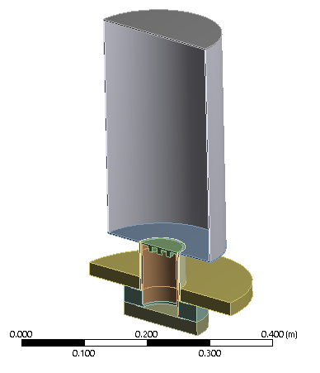
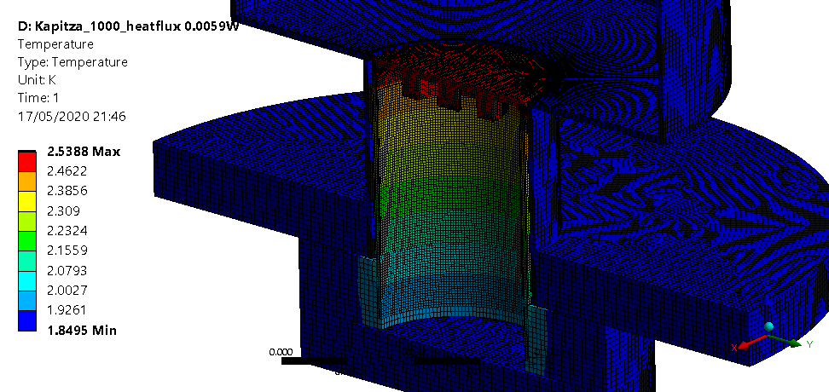
4) Other studies during teleworking period
QPR measurements rely on a calorimetric technique:
Currently ongoing simulations to understand better heat dissipation in QPR sample
Obtjective:
  Optimize shape of heater
  Better estimate intrinsic errors to the calorimetric technique.

Slide 19
Thanks for your attention.

Slide 20
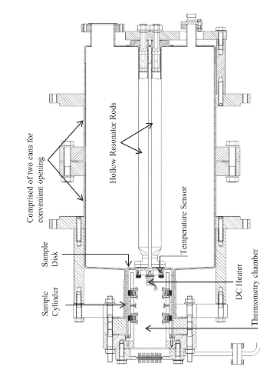
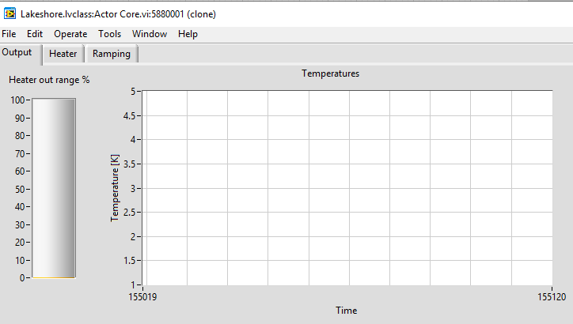
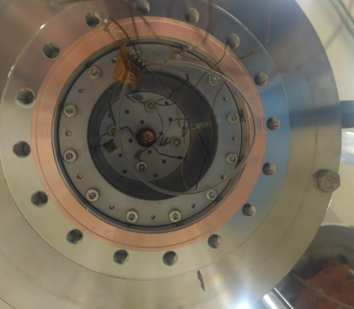
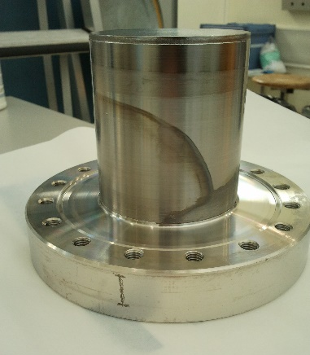
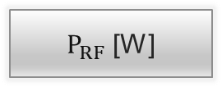
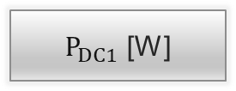
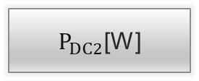
Operating principle
Measurements setup
T_Setpoint [K]
2.5
Heater
ON
OFF
OFF
RF
ON
Data acquisition
$P_{DC1}$ [W]
1
$P_{DC2}$[W]
0.8
Data post-process
$P_{RF}$ [W]
0.2
PRF: Power dissipated in the sample by RF fields
PDC2: Power of heater with RF ON
PDC1: Power of heater with RF OFF

Slide 21



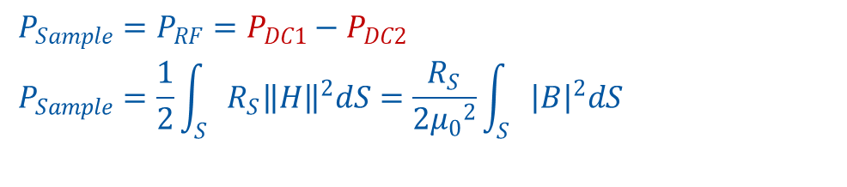


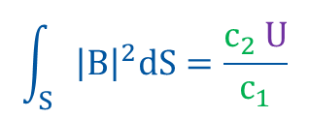

How do we calculate the surface resistance?
$$P_{Sample}=P_{RF}=P_{DC1}−P_{DC2}$$
$$P_{Sample}=\frac{1}{2}\int_{S}{R_{S}{\left\|H\right\|}^{2}dS}=\frac{R_{S}}{2{μ_{0}}^{2}}\int_{S}{{\left|B\right|}^{2}dS}$$
$$R_{S}=\frac{2{μ_{0}}^{2} (P_{DC1}−P_{DC2})}{\int_{S}{{\left|B\right|}^{2}dS}}$$
$$\int_{S}{{\left|B\right|}^{2}dS}=\frac{c_{2} U}{c_{1}}$$
$c_{1}$and $c_{2}$ are obtained from simulations:
The stored energy can be derived from RF measurables:
$$c_{1}=\frac{{B_{P}}^{2}}{\int_{S}{{\left|B\right|}^{2}dS}}$$
$$c_{2}=\frac{{B_{P}}^{2}}{U}$$
$$U=τ P_{L}$$
$P_{L}=2(P_{F}±\sqrt{{P_{R} P}_{F}}$) $for β><1$

Slide 22
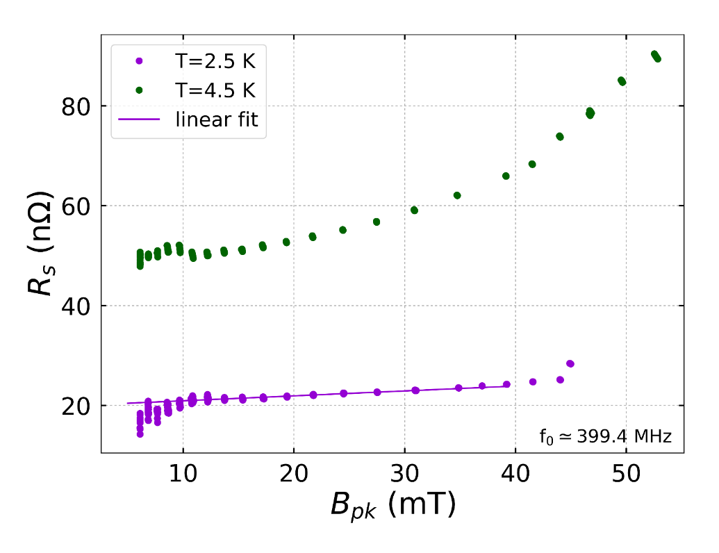
Surface resistance vs peak magnetic field
Steps
Set a fixed temperature (2.5K)
Increase RF power in steps 1-2 dBm until sample quenches or calorimetric system saturates.
Repeat scan at 4.5 K.
Duration
2.5-3 hours, approx. 10 minutes per point
Results
Obtain minimum surface resistance
Obtain slope at 2.5K
Obtain maximum magnetic field
*HiPIMS 2 sample results (coated by G. Rosaz)

Slide 23
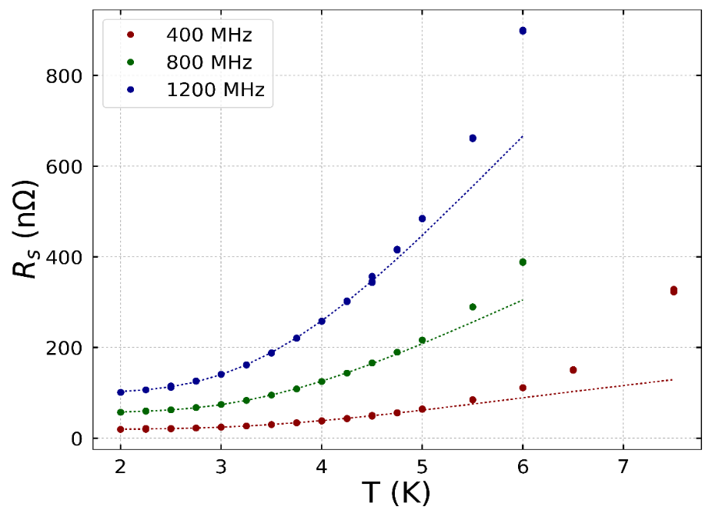


Surface resistance vs temperature
Steps
Set a fixed magnetic field (low value to ensure that we can apply the formula for fitting)
Increase temperature in steps of 0.25 K from 2 to 6-7K
Duration
3-4 hours, approx. 15/20 minutes per point
Results
Obtain superconducting parameters by fitting the curves to the simplified formula for BCS resistance:
$$R_{s}\left(T\right)=R_{res}+R_{BCS}(T)$$
$$R_{BCS}\left(T, H=0\right)=\frac{A_{BCS}}{T}e^{−(∆/k_{B}T)}$$
Mode [MHz] | R_{res} [nΩ] | Δ/k_{B} [K] | A_{BCS} [10⁻⁵ nΩ K]
400 | 19.6 | 20.4 | 1.25
800 | 57 | 20.3 | 4.36
1200 | 100.8 | 20.2 | 9.77
A_{BCS}: Parameter that depends on purity of the material
Δ/K_{B}: Superconducting energy gap
R_{res}: Residual resistance
*HiPIMS 2 sample results (coated by G. Rosaz)

