Slide 1
8Th FTEC Workshop | CERN
BE-BI-SW
Jordi Ustrell Garrigos
18/05/2020

Slide 2
Outline
    Introduction to ALPS/SPS
    Development of Expert GUI for ALPS:
      Phase-r application
      Scaling factors manager
    Maintenance and upgrade of the web application FESA WEB

Slide 3

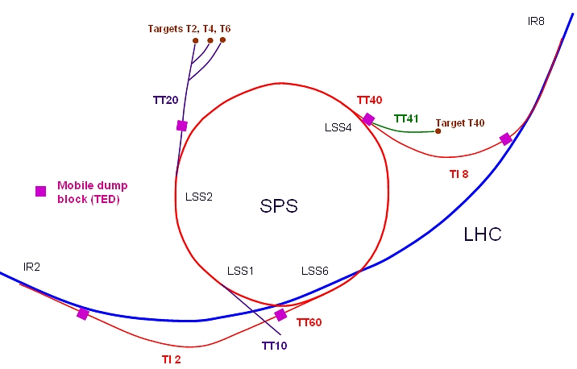
Introduction to ALPS/SPS
ALPS is the new orbit measurement system for the SPS.
SPS is the second-largest machine in CERN’s accelerator complex ( ͌7 km. in circumference).
It takes particles from the Proton Synchrotron and accelerates them to provide beams for the Large Hadron Collider, and others experiments.

Slide 4
Introduction to ALPS/SPS
Digital
Back-end
(VFC)
Digital
Back-end
(VFC)
FESA
(Front-end
Software Architecture)
BA1
A
BPM
B
SPS is divided into 6 sectors (from BA1 to BA6).
Each sector has:
  40 Position monitors
  10 VFC
  1 FESA Device
SPS
BA2
BA3

Slide 5
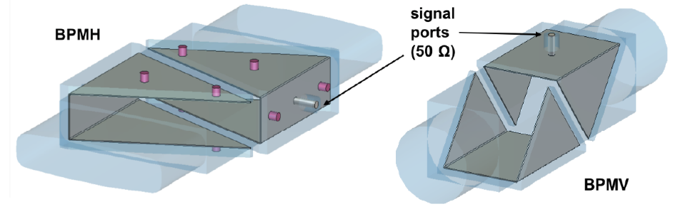
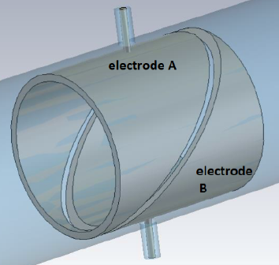
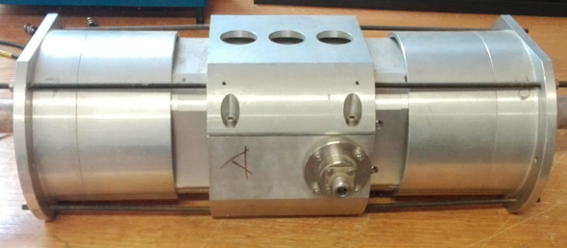
Introduction to ALPS/SPS (BMP)
Digital
Back-end
(VFC)
Digital
Back-end
(VFC)
FESA
(Front-end
Software Architecture)
BA1
A
BPM
B
Position monitors types:
Inside the BPM:
SPS
BA2
Vertical plane
Electrodes A
Horizontal
plane
Electrodes B
BA3
The BMP can detect:
Each electrode detects a signal that is sent to three acquisition chains to obtain three sensibilities:
Horizontal plane
Vertical plane
Both
High
Mid
Low

Slide 6
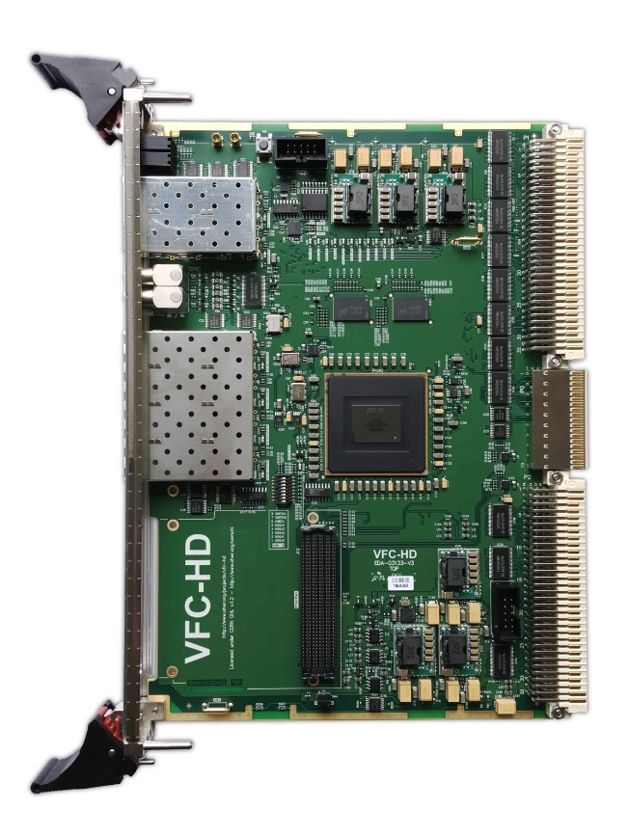
Introduction to ALPS/SPS (VFC)
Digital
Back-end
(VFC)
Digital
Back-end
(VFC)
FESA
(Front-end
Software Architecture)
BA1
A
BPM
B
VFC is an Acquisition Hardware with 4 acquisition channels.
Each channel process 1 BPM.
Firmware decides which sensitivity channel, received from the BMP, to use (Hi, Mid, Lo)
SPS
BA2
BA3
* BPM with 2 planes (horizontal and vertical) use 1 channel of the VFC for each plane.

Slide 7
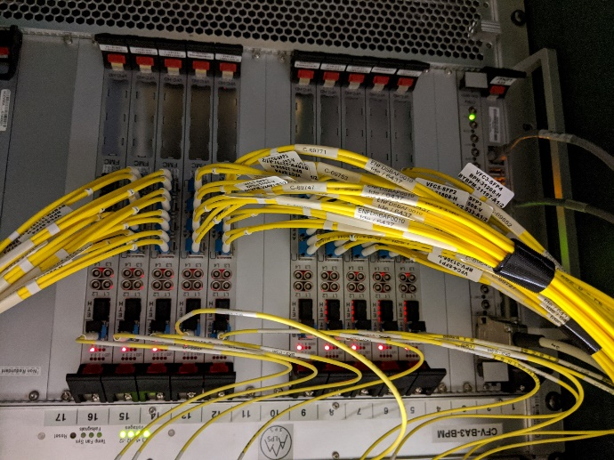
Introduction to ALPS/SPS (FESA)
Digital
Back-end
(VFC)
Digital
Back-end
(VFC)
FESA
(Front-end
Software Architecture)
BA1
A
BPM
B
FESA servers are created using the FESA framework, developed by CERN. This is the standard way to develop real-time software for accelerator controllers using C++.
SPS
BA2
BA3
Each sector has one instance of this FESA server and is used to obtain real-time data and update the settings in the hardware.

Slide 8
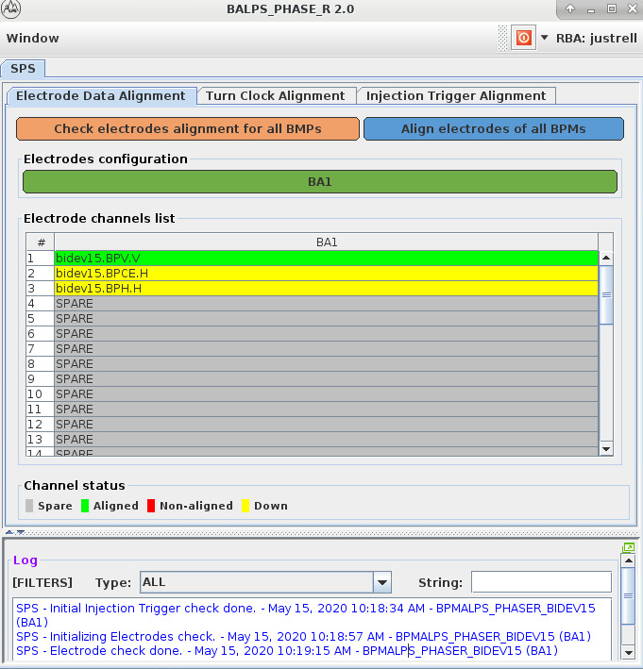
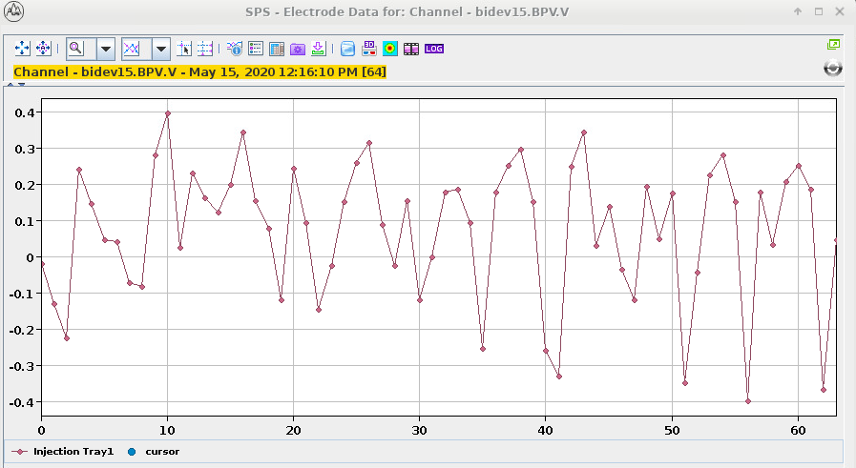
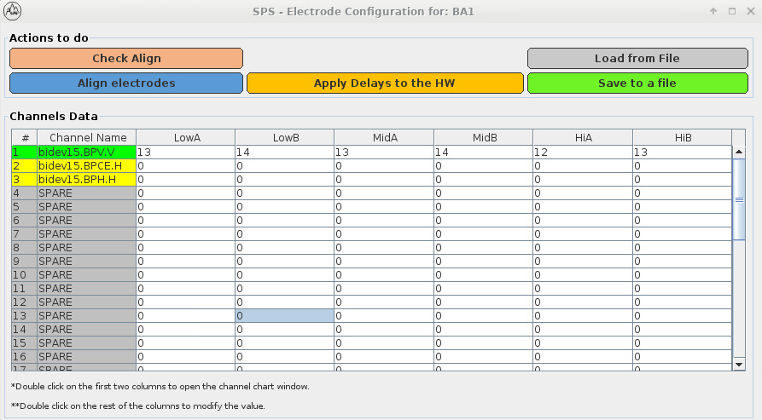
GUI for ALPS – Phase-r Introduction
The Phase-r application is used to align*:
  the data in time from each electrode due to the different electronic circuits,
  the received turn clock flag with the actual turn start for each BPM,
  the injection trigger to all BAs due to the different cable lengths.
* It is important to note that when we say "align", what we are actually doing is synchronizing, but the ALPS team call it alignment.

Slide 9
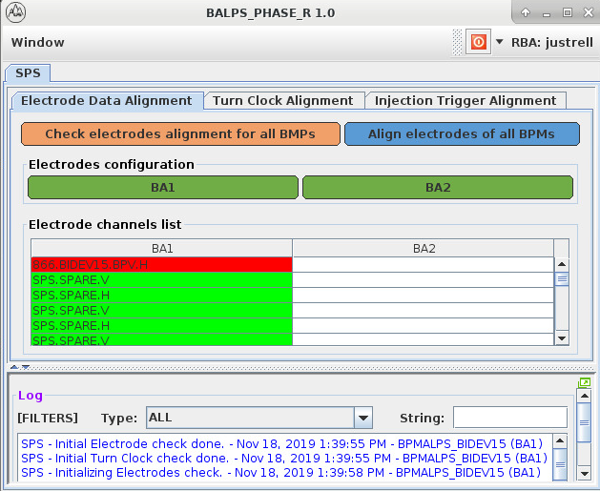
GUI for ALPS - Phase-r Evolution
Turn Clock alignment is cycle dependent
Turn Clock alignment implemented and tested
Injection Trigger alignment implemented and tested
Minor changes in the GUI
Import/Export data to CSV file
Minor bugs fixed

Slide 10
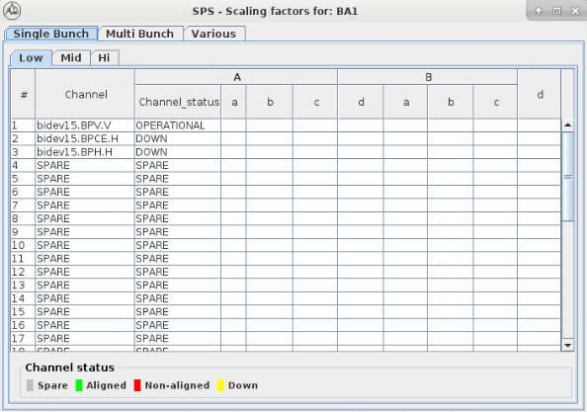
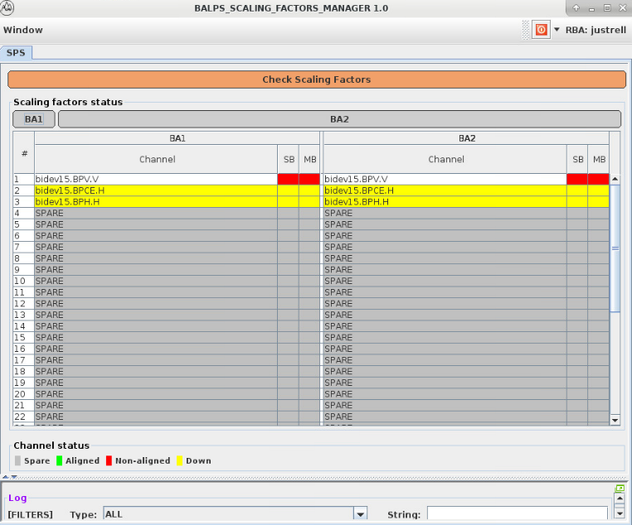
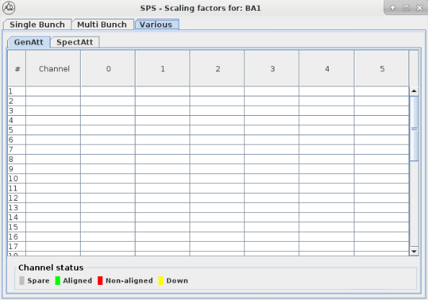
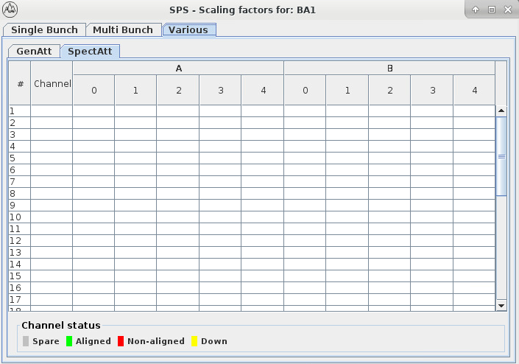
GUI for ALPS – Scaling Factors Introduction
The Scaling Factors Manager is an application used to check if the configuration of the ALPS devices inside the SPS is correct.
To do this, it compares the configuration of the devices with the data of multiple CSV files obtained from the database.
Each CSV file contains the configuration of a specific channel of a device, each device has 40 channels.

Slide 11
GUI for ALPS - Scaling Factors Status
GUI created with some minor bugs to fix.
Obtain the configuration data of the devices.
Read the data from a test CSV file.
Check if the device data matches with the CSV file.
Display the data in the main window.
To be implemented
Obtain data from the data base.
Display all the data of a device in the corresponding window.
Display a label for each field in the tables with the value of the data base.
Indicate which data is the same on the device and in the database.

Slide 12
Many thanks.
Questions?

