Slide 1


VLDB
Versatile Link Demo Board
DanieL HERNÁNDEZ MONTESINOS – EP-ESE-BE
Radiation Hard Optical Link project.
Supervisor: Sophie Baron.

Slide 2
Contents
Introduction: The VLDB and the GBTx.
VLDB support.
Ongoing work: LpGBT tester: hardware, firmware and software.
Conclusions.

Slide 3
Contents
Introduction: The VLDB and the GBTx.
VLDB support.
Ongoing work: LpGBT tester: hardware, firmware and software.
Conclusions.

Slide 4
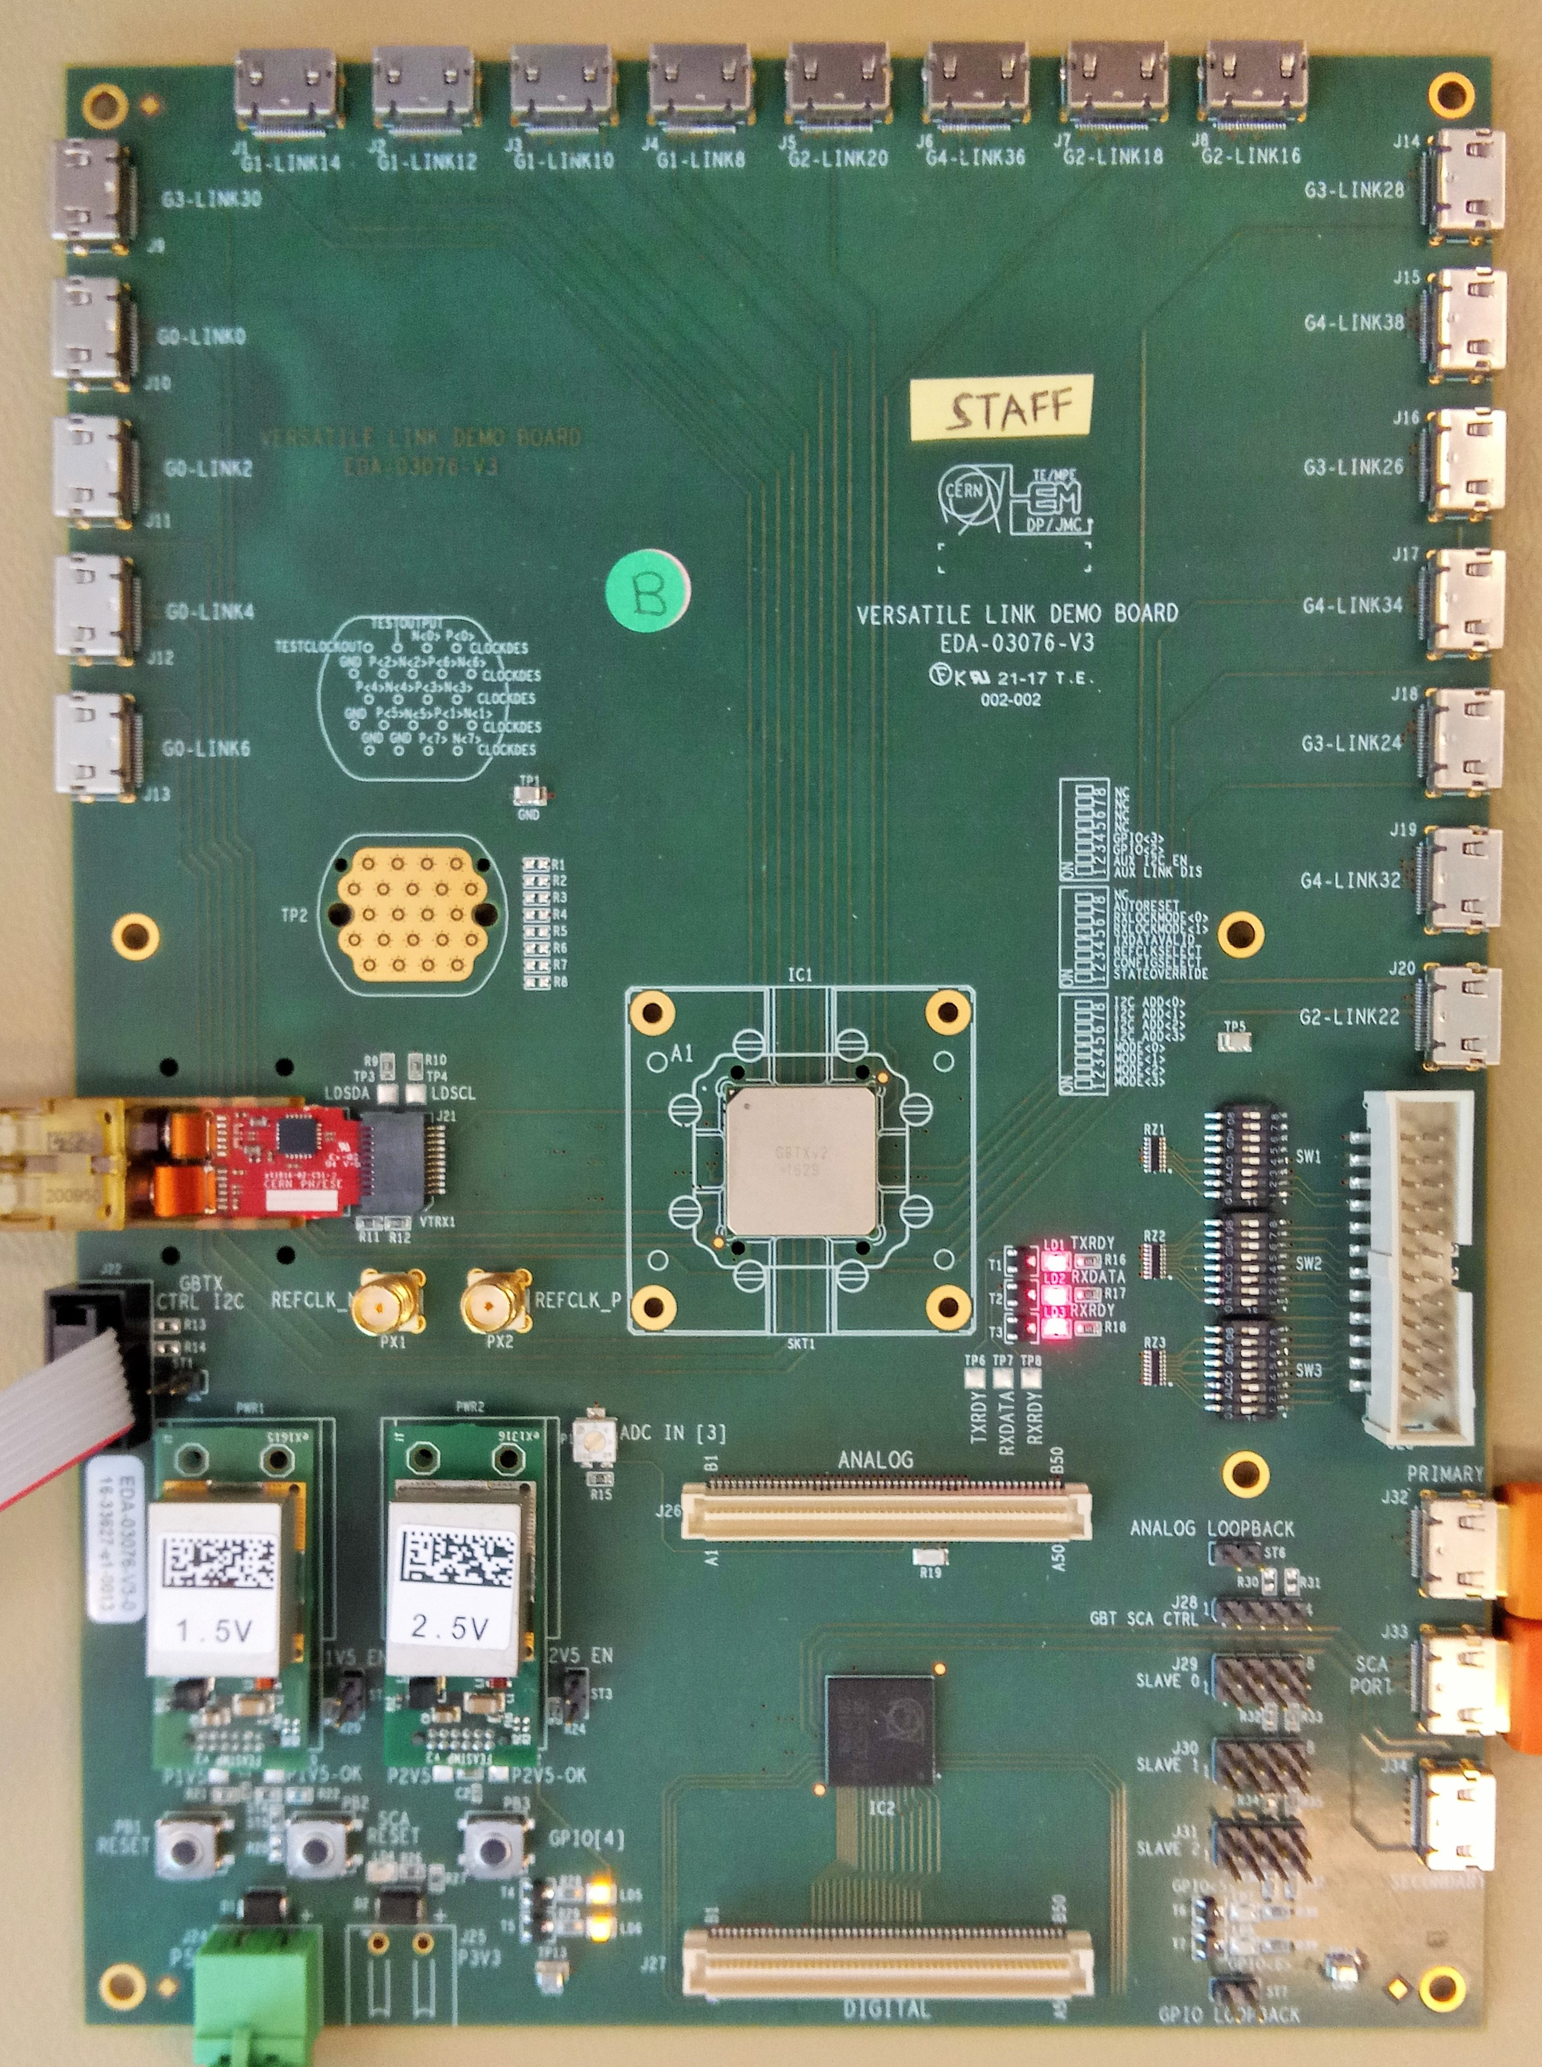
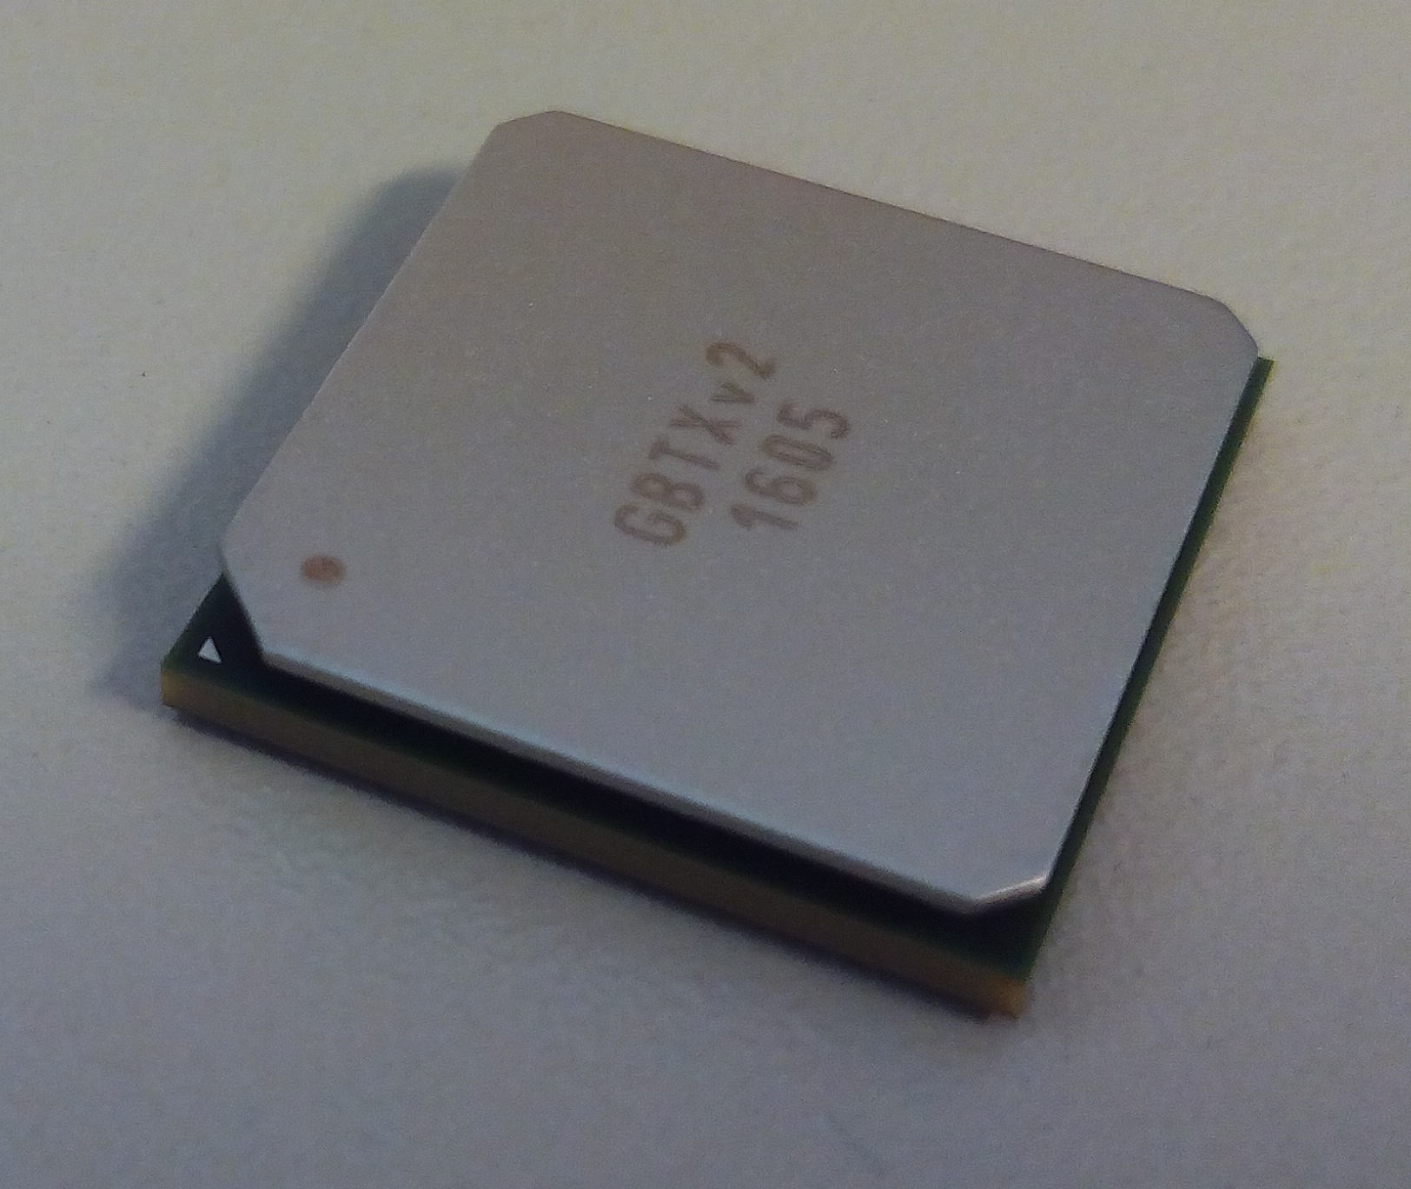
VLDB - Versatile Link Demonstrator Board
The VLDB is an evaluation kit for the radiation-hard optical link ecosystem.
It houses the GBTx and SCA ASICs (Application-Specific Integrated Circuit).
The GBTX is used by ALICE, ATLAS, LHCb, CMS and other external experiments, providing serialization, deserialization, data and clock recovery.

Slide 5
Contents
Introduction: The VLDB and the GBTx.
VLDB support.
Ongoing work: LpGBT tester: Hardware, firmware and software.
Conclusions.

Slide 6
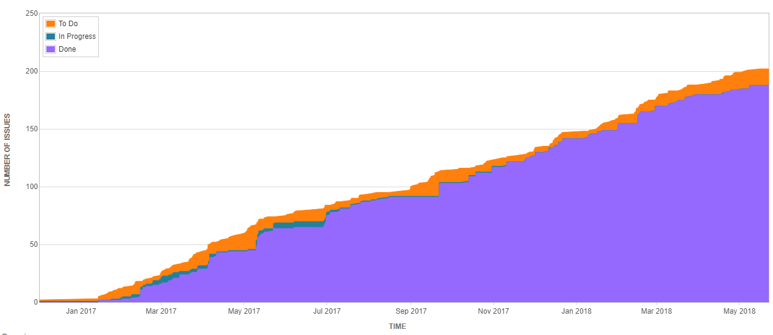
VLDB support through JIRA platform.
FTEC 2015
Raul M. Lesma finishes his contract. I get the total responsibility of the VLDB support.
Start of my contract and trying to solve some issues.
At present
JIRA software for VLDB support is created.

Slide 7
Contents
Introduction: The VLDB and the GBTx.
VLDB support.
Ongoing work: LpGBT tester: hardware, firmware and software.
Conclusions.

Slide 8

A new GBT is being submitted: LpGBT.
HL-LHC experiments demand a higher data rate, more radiation hardness and less power consumption electronics.
It will be tested: To test this chip two dedicated boards will be made: the Mezzanine and the Breakout boards.
I am in charge of the infrastructure firmware part and the software implementation. I am not it charge of the hardware part but is necessary to be acquainted with it.
It will be available at the end of 2018.
4.8 Gb/s
2.2 Watts
130 nm CMOS
~100 Mrad total dose
10.24 Gb/s
0.5 Watts
64 nm lp-CMOS
~200 Mrad total dose

Slide 9

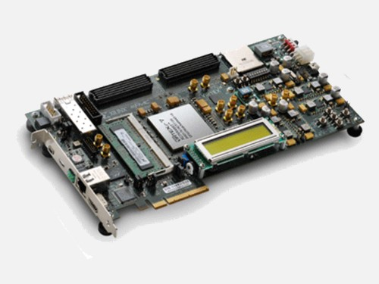
Mezzanine and Breakout boards.
These boards will be made to test the LpGBT ASIC and ensure its functionality.
They will be connected to a Virtex-7 FPGA through its dual FMC form factor connectors.
The Mezzanine board houses the LpGBT.
The Breakout board can be connected to the Mezzanine, it is a complementary board.
Most of the LpGBT signals will go through the Breakout board to the FPGA through the dual FMC-HPC connectors.

Slide 10
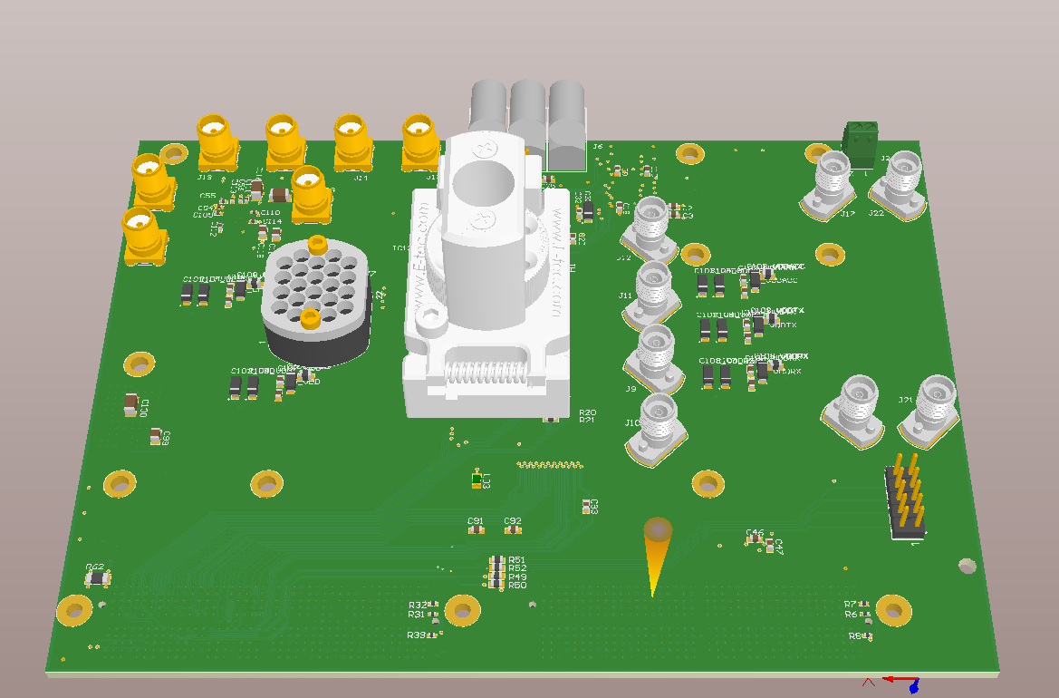
Mezzanine board: Main test board.
TOP
It will house the LpGBT chip on a test socket. We can test several LpGBTs.
SMA Reference clocks.
It has an SMA and a bullseye connector for the LpGBT clock analysis.
VTRx+ test board connector.
Made by David Porret.

Slide 11
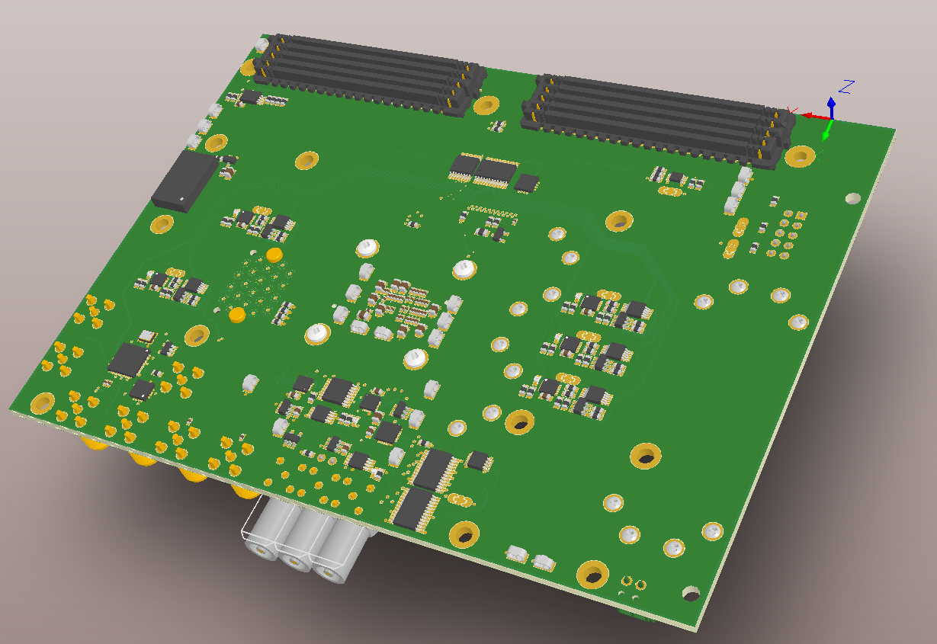
Mezzanine board: Main test board.
BOTTOM
Dual FMC-HPC connectors for the link to the VC707 FPGA.
Temperature sensor (I²C).
Clock generator (I²C).
Programmable power supplies (I²C).
DAC & ADC (SPI).
Delivery on August.
Made by David Porret.

Slide 12
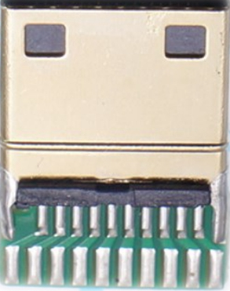
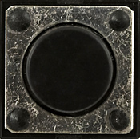
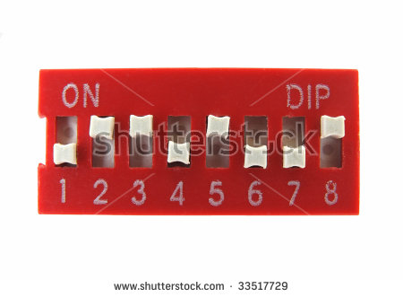

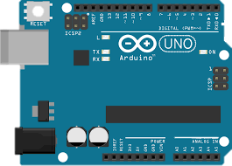
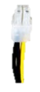
BoB: Break Out Board, a secondary board.
Full FMC connectivity
GPIO
Control
I2C masters x3
SC Elink
Reset
I2C-USB Dongle
(LpGBT control)
Elink clk
pairs (x24)
Elink clk pairs (x16)
ClockDes pairs (x4)
Elink Din pairs (x4)
Arduino
Power Plugs (x3)
Power supplies, clock and ADC, control.
Reduced FMC connectivity (control, Elink Din)
>> Under design.
Full characterisation test board.

Slide 13
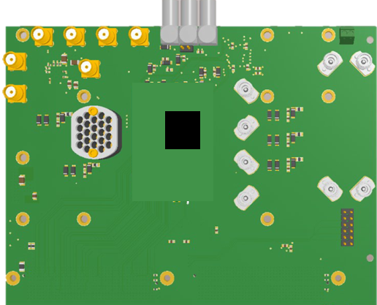
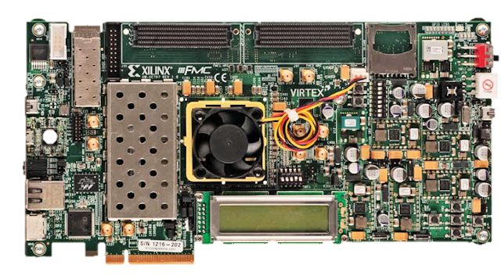
Different configurations for different tests.
LpGBT
Functional tests.
Clock characterisation.
Radiation tests.
Production tests.
Debugging.
Full characterisation.
More specific tests.

Slide 14

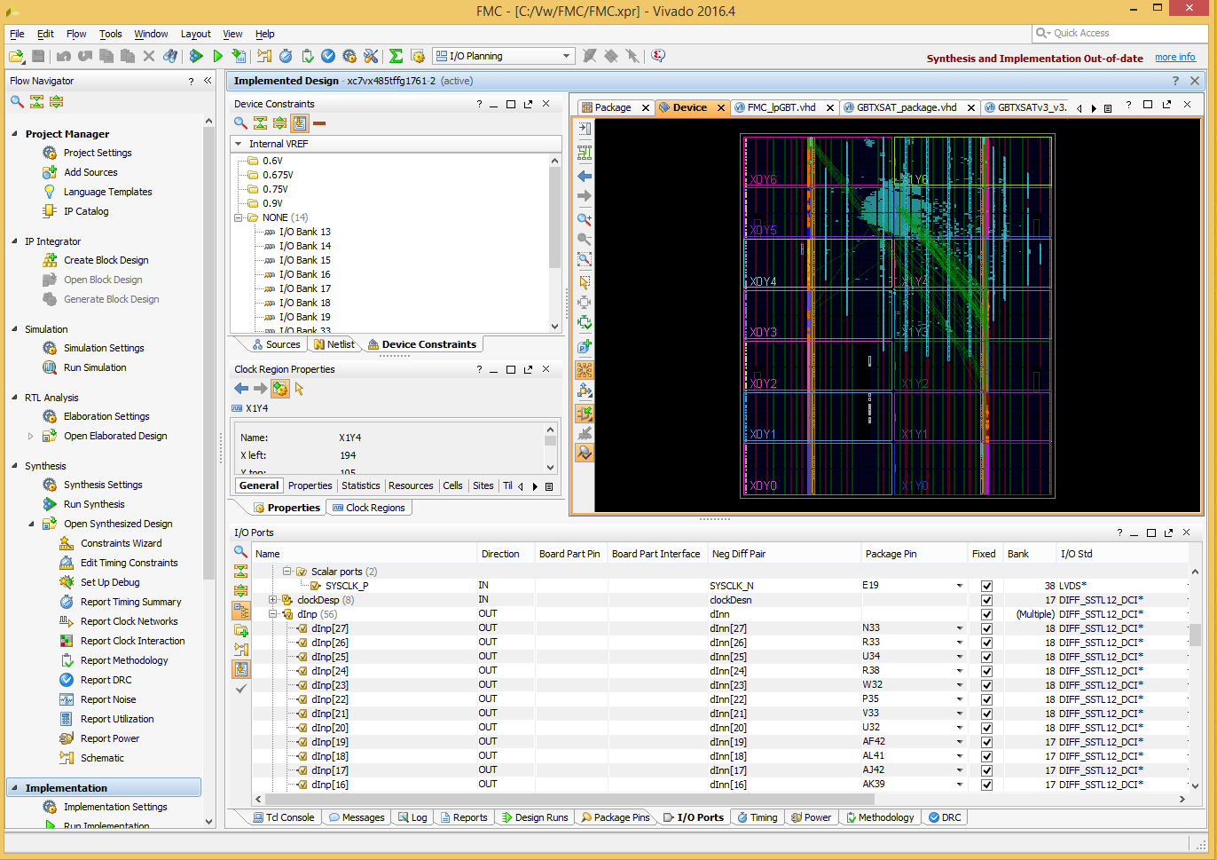


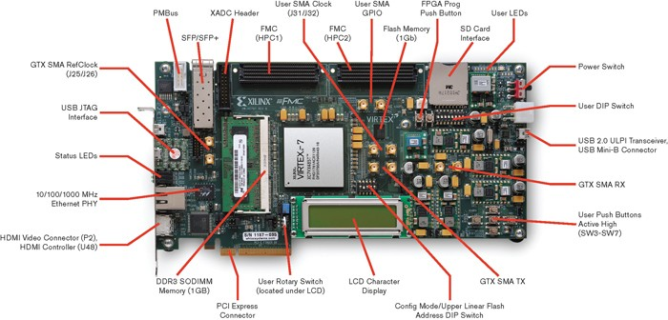
Firmware infrastructure implemented on the VC707 FPGA.
The firmware is based on the IPBus protocol to communicate with the FPGA via Ethernet from the computer.
All the LpGBT signals are mapped onto the VC707.
Several slaves are inside the IPBus protocol. More must be added.
So far, GPIO, I²C and SPI slaves are implemented.
They control the environment: voltage, temperature, power, reference clocks…

Slide 15

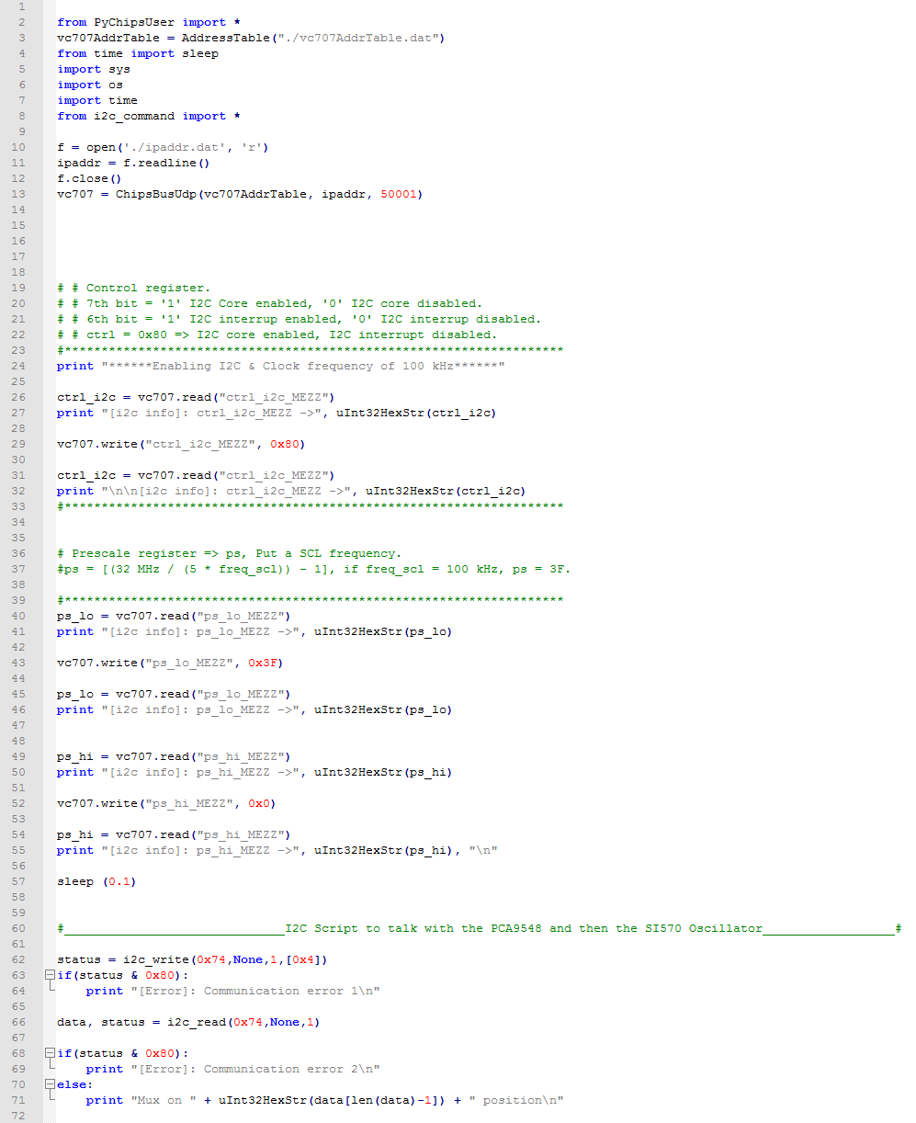
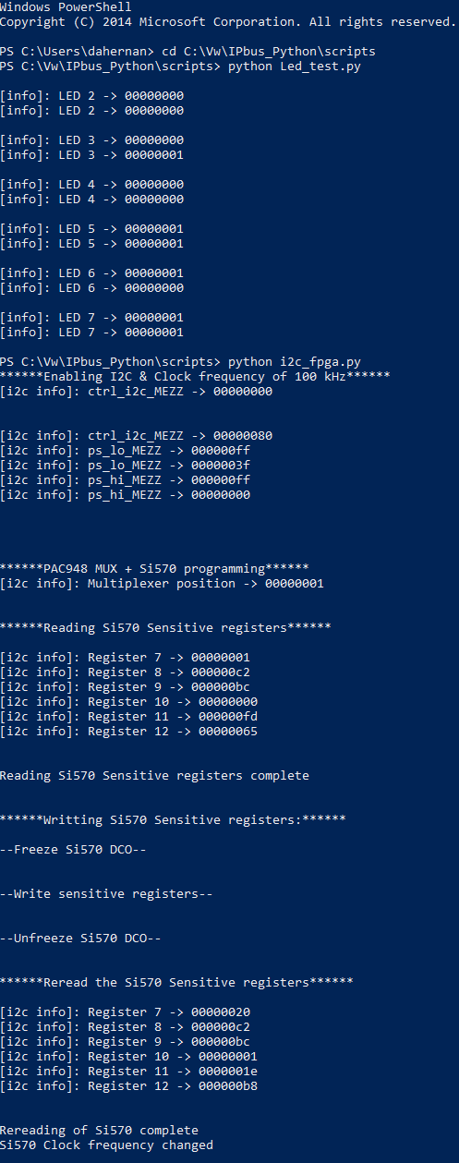

Python scripts to control the mezzanine board.
Python scripts to communicate with the slaves.
Scripts to simplify the I²C and SPI protocols have been written.
One big script to test the I²C and SPI modules is being made.
Next step: Test the mezzanine board in practice.

Slide 16
Contents
Introduction: The VLDB and the GBTx.
VLDB support.
Ongoing work: LpGBT tester: hardware, firmware and software.
Conclusions.

Slide 17
Conclusions
We are on the final stage of the firmware and software implementation of the LpGBT tester.
The Mezzanine board will be available in 2 months: tests of the Mezzanine board without LpGBT will be done.
VLDB support is a parallel work that also requires time: So far, we have answered to around 200 requests from users.
Future work:
Finish the necessary scripts to test the I²C and SPI protocols with the mezzanine’s modules.
Write python code to control these modules, ensuring a good LpGBT analysis on its start-up.
Contribute to the rest of the LpGBT automated tests.
Next VLDB generation: VLDB+ (LpGBT + SCA + VTRx+).

Slide 18
Thank you for your
attention.

