Slide 1
TE6770 – Design and implementation of a versatile readout system for a second-generation quench detection system
FTEC 2017 2nd Workshop
Daniel Blasco Serrano

Slide 2
Table of contents
Universal Quench Detection System (uQDS)
  Description and state of the art
  FW developed
    Slow readout
    Fast readout
    Others
DQLPU-B Quench Detection Unit Testbench
  Description and state of the art

Slide 3
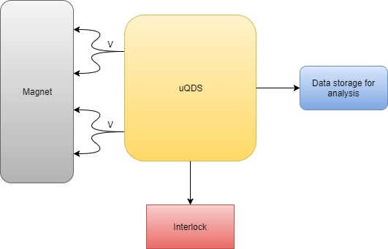
Universal Quench Detection System (uQDS)
Measures different voltages in the magnet and compares them to detect an increase of resistance (quench)
In case of quench, cuts the Interlock loop, which will start magnet protection systems and dump the beam
Universal
  High frequency and high resolution acquisition for analysis
  Up to 16 independent channels for any magnet protection. Any quench detection algorithm can be programmed
  Other possible uses as DAQ

Slide 4
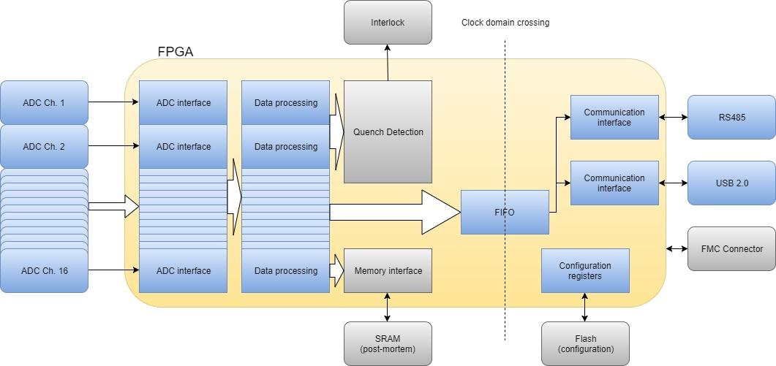
Description of uQDS
Description
  FPGA based with up to 16 ADC connected
  Samples are filtered and processed for quench detection (comparing voltage values) → high flexibility
  Online acquisition system and post-mortem
State of the art
  First version of firmware almost finished
  Hardware version 2.1 almost finished (FW migration needed)
  Will be used as quench protection device for FAIR magnet in SM18

Slide 5
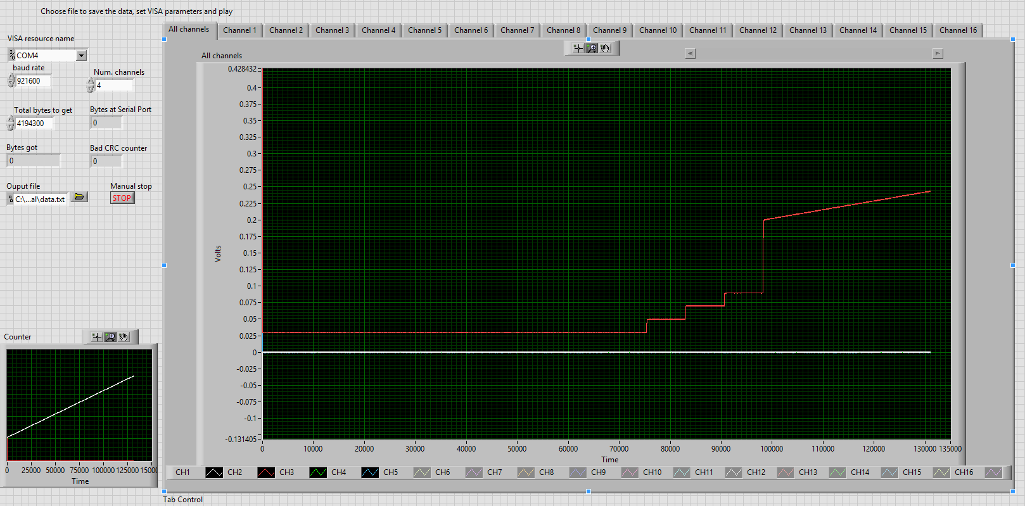
FW: Slow readout
Read rate slower than acquisition rate (data needs to be stored before being transmitted)
Using UART protocol
Combined with SRAM modules to store several milliseconds of data
Readout software with error detection (1 byte CRC per sample in all channels)
Achieved error of ~0% in packet transmission

Slide 6
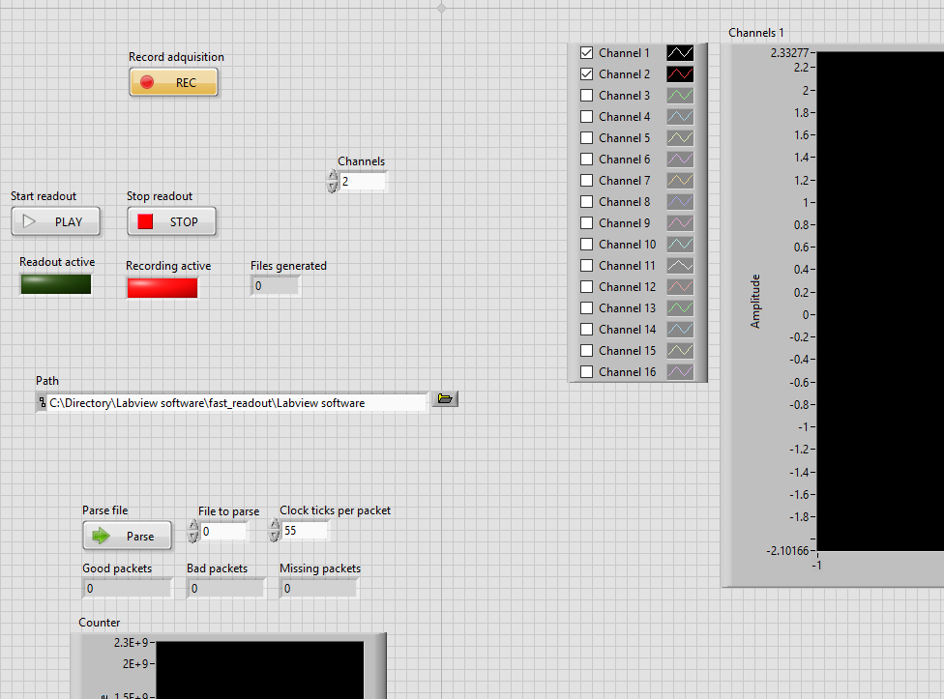
FW: Fast readout
Read rate faster than acquisition rate (it is possible to save data while being acquired indefinitely)
Readout software with error detection (1 byte CRC per sample in all channels)
USB 2.0 chip used: FT232H
  It works with its own clock: needs clock domain crossing strategies
  Specific communication protocol that needs to be analyzed

Slide 7
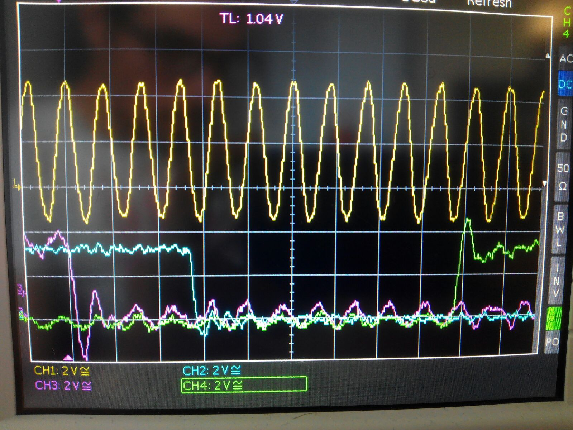
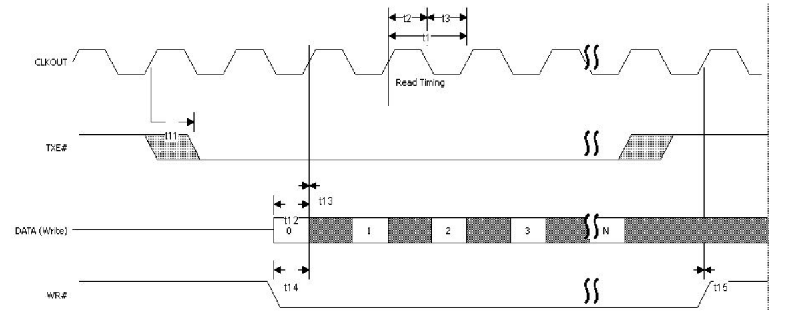
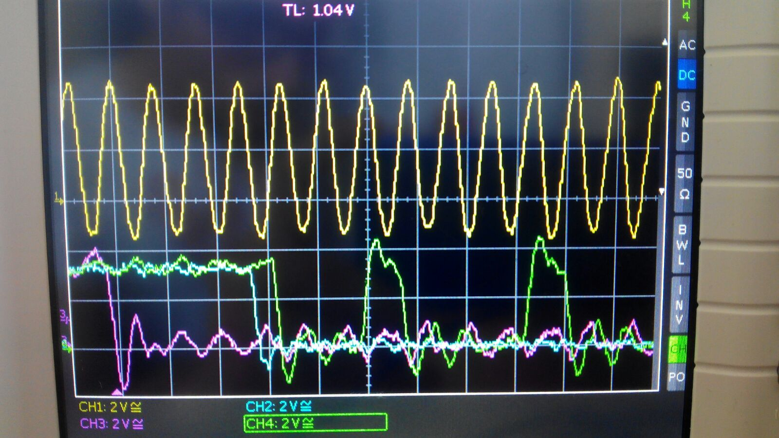
FW: Fast readout communication protocol
Yellow: clock
Pink: TXE#
Blue: WR#
Green: data
FT232H datasheet. Source: FTDI
Problems:
Internal FPGA delays
Working with rising and falling edge of the clock

Slide 8
FW: Others
Added quench detection logic. Firsts tests performed (simulated signal)
Adapted existing SRAM logic modules (used for post-mortem)
Tested flash memory modules for saving actual configuration
Added SPI (previously UART) communication for register configuration

Slide 9
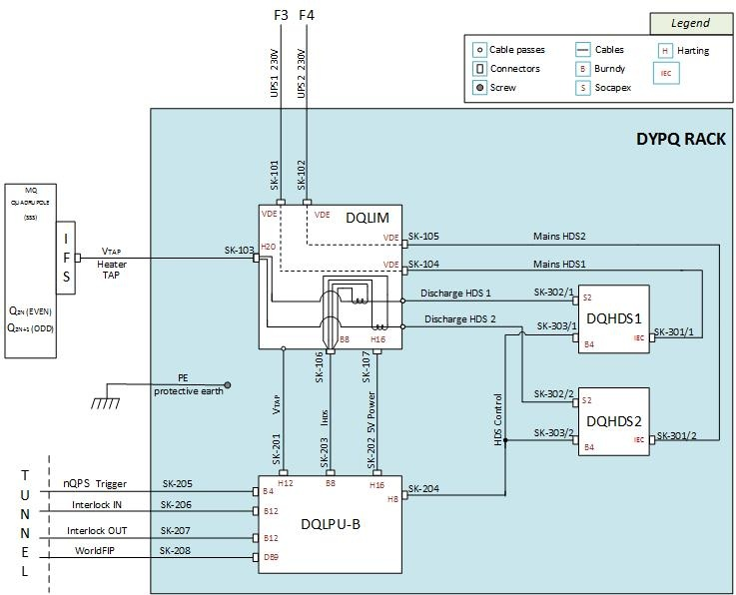
DQLPU-B Quench Detection Unit Testbench
Part of a Quench Protection System for quadrupole magnets
  Quench detector
  Heater monitor
  Interlock
  WorldFIP communication
Tests to be performed
  Validation
  Functional

Slide 10
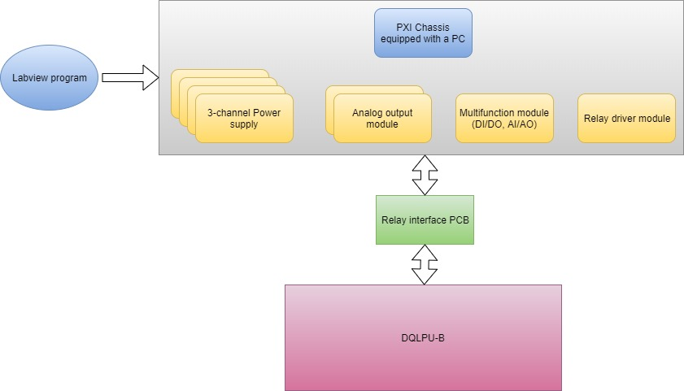
State of the art
Validation test list under development
  Power supply tests (redundant or total voltage fail, power up, power cycle, …)
  Quench heater signal tests
  Quench detection (simulation with real data of quenchs)
  Others: communication, testmodes, other functionalities, …
Relay PCB corrections and redefinition
  Crosstock, anti ESD, …
  Definition of the hardware needed using the test list

