Slide 1
Integration Tests and Commissioning of the Upgrade of the ATLAS Liquid-Argon Calorimeters Trigger Readout

Slide 2
Outline
Introduction
  ATLAS Liquid Argon Calorimeter (LAr)
  LAr measurement
LAr Phase 1 readout electronics upgrade
  Higher granularity for Trigger
  LAr Phase 1 trigger readout upgrade
  Phase 1 Back End System
  My role in the past 4 months
  LDPB temperature & power monitoring
  LTDB pulse on local monitoring PC
  LArC + 2 LATOME in USA15
  My work - injector/checker for devkit
  Future work

Slide 3
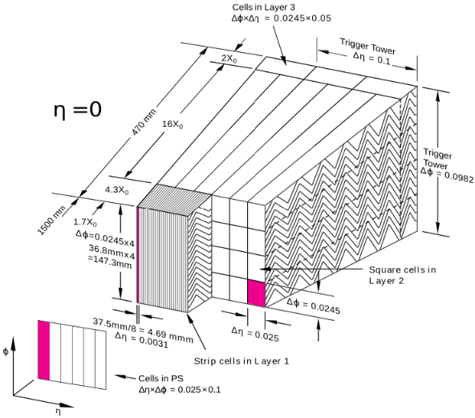
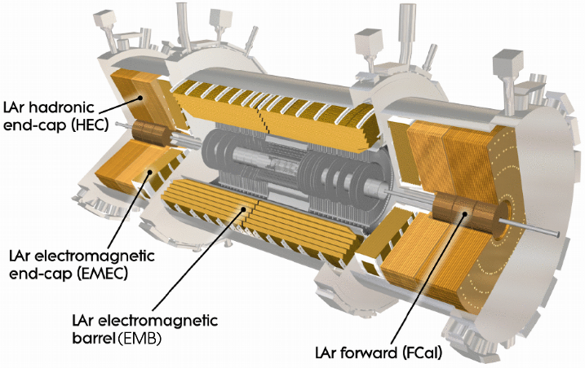
ATLAS Liquid Argon calorimeter
Main goal: measure path and energy of electrons, photons and jets
Lead / Liquid Argon sampling with accordion geometry
Total of 180k calorimeter cells
3k Trigger Towers: group of cells in (η,Φ) of size 0.1 x 0.1
4000 tons
Liquid Argon (LAr) calorimeters cells
3
12m
2
1
0
8m
Trigger Tower

Slide 4
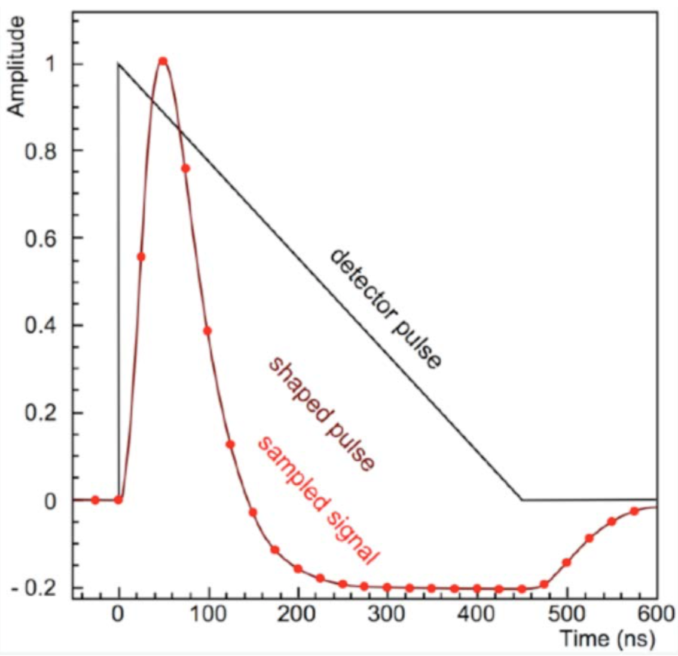
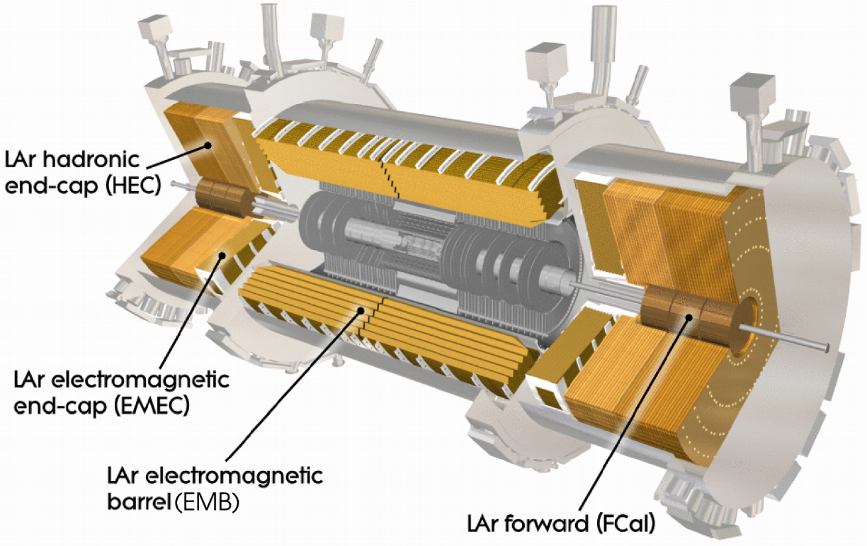
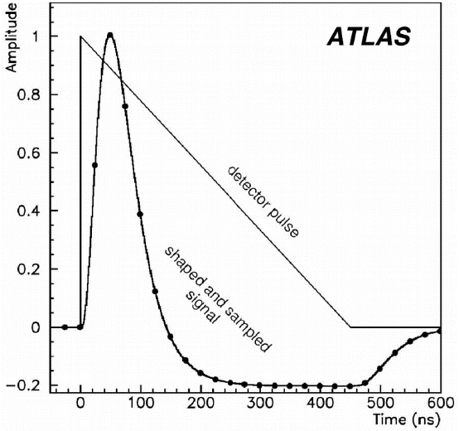
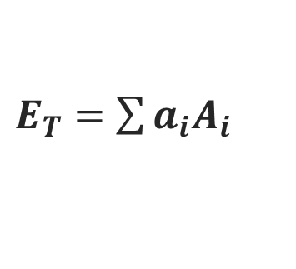
LAr measurement
LAr calorimeter
LAr ionization pulse
Energy calculation
$E_{T}=$ $\sum{a_{i}A_{i}}$
coeff.
ADC
sample
Incoming particles create a shower
Electrons in shower ionize Liquid Argon
Ionization electrons create a current

Slide 5
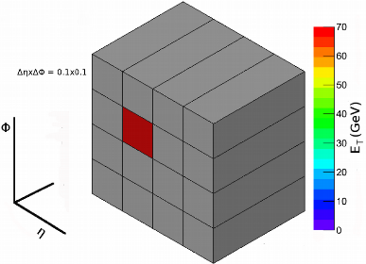
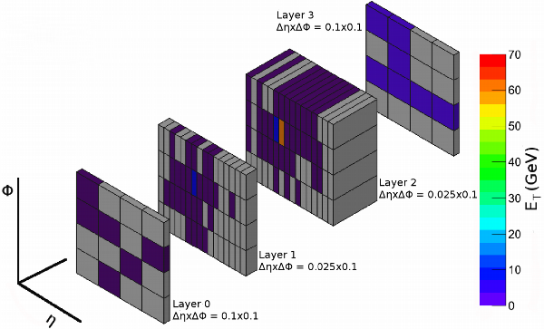
Higher granularity for Trigger
Simulation of electron with 70 GeV of transverse energy
Trigger Towers
Super Cells
LAr Phase 1
Upgrade
10 times finer granularity
Current Trigger Tower: provide limited performance → similar results despite event rate increase
Improvement: Trigger Tower → Super Cells (lateral + longitudinal segmentation)
  Higher trigger resolution → enhanced rejection algorithms → higher quality data

Slide 6
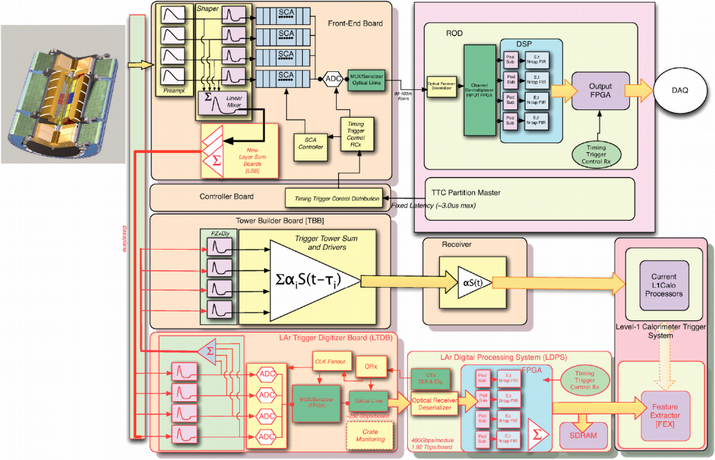
LAr Phase 1 trigger readout upgrade
Current system:
Analog Trigger
3000 TT
Upgrade system: Digital Trigger
30000 SC

Slide 7
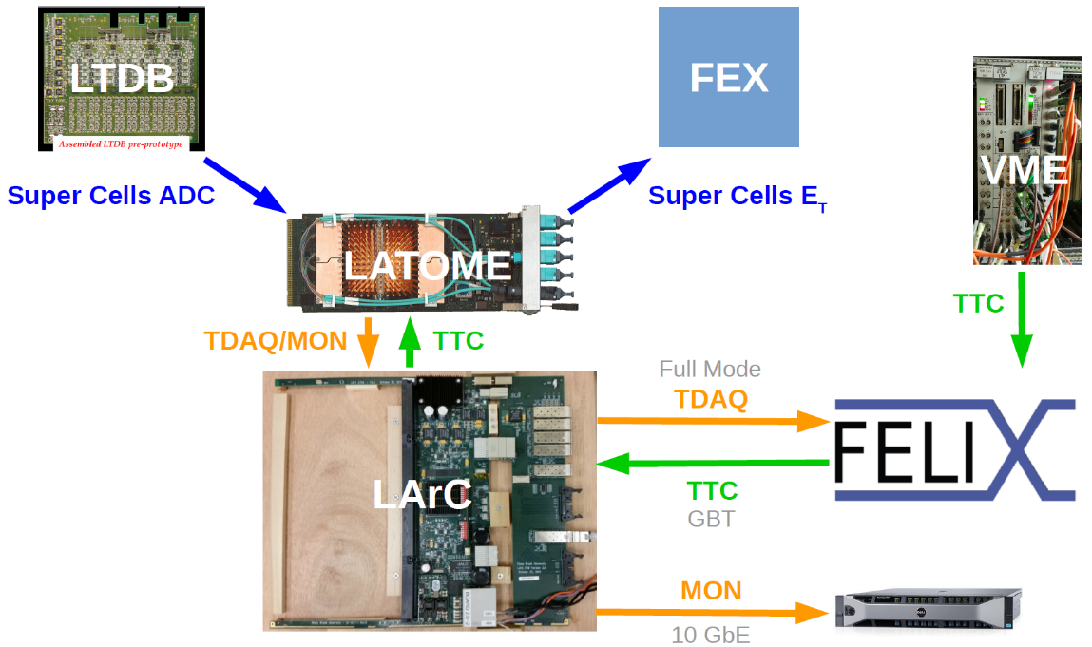
Phase 1 Back End System Test
TTC
partition
MGT
LVDS

Slide 8
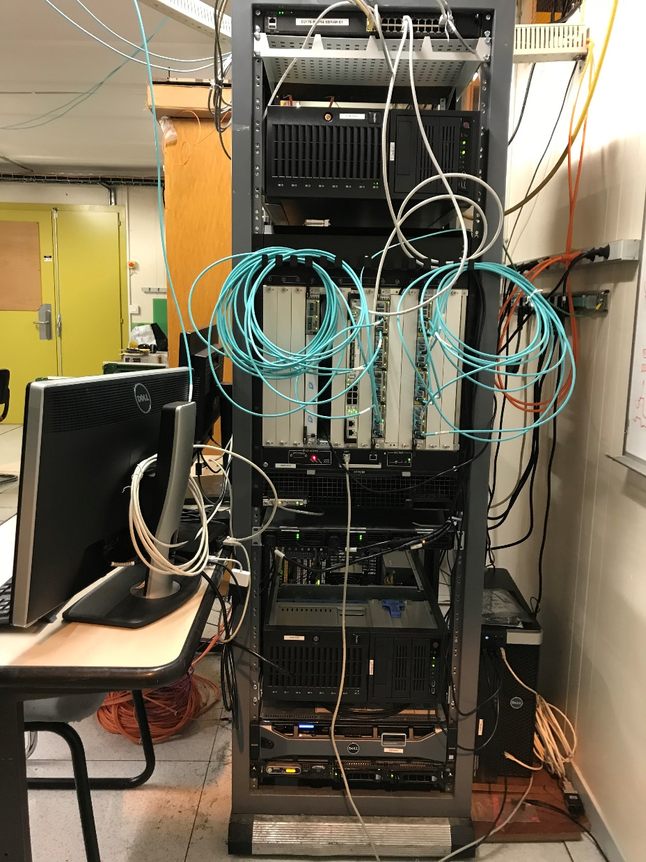
My role in the past 4 months
Participate in the developments needed to integrate BE readout with real data coming from a LTDB prototype
BE readout validation tests in laboratory:
  Power & temperature monitoring
  LTDB pulse recorded in local monitoring PC
Report progress in meetings
Firmware development (VHDL, Python)
  Improve TTC block and TTC testbench (ongoing)
  Injector/checker for Development Kit (ongoing)
Elaboration of documentation
BE system crate

Slide 9
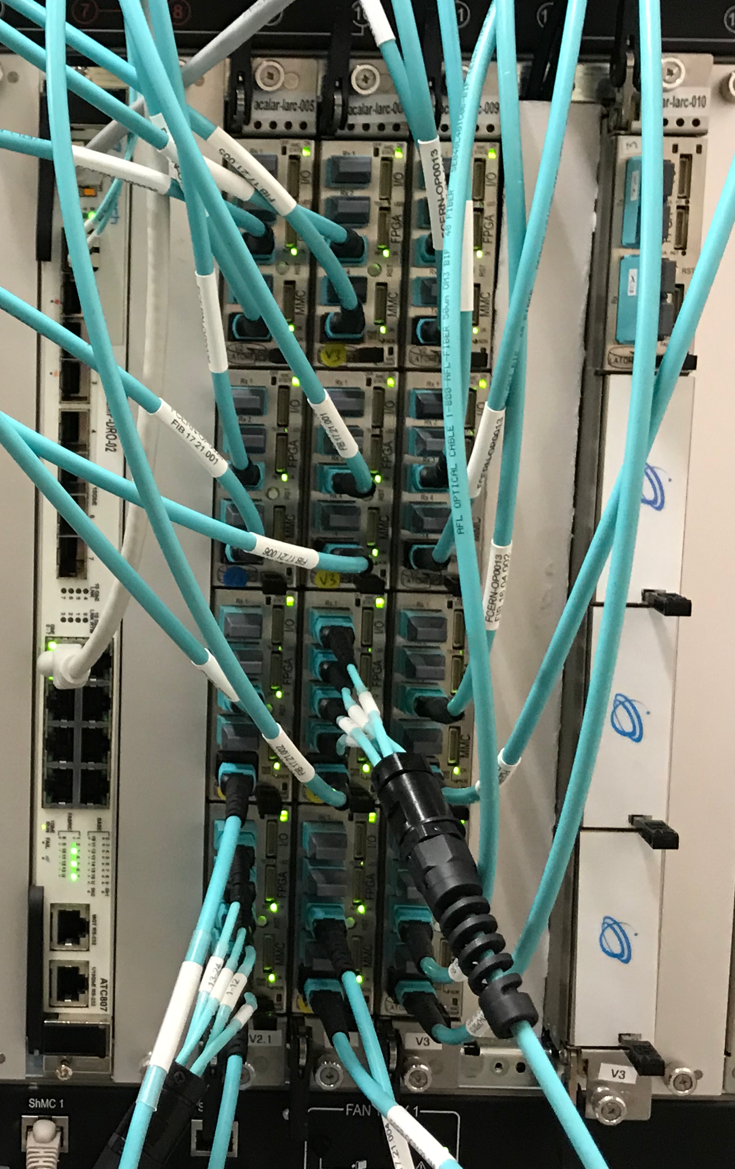
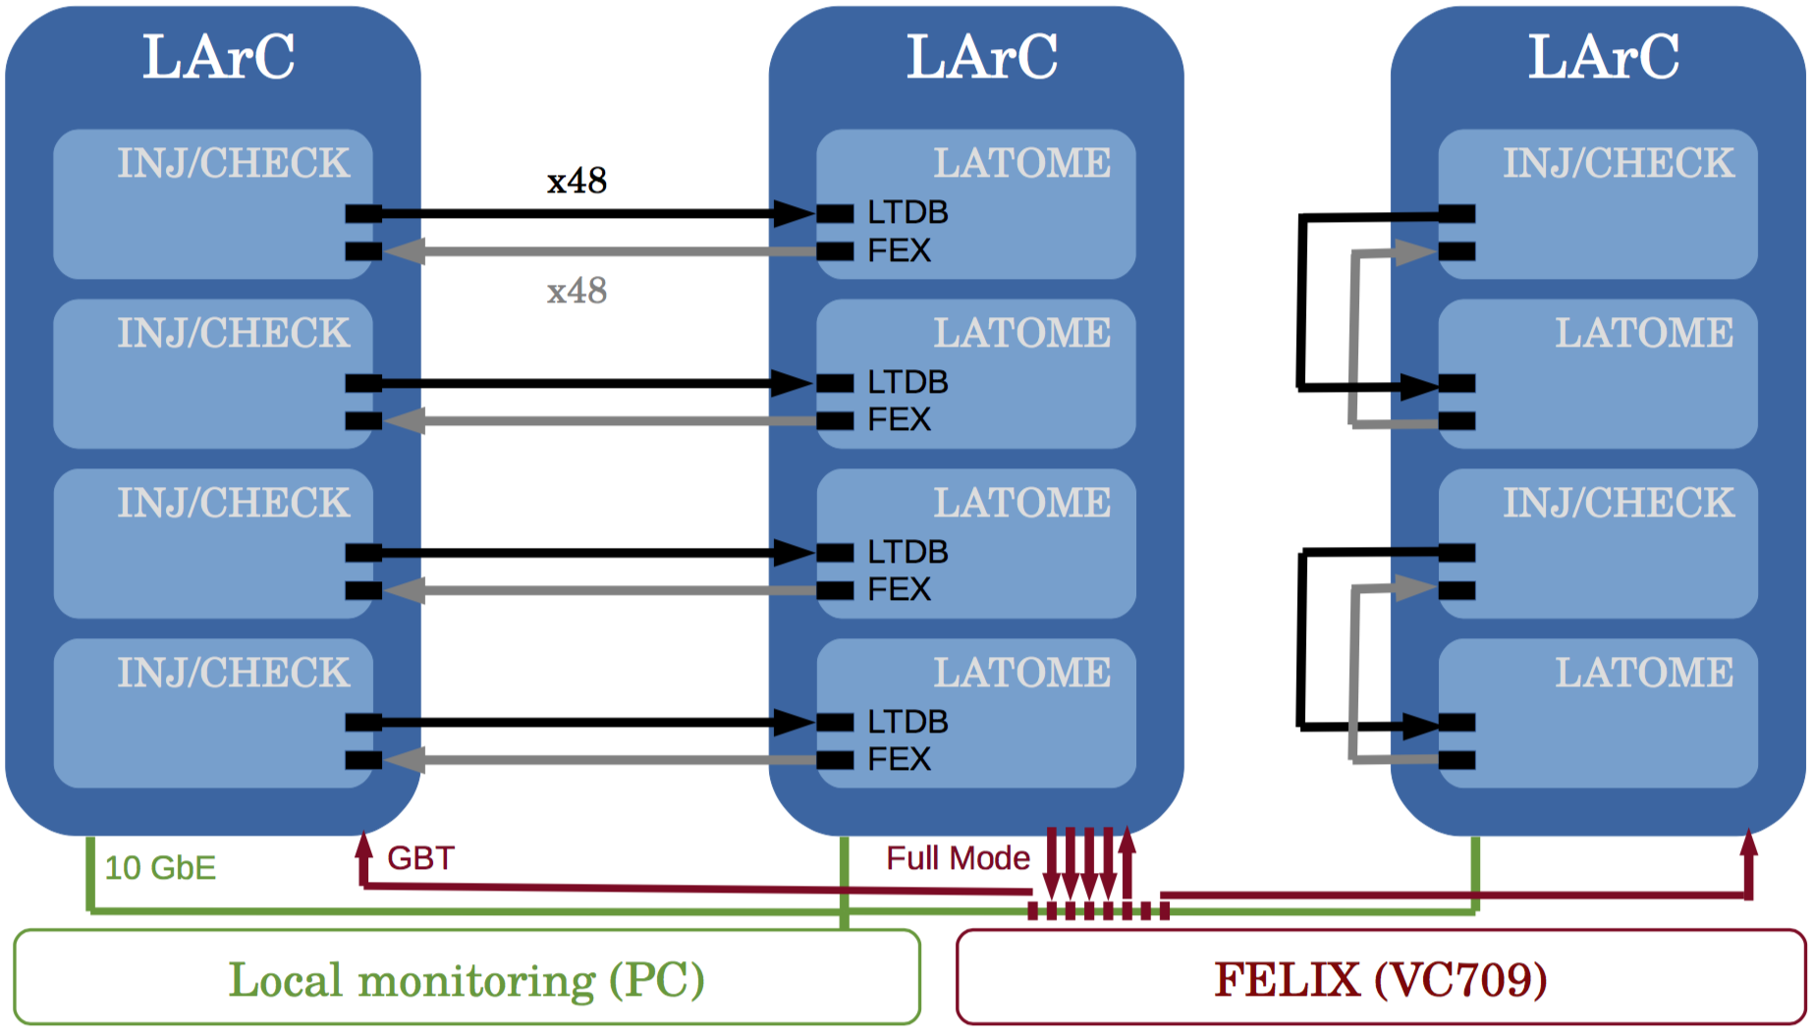
LDPB power & temperature monitoring
3 LArC fully loaded: 5 LATOME v2 + 7 LATOME v3
LArC of reference

Slide 10
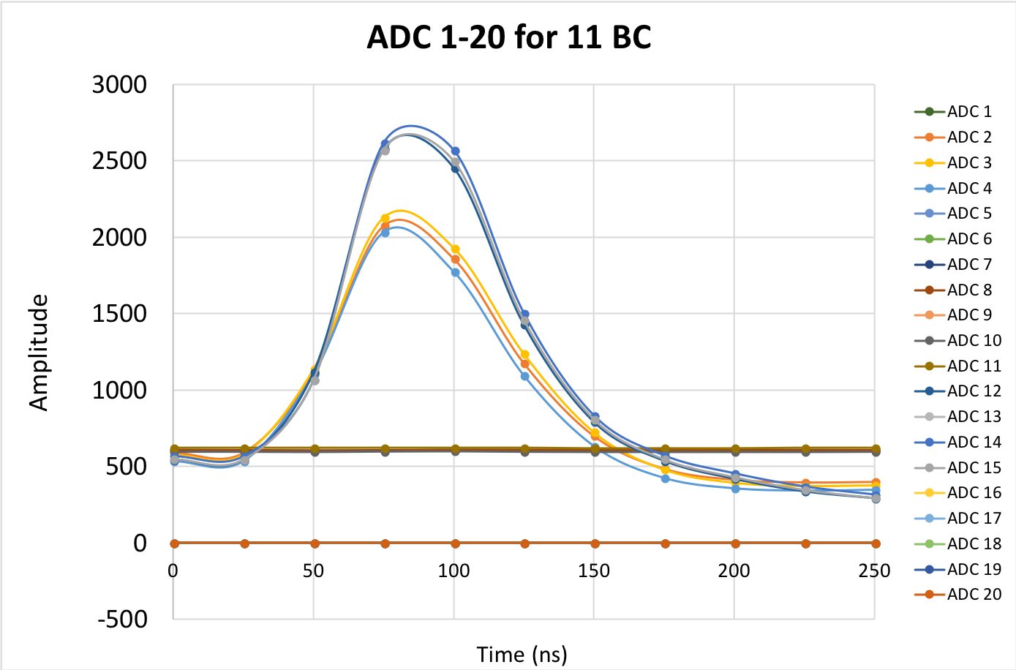
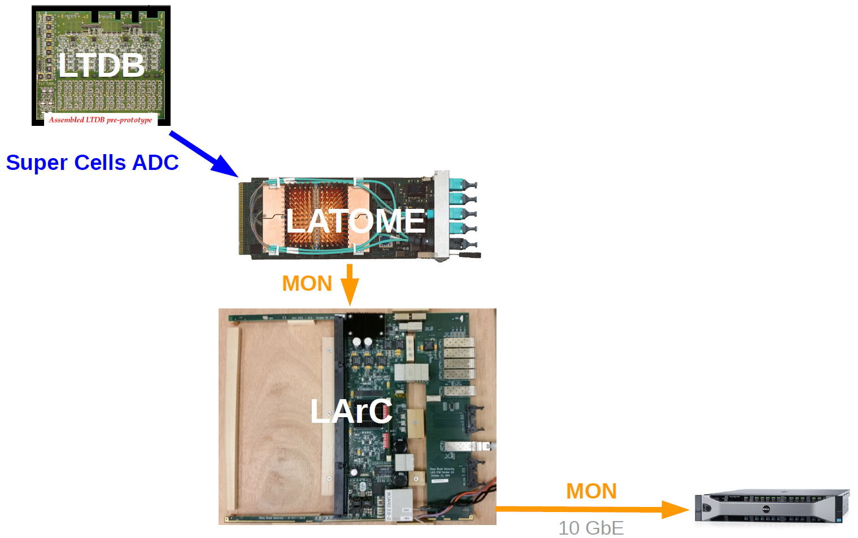
LTDB pulse on local monitoring PC

Slide 11
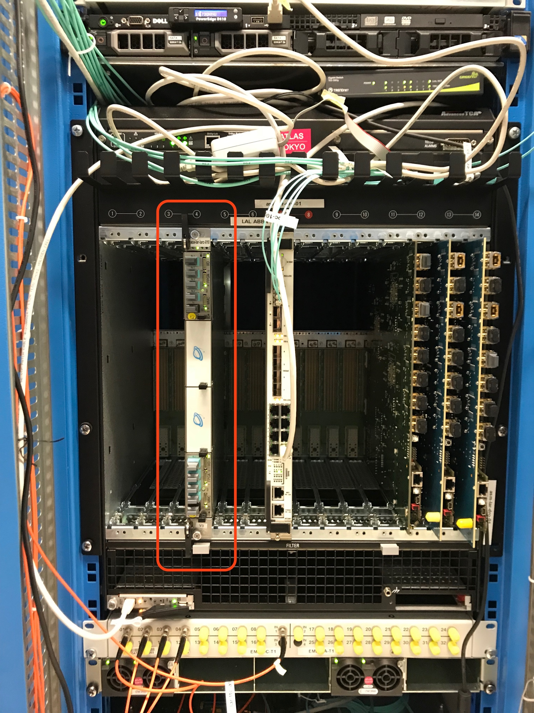
LArC + 2 LATOME in USA15
LArC + 2 LATOME installed in USA15
  Since last week up and running
When will the BE demonstrator start taking real data?
  Solve bugs in LATOME firmware
  Validate that all ADC values are correctly recorded in local monitoring PC
ATCA crate in USA15

Slide 12
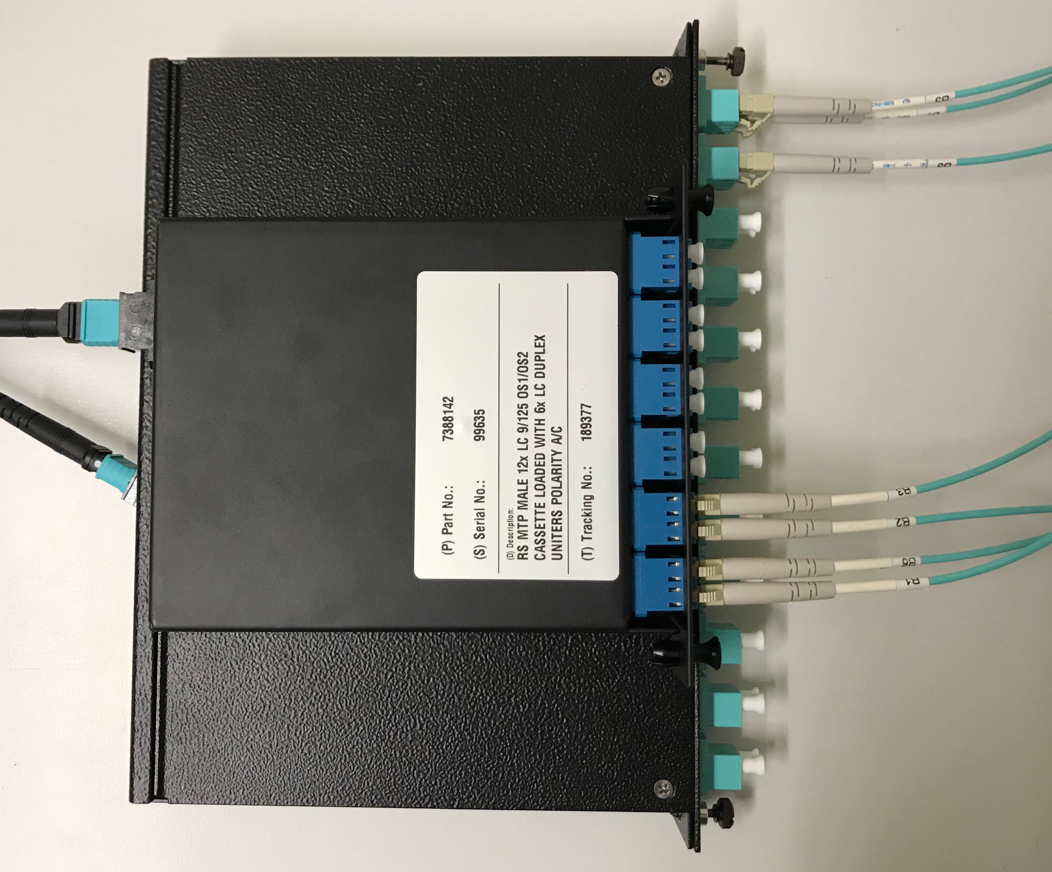
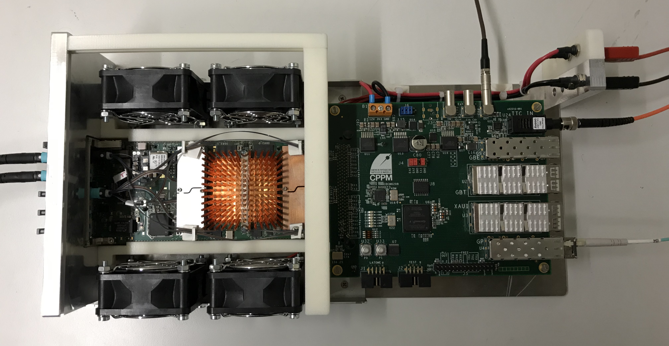
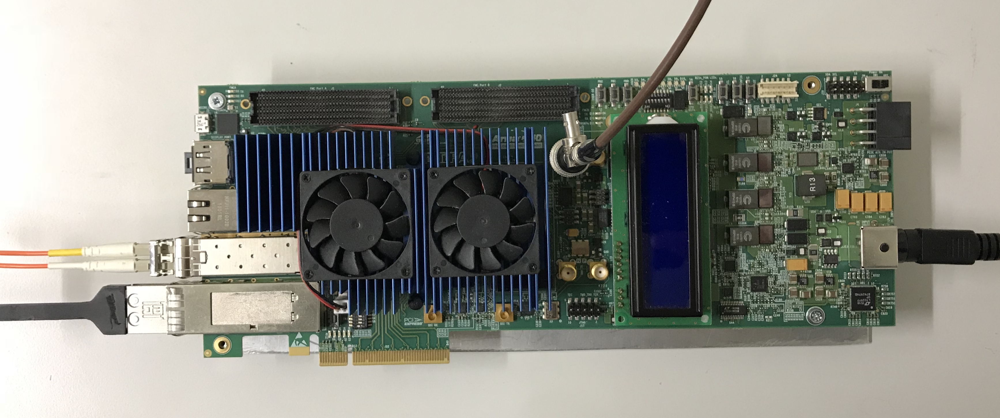

My work – injector/checker for devkit
MTP to LC
CLK @ 160 MHz
RX
3
RX
4
TX
TX
8
DIN
Power supply
(12 V)
Power supply
(12 V)
LATOME
IPBUS (rd/wr registers)
SMA
TTC VME
Arria 10 Development Kit
TTC @ 1.28Gb
1 GbE
LATOME test
QSFP
LATOME firmware ($E_{T}$^{Super Cell})
pattern generator (injector) + FEX (checker)

Slide 13
Future work
Continue with the development of the injector/checker project for Arria-10 Development Kit
Continue with the developments needed to integrate the BE readout
Firmware development for LATOME board
Validate demonstrator in USA15 during 2018 p-p run
Full system installation & commissioning in 2019-2020. In run 3 the system operation is mandatory because of the expected higher luminosity

Slide 16
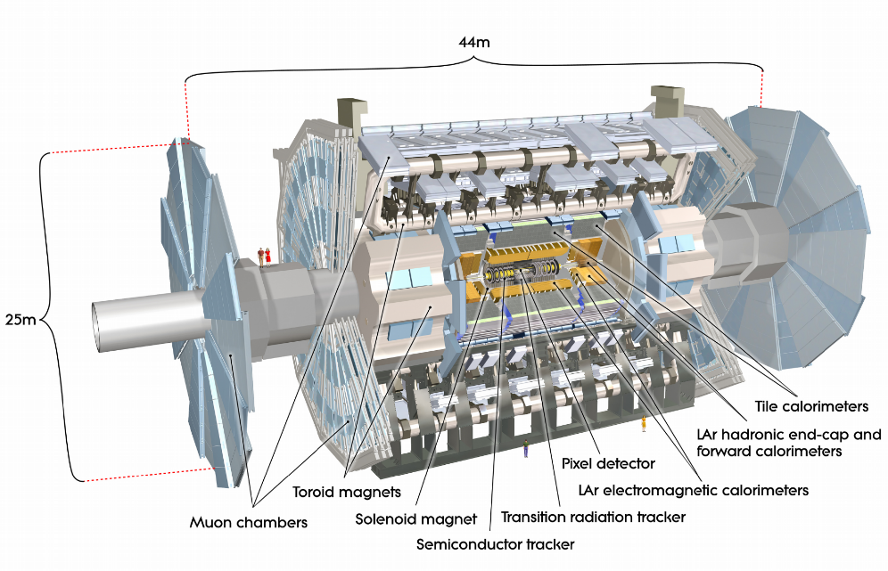
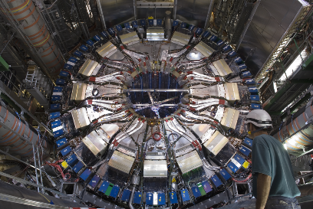
ATLAS detector
Multi-purpose detector with Forward-Backward symmetric cylindrical geometry
Designed to study elementary particles and their interactions
Tracking system
Solenoidal and Toroidal Magnets
Electromagnetic and Hadronic calorimeters
Muon chambers
Overall weight: 7000t

Slide 17
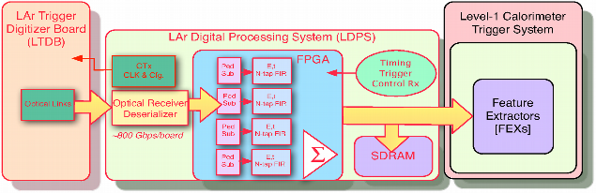
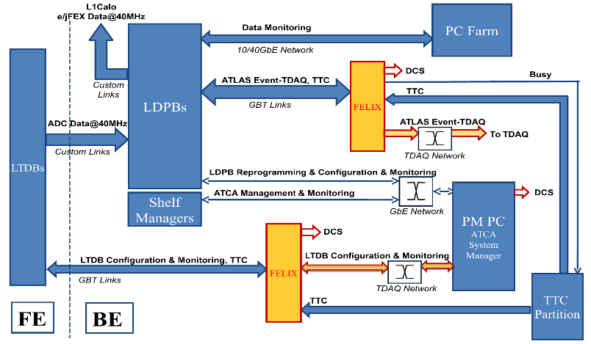
Phase-1 Back End System

Slide 18
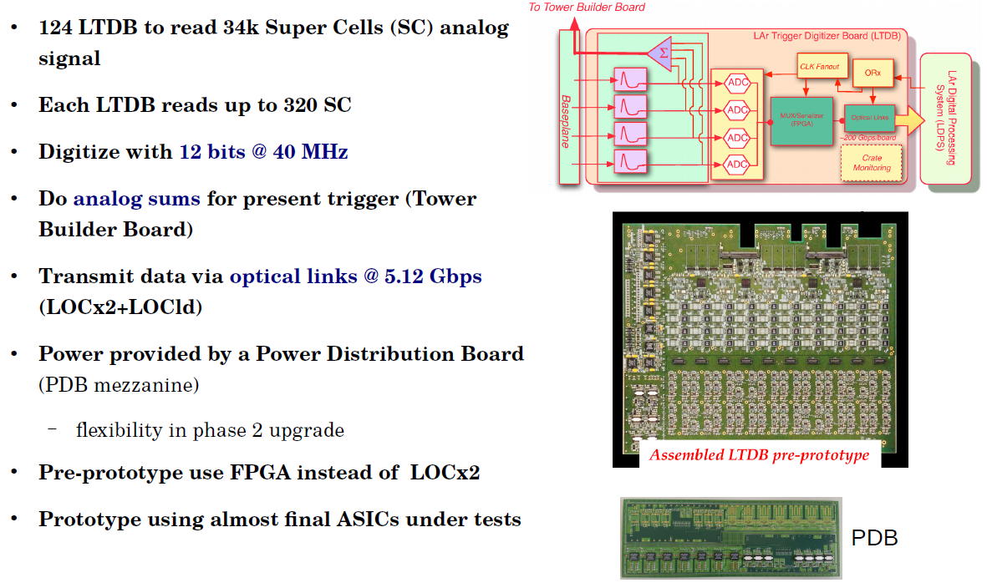
LTDB

Slide 19
My work - TTC testbench
Testbench to generate Timing and Trigger Control (TTC) signals
What are TTC signals? Provide information of the time and type of the trigger events
Clock (LHC @ 40 MHz)
L1A: Level 1 Accept (up to 100 kHz)
BCR: Bunch Crossing Reset (~80 us)
ECR: Event Counter Reset (~30 s)
TType: Triger Type (8bit)
3564
0
1
2
3
4
Event ID:
…
25 ns
8 bit
24 bit
ECR counter
L1A counter
BCID: Bunch Crossing ID [0, 3663]
18

Slide 20
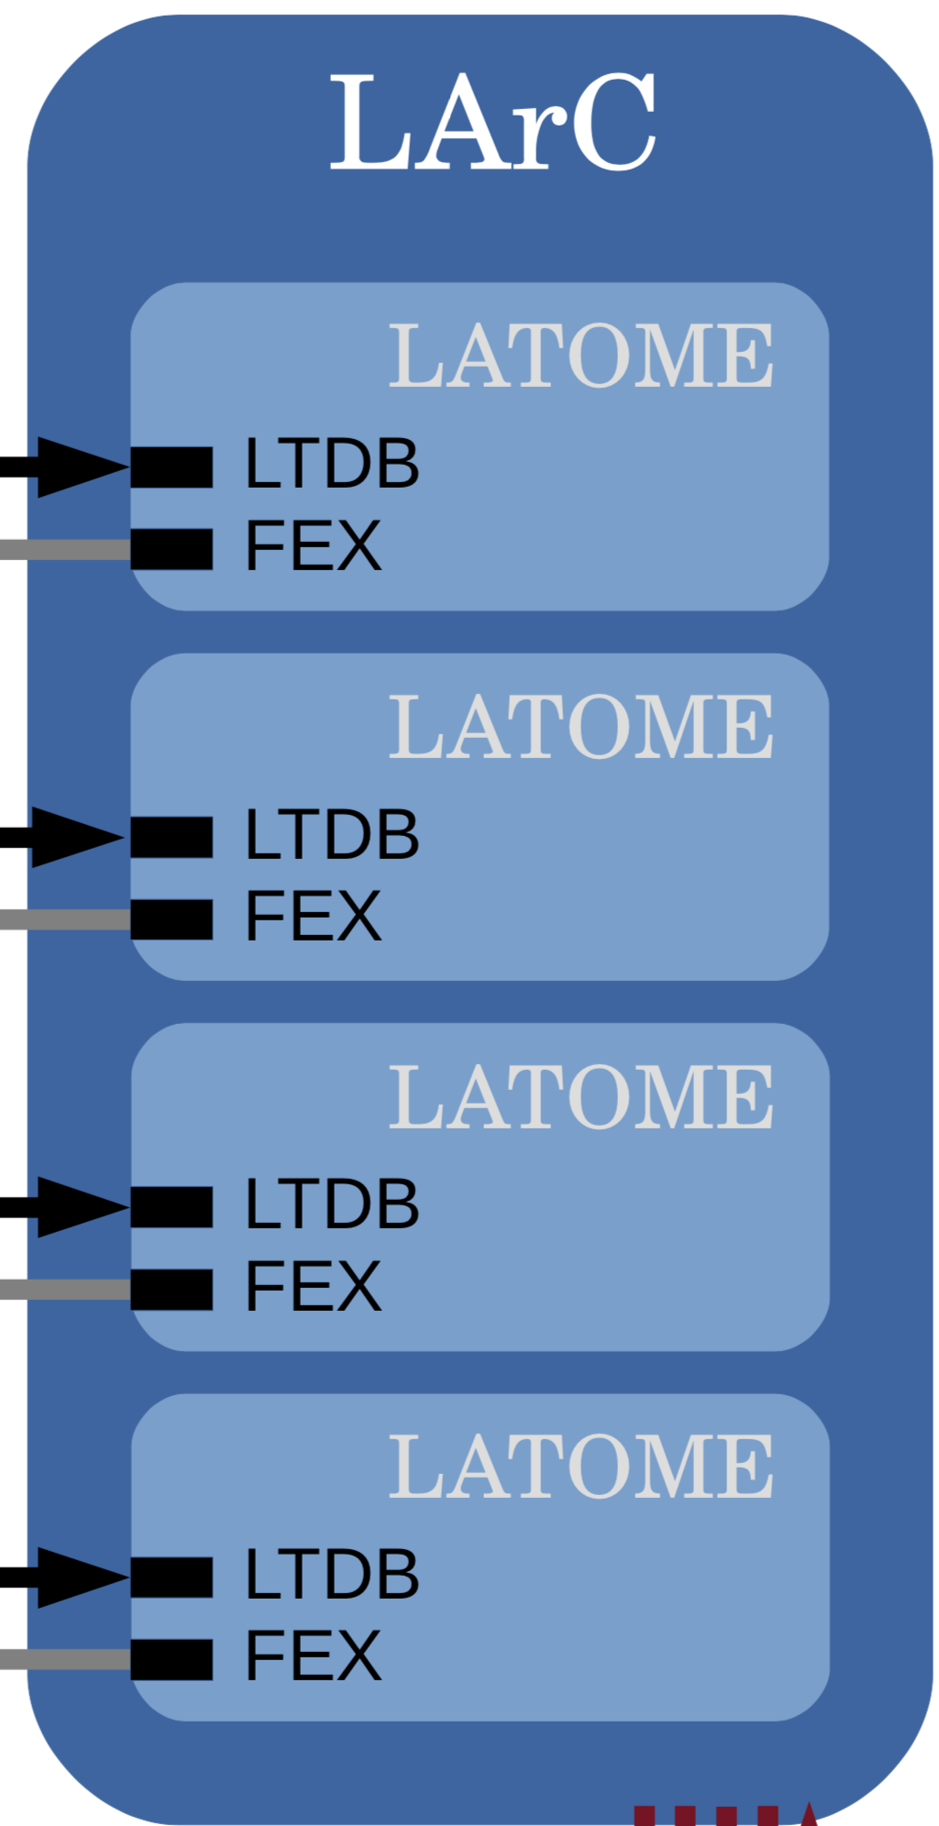
Summary on power & temperature
With final setup with 12 LATOME, running full code (+ baseline corr.)
  Total current: 23.7 A → 284 W (max. allowed 400 W)
  Temperature LArC: 36 °C (max. allowed 70 °C)
  AMC1 : 5.5 A, 76 °C (max. allowed 6.7 A, 85 °C)
  AMC2 : 5.4 A, 72 °C
  AMC3 : 5.1 A, 62 °C
  AMC4 : 4.55 A, 52 °C
The temperature and power requirements are fulfilled
Similar results as the test with the E_{T} firmware after improving the cooling
  Removed the rails to host 8 compact-sized AMC connectors that slow the air flow
1
2
3
4

