Slide 1
TE-MSC

Slide 2



24/01/2018
TE6724: Electromechanical engineer for the design and construction of the HL-LHC model magnets
1st Workshop
FTEC 2017 - Project follow-up
Salvador Ferradas Troitiño (MEng – Electrical engineering) TE-MSC-MDT
under the supervision of:
Juan Carlos Perez (Electromechanical engineering) TE-MSC-MDT
TE-MSC
Notes:
I work as an electromechanical engineer for the design and construction of the HL-LHC model magnets under the supervision of Juan Carlos Perez.

Slide 3
Outline
About HL-LHC
TE-MSC-MDT R&D
My role and tasks

Slide 4
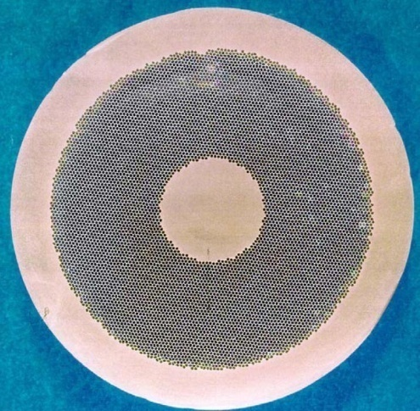

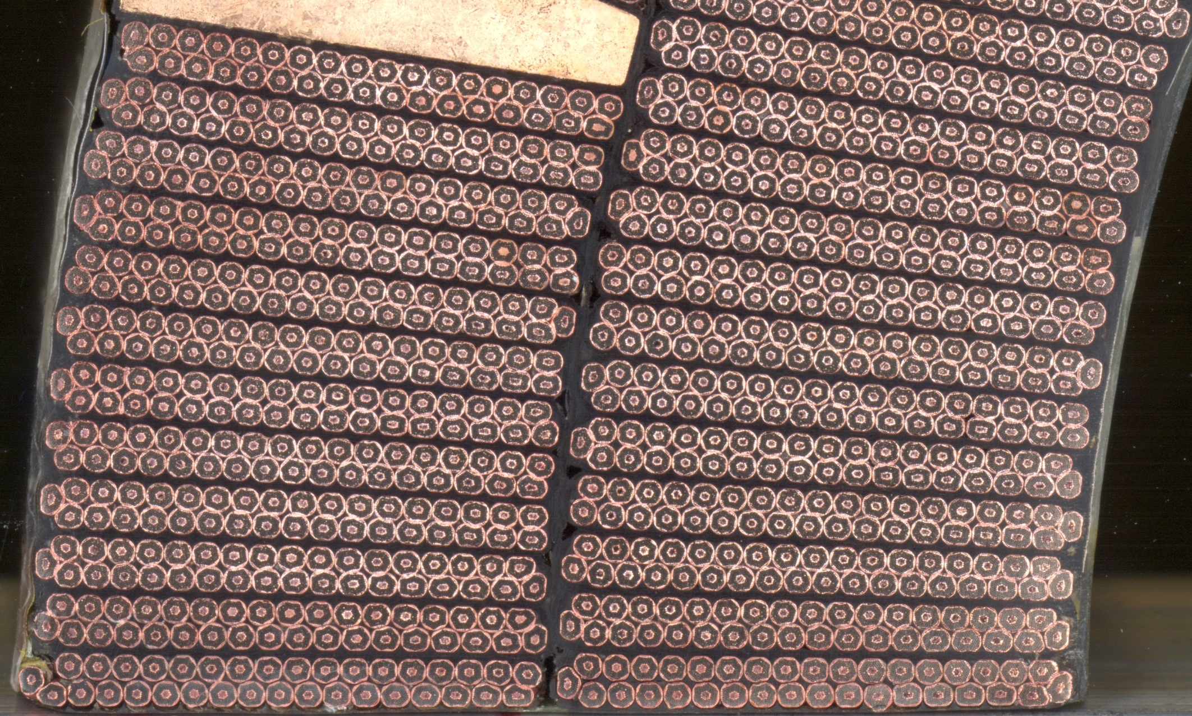
1. About HL-LHC
Main Objective:
To increase luminosity by a factor of 10 beyond the LHC’s design value¹
Upper Block
NbTi
Nb₃Sn
²
³
Lower Block
¹https://home.cern/topics/high-luminosity-lhc
²Concept of luminosity, Werner Herr and Bruno Muratori, CERN, Geneva, Switzerland
³USPAS Lectures, E.Todesco et al.

Slide 5
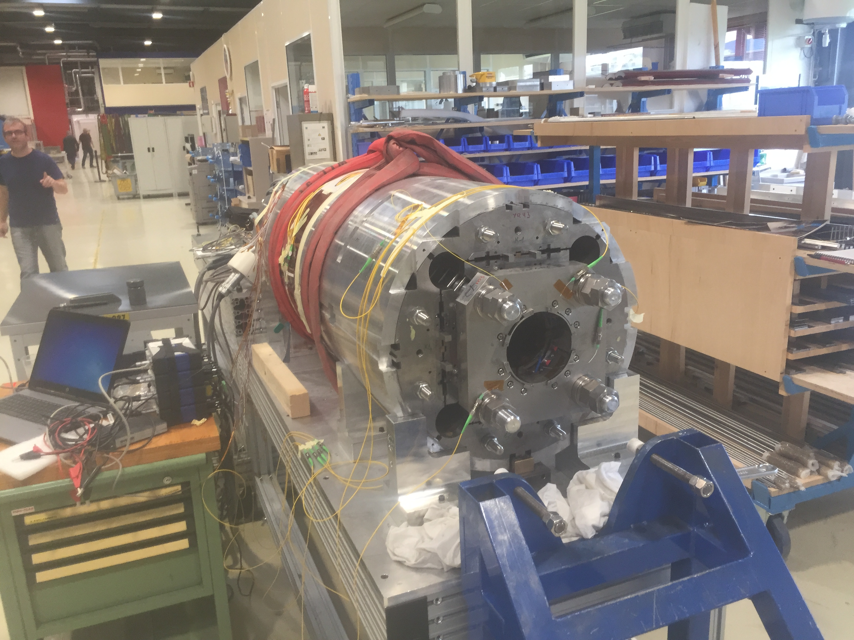
2. TE/MSC/MDT – R&D
Upper Block
Superconducting magnet design and technology: from functional specification to the construction of short prototypes.
Design study of the LHC upgrade and future projects involving superconducting magnets.
Superconducting magnet performance analysis and feedback on the design.
…. and more
¹
²
Lower Block
¹https://espace.cern.ch/TE-MSC-MDT/_layouts/15/start.aspx#/SitePages/Home.aspx
²Section acitivities slides, Nov 2014. Credits to Gijs de Rijk?

Slide 6
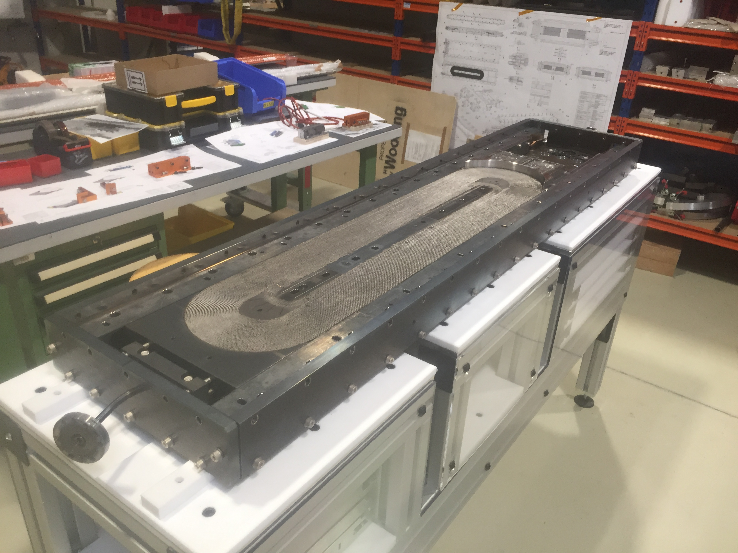
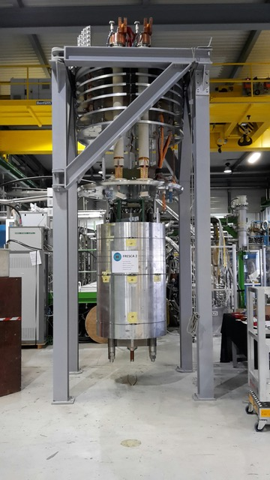
2. TE/MSC/MDT – R&D
Upper Block
  The High Luminosity LHC
  MQXF: 150 mm aperture Nb₃Sn quadrupoles for the inner triplet upgrade
  (…)
  The 11 T dipole model magnet¹
  FRESCA II (co-financed by HL-LHC)
  Towards FCC
  ERMC
  RMM
  HTS Magnets
  Feather
Lower Block
Picture by Gijs de Rijk
¹https://espace.cern.ch/TE-MSC-MDT/_layouts/15/start.aspx#/SitePages/Home.aspx

Slide 7
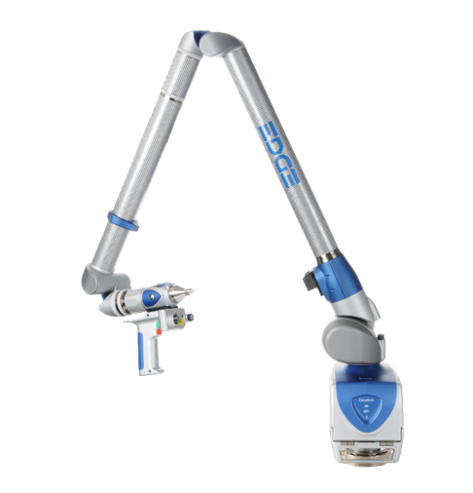
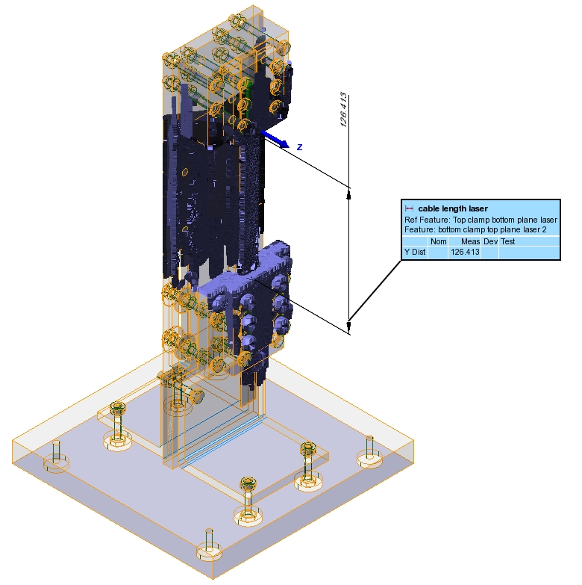
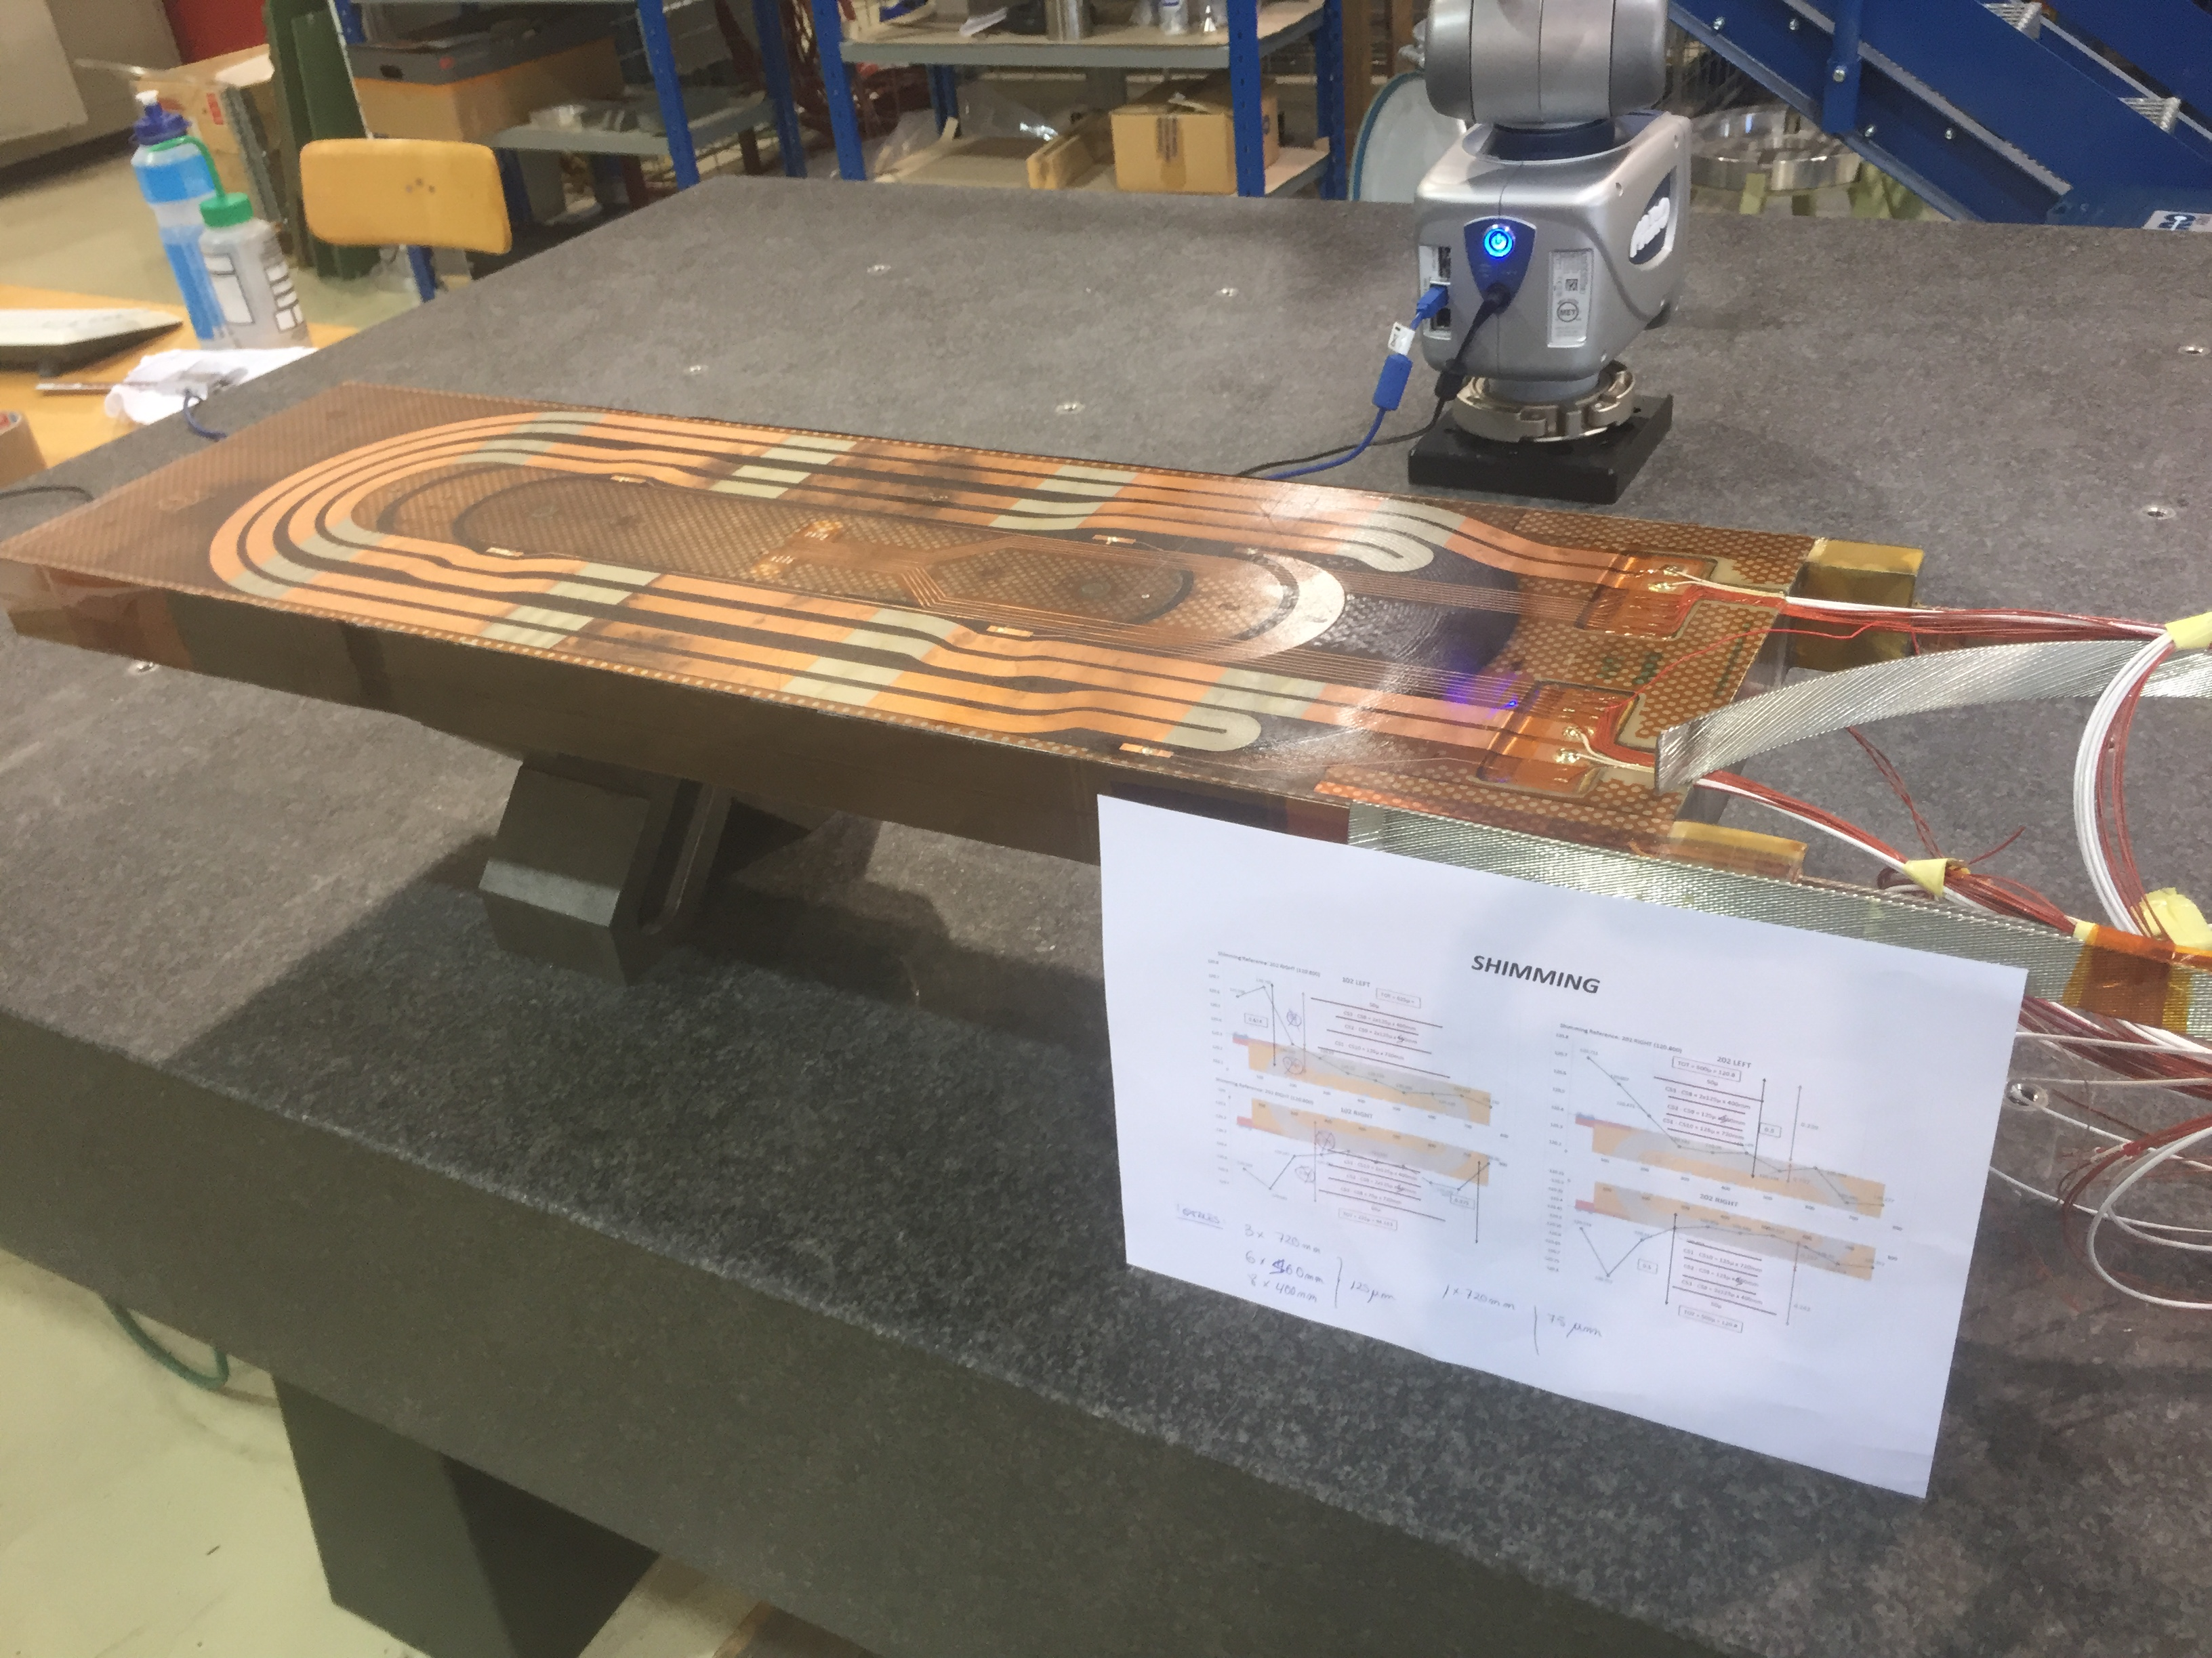
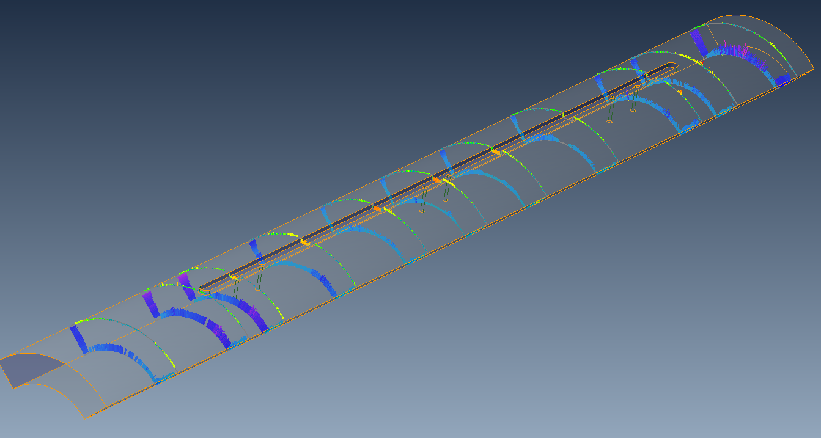
3. My role and tasks
Main Objective:
Dimensional control of coils, parts and tooling used in several types of model magnets, among other applications
Upper Block
CMM Portable device: Faro Arm Edge 2.7
  3 mm. Touch Probe
  Faro Arm Edge 2.7 volumetric maximum deviation: 41μm
  Faro Arm Edge 2.7 repeatability: 29 μm
Lower Block

Slide 8
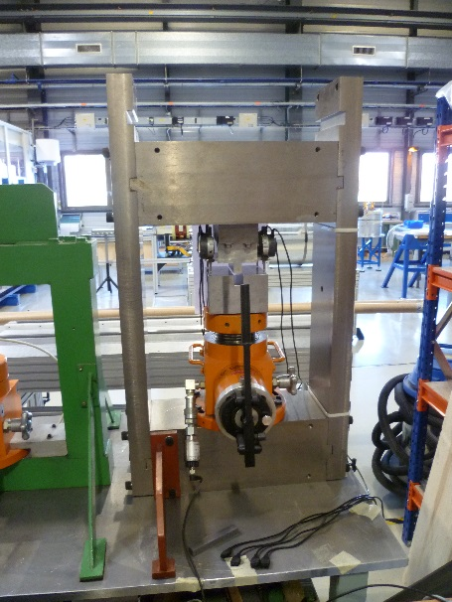
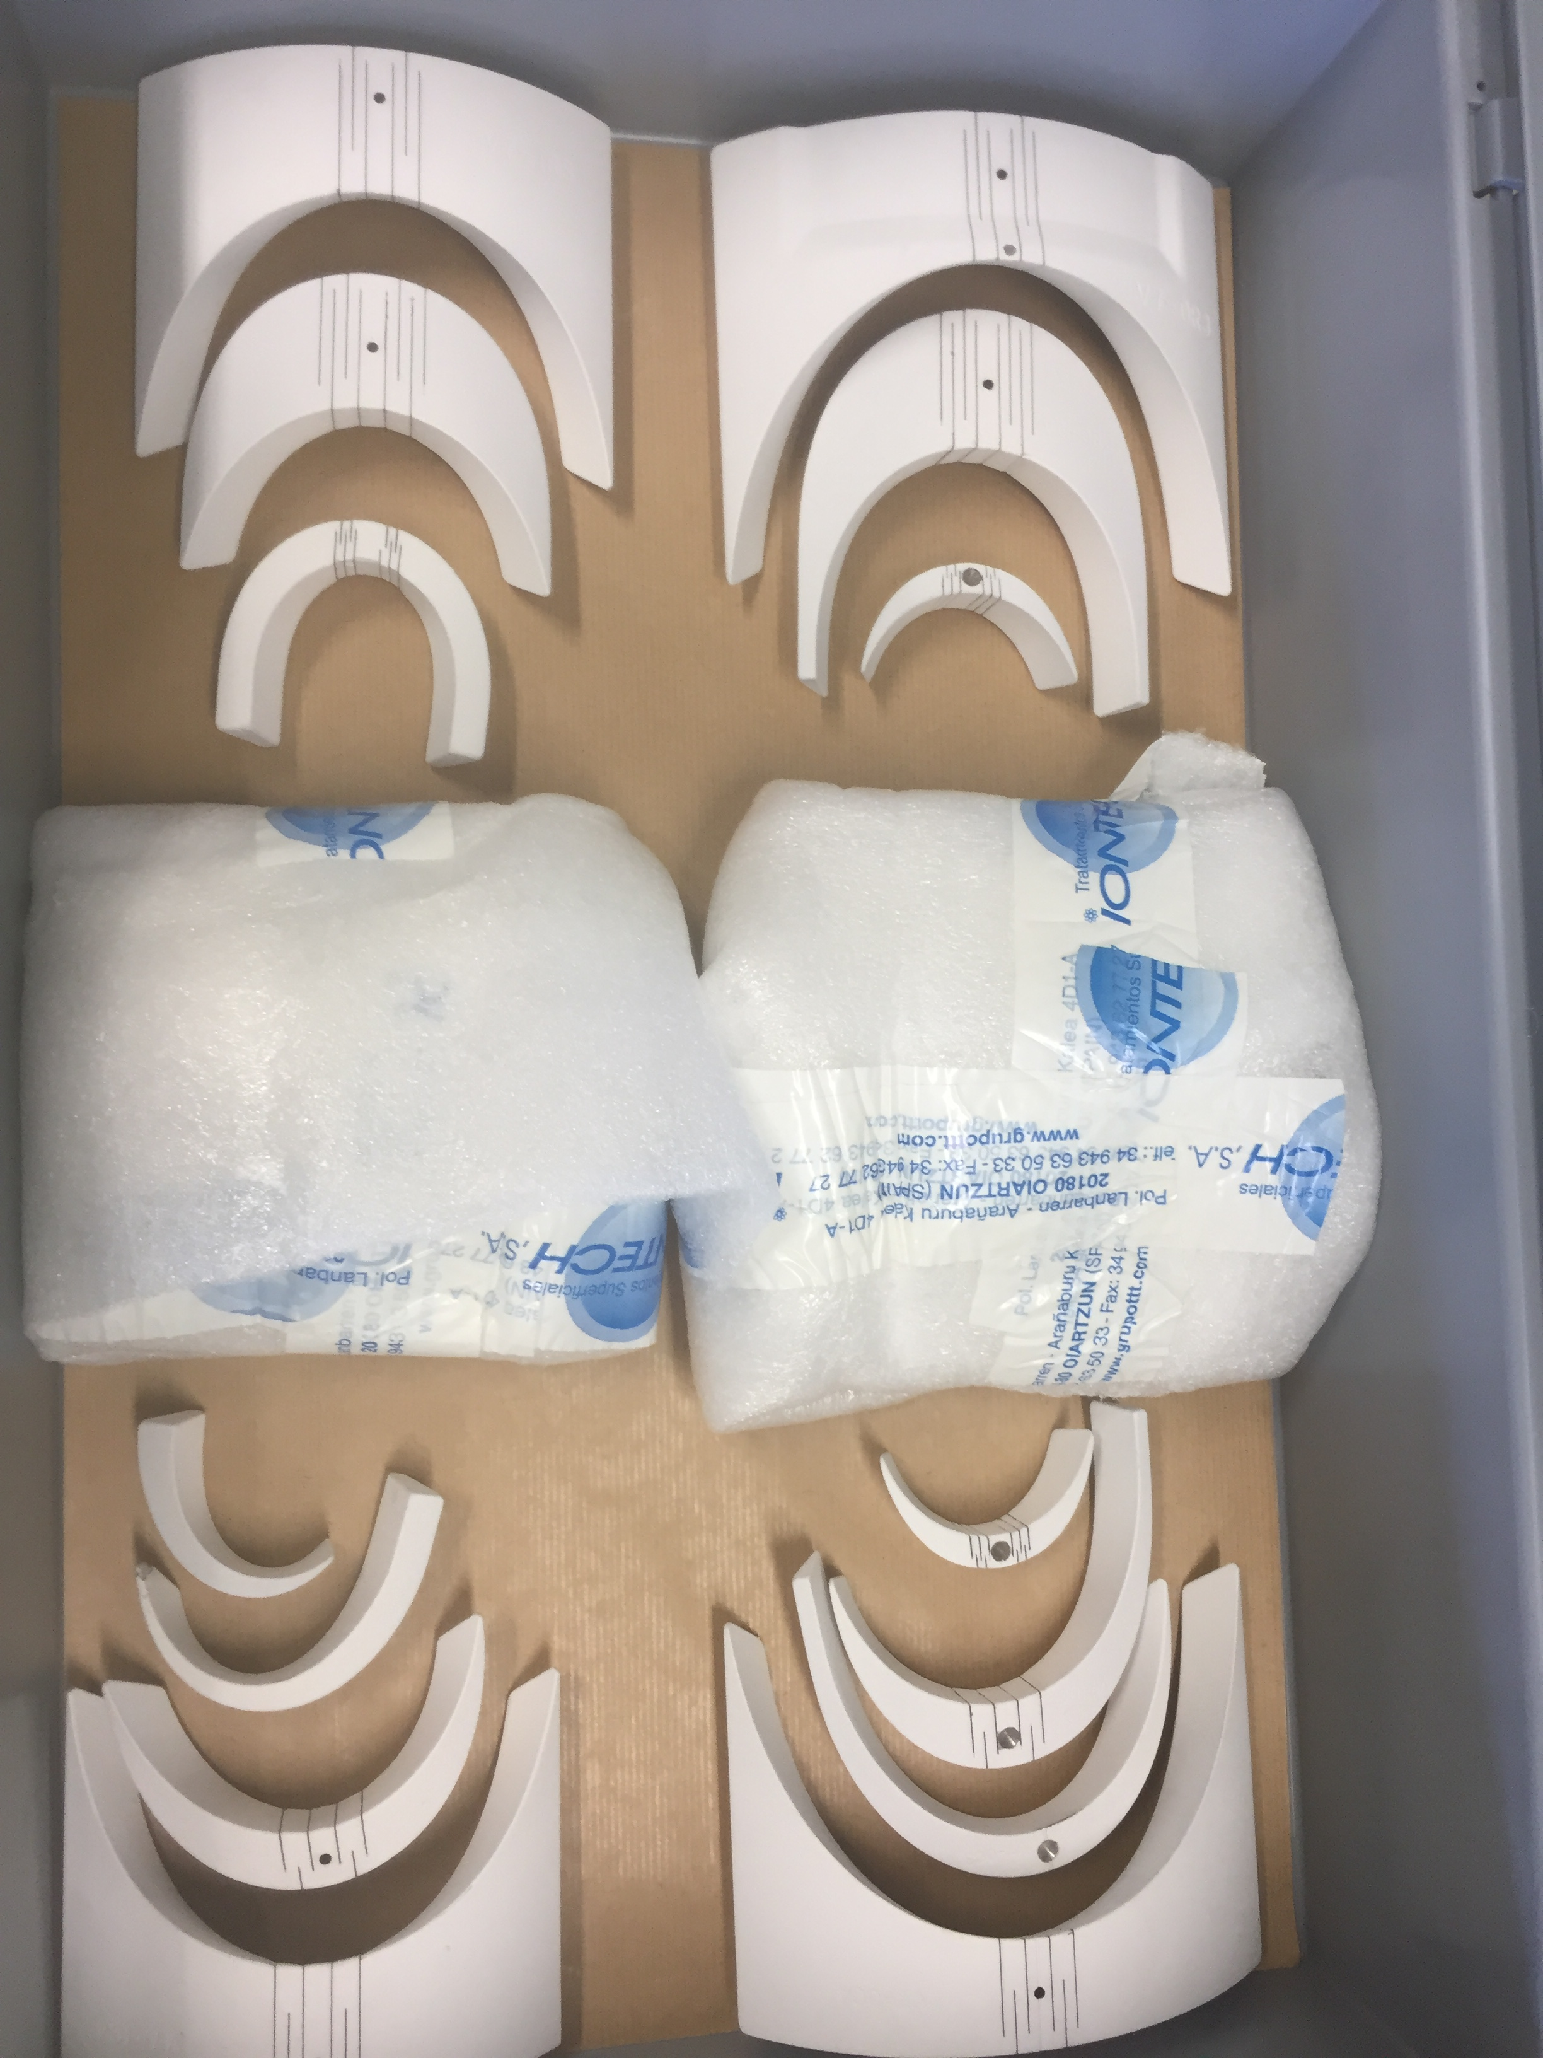
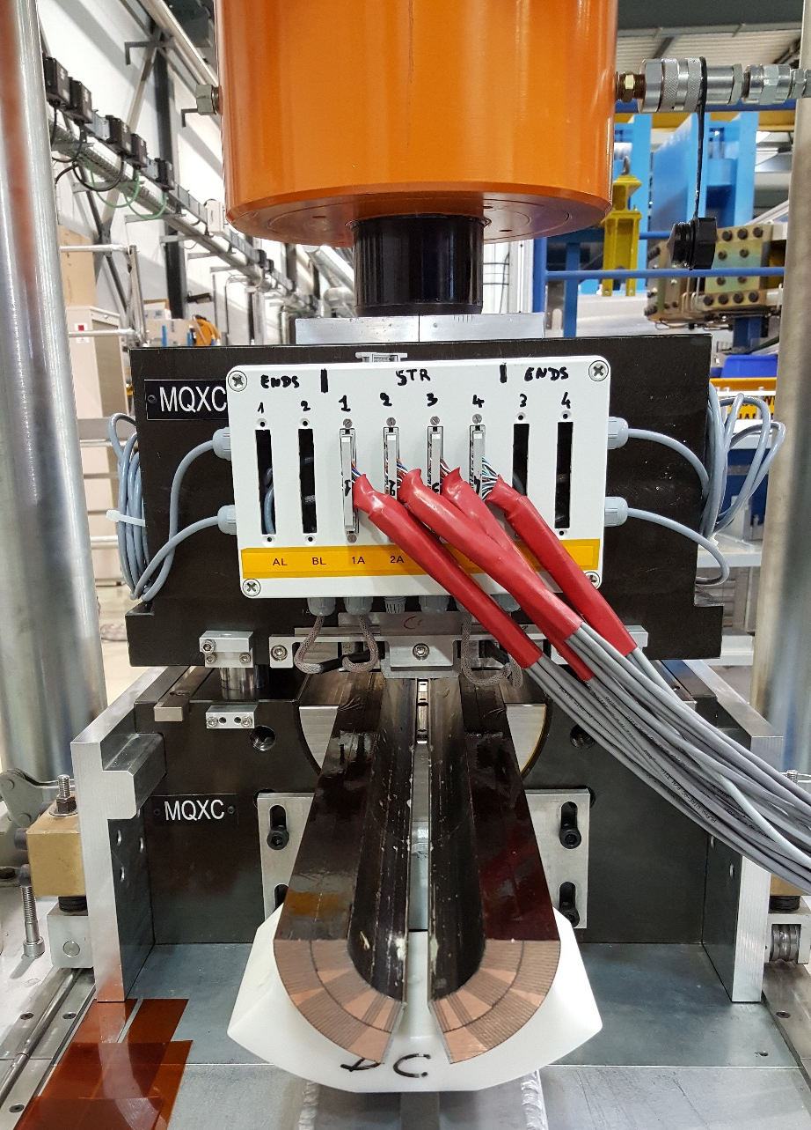
3. My role and tasks
Upper Block
Precise determination of the the insulation thickness of superconducting cable
TO of the supply of Al₂O₃ coating of sets of parts for the MQXF coils
Lower Block
11T E-modulus press.J. Luis Rudeiros Fernandez

Slide 9
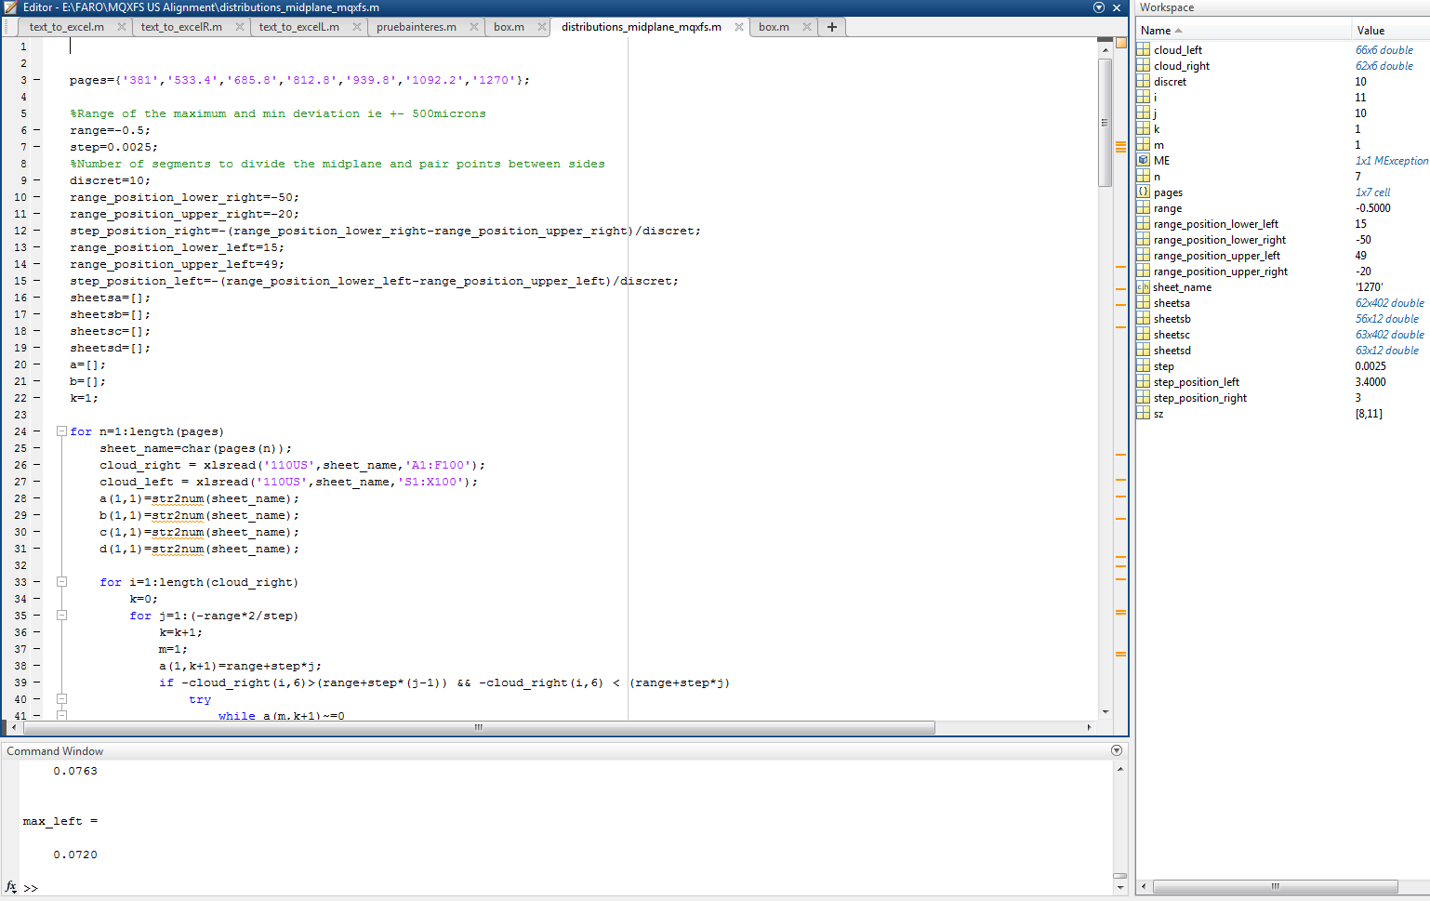
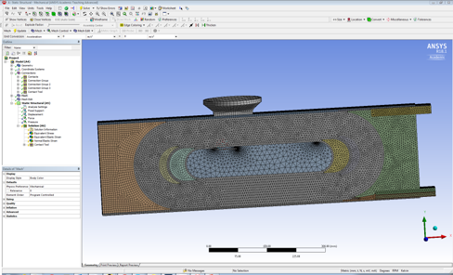
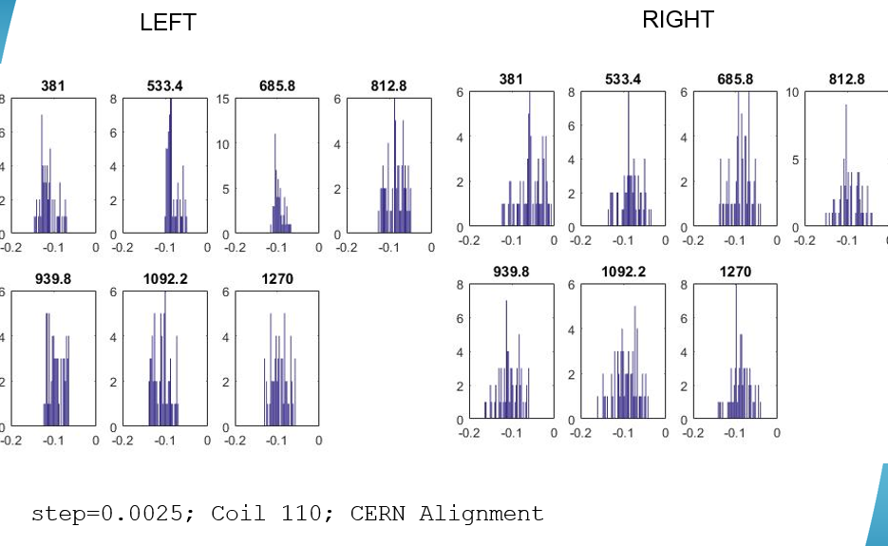
3. My role and tasks
3D FEA Modelling
Statistics using data collected from geometrical measurements (MQXFS mid plane deviations)
Data analysis using Python and Matlab from Catman

