Slide 1



Electromechanical Engineering for the Fabrication of Superconducting Model Magnets - TE6728
Ricardo de Paz Ludeña
Supervisor: Juan Carlos Perez
Seguimiento de Proyectos FTEC 2017 – 29th May 2018

Slide 2
SUMMARY OF MY WORK
- Coordination of the 11T DP102 magnet disassembly and elaboration of the final detailed report.
- Participation in eRMC magnet Winding and elaboration of the Procedure.
Notes:
I have been working on two activities: one is the coordination of the 11T DP102 magnet disassembly and the elaboration of the final detailed report. And second the participation in the eRMC magnet winding and elaboration of the procedure.

Slide 3
SUMMARY OF MY WORK
- Coordination of the 11T DP102 magnet disassembly and elaboration of the final detailed report.
- Participation in eRMC magnet Winding and elaboration of the Procedure.
Notes:
Starting with the 11T model.

Slide 4
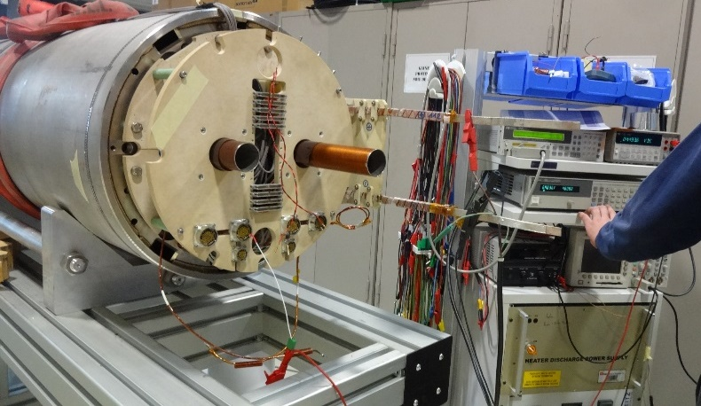
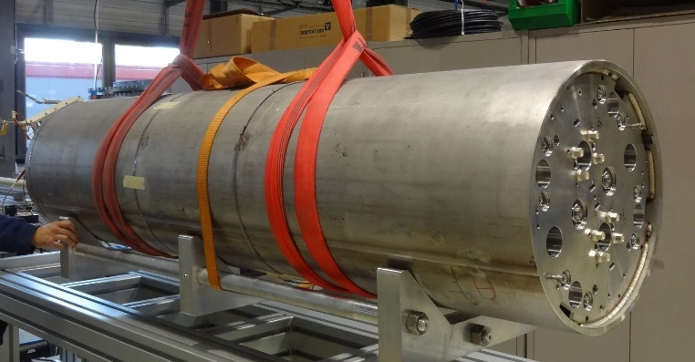
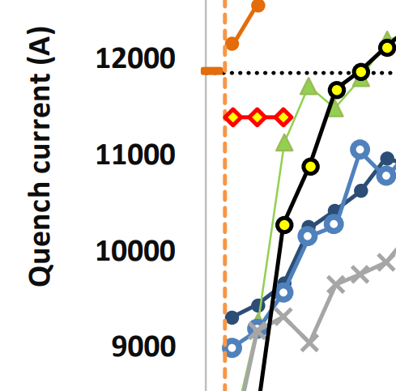
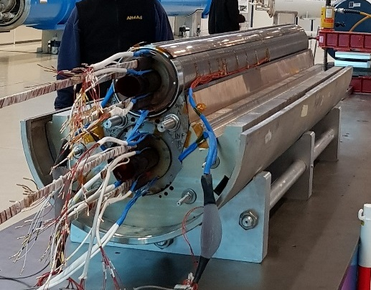
Disassembly of 11T DP102
This is a shorter model prototype
COLD MASS
- 11T Magnet will serve the LHC upgrade.
- By replacing some of the 8.3 T dipole magnets of the accelerator.
Problems to reach the nominal current
11850 (nominal)
11400 (stuck)
DISASSEMBLY
Notes:
As I already exposed in the previous FTEC workshop, the 11T magnet will serve the LHC upgrade. This is a short model prototype. During the training, this magnet was stuck and couldn’t reach the nominal current. Here in this graph you can compare with other magnets progression. Because of this problem, it was decided to disassemble and test step by step to try to understand the problem and probably learn something new. Here you can observe the magnet in its cold mass, what allows for the operation in the cryostat. By cutting the shell, this cylinder, we get access to the two collared coils units.

Slide 5
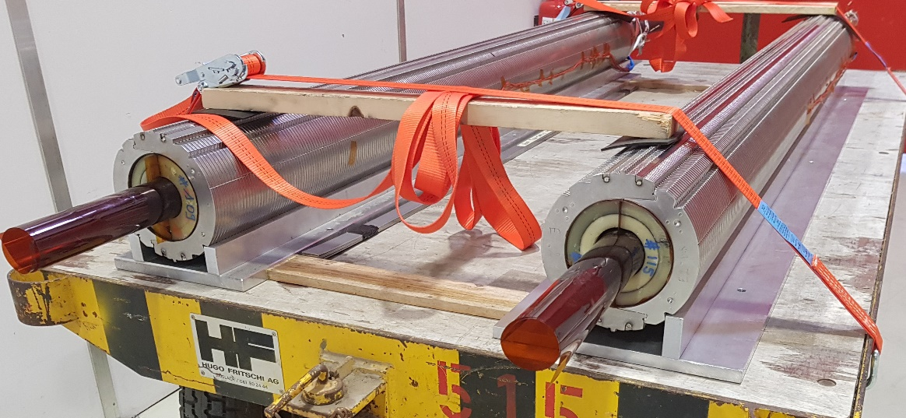
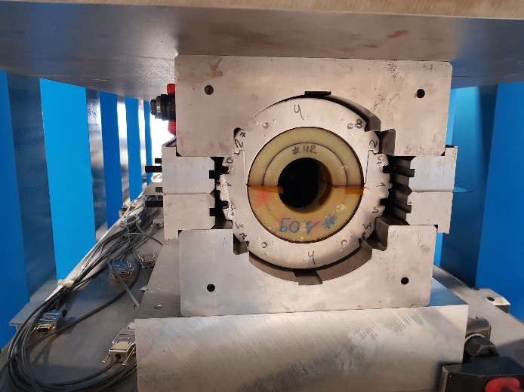
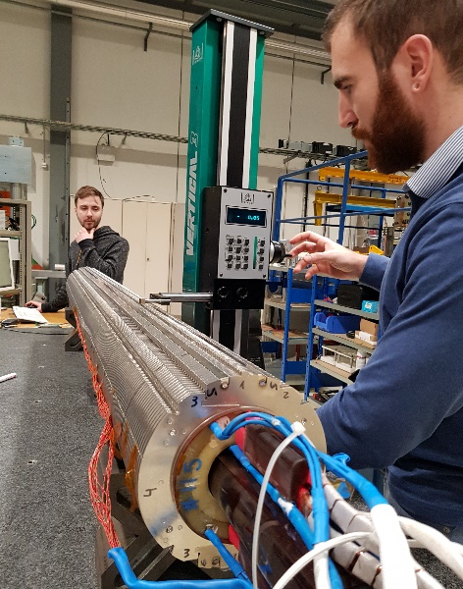
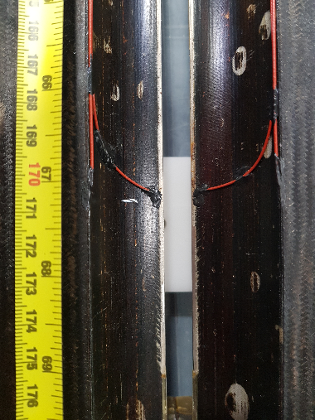
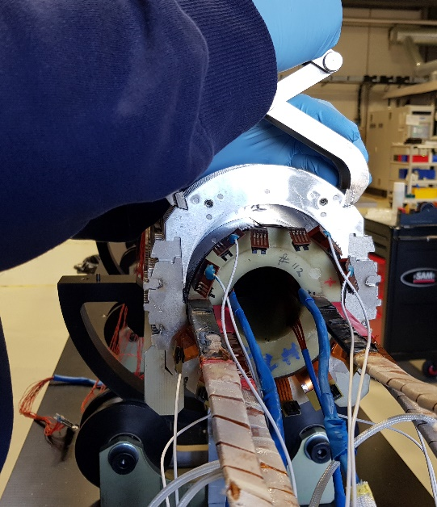
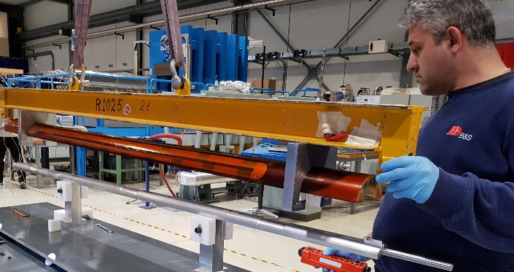
REPORT ELABORATION
Disassembly of 11T DP102
COLLARED COILS
Geometrical measurements
Decollaring
Collars removal
COIL
Coils visual inspection
Notes:
Here you can observe these two collared coils already removed. Among other control tests, here you can see Salva taking geometrical measurements. After the desired tests each collared coil is inserted in the press for decollaring, allowing for the collars removal, and we get four coils like this one. This is a photo I took for recording during the visual inspection of one of the coils. More tests have been applied to them like electrical, magnetic, mechanical stress. I am elaborating the report with all the relevant information of the disassembly.

Slide 6
SUMMARY OF MY WORK
- Coordination of the 11T DP102 magnet disassembly and elaboration of the final detailed report.
- Participation in eRMC magnet Winding and elaboration of the Procedure.
Notes:
And concerning the eRMC magnet winding.

Slide 7
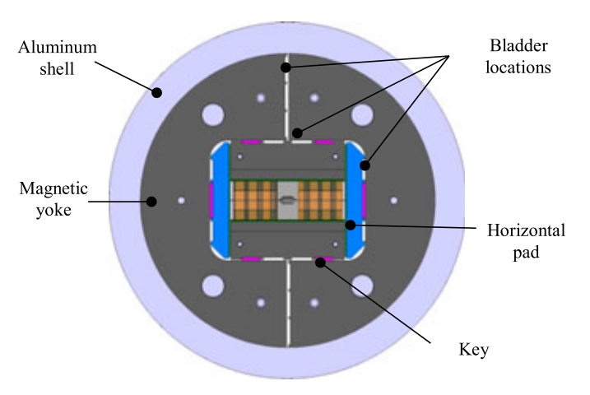
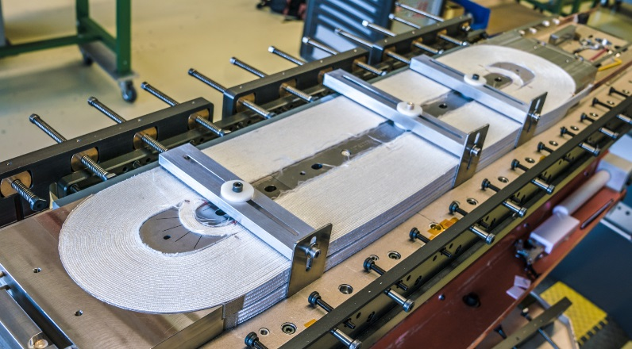
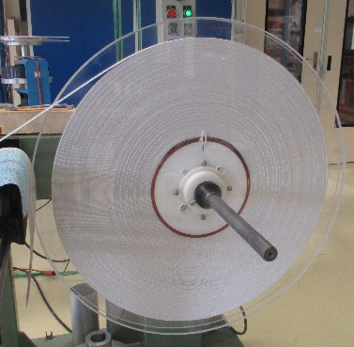
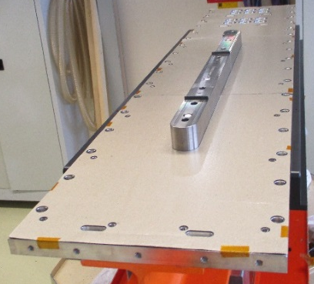
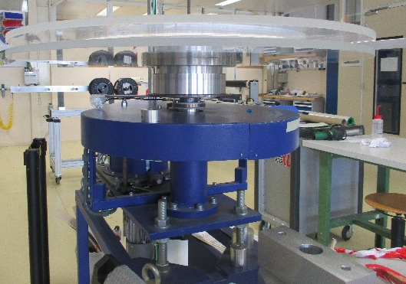
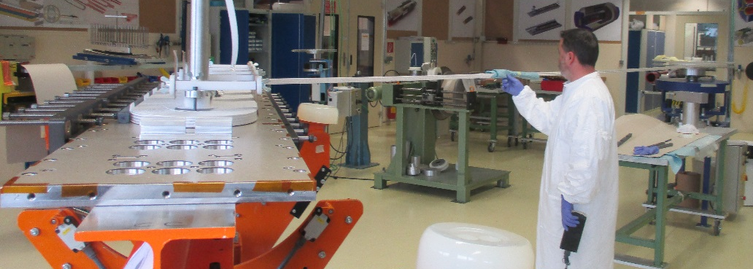
PROCEDURE ELABORATION
Winding of eRMC magnet coils
· The eRMC project
Magnet cross section
Coil winding finished
- The “enhanced Racetrack Model Coil” (eRMC) is a project for FCC.
- Its aim is to explore the performance limits of Nb₃Sn superconductor in the range of 16 to 18 T.
· Winding. First fabrication phase.
Superconducting cable
Pole
Tensioning machine
Pole rotation. Winding
Notes:
The eRMC is a project for FCC. As you well know, FCC is the future circular collider, for which the required dipolar magnetic fields are in the range of the 16 – 18 T. eRMC aims to explore the performance of Nb3SN superconductor in this range. In this cross section you can observe a layout of the magnet in the cold mass. Here you can see that it is composed of two coils. Just after wound, each coil looks like this one in the photo.
The first fabrication phase consist in winding the superconducting cable around the pole. For that we mount this spool on the tensioning machine and rotate the board, piling up turns until completing the 45 turns. When all the turns has been completed, this is the result.

Slide 8
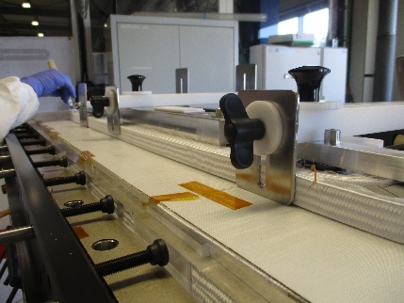
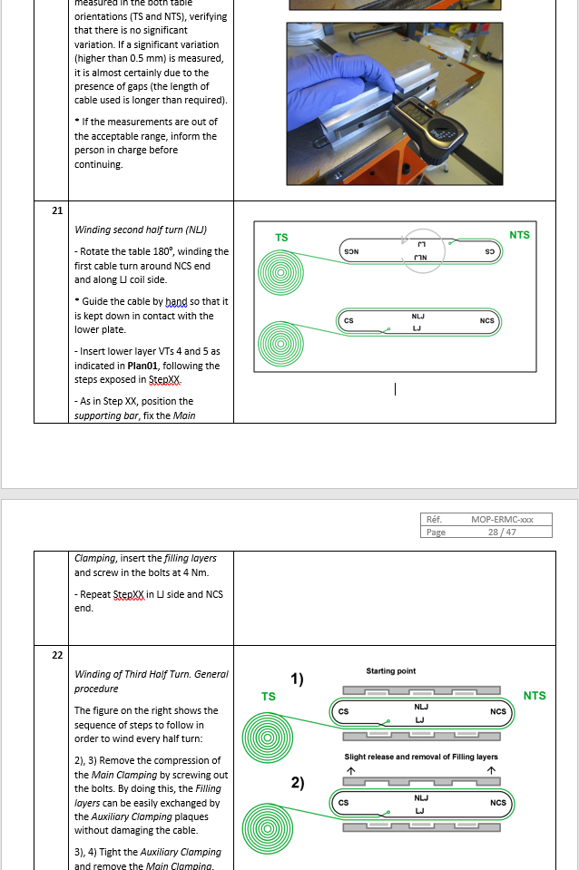
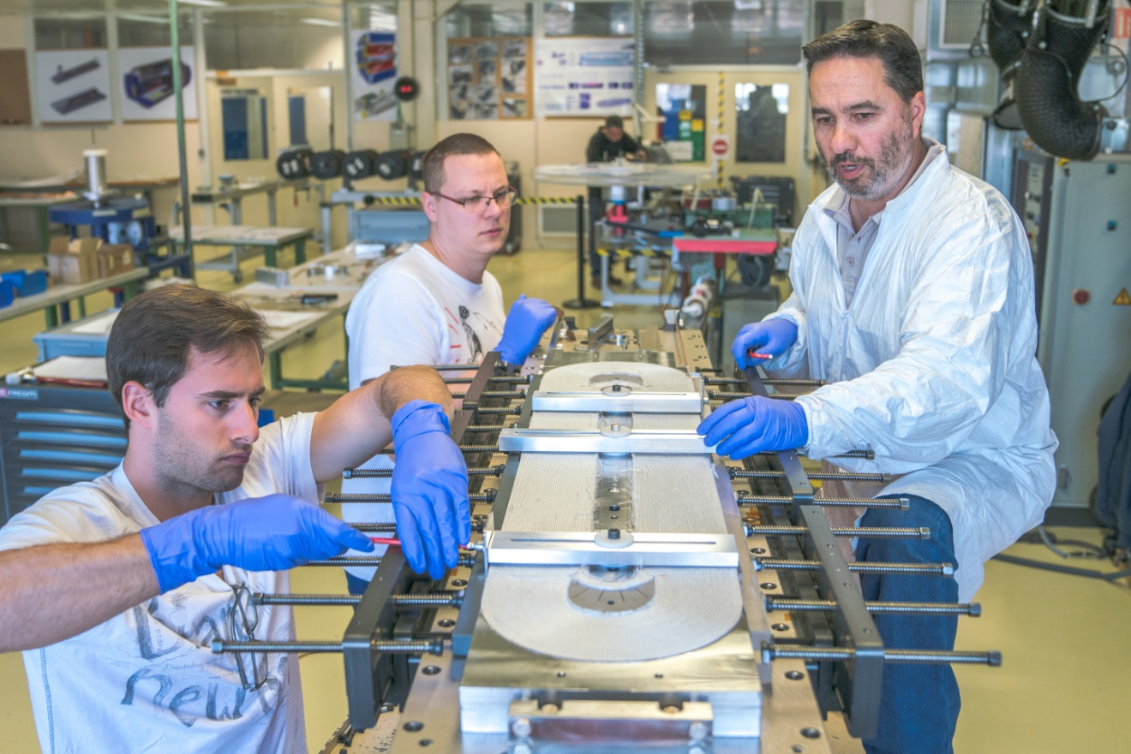
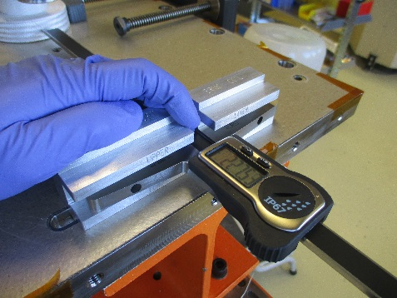
PROCEDURE ELABORATION
Winding of eRMC magnet coils
· Winding Quality Assurance
Auxiliary clamping system
- Procedure elaboration:
* 1st coil: problems solving ➔ implementation new toolings and methods along the process ➔ PROCEDURE DRAFT
* 2nd coil: verification of new methods ➔ implementation of needed corrections ➔ FINAL PROCEDURE
* 3rd coil: application of the procedure.
- Follow-up sheet:
To record and monitor all the significant information
during the winding.
Example: Dimensional control at every turn.
Procedure extract
Notes:
To assure the desired quality, we make use of a procedure and a follow-up sheet. Concerning the elaboration of the procedure: during the winding of the first coil I elaborated a first draft. We found different problems and implemented and tested new toolings to solve them. For example, here you can observe an auxiliary clamping system that we implemented to prevent the cable expansion. We have just wound the second coil, in which we have verified the methods tested in the 1st one and implemented other slight variations. Before starting the 3rd coil, I need to complete the procedure. The second document we use during the winding is a follow-up sheet to record and monitor all the significant information like the references of the components, comments, or dimensional control at every turn, like I show in this photo.

Slide 9
THANK YOU FOR YOUR ATTENTION

