Slide 1
OUTLINES
PSB ABSORBER/SCRAPER
HRMT-35
CRYSTAL COLLIMATOR
Trainee: Jorge Maestre
Supervisors: Inigo Lamas and Marco Calviani

Slide 2

DESIGN OF A NEW PSB ABSORBER/SCRAPER
Trainee: Jorge Maestre
Supervisors: Inigo Lamas and Marco Calviani

Slide 3
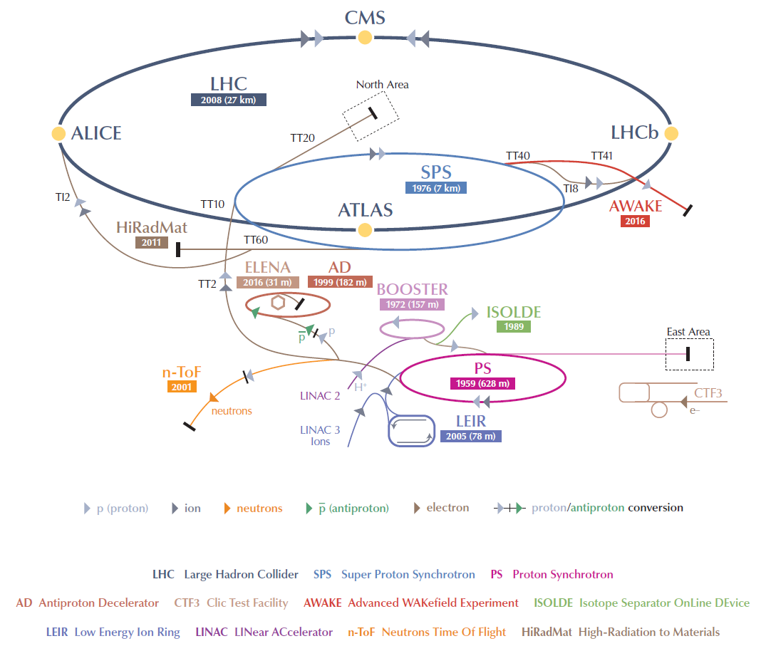
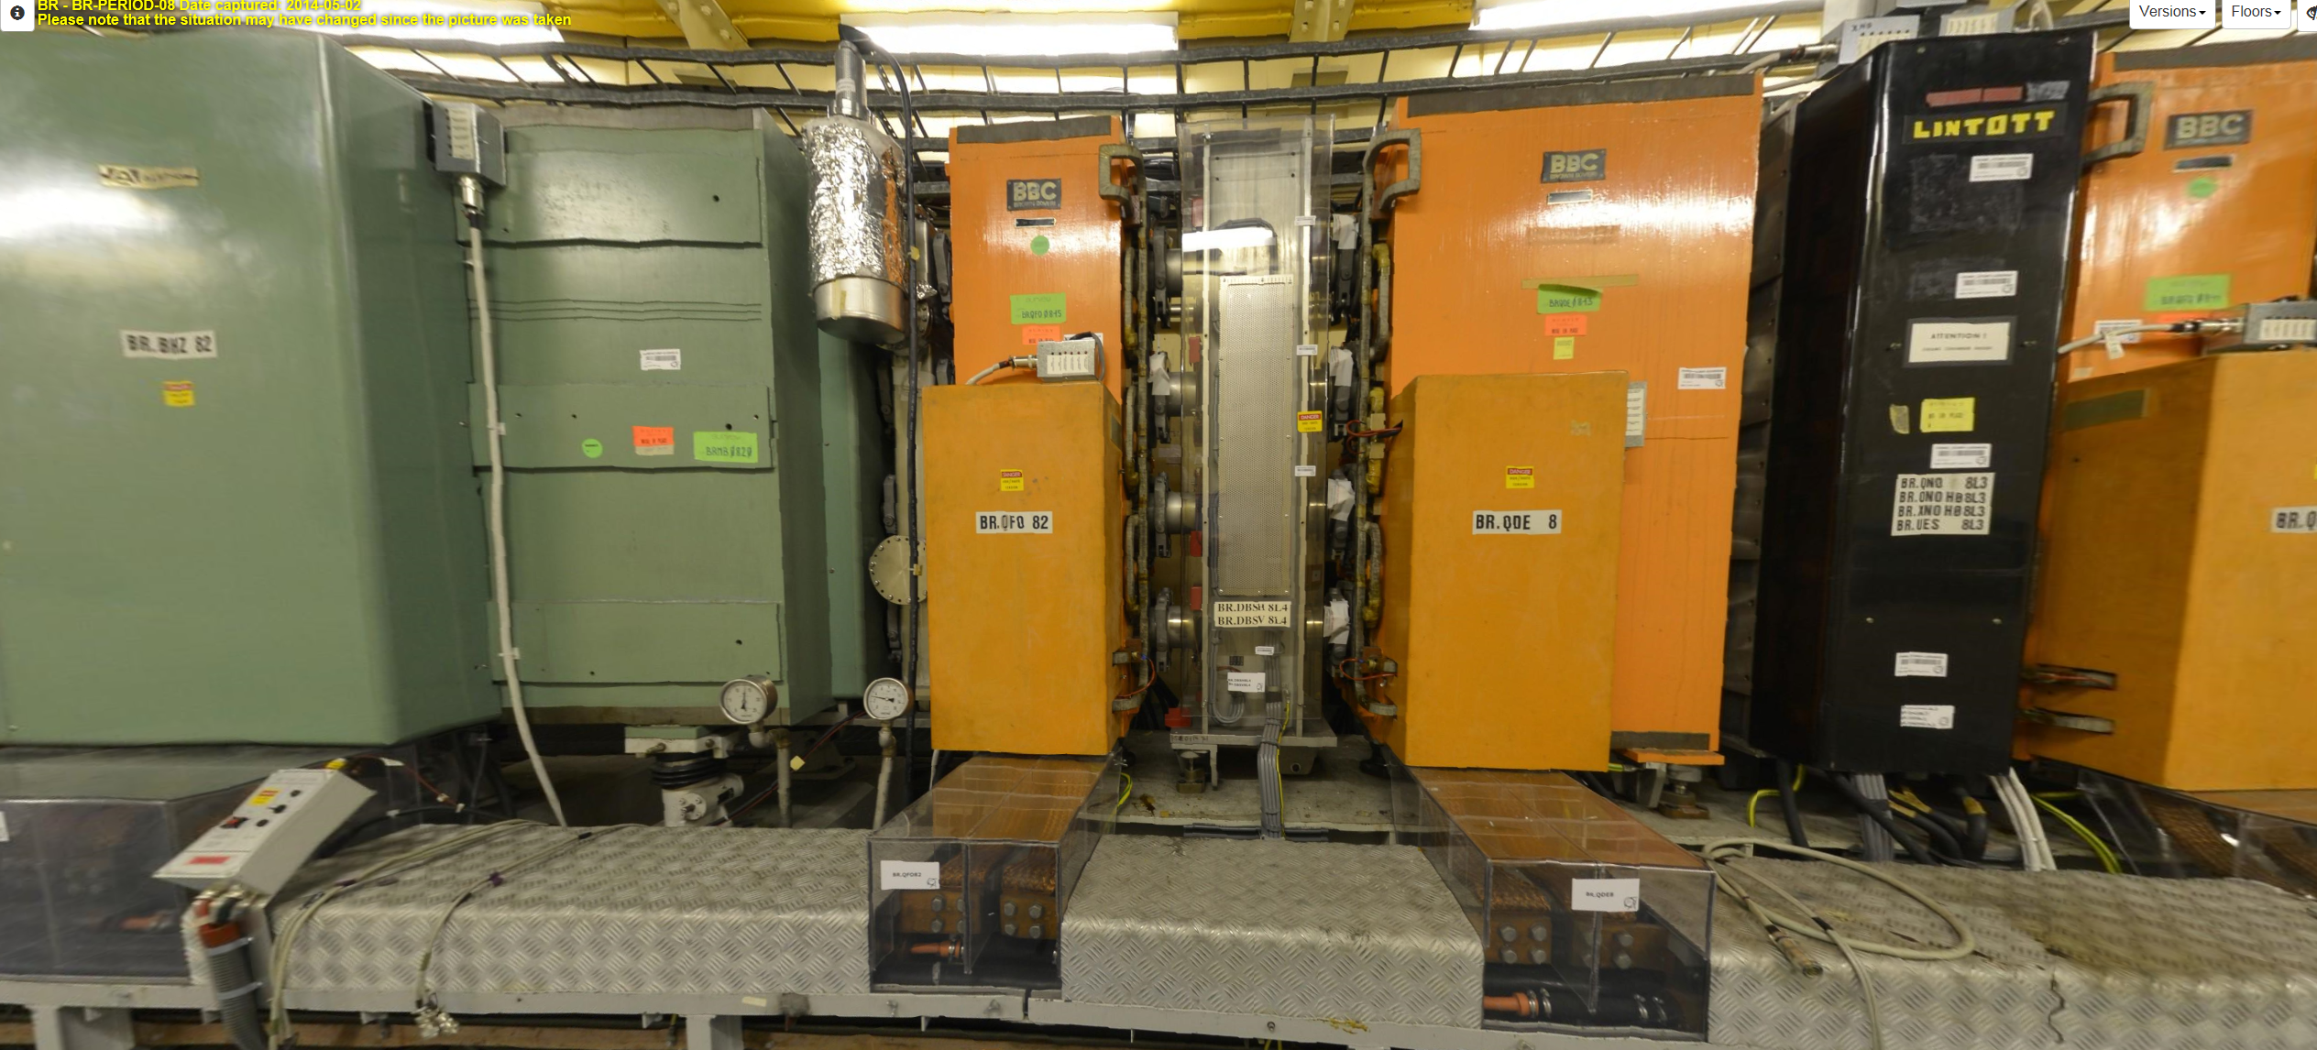
INTRODUCTION
PSB ABSORBER
IN THE CONTEXT OF THE LHC INYECTOR UPGRADE PROJECT, THE PS BOOSTER KINETIC INJECTION IS PLANED TO INCREASE THE ENERGY FROM 50 MeV TO 160 MeV
NOWADAYS, THERE IS A SO-CALLED WINWDOS BEAM SCOPE (WBS) DEVICE INSTALLED IN THE SECTION 8L2. ITS FUNCTIONS CONSISTS ON CLEANNING THE HALO PARTICLES AND PROTECT DOWNSTREAM DEVICES.
AT THIS LEVEL OF ENERGY THE PROTONS CANNOT BE STOPED AND A NEW DEVICE MUST BE DESIGN TO ACCOMPLIS THE NEW OPERATION REQUIREMENTS
THE NEW ABSORBERS/SCRAPERS WILL BE INSTALLED BETWEEN THE DEFOCUSING AND THE SECOND FOCUSING QUADRUPOLE MAGNET IN THE SECTION 8L4.
BR.DBSV/H8L4 will be removed for the new PSB-absorber/scraper
522 mm

Slide 4
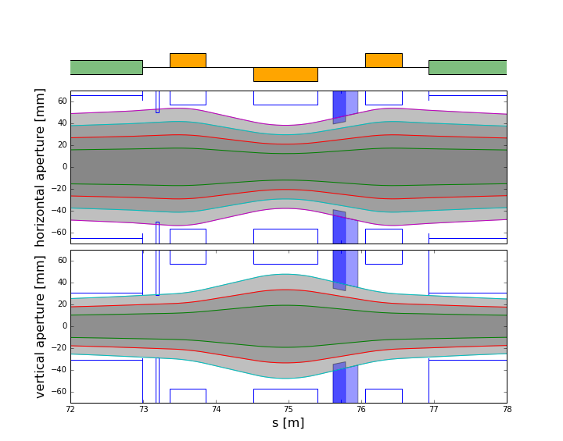
DESIGN PREVIEW
PSB ABSORBER
De/focusing quadrupole magnet
Chassis
The main function is to protect downstream devices.
Low Z-material are considered for the design of the PSB-absorber-scraper (Carbon graphite). Simulations reveal that a block of 130 mm of graphite is enough to stop 160 MeV protons
The control of each PSB-absorber/scraper is independent per each rings
2 Mask are installed per ring:
  A Fixed mask (mayor aperture limitation): it is always in the beam line
  A movable mask (smaller aperture). The mask can be in or out of the beam line depending of the operational requirements
  One mask is able to stop the 160 MeV protons
  An extension chamber is introduced instead of the movable mask in order to reduce the impedance
4 rings
PSB-absorber/scraper
Fixed mask
Vacuum pump
Flexible junction
Worm gear
Electric motor
Fixed mask
Extension chamber
Fig : Beam trajectory
Fig : movable mask in

Slide 5
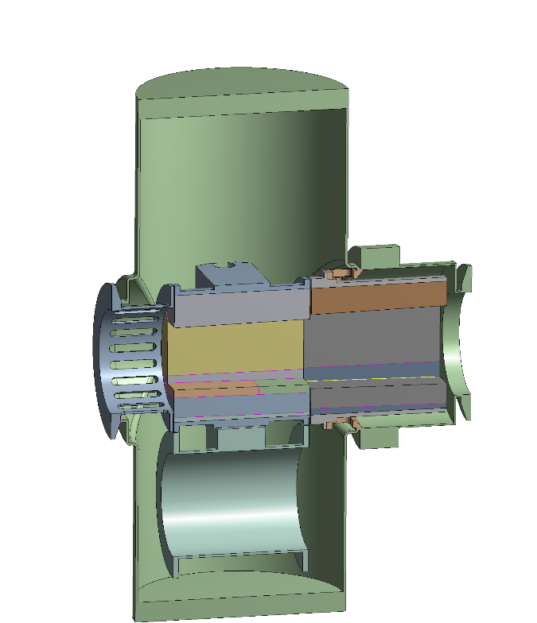
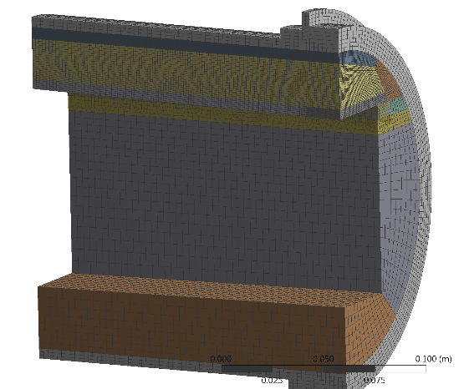
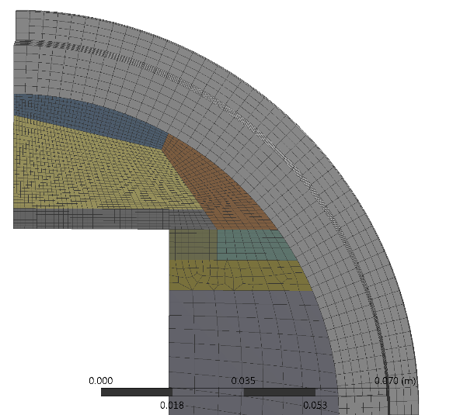
THERMO-MECHANICAL DESIGN
PSB ABSORBER
Model
Amb. Temp 20C
Beam load:
Montecarlo method (FLUKA)
Thermo-mechanical analysis:
FEM (ANSYS)
Radiation
Radiation
Convection
Contact
ASSUMPTIONS
Simplification of the geometrical model
Symmetric condition
Vacuum tank
Beam load are imported as energy deposited in the jaws.
Heat transfer methods:
  Tank-inside → radiation
  Tank-ambient → convection and radiation
  Conduction
Material properties → Temperature dependent
  Contact:
    Housing-graphite: frictional
    Tank parts (screw union): bounded
    Thermal contact computed iteratively considering thermal expansion and presfitting.
Indirect couple thermo-mechanical analysis
First order elements for thermal analysis and second order for structural model
Beam
Finer mesh
more coarse
Fig : Detail of the mesh of the fixed mask

Slide 6
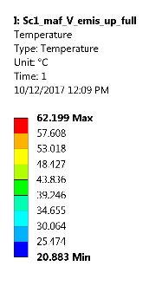
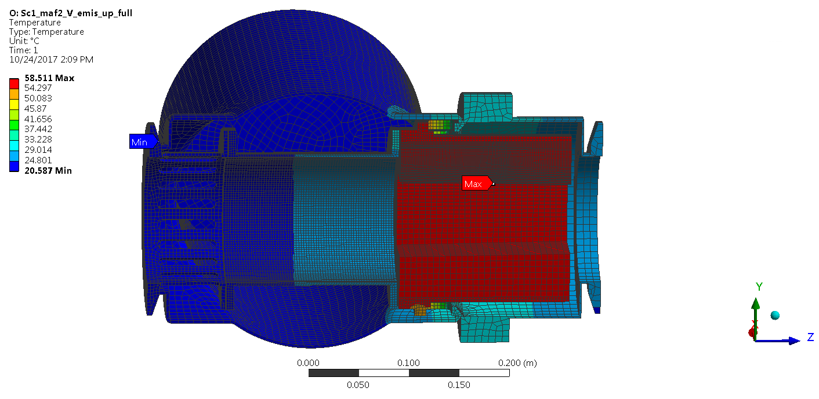
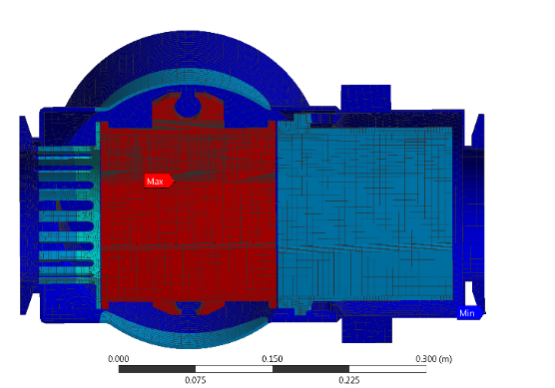
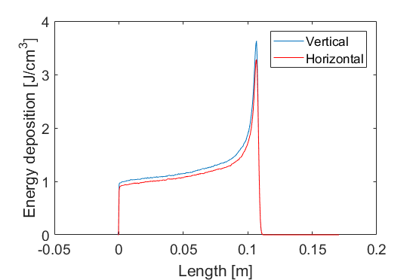
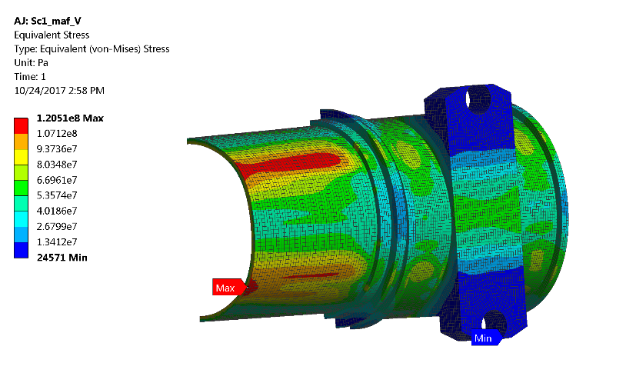
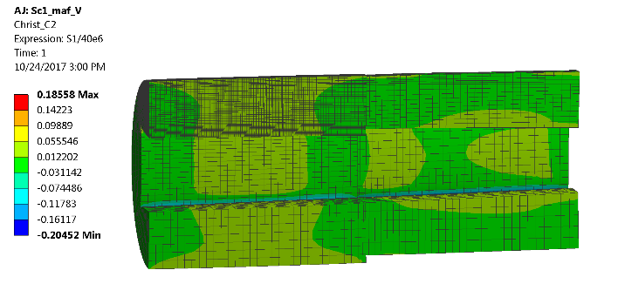
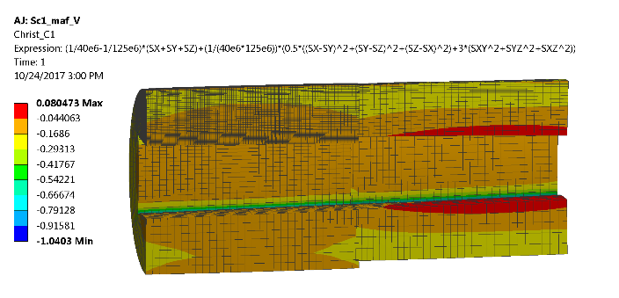
THERMO-MECHANICAL DESIGN
PSB ABSORBER
SCENARIO 1: Thermal
Fig: Temperature distribution with mobile mask in
Fig: Temperature distribution with mobile mask out
Fig: Energy deposition in the movable mask
SCENARIO 1: Mechanical
Fig: Eq. Von-Mises Stress of the housing considering Movable mask in
Fig: Evaluation of failure criterion considering Movable mask in
Steady analysis
Initial presfitting is take into account. The maximum interference case between the mask and housing is the worst scenario
The scenario 1 (Scraping at low energy) is more critical
Stress of the housing is lower than the yield limit (safety factor greater than 2)
Graphite are evaluated as a brittle material and have a safety factor greater than 3.

Slide 7
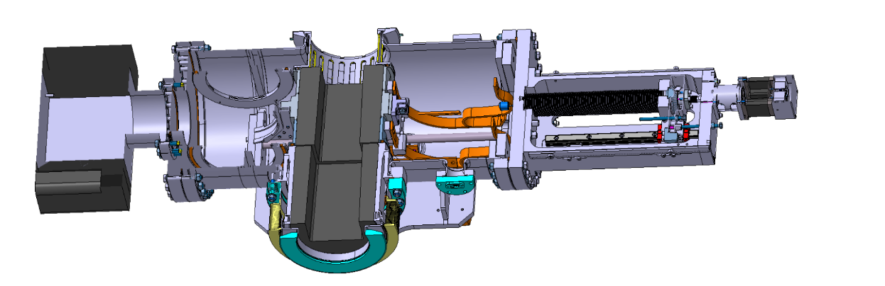
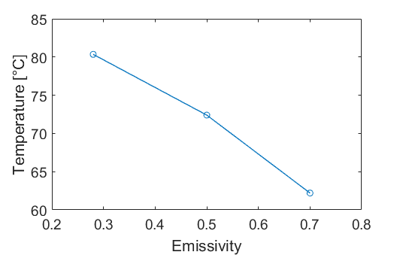
THERMO-MECHANICAL DESIGN
PSB ABSORBER
Copper connector to evacuated heat
Fig. PSB absorber/scraper. Thermal braided copper connector details
Size of the Gr. masks: To be able to absorb all the primary particles.
Thermo-mechanical optimization:
  Check different material for the housings:
    Stainless steel 316L
    Ti6-Al4-V (low thermal expansion coeff.)
  Check different configurations of the graphite block
    Quadrilateral apertures
    Octagonal apertures (better distribution of stress)
    Check different thickness
  Degassing of the graphite blocks is important for temperatures higher than 70°C
    Surface treatment to increase the emissivity
      Laser Engineering Surface
      Optical Coating-Politeknik
      Ion bombardment-Bodycote
      Thermal superficial oxidation
    Water cooling system
    Braided copper connector
Fig. Maximum thermal deformation of the Gr mask for different configuration of the housing-Gr
Fig. Maximum temperature in Gr mask for different values of the Emissivity

Slide 8
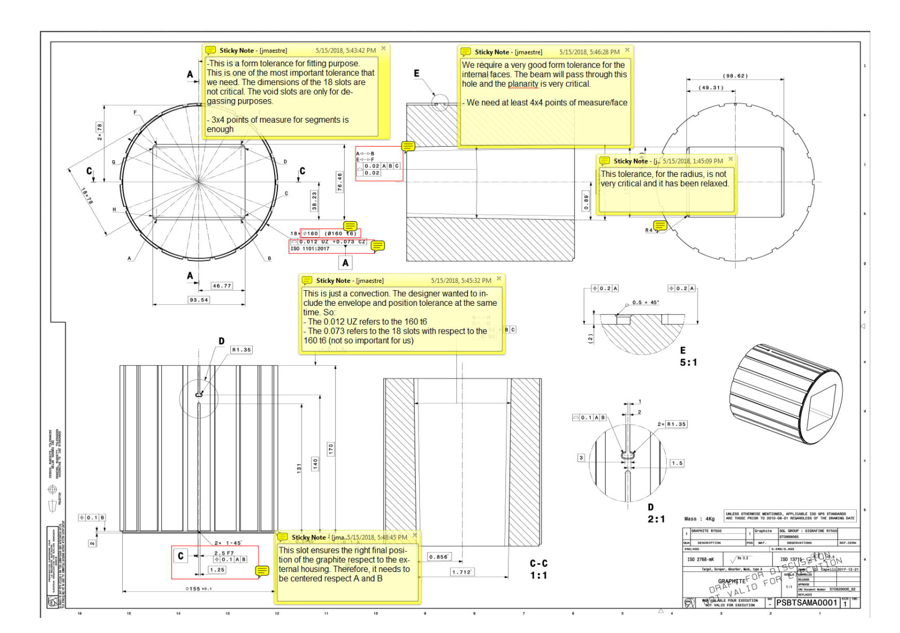
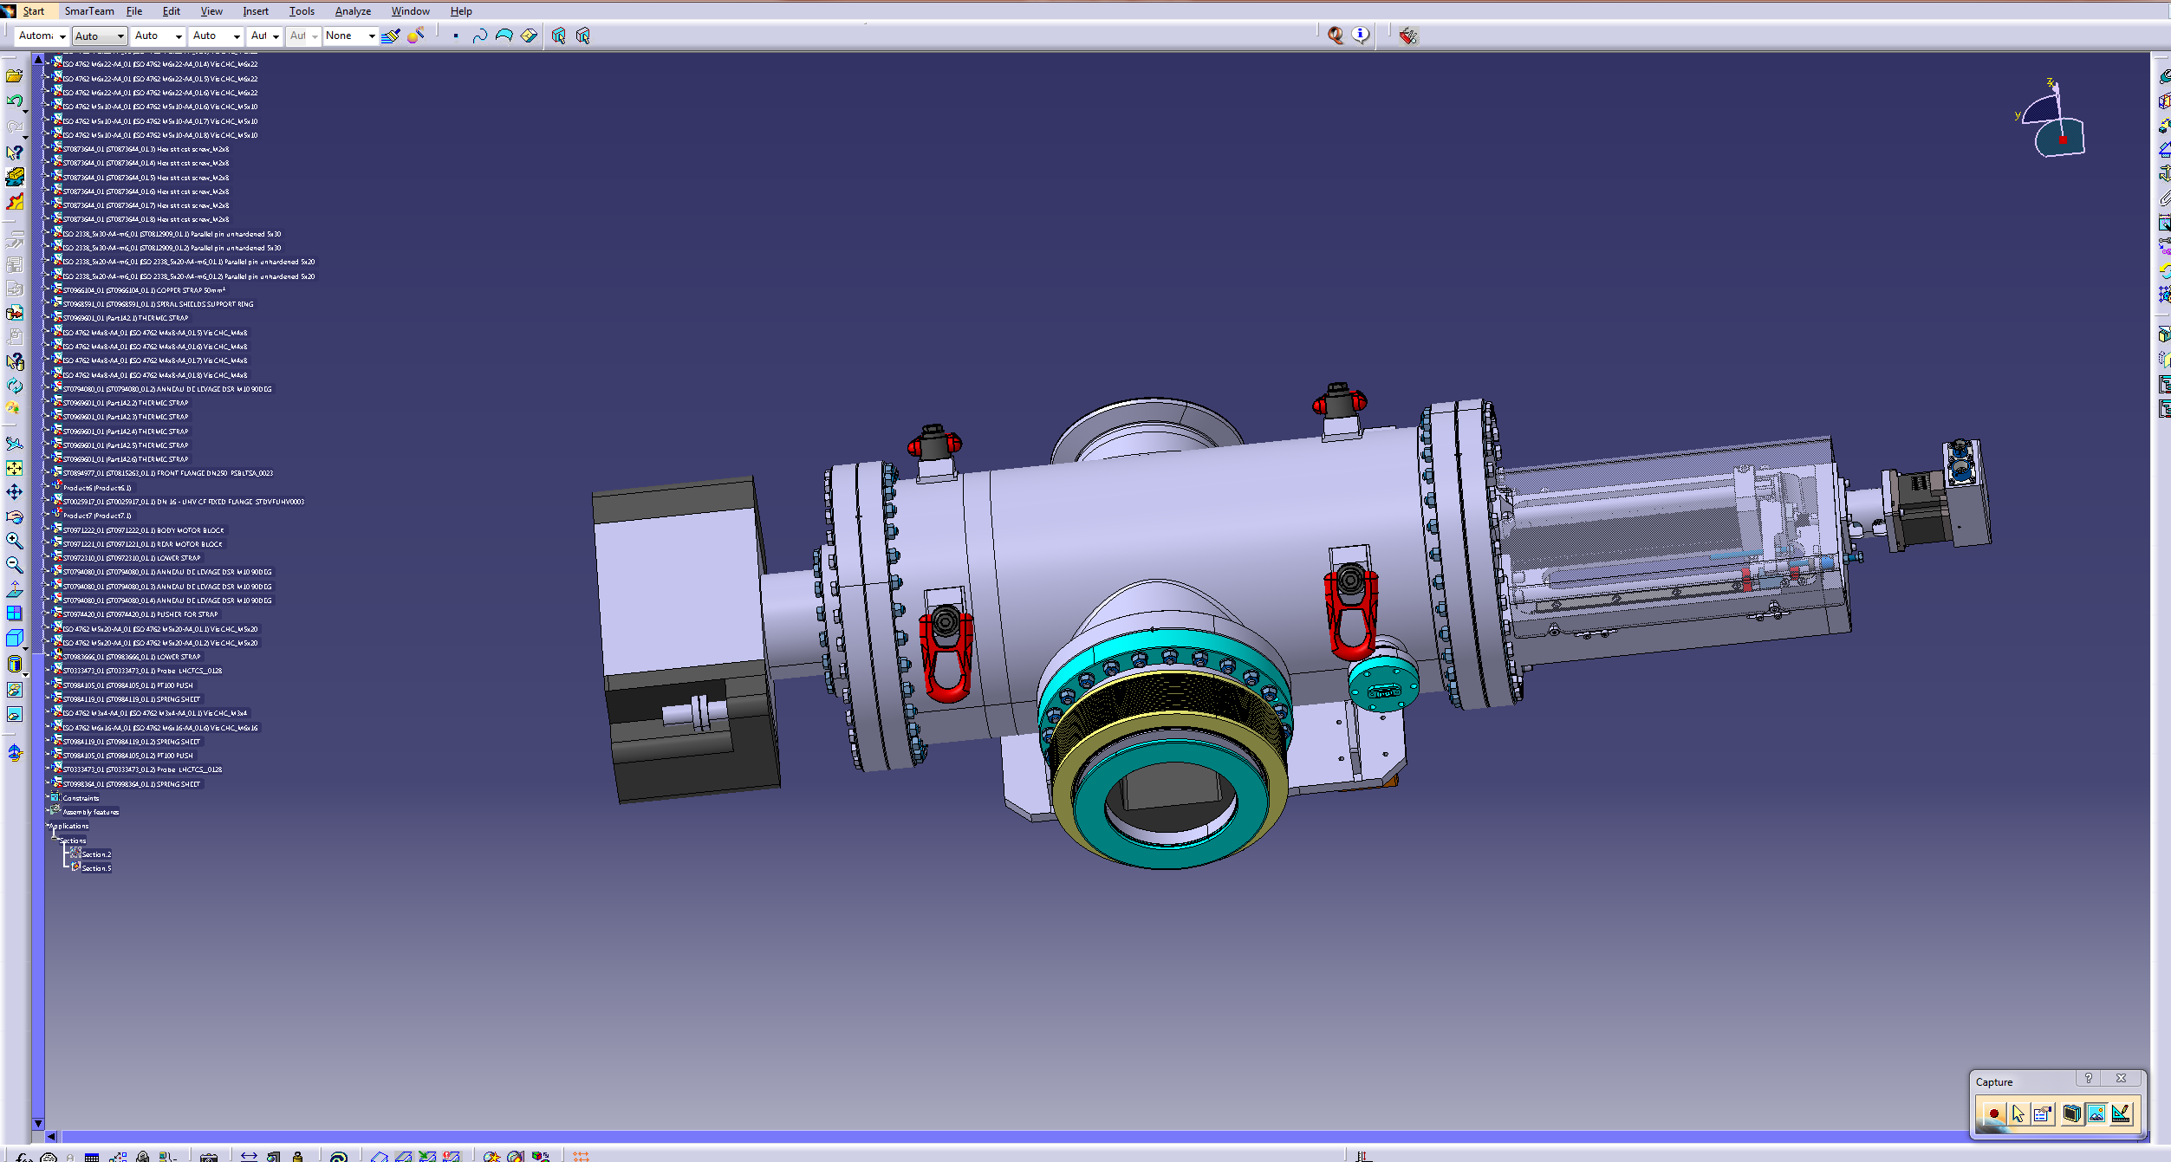


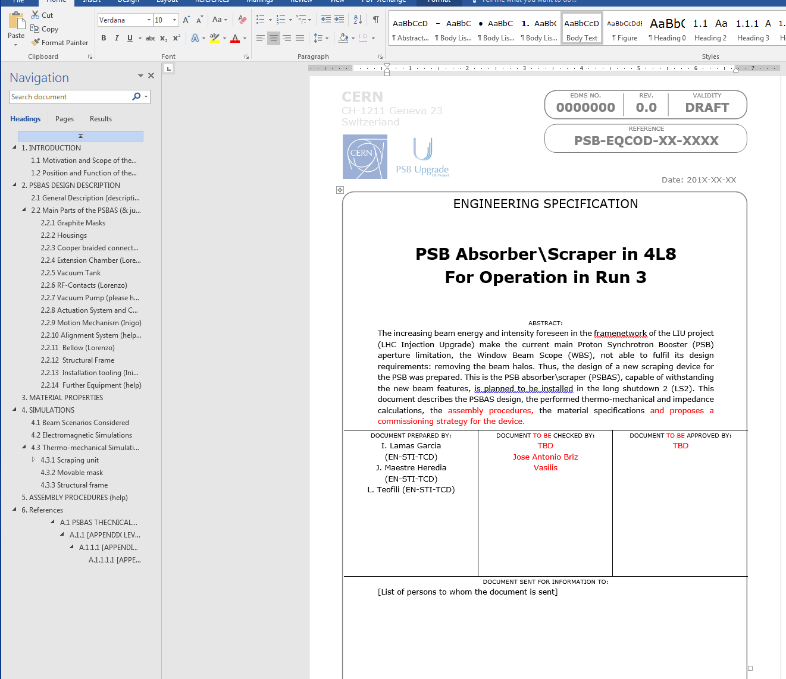
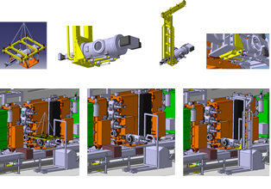
SUMMARY
PSB ABSORBER
Design requirements
Mechanical design
Fabrication
Prototyping
Installation

Slide 9
HRMT-35
Trainee: Jorge Maestre
Supervisors: Inigo Lamas and Marco Calviani

Slide 10
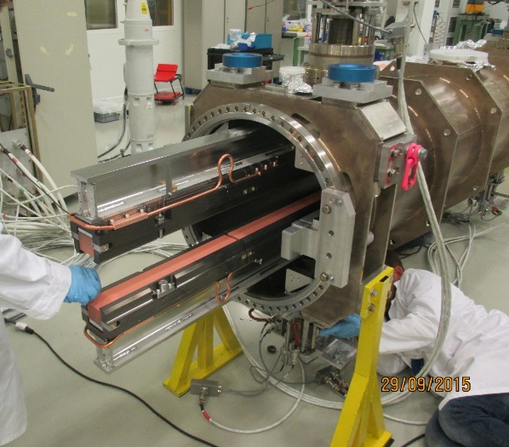
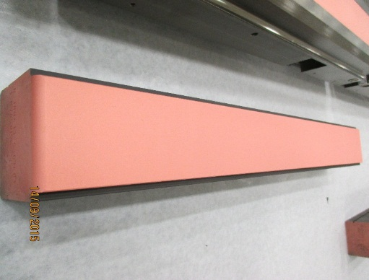
INTRODUCTION
HRMT-35
Absorbing coated blocks are used in many beam intercepting devices and collimator e.g. TDI, TCSPM, etc.
Absorbing blocks are positioned in the beam trajectory or close to and it is usually based on low Z-material as Graphite and derivate (CFC or MoGr). This type of materials are able to capture the beam energy slowly and exhibits suitable thermo-mechanical properties.
Collimators represent the majority of losses due to impedance in the LHC. High conductivity coatings help to reduce the impedance of the device.
The LHC Machine Committee (LMC#256) recommended to test and validate the sputtered Cu performance under the worst impact conditions that the TDI could face.
Given the past issues and the general uncertainties on coatings behavior when grazed by a high intensity proton beam, other coating configurations were tested (HMRT-35, Multimat) on low-Z carbon based materials in order to gain important information for future beam intercepting devices.

Slide 11
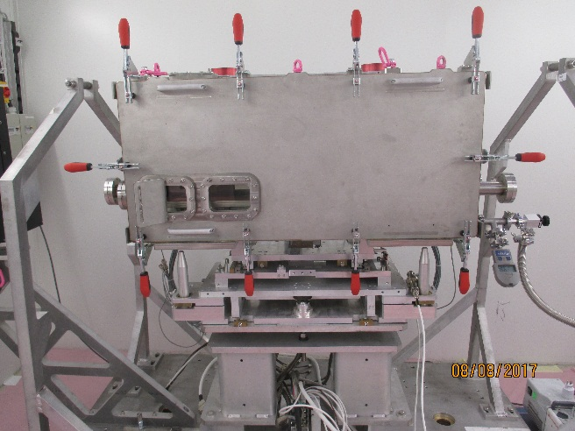
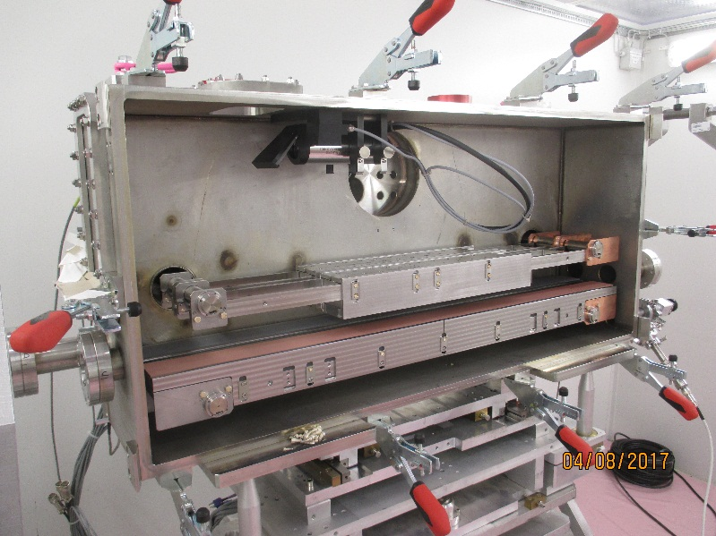
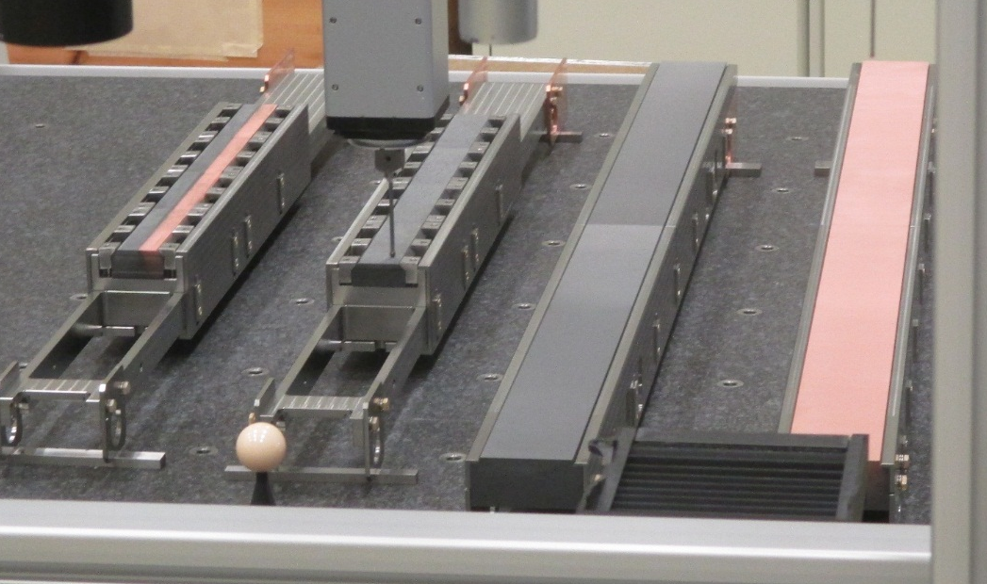
EXPERIMENTS
HRMT-35
HRMT-35 experiment was executed to acquire more information about the coated low Z-carbon based material.
4 different absorbing materials and coating configurations:
  SGL Graphite R7550 TDI coating configuration with Cu coating
  SGL Graphite R7550 TDI coating configuration with Mo coating
  Tatsuno 2D CfC in a TCPPM/TCSPM configuration with Mo coating
  Molybdenum Graphite (MoGr) with Mo coating and Cu coating
Coated blocks
500
HD camera
1200
4
3
4 Blocks
2
1

Slide 12
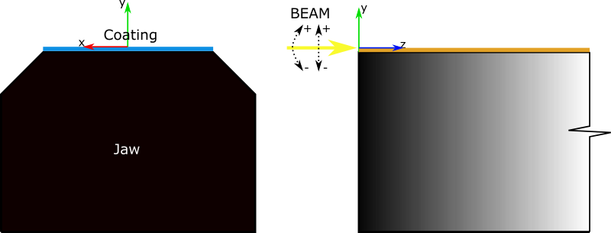
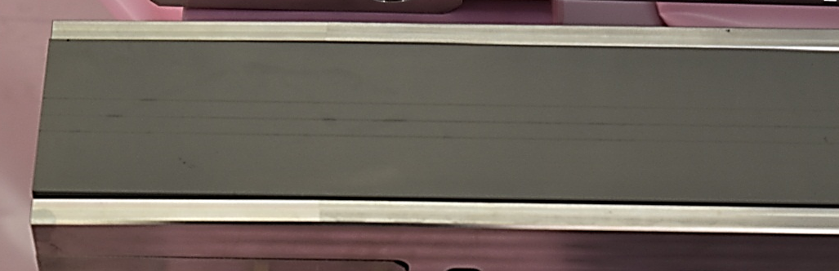
EXPERIMENTS
HRMT-35
Three different impacts were selected in order to reproduce the worst scenarios.
Deep impact
Grazing impact at 0σ_{y}
Grazing impact at 0σ_{y} with tilted jaw
Fig 1: illustrative scheme of the impact position
Shots for Stripe 1 | Shots for Stripe 2 | Shots for Stripe 3
0σ_{y} | 0σ_{y} | 0σ_{y} jaw tilted 0urad
-0,25σ_{y} | 0σ_{y} | 0σ_{y} jaw tilted 150urad
-0,5σ_{y} | 0σ_{y} | 0σ_{y} jaw tilted 300urad
-0,75σ_{y} | 0σ_{y} | 0σ_{y} jaw tilted -150urad
-1σ_{y} | 0σ_{y} | 0σ_{y} jaw tilted -300urad
-2σ_{y} | 0σ_{y} | -
Number of bunches | 288
Bunch time | 25 ns
Energy | 440 GeV
Intensity | 1.20E+11 ppb
Beam distribution | Gaussian
Beam size | σ_{x} = σ_{y} = 300 μm
Table 1: Beam impact configuration
Table 2: Nominal beam parameters
Stripe 2
Stripe 1
Stripe 3
Fig: Experimental test of the SGL7550 – Mo coating

Slide 13
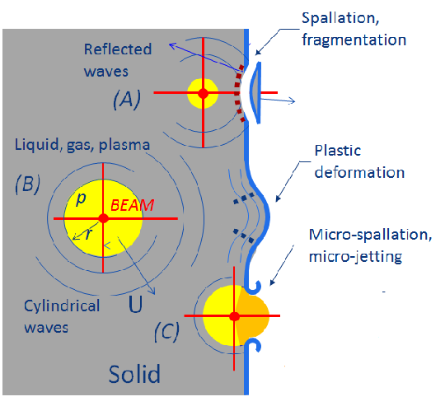
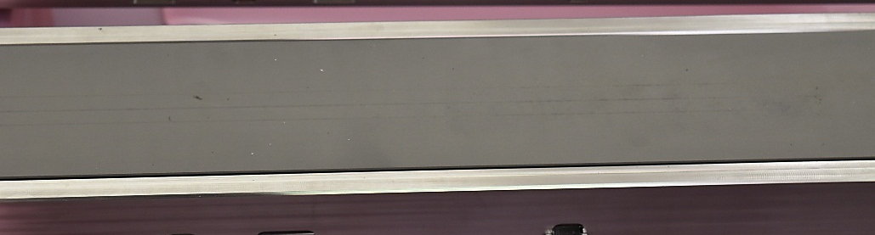
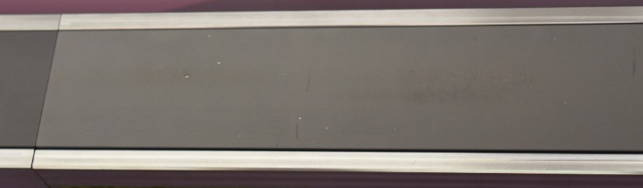
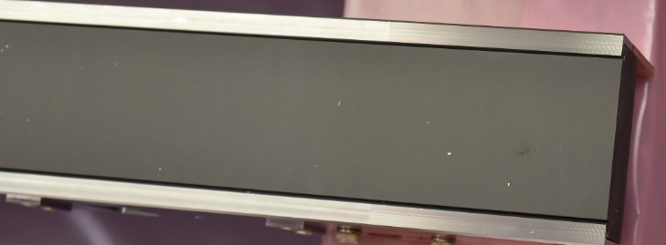
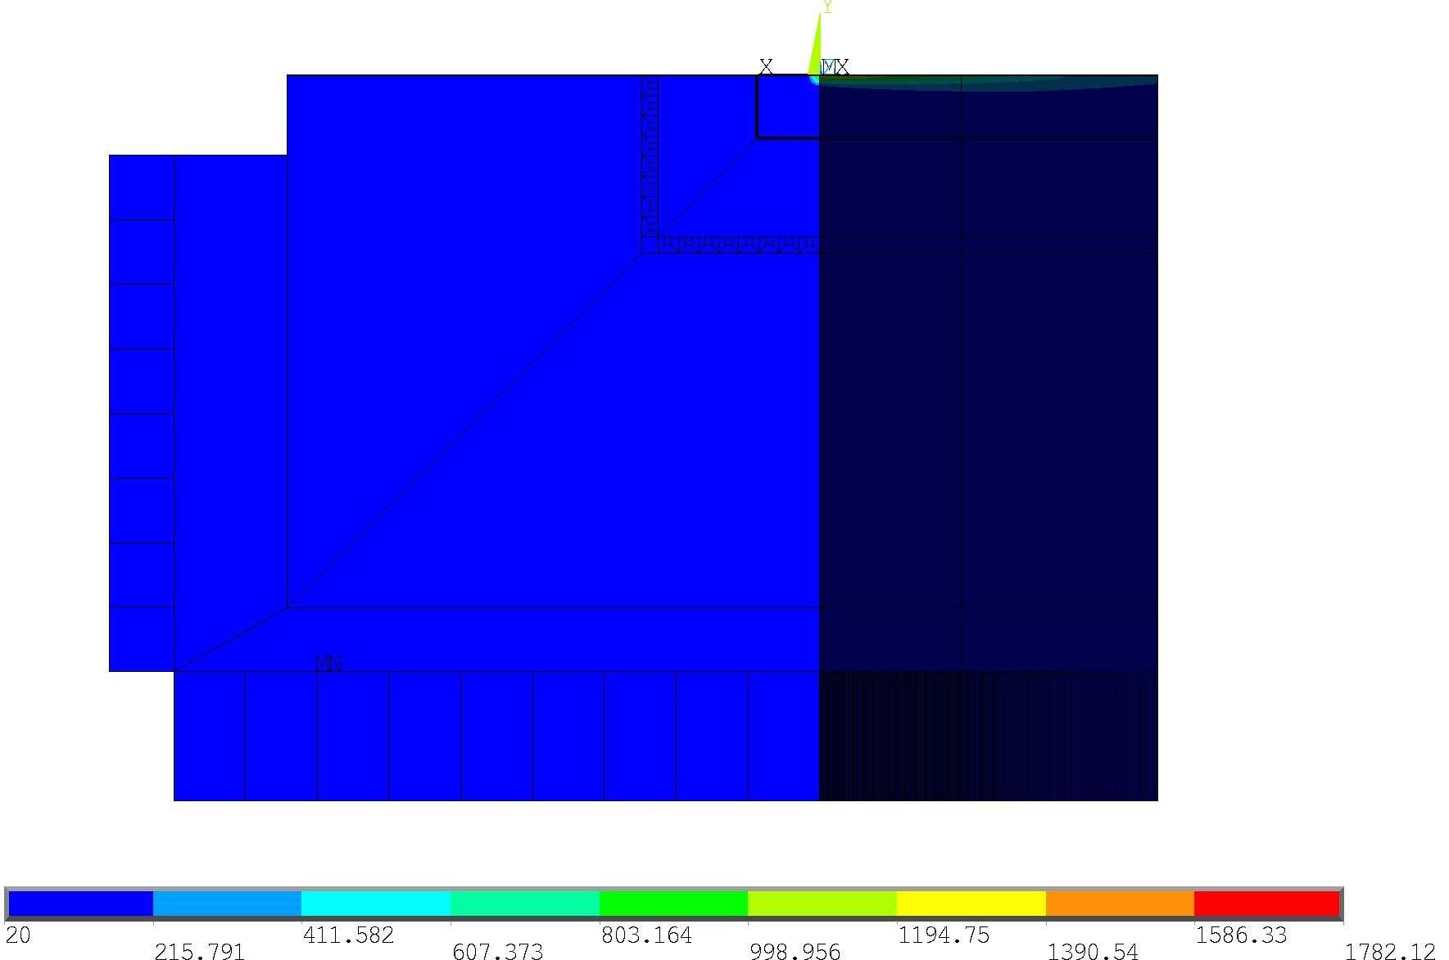
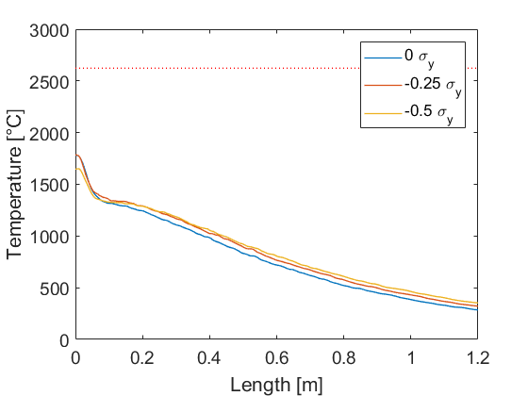
NUMERICAL SIMULATIONS
HRMT-35
SGL 7550 Mo Coat.
Upstream
Fig : Physical phenomena*
Fig : Temperature distribution in the Mo coating at the of the pulse for 0 σ_{y} ,0 tilt
Downstream
Fig: Longitudinal temperature distribution on the Mo coating at the end of beam pulse
* F. Carra. Some theory on the particle beam impact problem and few suggestion on how to simulate it. HL-LHC Collimators: Design, Engineering and Prototyping #21

Slide 14
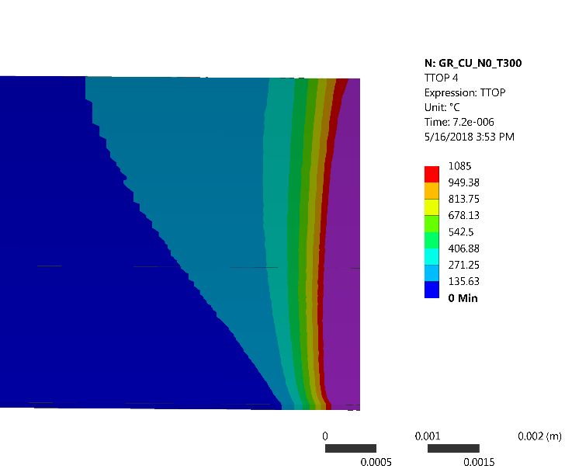
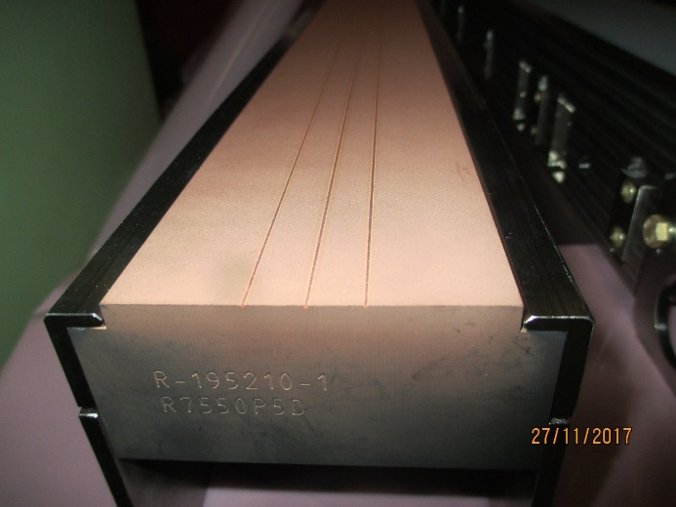
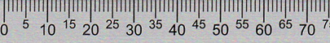
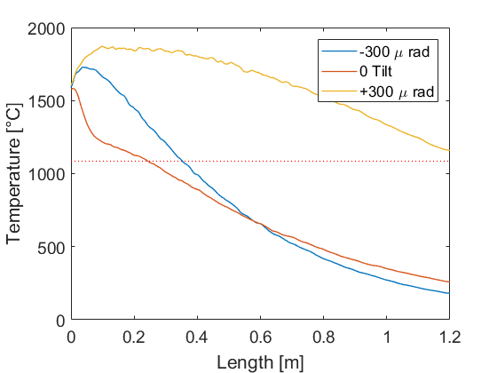
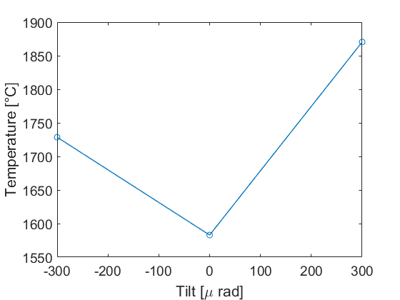
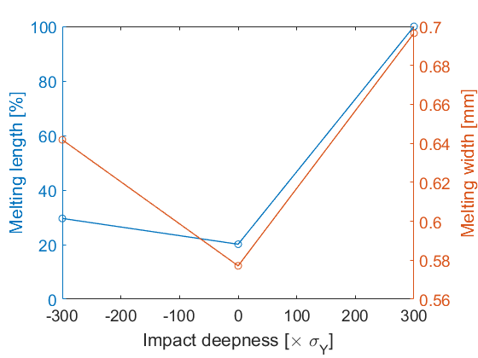
NUMERICAL SIMULATIONS
HRMT-35
SGL 7550 Cu Coat.
1.2 m
Fig : Temperature distribution on the coating at the end of beam pulse
Fig : Coating after the beam impacts
Fig : Longitudinal temperature distribution on the coating at the end of beam pulse
Fig : Maximum temperature at the end of beam pulse for different tilts
Fig: Melting size for different tilts

Slide 15

SUMMARY
HRMT-35
THERMODYNAMIC SIMULATION OF THE DIFFERENC GRAPHITE-BASED BLOCKS.
PRE ANALYSIS COMPARATIVE BETWEEN THE NUMERICAL AND EXPERIMENTAL OBSERVATIONS.
THERMO-MECHANICAL CHARACTERIZATION OF COATED BLOCKS
DEVELOPMENT AND RESERCH OF NEW MECHANICAL MODELS WHICH ARE ABLE TO COSIDER CHANGE OF PHASE, EROSION AND SPALLATION PHENOMENA.
DESMANTELING OF EXPERIMENTS AND ANALYSIS OF THE EXPERIMETAL SAMPLES. FIB TECHNIQUE

Slide 16
CRYSTAL COLLIMATORS
Trainee: Jorge Maestre
Supervisors: Inigo Lamas and Marco Calviani

Slide 17
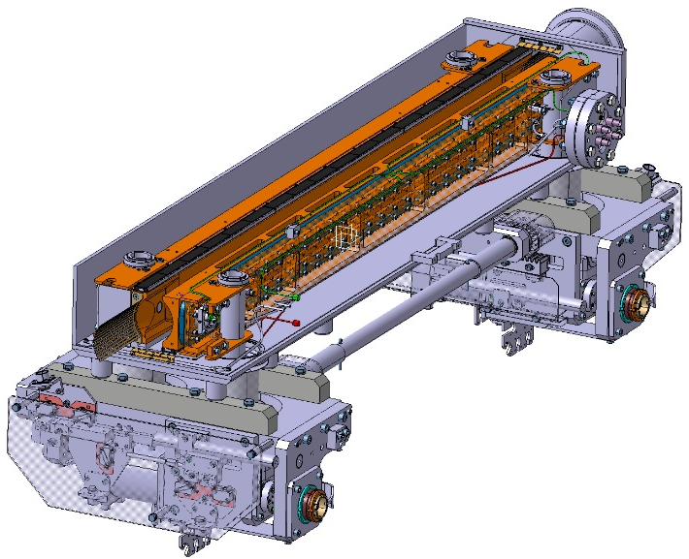
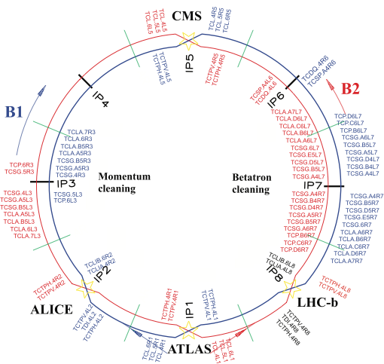
INTRODUCTION
CRYSTAL COLLIMT.
STANDARD COLLIMITARS:
Cleaning the beam by removing stray particles which would induce quenches in the SC magnets
Protect the downstream machine elements by shielding
Fig. Standard collimator
Beam propagation
Core
Primary
halo (p)
Unavoidable losses
Secondary
halo
π
Primary Collimator
p
Shower
π
Tertiary halo
Secondary Collimator
p
e
p
Shower
Absorber
Absorber
e
Super-conducting magnets
SC magnets and particle physics exp.
Total of 118 collimators
More than 10 different designs
C/C
C/C
W
W
Fig. Scheme of standard collimator

Slide 18
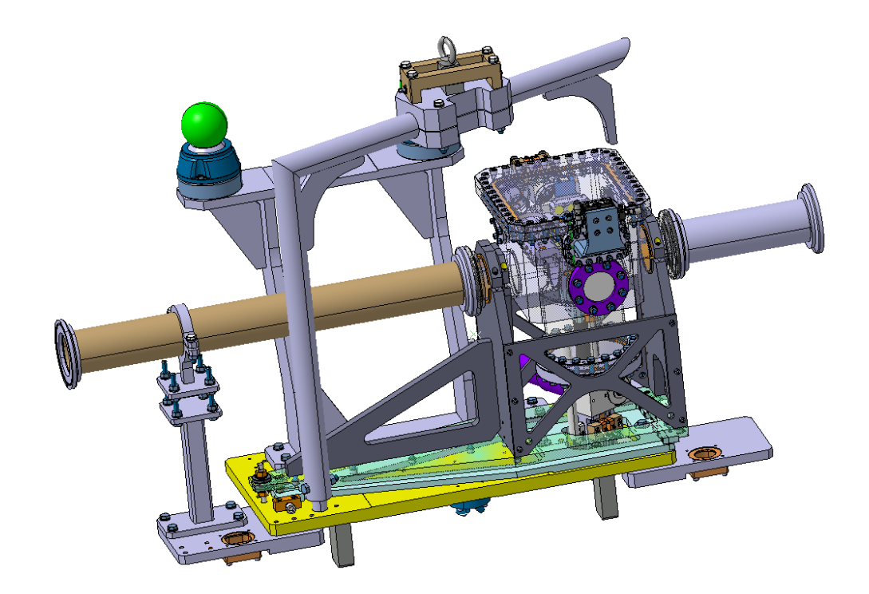
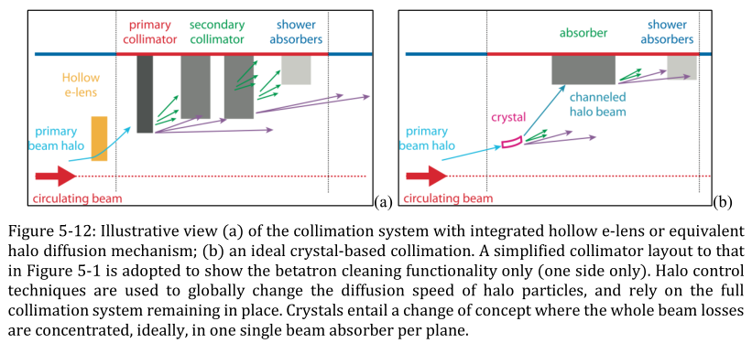
INTRODUCTION
CRYSTAL COLLIMT.
IN THE CONTEXT OF THE HL-LHC: NEW GENERATION OF COLLIMATOR BASED ON SILICON CRISTAL
Crystal: bending of high-energy particles trapped between lattice planes
Cleaning improvement
Improved cleaning of physics debris close to experiments
Impedance improvement
Fig. Scheme of the crystal collimator
Fig. Design of the crystal collimator

Slide 19
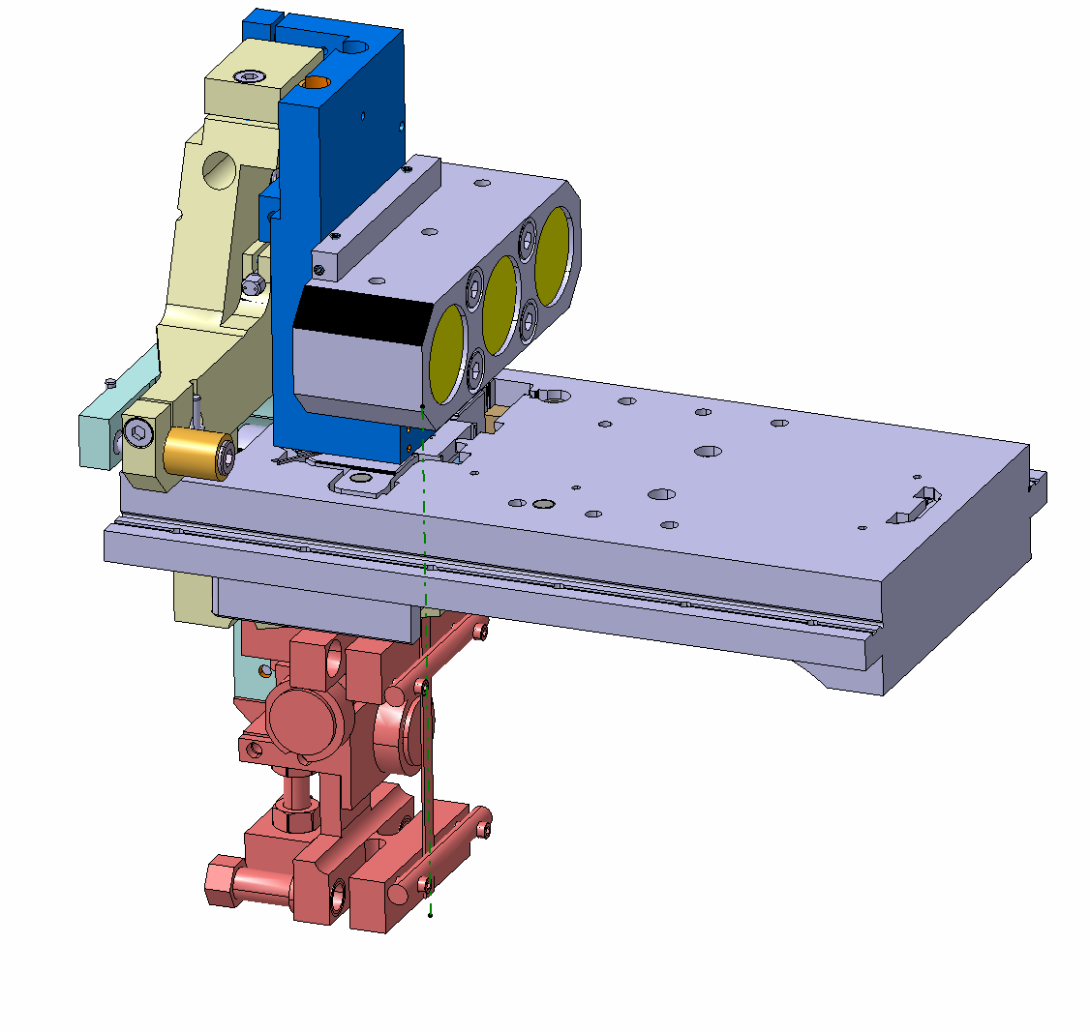
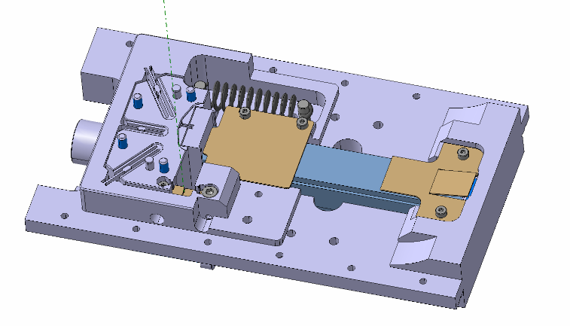
ROTATIONAL STAGE
CRYSTAL COLLIMT.
ROTATIONAL STAGE:
For functional requirements, the position/orientation of the silicon crystal must be controlled by a high precision system.
The crystal is allow to rotate about its longitudinal axis in the range between -10 and 10 mrad in order to bend the beam trajectory.
The system consists in a rotational stage. The rotor, where is connected the crystal, is moved by the action of a piezoelectric material.
The measure of the current position of the crystal is indirectly done by a mirror system.
Because to the high sensitivity and accuracy of the rotational mechanism, the mechanical behavior of this device must be carefully checked.
Mirrors
Rotational axis
Rotational stage
beam
Crystal
Rotation [-10,10] mrad
Rotational stage
Piezoelectric
rotor

Slide 20
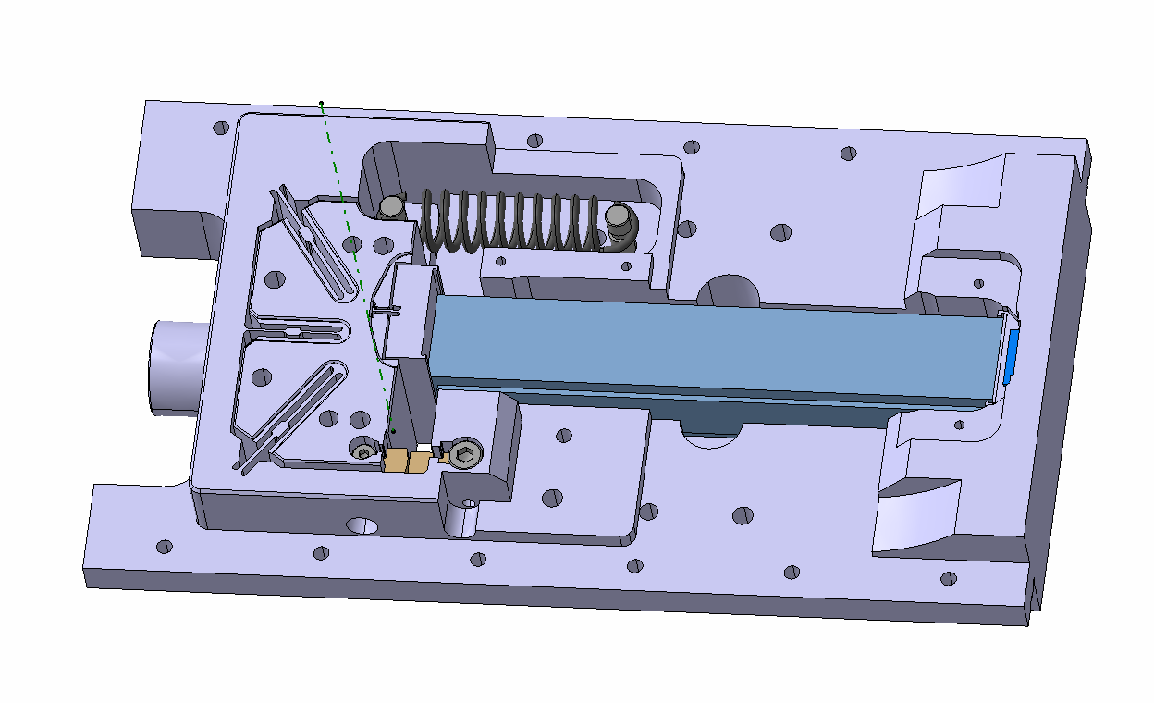
ROTATIONAL STAGE
CRYSTAL COLLIMT.
To ensure the contact between the piezo and piston. Moreover, it is responsible of returning the rotor to the initial position.
Pre-load spring
Axis
Piezoelectric material
Active material that pushes the piston. The stroke of the piezo is controlled via electric field
Rotor
Part that allows the rotation of the rotor by an elastic deformation of the blades.
blades
Piston
To avoid possible movements of the piezo during bake out. This part ensures a continuous contact between the rotational stage and piezo.
Stopper
To limit the maximum rotational movement of the rotor.
Wedge

Slide 21
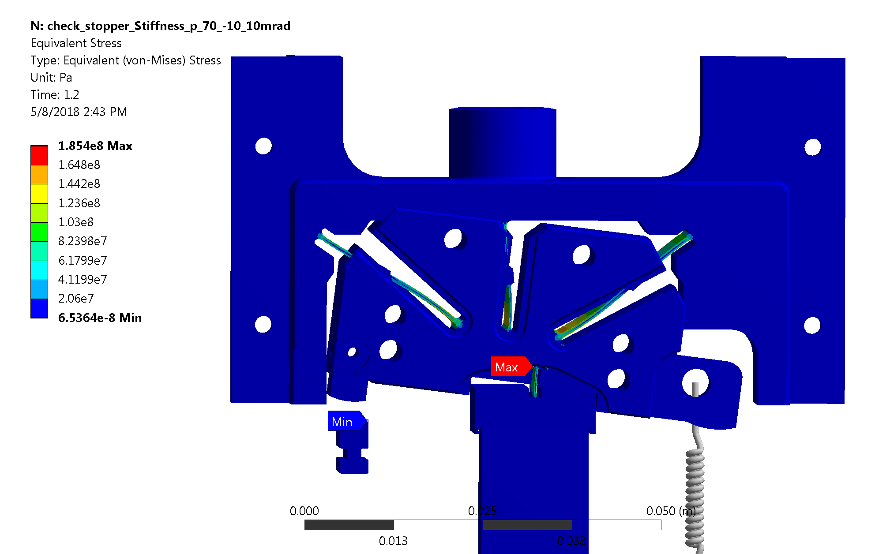
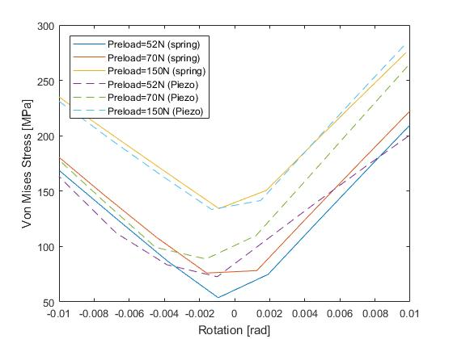
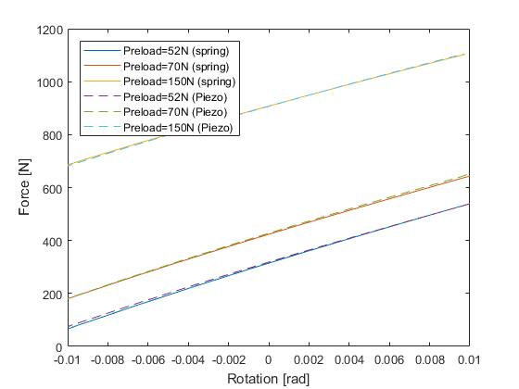
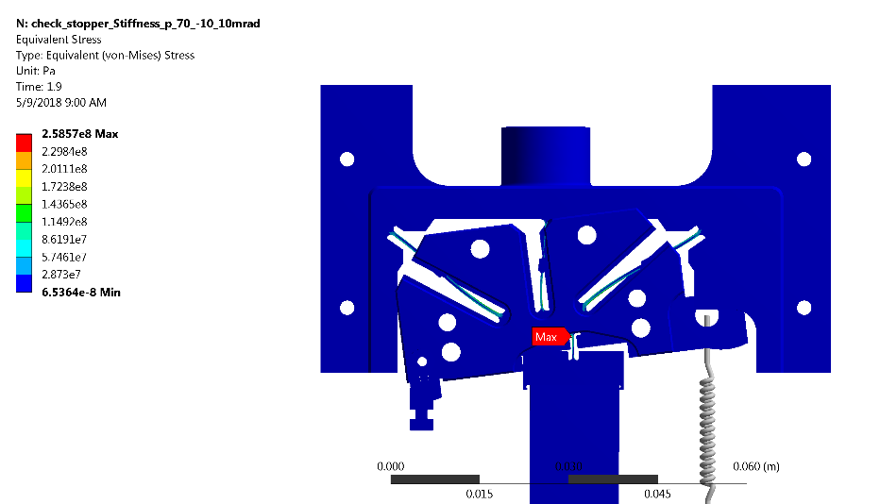
MECHANICAL ANALYSIS
CRYSTAL COLLIMT.
Fig. Von-Mises stress for different pre-loaded springs
Fig. 1 Rotational stiffness for different models and spring pre-load.
Fig. Von-Mises stress at -10.5 mrad (Pre-load 70N)
Mechanical analysis of the rotational stage for different configuration
Analysis of piezo-electric characteristic and behavior
Analysis of the rotation stiffness
Fig. Von-Mises stress at 9.7 mrad (Pre-load 70N)

Slide 22
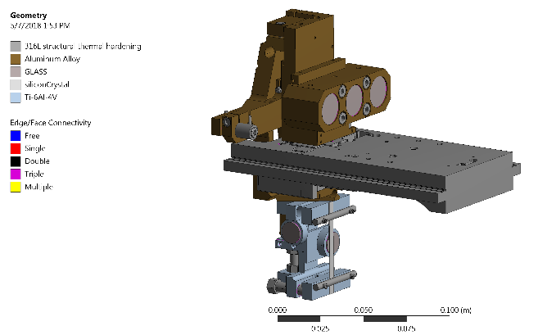




FEM Model
pre-stress analysis
Non pre-stress analysis
MECHANICAL ANALYSIS
CRYSTAL COLLIMT.
Large displacement is set on.
Gravity is considered
Spring model is used. Most pessimistic case with the lowest stiffness value of the piezo ($0.4632e8 N/m$)
Table 1 Natural frequencies
 |  | Pre-stress | Non pre-stress
modes | 1 | 176.97 | 183.91
 | 2 | 204.29 | 210.14
 | 3 | 245.29 | 254.55
 | 4 | 316.06 | 331.03
 | 5 | 515.59 | 537.62
 | 6 | 682.72 | 692.85
The first 2 modes is related to the rotation of the crystal and also to the bending of the arm which support the crystal.
5% of difference approx. between pre-stress and non pre-stress analysis.
Fig. 1 FEM model
Fig. 2 First three modes of vibration considering pre-stress effect

Slide 23
SUMMARY
CRYSTAL COLLIMT.
DESIGN OF THE CRYSTAL COLLIMATOR IS FINISHED
SEVERAL PROTOTYPES IS ALREADY INSTALLED IN LHC
OPTIMIZATION AND IMPROVEMENT OF THE CRYSTAL COLLIMATORS IN BASE ON PREVIOS EXPERIENCES

Slide 24
THANKS FOR YOUR ATTENTION

