Slide 1


The LIEBE high-power target: Offline commissioning results
Ferran Boix Pamies

Slide 2
Outline
Introduction/Context
LIEBE prototype design & finished assembly
Offline commissioning
Conclusion

Slide 3
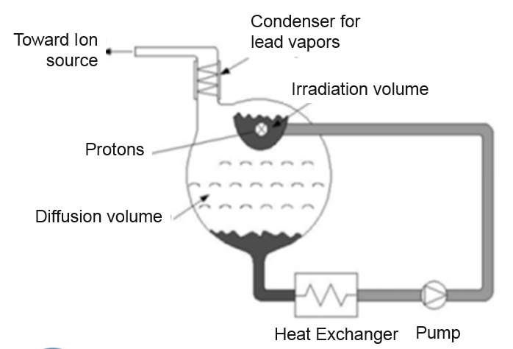
Introduction/Context
High power target for exotic species
Enhance the release of short-lived isotopes through:
  Droplet formation
  Lower density of the liquid
Primary beam heat deposition dissipation:
  Custom-made heat exchanger
Concept scheme, E. Noah et all, EURISOL-DS
Concept
Prototype
Offline commissioning
Online tests

Slide 4
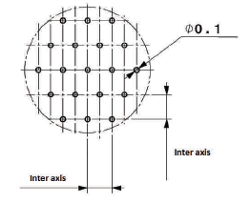
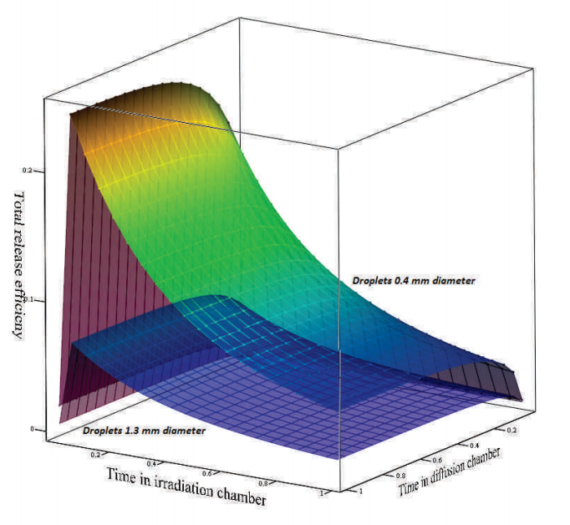
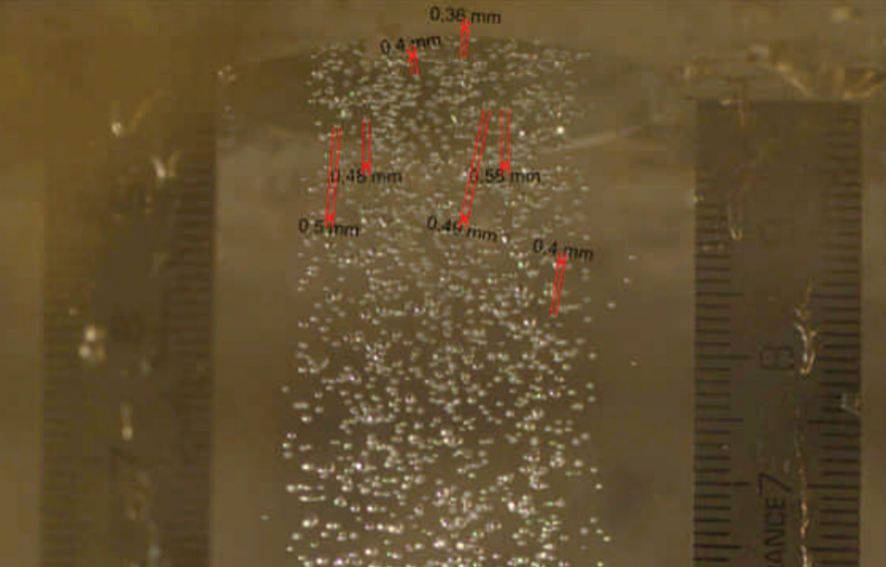
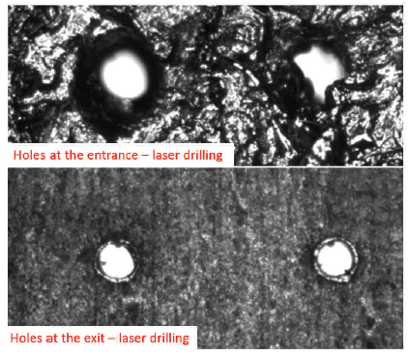
LIEBE: LIquid Eutectic lead Bismuth for Eurisol
Introduction/Context
Target material: LBE
Operational temperature [200-600]°C
Targeted isotope: ¹⁷⁷Hg (130ms half-life)
LBE Velocity preferred: 2 m/s Q=0.13 l/s
Ø0.4 mm droplets factor 5 more release
$$i=Φ.σ.N.ε_{target}.ε_{source}.ε_{sep}.ε_{transport}$$
Images from Melanie Delonca CERN Ph.D thesis

Slide 5
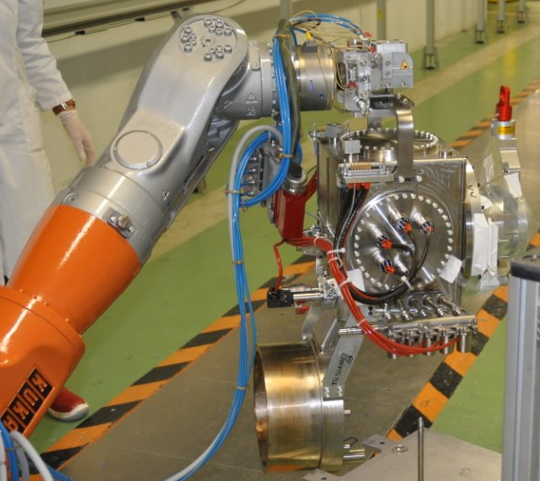
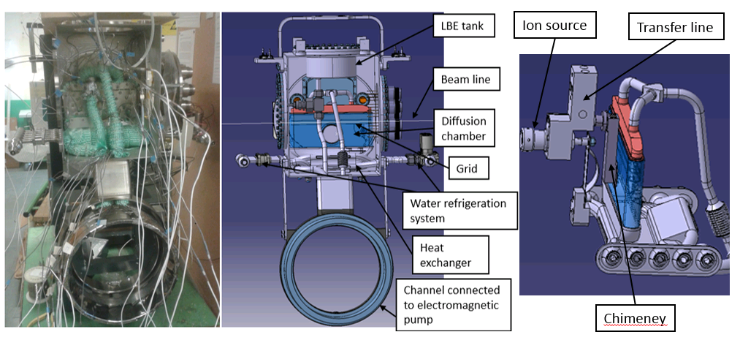
LIEBE prototype design & completed assembly
The target:
  Compatible with existing target handling at ISOLDE
Chimney

Slide 6
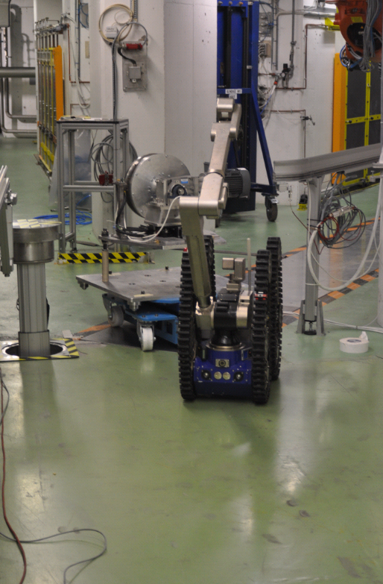
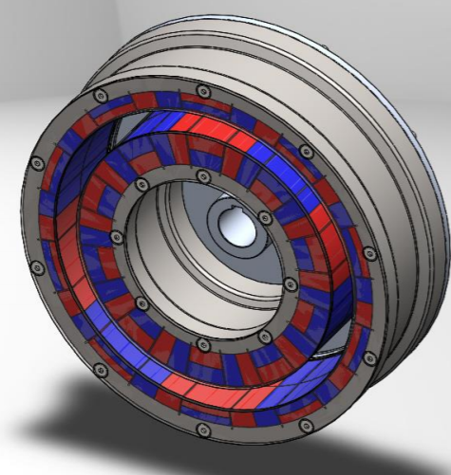
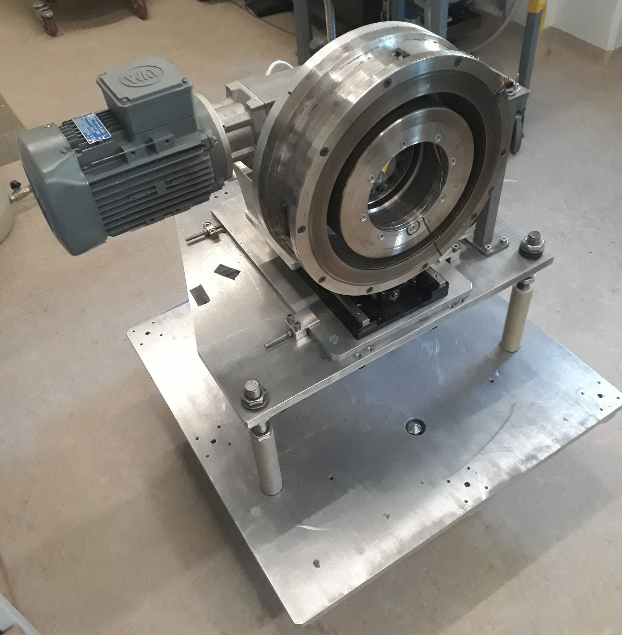
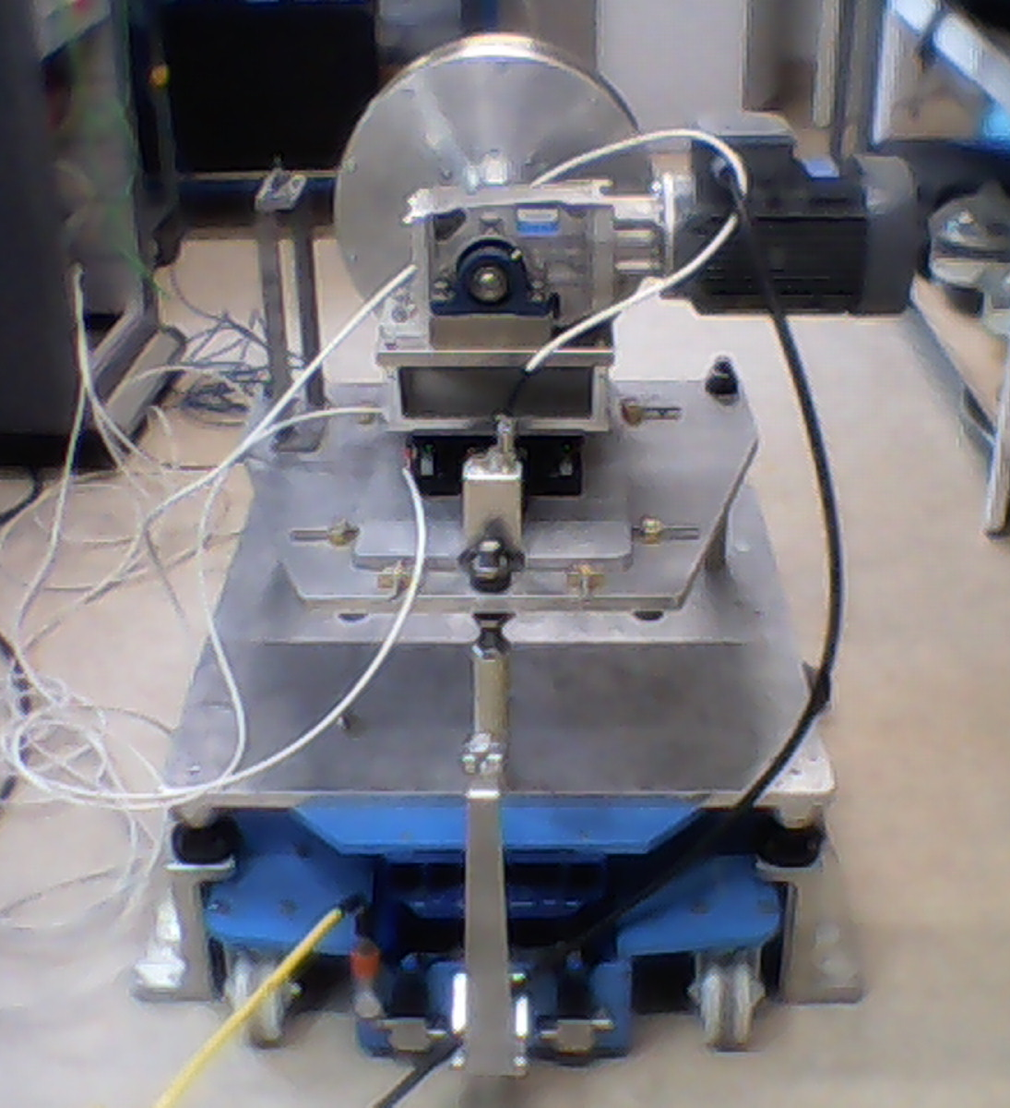
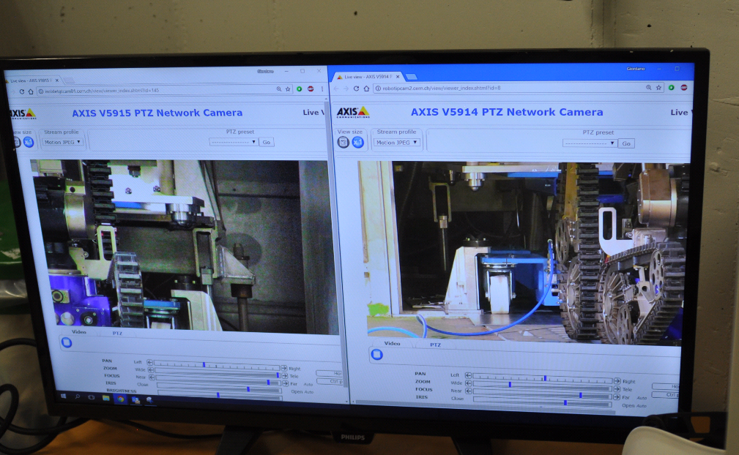
LIEBE prototype design & finished assembly
The EM pump:
Double Hallbach array axisymmetric
P=2,2kW , B=1,1T
Magnetic wheel
Coupling rails
Alignment table
Dedicated trolley

Slide 7
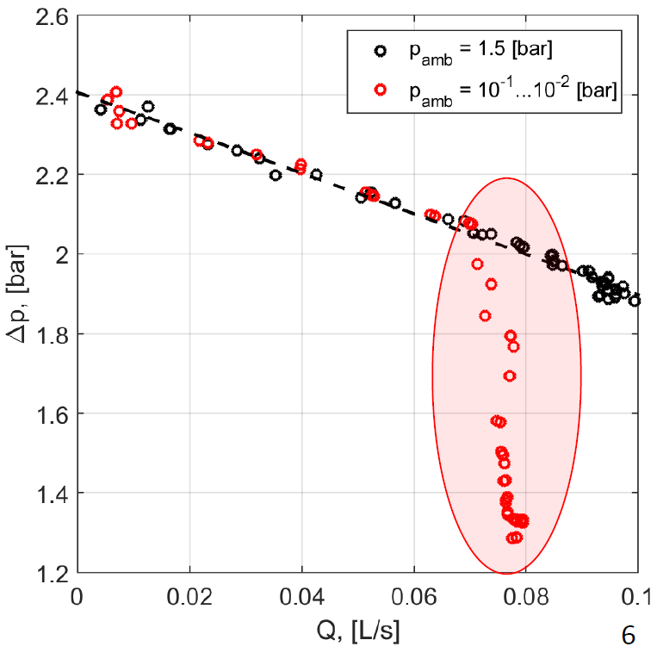
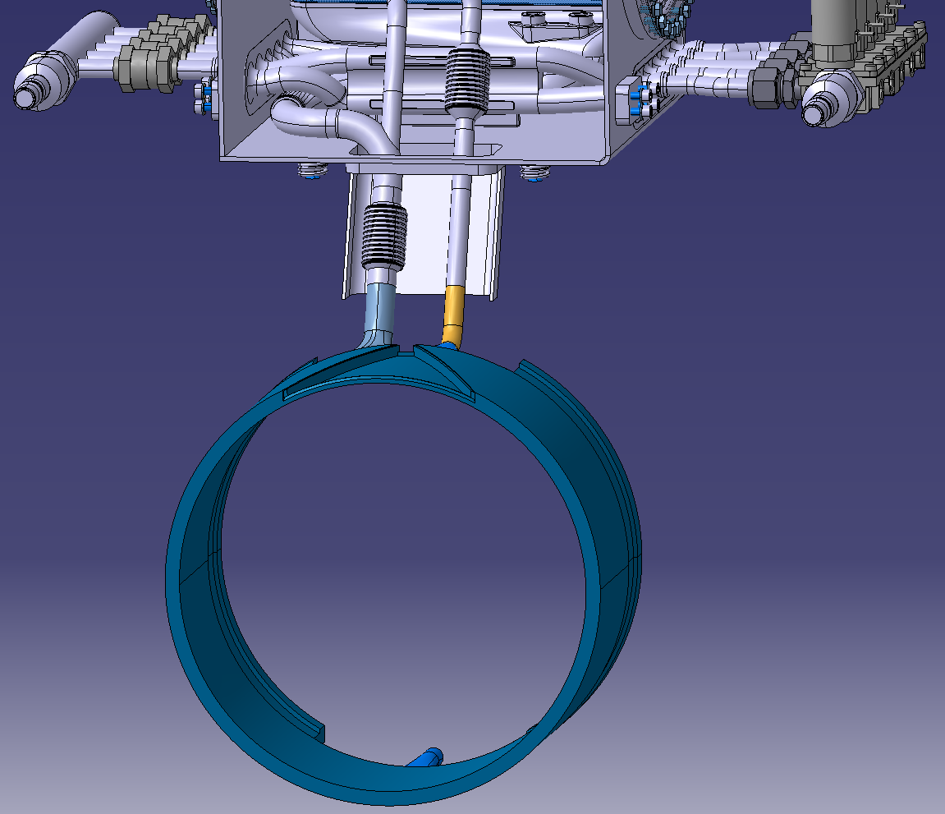
Offline commissioning: Flow assessment
Test objectives:
  Operate in the absence of cavitation
  Reach the desired flow for release optimization (0,13L/s)
Flow assessment in previous tests at IPUL
Increased diameter: Ø10mm Ø16mm

Slide 8
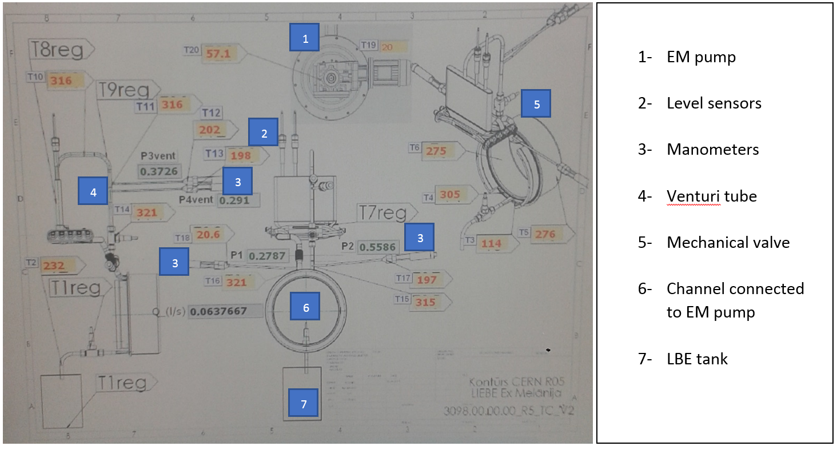
Offline commissioning: Flow assessment
Tests done with a LIEBE loop replica at IPUL
Screenshot of the tests setup

Slide 9
Offline commissioning: Flow assessment
Results:
  Drift observed between measurements due to clogging of the sensors
  LBE oxide formation in contact with air
0,13

Slide 10
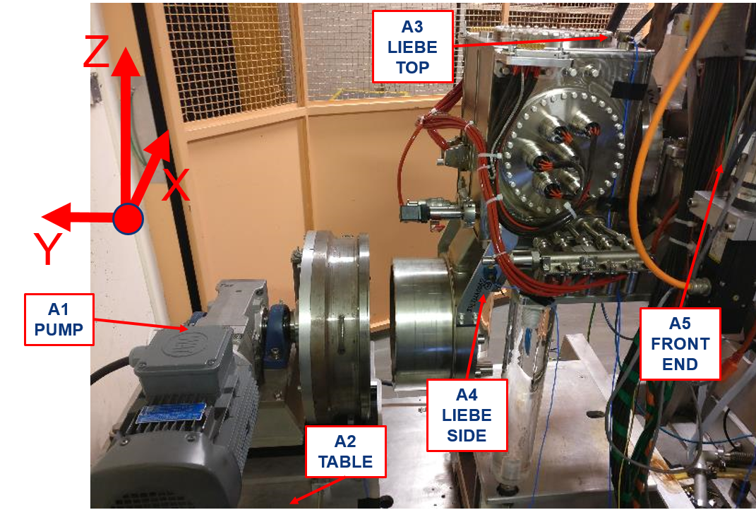
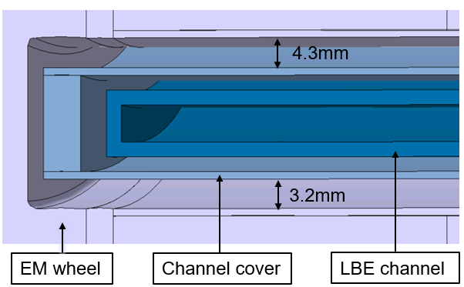
Offline commissioning: Alignment/vibration tests
Vibration tests:
  Check vibration transmission
  Evaluate the level of vibration for each rotational frequency
Empirically measured maximum distances in case of perfect alingment
Test setup after alignment

Slide 11
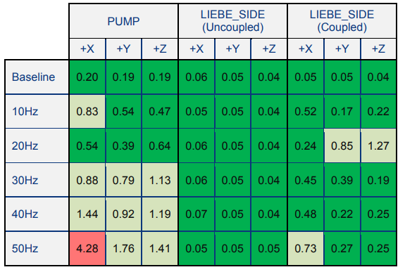
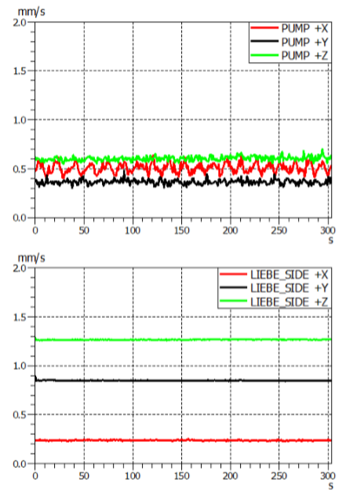
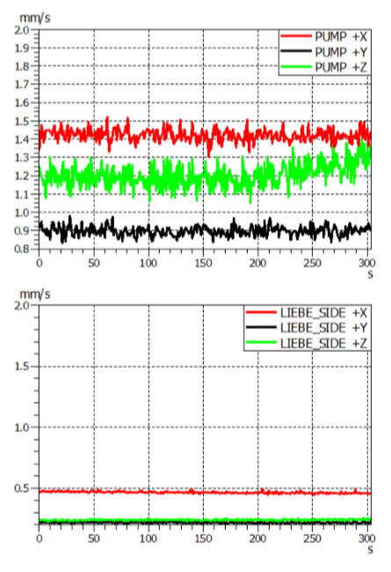
Offline commissioning: Alignment/vibration tests
Results:
  Sudden vibration increase due to natural resonant frequencies
  Good/satisfactory levels for operational frequencies of LIEBE
  Addition of an accelerometer to monitor the vibration throughout operation with LBE
Rotor Fr= 20Hz
Rotor Fr= 40Hz

Slide 12
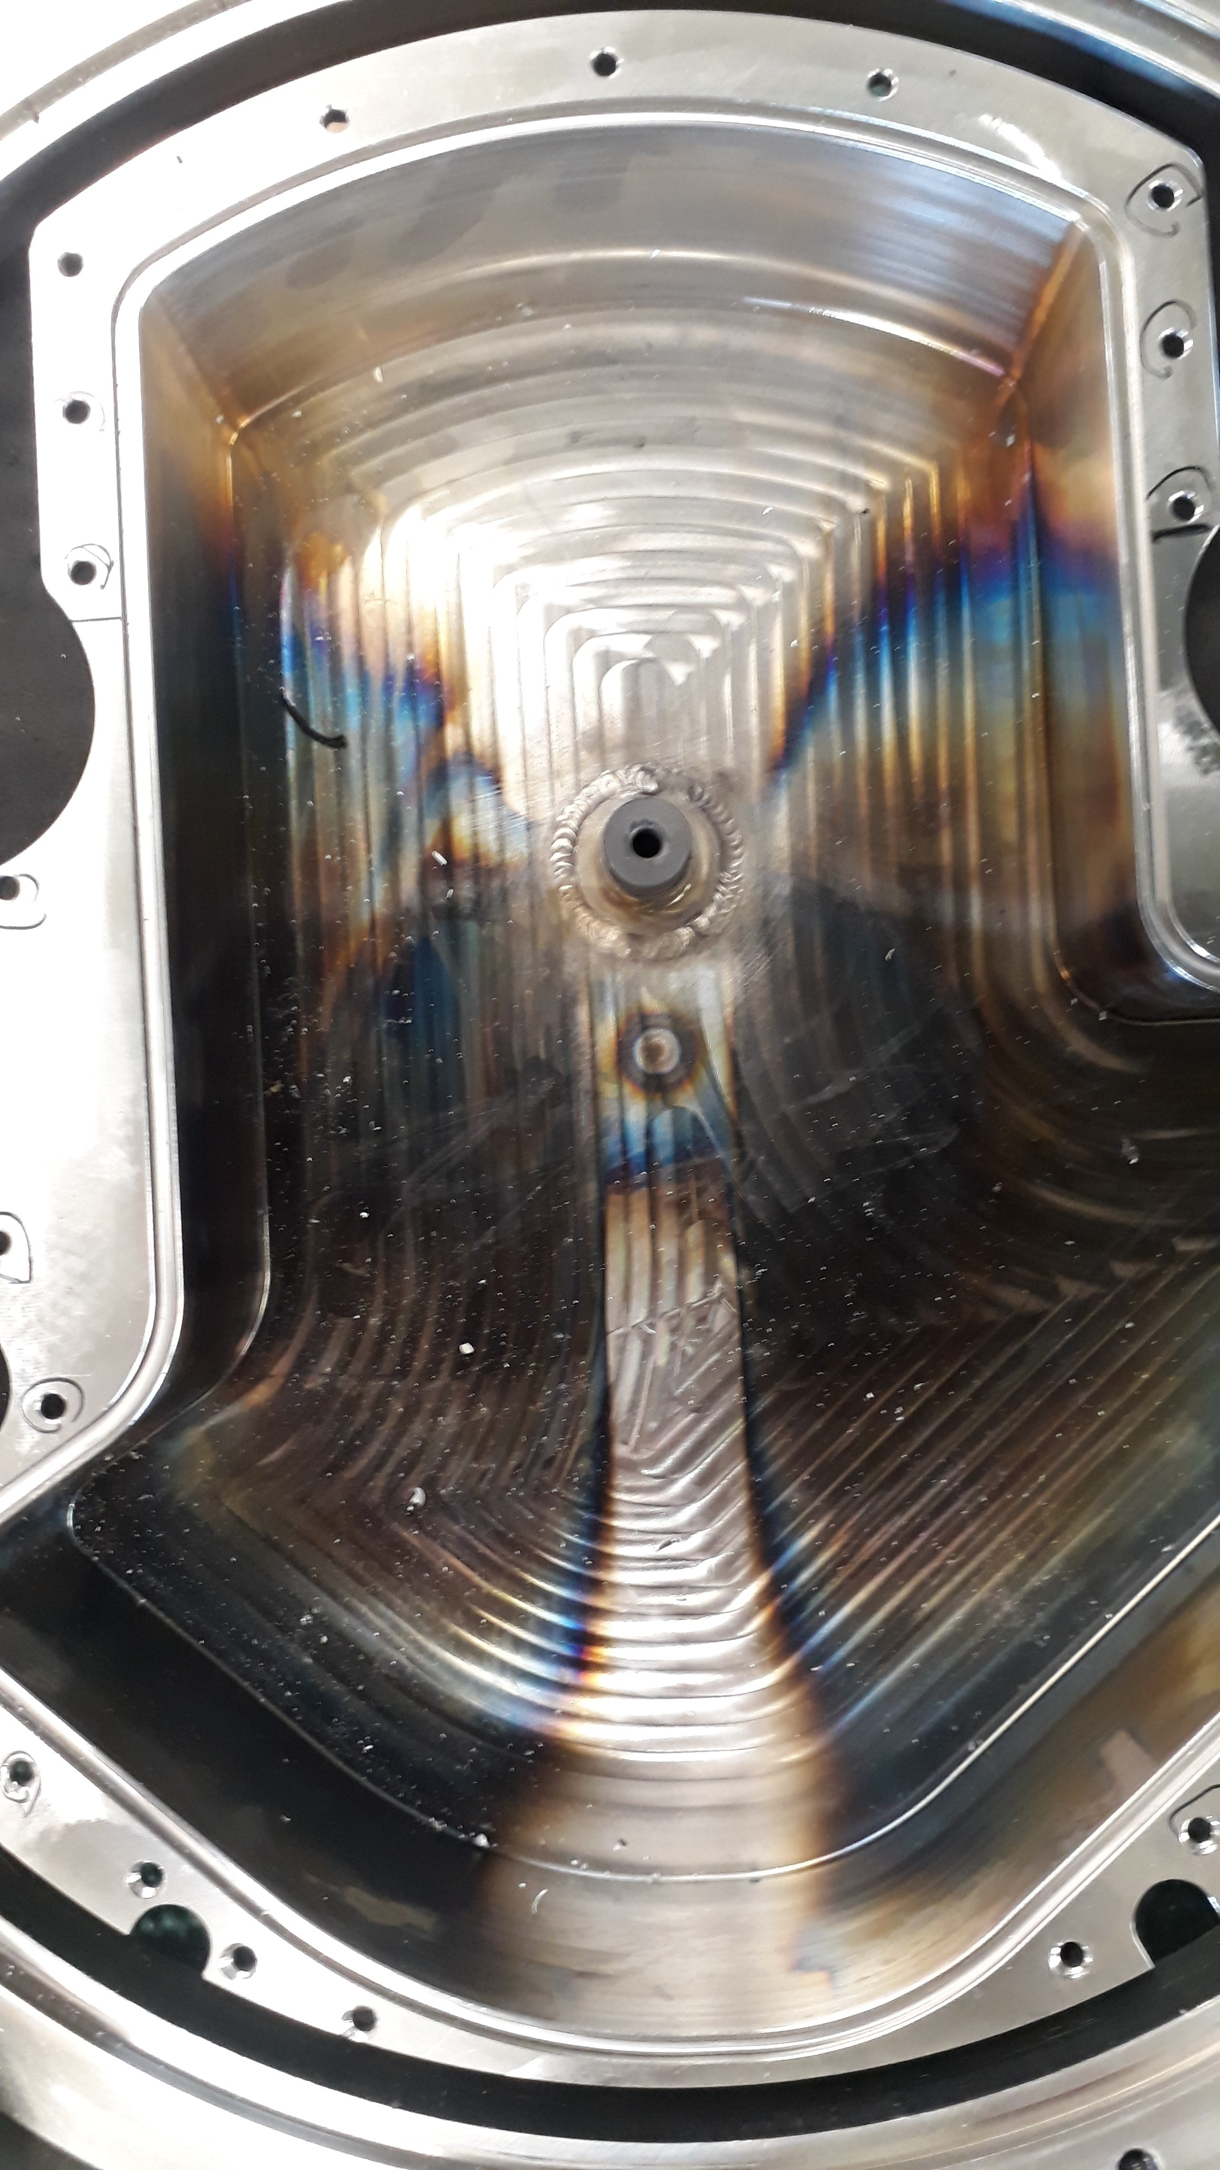
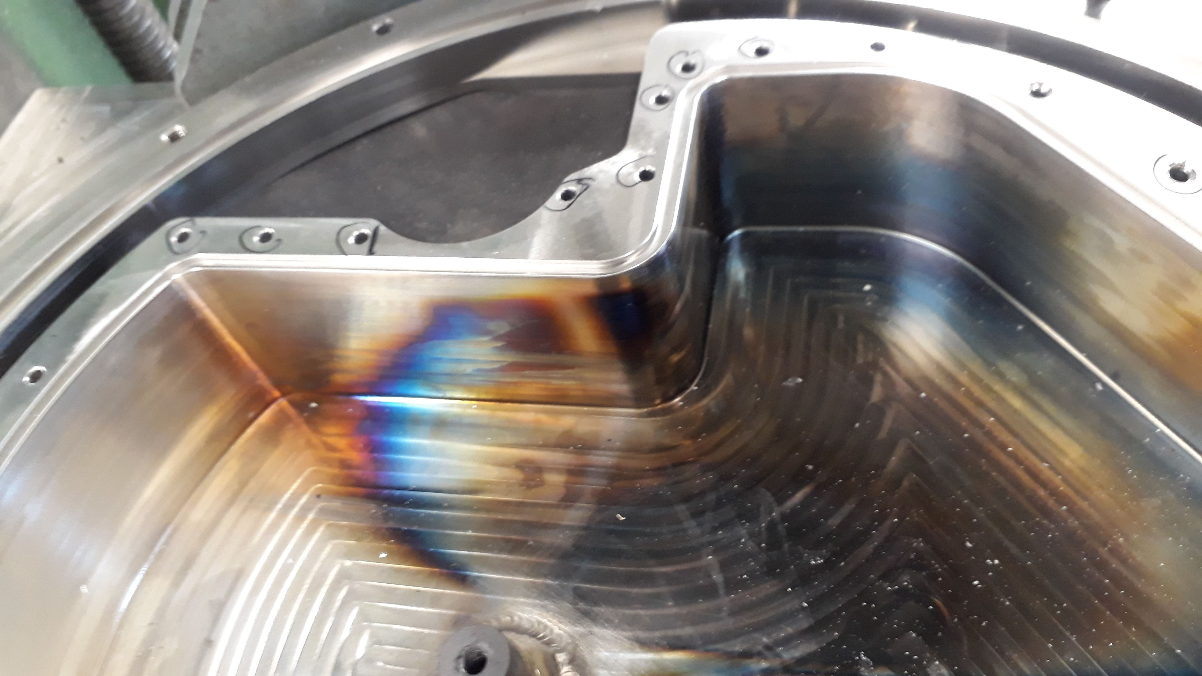
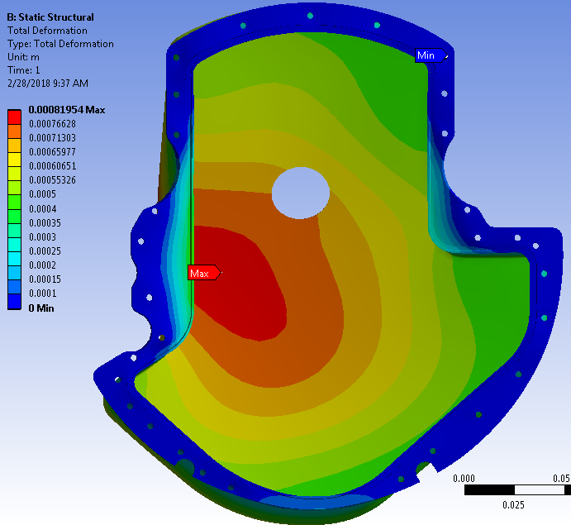
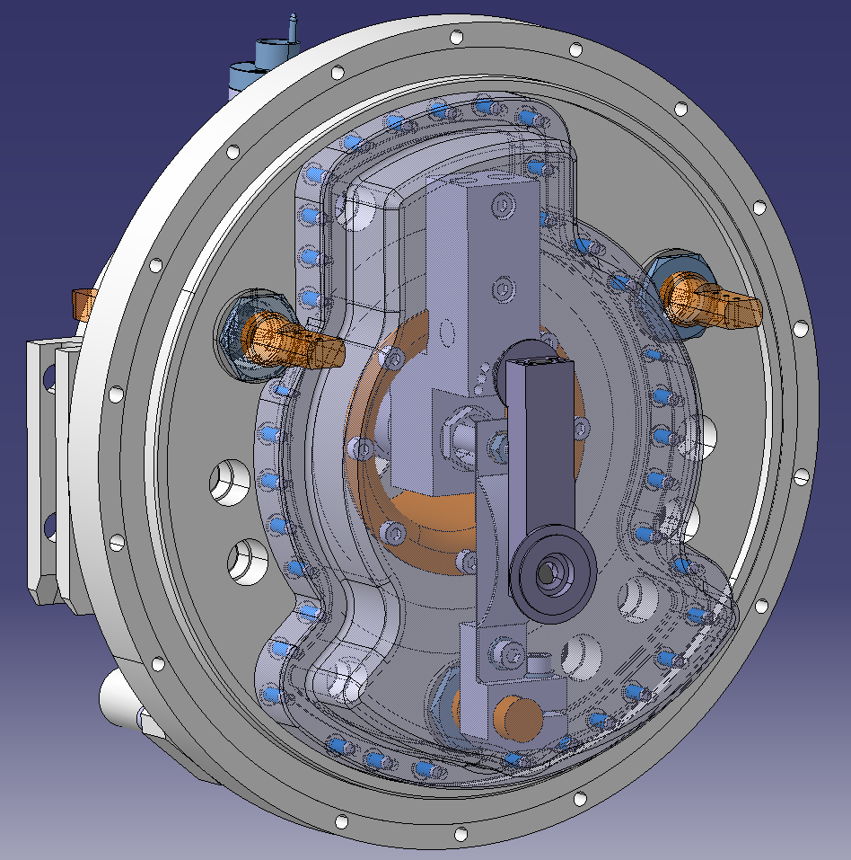
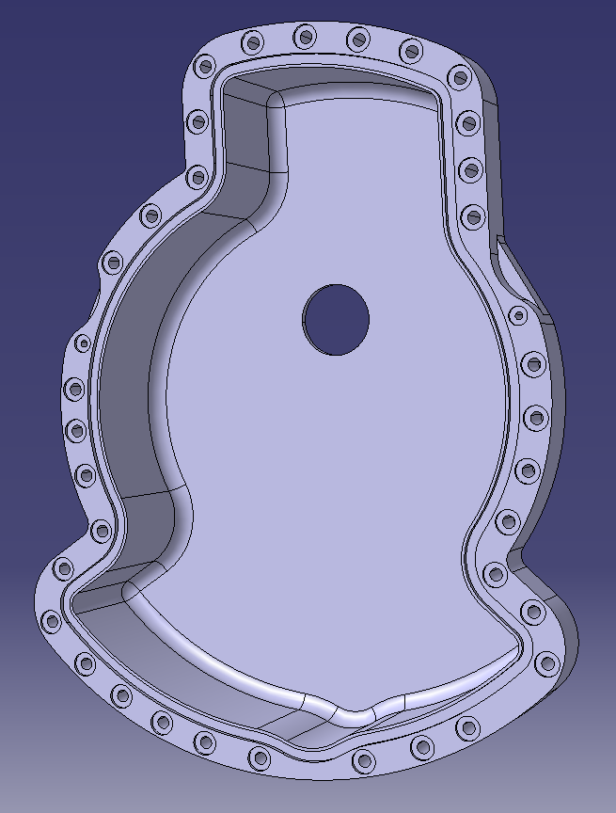
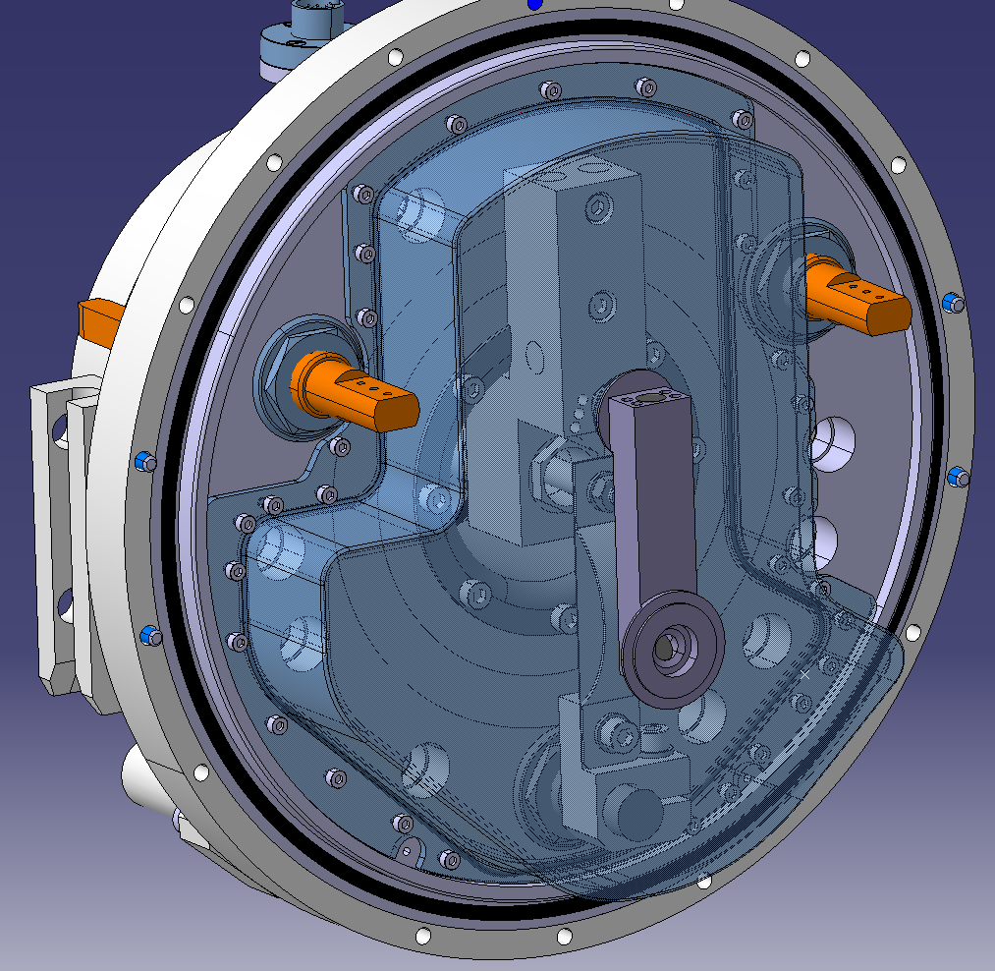
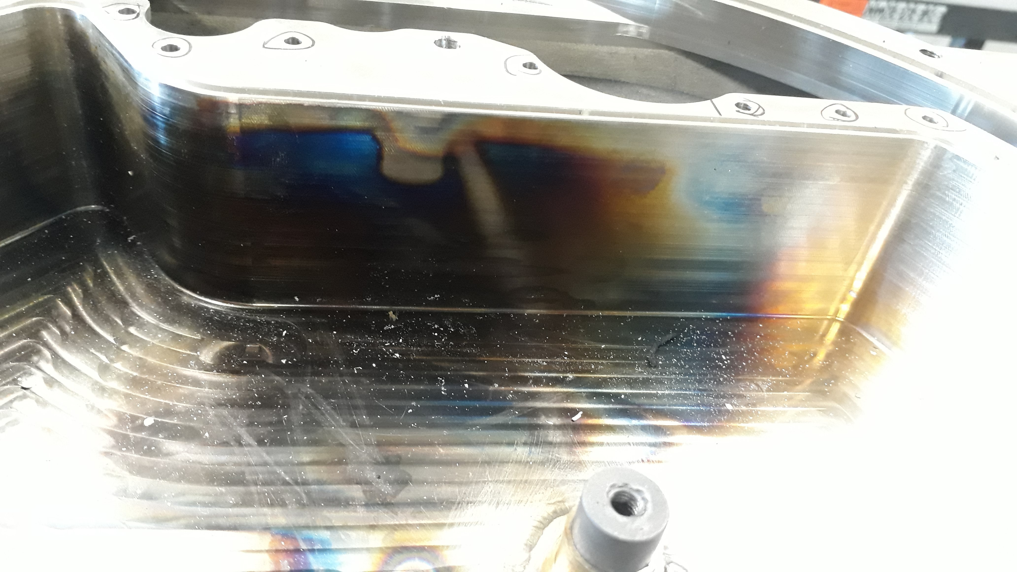
Offline commissioning: Leak issue
Leak emergence:
  Appropriate vacuum level with cold target
  Leak appearing when heating up the ion source to 1700 ºC
Ansys mechanical static structural simulation

Slide 13
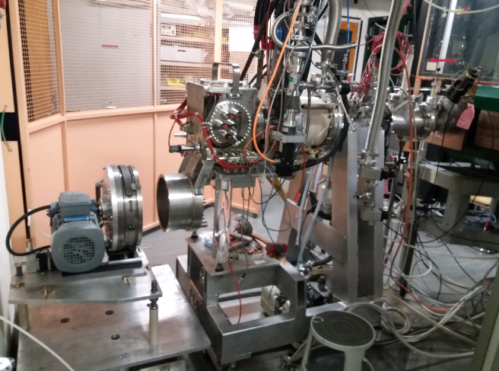
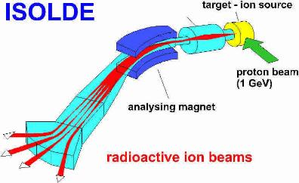
Offline commissioning: Remaining tests
Full operation of the loop with molten LBE in an offline mass separator:
  Thermal control (Heat exchanger)
  Safety measures:
    Pressure sensor
    Accelerometer
  Mass scans
LIEBE target coupled to offline separator

Slide 14
Conclusions
Flow developed by the EM pump within the calculated values for isotope release
Satisfactory vibration levels
New base design coping with the leak issue at high temperature
Remaining full operational tests in an offline separator before final online test with proton beam

Slide 15
Acknowledgements
Contribution of many people from different disciplines:
Melanie Delonca, Thierry Stora, TISD group, Laurent Prever-Loiri, Thierry Feniet, Kalvis Kravalis, Donald Houngbo, Vincent Barozier, Edouard Grenier Boley, Ana–Paula Bernardes, Antje Behrens, Alexandre Beynel, Lukasz Jerzy, EN/STI/RBS
7th High Power Targetry Workshop

Slide 16
Thank you for your attention

Slide 17
Backup slides

Slide 18
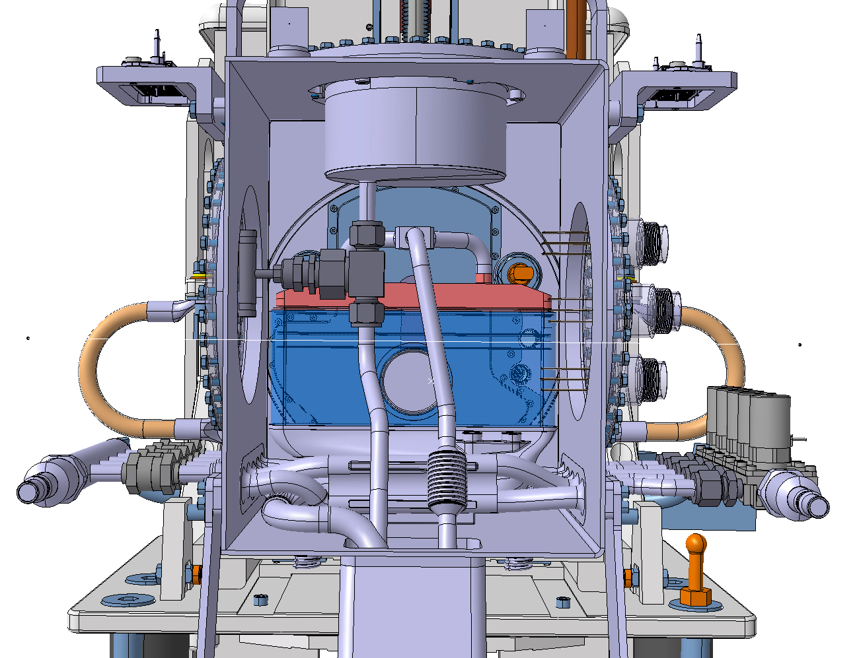
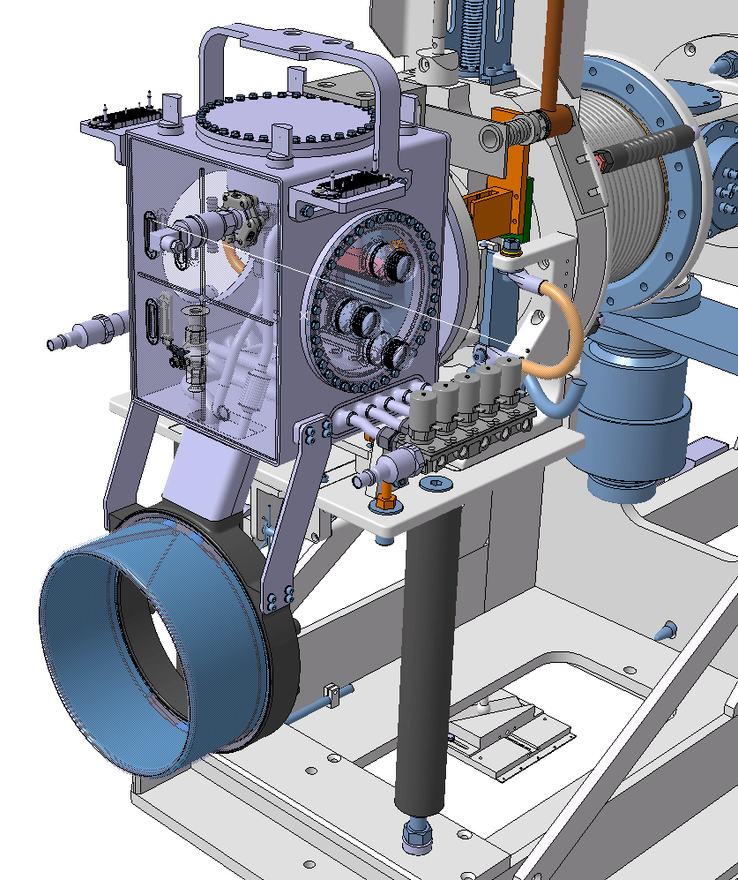
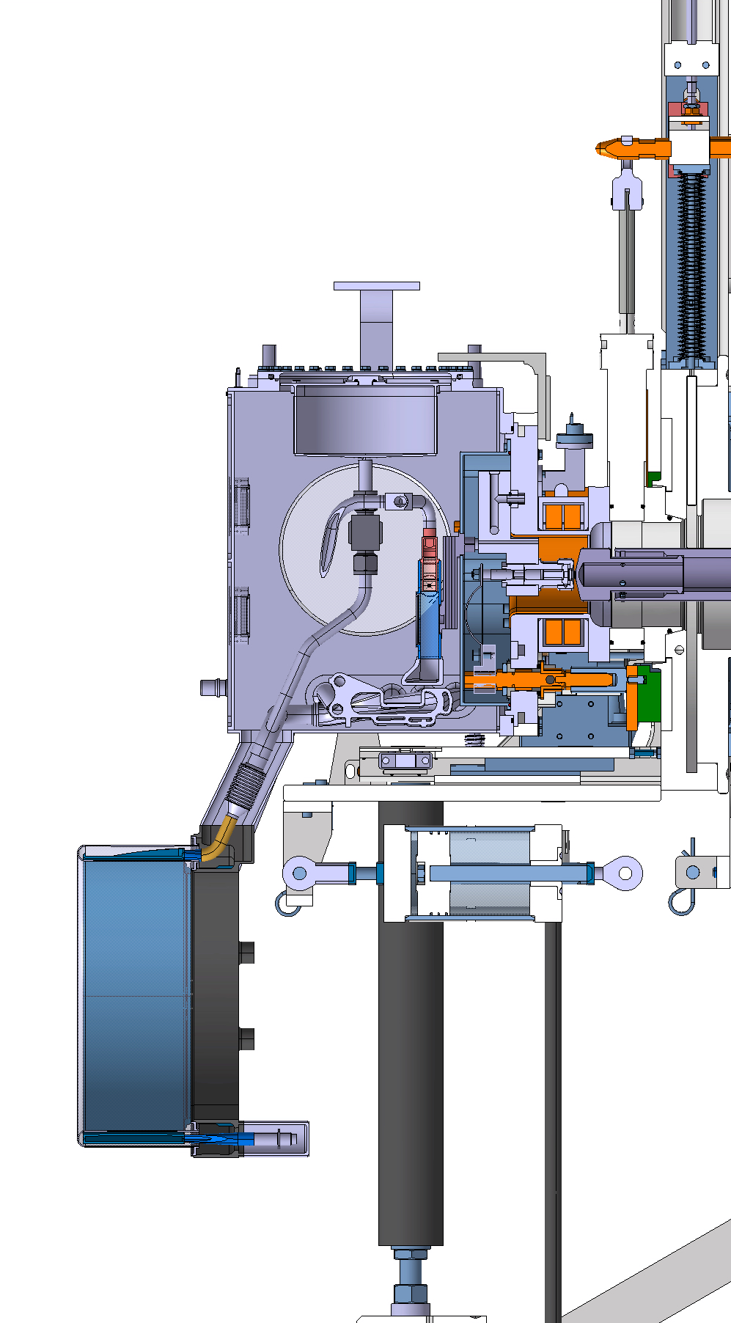
The main loop part
  Filling tank
  Heat Exchanger (HEX)
  Irradiation & diffusion chamber
  Hypertaks/feedthroughs
  Water connectors
  Electrovalves
  Bellows
  Extraction line and ion source -> standard VADIS ion source

Slide 19
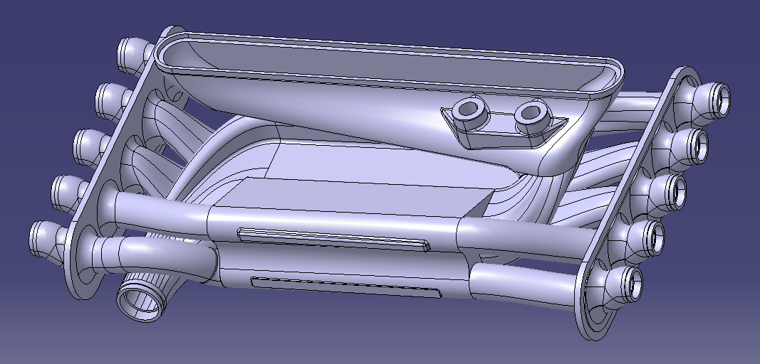
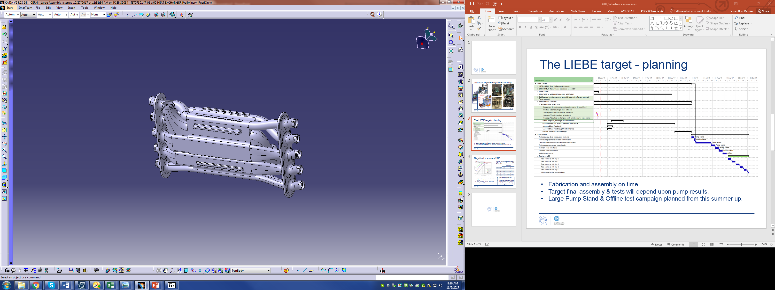
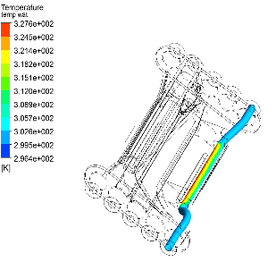
LIEBE: Heat Exchanger
5 LBE temperatures (200-600degC)
CFX Calculations of the heat exchanged for every channel
1
2
5
4
3
3D printed steel Heat Exchanger

Slide 20
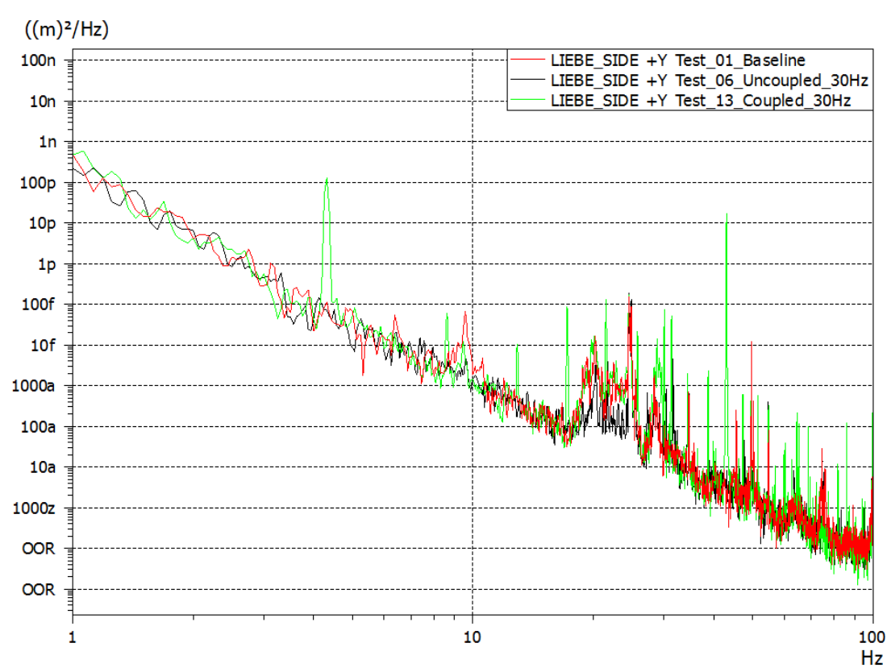
Offline commissioning: Alignment/vibration tests
Results:
Displacement Power Spectral Density comparison, Rotor Fr=30Hz, EM Wheel Fr= 4,11Hz direction +Y

Slide 21
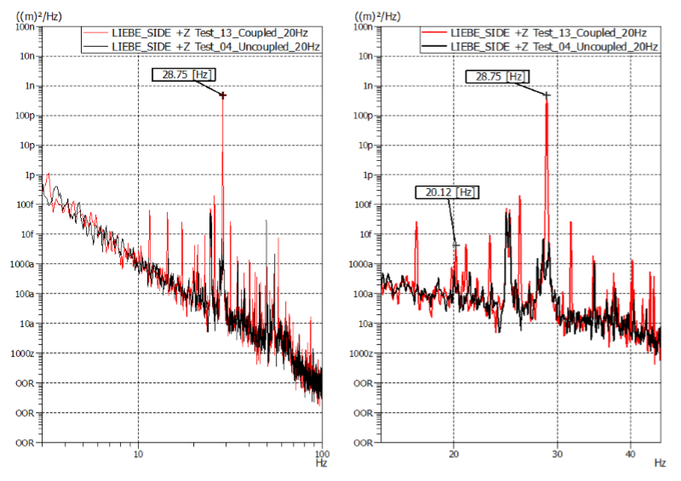
Offline commissioning: Alignment/vibration tests
Displacement Power Spectral Density comparison, Rotor Fr=20Hz, EM Wheel Fr= 2,75Hz direction +Z

Slide 22
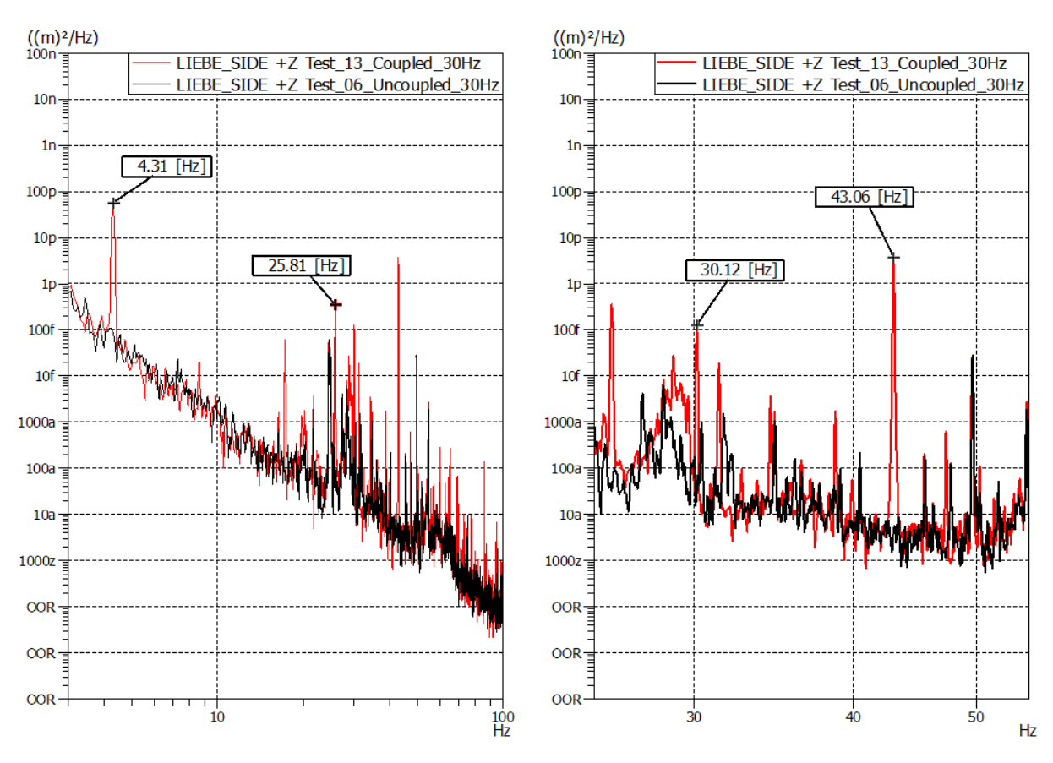
Offline commissioning: Alignment/vibration tests
Displacement Power Spectral Density comparison, Rotor Fr=30Hz, EM Wheel Fr= 4,11Hz direction +Z

Slide 23
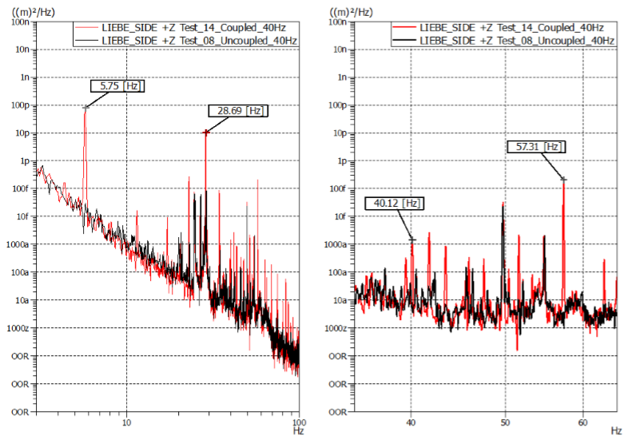
Offline commissioning: Alignment/vibration tests
Displacement Power Spectral Density comparison, Rotor Fr=40Hz, EM Wheel Fr= 5,48Hz direction +Z

Slide 24
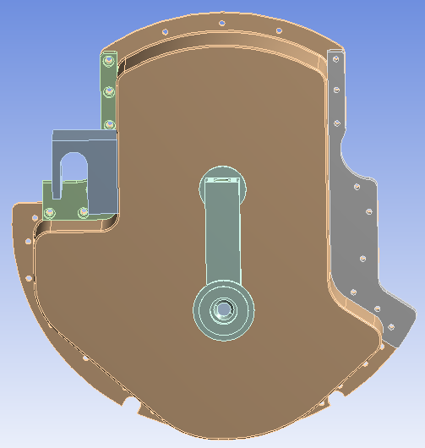
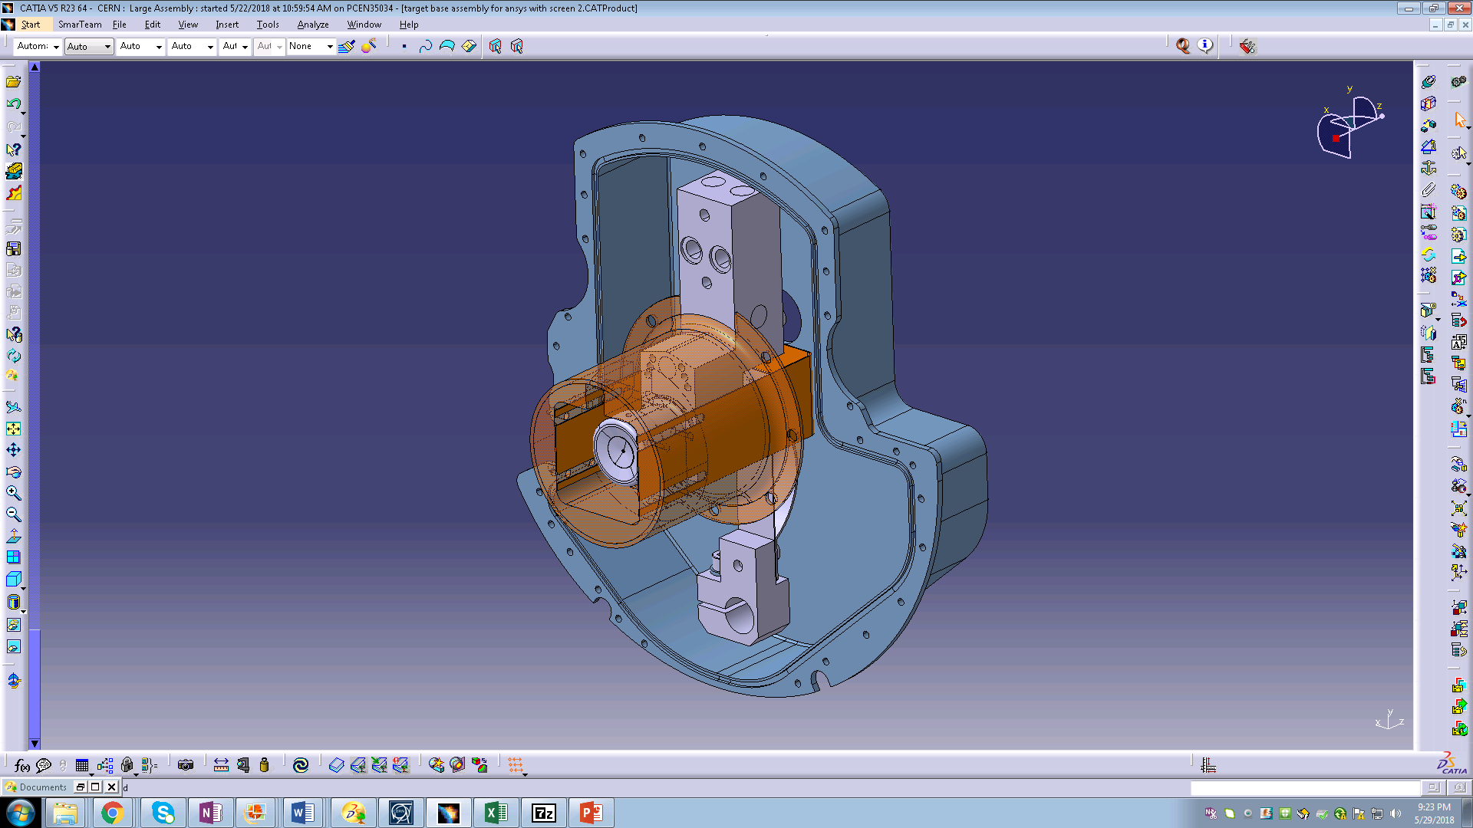
Offline commissioning: Leak issue
Attempts to solve it:
  Increasing sealing pressure
  Shielding the ion source
  Only able to operate the source up to 1900 ºC

Slide 25
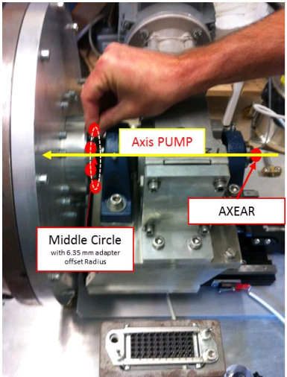
Offline commissioning: Alignment/vibration tests
Alignment tests:
  Cylinder axis and pump axis are on the same line within 0.1mm
Best fit distances between EM pump and target
Measurement of the EM pump axis

Slide 26
Offline commissioning: Flow assessment

Slide 27
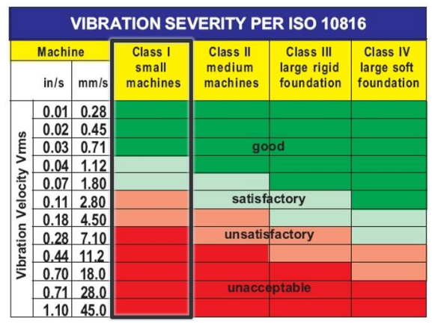
Offline commissioning: Alignment/vibration tests

