Slide 1
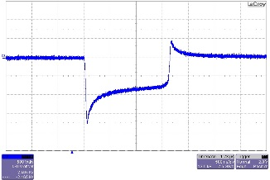
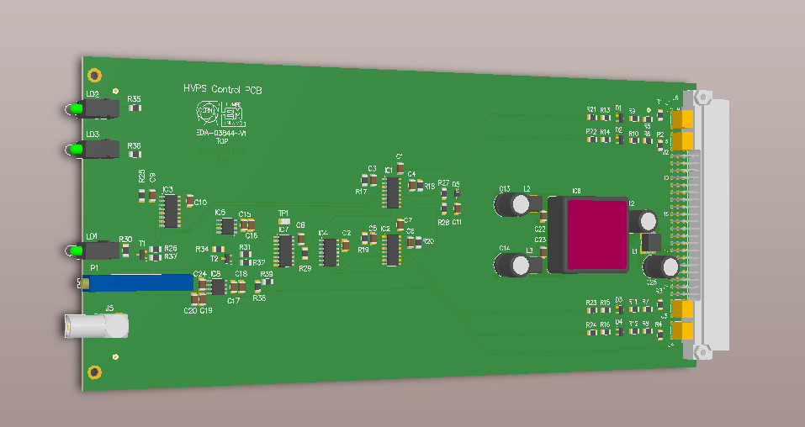
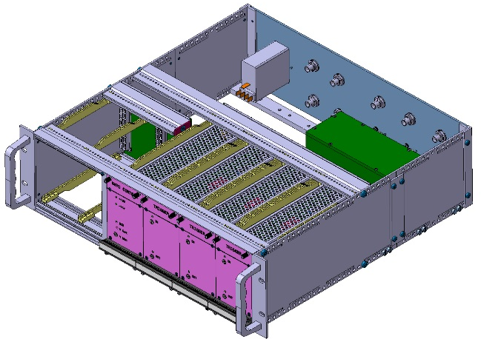
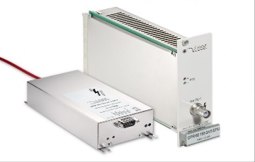
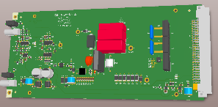



Thyratron Power Trigger Consolidation at CERN
Enrique de Nicolás Lumbreras
TE-ABT-EC CERN- Ciemat
Analysis Stage
Design Stage
Analysis the different thyratron triggering system currently working at CERN
Simulation of the current systems with Pspice
Tests with Thyratrons to check the critical parameters of the triggers
Analysis of advantages and drawbacks of every system
AC/DC Power Supply
HV Power Supply
4000V IGBT Trigger
Thyratron
LINE
HVPS Control
Trigg_IN
SCR
Design Stage
Mechanical Integration
Design of the trigger unit.
Selection of AC/DC Power Supply
Specify a HVPS
HVPS Control PCB
Collaborate with the mechanical team in the mechanical integration
Back panel design
Specify the connectors

Slide 2
About the program
Enrique de Nicolás Lumbreras
TE-ABT-EC CERN- Ciemat
Advantages
If you are graduate is a good boost of your career
Good Human resources Selection (Project related with my past an future)
Learn about accelerator technology
Training opportunities depending on your section/department
Reasonable working conditions (between fellow and Project associate)
Good Salary, long paid holydays, good work-life balance
Good work opportunities after the program
International working environment
Possibility to use your time for learning
Drawbacks
Possibility of continuing your job depending on internal politics
No long term career prospect
Short term thinking
Lack of management from supervisors due to his high work load
Problems of this program are not related with the management of the program, that is related with the CERN structure

