Slide 1
Computing engineer for robotics: EN4950
Research group: EN-STI-ECE (Robotics)
Advisor: Mario Di Castro
Author: Carlos Veiga Almagro
Notes:
1

Slide 2

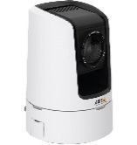
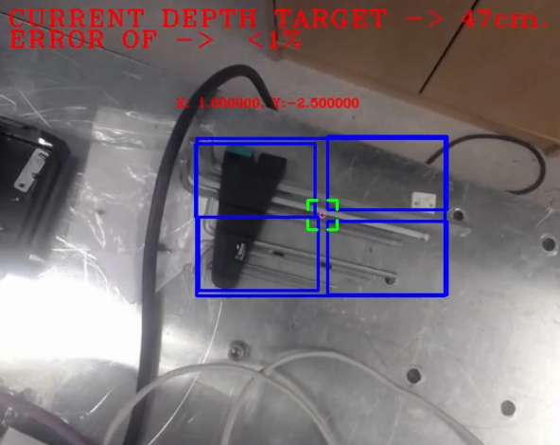
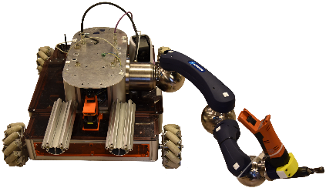
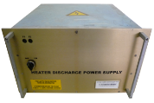
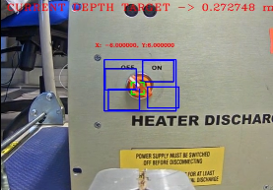



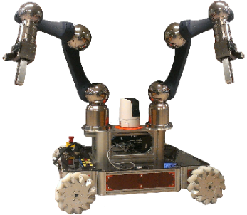
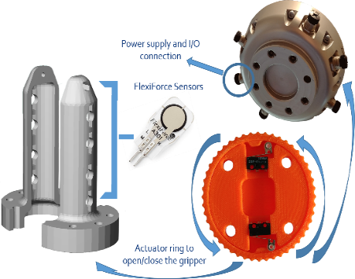
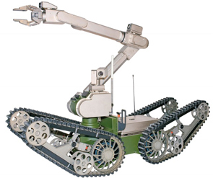
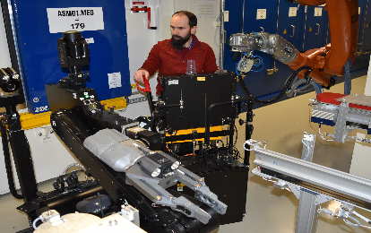
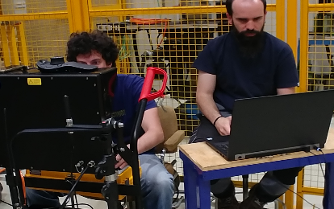
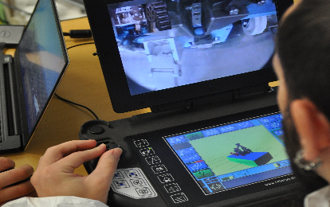
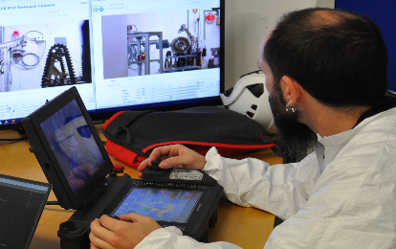
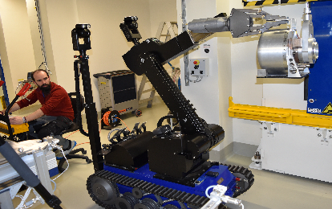

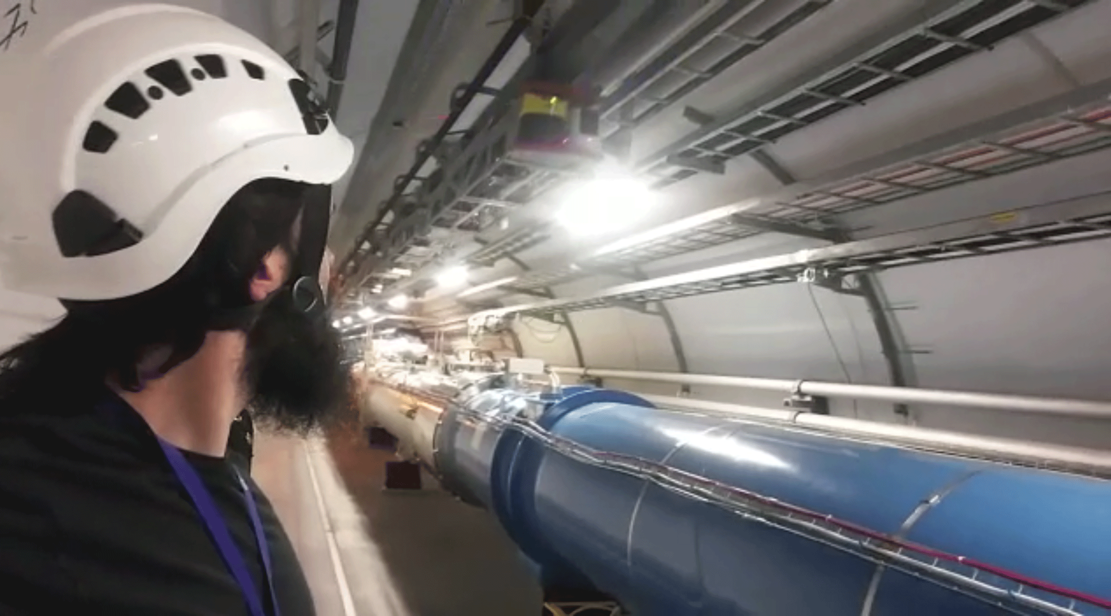
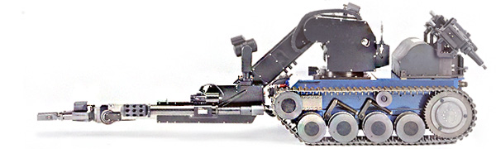
Work Overview
CERN robotic framework improvements
Depth estimation
Integration and testing of systems developed for autonomous tasks
Visual system development
C++/Python
OpenCV
Tracking
Feature detection
Distance determination
Triangulation
Normal distribution
Benchmarks correlation on metallic pieces
PTZ Camera
PTZ camera + SURF to search the QPS device
Control orientation regarding to QPS
Switch detection and distance estimation
QPS
For tele-operation assistance
QPS switch
Tools design
Robotic Interventions
Training for tele-operation
Coordination and carrying out of interventions
Installation and supervision of new robotic equipment
Notes:
- N. Distribution to allow the system show the distance with less than 5% of error
- Drag & drop
- Insulated Sq. Behaviour, if some square is getting a weird behaviour, if compulsory to remove it from the estimation. I used some thresholds for it
Faster-RCNN-based. The model that offered better accuracy for this technique was the ResNet101

Slide 3
Program Feedback
Positive points (the stay)
Knowledge improvement and gaining the new skills that otherwise I would never have achieved.
Increase my professional background in one of the most important international environment for research.
The new chance for the scientific coming, in an amazing experience, knowing new people (the best in their fields)
Points to improve (lack of coordination)
The coordination never was the strongest point of the program, since the day CIEMAT contacted us to give the news. It is pretty important to keep in mind we are working and there is a schedule behind that we have to follow.
A small guidance for the future candidates it is going to be necessary, simple things such as how to find an apartment, open a banc account, etc.
Reports and presentations: It does not make sense to make a report every 3 months and every 6 a presentations. The half of reports are showing the same than the presentations, the last ones could be useful to fill the reports necessities instead.
And after that …
I have become an important piece of the robotic team, I will stay on it, supervising the computer vision systems and performing as a tele-operator for the interventions.

Slide 4

Thank you for the Opportunity
FTEC program 2016

