Slide 1
EP6823: Control and Data Acquisition for Particle Physics Experiments

Slide 2
Control and Data Acquisition for Particle Physics Experiments
Manuel J. Rodriguez
Notes:
Good morning everybody, my name is Manuel Jesus and I’m going to show you the project were I been working for this six months

Slide 3
protoDUNE SP
Interface Supervisor
  Design Graphical Interfaces
  Operation & Monitoring
Slow Control
  Low-rate signals
  Managed by PLC
  Control Status & Conditions
Detector Systems
Run Control
  Control during the operation
  High rate signal
  DAQ

Slide 4
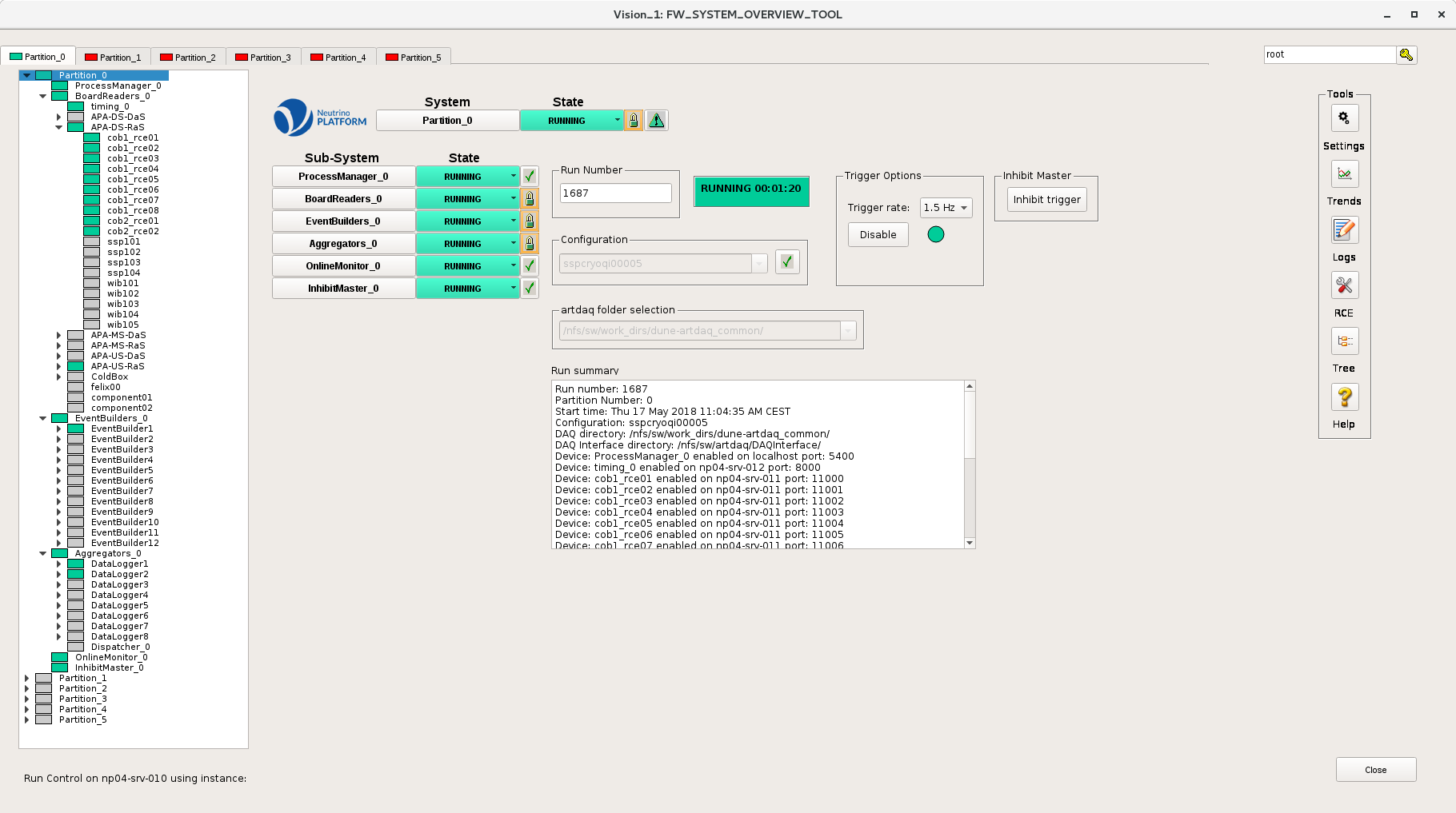
Run Control
Partitioning
  Simultaneous data-taking
  Component Selection
  Runs completely independent

Slide 5
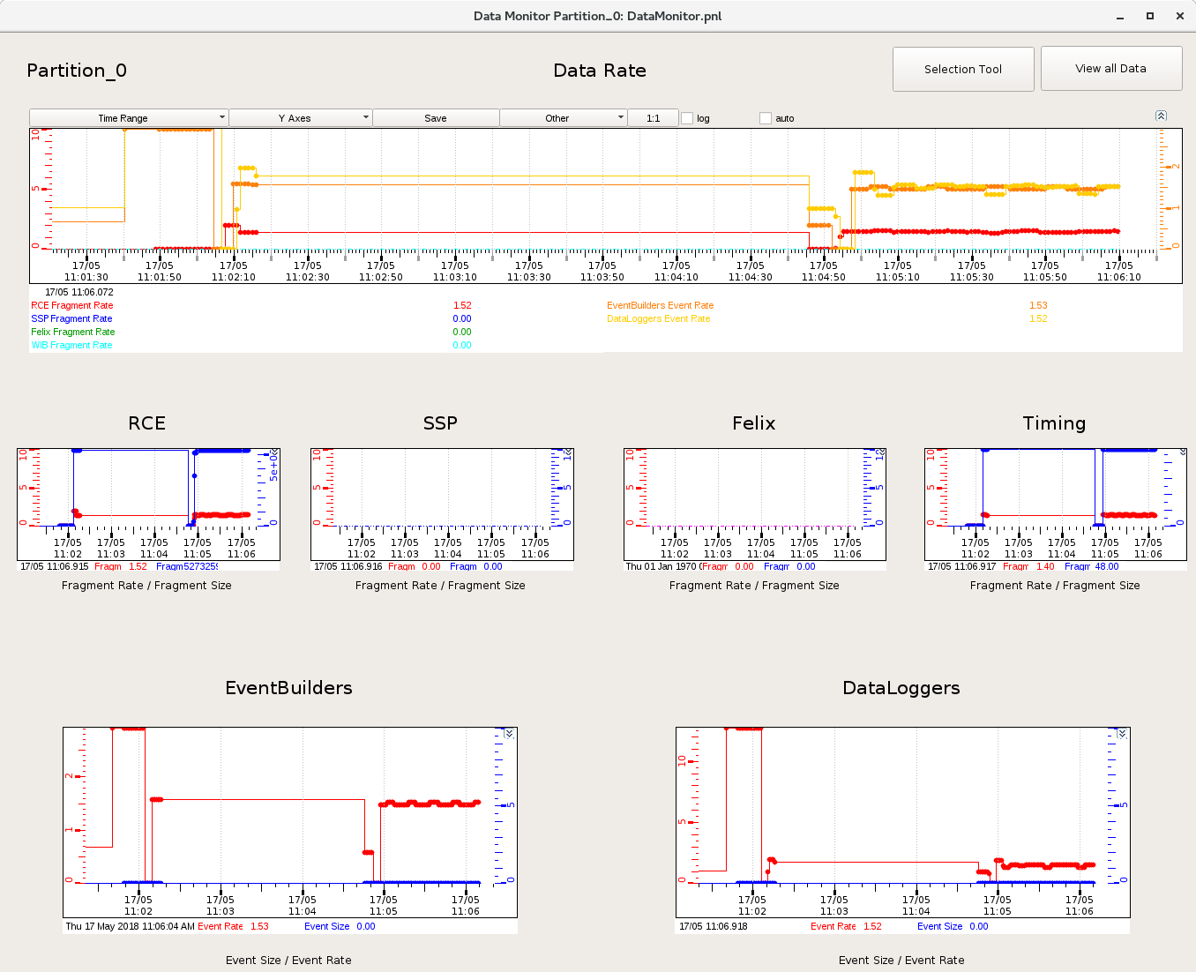
Data Monitor
Dashboard
  Main metrics
  Other tools

Slide 6
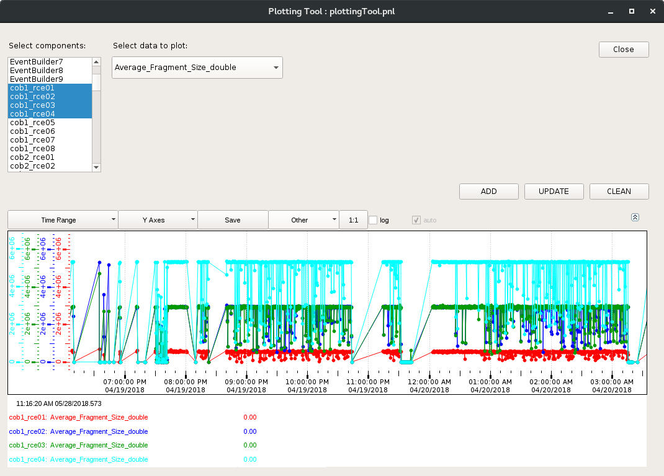
Data Monitor
Dashboard
  Main metrics
  Other tools

Slide 7
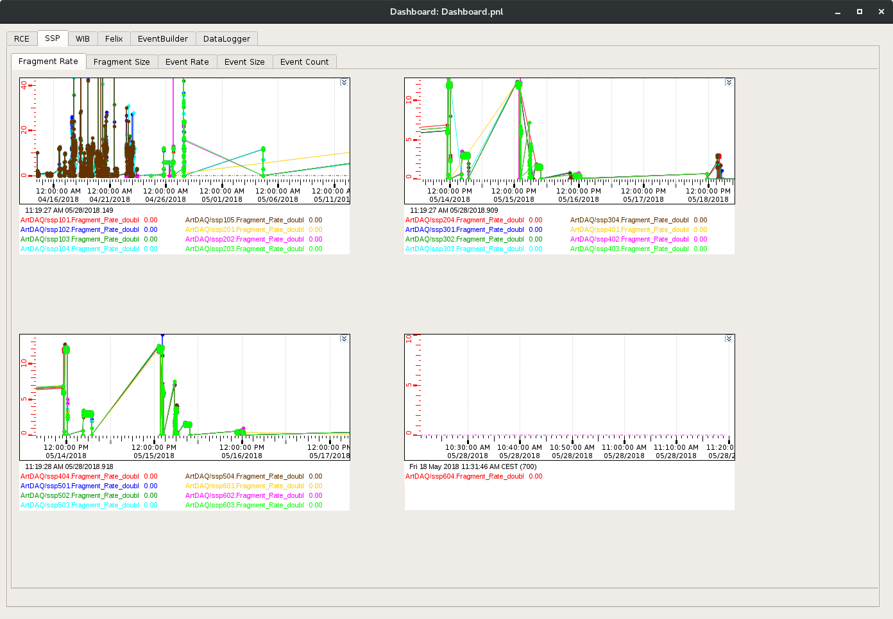
Data Monitor
Dashboard
  Main metrics
  Other tools

Slide 8
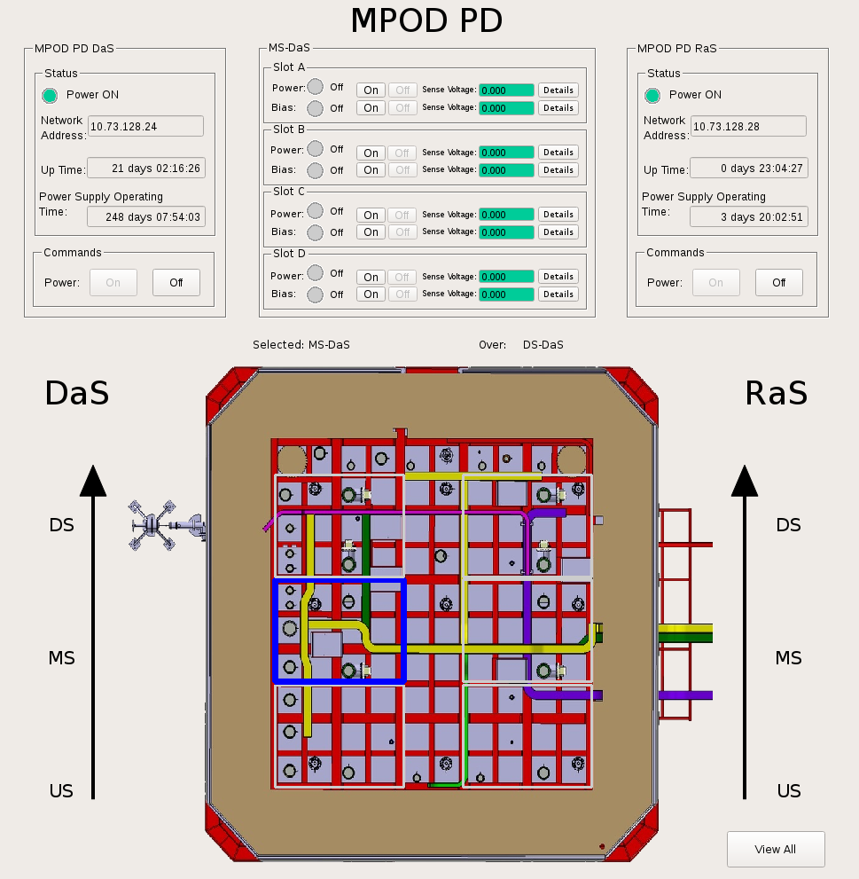
Slow Control
Power Supply
    Commissioning purposes
Photon Detectors
  Status via DIM

Slide 9
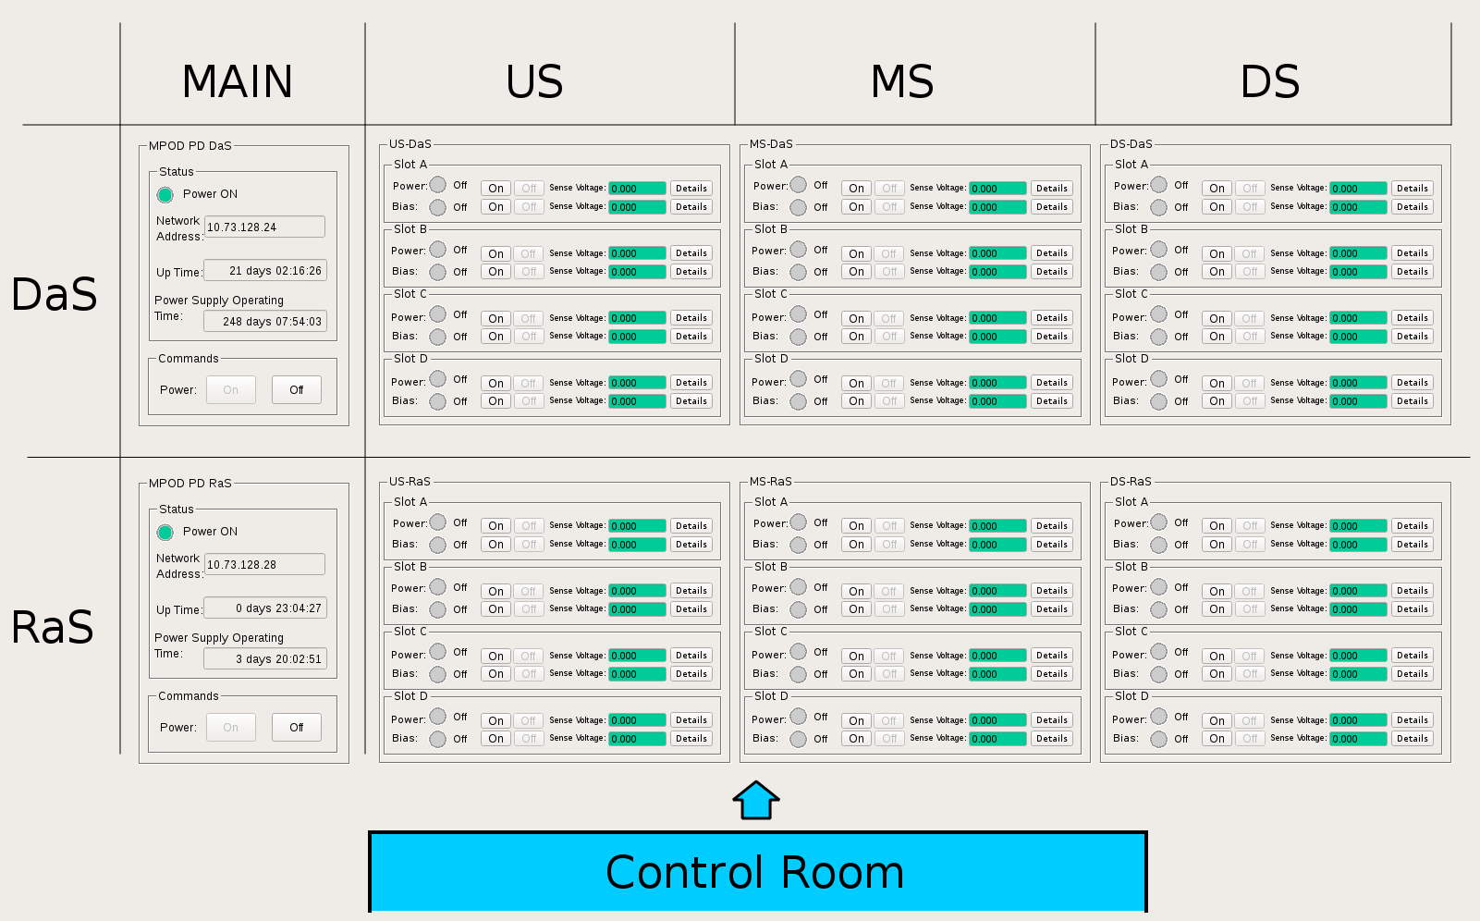
Slow Control
Power Supply
    Commissioning purposes
Photon Detectors
  Status via DIM

Slide 10
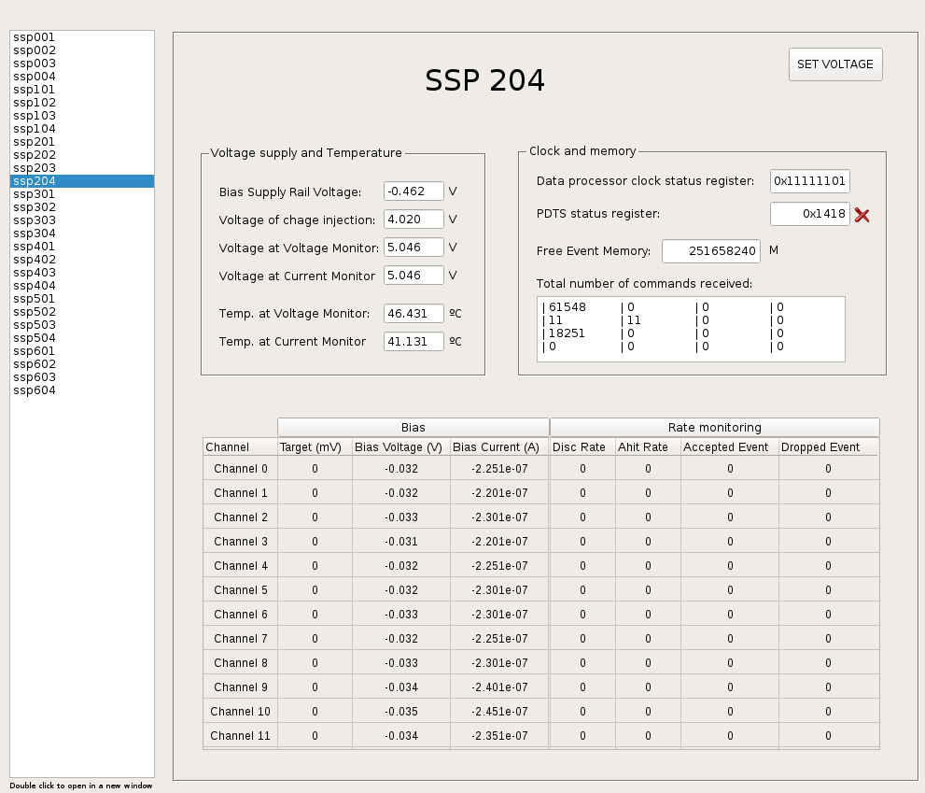
Slow Control
Power Supply
    Commissioning purposes
Photon Detectors
  Status via DIM

Slide 11
Next six months
Ground Planes
DCS
Beamline Info
Gradient Monitor
DCS
Cryogenics
Subsystems integration
Purity Monitor
Heizinger HV
APA Control
Beam Plug

Slide 12


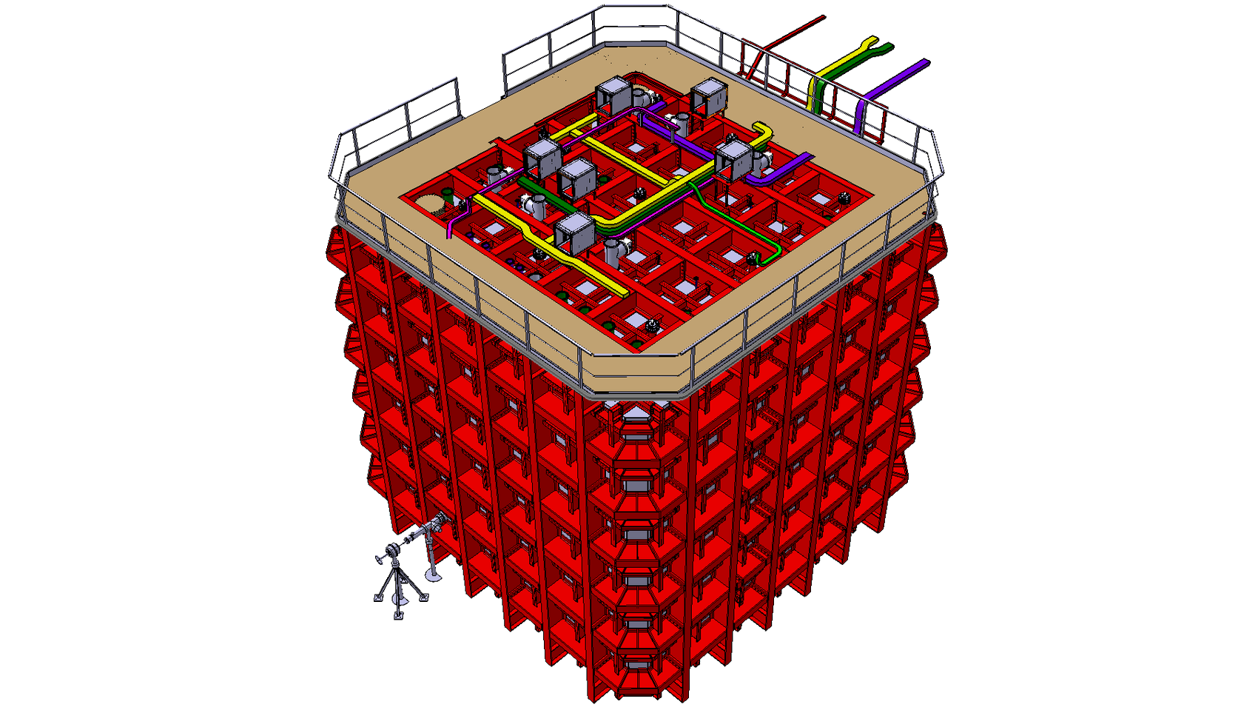
Next six months
Summer Student Program
  Supervisor of a Summer Student for 2 months
CHEP Conference
  9-13 July on Sofia
NP04 Data Taking
  Expert On Call & Shifter

Slide 14
Any questions?

