Slide 1
Deploy a Devops Software Infrastructure for Agile Software Engineering Project Management
Pablo Gonzalez Jimenez
Brice Copy
Beams Department
Industrial Controls and Safety Group
Tools & Infrastructure Section
Notes:
Welcome everybody, I am Pablo, I work for Tools & Infrastructure Section of beams department.
I am here to present our project If…

Slide 2
Objective
Take a single Jenkins master featuring :
  558 active jobs
  Java, C++, Python, WinCC OA, PLC code generation projects
  116 active Jenkins plugins
  Credentials management is difficult
And replace it with multiple Jenkins master instances placed under managed configuration.
Notes:
The principal objective is take a single jenkins master featuring and replace it with multiple jenkins master instances placed under managed configuration
Because now we have a lot of active jobs, active jenkins plugins and it is very difficult to management the credential.

Slide 3
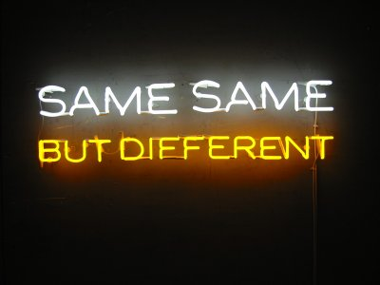

Slide 4


Slide 5


Slide 6




Remember
What is Docker?
Docker is the software technology
What is a Docker Image?
A Docker Image is like
What is a Docker Container?
A Docker Container is an instance
of the image running — similar to when
you actually put the game into your
What is a Dockerfile?
INSTRUCTIONS TO BEATING 1ST GYM
- Choose Squirtle as your starter Pokemon
- Train until Squirtle is level 10
- Stop at Pokecenter and heal Pokemon
- Fight leader using the move “Watergun”
Notes:
Docker
It is a software technology providing containers
Image
it is software. It is standardized to run on any Game Boy

Slide 7
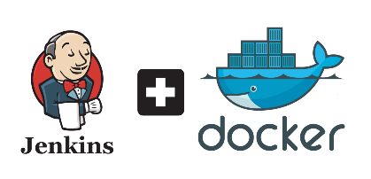



Notes:
Describe how Jenkins can be configured and deployed into a cloud as a managed service.
For this job we have used Jenkins together Docker, the configuration and the deployment of the Master and the Slaves
have been with the help of Groovy is an object-oriented programming language, it is an agile and dynamic language similar to Java.
Openstack gave us the service to create the different machines and as repository of code we have used Gitlab.

Slide 8

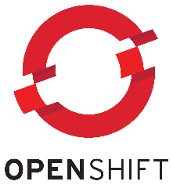
SECOND ROUND
Jenkins Migration to OpenShift

Slide 9


Model
R. A.

Slide 10
Master Configuration and Deployment
Dockerfile
Groovy Scripts
Plugins.txt
yet-another-docker-plugin:0.1.0-rc47
gitlab-plugin:1.5.4
init-jenkins.groovy
create-dsl-job.groovy
…
SSH
  Id_rsa ; id_rsa.pub
Scripts / XML
  jenkins-common.sh, run
  maven-settings-files.xml, settings-security.xml
Notes:
The first is the construction of the Jenkins Master.
Build a Dockerfile
Using the official Jenkins Docker image modify
Installing more tools: like git, curl, java, zip, unzip, docker-io
We modified the preinstalled of the plugins, (skip the wizard)
The preinstalling plugins, we installed the plugins that we want and have in the text file
And we configure the Jenkins automatically upon start-up and the plugins like docker-cloud through the groovy scripts
we used the script of the image that set of plugins to download with their dependencies, By default, plugins will be upgraded if they haven't been upgraded manually and if the version from the docker image is newer than the version in the container. Versions installed by the docker image are tracked through a marker file.
Configuring the jenkins automatically.
We used Groovy language to configure previously the different plugins installed in Jenkins
Examples: Git Global, Jenkins Location, Sonar, Credentials API Token of Gitlab, Gitlab, CVS, Management slave nodes, Credentials, Clouds and much more

Slide 11
AGENT Configuration and Deployment
Dockerfile
SCRIPT
createServerOpenstack.sh
user-data.sh
another-docker-cloud-body.groovy
add_permanent_agent.groovy
GROOVY
id_rsa
id_rsa.pub
SSH

Slide 12

Advantages of OpenShift
Running Docker from the Gitlab-Registry
Create and add Secret (SSH Key)
Increase Memory Limits
Persistent Volume
Create Route (without TLS certificates)

Slide 13
JENKINS OPENSHIFT WORKING
WinCCOA Jenkins Project
  https://wccoa-master.web.cern.ch
DIP Java-Master
  https://java-master.web.cern.ch
OPCsimulation
  https://opc-venus.web.cern.ch

Slide 14



