Slide 1
Workshop CIEMAT FTEC-2017
Francisco Javier Saura Esteban
Eric Montesinos
Sebastien Jerome Calvo
BE-RF-PM
Notes:
Good morning, my name is Franisco Javier Saura, I work as mechanical engineer in the section: Beams, Radiofrequency, Power Modules and Amplifiers. And I work with Sebastien Jerome Calvo, and my supervisor is Eric Montesinos.
In this presentation I am going to try to explain the whole work I have developped in this period.

Slide 2
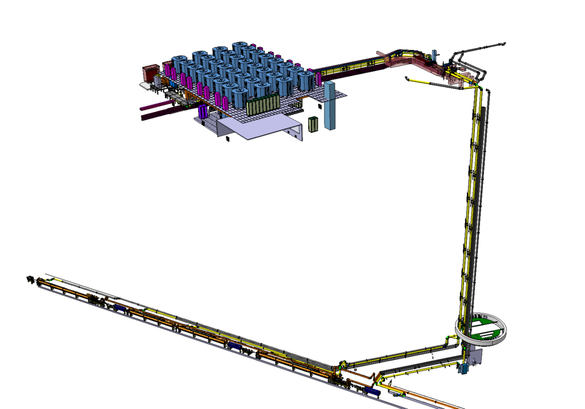
PROJECT LIU – SPS
Injectors Upgrade in order to increase the luminosity of LHC
RF power from 4x 0,75 Mw (Actual) to 4x1 + 2x2 Mw (LSS2)
New Building BAF3, 32 RF generation towers , 2 combinors directed through coaxials and waveguides to LSS3 LS2
50% Planification, ressources prevission and time management.
50 % Design of the necessary tooling to install towers, coaxials and cavities. Comissioning, tests and maintenance.
BAF3
Shaft
LS2 /LSS3
Notes:
The context of my work is the project LIU-SPS which means LHC Injector upgrade. This project has the objective of increasing the luminosity of LHC by increasing the injection of RF power and the number and disposition of RF cavities.
We actually have 3 Mw of RF power and when we finish we will reach the 8 Mw. For this purpose we will install 32 new RF towers on the mezzanine of BAF3. This 32 new lines will reach two hybrid combinors, and after the two lines from the combinors will reach the tunnel through shaft.
My work in this project is divided in two main parts:
First one, the elaboration of flip books which will resume the planification of timing, material , human resources, for the project management.
And a second one, which is the design of the tooling necessary for carry on this project, as well as comissioning, tests and maintenances of RF installation we already have.

Slide 3
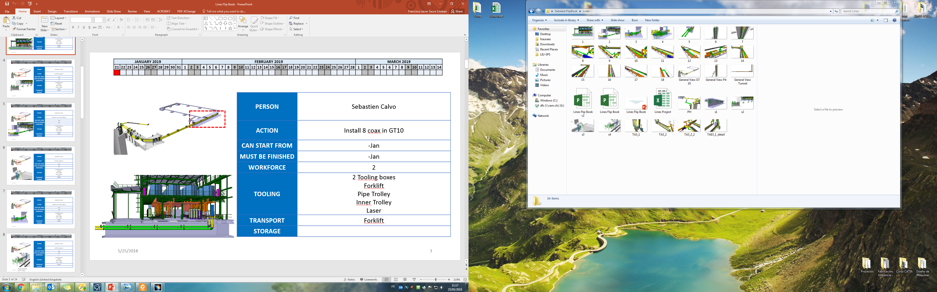
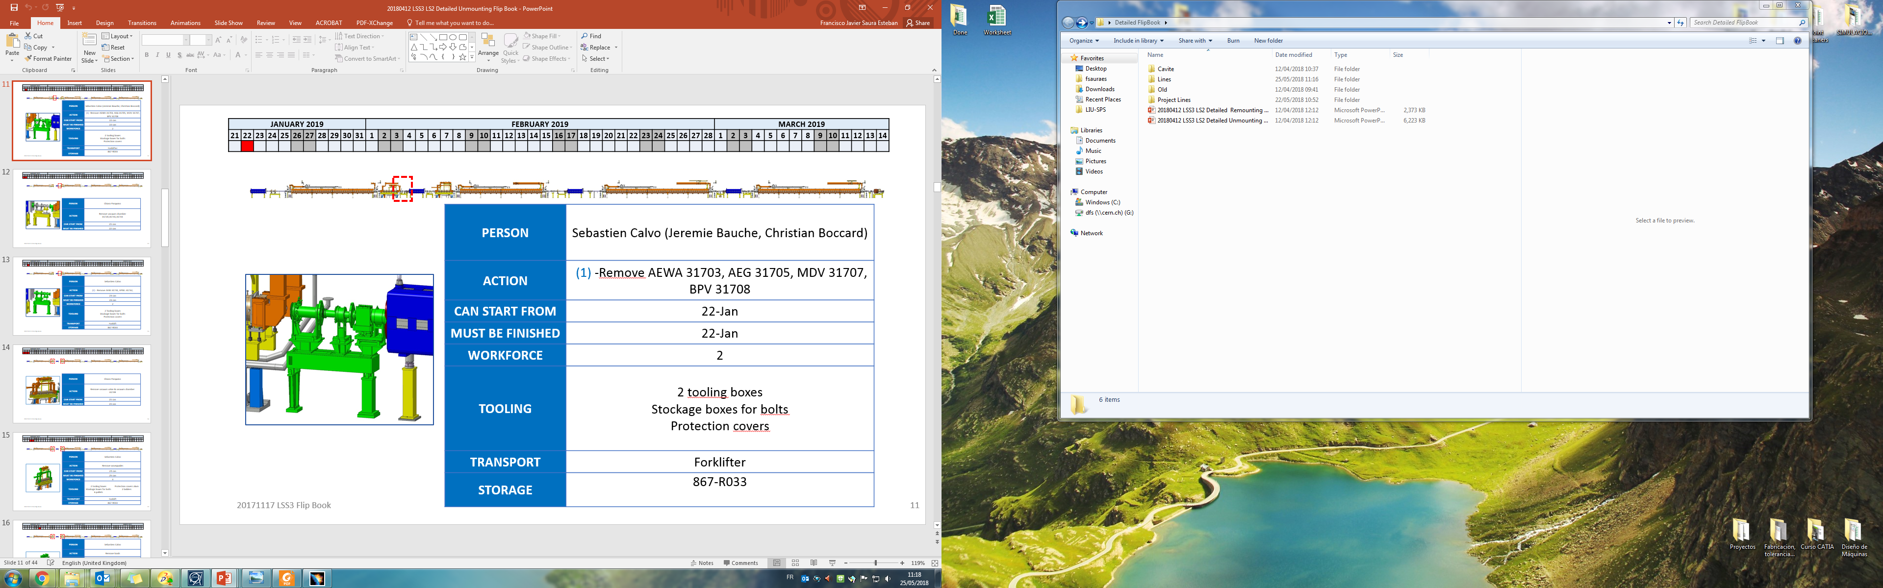
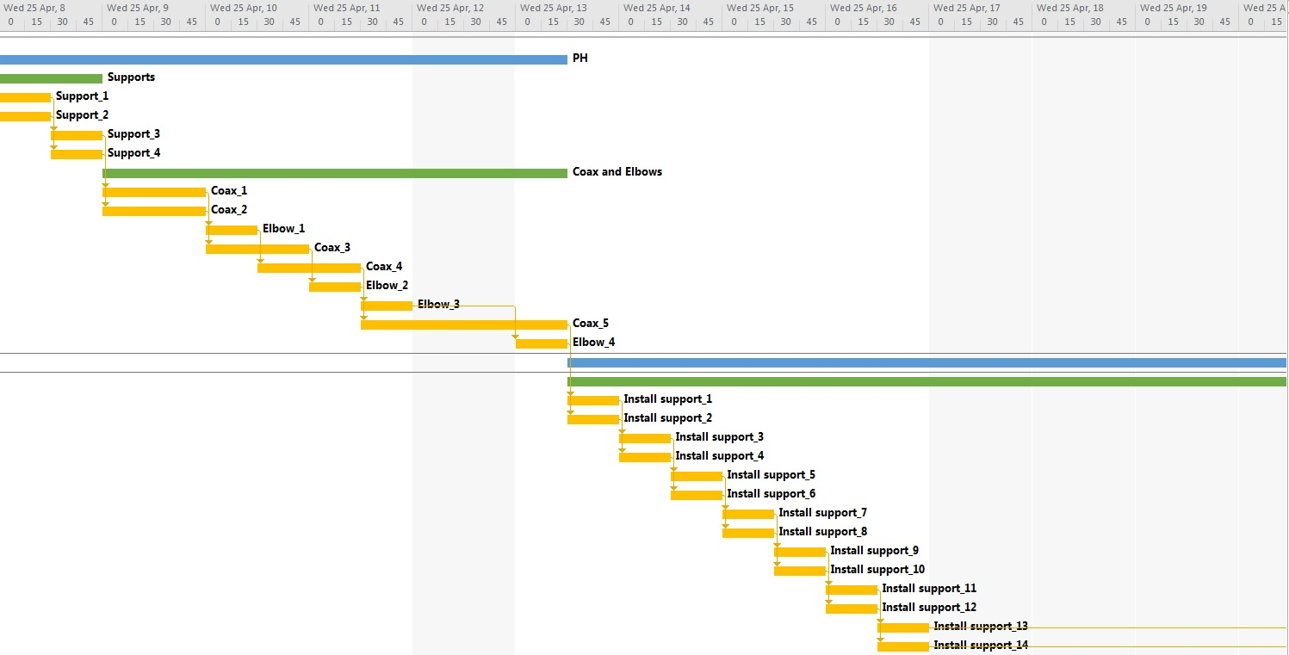
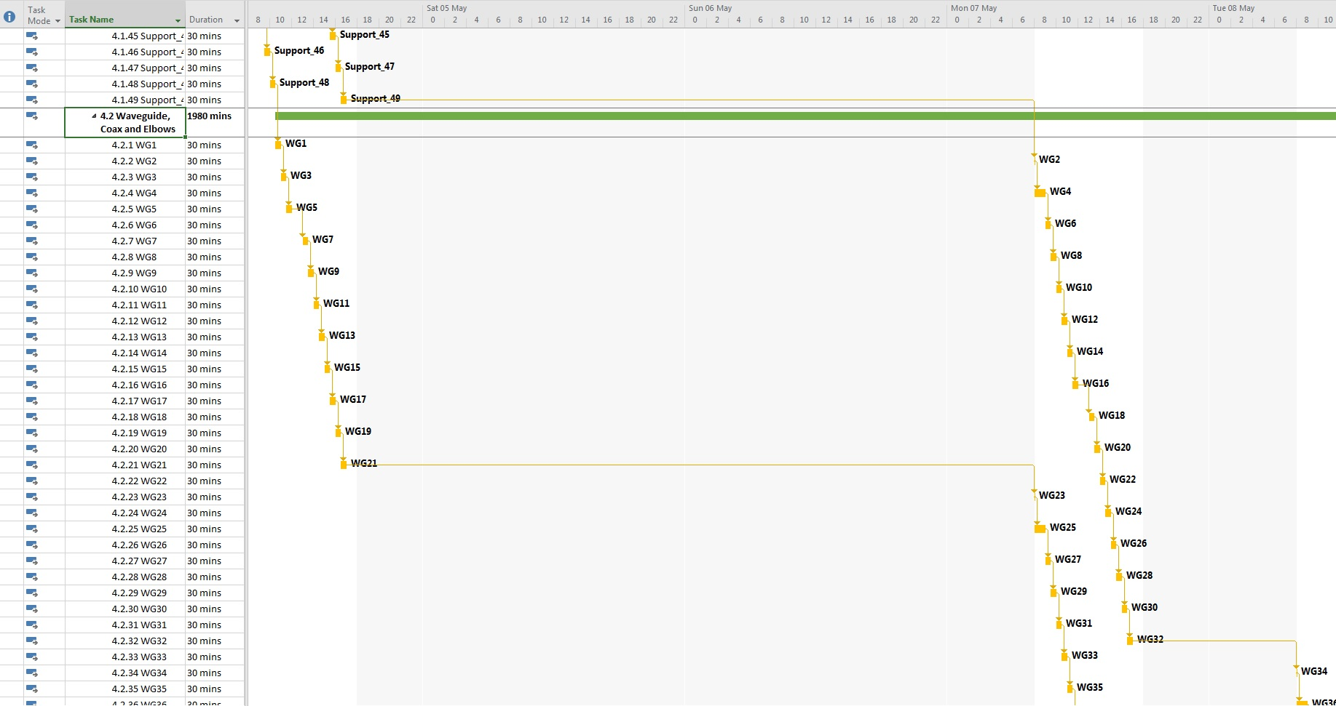
Planification RF Lines installation / LS2 Unmounting / LS3 Mounting
Notes:
In order to foresee the time, material and human ressources for this this project it is necessary to detail each one of the steps. I had to estimate mounting or unmounting time, people we need, tooling, transport, where to storage, etc
Until now I have worked in different phases:
The future unmounting process of the actual cavities.
Storage of these ones
Update and maintenance.
Mounting of the new cavities.
Mounting of the new RF lines.
Even though it is all more o less resumed in one slide but I guarantee it has been almost the 50% of my work as I previously told.

Slide 4
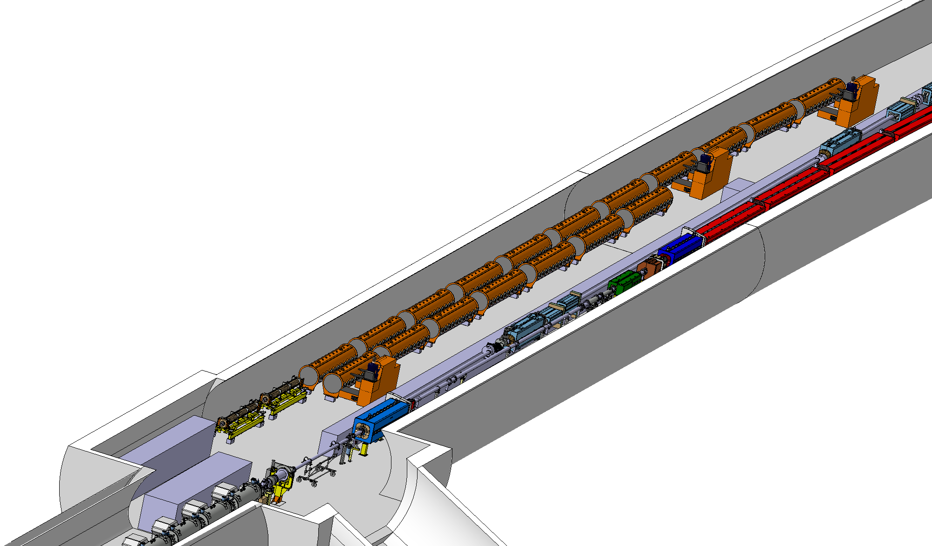
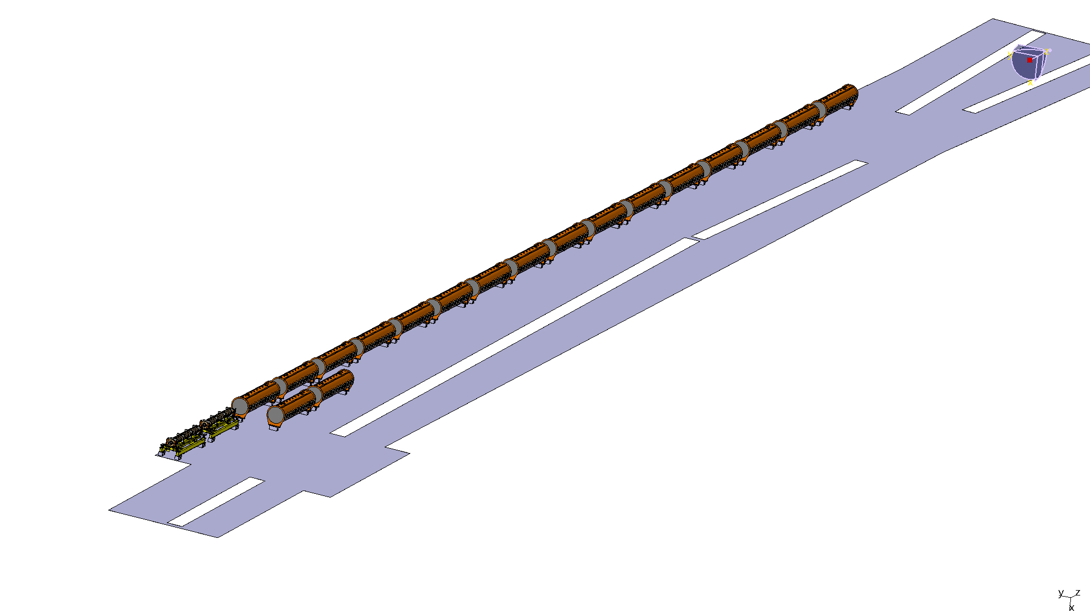
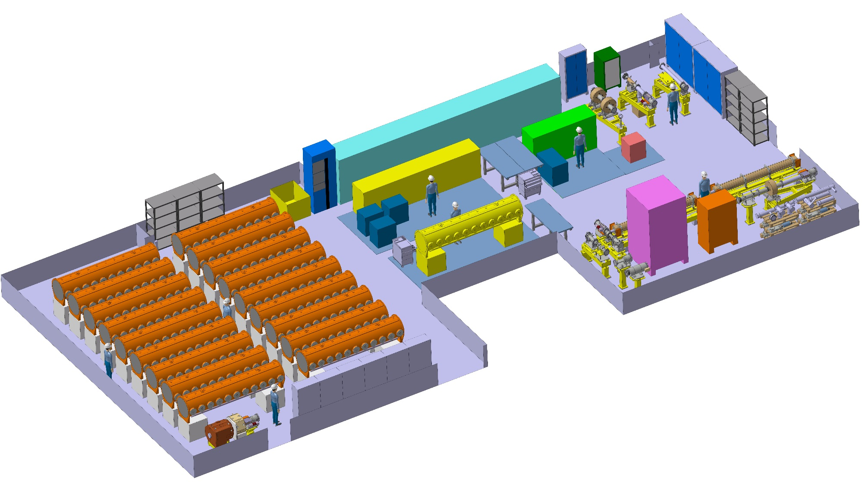
LS2/LS3 Storage Options and Arrangement
TT20
TT60
867
Notes:
We had to know where to storage the cavities we are going to unmount from the long straight section three.. The options were the TT20 and TT60 inside SPS and 867 building in Prevessin.
After analyse the possible options, the chosen one was the 867 building, where there is space enough to storage, and also space for work at the same time, in mechanics and electrical machines.

Slide 5
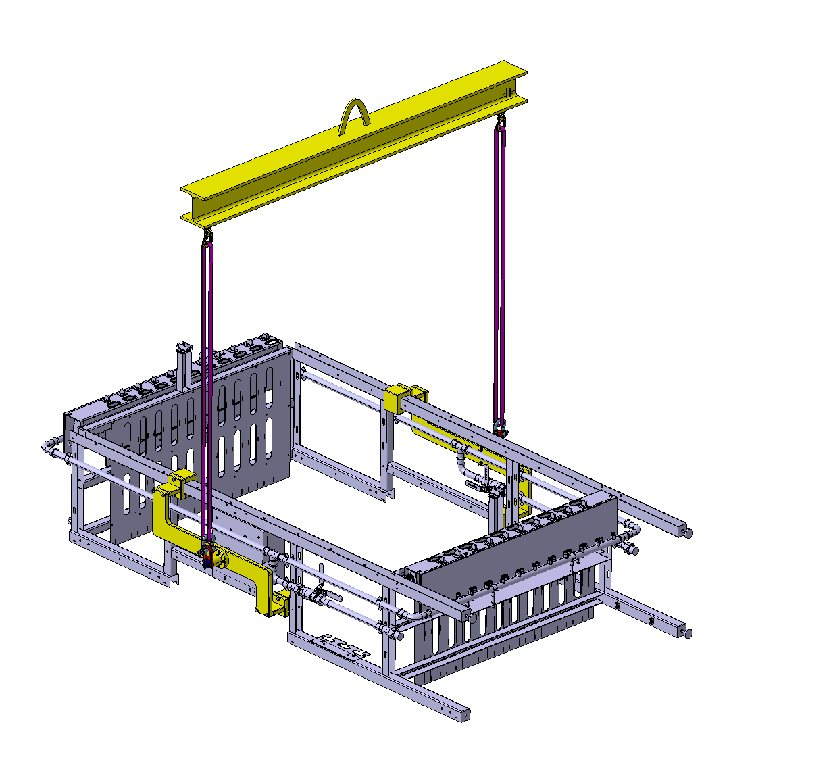
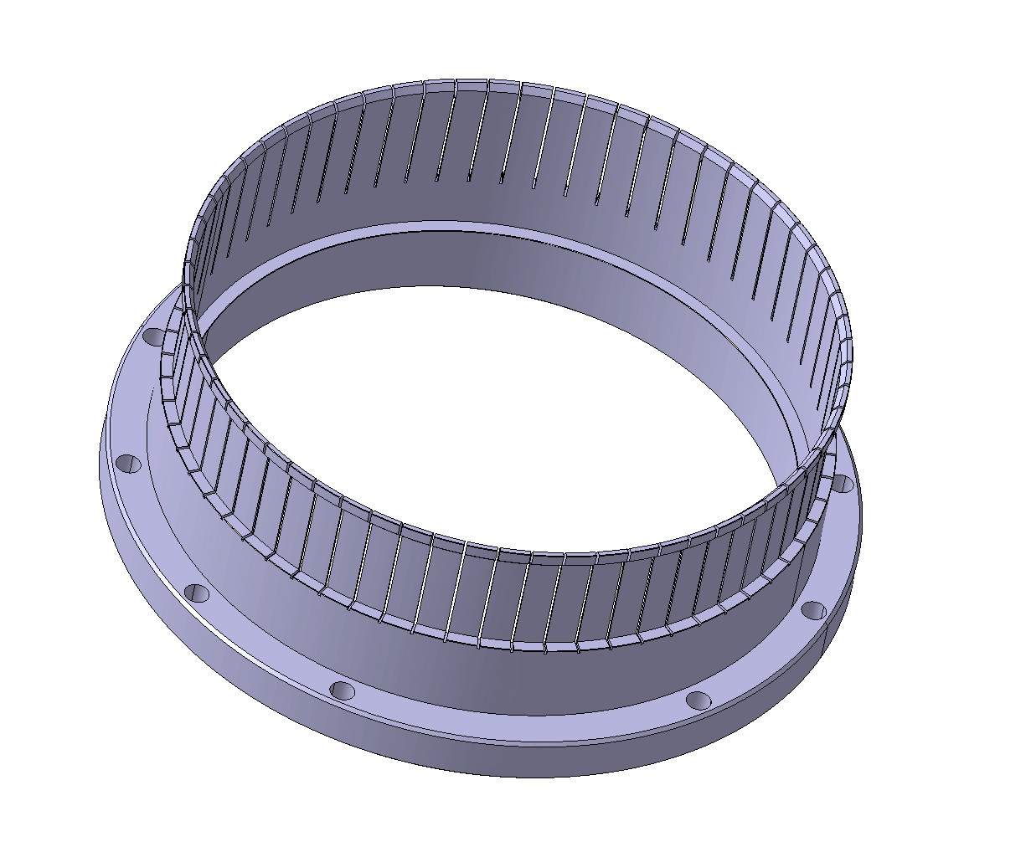
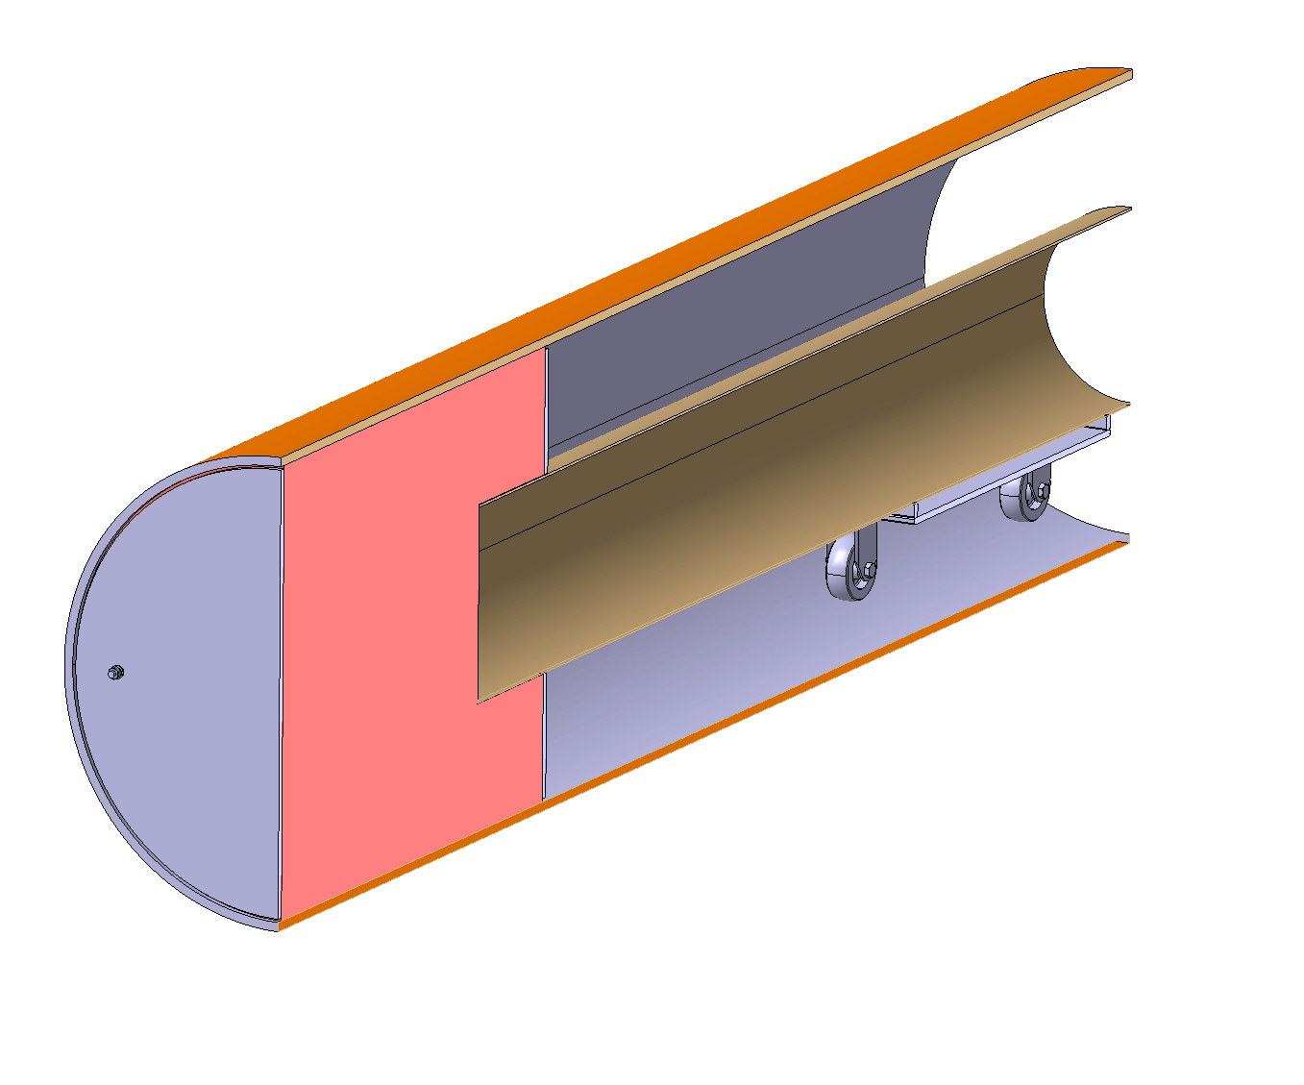
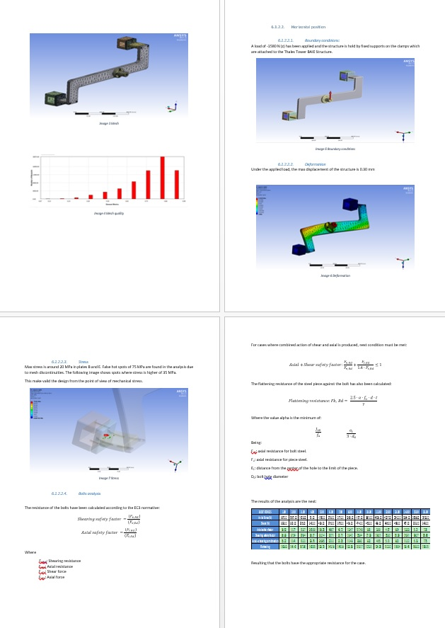
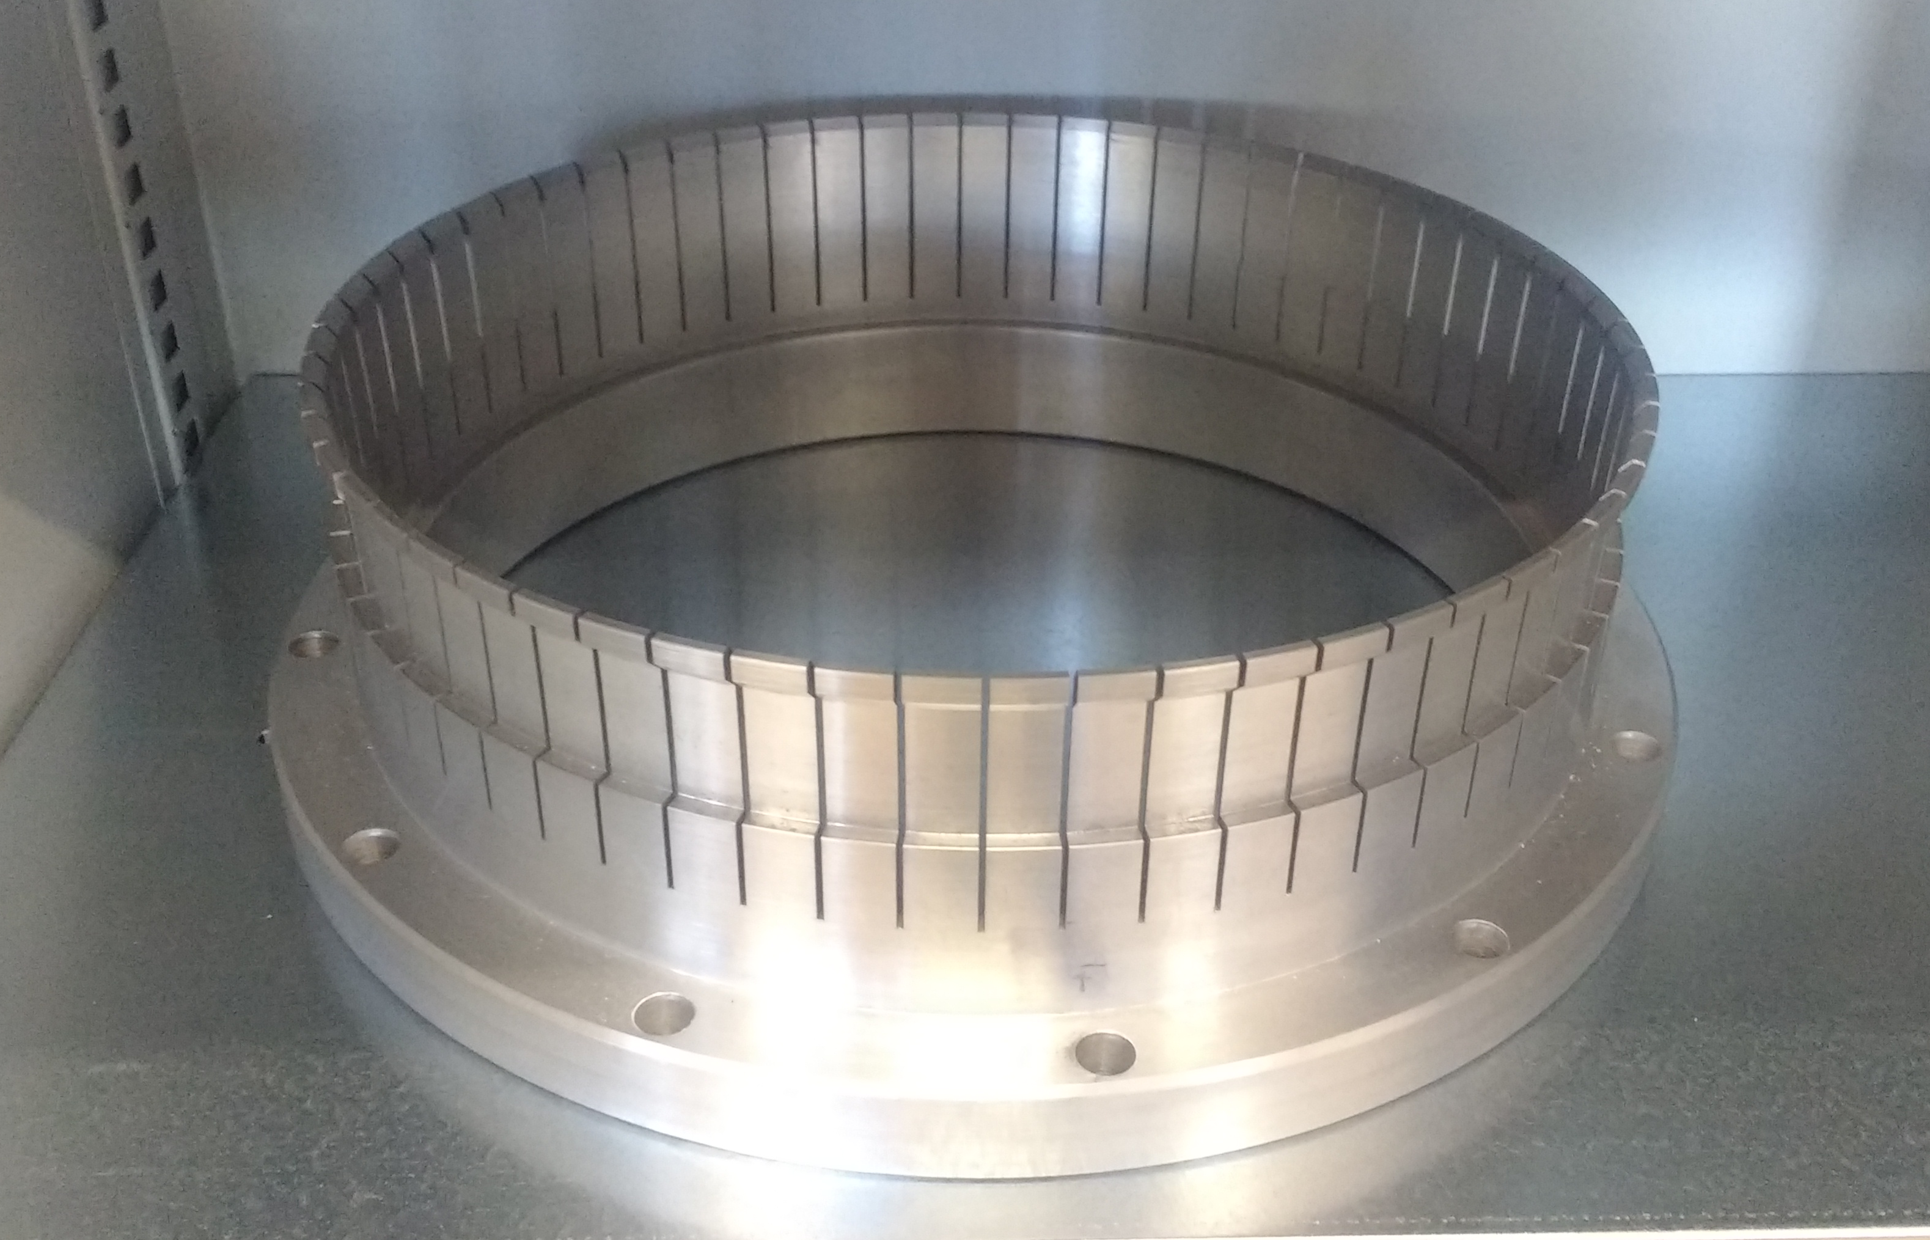
RF Towers Lifting Device
Safety file redaction
RF Flange
Pipe Inner Cleaner
Notes:
As I explained, the second half of my work has been the design of tooling necessary for the project .
As we dont have a lot of time I am going to try to explain it roughly.
The first one was this lifting device, which will help to lift and put in vertical position on the mezzanine of BAF3, as well as the redaction of the safety file.
Other tooling has been this RF Flange, which will be used for attach RF pipes por different purposes (as tests, coupling pipes, etc.. )
Before installing the coax lines, it is necessary to clean very well the inner of these. For that problem we have designed a small trolley with foam nose.

Slide 6
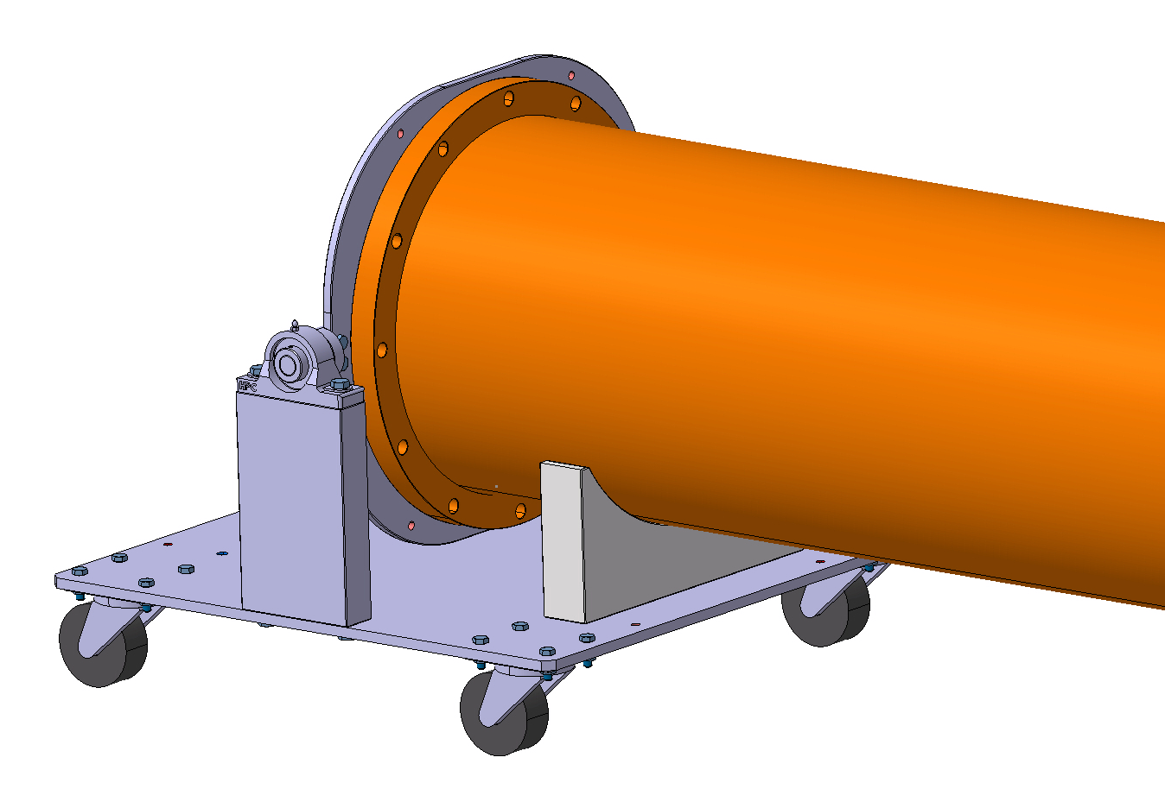
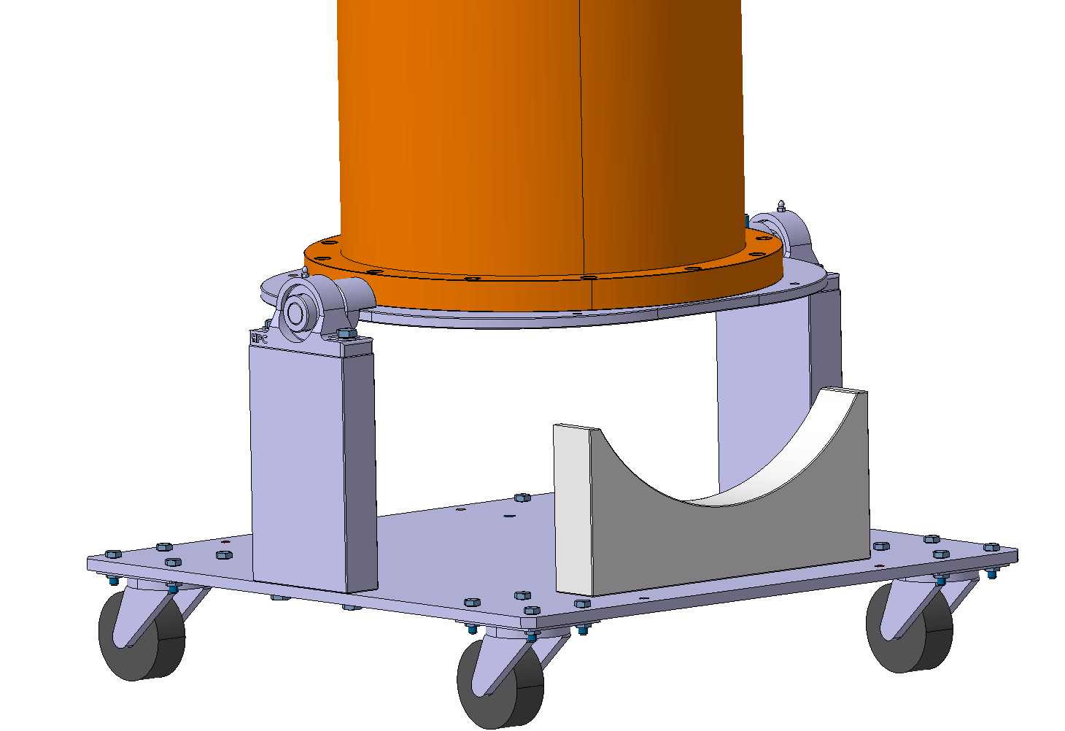
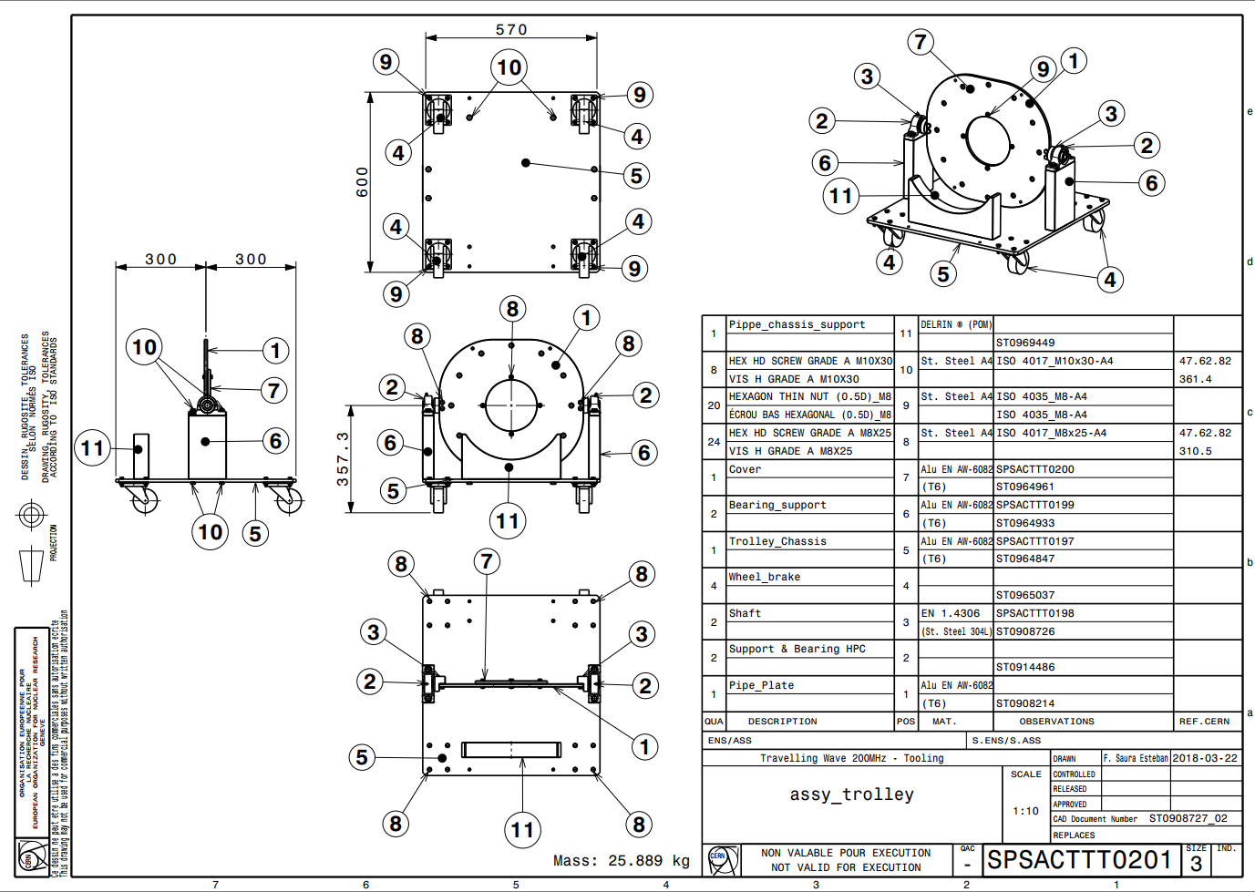
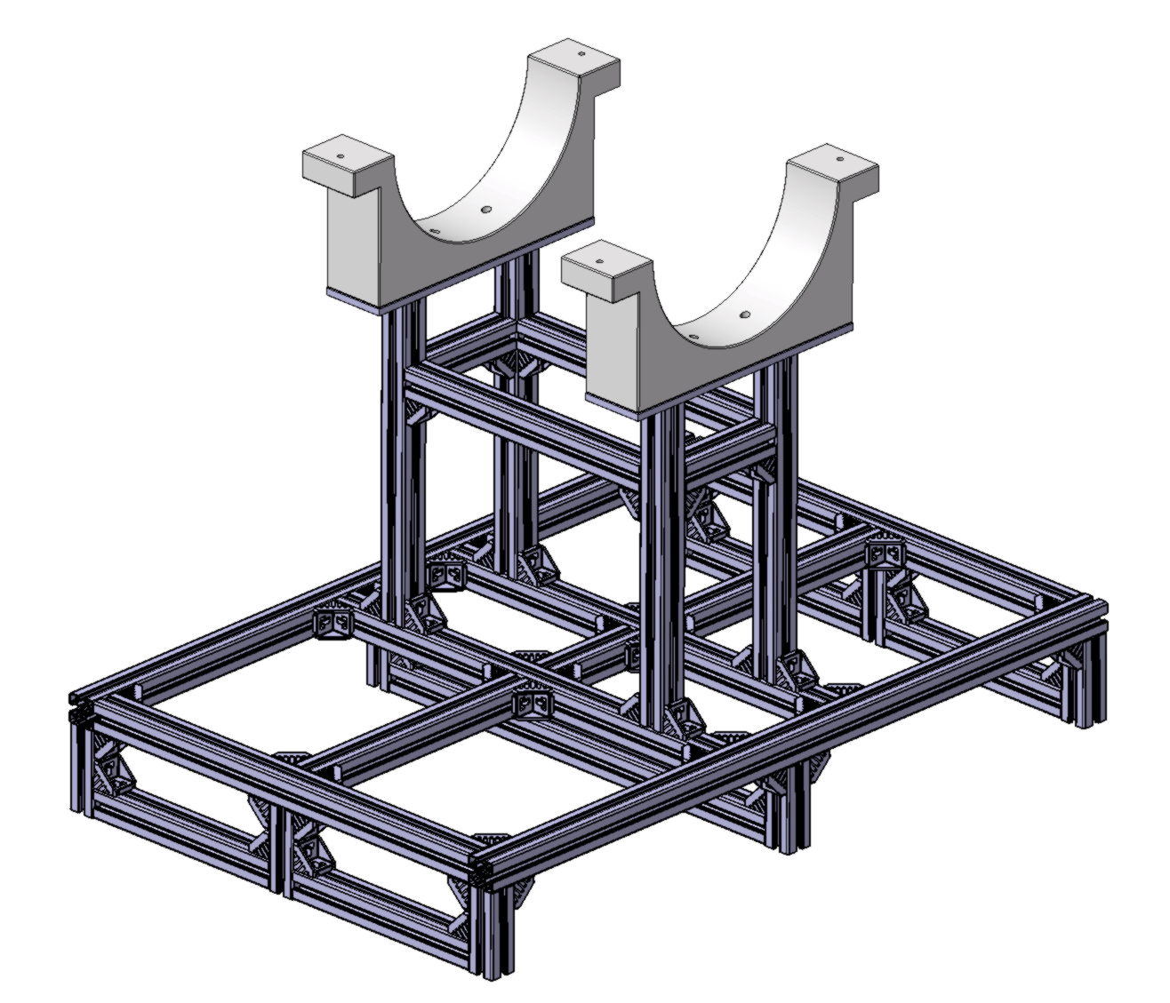
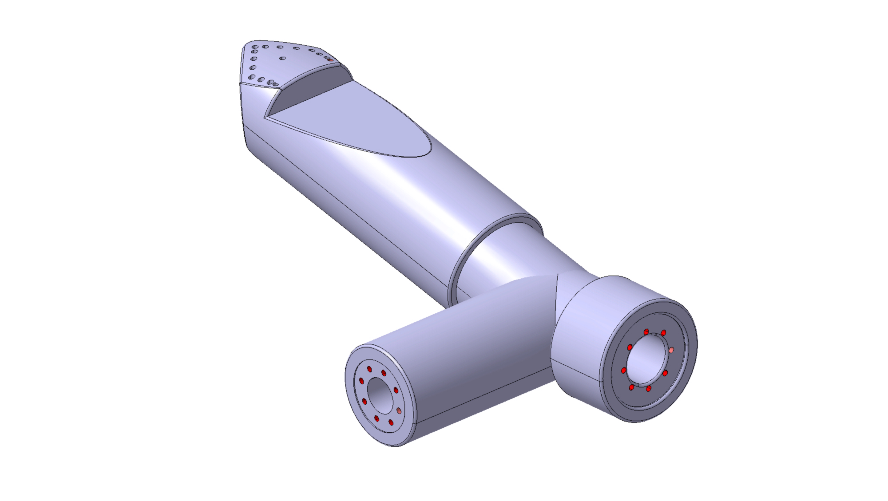
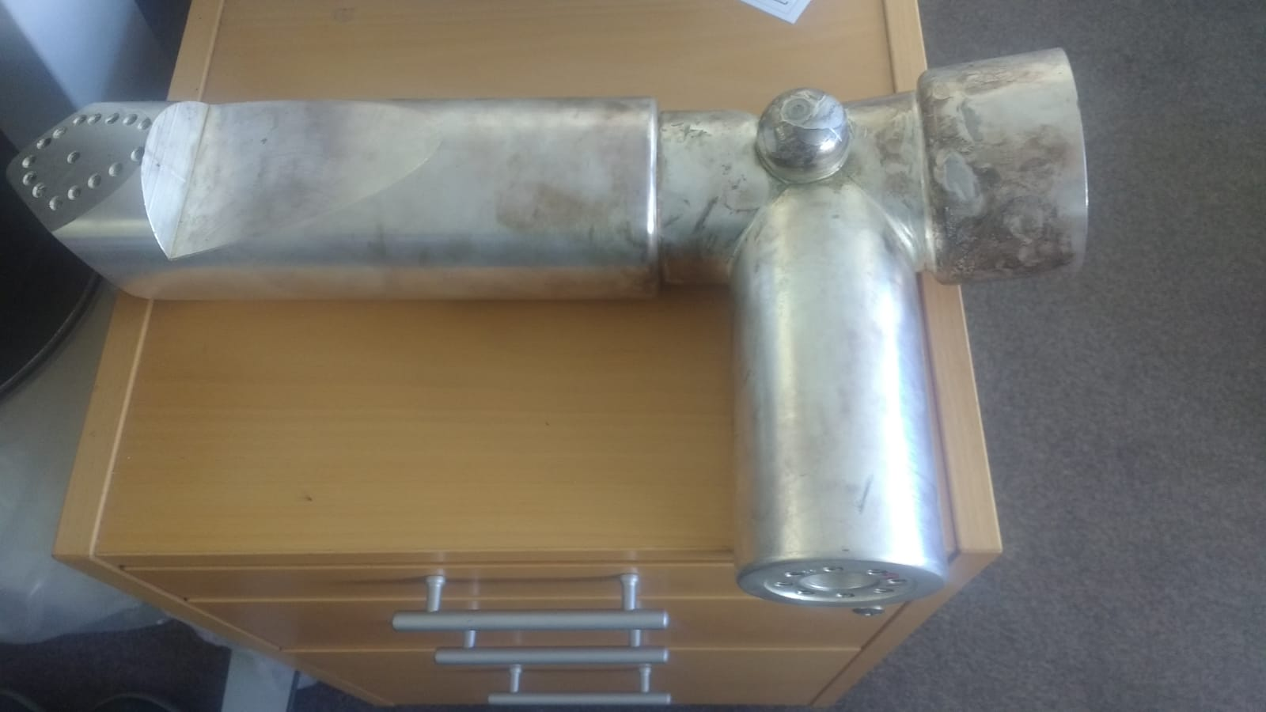
Pipe Transport Trolley
Forklift Support
Hybrid Combiner – Inner Line
Notes:
The main RF coax lines are 5.5 meters long and weigh 165 kg. For transport these lines along the tunnel it has been necessary to design a trolley which will allow the rolling of the pipe to work in different positions. We are actually mounting the 10 trolleys we have send to manufacture.
Inside the tunnel, we have to elevate to 3 m height these pipes, for that we will use an electrical forklift and we have designed an special support to reach this height without problems with the circular roof.
In parallel I have also helped my colleague Frida with the inverse engineering of the inner line of the hybrid combiner which we need to manufacture.

Slide 7
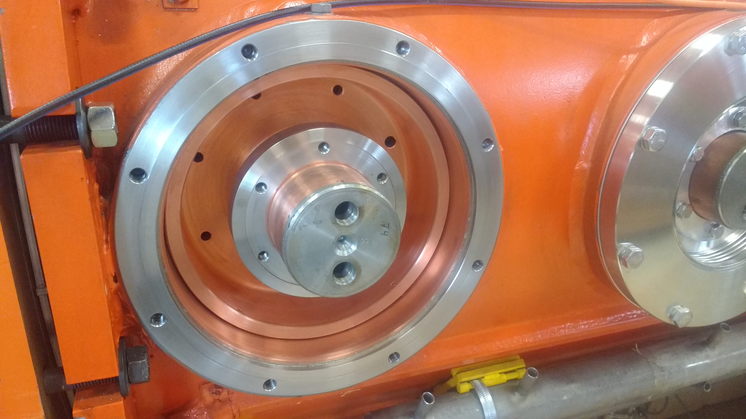
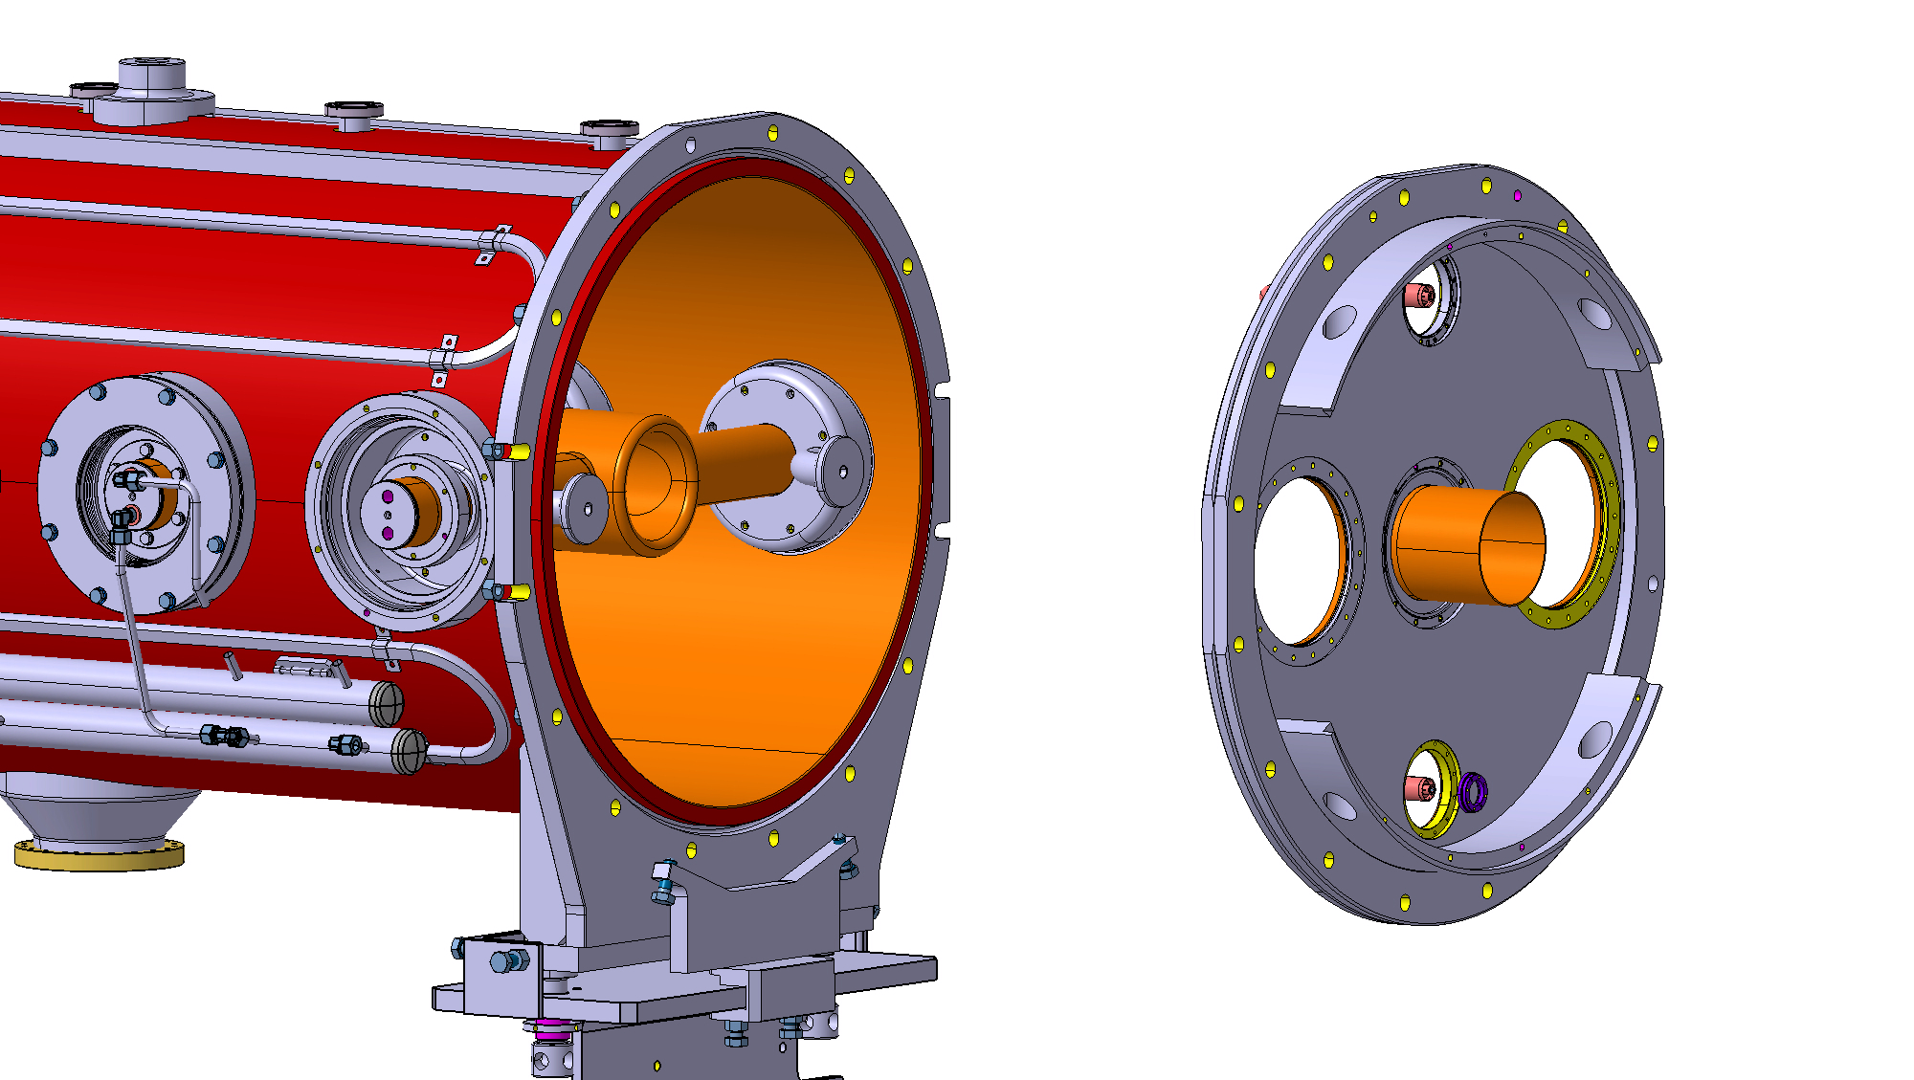
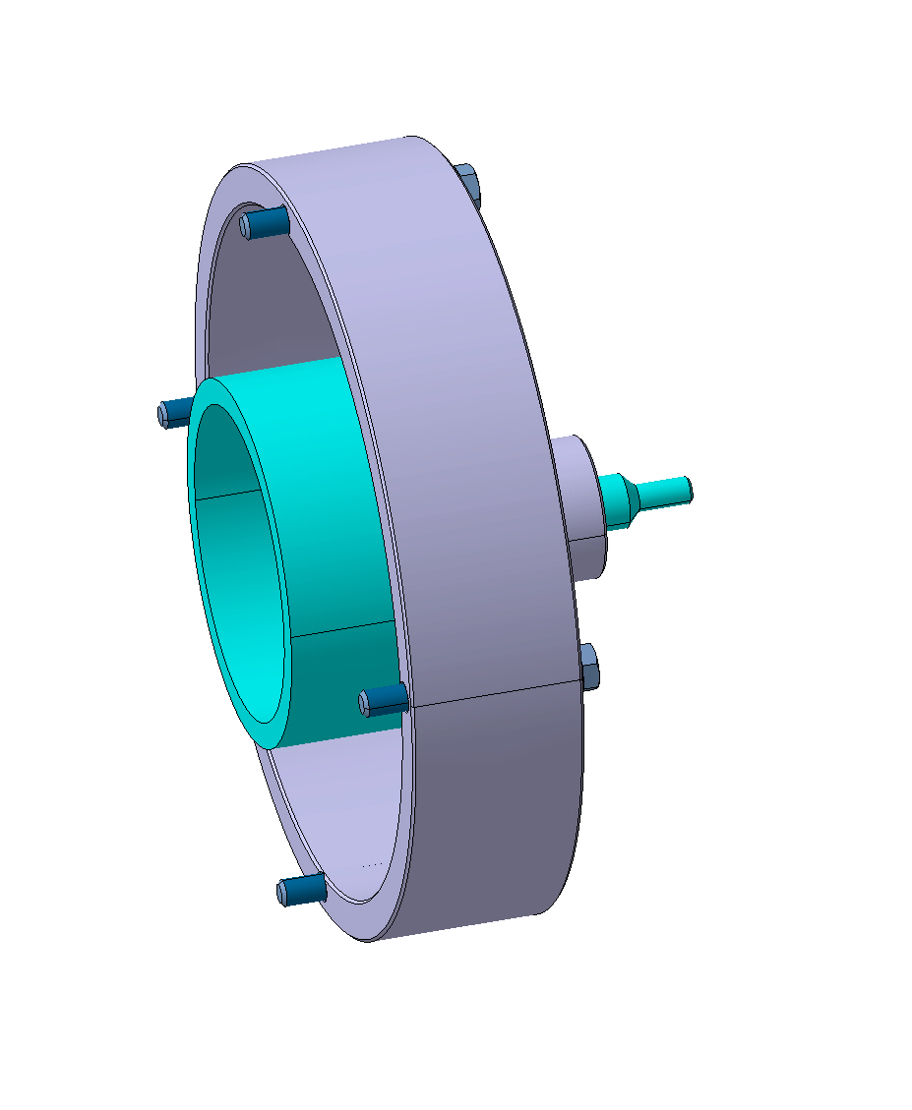
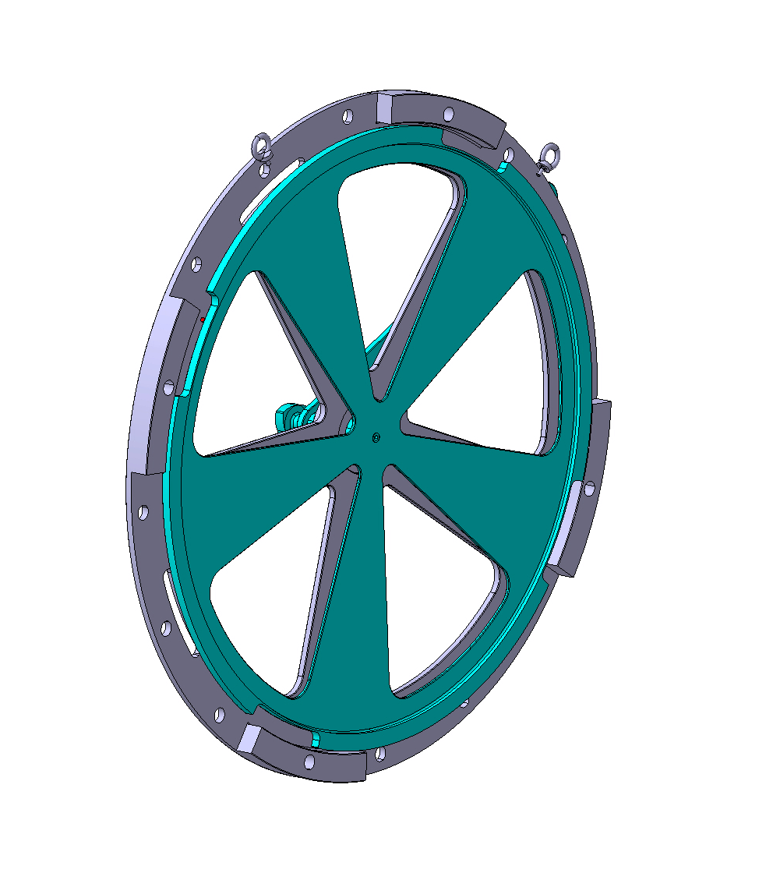
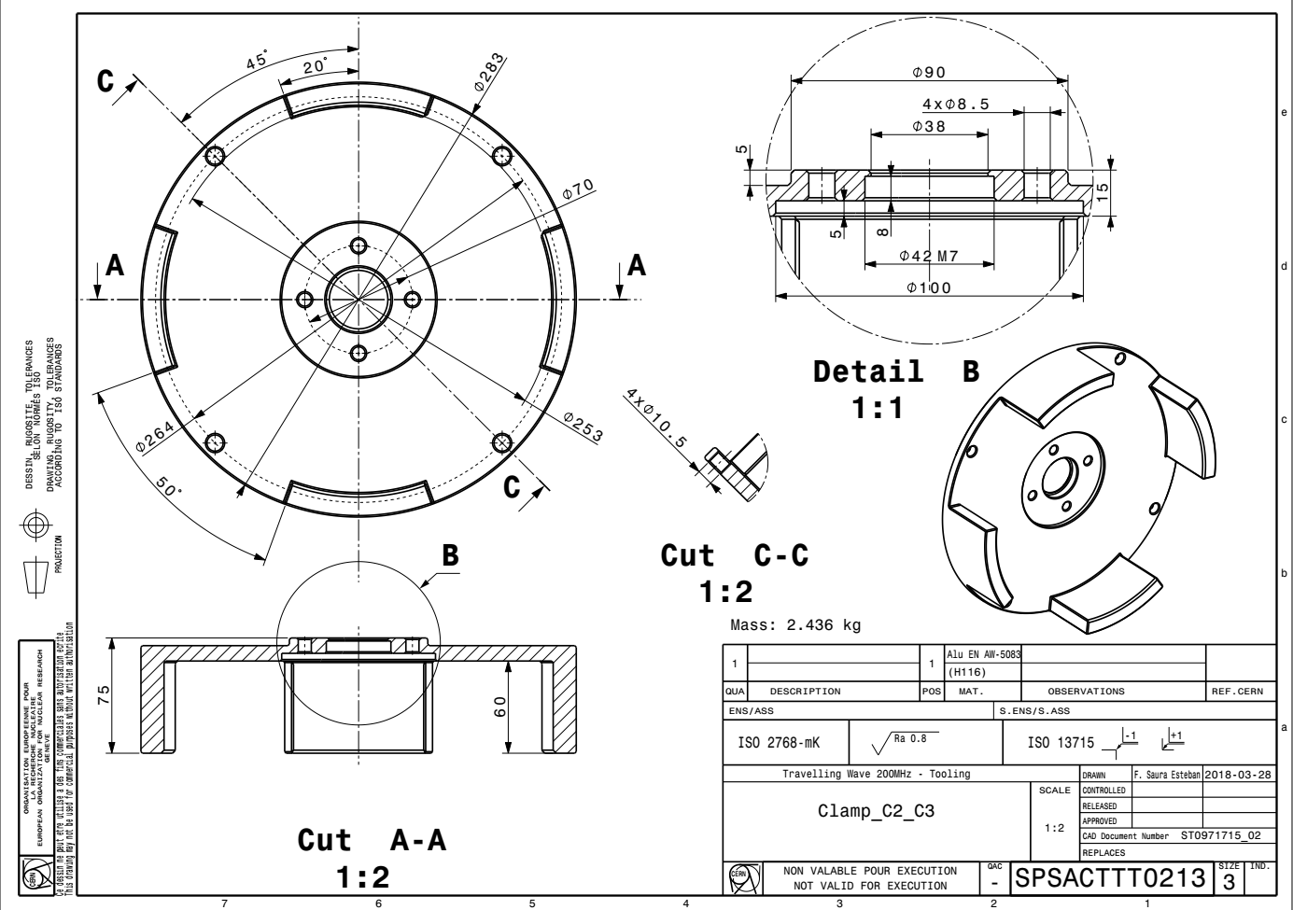
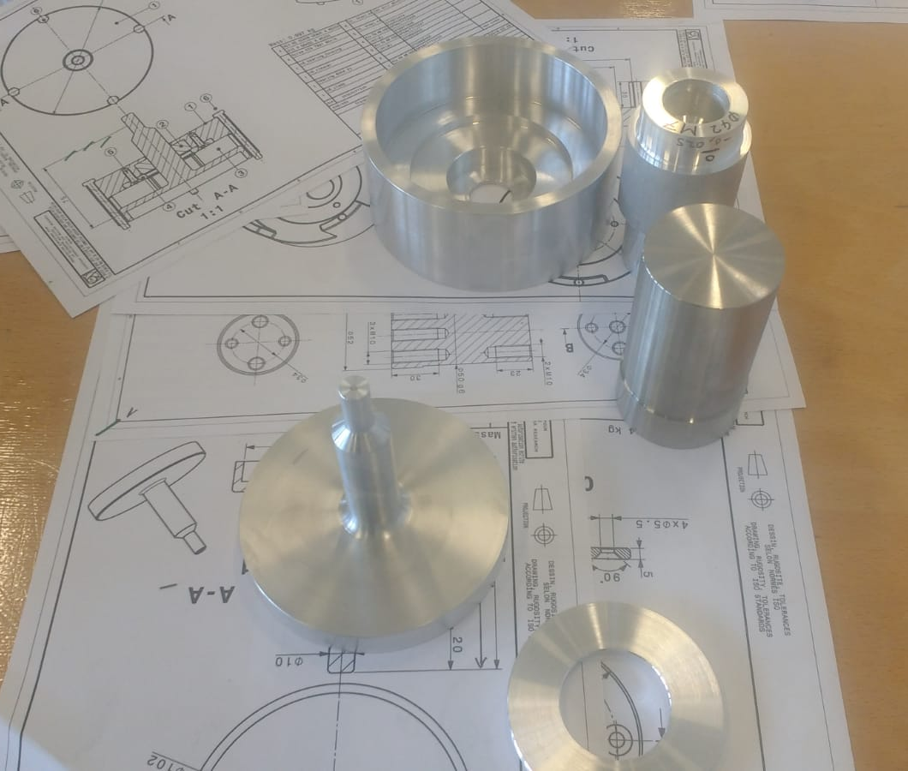
Cavity Joints Cleaners
Notes:
One of the work which have occupied lot of my time has been the design of 7 different cavity joint cleaners. In order to achieve a good vacuum, without dust, it is necesary to clean properly the joints with the rotary cleaners we designed. Some of them are already being manufacture inside CERN and the biggest have been outsourced.

Slide 8
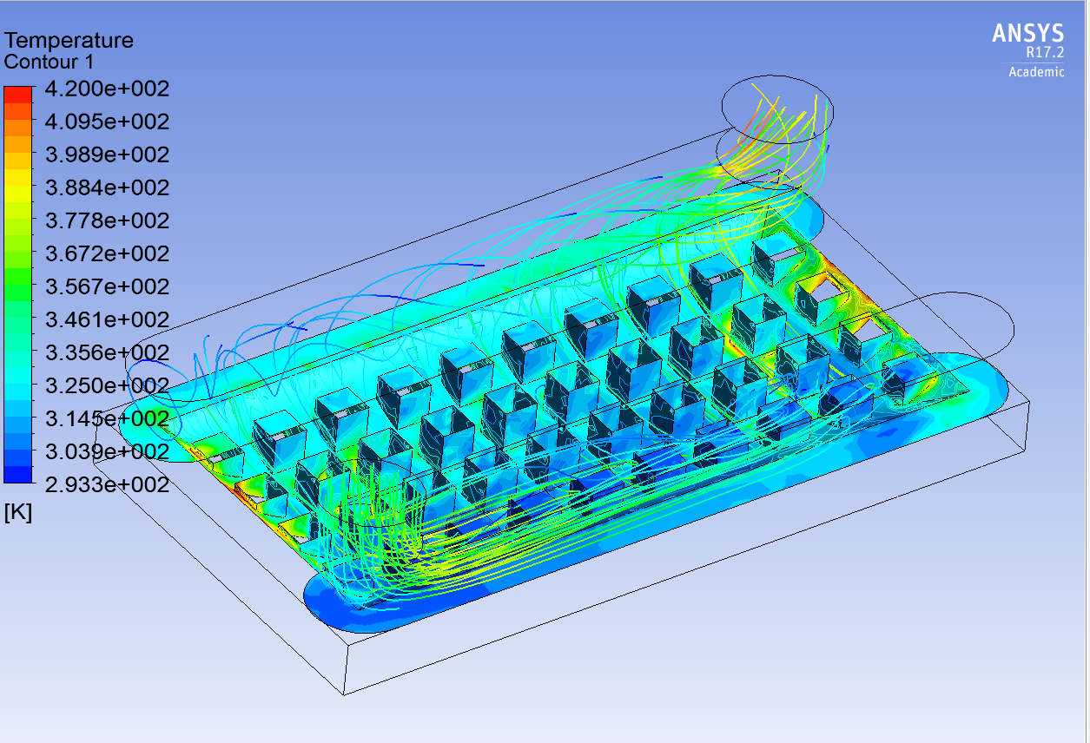
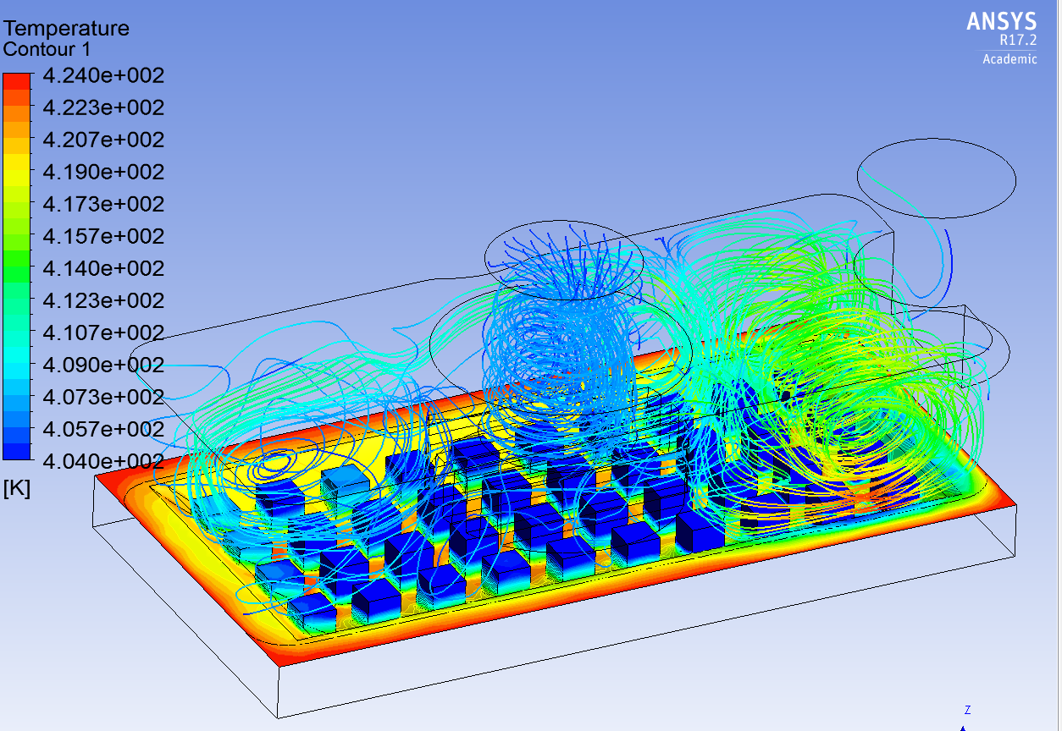
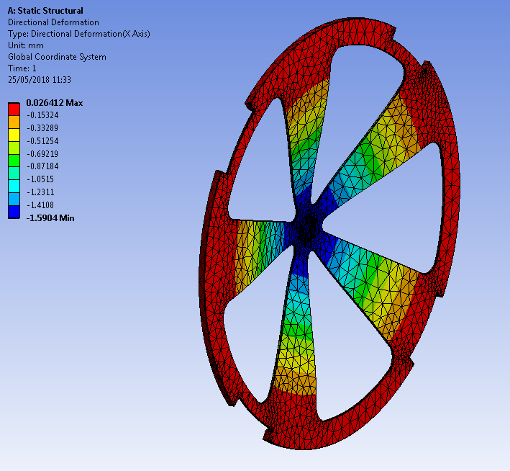
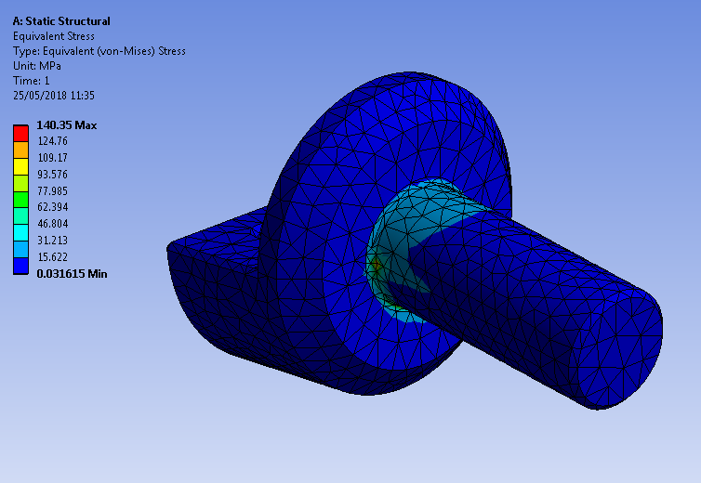
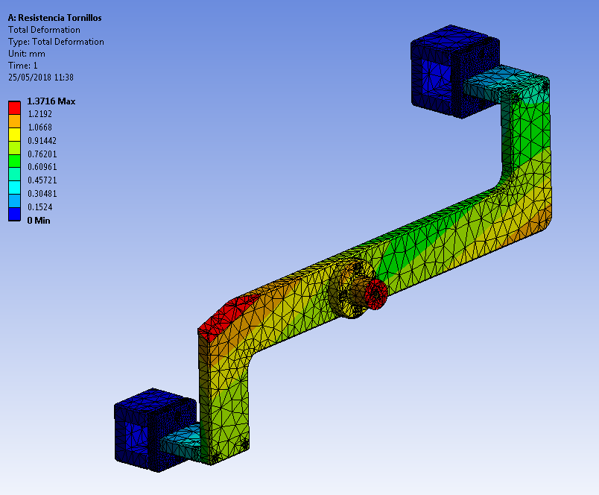
Heat Exchanger Analysis
Cleaner Plate Deflection
Trolley Shaft Resistance
Lifting device / Bolts Static Analysis
Notes:
In many of my designs I have also had to perform finite element analysis to check deflection, structural resistance, bolt resistance of different parts of my designs. I am actually working in the flow analysis of two different heat exchange systems in order to determine the best for our RF tower electronics coooling.

Slide 9
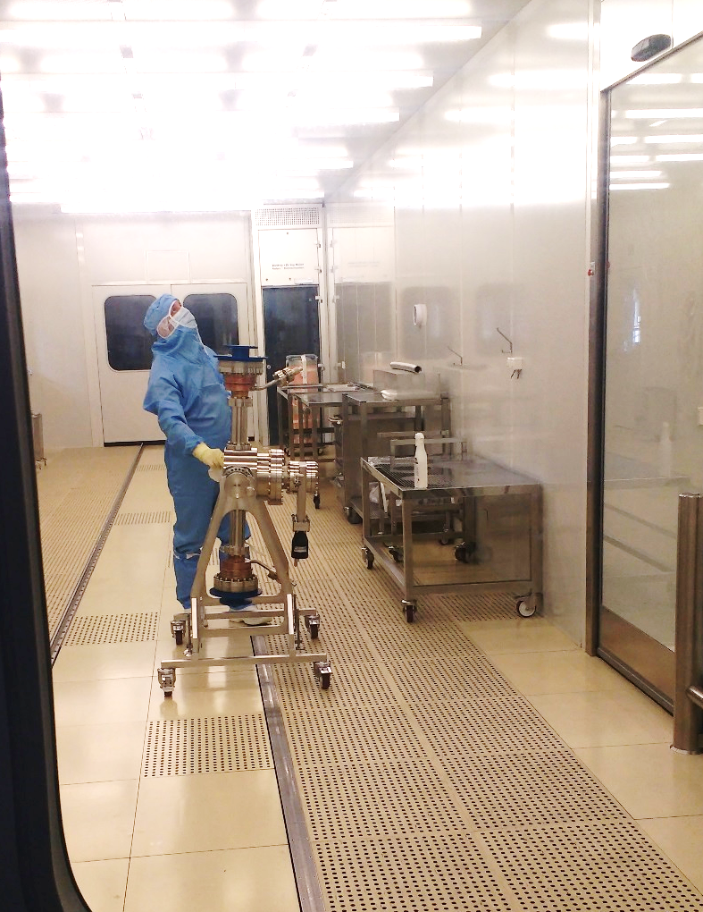
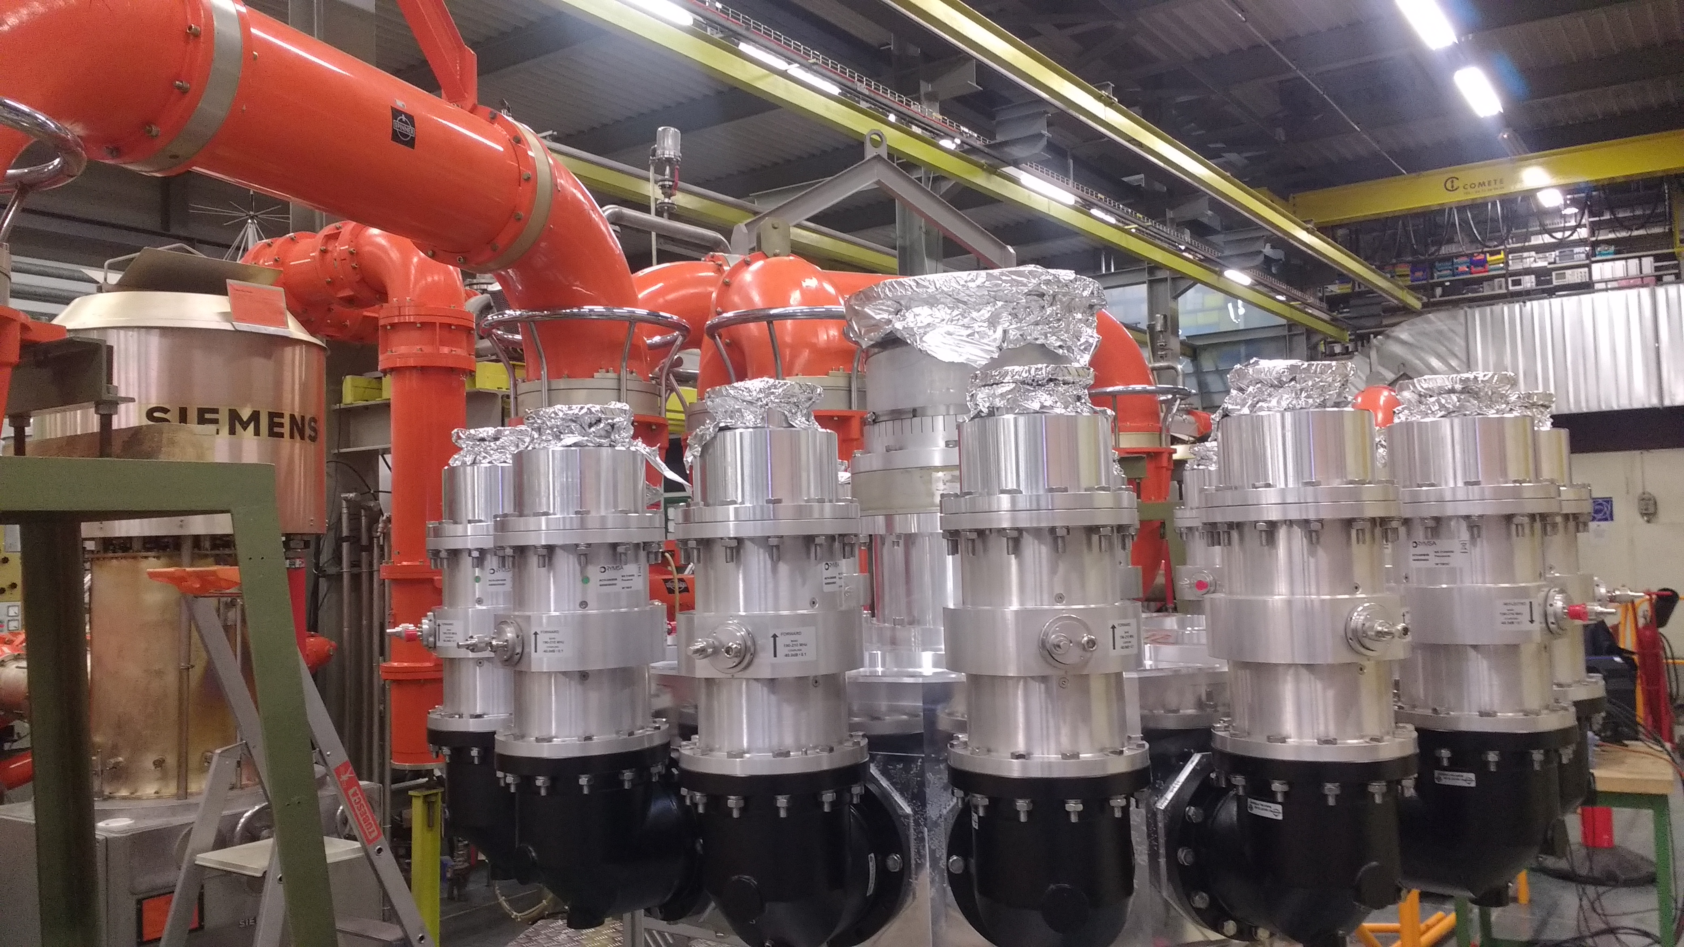
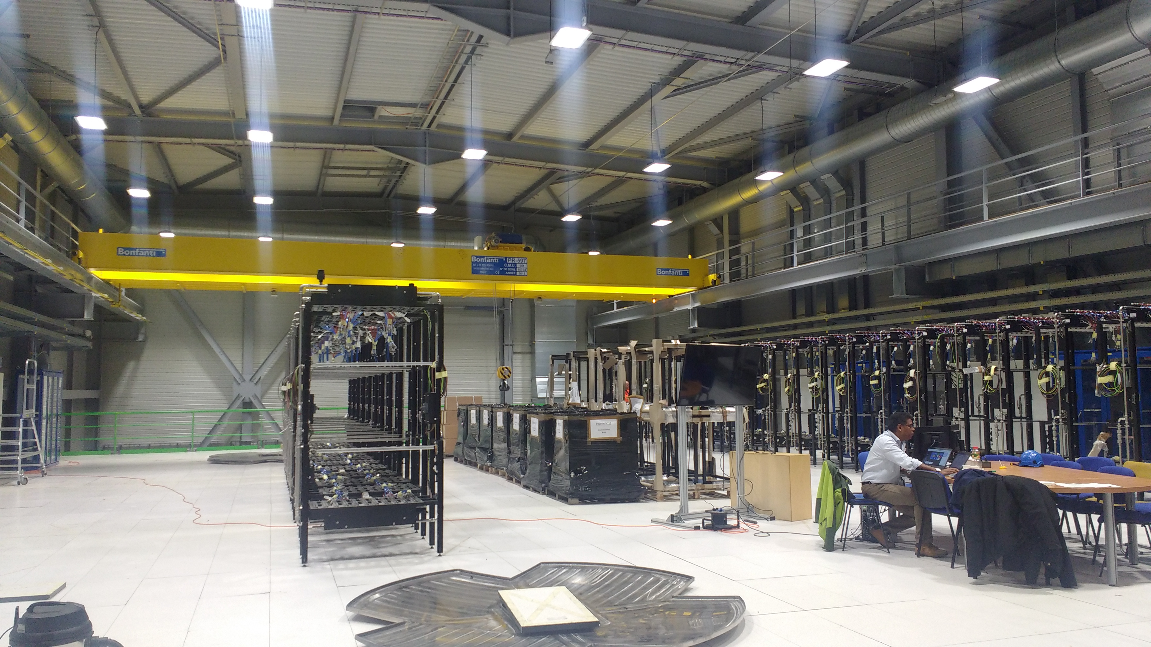
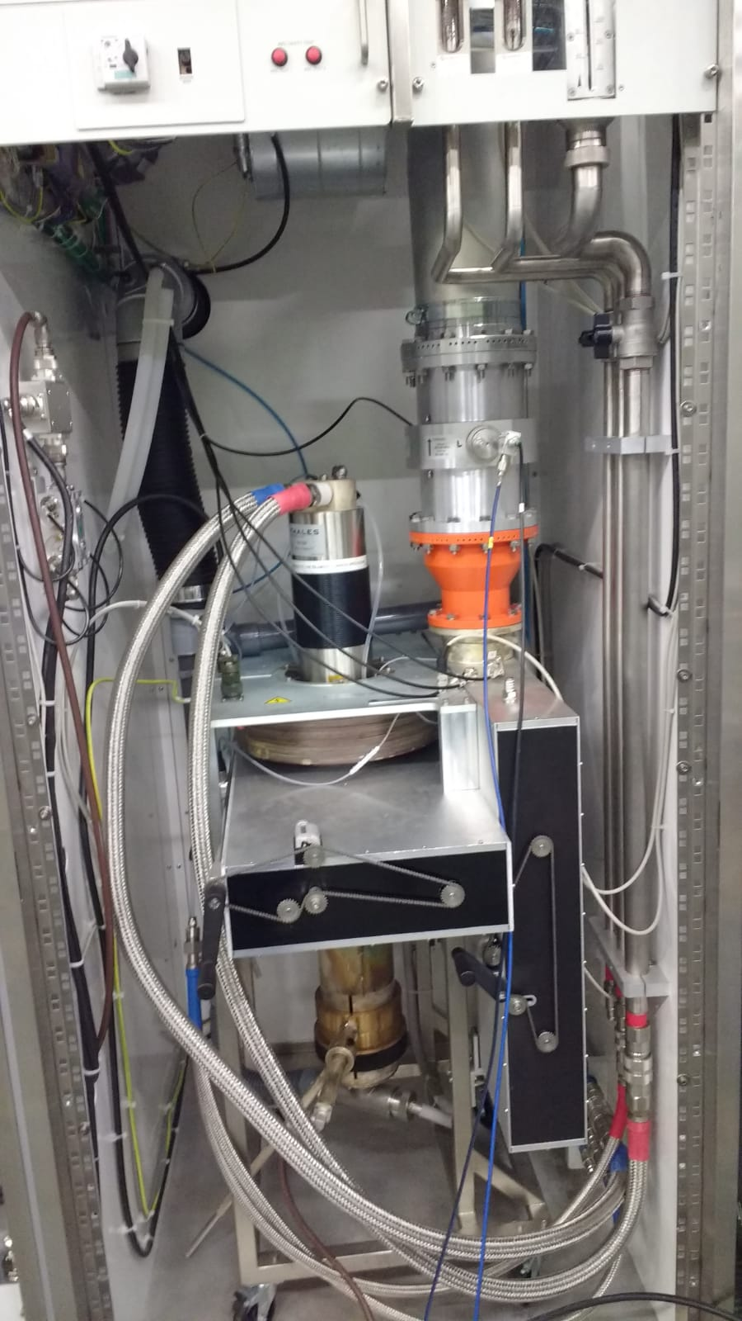
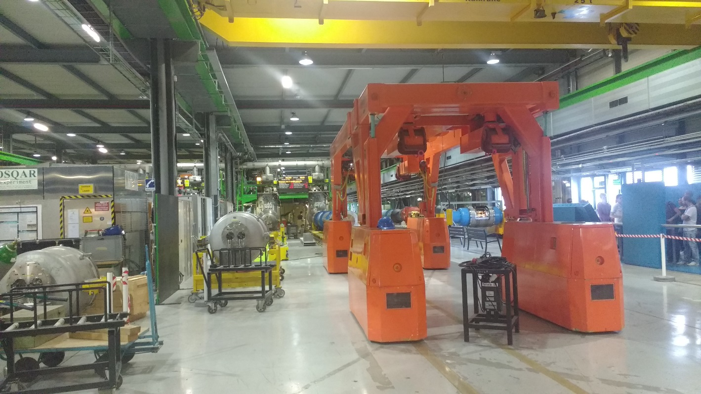
General RF installations commissioning, tests and maintenance
Notes:
In parallel to all my work, I have spent a lot of time hands on, helping in the maintenances of the RF lines we already have. Mounting, unmounting, performing tests, cleaning in white room, etc…

Slide 10
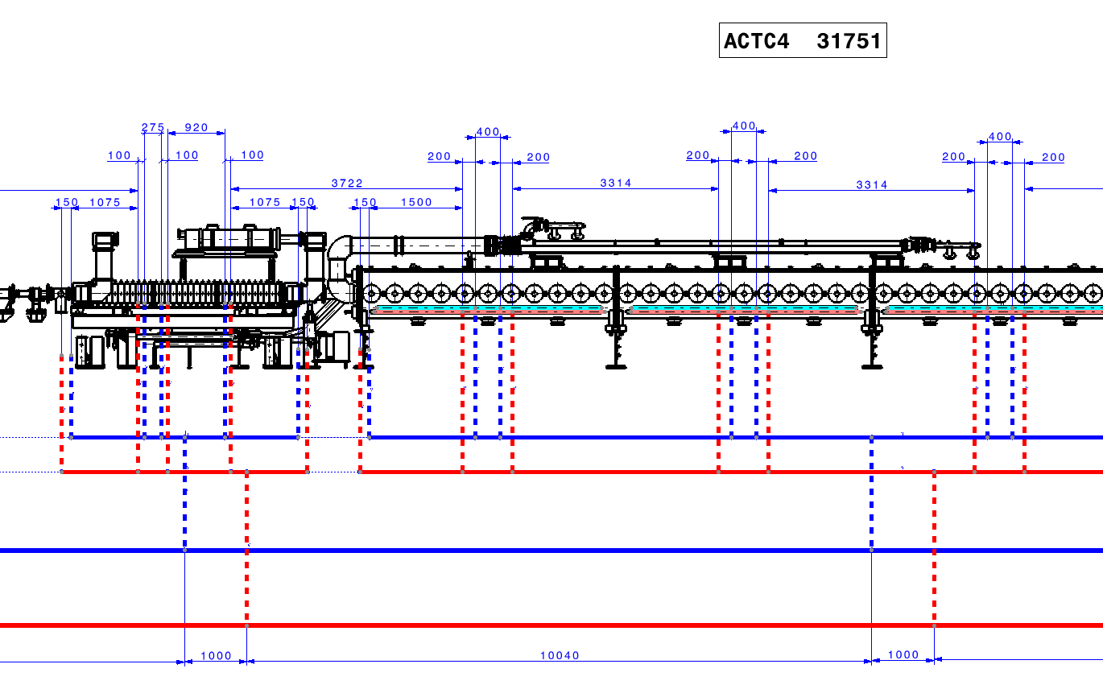
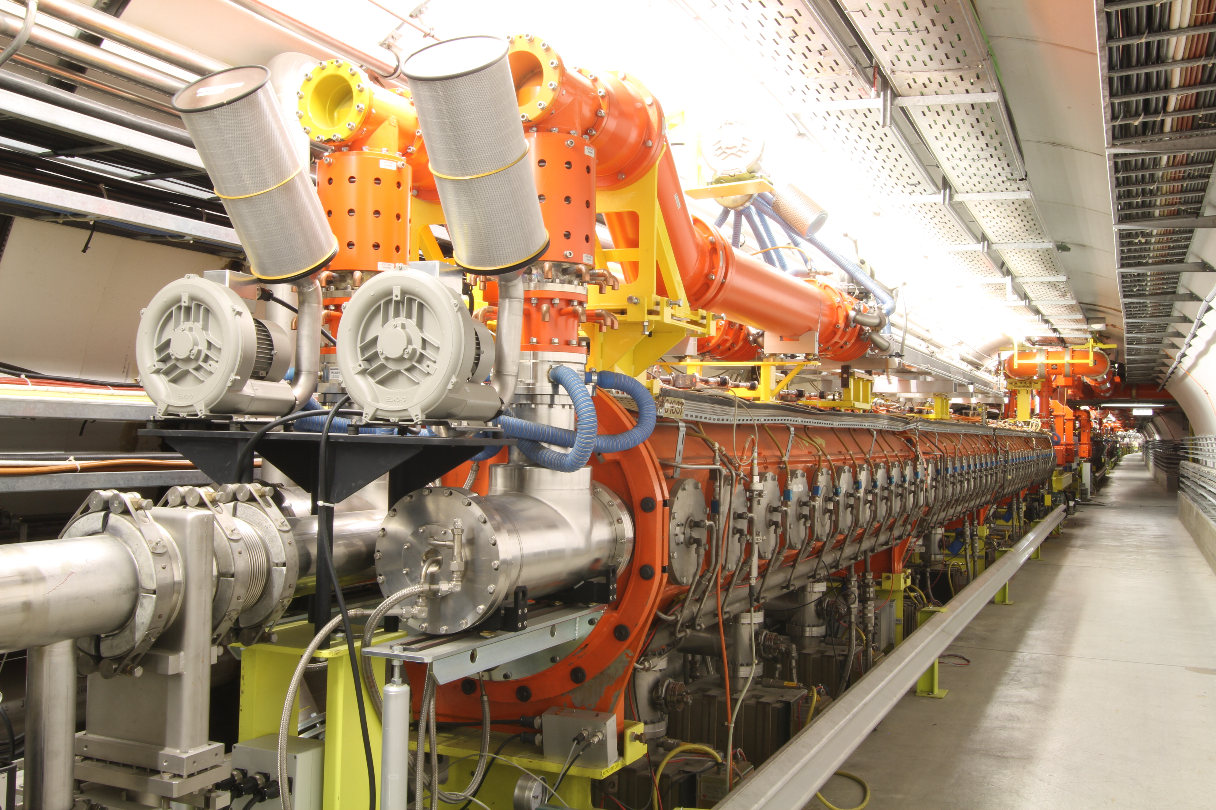
LS3 200 MHz / 800 MHz Cavities Cooling Pipe Diagram
Notes:
I am actually working in the cooling piping system of the new LS3.
With the new disposition of cavities, the feeding water lines will also change and Im in charge of design, supply and install the pipes and components of this lines.

Slide 11

Thank you very much for your attention
Any question?
Notes:
So, this has been all. If you have any question…
Thank you very much.

