Slide 2
Power Electronics System Testing and Commissioning
FTEC 2017 2nd Workshop
Guillermo Navarro Patrón
Konstantinos Papastergiou
Technology Department
- Electric Power Conversion Group
- Medium Power Converters Section

Slide 3
Outline
Introduction
Power converter
Tester features
Hardware integration
Software implementation
Conclusion

Slide 4
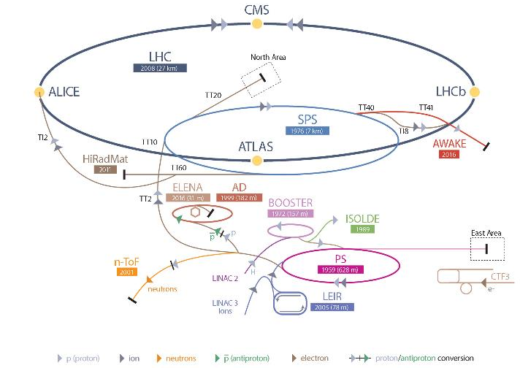
Introduction
150 Converters
  TT2
  Booster Transfer Line
  East Area

Slide 5
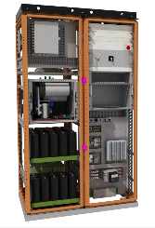
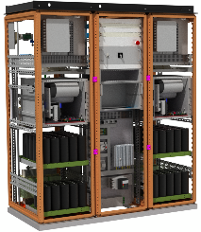
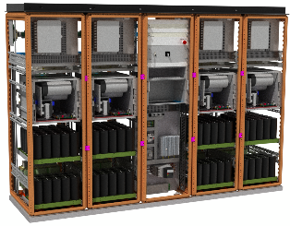
Power converter
SIRIUS main configurations
  SIRIUS – S SIRIUS – 2P SIRIUS – 4P
Parameter | SIRIUS – S | SIRIUS – 2P | SIRIUS - 4P
Output Current | 200A_{RMS} / 450A_{PEAK} | 400A_{RMS} / 900A_{PEAK} | 800A_{RMS} / 1800A_{PEAK}
Output Voltage | 450V | 450V | 450V
Input Power | 3x400V / 50Hz. 32A_{RMS} | 3x400V / 50Hz. 63A_{RMS} | 3x400V / 50Hz. 125A_{RMS}

Slide 6
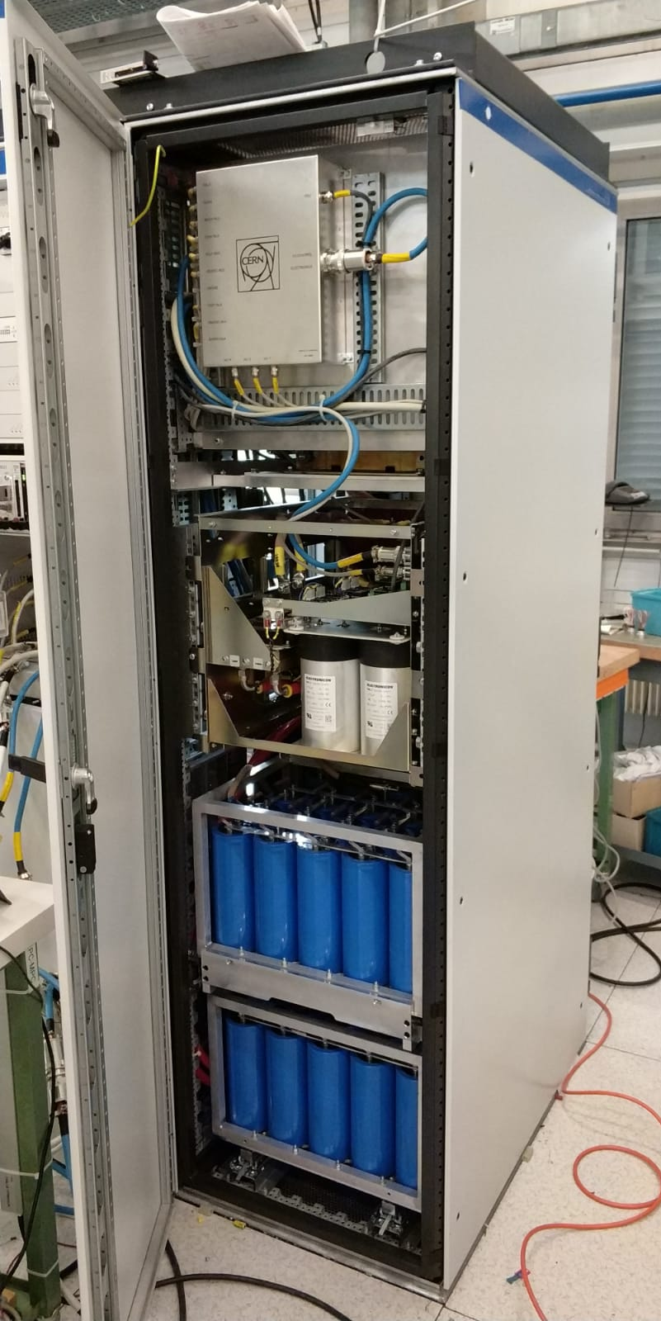
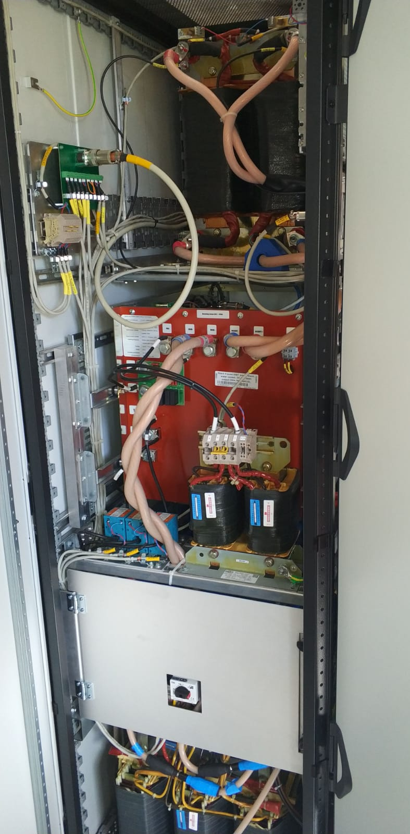
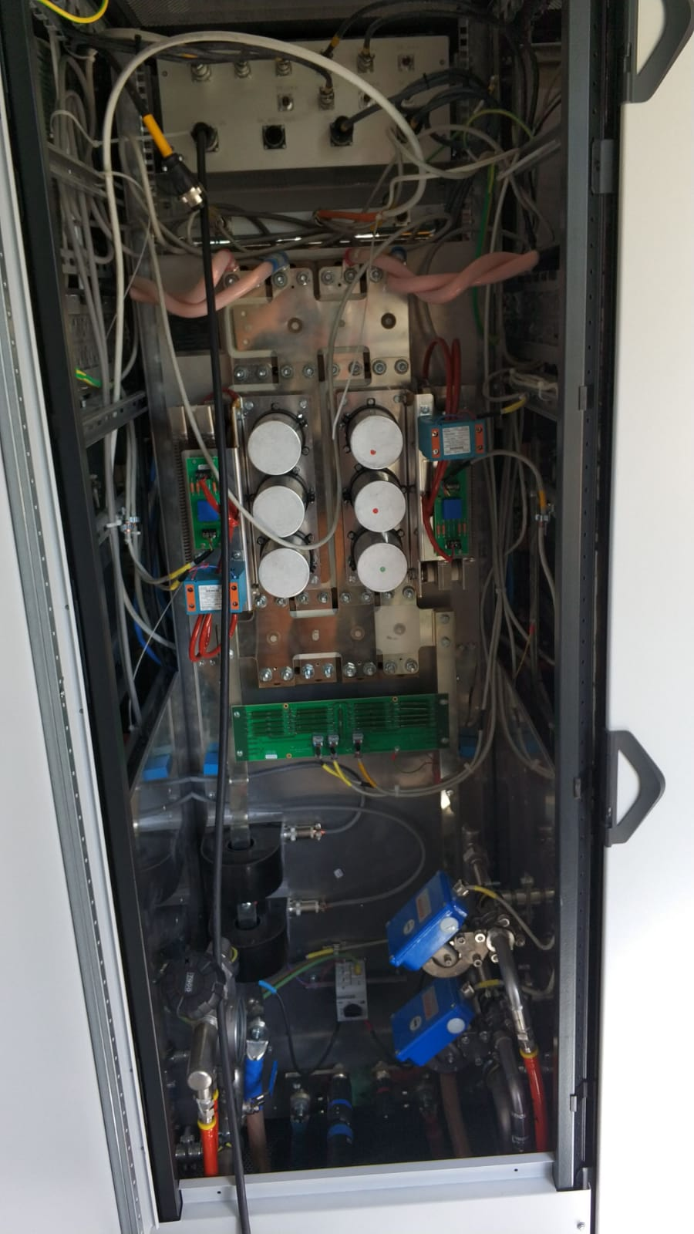
Power converter
SIRIUS 2P prototype
  Power brick front side
  Power brick rear side
  Main brick rear side

Slide 7
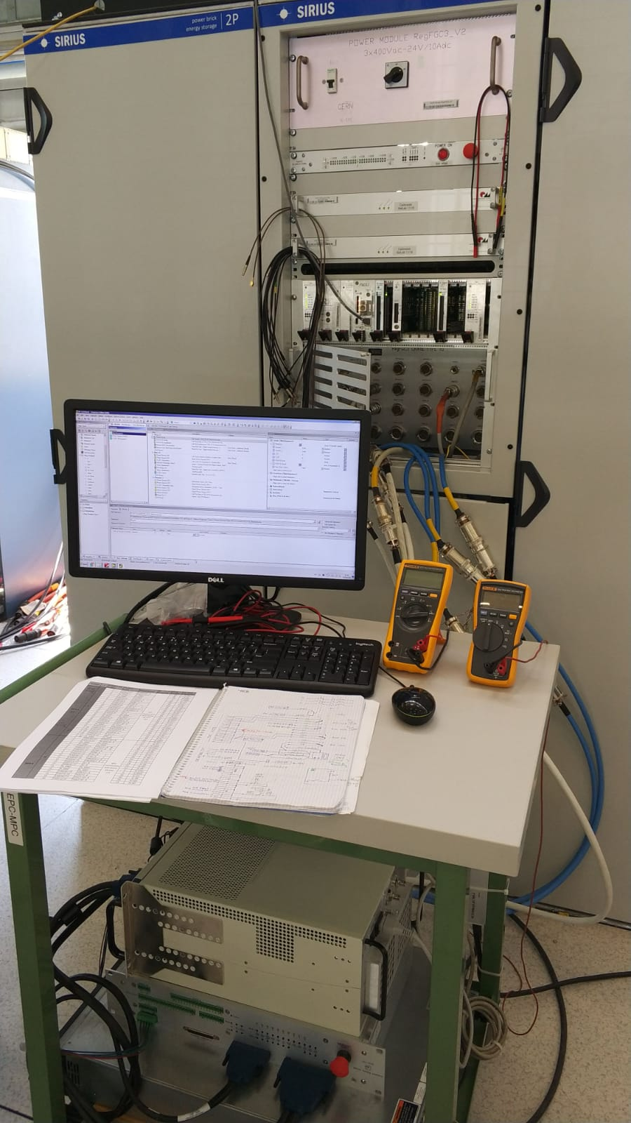
Tester features
Flexibility.
  One tool for all SIRIUS configurations.
  Automation of test tasks
  No need for CERN control electronics.
User friendly and intuitive.
  Operated by non-qualified personnel.
  Standard connections.
  Tests performed automatically and easily.
Safe. Low voltage operation.
Portable.

Slide 8
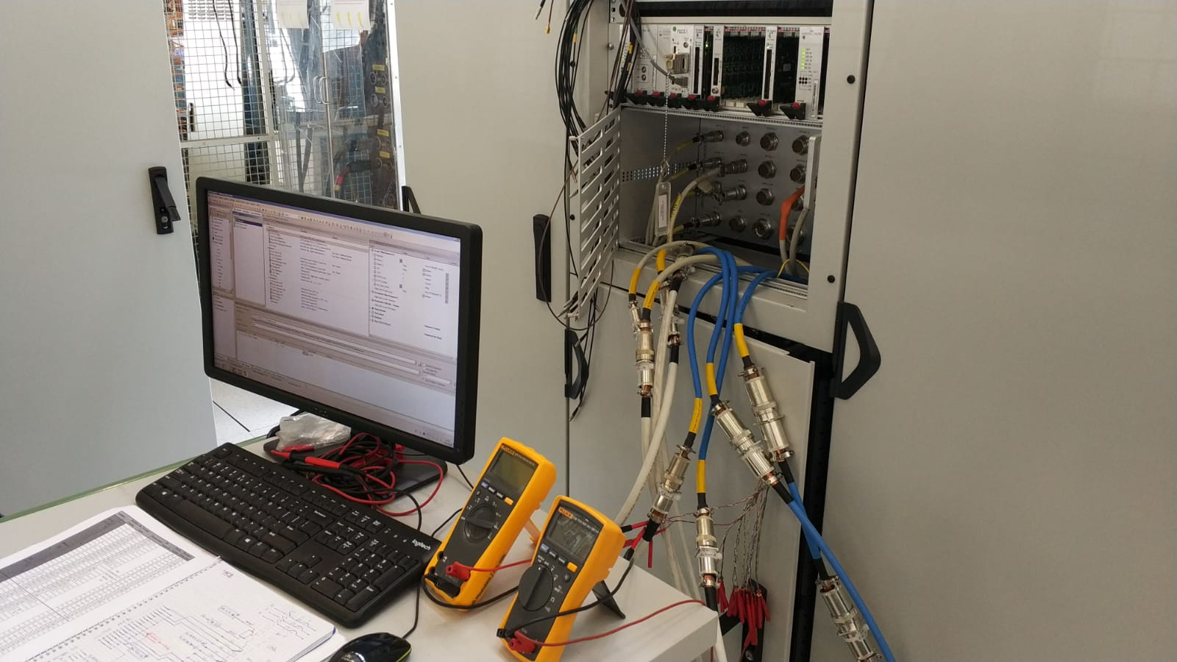
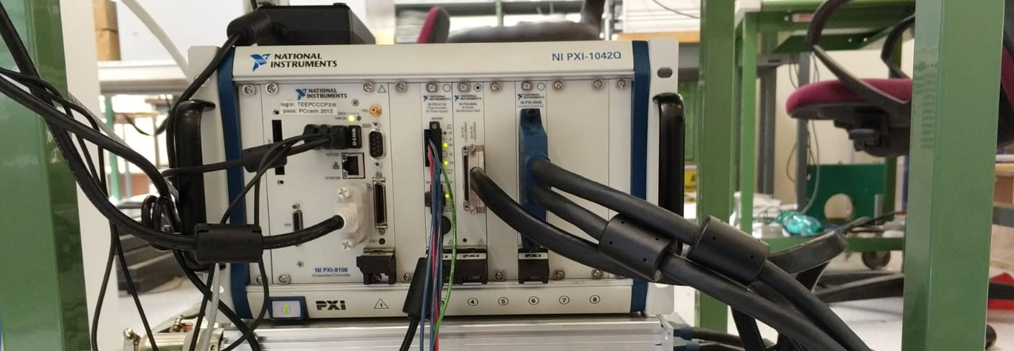
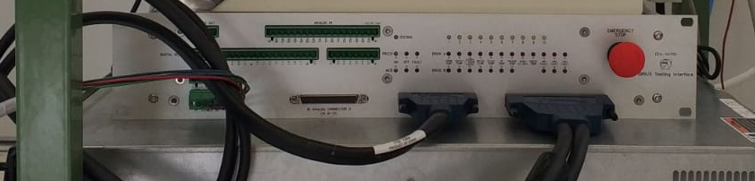
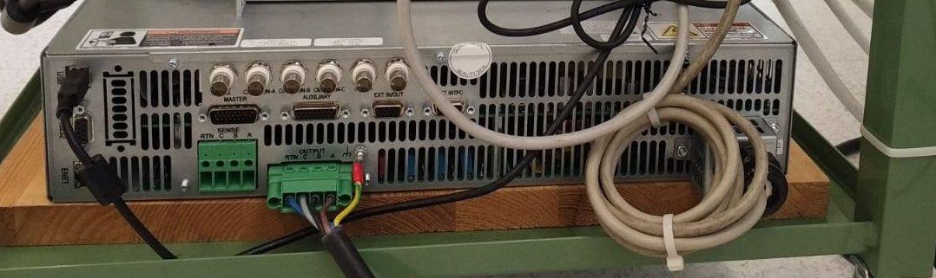
Hardware integration
  HMI +
  Interface
  connections
  PXI
  Interface board
  Power source output

Slide 9
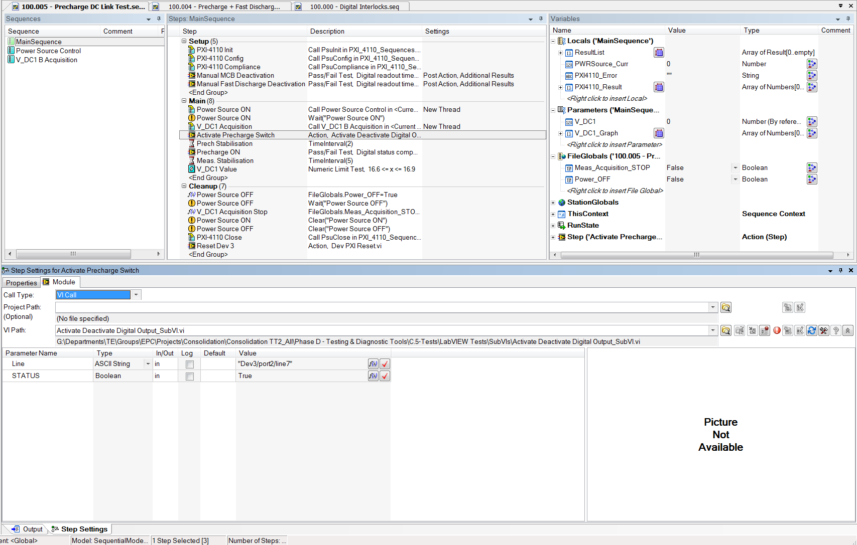
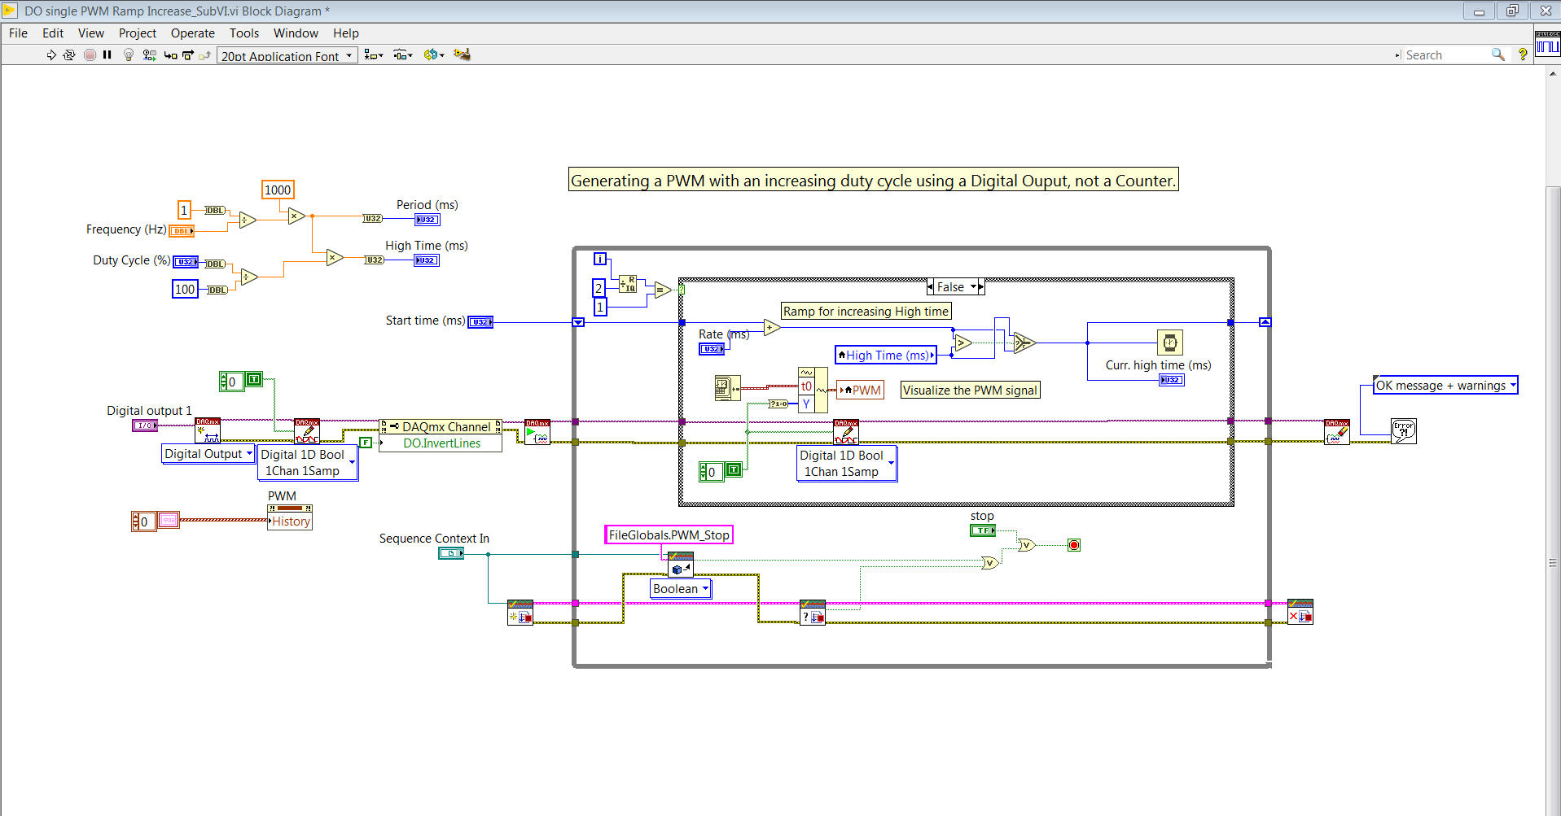
Test implementation
  TestStand
  LabVIEW
  Sequence manager.
  Synchronization of steps.
  Customization of steps.
  Execution of steps/instructions.
  Execution of User Interfaces.
  Monitoring variables.

Slide 10
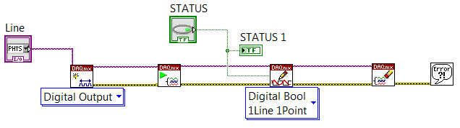
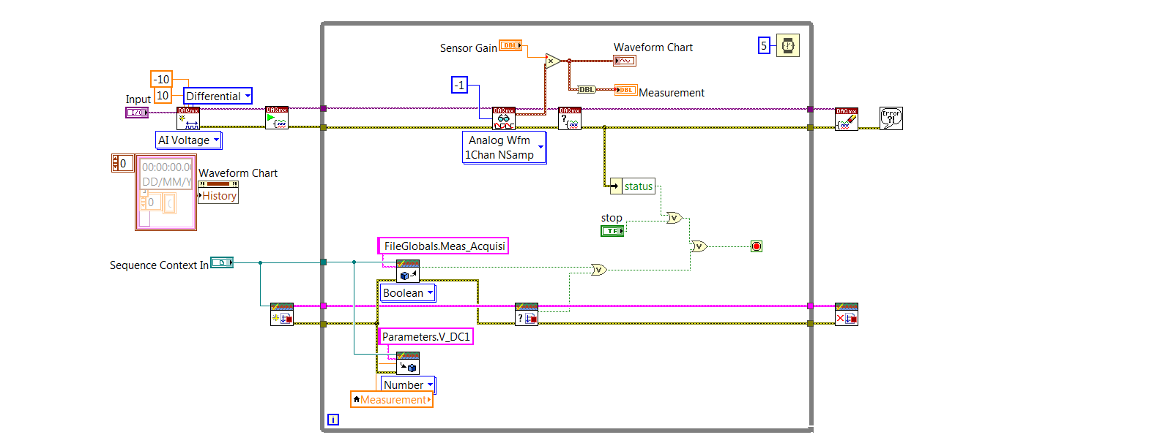
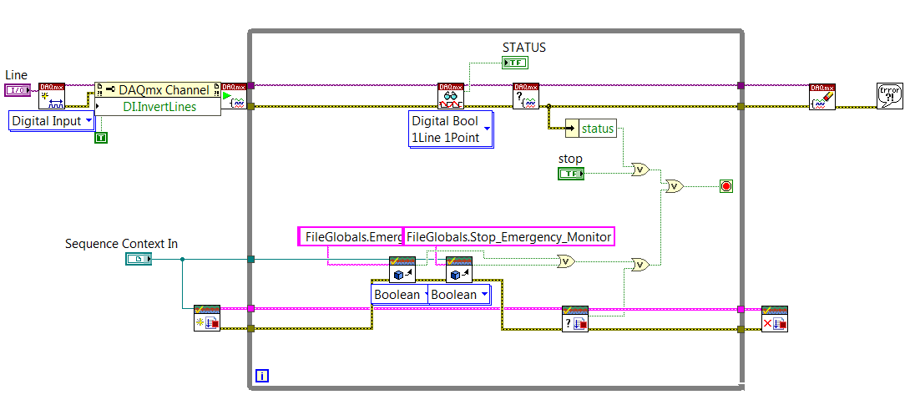
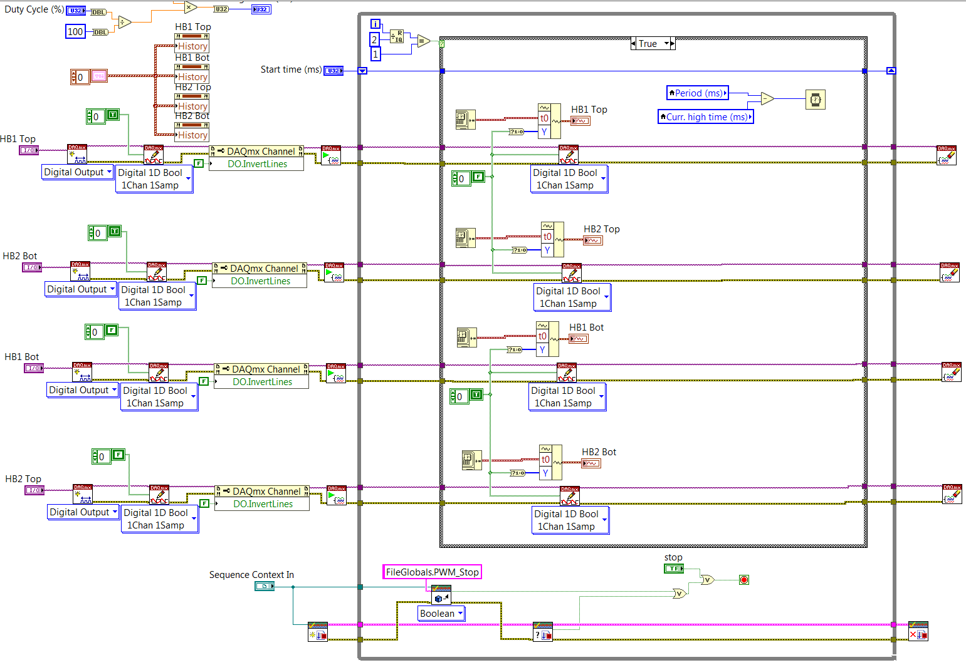
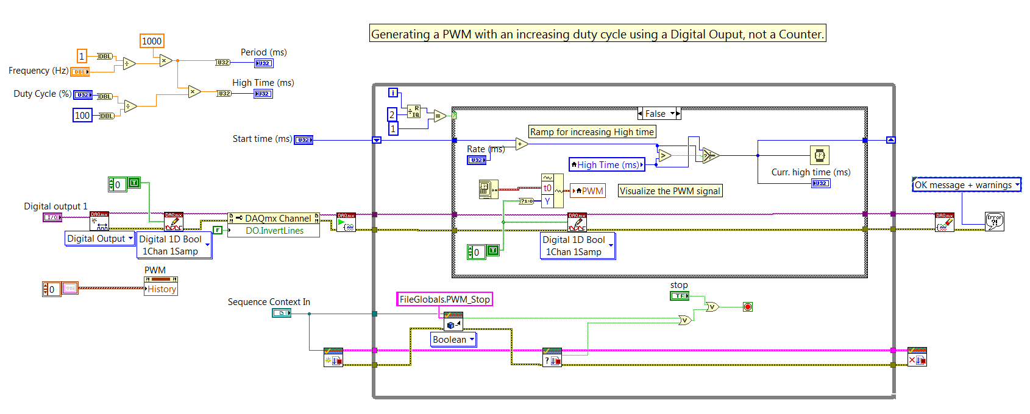
Test implementation
  LabVIEW: Interface board
  Digital outputs command
  Analog signals readout
  Digital inputs status readout
  Single PWM Generation
  Full H-Bridge PWM Generation

Slide 11
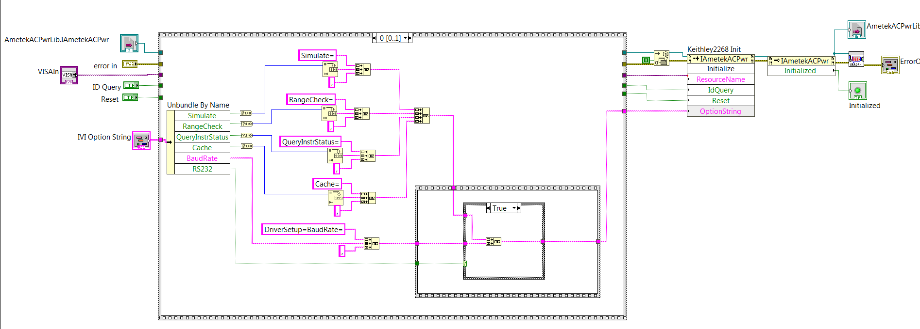
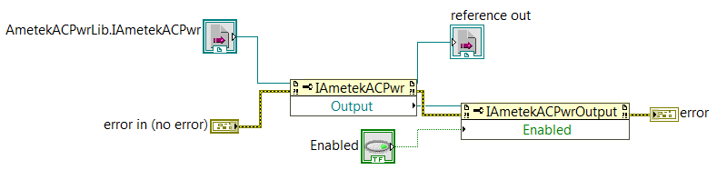
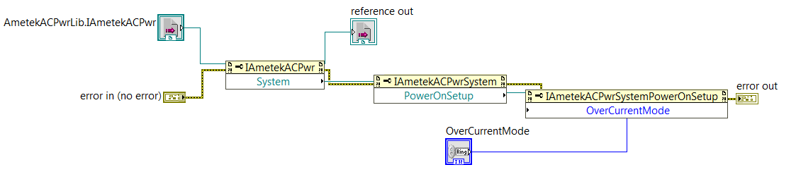
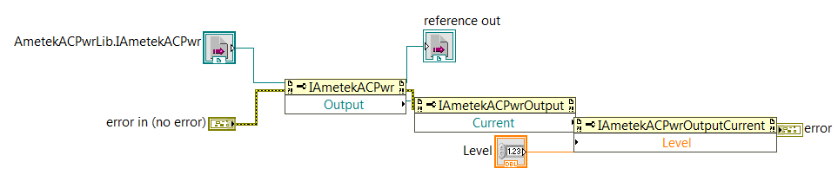
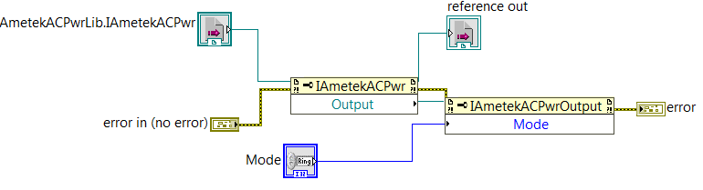
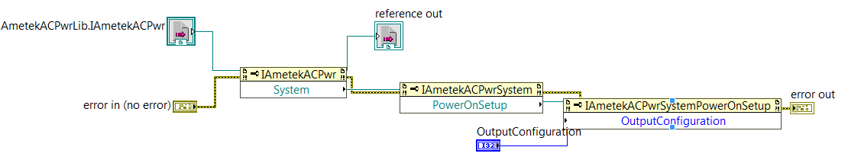
Test implementation
  LabVIEW: Power Source (ActiveX controls)
  Output activation
  Power source initialisation
  Output protection configuration
  Current level setup
  Output Voltage Mode
  Three/Single-phase configuration

Slide 12
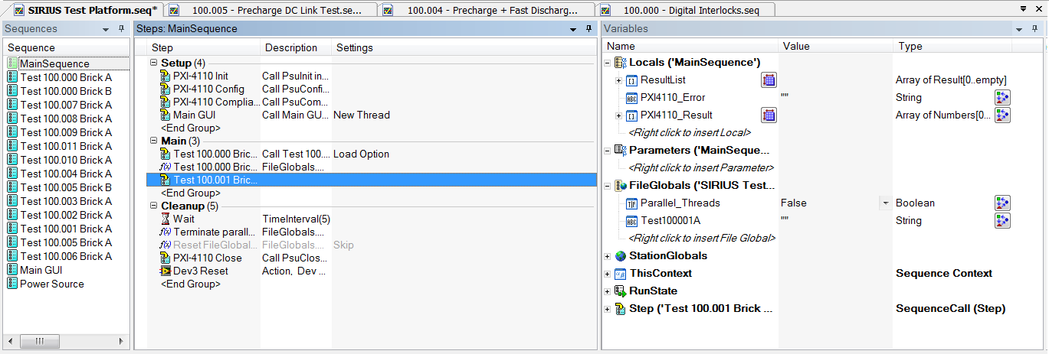
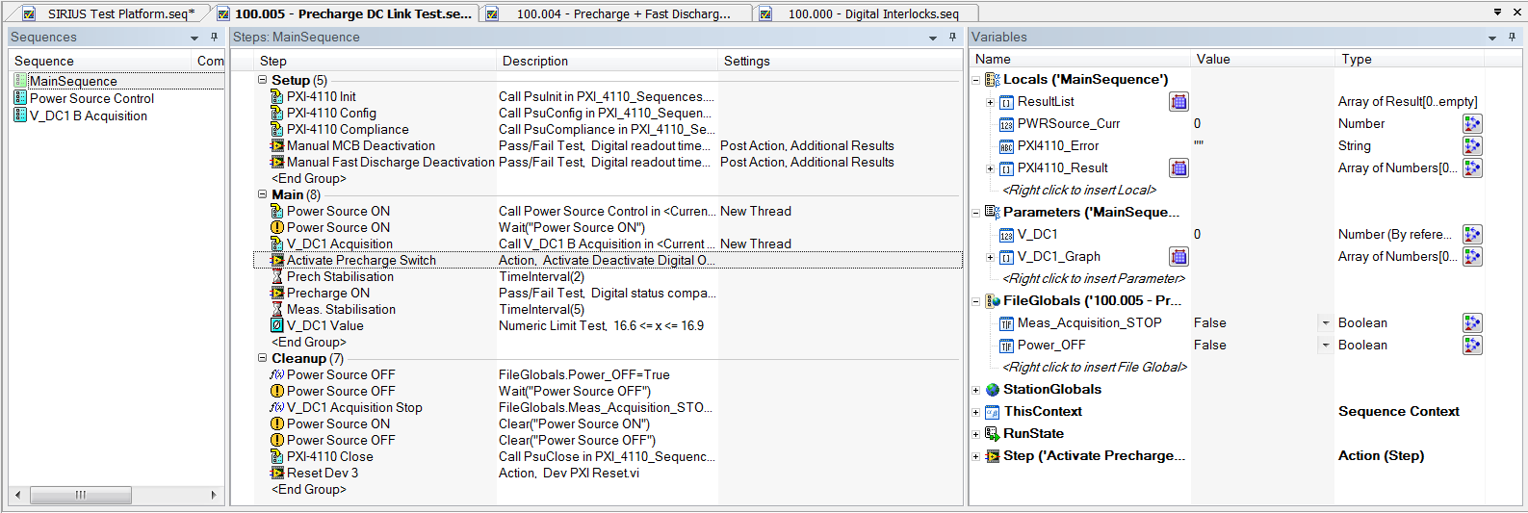
Test implementation
  TestStand
  Main sequence:
  · Main configuration
  · Calls every test.
  · Clean up.
  · Main GUI call
  Test sequences:
  · One per test.
  · Calls every VI.
  · Test GUI.

Slide 13
Conclusion
Current status
  Hardware assembled.
  Correct operation of Converter – Tester verified.
  Developing test sequences.
  Validating test platform with power converter in the workshop.
What’s next?
  Finishing the implementation and integration software.
  Preparation of the performance qualification tests.
  Factory visit and training of test personnel in Romania.
  Coordination of the teams in the test platform.

