Slide 1
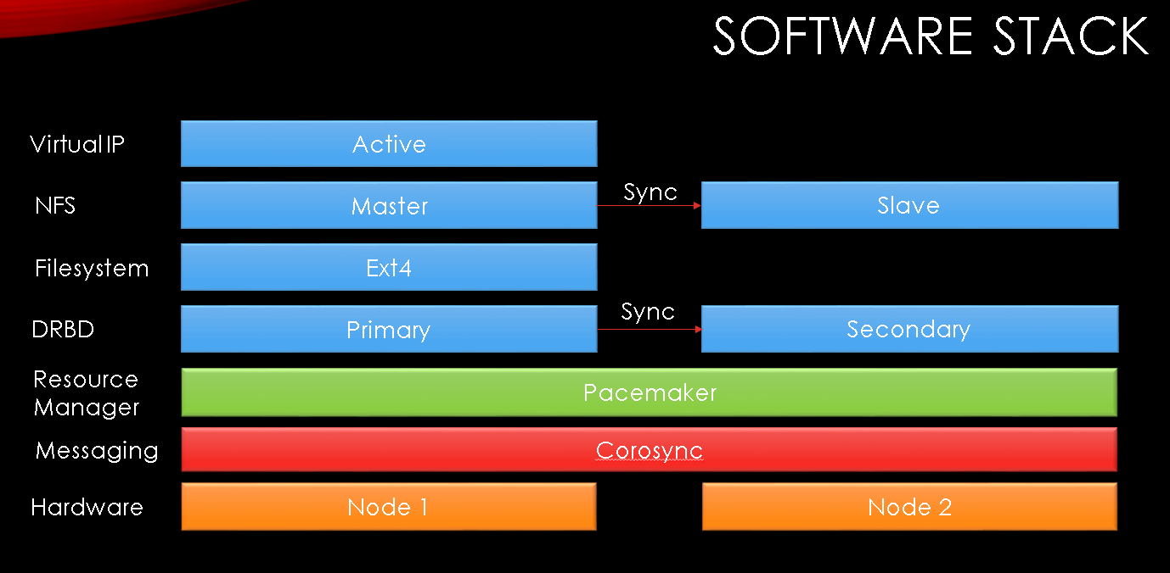







Pablo Pinés León | BEams / COntrol / INfrastructure |  | pablo.pines.leon@cern.ch
Investigate redundant network filesystem technologies for CERN's Accelerator Control System servers
4 NFS servers, one for each subsystem 4 subsystems, about 1500 computers Unavailability causes serious problems No reboots, no new boot ups Chosen solution: Pacemaker stack on Red Hat 7 2 nodes, Active-Pasive Shared virtual IP 4 nodes posible, too complex Implemented using two Ansible roles
Virtual Personal Computers and Terminal Servers service support
 |  | Over 750 virtual machines and circa 100 Terminal Servers: Software developers CERN Control Center operators 2 virtual data centers on CERN Openstack Operating Systems: Linux: Red Hat 6 / 7 Windows 7 / 10, Server 2012 / 2016 Troubleshooting and system evolution Infrastructure phasing out, monitoring
Jornada de Transferencia de Conocimiento y Tecnología para la Creación de Nuevas Actividades
Programa FTEC 2016
Málaga 15 de Febrero de 2018

Slide 2










Pablo Pinés León – pablo.pines@gmail.com
Education
2003-2008: BSc Management IT Technical Engineer 2009-2010: Erasmus - Master Informatik 2008-2012: MSc IT Engineering 2011-2012: MSc in Telematics Engineering
Experience
2012: Studentische Hilfskraft (Kassel, Germany) 2013-2014: Young Graduate Trainee (Roma, Italy) 2015-2016: Cibersecurity Engineer (Madrid, Spain) 2016-2018: Computing Engineer (Geneva, Switzerland)
Cloud Computing, Cibersecurity, Cloud Security, Networking, IT Project Management, IT Service Management, System Administration
Languages
 | English: C1 |  | German: B2 |  | French: B1
 | Italian: B2 |  | Galician: Native
Jornada de Transferencia de Conocimiento y Tecnología para la Creación de Nuevas Actividades
Programa FTEC 2016
Málaga 15 de Febrero de 2018

