Slide 1
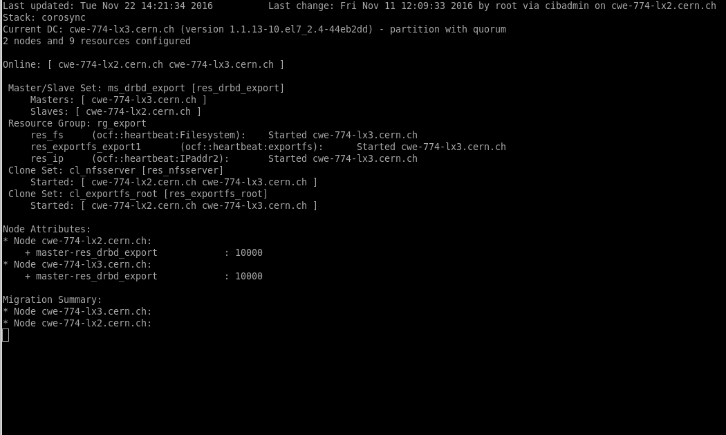
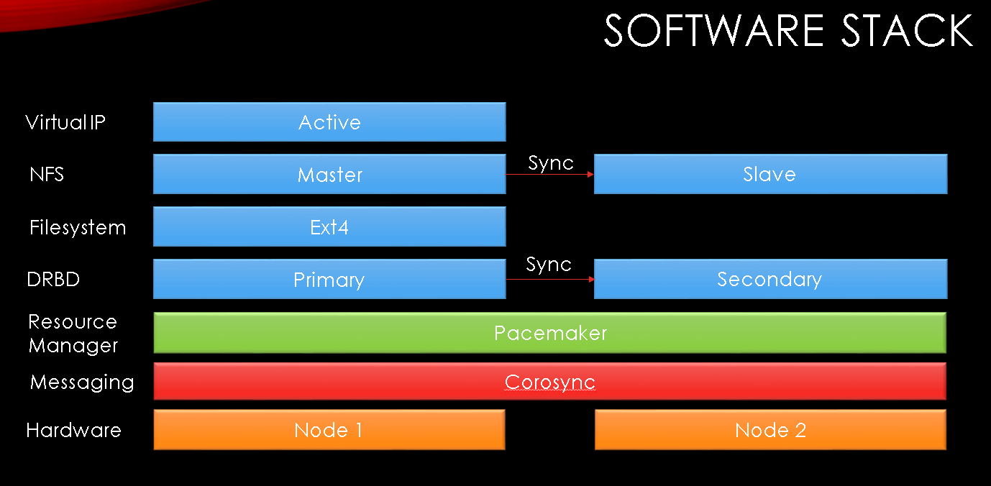


INVESTIGATE REDUNDANT NETWORK FILESYSTEM TECHNOLOGIES FOR CERN’S ACCELERATOR CONTROL SYSTEM SERVERS / VIRTUAL PERSONAL COMPUTERS AND TERMINAL SERVERS SERVICE*
Pablo Pinés León†
CERN
Abstract
This solution has been thoroughly tested on both virtual and physical (workstations) systems, and is pending, for the final testing on the availability of hardware akin to the one on which it will be implemented in the future. Two Ansible roles will be used for that, one for the installation and initial configuration, the second one for the synchronization and additional configuration.
BE-CO-IN is responsible for the infrastructure of CERN’s accelerator control servers. The Author is member of the system administrators (ACC-ADM) team, which is responsible for managing them. About 1500 of them, divided in 4 subsystems, use the NFS servers, currently there is one NFS server per subsystem. An investigation on redundant deployments for the NFS has been performed and tests with success. Additionally, hundreds of virtual machines have been created and managed for the VPC and Terminal servers service
High Availability NFS
There is currently one dedicated NFS server for each of the 4 subsystems in which CERN’s accelerator control servers have been divided. These subsystems comprise about 1500 servers that need to access the files on the NFS servers to boot up. Therefore if the NFS server of their subsystem is unavailable these servers cannot be booted up if shutdown, or rebooted if already running. Moreover, each time an NFS server goes down the procedure to get it into operational state requires a significant effort and requires restarting all the servers of the subsystem that were connected before to the NFS server.
For this reasons it has been considered that a High Availability setup would be a clear improvement with respect to the current situation. Additionally, the infrastructure could possibly be used for other services too.
The investigation started from the analysis of a previous effort with GlusterFS that didn’t deliver the expected results. Having learned some lessons different software solutions were considered, including CEPH, HA-NFS and Mars. Also, different setups were explored, such as the Active-Active solutions offered by OCFS2.
After careful investigation based on online resources it was deemed that Pacemaker would be the best choice, based on the maturity of the solution, the support from big companies such as Red Hat or Suse, and the availability of abundant documentation.
The solution chosen is based on a cluster of two nodes running CERN CentOS 7 in an Active-Passive setup. This means that one node, called Master, is actively working and receiving the requests, while the other node, called Slave, is in standby, replicating the information and ready to take over the role of the Master as soon as it is unavailable so as to ensure that there is no service disruption. They also share a virtual IP so that the clients are unaware of which server of the cluster is actually providing them the service.
An architectural view of the software stack is provided in the illustration below.
Fig 2: Screenshot of the cluster running on workstations
A 4 nodes setup was explored but discarded due to the additional complexity. It required newer versions of the software for which precompiled packages don’t exist, and the set up is much more complex because each node needs to have a direct connection to each node.
VPC and Terminal Servers support
BE-CO-IN is also responsable for the provision and support of circa 750 VMs, known as Virtual Personal Computers, and about 100 Windows Terminal Servers, for the developers in the accelerator sector, mainly in the ACC Operational Support and in the BE, TE and EN departments of CERN.
Fig 3: Distribution of all Openstack VPCs October 2017 – 730 provided
Fig 1: Architectural view of the cluster
Supported systems are both Linux and Windows. For Linux, Scientific Linux CERN 6 and CERN CentOS 7 are supported, while for Windows the supported versions are 7 and 10 for VMs and Server 2016 and 2016 for the Terminal Servers. All of them run on two virtual datacenters provided by the IT Department running on CERN’s Openstack.
The communication between the nodes is enabled by the Corosync messaging system, controlled by the resource manager, Pacemaker. The two components run on both nodes and are the actual cluster software. Pacemaker also controls DRBD, which is akin to a software RAID 1 solution, this means that it actively replicates the content of the disk on the Master node to the Slave. This disk has the Ext4 format, and the data on it is offered by the NFS service to the clients, running on both nodes and managed by Pacemaker. Finally, Pacemaker ensures that the Virtual IP resource is running on the Master node, which that way receives the NFS requests.
Conclusions
A viable software solution for a highly available setup of the NFS servers has been found, the results have been satisfying and it is foreseen that no changes or only minor adjustments on the setting would be needed for its final deployment.
Regarding the VPC and Terminal Servers support, the service continues to be provided with a high level of quality and satisfaction
  ^{FTEC Program 2016}
  †Pablo.pines.leon@cern.ch

