Slide 1
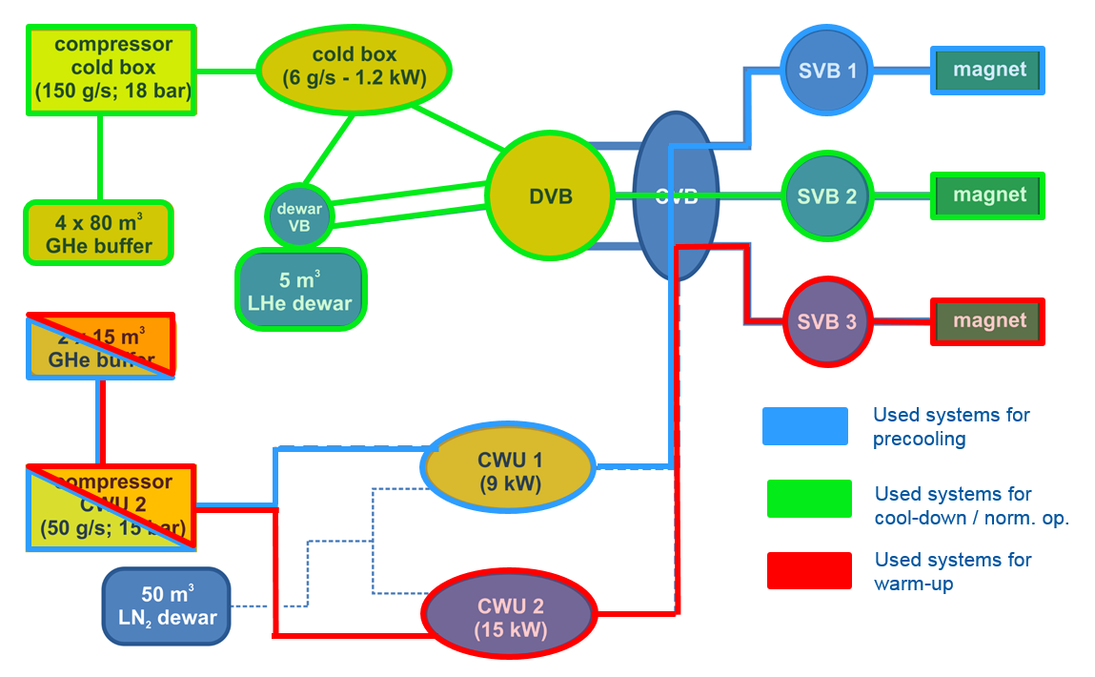
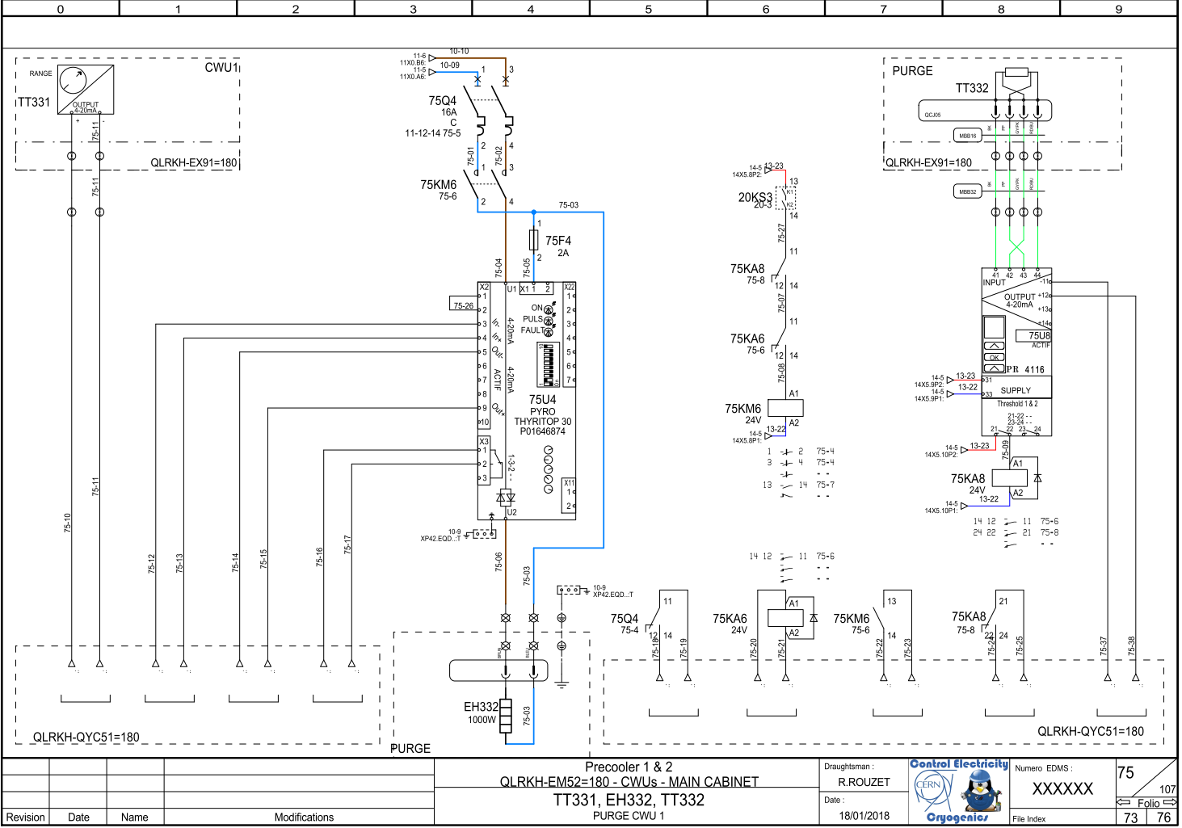
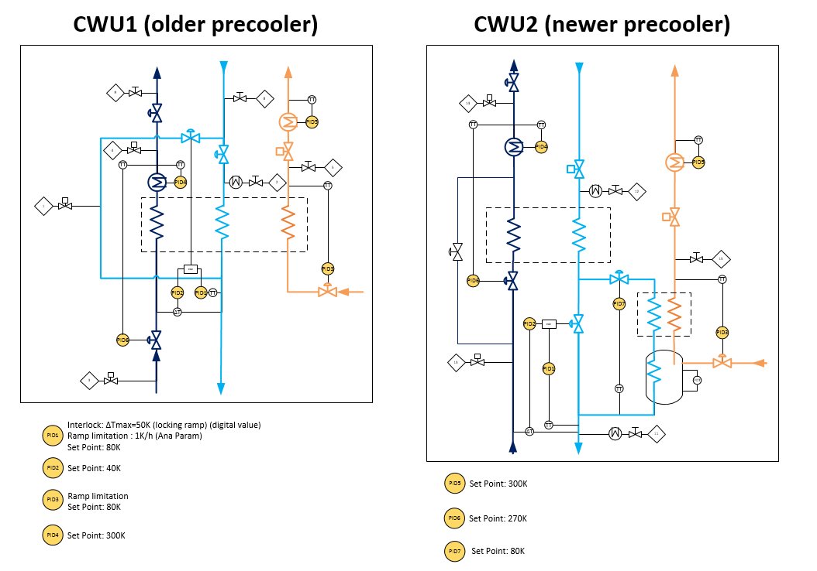
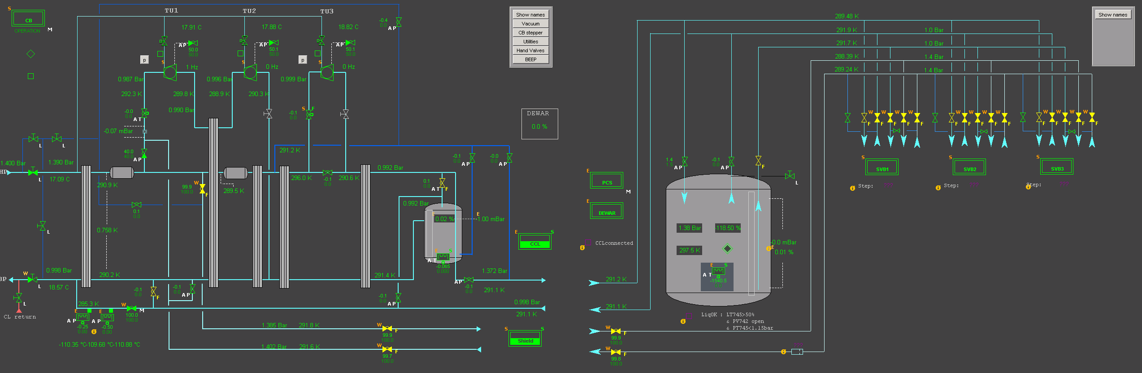


Cryogenic control system for FAIR’s Super-FRS magnets test bench
Fernando Jusdado Serrano†, Marco Pezzetti, Thomas Barbe, Benoit D'Hulster, Antonio Perin, Jan Hendrik Derking
CERN (Geneva, Switzerland)
Abstract
Test Requirements
The Super-FRS magnets of the international Facility for Antiproton and Ion Research (FAIR) being built at GSI in Germany will be tested at a new cryogenic test facility currently under construction at CERN. During nominal operation the magnets will be cooled with liquid helium to 4.5 K. Over a period of three years in total 57 magnets will be tested of three different types.
The work performed by TE-CRG-CE on this project consists on the development of the control software to fulfil the cryogenic process as well as the construction of the electrical cabinets and cabling testing of the control and measurements devices.
The facility must be able to test up to 21 magnets per year. The equipment that CERN has available for this facility provides a cooling/warming power of 15 kW and a liquefaction capacity of 5.6 g/s, thus allowing to test 7 magnet per year. In order to fulfil the requirement of 21 magnets per year it is needed three test benches working at the same time.
PLC Architecture
There are two manufacturers of PLCs involved in this project: Siemens and Schneider. The Siemens PLCs have been used for the machine protection of the two compressors (CPU 315-2) and for the magnets (CPU 317-2 PN/DP), whereas the Schenider PLCs (M580) have been used for the process of Helium liquefaction.
Electrical Diagram
Process Control
SCADA
References
[1] J. Casas-Cubillos, P.Gayet, P.Gomes, C.H.Sicard, M Pezzeti, F.J.Varas, Application of object-based industrial controls for cyogenics, EPACS, Paris, France, 2002.
[2] M. Pezzetti, V. Inglese, Revamping of the cryogenic control system for the SM18 test facility, CERN internal note, EDMS id 1077338, 2010.
^{† fernando.jusdado@cern.ch}
  FTEC 2017

