Slide 1
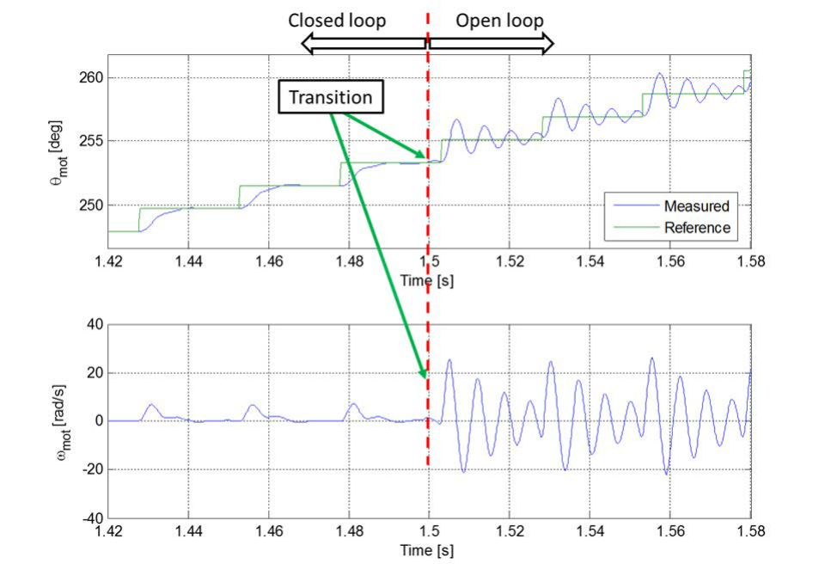
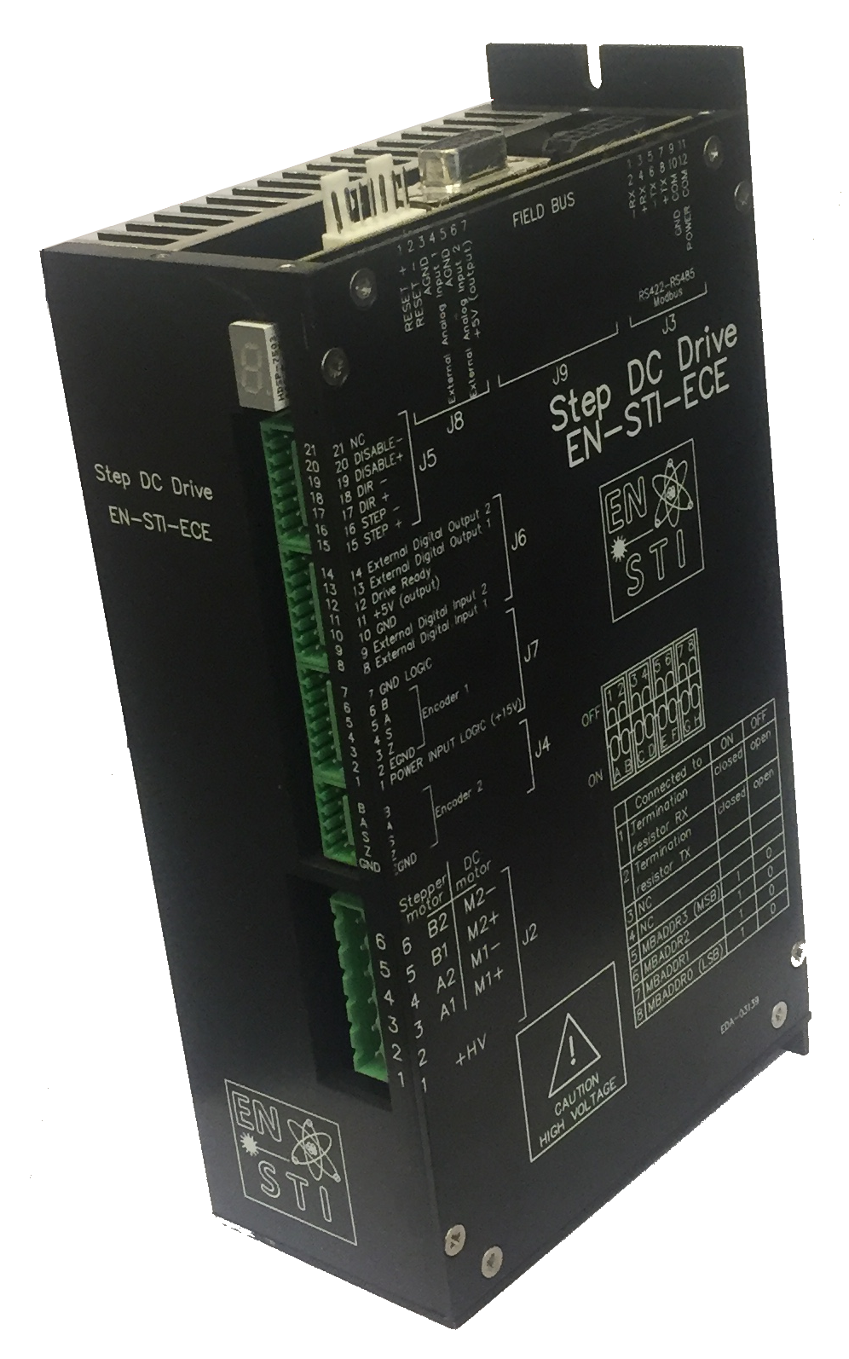
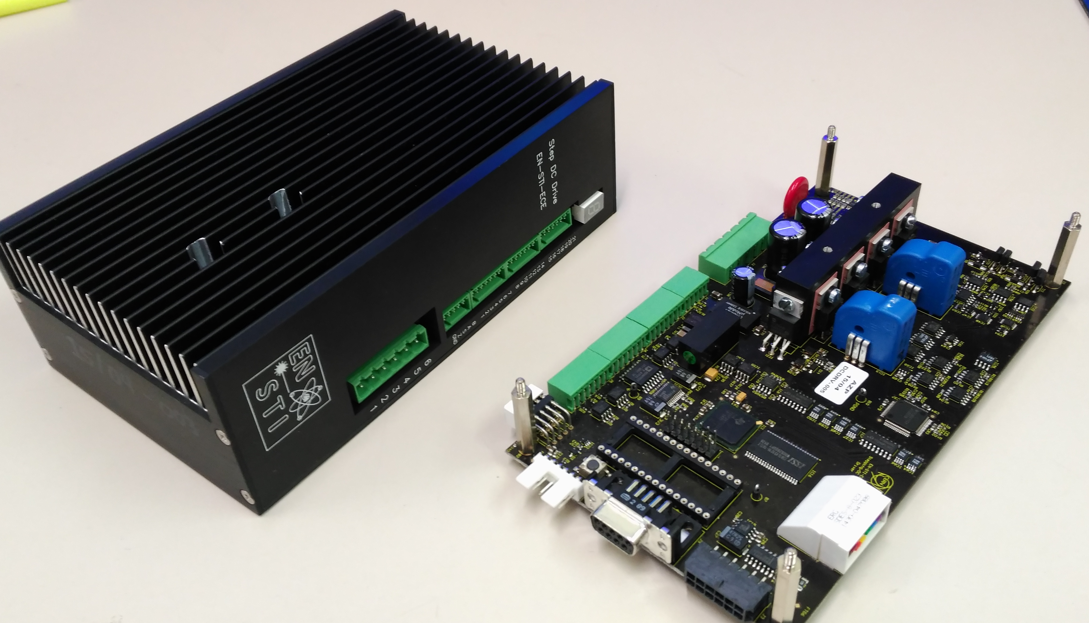
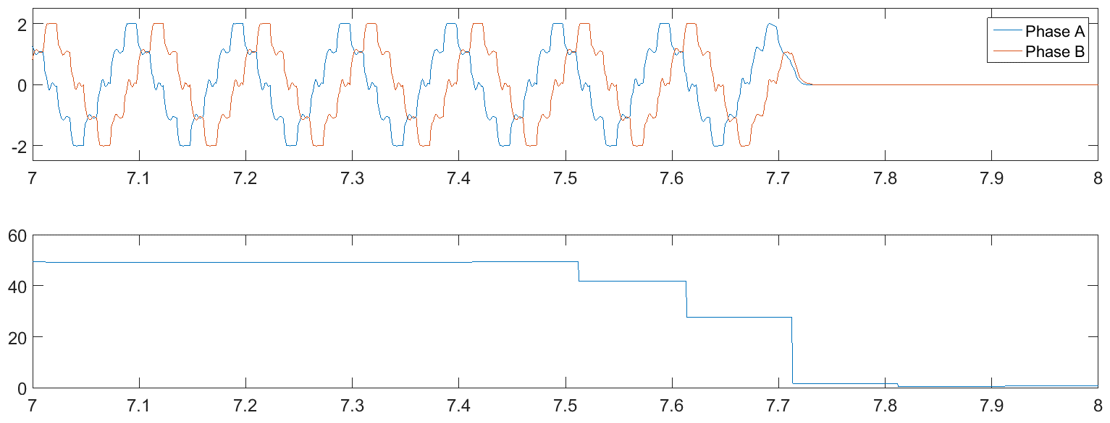
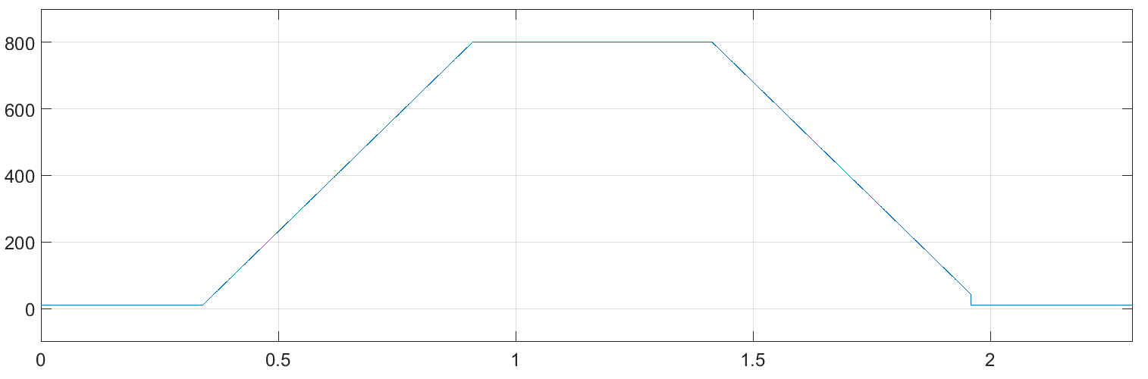
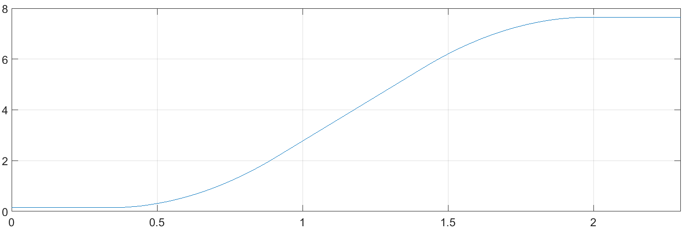


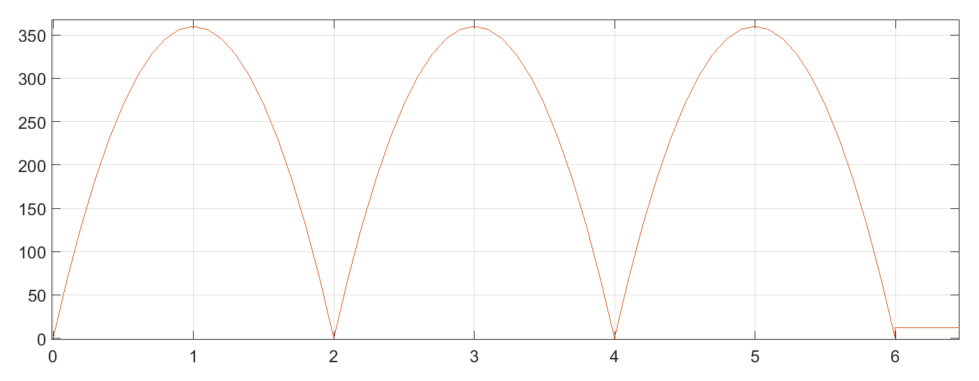





Development, implementation and deployment of a drive for electric motors in harsh environments*
Jorge Sola Merino^{12†}, Mark Butcher¹, Ricardo Picatoste Ruilope¹, Alessandro Masi¹
¹ CERN, Engineering department, STI group, Switzerland
² Ciemat, Spain
Abstract
Closed loop operation
Stepper motors are widely used for open-loop positioning applications. Highly radioactive environments lead to the use of long cables, where commercial motor drives tend to have poor performance or fail completely.
A full custom stepper motor drive has been designed to work with long cables of up to 1 km and with emphasis on reliability and self diagnostic capabilities. More features have been added to enhance the overall system performance.
The drive is capable of closed loop operation by means of an encoder signal or sensorless control, allowed by an integrated Extended Kalman Filter [2] (Fig. 2). A closed to open loop real time switch in the case of sensor failure allows for safe and seamless operation.
Introduction
When commercial stepper motors drives are connected through long cables to its motor, the current control is degraded due to the undesirable effect of transmission lines [1]. This issue has been solved by developing a DSP based custom drive (Fig. 1).
Fig 2: Transition from closed to open loop operation. Top: position, bottom: speed
Improved diagnostics
The main motor signals can be constantly monitored to predict machine degradation and perform preventive maintenance work.
A post-mortem feature allows to trace back the cause of a problem, its effects and the absolute timestamp when it happened (Fig.5).
Fig 1: Developed stepper motor drive to work with 1km cables
Trajectory planning and tracking
The drive is able to generate constant speed and constant acceleration profiles, as well as tracking any kind of motion profile, defined by an array of positions and timestamps (Fig. 3 and 4).
Measured phase currents
Current (A)
Speed (steps/sec)
Supply Voltage
Cause of error
Voltage (V)
Time (s)
Fig 5: Post mortem analysis shows power supply error
Position (turns)
Conclusions
A powerful DSP based drive has been developed to control electric motors connected through long cables. The capabilities of this drive have been extended to allow for closed loop control, safe operation, trajectory planning/tracking, autotuning and remote upgrade of firmware among many other features.
This drive can be very useful especially in harsh environments, such as nuclear plants, underwater applications, etc.
Time (s)
Fig 3: Auto generated trapezoidal speed profile
Position (deg)
References
Time (s)
[1] R. Picatoste, PhD ‘Modelling and Control of Stepper Motors for High Accuracy Positioning Systems Used in Radioactive Environments’, 2014.
[2] M. Butcher, A. Massi, M. Martino, A. Tacchetti, ‘Implementation and tuning of the Extended Kalman Filter for a sensorless drive working with arbitrary stepper motors and cable lengths’, IEEE.
Fig 4: User defined profile tracking
  *This work has been funded by CERN/Ciemat
  †[ jorgesome@hotmail.com ]

