Slide 1
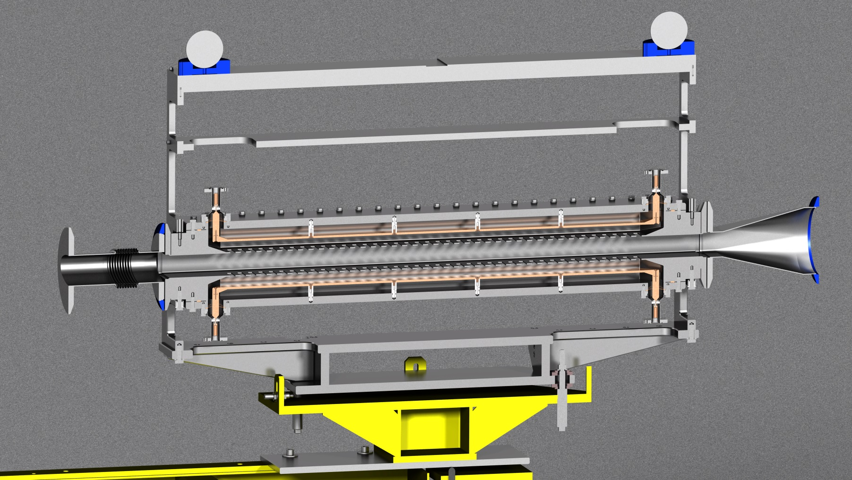
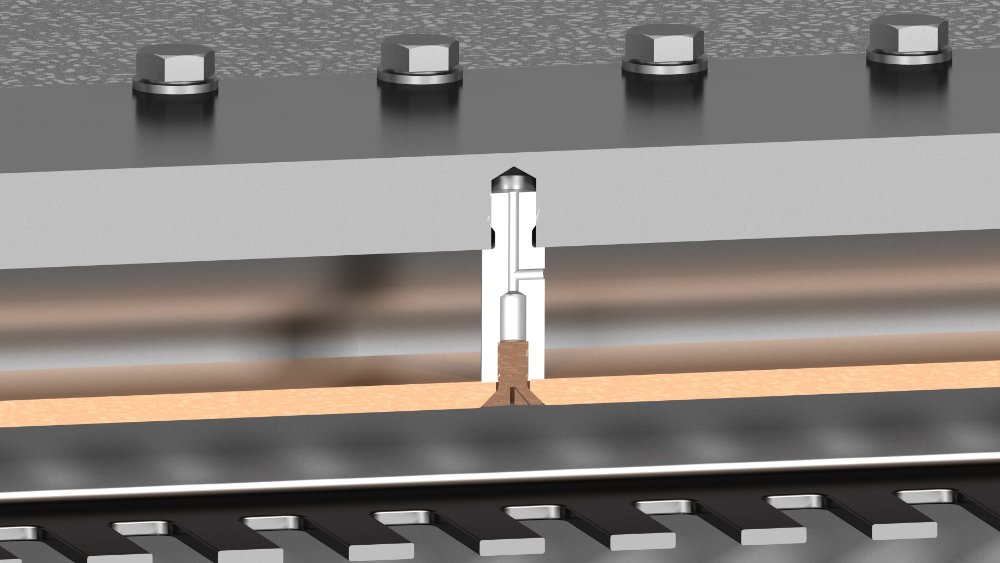
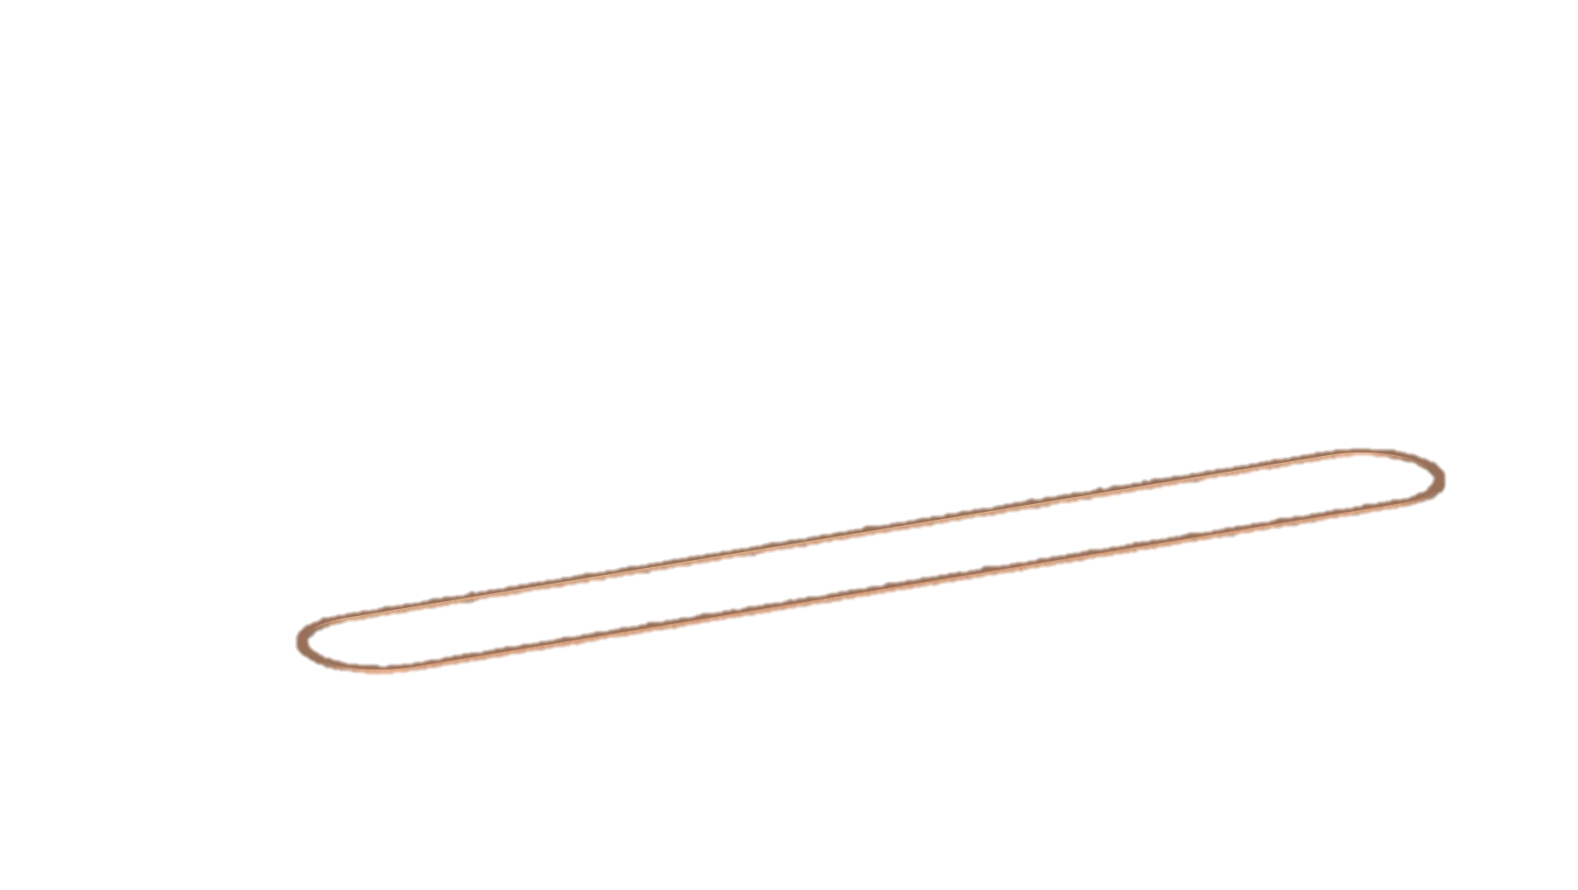
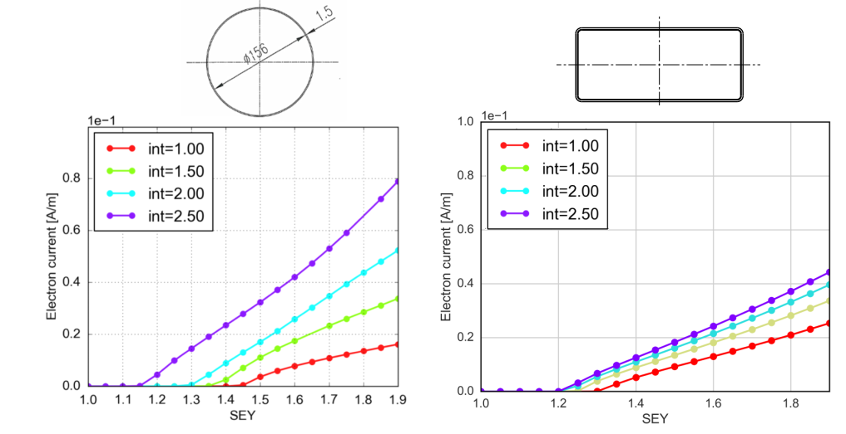
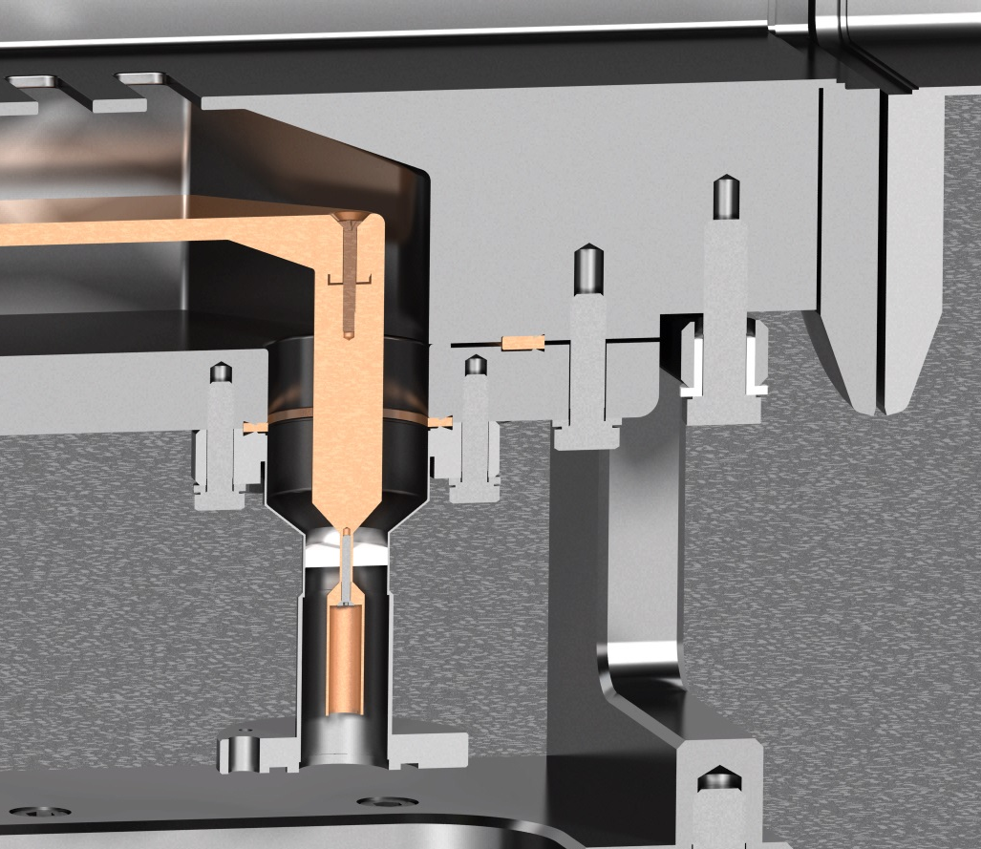
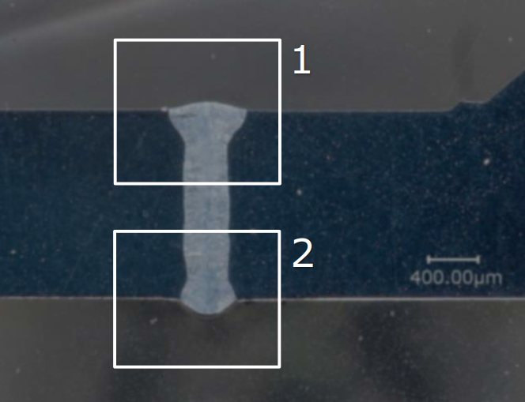
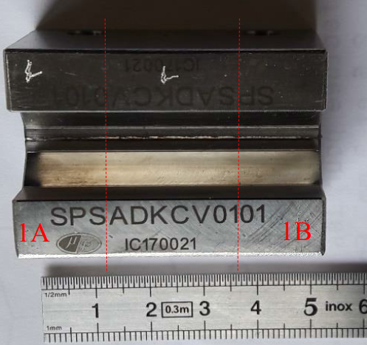
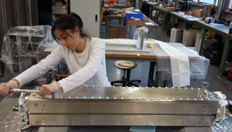
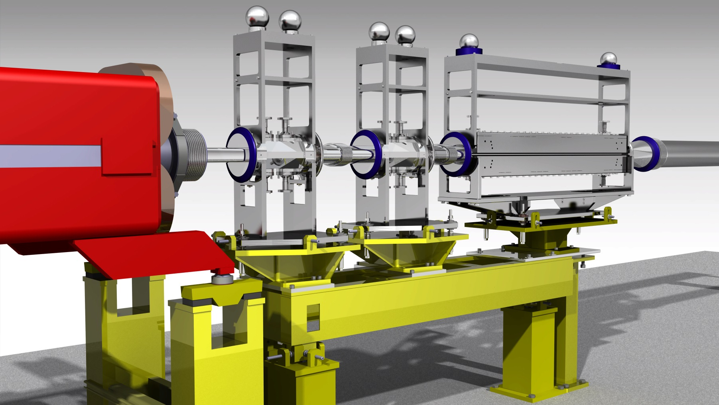
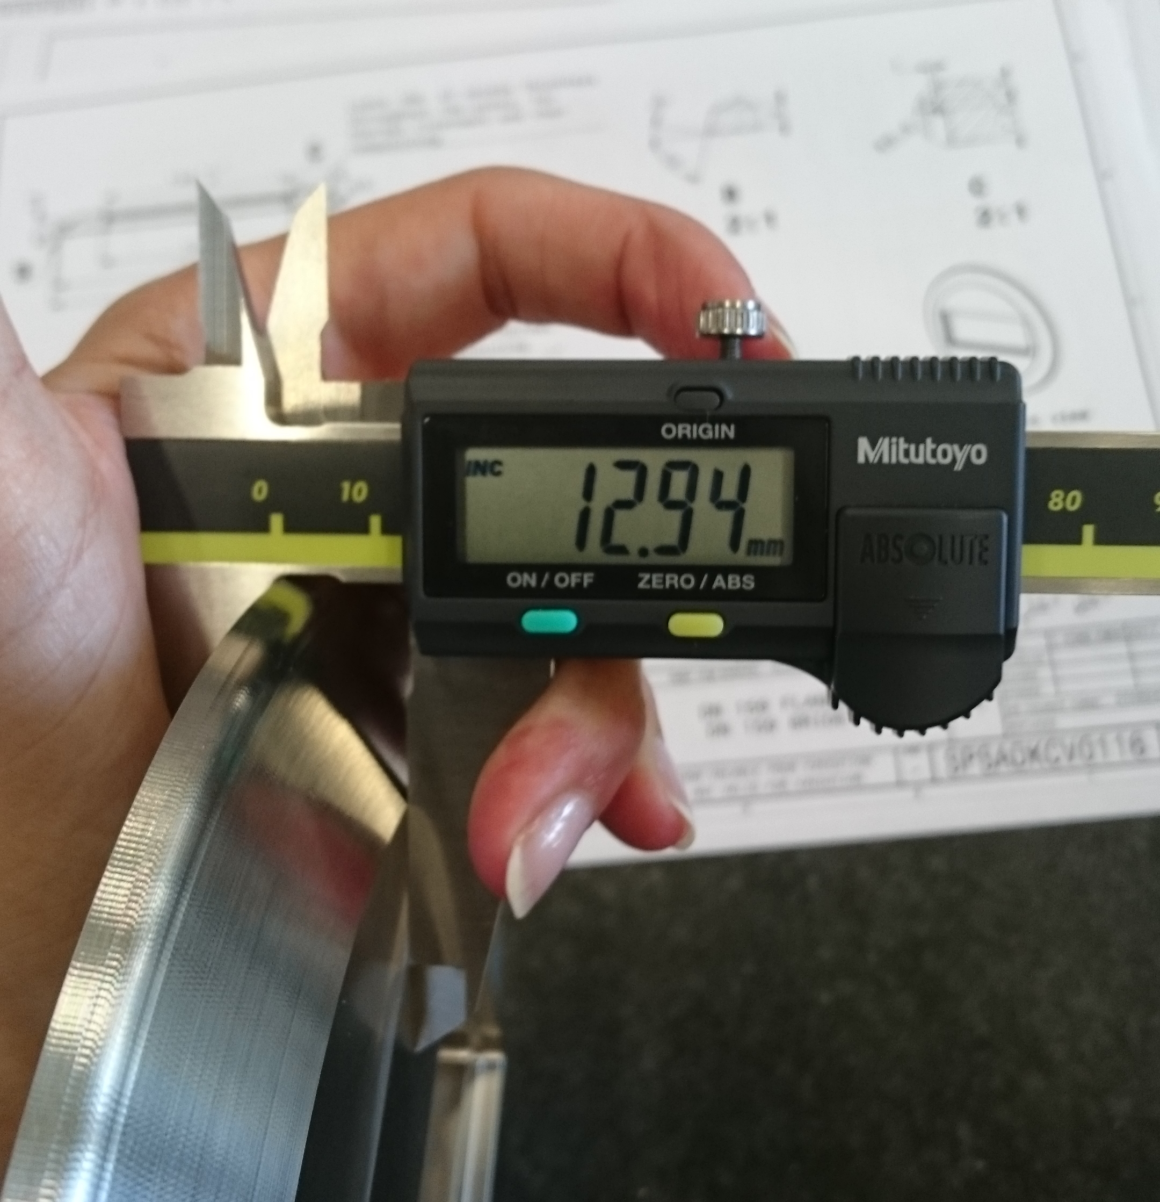
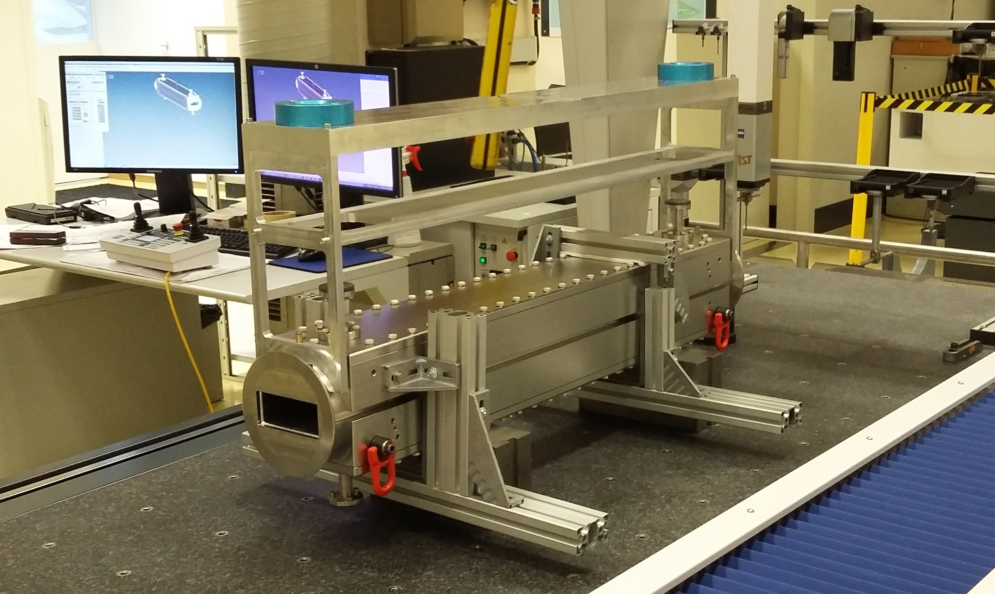
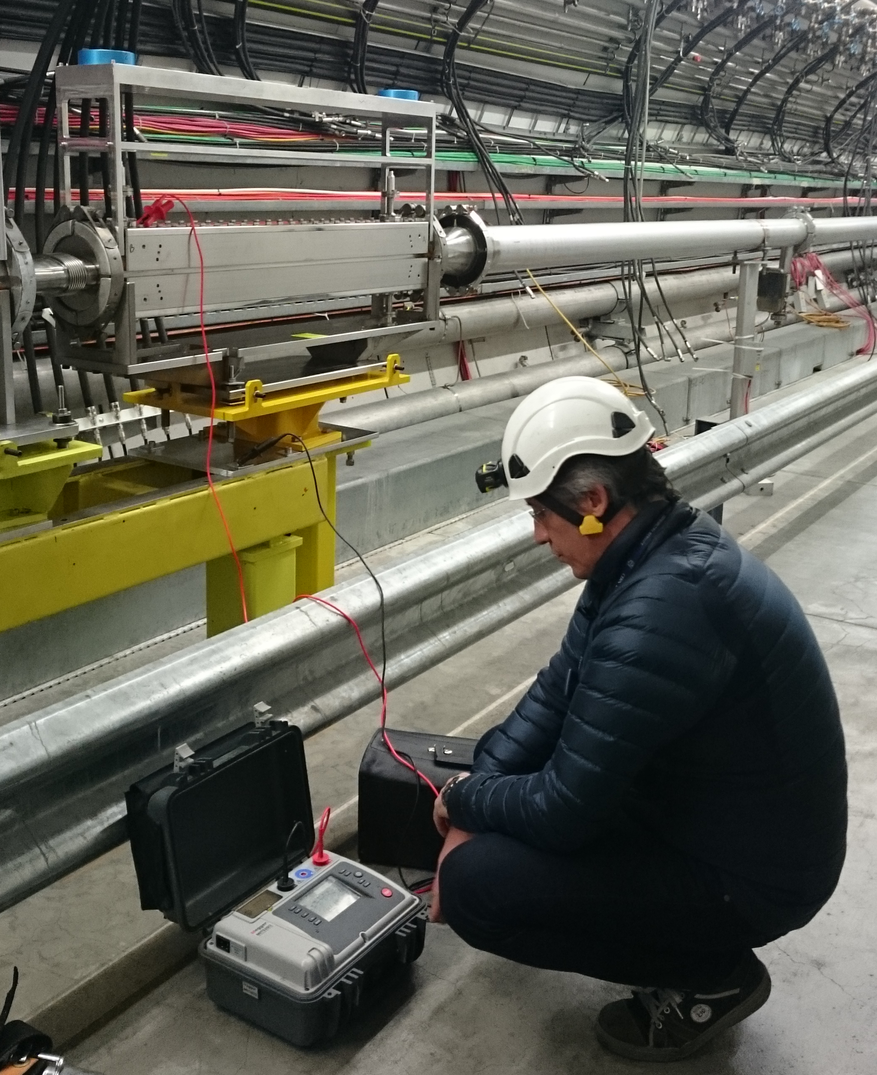
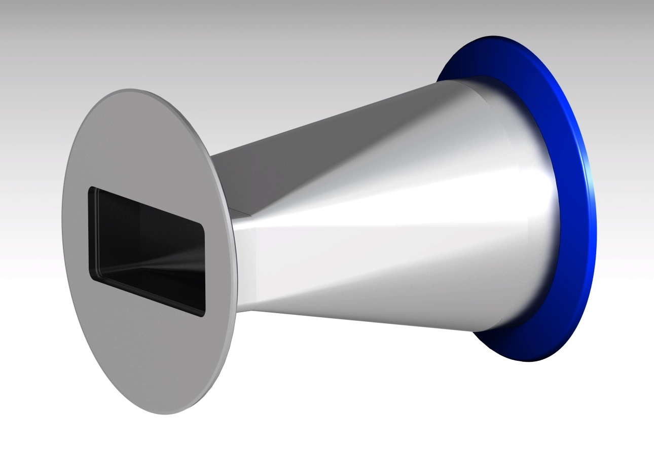
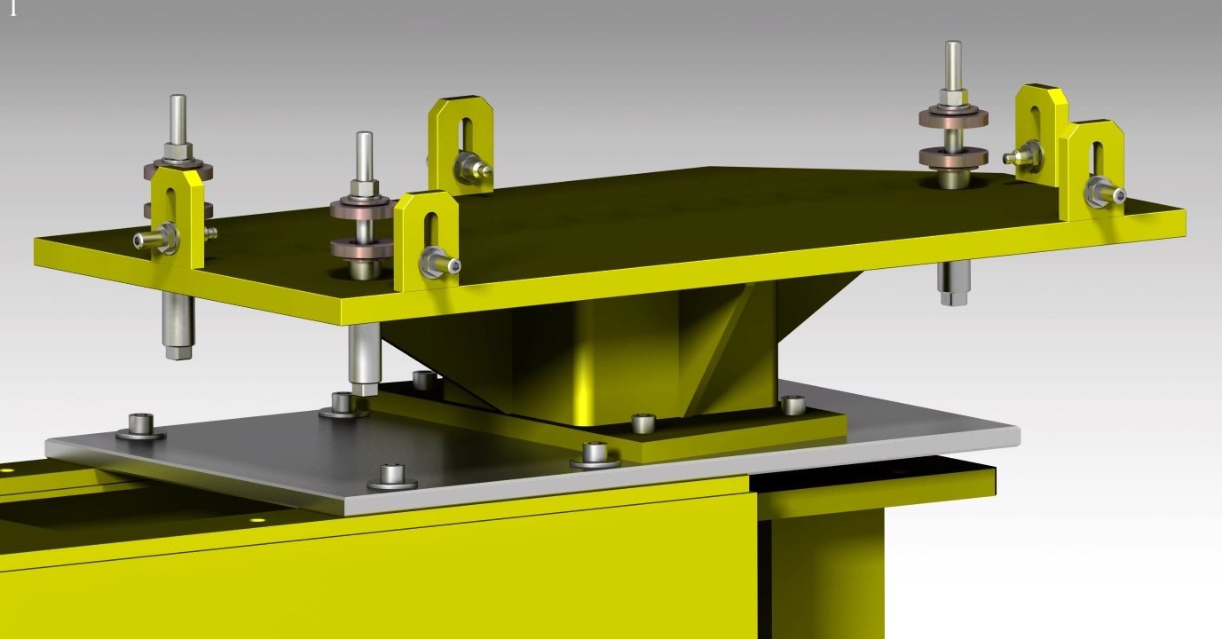
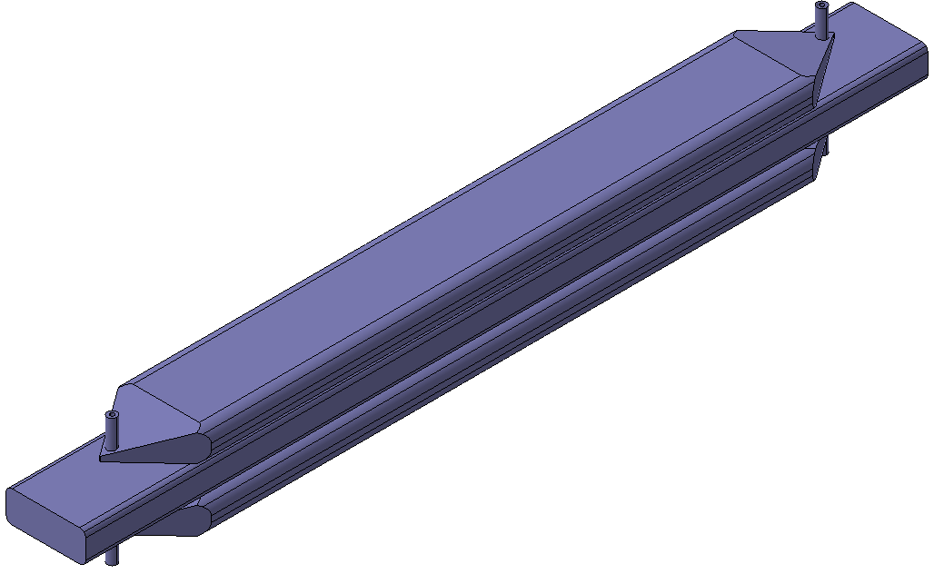
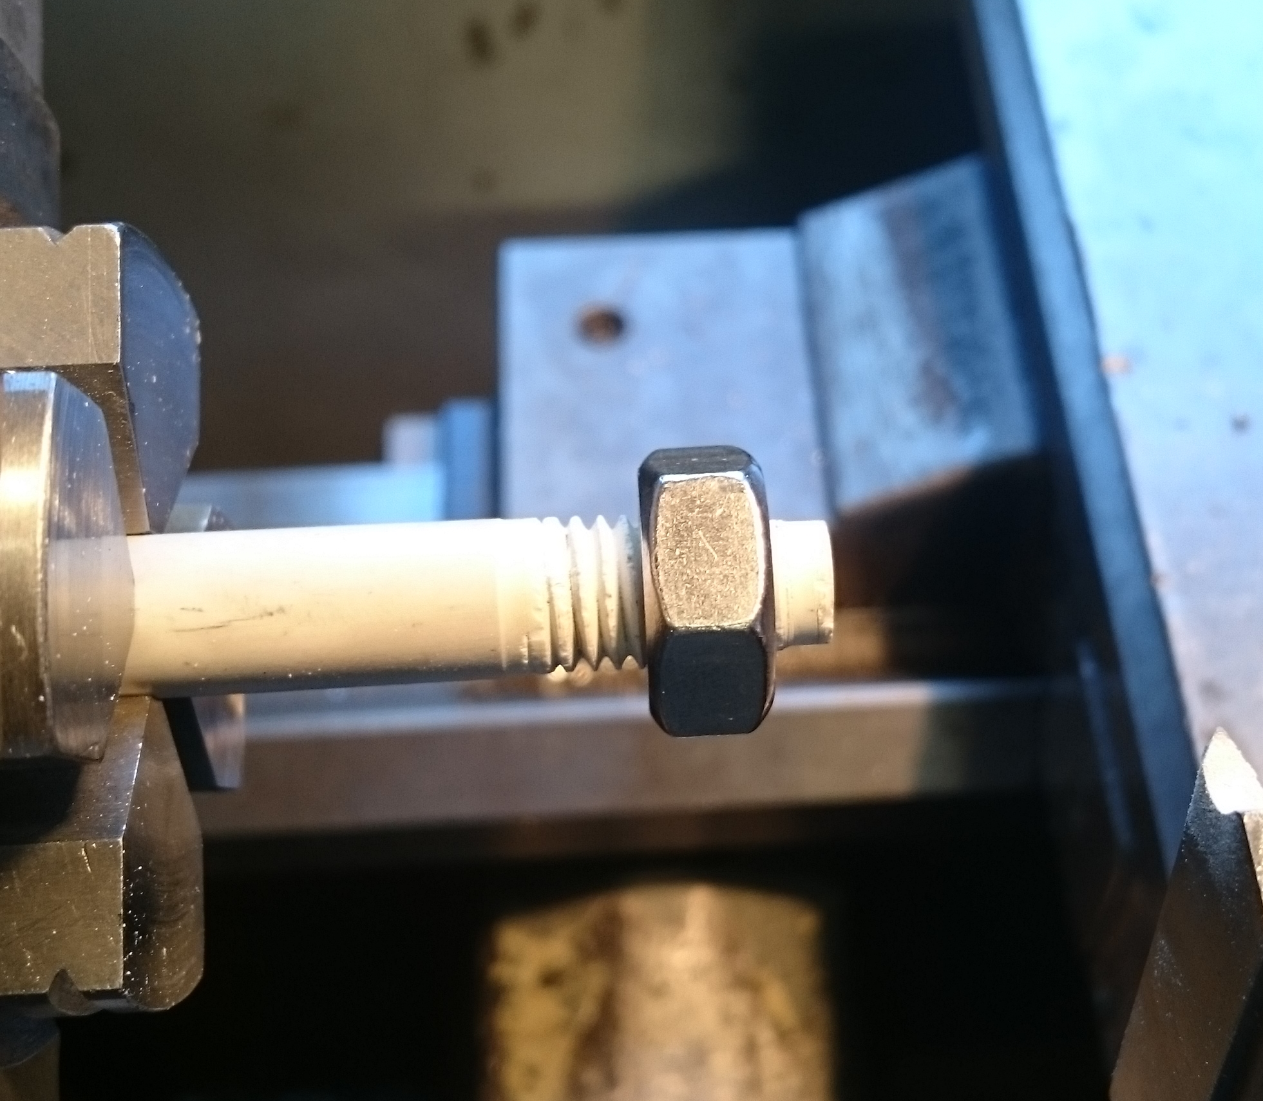
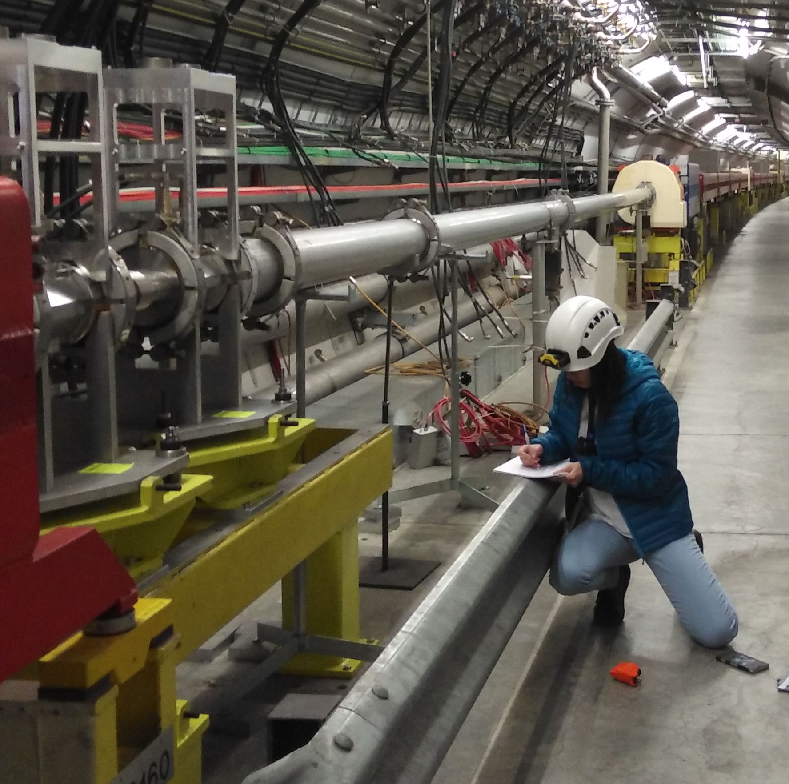


HBWD. SLOTTED LINE KICKER
J. M. Cesaratto¹, J. D. Fox¹, C. H. Rivetta¹, D. Alesini², A. Drago², A. Gallo², F. Marcellini², M. Zobov², S. DeSantis³, Z. Paret ³, A. Ratti ³, H. Qian ³, W. Hoﬂe⁴, M. Wendt ⁴, O. R. Jones ⁴, C. Zannini ⁴, A. Romano ⁴, G. Iadarola ⁴, G. Rumolo ⁴, E. Montesinos ⁴, S.J. Calvo ⁴, I. Alonso Romero^{* 4 5}.
SLAC National Accelerator Laboratory, Menlo Park, CA, USA¹; INFN-LNF, Frascati (Roma), Italy²; Lawrence Berkeley National Laboratory, Berkeley, CA, USA³; CERN, Geneva, Switzerland⁴; and FTEC Programme 16, CIEMAT, Madrid, Spain⁵.
Abstract
The update of the High-Luminosity Large Hadron Collider (HL-LHC) requires certain beam intensities in the Super Proton Synchrotron (SPS), for which it is necessary to control and mitigate the transverse beam, caused by an electron cloud (ECI), and the transverse mode coupling instability (TMCI). For this, a wideband intra-bunch feedback method has been proposed to be installed in the SPS, based on a 4 GS/s front end data acquisition and processing, and on a back end frequency response extending to at least 1 GHz.
After studying several designs, to achieve the aforementioned, the design of a slotted line kicker fulfilling the bandwidth and kick strength requirements for the SPS application has been approved.
Copper seals
Spacers Shapal™ Hi-M SOFT
Flanges
St. Steel 316LN
Bodies
St. Steel 316LN
Electrodes
CU-OFE
Feedthroughs
St. Steel 316LN and CU
Fig 1: On the left, the simulation of the initial state, and on the right, the simulation with the slotted line kicker.
Fig 6: Interior of the slotted line kicker and materials used
At first it was thought to make the body in one piece, but the tolerances (0.1mm) required along the body, led to manufacture it in two bodies (1280x190x85mm) joining them by laser welding.
Introduction
To make sure that the parameters (thickness, laser power, position with respect to the pieces, ...) used for this welding, a test was made with its corresponding report indicating results and conclusions.
The type of seal and the connection of the feedthroughs were also a reason for study. In the first case because of the dimension of the seal and the ductility of the material, and in the second case because the union between the electrode and the feedthrough should prevent a gap from occurring.
The objective of the project is the design and manufacturing of a wideband slotted kicker for the SPS in the framework of the LHC injectors upgrade (LIU).
It should be noted that the design meets the demands of the radiofrequency department, following at all times the forms, dimensions and tolerances demanded, and agreed, with respect to what is feasible in mechanical terms.
Fig 7: Laser welding tests
Bellow
Alignment system
Connector
Fig 8: Assembly of the parts
Slotted line kicker
Main support
Secondary support
Type VI support
Fig 9: Dimensional control
Fig 10: Metrological control
Fig 11: Impedance control
Auxiliary parts
Fig 2: General image
As can be seen in Figure 2, for the installation of the assembly in the SPS it was necessary to design and analyse several supports and connectors. Both for the bellow and for the connector TIG welding was used for the connection between flanges and body, one of the flanges possessing an enamel that allows the isolation.
For the correct installation, it was necessary a system for the alignment and levelling of the assembly (secondary support), and another system that could measure this levelling (alignment system). You can observe both systems in Figure 2 and 13.
In Figure 2, one can see both the assembly of the slotted line kicker, as well as other supports and auxiliary assemblies necessary for its installation.
Development
.
Fig 12: Transitional connector
Once the idea and simulation of what the radiofrequency group wanted to obtain was verified, it was studied if this idea was realizable in mechanical terms, and that means, technologies and processes would be necessary.
At the same time the materials to be used were also studied, taking into account that all will be exposed to radiation, and some will have to withstand high temperatures and humidity. In turn, the parts where the beam circulates must ensure the ultra-vacuum for a long period of time (the materials of the main pieces are indicated in Figure 6.
Fig 13: Secondary support
Conclusions
Regarding mechanical engineering, the prototype did not need any design modification or any re-machining, so it could be installed in the SPS in the established time, to study the performance of the beam after its incorporation.
Fig 3: Initial idea
References
[1]http://accelconf.web.cern.ch/AccelConf/ipac2017/papers/tupik053.pdf
[2]https://www.researchgate.net/profile/Mikhail_Zobov/publication/273315129_Poster_A_Wideband_Slotted_Kicker_Design_for_SPS_Transverse_Intra-Bunch_Feedback/data/54fda5e10cf2c3f524254525/WEPME061-Poster.pd
[3]http://www.slac.stanford.edu/pubs/slacreports/reports18/slac-r-1037.pdf
Fig 4: Test with Shapal™ Hi-M soft
Fig 5: Checking dimensions
  This work has been funded by CERN
  *[irene.alonso.romero@cern.ch]
  [ir.alonso.r@gmail.com]

