Slide 1
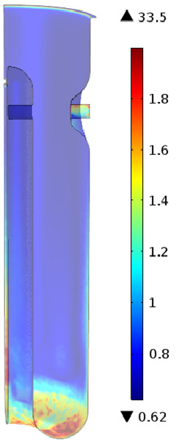
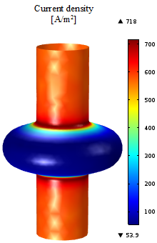
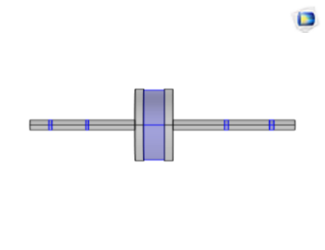
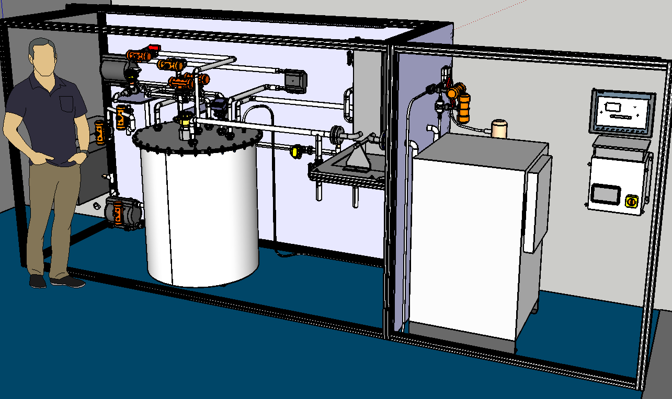
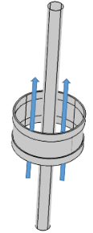
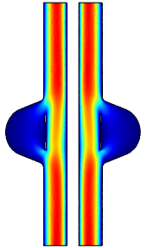





R&D OF SURFACE FINISHING IN SUPERCONDUCTING RF CAVITIES
Alejandra Pérez Rodríguez
Technology department– Vacuum group- Surfaces, coatings and chemistry section
Characterisation of the surface treatment used in the processing of HIE-ISOLDE cavities
Results achieved
Identification of a correlation between the etching rate and a fluid dynamic parameter:
Optimisation of the current process.
Design of an installation of electrochemical polishing
Process optimisation
Foresee the quantity of material removed
Cavity processing with the best technological process available (Electropolishing) to fulfil particle acceleration requirements.
Supply data for the Future Circullar Collider (FCC) study.
Energía cinética de turbulencia [m²/s² ]
Work performed
Optimisation of the tool geometry used in the chemical polishing and definition of the working conditions.
Performance of fluid dynamic and electrochemical simulations.
Definition and optimisation of the tools used in the surface treatments.
Project coordination.
Definition of the hydraulic circuit and dimensioning of the main equipment.
Creation of Technical specifications for the control system and facility assembly.
Generation of the documentation related to machine safety ( risk analysis, measures to put in place, etc.)
X
Complete facility definition and equipment purchasing.
Coordination of the facility assembly at CERN.
Jornada de Transferencia de Conocimiento y Tecnología para la Creación de Nuevas Actividades
Programa FTEC 2016
Málaga 15 de Febrero de 2018
Alejandra Pérez Rodríguez
alejandra90pr@gmail.com

Slide 2
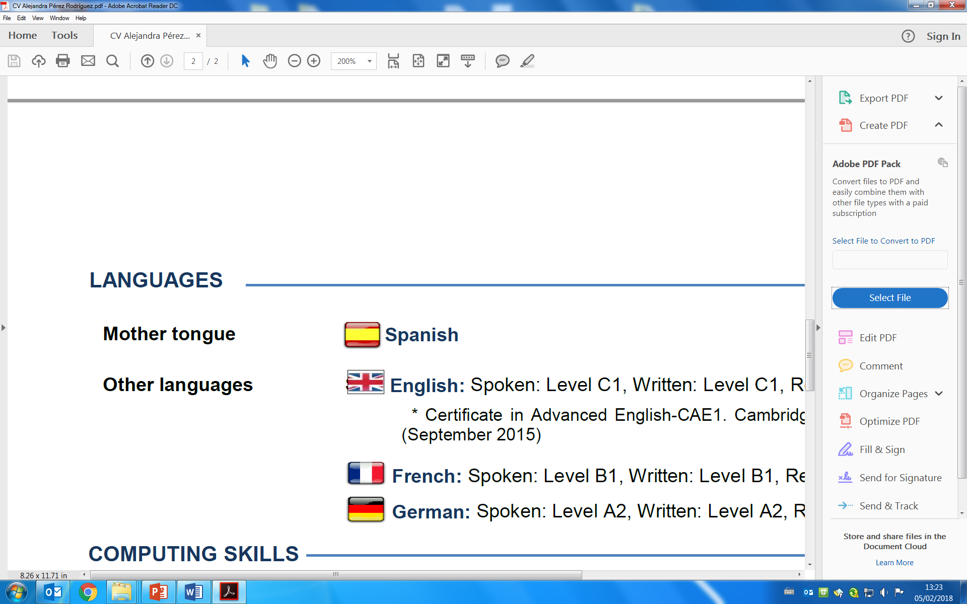
PROFESIONAL MOTIVATION
Education
Languages
2011-2014 MSc Industrial Engineering, specialized in power and fluids engineering (University of Oviedo)
2008-2011 BSc Industrial Chemistry Engineering Intensified on Environmental Technology (University of Oviedo)
Jun. 2016- Present Industrial Engineer at CERNT. FTEC program, Geneva (Switzerland)
Sept. 2015- May. 2016 R&D Engineer in the department of patterned glass products development, Saint-Gobain, Avilés (Asturias)
Nov. 2014-Ago. 2015 Engineer in the department of Energy Saving and Efficiency in the Industry (Institute for the Diversification and Saving of Energy), Madrid
Mother tongue
Level C1
Level B2
Level A2
Work experience
Computing skills
• Microsoft Office
• COMSOL Multiphysics
• SolidWorks
• AutoCAD
• Visio
• SketchUp
• Matlab
International character
R&D
Profesional developement
Process optimisation
Goals achievement
Team work
New challenges
Industrial field
Jornada de Transferencia de Conocimiento y Tecnología para la Creación de Nuevas Actividades
Programa FTEC 2016
Málaga 15 de Febrero de 2018
Alejandra Pérez Rodríguez
alejandra90pr@gmail.com

