Slide 1
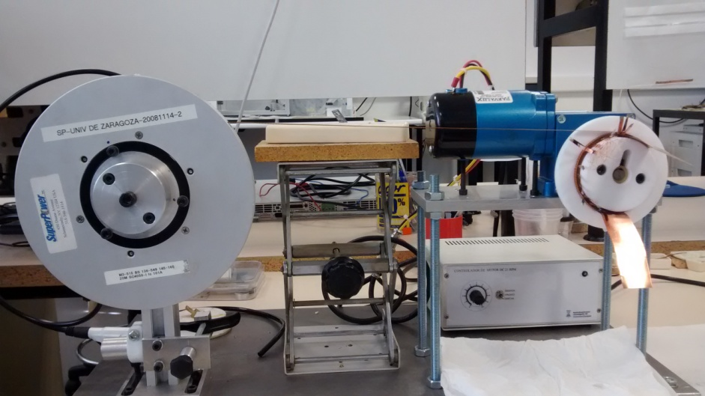
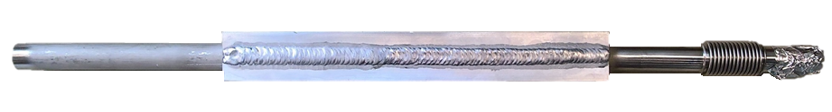

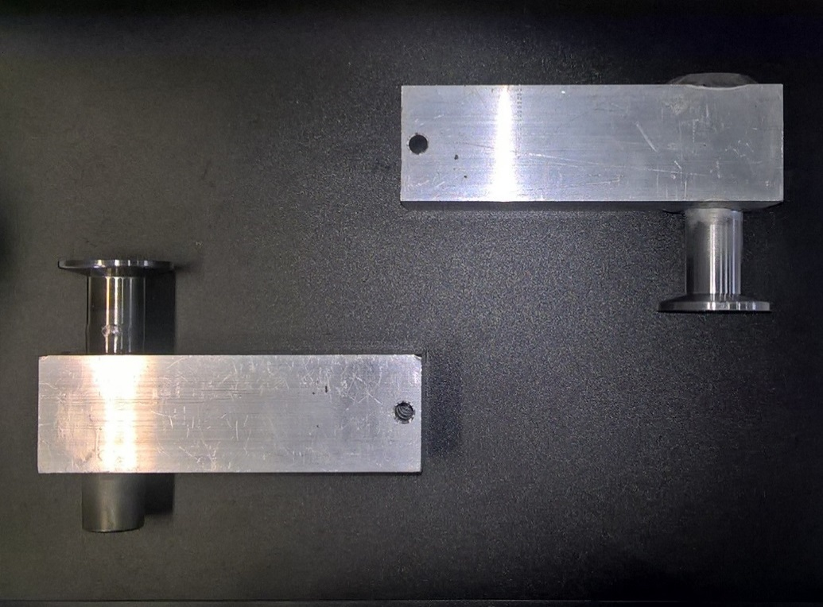
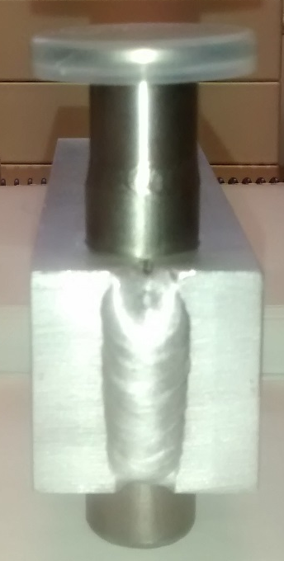
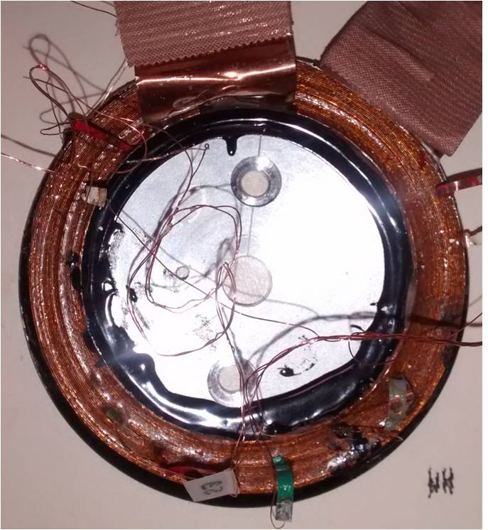
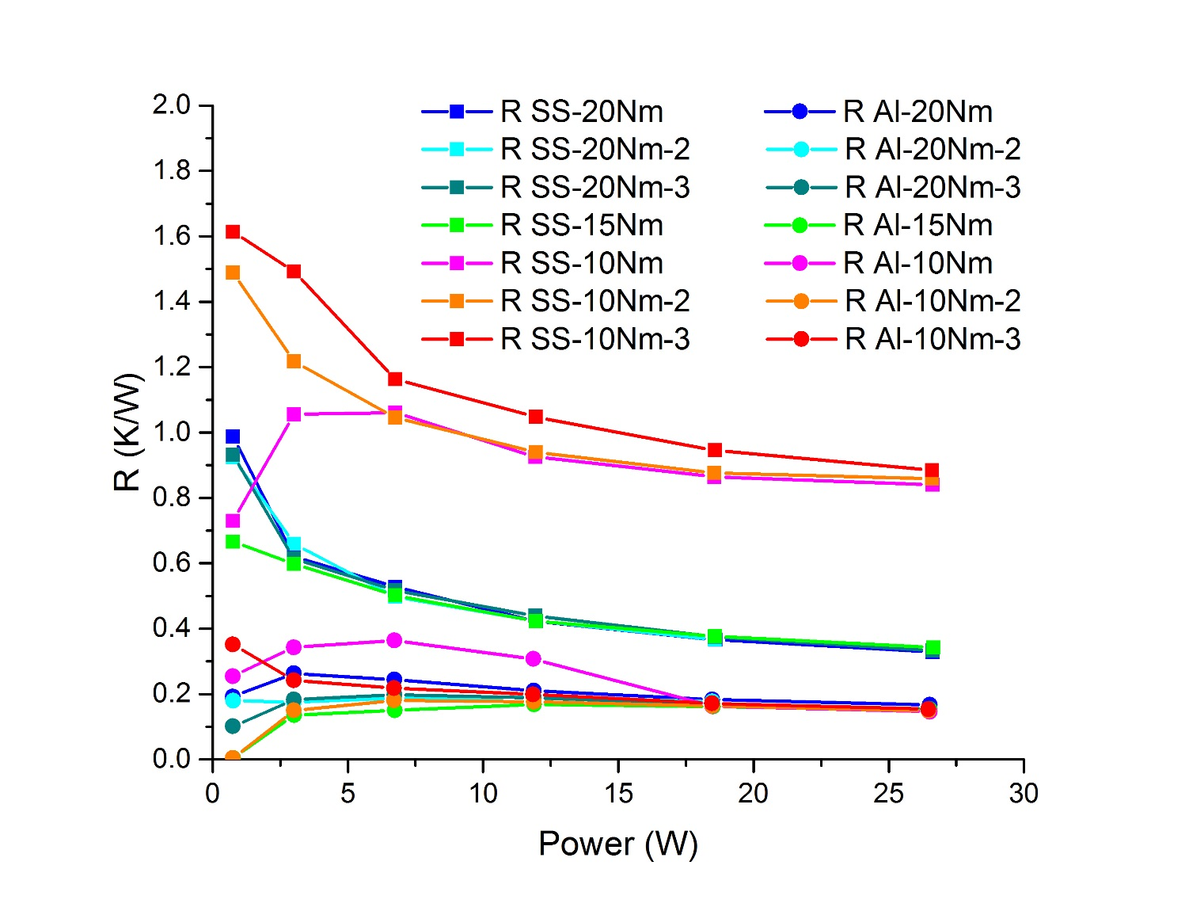
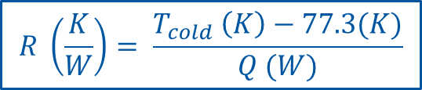
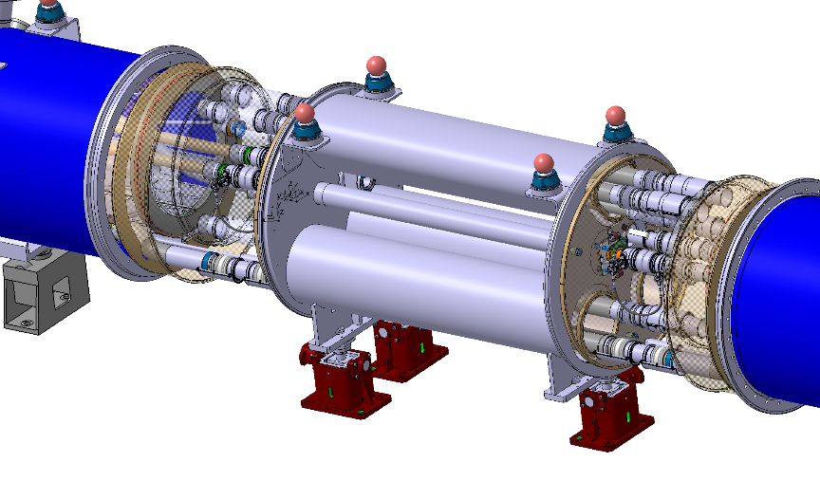
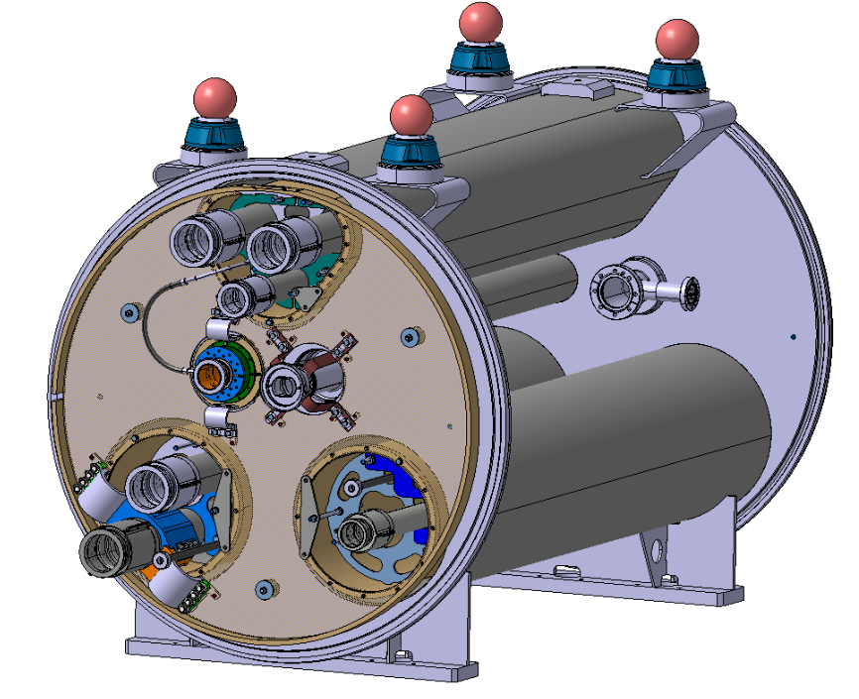
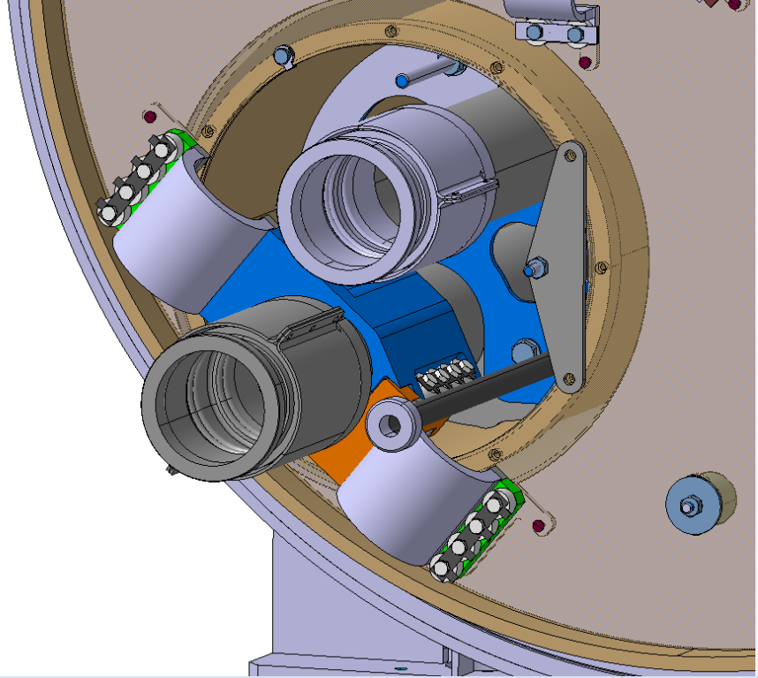
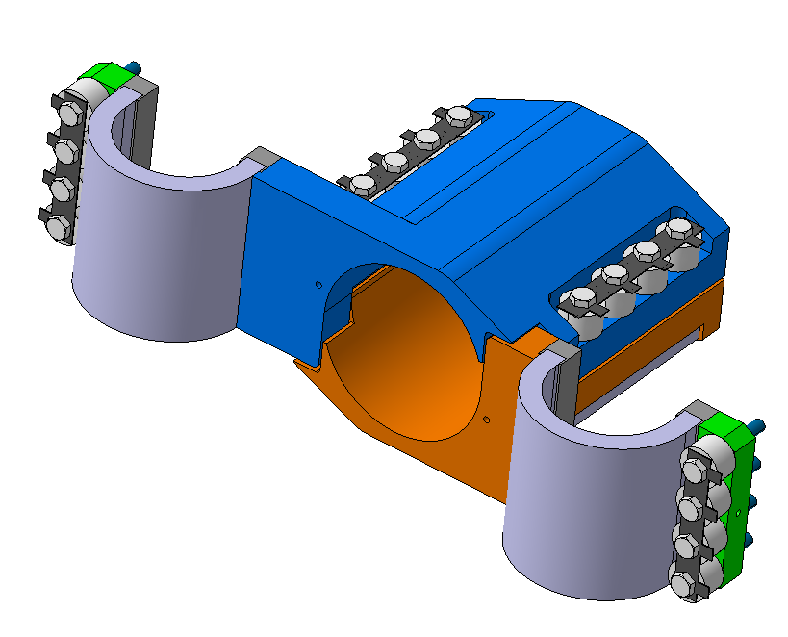
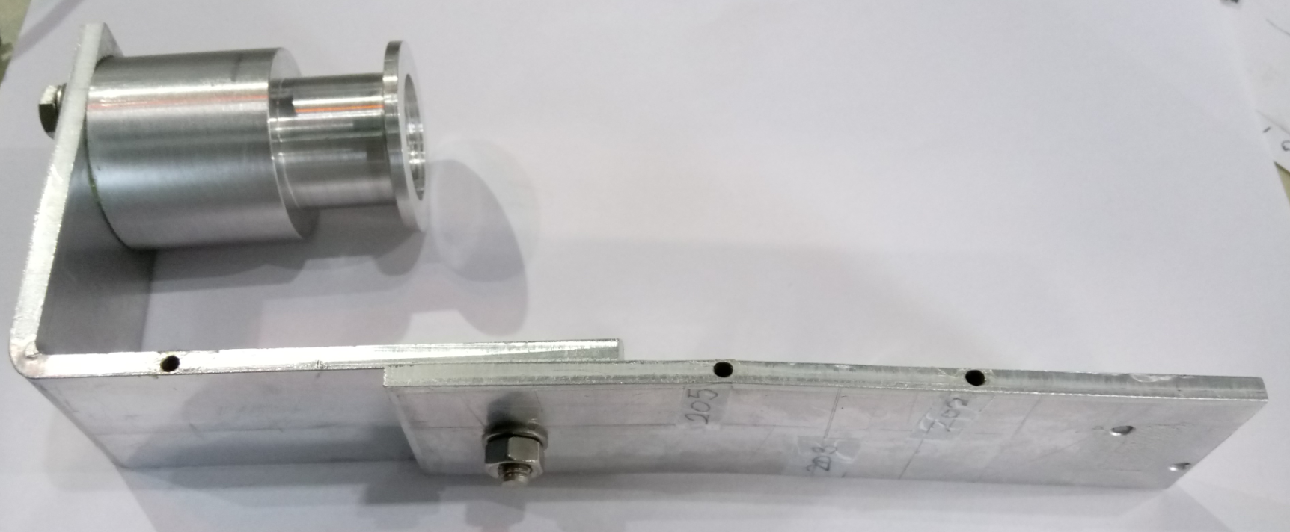
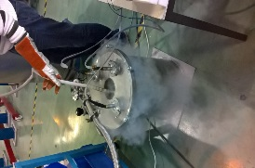
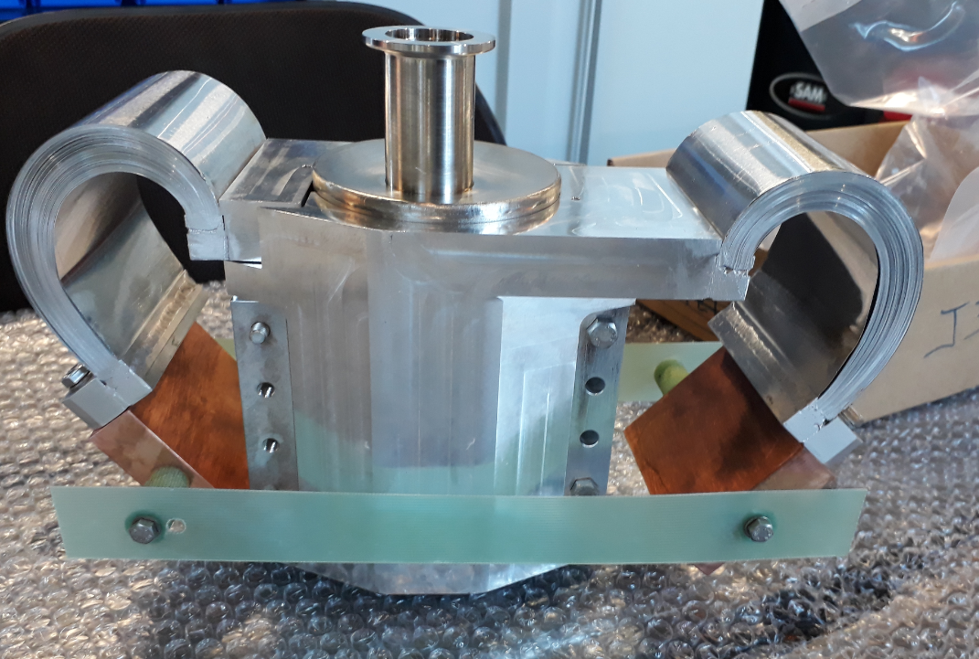
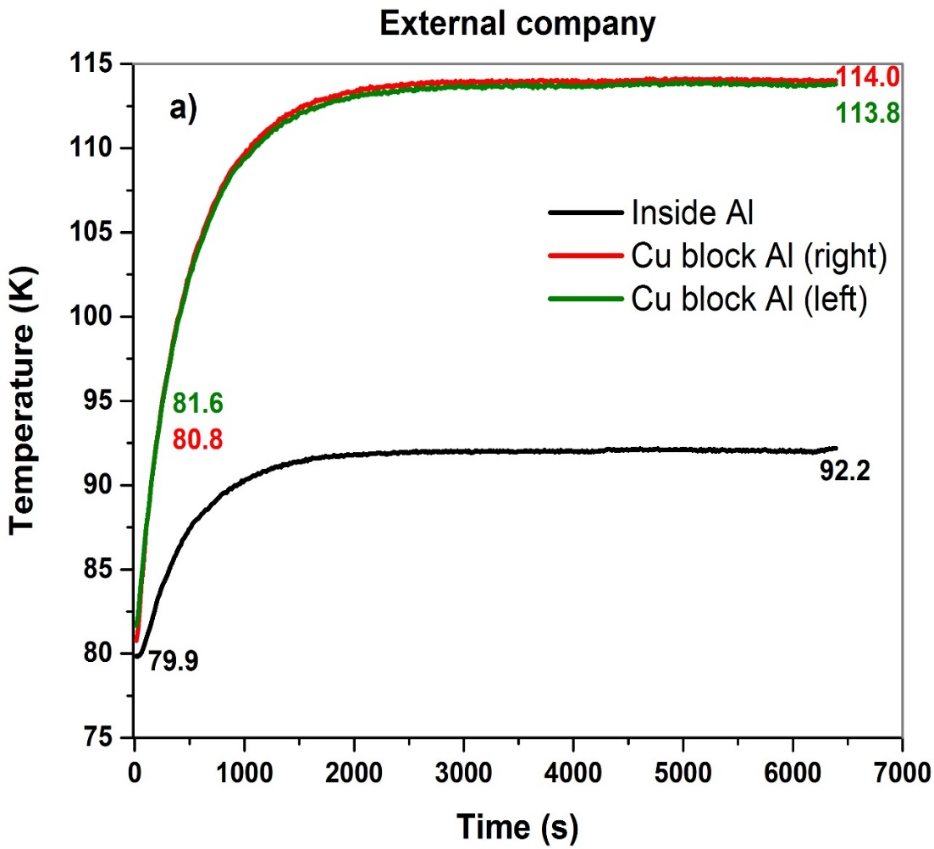
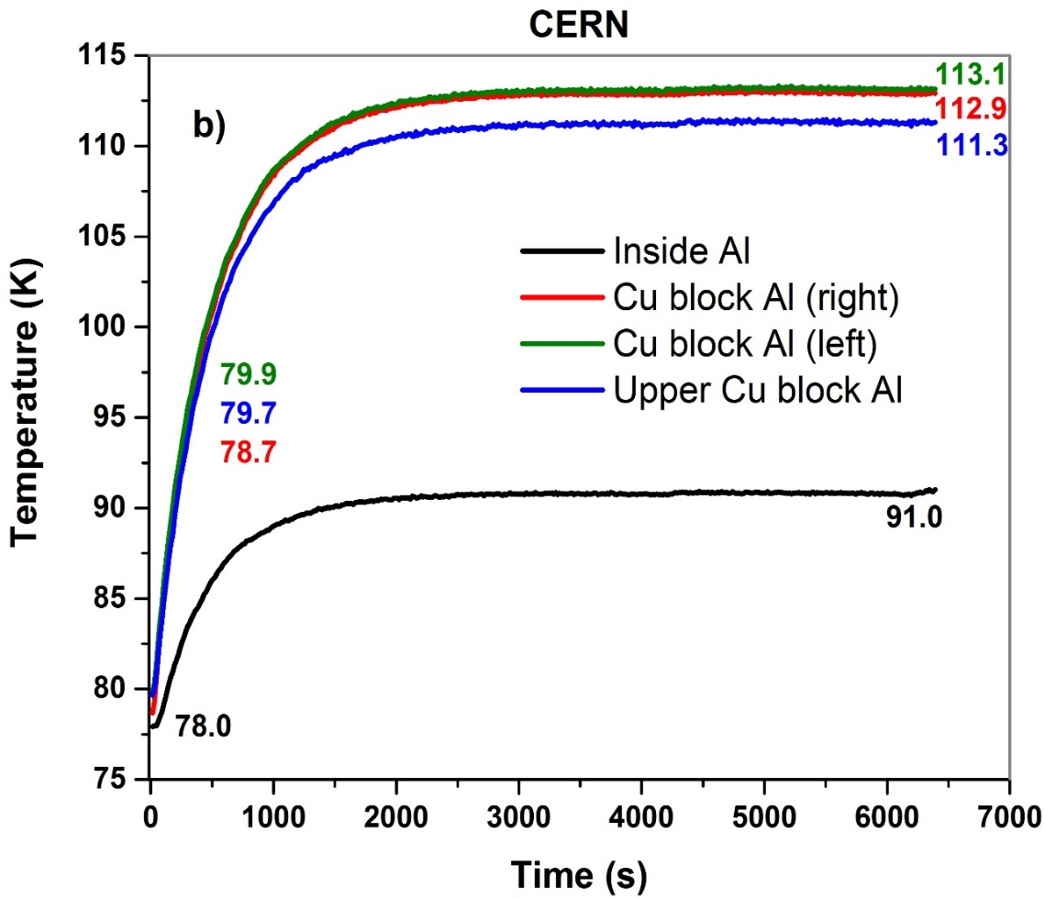



OPTIMIZATION OF HEAT INTERCEPTS FOR CRYOGENIC APPLICATIONS & DEVELOPMENT OF 2ND GENERATION SUPERCONDUCTING PANCAKE COILS FOR POWER APPLICATIONS
A.B. Nuñez-Chico^{1,3 †} , D. Duarte Ramos², E. Martínez³, L.A. Angurel³.
CIEMAT¹ (Spain),CERN² (Switzerland), ICMA³ (Spain)
OPTIMIZATION OF HEAT INTERCEPTS FOR CRYOGENIC APPLICATIONS
DEVELOPMENT OF 2ND GENERATION SUPERCONDUCTING PANCAKE COILS FOR POWER APPLICATIONS
Introduction
Introduction
Contact heat transfer is important in many cryogenic engineering applications such as superconducting magnets, plate fin heat exchangers and spacecraft electronic components. The thermal designs for these applications require experimental investigation of the thermal contact conductance, which can be used to characterize heat transfer across interfaces in contact. Thermalizations or thermal bridges are a solution to cool a component or subassembly of a cryostat by conduction to a heat sink. Because they must be designed for low heat impedance and be compatible with integration requirements, it is often necessary to use assemblies where heat transfer occurring between two surfaces in contact cannot be avoided and must therefore be well characterized.
The development and analysis of pancakes coils made with 2nd generation high temperature superconductors (HTS-2G) has a great relevance in the design of power applications in order to determine the main limits and how to overcome them. When HTS 2G tapes are used to fabricate the coils, delamination processes has been observed associated to uneven thermal expansions of constituting materials during thermal cycles and with damages produced by the low quench propagation velocities associated with the low thermal conductivities of some involved components. HTS-2G pancake coils are prone to deteriorate when quench occurs. A quench is the transition of the entire superconducting device, which is generally initiated by a local heat perturbation. Quench propagation velocities in HTS-2G are much slower than in LTS coils, which may cause local burn out of the coil before quench is detected. We have explored different designs and ancillary materials to improve the thermal stability of these coils.
Thermalization with aluminum blocks
2G-HTS coils fabrication and instrumentation
One of the improvements in cryostats could be to cool down the thermal shield adding thermalization aluminum blocks. The main goal is to characterize the thermal resistance across the interface between the cryogenic fluid and the aluminum block. In addition, to better understand the thermal contact between stainless steel and aluminum.
Stainless Steel pipe
Bellows
Thermalization block (Al)
Figure 1.1. Thermalization aluminium block
SS pipe (He Gas @60K)
Figure 2.1. Configuration of SuperPower® 2G HTS Wire
Figure 2.2. Winding machine
Figure 1.3. Aluminium sample
Figure 1.4 . Stainless Steel sample
R_{10Nm} is 3 and 4.5 times higher than R_{15Nm} or R_{20 Nm} for high and low power respectively.
10 Nm is not enough preload, R is 4.2-10 times higher than R_{Al}.
15 Nm and 20 Nm R is 2-5 times higher than R_{Al} ➔ Could be some options.
Figure 2.3. Voltage taps distribution in co-wound coils
Figure 2.4. Kh30W coil glued to an aluminium support
BOBINA | K20W | Kh10W_0 | Kh10W_1 | Kh10W_2 | Kh10D | Kh30W | SS10W | SS20D_1 | SS20D_2 | AAl20D_1 | AAl20D_2 | K20D
N (Turns) | 20 | 10 | 10 | 10 | 10 | 30 | 10 | 20 | 20 | 20 | 20 | 20
Ø_{in} (mm) | 65 | 65 | 65 | 65 | 65 | 65 | 65 | 68 | 66 | 65 | 68 | 67
Ø_{out} (mm) | 73 | 75 | 72 | 72 | 72 | 87 | 70 | 73 | 73 | 75 | 76 | 73
Impregnation type | Turn by turn | Turn by turn | Turn by turn | Turn by turn | Vacumm | Turn by turn | Turn by turn | Vacumm | Vacumm | Vacumm | Vacumm | Vacumm
Co-winding material | Kapton | Kapton | Kapton | Kapton | Kapton | Kapton | Stainless Steel | Stainless Steel | Stainless Steel | Anodized Aluminum tape | Anodized Aluminum | Kapton
Epoxy | Loctite 420 | Stycast 1266 | Stycast 1266 | Stycast 1266 | 2850 FT | Stycast 1266 | Stycast 1266 | Stycast 1266 | Stycast 1266 | Stycast 1266 | Stycast 1266 | Stycast 1266
Tape I_{c} (A) | 94 | 101 | 101 | 101 | 101 | 101 | 102 | 102 | 102 | 110 | 110 | 110
Coil I_{c} (A) | 58 | 15 | 64 | 65 | 68 | 48 | 80 | 60 | 65 |  | 72 | 63
Thermalization E line on bypass cryostat
Testing the thermal performance of the HL-HLC bypass cryostat thermalization E-line clamps. These clamps will be joined with aluminum straps fabricated with Al flexible sheets. Moreover, the heat transfer between the thermal shield and the bolted joints have to be estimated in order to improve the thermalization in the thermal shield.
Table 2.1. Coils characteristics summary
Thermal Cycling and Thermal Stability
The differences in the coefficients of thermal expansion which occur during the cooling and heating processes of the coils, generate tensions in the direction perpendicular to the tape that can lead to reductions in the critical current values of the superconducting material.
E line (He Gas circulating at 60K)
Figure 1.2. HL-LHC bypass cryostat 11T schematic
Thermal resistance across the bolted joint.
LN₂ @ 77K
Different torques
Q
Figure 1.5. Group of two pure aluminium plates
Figure 1.6. Test cryostat
The aluminum flexible parts were welded to the aluminum bulk with two methods: Electron Beam and Metal Inert Gas
Stainless steel
LN₂ sample tank
Pure copper temperature spreaders
SS20D_2, 0.9I_{c} @70K, 560 mJ, 343 ms
The MQE (minimum quench energy) values, measured at temperatures such that I_{c}= 105 A.
GFRE squeezer rods
Quench propagates faster in the inner turns by self-field effects.
Figure 1.7. Test assembly
Conclusions
Conclusions
Twelve round pancake coils were fabricated to investigate the effects of thermal cycling and thermal stability under two cooling conditions: liquid nitrogen and conduction cooling. Thermal cycling on coils with small number of turns did not affect their superconducting properties, even if different epoxies have been used.
The radial and azimuthal components of the quench propagation velocity have been measured. The effects of co-winding superconducting tapes with electric uninsulated stainless steel or anodised aluminium tapes have been studied and the results compared with similar coils co-wound with Kapton.
Several samples have been fabricated and characterized in order to measure the thermal resistance on them.
The experiments were satisfactorily done with interesting results in the thermalization with aluminium blocks. Moreover, different methods of welding were tested and no important differences were observed comparing with the data from FEM simulations. Bolted joints tests will be finished in the following months.
  *This work has been funded by: CERN under Spanish Trainee Program (FTEC2016)
  †ana.belen.nunez.chico@cern.ch
  ananunez1978@gmail.com

