Slide 1
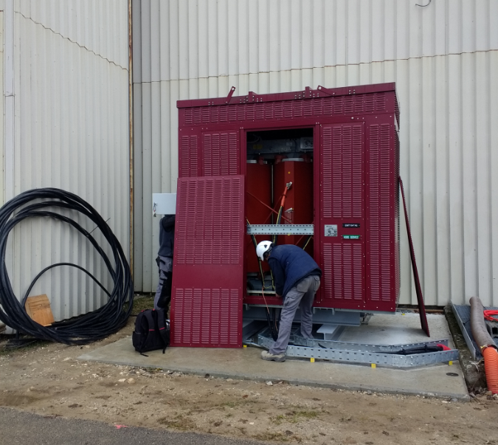
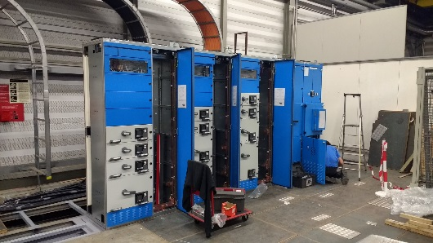
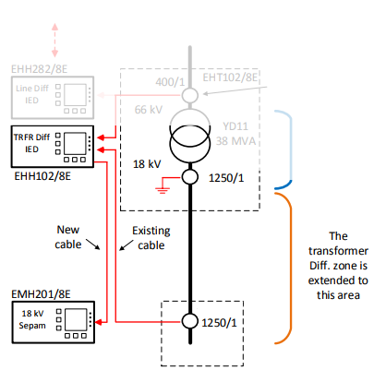
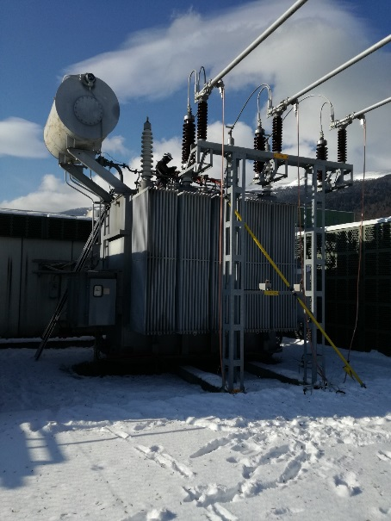
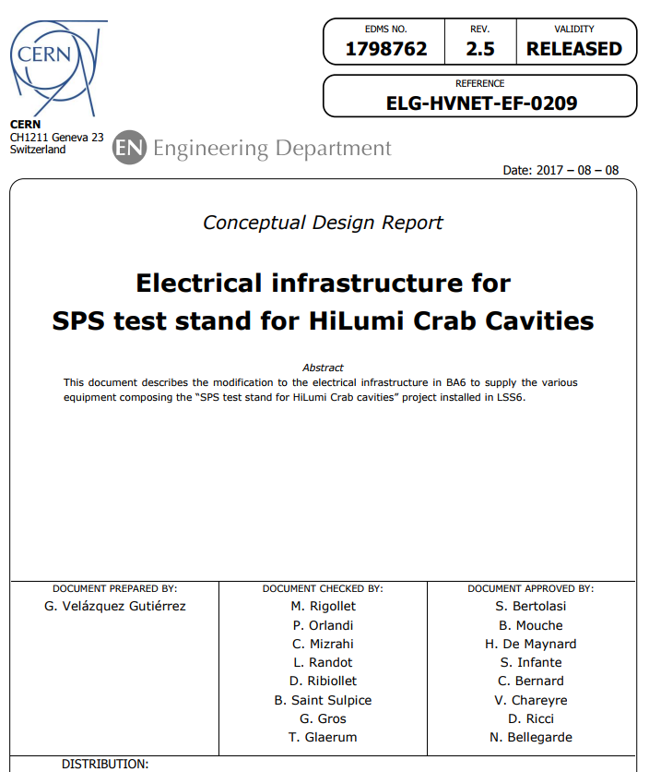
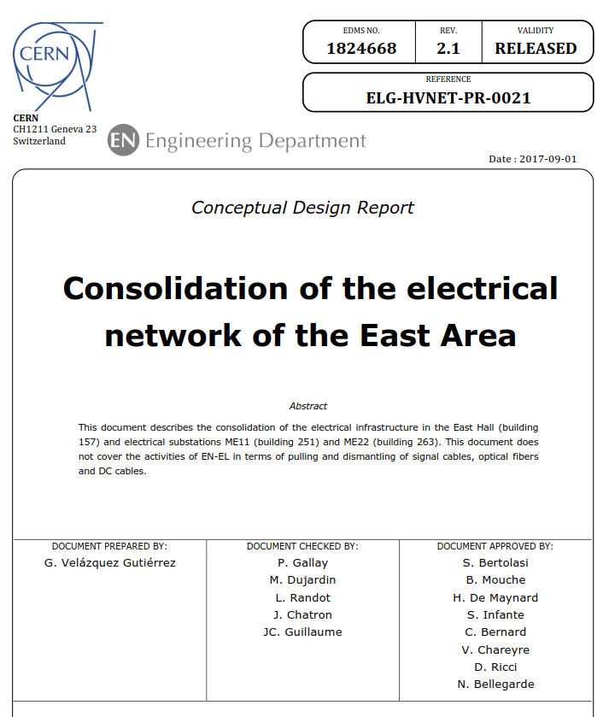
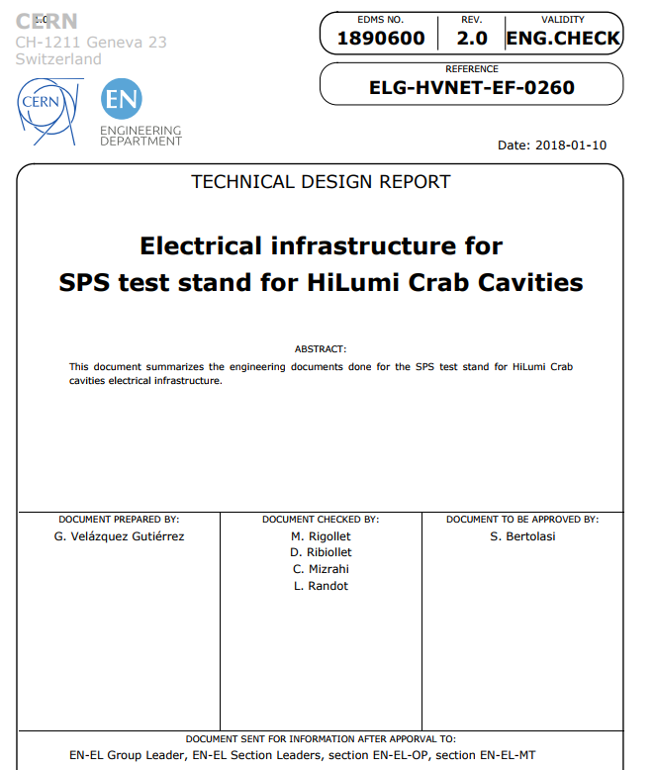


REFURBISHMENT OF ELECTRICAL SUBSTATIONS
G. Velazquez Gutierrez¹ †, S. Bertolasi¹, M. Wolf¹, E. Freddi¹, R.Grimand¹, M. Rigollet¹, L. Randot¹, C. Mizrahi¹, D. Ribiollet¹
CERN¹ (Switzerland)
Abstract
Electrical infrastructure for SPS test stand for Crab Cavities
CERN, the European Organization for Nuclear Research, has as the main source of energy to drive the accelerators, the electricity. CERN has its own transmission and distribution network, which is operated, maintained and consolidated by the Electrical Engineering group [1]. The high voltage network is composed of a 400 kV substation fed from France and called BE, a 130 kV substation fed from Switzerland and seven 66/18 kV substations fed from the CERN BE substation. The size of the CERN electrical network has increased over the years and continues increasing with the growth of CERN. To face this continuous growth, consolidation and upgrade projects take place and are managed by the Electrical Network Projects (ENP) section.
Consolidation and upgrade projects are necessary to replace the equipment that is at the end of its operational life and or to supply the power requested by the experiments. The ENP section is responsible for the management of the projects and coordinates all associated design, procurement, installation, commissioning and handover activities with the support from other sections of the group as required.
The main aim of this poster is to provide a global overview of the activities carried out and to show the variety of activities required to face the different requests done by the experiments.
Superconducting crab-cavities are baseline for HL-LHC, to decrease bunch crossing angle at IP. A prototype crab-cavity cryomodule, hosting two DQW-type cavities, has been installed in SPS tunnel, end 2017 for test with beam. Validation of crab-cavities in high-energy proton beams is required before launching series production for HL-LHC.
To supply the test stand, EN-EL has been requested to supply 1.2 MVA from the 400 V General Services network and 30 kVA from the UPS network. To accomplish this mission, a dedicated distribution network has been installed to supply the test stand. This network consists of a 2 MVA 18/0.4 kV transformer connected to the 18 kV SPS stable distribution network. The transformer supplies a TGBT (“Tableau Général Basse Tension”), which in turns supplies another distribution switchboard.
Figure 3 shows the works done during the installation of the transformer and Figure 4 shows the works done during the installation of the TGBT.
Introduction
Protection modifications at 66/18 kV substations
Due to a fault, happened in the 66kV network in April 2016, the bushings of the transformer placed in the SE8 substation get damaged and EN-EL decided to change the protection philosophy of the protection system.
At that time, there was no differential protection between the 66/18kV transformer and the 18kV cubicles. EN-EL decided to improve the protection system by extending the differential protection to the cables that join the transformer with the 18kV cubicles. This solution allows the system to protect a region of the network that was not covered previously.
The tripping times of the protection system were not fast enough. In the mentioned fault, the arc was propagated from the low voltage bushings to the high voltage bushings. It was decided to revise the protection settings: thresholds and tripping times. The tripping time for the first overcurrent threshold is set to 50 ms and the second threshold is set to 500 ms. Back-up protections are delayed by 300 ms from each threshold.
Figure 1 shows the proposed solution and Figure 2 shows the commissioning works done in the 66/18 kV substations.
Fig 3. Transformer installation
Fig 4. TGBT installation
The 18 kV protection system of the medium voltage cubicle that feeds the transformer has been refurbished because the medium voltage cubicle, which dates from 1980, was prepared to supply oil transformers and at the current situation, the transformers installed when the power required is less than 5 MVA are dry type transformers.
Conceptual and Technical Design Reports
Every project starts with a Conceptual Design Report. This document explains the motivation of the project, the high level technical solution, the new equipment to be installed, the budget requested for the project, the planning and the manpower required to carry out the project. The Conceptual Design Report is the guideline of the project. Once the project starts, the detailed design is done. These documents are the baseline for the ENP section to manage the technical solution to be implemented. Figure 5 shows the Conceptual and Technical Design Reports.
Fig 5. Conceptual and Technical Design Reports
Conclusions
The consolidation activities realized in the CERN electrical network are necessary to adapt the network to CERN’s necessities. The cohabitation in the network between electrical equipment which dates from very different ages, made the projects challenging in technical and managerial aspects.
The projects described in this poster are completed, the equipment is energized and the installations are running as per requirement.
Fig 1. Proposed solution [2]
Fig 2. Commissioning Works in substation SE4
References
These enhancements allow the protection system to trip faster, therefore, the damage to the equipment would be reduced in case of fault. The number of back-up levels in the protection system has also been increased to enhance reliability.
The works done include the new protection system proposal, the revision of the protection settings and logics, the implementation in the protection relays, the cabling and the commissioning of the system.
[1] G. Cumer, “Description of the CERN Electrical Network [October 2015]”, EDMS 559013, 2015.
[2] M. Wolf, “Behavior of the protection system during the fault on the 66/18 kV power transformer in LHC8 on 29-04-2016”, EDMS 1686687, 2016
gerardo.velazquez.gutierrez@cern.ch
FTEC PROGRAM 2016

