Slide 1
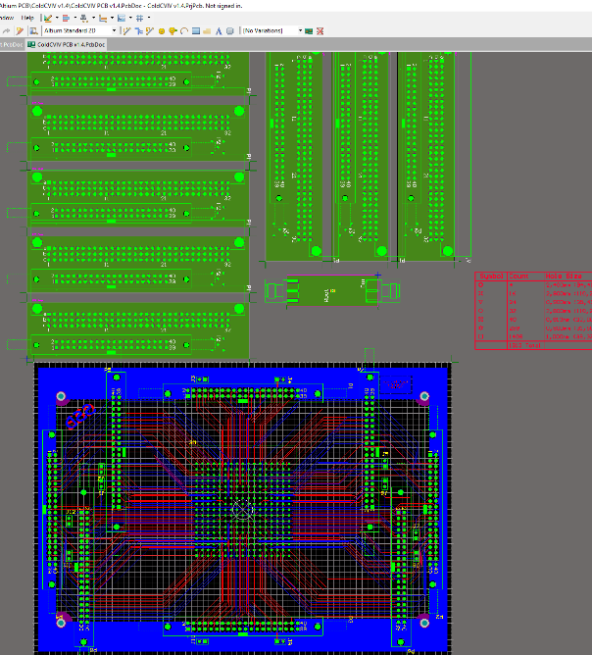
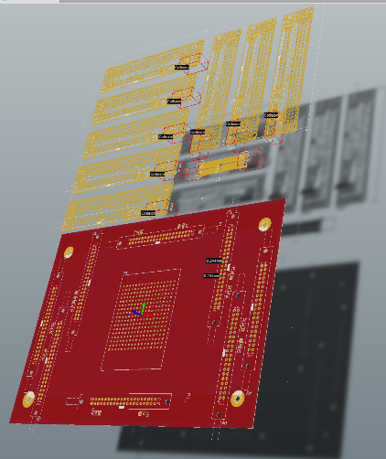
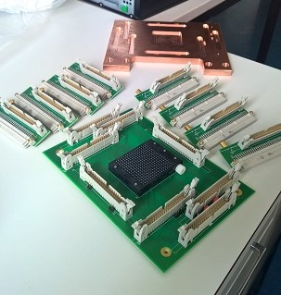
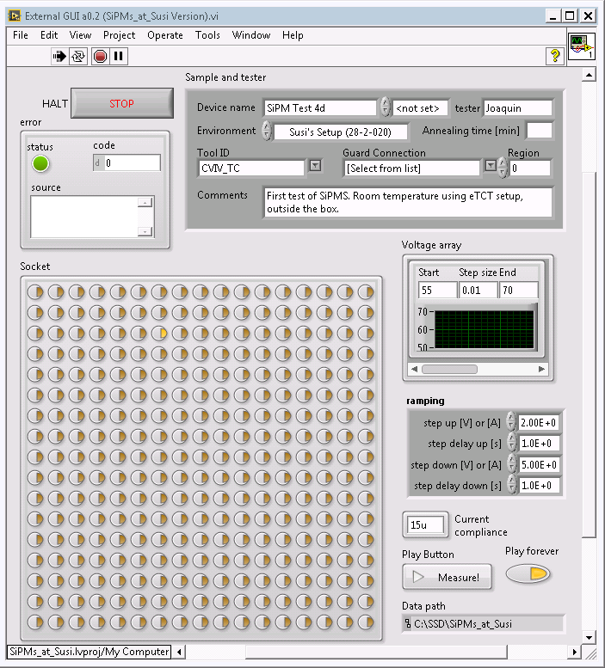
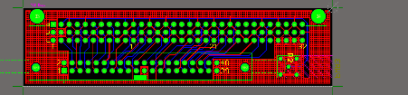
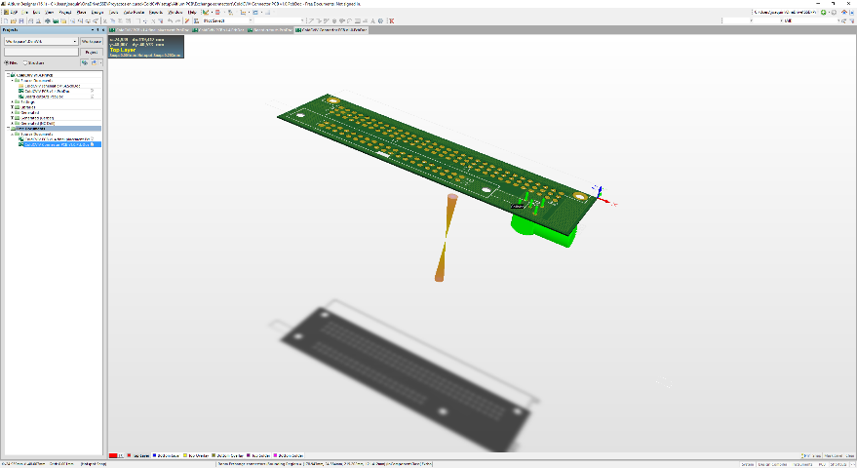
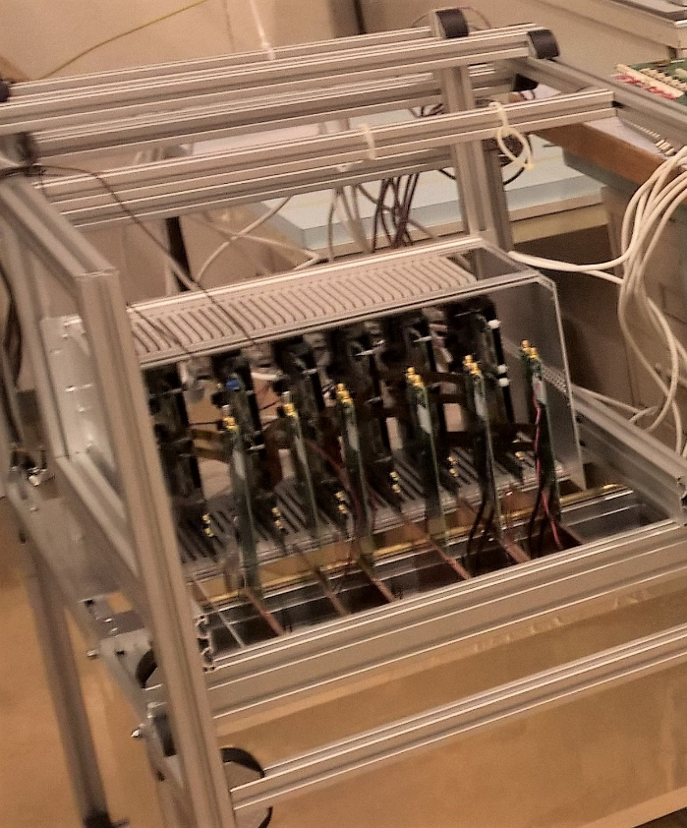
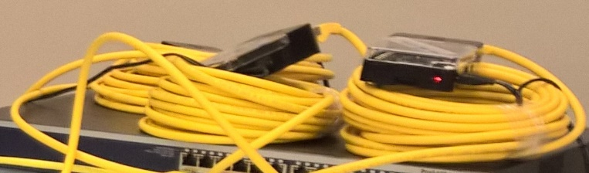
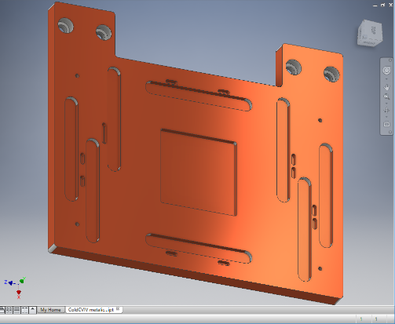
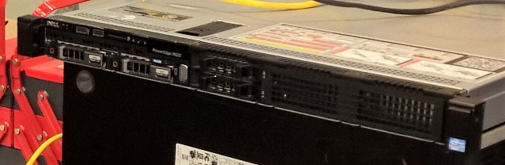
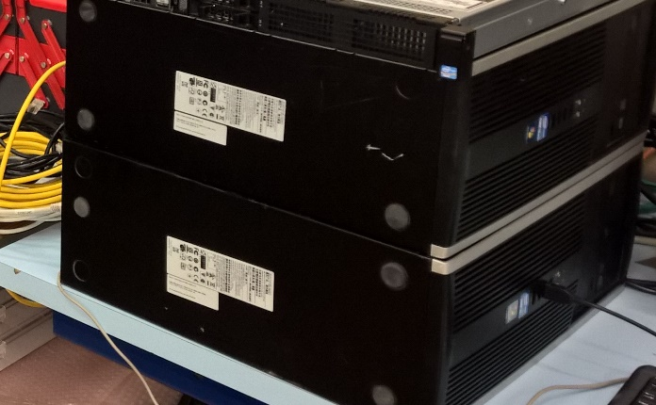
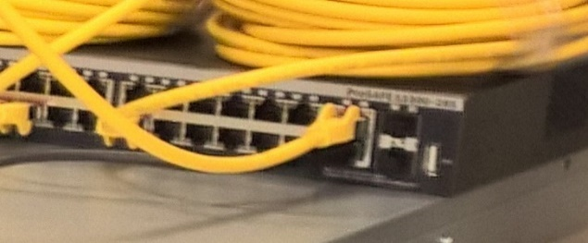
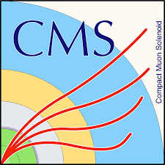
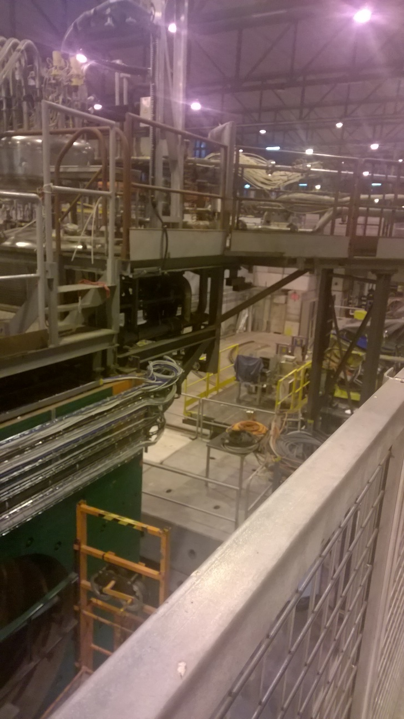
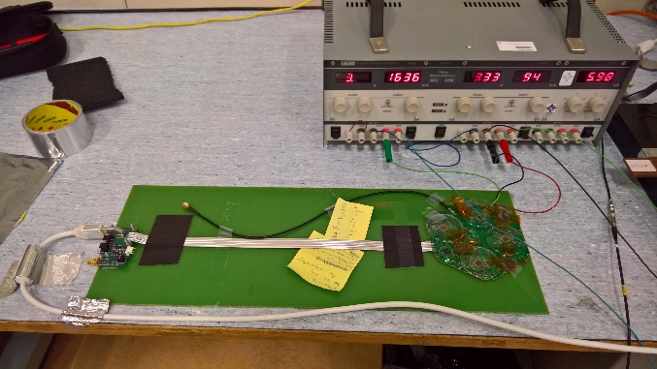

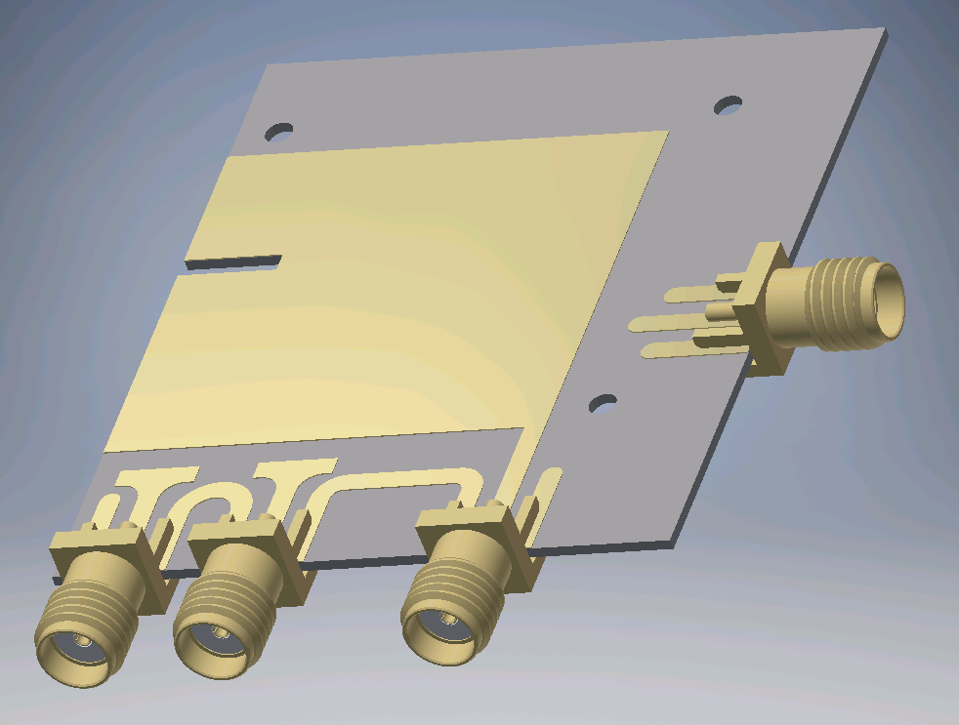
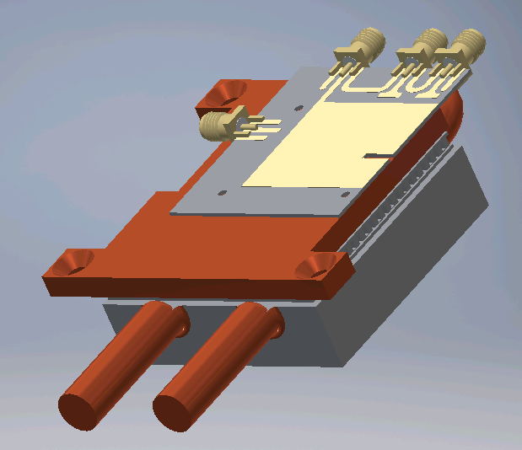
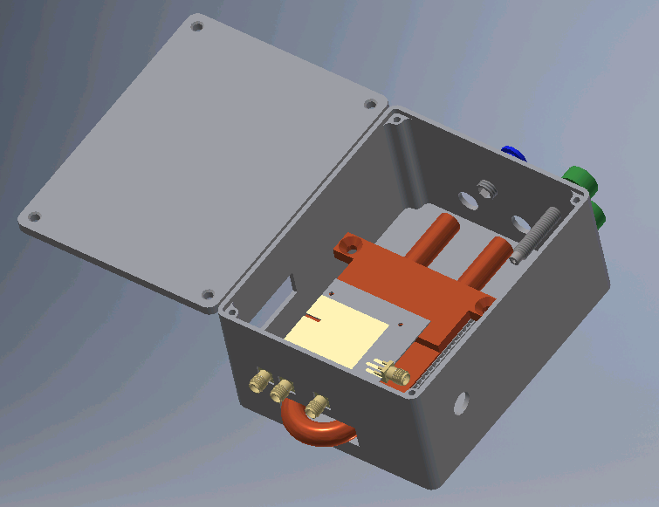
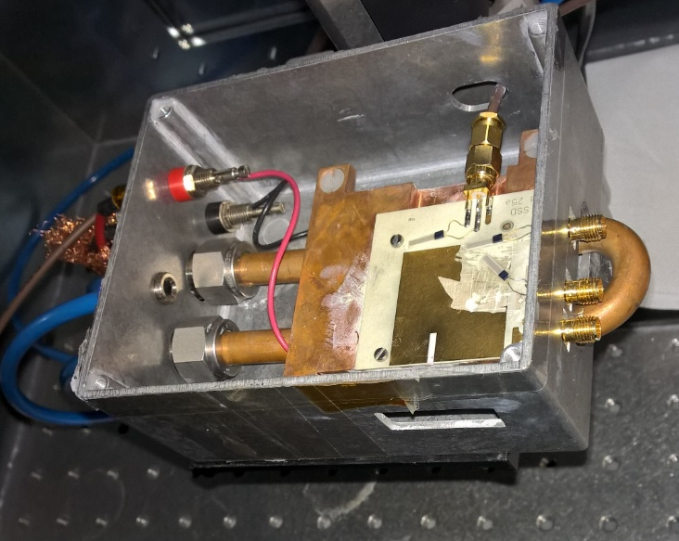
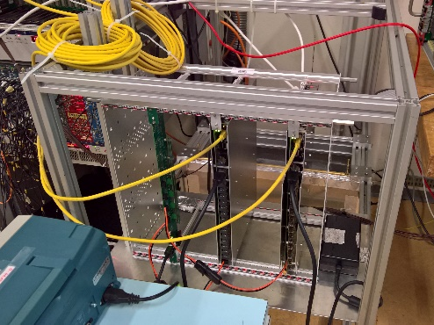
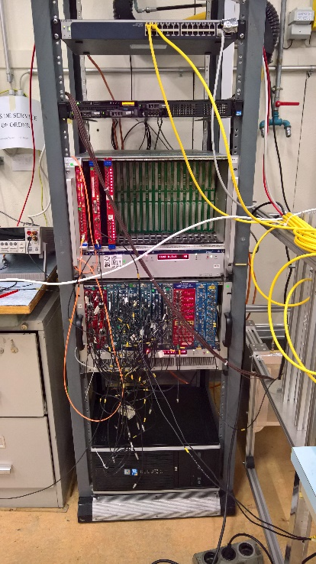
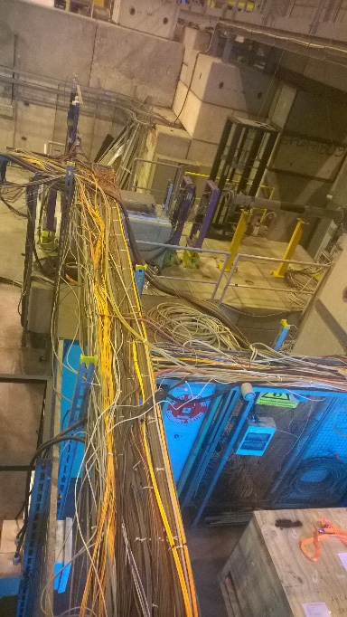
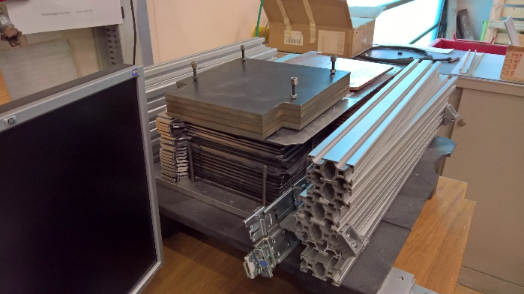
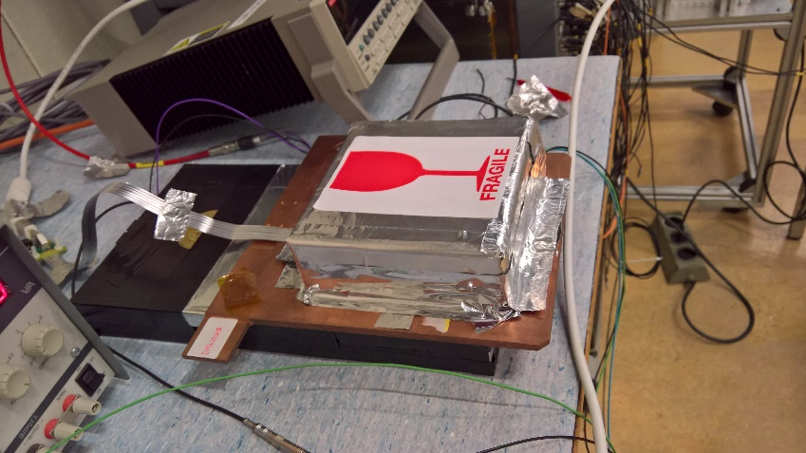
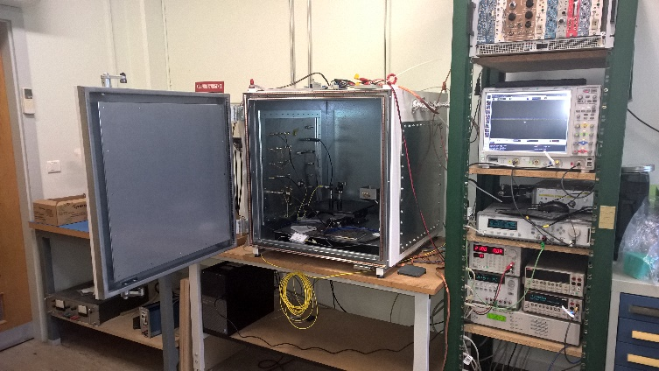
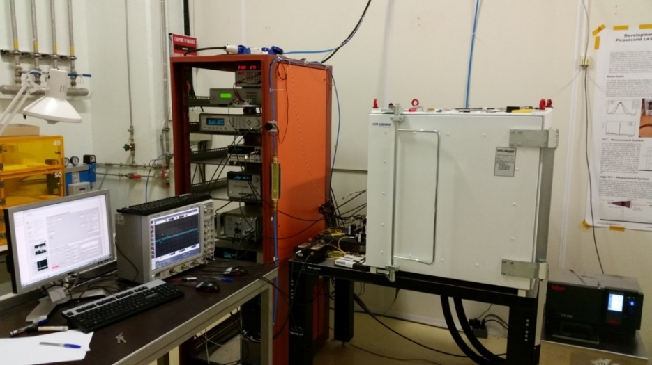
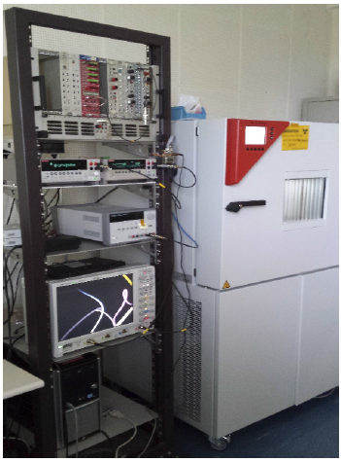
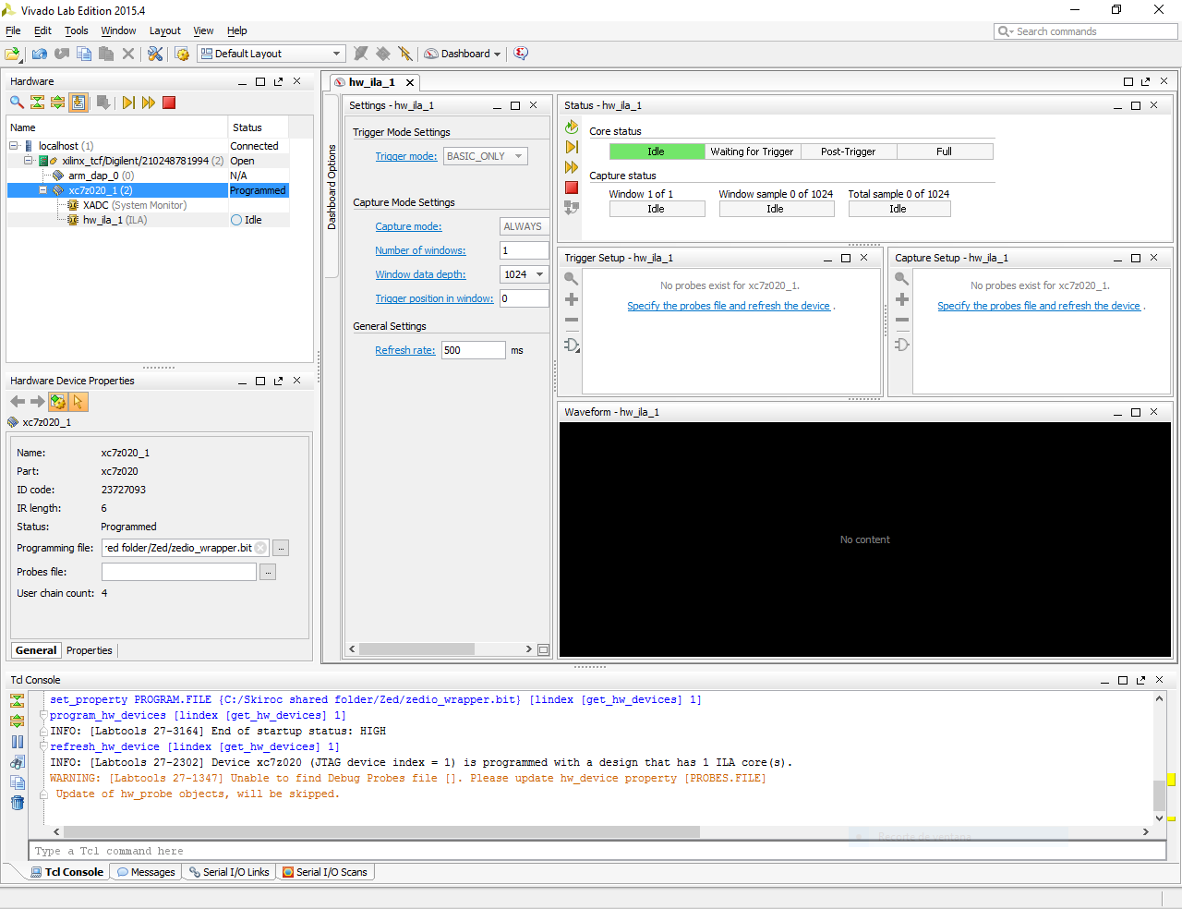
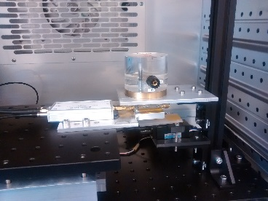

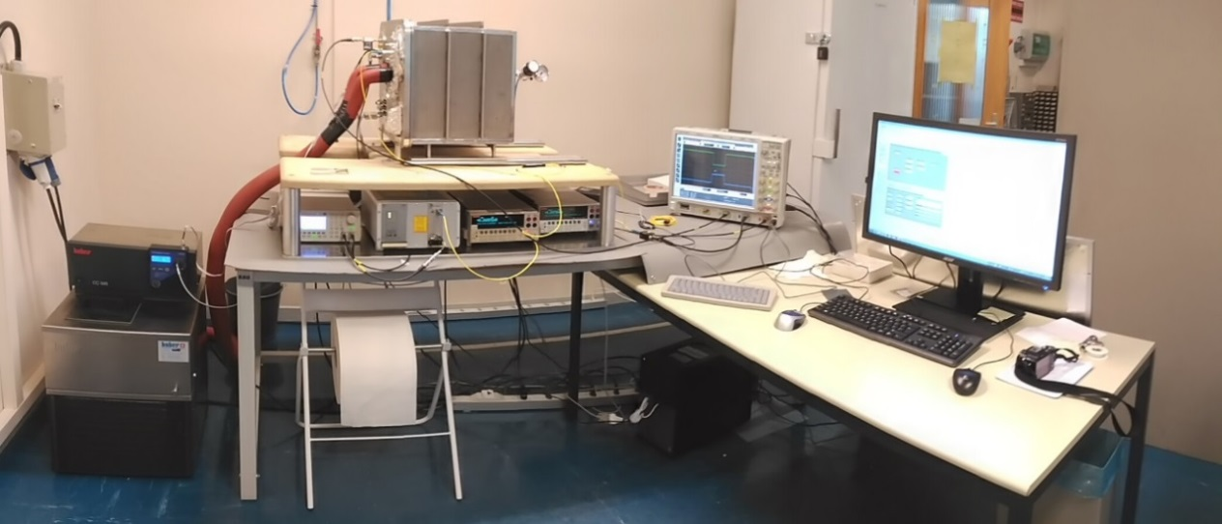
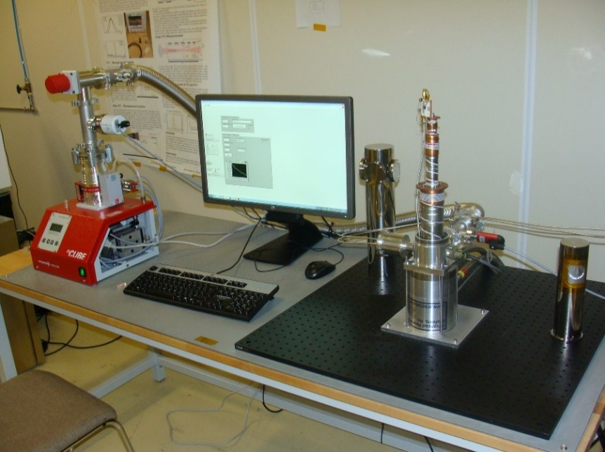
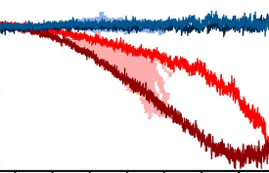
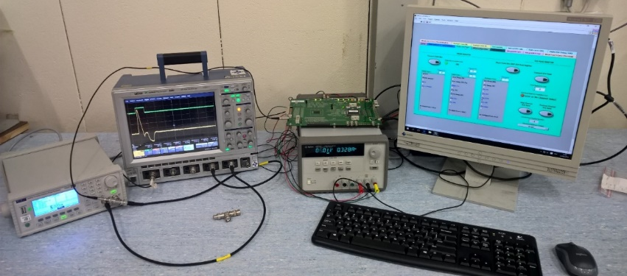
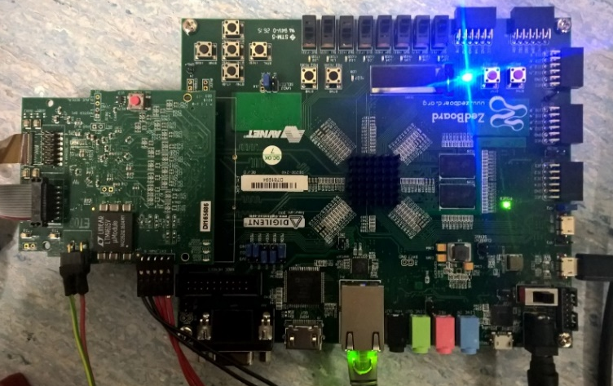
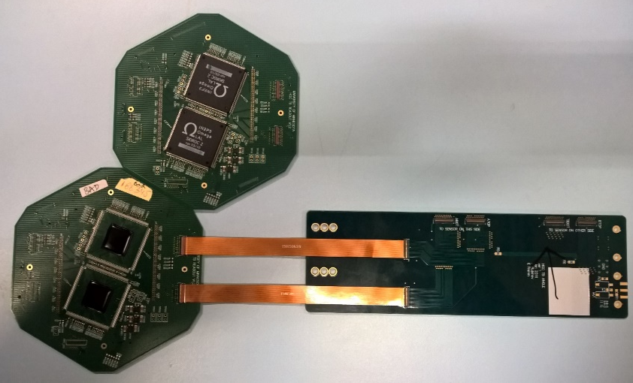
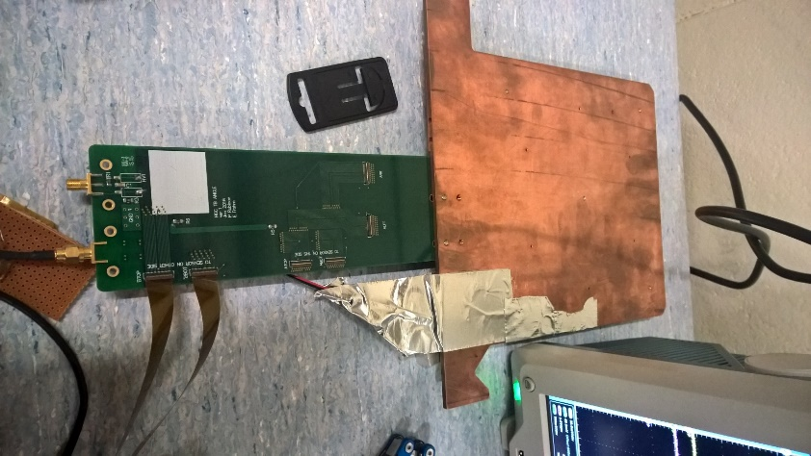
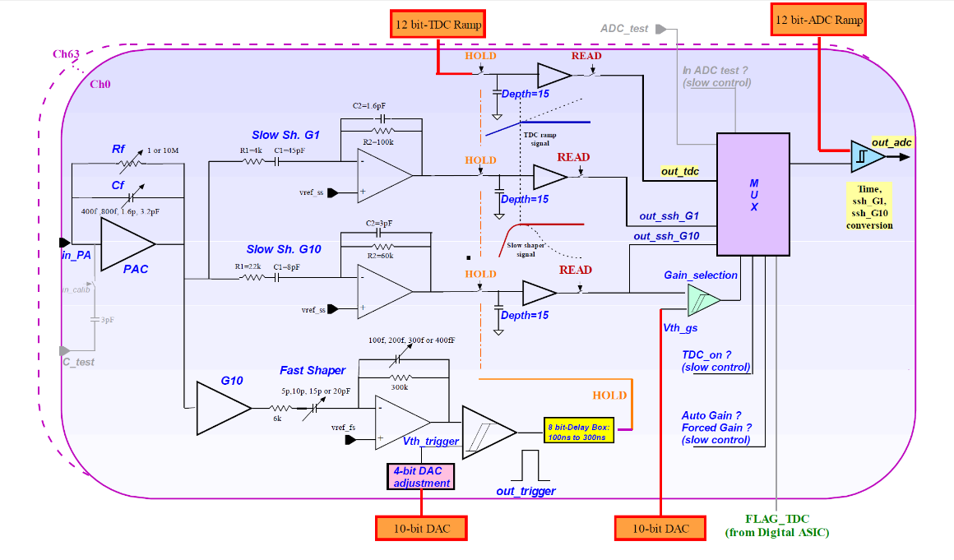




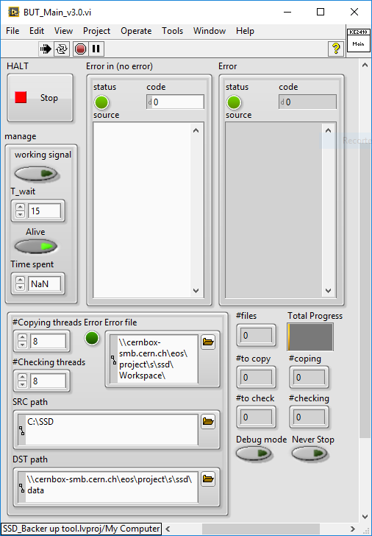

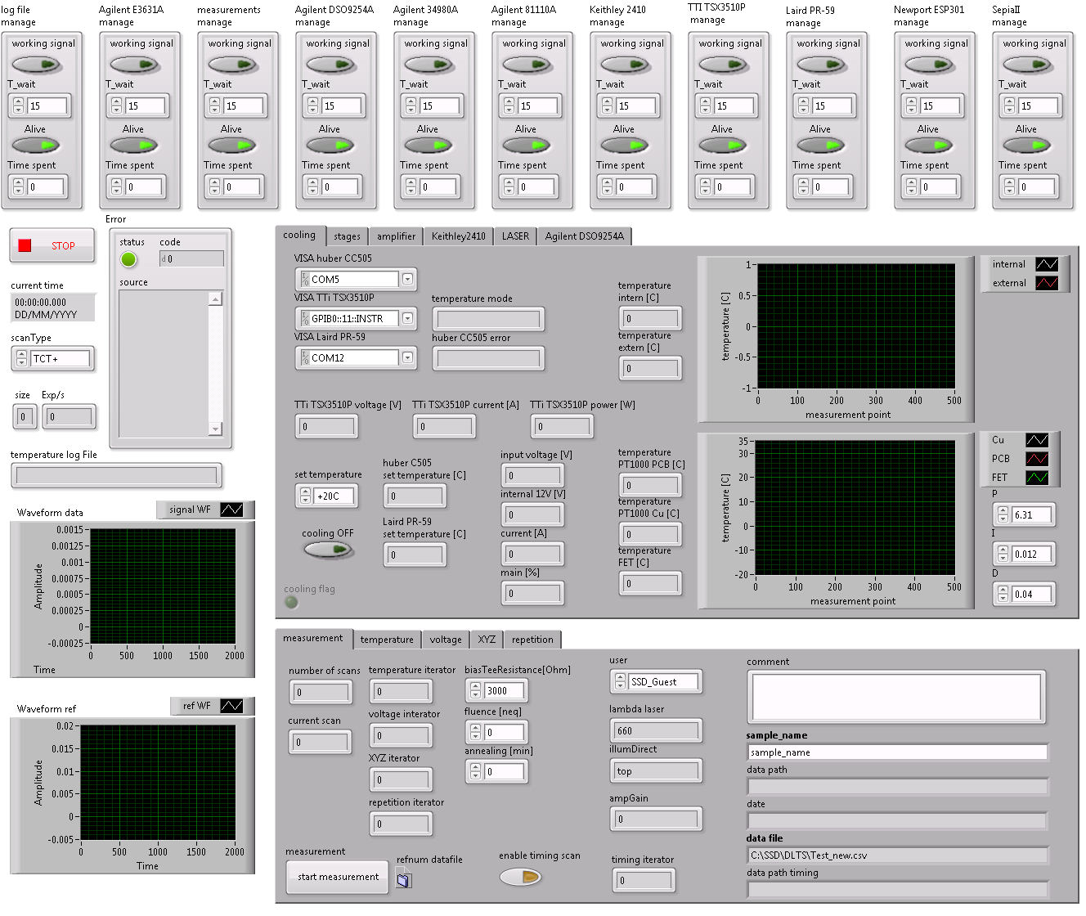



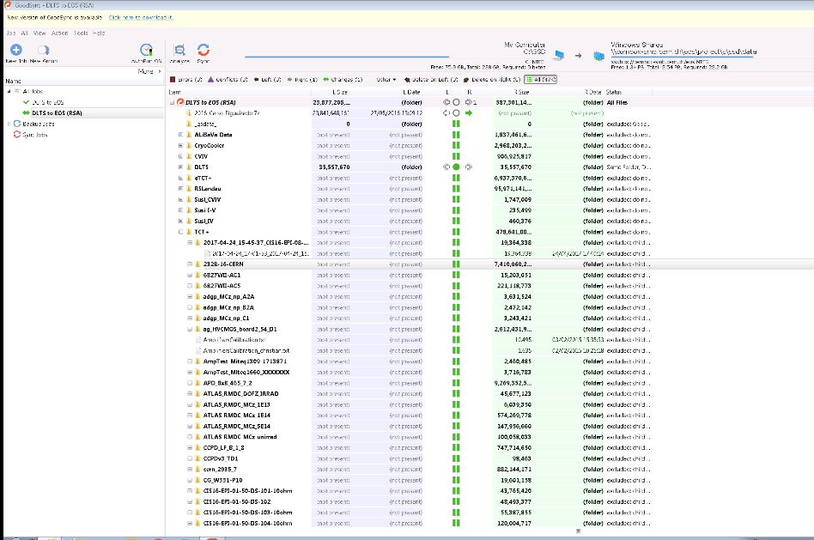




Development of Electronics
for Solid State Detectors R&D
Joaquín B. González
Telecommunications engineer
CERN - CIEMAT
The upgrade of the LHC experiments requires the development of highly specialized solid-state detectors. The CMS silicon based inner tracking detectors and the CMS HGCAL calorimeter silicon sensors are two prominent examples.
My task is to support the physicist developing and characterizing these detectors by designing and implementing customized electronics for data acquisition and calibration of their systems as well as the corresponding readout and control software.
SiPM@Susi
Electronic and Mechanical design. Software development
Entire project under my responsibility: Development of a new setup to measure SiPMs (for CMS HCAL)
Involves design of two new PCBs, new cooling block, new setup and new software
HGCAL testbeam backend
Design of communication and data handling infrastructure
Hardware and protocol design to fit with CERN network standards
Entire 2017 beam test season very successful
Test beam in H2 (North area) with particles from SPS
8.8Gbps (peak) during 5s (one spill). 2 spills/1min
Zero DAQ-related down time
Start Production
Start desing Electronics
Kick-off meeting
Data analisys
Star data taking
Start Software
2017
Feb
Mar
Apr
May
…
Nov
  Presently, data is being analysed, and prepared for publication
eTCT cooling
Mechanical design
A totally new thermomechanical design
Optimized and more robust fixation, keeping the same cooling power
The new box was successfully tested. Minimum temperature of -20 ºC was reached
Detector is now mounted on its own PCB, without any electronics, just connectors
Copper plate built at CERN, compatible with all sample PCBs in the lab
EP-CMX: HGCAL tb
Testbeam team
-70C to 180C
Skiroc2CMS is the next iteration for Skiroc family
Design and building up of a calibration setup
  Acquiring knowledge on Skiroc and training of students
  Developing systematic calibration for parameters such as SNR, Noise, common mode error and other parameters relevant for normal operation of the device (HL-LCH run 1)
Setup and tools designed for Skiroc2 Dev board. Tools developed to be scalable and to repeat the studies with Skiroc2CMS, for a much bigger number of acquisition channels
Skiroc Calibration
Setup design, and DAQ calibration
eTCT: TCT (Transient Current Technique)
TCT+: TCT (Transient Current Technique)
EP-DT-DD: SSD
Solid State Detectors
CCE (Charge Collection Efficiency)
TSC (Thermally Stimulated Currents)
I-DLTS (Current Deep Level Transient Spectroscopy)
Cooling to 10K
Backer Up Tool
Infrastructure design and Software development
TCT v0.4 to v0.9
(original)
TCT v1.0.0 to v1.0.1
TCT v1.0.2 to v1.0.5b
TCTPlus_basic
Software development
Safe space for long term data storage
Fully adapted and integrated within external infrastructure
Software design intrinsically parallel and scalable
Software package ready for being integrated for the control software of all the setups
Automatization of all the backing up processes. Virtual machines 24/7 in Openstack to optimize the performance
  Alarm system implemented
Safe copy processes over RSA to cross check
New features for safe file storing
  External sharing
  Automatization of the dataset
  Fully integrated with CERN-wide services (EOS platform) like WebDAV, Cernbox, SFTP, etc.
Interface
Math
Data manipulation
Algorithm
Instrument control
Interface
Math
Data manipulation
Algorithm
Instrument control
Interface
Math
Data manipulation
Algorithm
Instrument control
Hot swapping coding!!!
14 parallel loops
Up to 200 controls-indicators
12 semaphores (work managers)
~0.6 s per measurement (was~4 s)
  Even less avoiding to read the temperature each measurement
  Down to 0.04 s in special case (timing)
Independent time control for each worker (ctrl loop) and watchdogs for communications
  ^{Joaquin.Gonzalez@cern.ch}
  This work has been funded by CERN
  under Spanish trainee program with number PH3472 Development of electronics for Radiation and Solid State Detectors R&D

