Slide 1
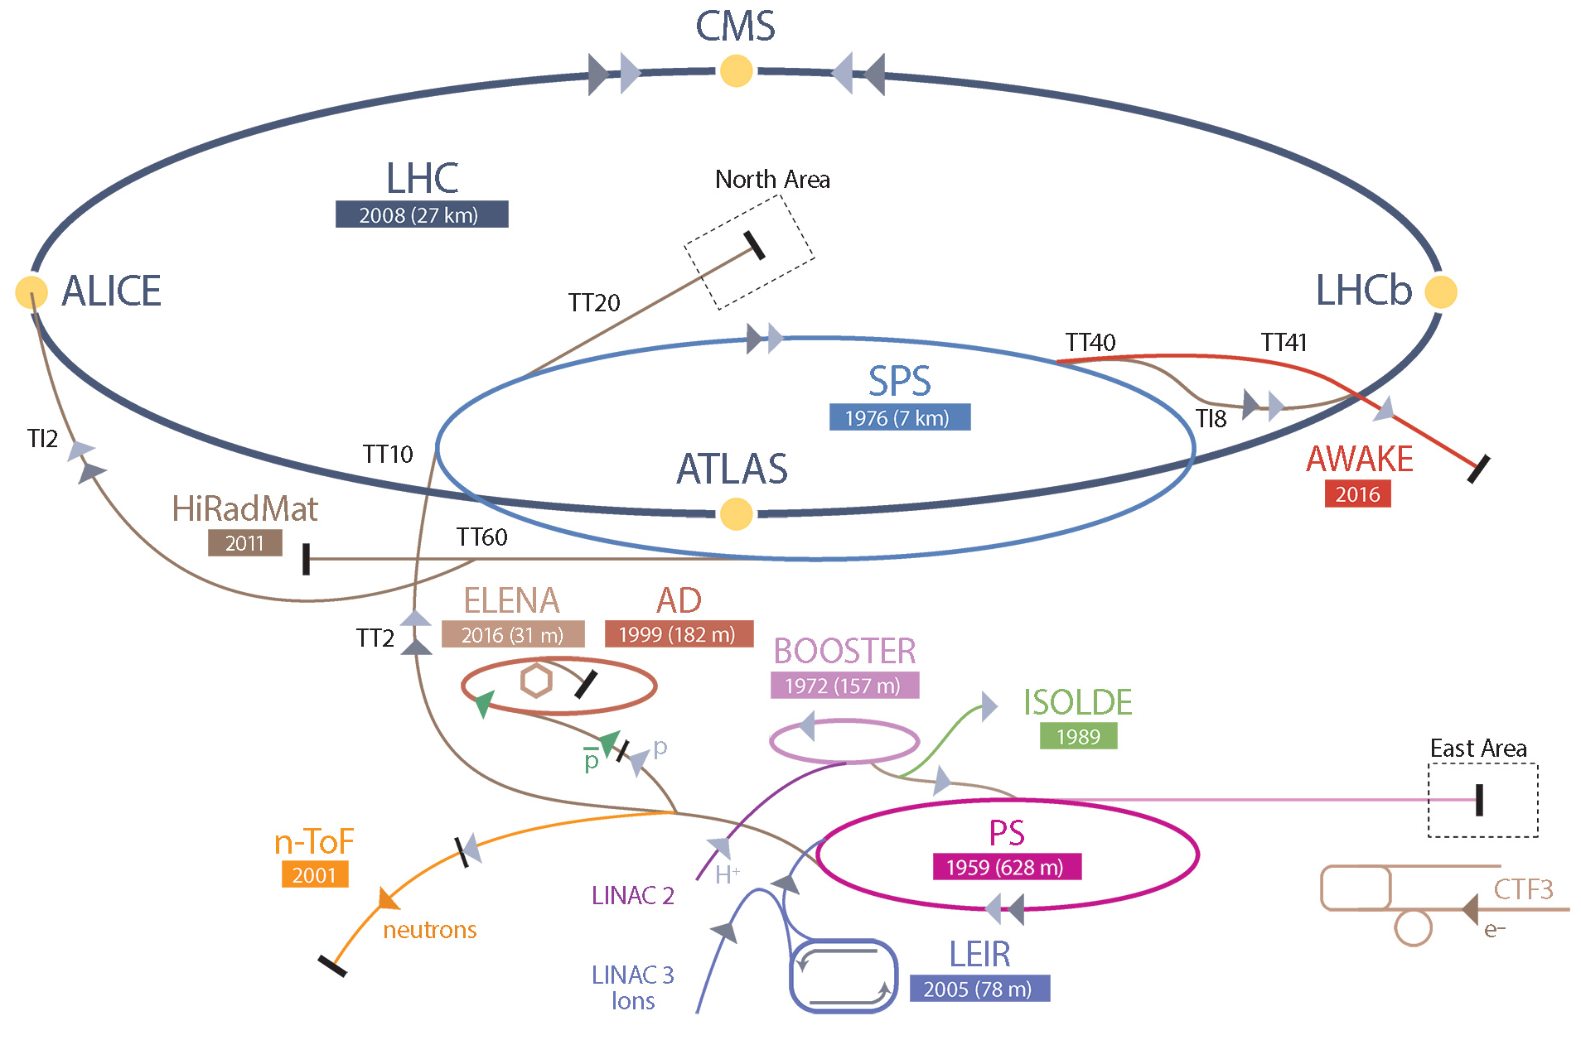
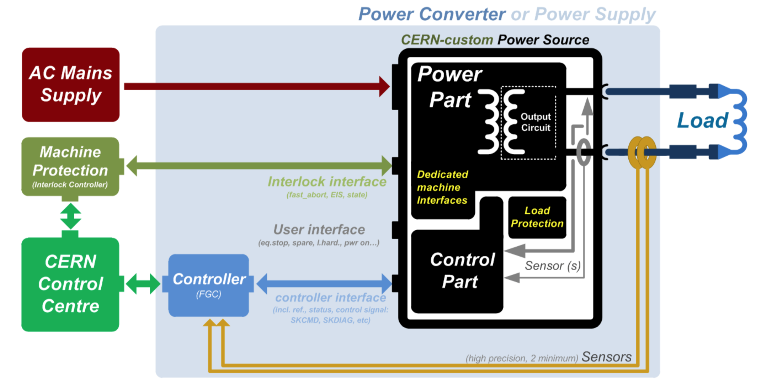
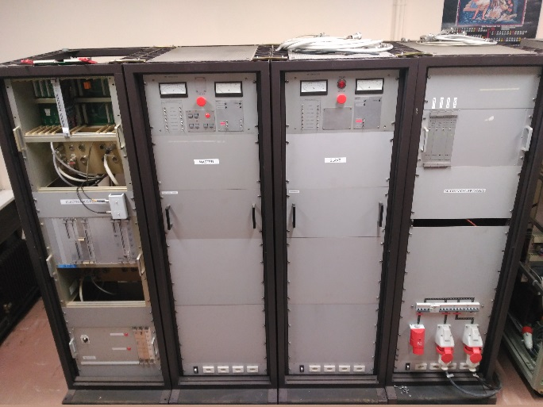
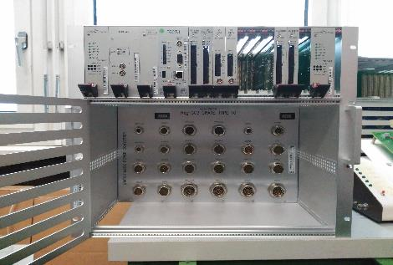
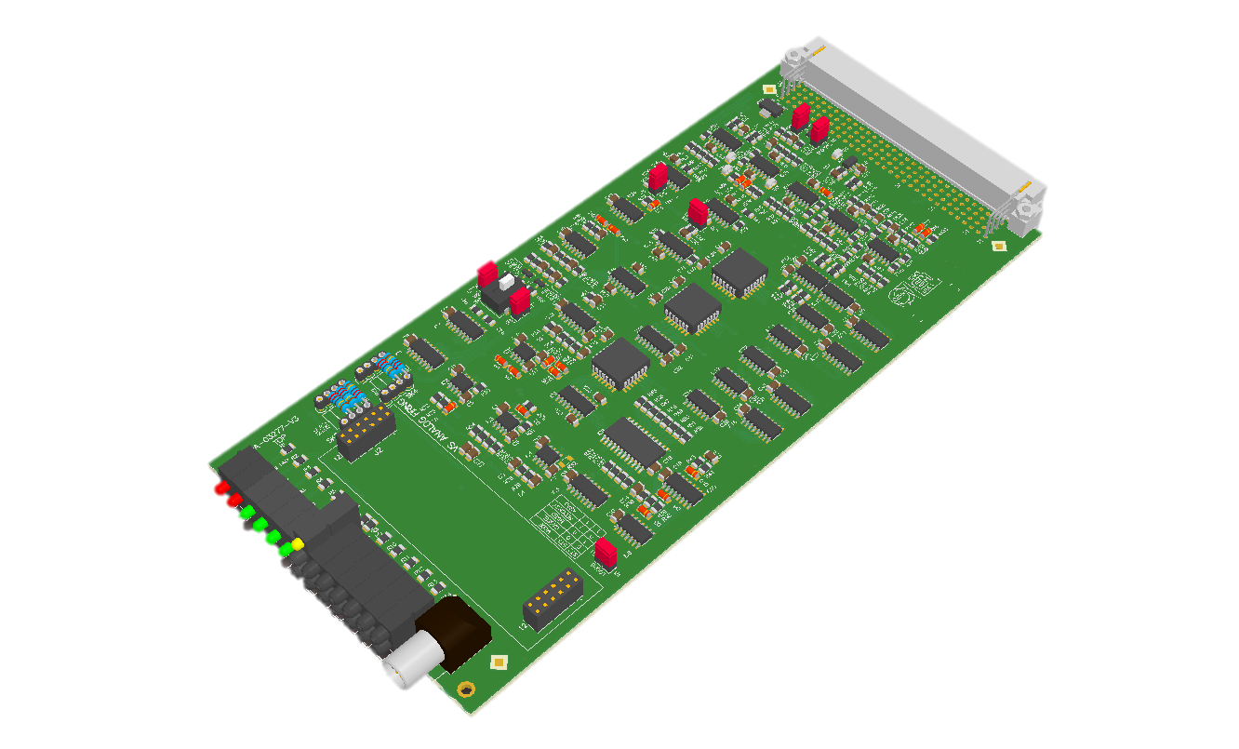
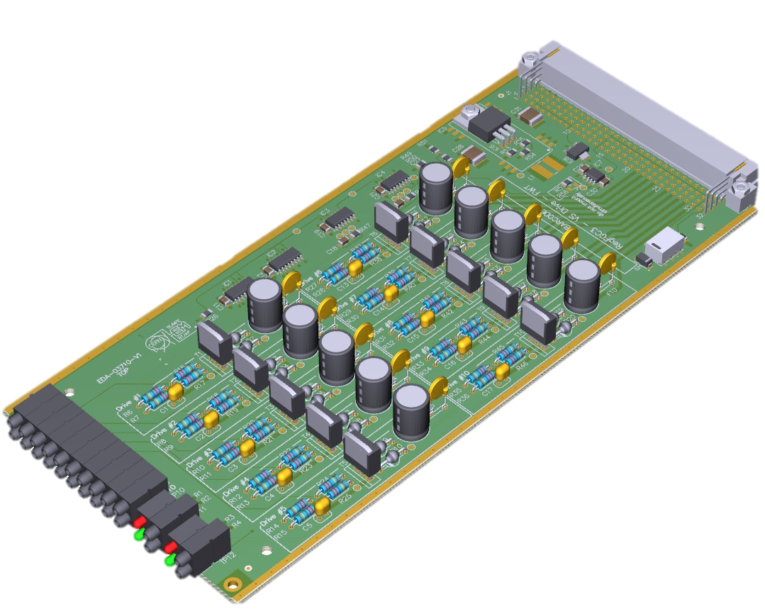
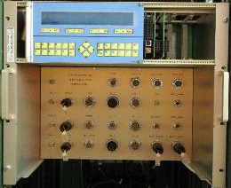
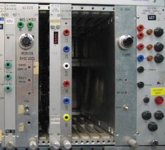
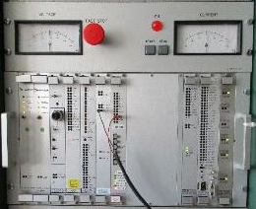
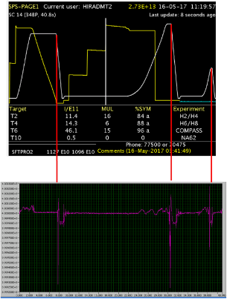

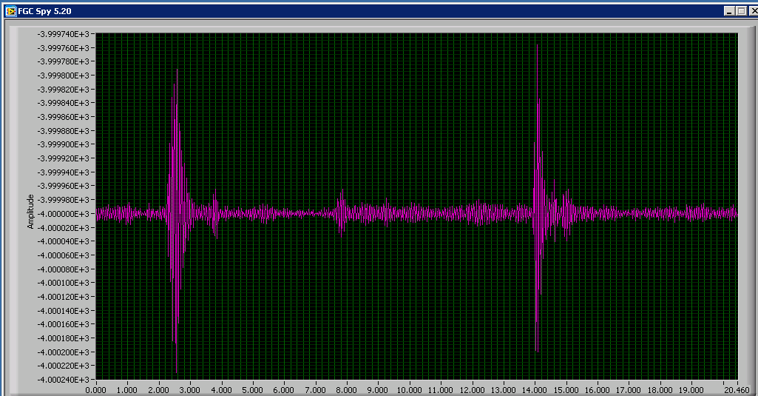
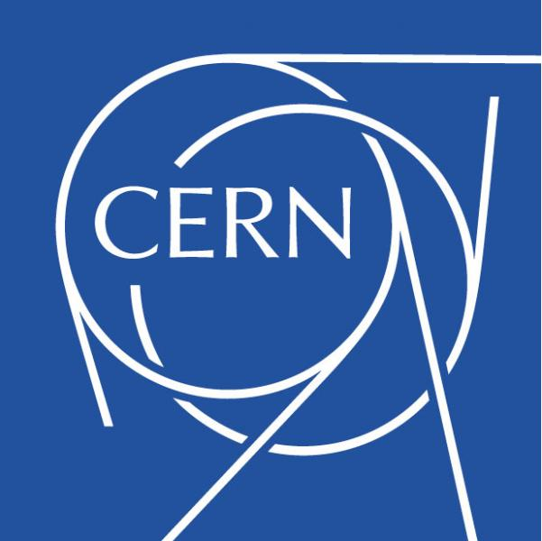


Upgrade of CERN Power Converters Control Electronics
José María Fernández-García^{†12}, Hugues Thiesen¹
Medium Power Converters Section, CERN, Geneva, Switzerland ¹ CIEMAT, Madrid, Spain ²
Abstract
CERN Particle Accelerators Chain
Within the Electrical Power Converters group, the Medium Power Converters section is responsible for the development and exploitation of the medium power converters of the CERN accelerators (PS, SPS and LHC complexes). This project main objective is to take part in the consolidation program of the CERN power converters for the LHC Injector Upgrade (LIU) and High Luminosity LHC (HL-LHC) projects.
This program consists of the development, production, installation and commissioning of a new control electronics for the power converters, based on CERN's digital power converter control standard, the RegFGC3 platform.
Main activities range from the development of the new control crate for the integration of this new electronics with the power converters, the accelerator environment and in particular, the development of the interface with the power part.
~ 5000 power converters are in operation at CERN:
      1718 for LHC
      1461 LHC injector (LN2 to TI2&TI8)
      1730 Experimental areas
Fig 4: Interior of the slotted line kicker and materials used
Power Converters
New Control Electronics
All over the accelerator chain, Power Converters are use to supply electrical energy to different kind of loads, from room temperature or superconducting magnets to experiments solenoids.
This converters have different sizes, power ratings and technologies. The objective of this Project is to upgrade the control Electronics of Thyristor converters, with power ratings up to few MW.
Based in the CERN RegFGC3 platform, a new backplane called Type 7 has been designed and tested in both a step down version of a real converter and a hardware-in-the-loop platform.
New boards were developed and tested and the first prototype was successfully deployed, it is already in operation in COMPASS feeding the experiment’s solenoid with a power of 3,6 MW.
New Challenge
During LS2 (2019) the Control Electronics of the thyristor power converters used in the transfer lines between the Super-Proton-Synchrotron (SPS) and the Large Hadron Collider (LHC) which are known as TI2&TI8 will be upgraded from the “Renovation SPS” crates with the new Type 7 crate. Estimated cost: 420k CHF.
Improved Performance
The current regulation loop is mixed, having a digital outer current loop and an inner analog voltage and active damping loops.
Thanks to the new crate, the performance has already increased with the the corresponding positive impact on the experiment.
This new crate also enables the use in the future of the full capabilities of the RegFGC3 platform, having both current and voltage loops running digitally in the controller.
SR2
TI8
SR8
RegFGC3 Electronic
TI2
  *This work has been funded by CERN and CIEMAT. † jose.maria.fernandez@cern.ch

