Slide 1




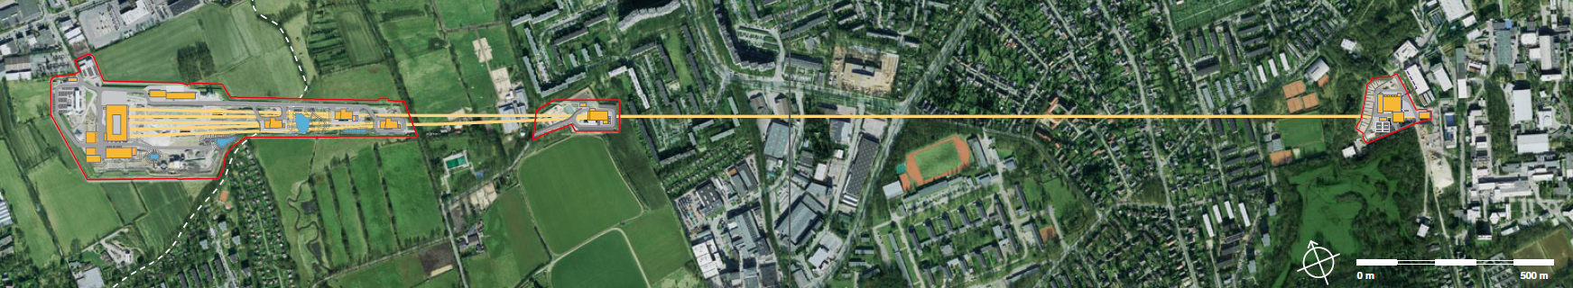
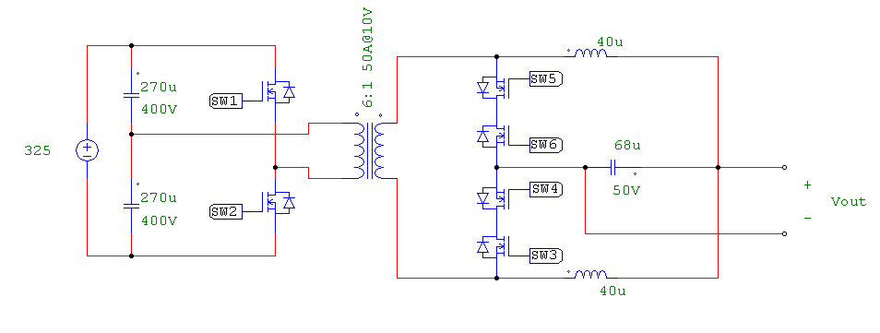
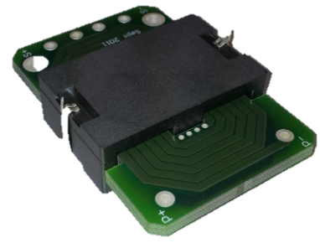

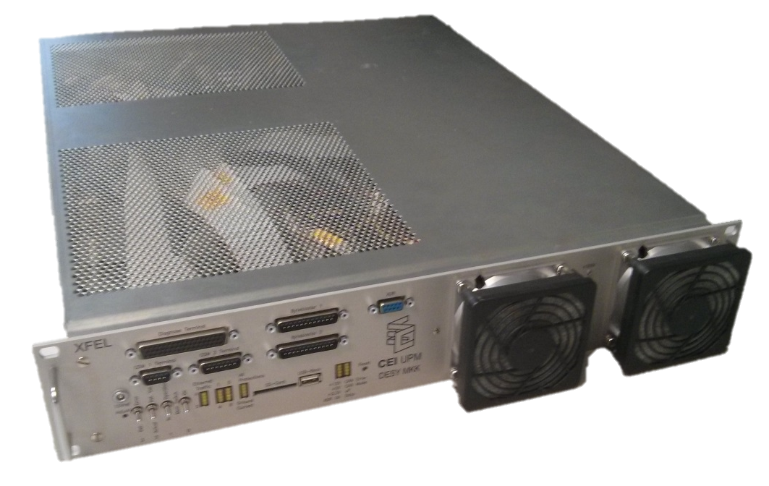
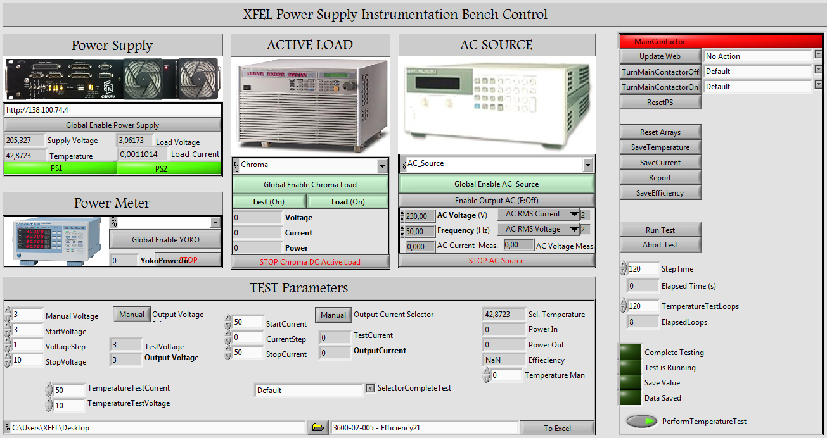
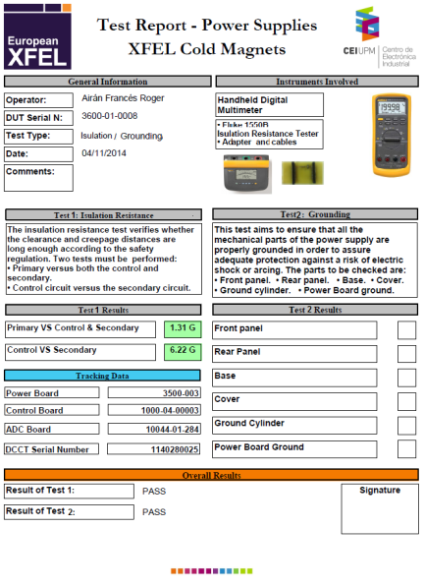
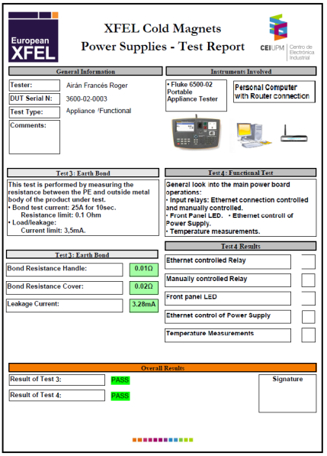
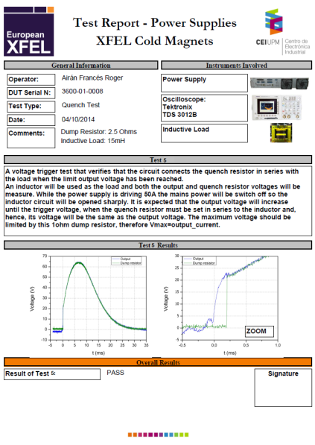
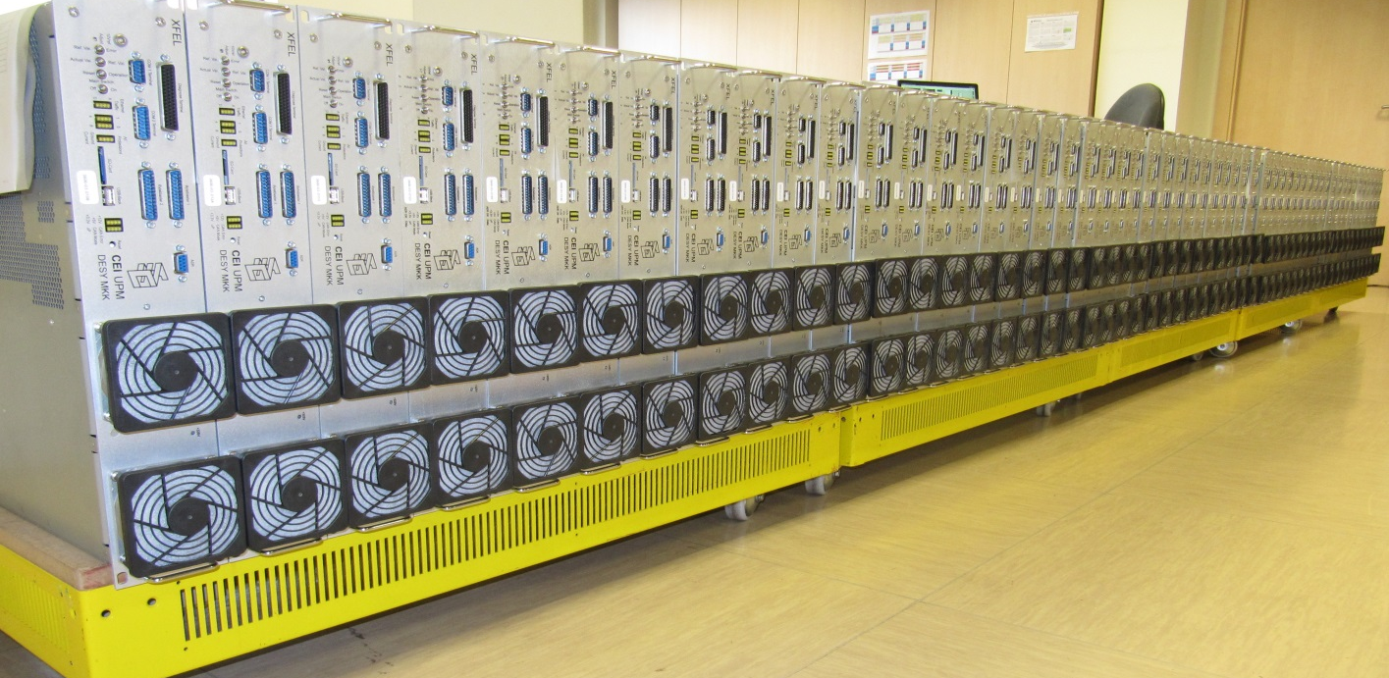



TE4892 – Upgrade of CERN Power Converters Control Electronics
José María Fernández-García [TE-EPC-MPC Technology Dept., Medium Power Converters Section] jose.maria.fernandez@cern.ch
Sup.: Dr. Hugues Thiesen
Background
Previous Project
Ingeniero Técnico Industrial, Electrónica, UMA.
Ingeniero en Automática y Electrónica Industrial, UPM.
Design and Production of 250 Power Supplies for the Superconducting Magnets of the European X-Ray Electron Laser (XFEL) main linac.
The European XFEL
10V - 50A DC/DC, 17bit precision current.
4km long tunnel at DESY. Hamburg.
Superconducting magnet load (correctors).
Topology optimized: current doubler.
Planar technology for Transformers.
Automatic instrumentation bench.
1.5M€ Public Call for Tender.
Production of 250 units in Industry.

Slide 2
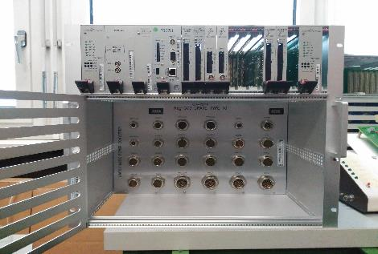







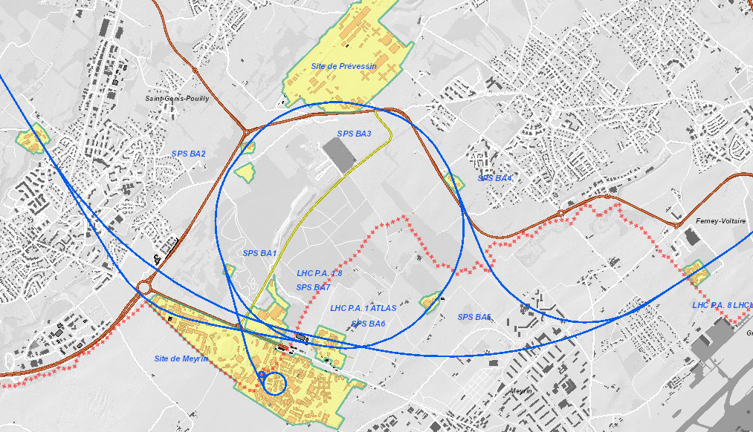
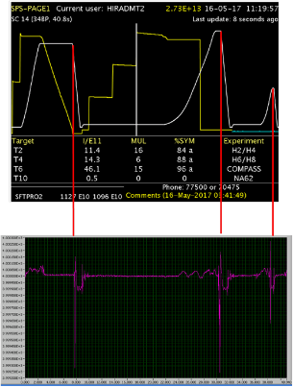
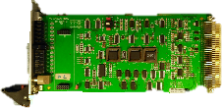
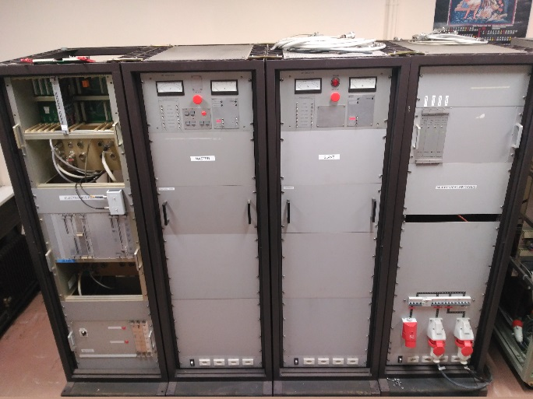
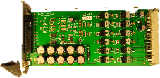
TE4892 – Upgrade of CERN Power Converters Control Electronics
José María Fernández-García [TE-EPC-MPC Technology Dept., Medium Power Converters Section] jose.maria.fernandez@cern.ch
Sup.: Dr. Hugues Thiesen
Current Work at CERN
Tools
Project leader for Type 7 Backplane.
Upgrade of Control Electronics for Power Converters.
Thyristor based converters.
Power range: Up to few MW.
CERN standard platform RegFGC3.
First crate into operation in COMPASS – 3.6MW.
Intended use: renovation of SPS Control Electronics.
B2
C1
Project Development
Project Management
Crate development and validation of new cards.
Tests in Analog “Maquette”: Reduced version of a real Power Converter already in operation.
Development of a Hardware-in-the-loop platform.
New Challenge: Upgrade of 36 Power Converters Control Electronics in Transfer Lines between SPS and LHC.
Estimated Budget: 420k CHF in 2019.

