Slide 1
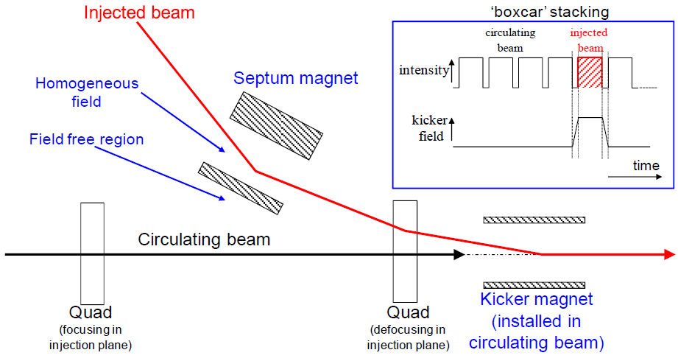
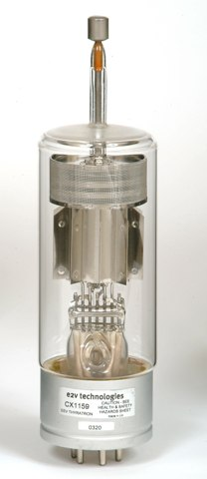
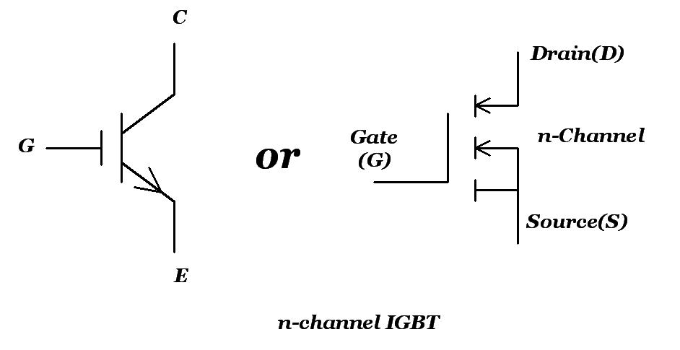
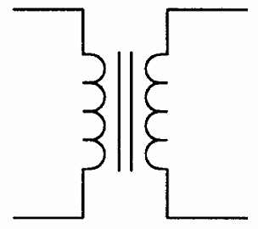
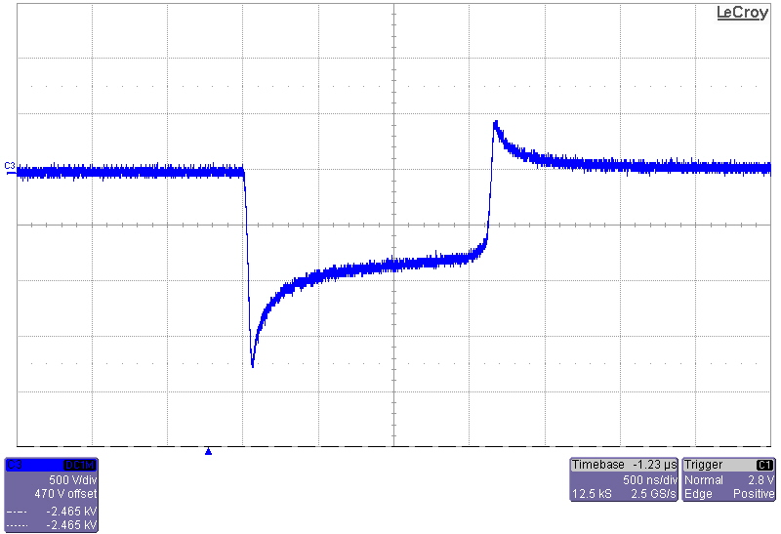
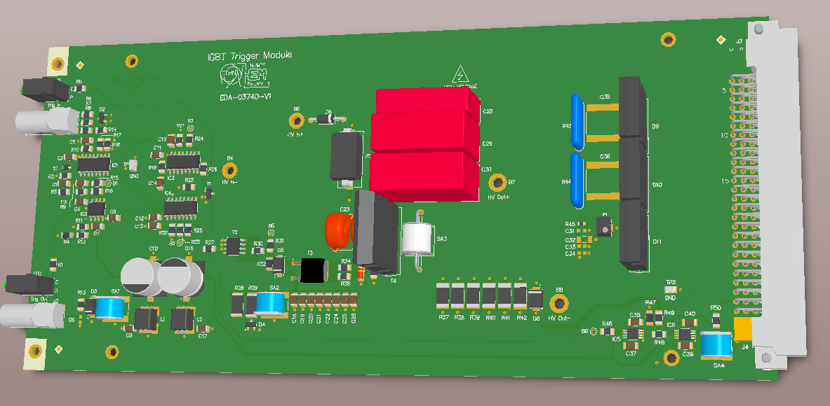
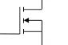
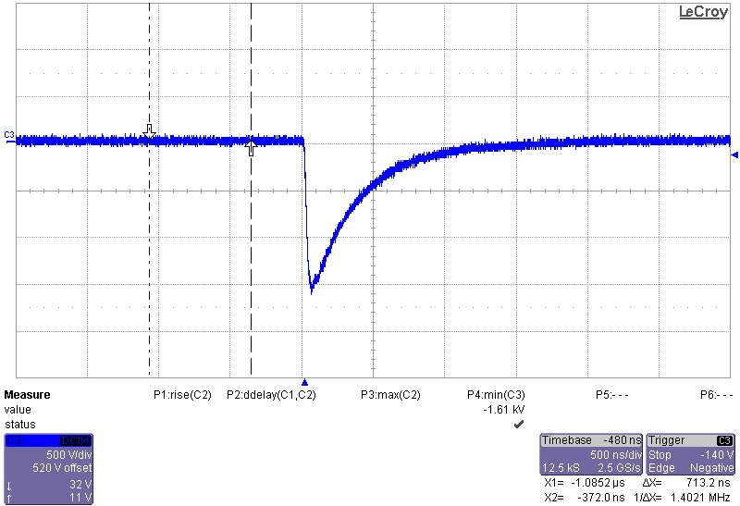


Consolidation of Thyratron Triggering Systems at CERN
E. de Nicolás Lumbreras*, L. Allonneau, E. Carlier
TE-ABT-EC
Abstract
 | Power Mos HV Trigger Amplifier | 1600V IGBT Thyratron Trigger | 400V IGBT Thyratron Trigger
Voltage (V) | 3500 | 1600 | 400
Current (A) | 70 | 32 | 12
Fall time (ns) | <50 | <300 | <300
Delay time (ns) | <250 | <300 | <300
AT CERN, Kicker magnets are used to transfer beams between accelerators. In these Kickers, thyratrons are widely used to generate high pulsed currents with fast rising and falling edges.
In the framework of the consolidation of triggering systems project, the work carried out focuses on Proton Synchrotron (PS) and Super Proton Synchrotron (SPS) facilities.
In order to create a system, different types of thyratron triggering systems have been analysed and compared.
Finally, a new system compatible with all different existing configurations have been proposed and measurements with the prototype have been taken.
Fig. 7:Thyratron triggering systems comparison
Power Mos HV Trigger Amplifier presents a better performance than the other systems even with higher voltages and currents. In addition, the output switch is not holding high voltage continuously reducing the failure rate of this system and increasing reliability.
Introduction
Measurements done in tests with real thyratron type involved show that thyratron dynamic response is affected by voltage, rise time and delay time of the triggering system. The difference of output voltage shape between both systems seems not to affect thyratron switching performance.
Kickers are fast pulsed dipole magnets, used to kick in or out circulating beam of an accelerator,
for three different operations: injection [2], extraction and beam dump.
Fig. 8:Thyratron delay and rise time vs triggering voltage
Fig. 1: Injection process layout
4000V Thyratron Trigger
The thyratron is a power switch which uses hydrogen gas as the switching medium. The switching action is achieved by a passage from the insulating properties of neutral gas to the conducting properties of ionised gas [1].
230V
AC
AC/DC
Power Supply
HV DC/DC
Power Supply
Thyratron Grid
Fig. 9: 4000V Thyratron Trigger power architecture
IGBT Trigger
Thyratron triggering systems, provides a high voltage pulse, that ionizes the thyratron hydrogen. Essentially, this system charges capacitors with high voltage and discharges these capacitors into the thyratron grid circuit.
.
The first stage have been replaced by an AC/DC power supply and the HV DC/DC power supply is responsible of the capacitor charging. Both power supplies are commercial in order to ensure good reliability in this system; furthermore, the number of modules have been reduced obtaining better modularity.
For the designing of the new system advantages of both systems have been taken into account; basically, the simplicity of the 1600V/400V IGBT Thyratron Trigger capacitor charging stage have been combined with the great performance of Power Mos HV Trigger Amplifier output stage.
Fig. 2: Thyratron
Systems Currently in operation
230V
AC
Voltage divider
Thyratron Grid
IGBT Trigger Unit
IGBT Trigger
Within new design, IGBT Trigger Unit is responsible for the discharge of the HV capacitors. In order to increment the reliability of the system Mosfet technology have been replaced by IGBT, modifying from 4 Mosfets in series for only one IGBT. Due to the fact that IGBT are slower than Mosfet, IGBT driver has been optimised to reach high dynamic performance. In addition, new features have been added such as active pulsed current measurement and output voltage measurement.
1600V/400V IGBT Thyratron Trigger are two systems used in the SPS complex. These systems consist of a HV transformer, rectifier and a filter that charges an output capacitor, up to 1720V. At triggering moment, the IGBT switch on, providing a voltage pulse at the Thyratron grid. A voltage divider is used to adapt the voltage from 1720V to the desired voltage (1600V or 400V).
Fig. 3: 1600V/400V IGBT Thyratron Trigger power architecture
IGBT Trigger Unit highlights:
Maximum Voltage 4000V
Operating voltage 3500V-400V
Operational current 70A-12A
Rise times<50ns
Delay times<200ns
Only one IGBT
Smaller than previous design
Fig. 4: 1600V Thyratron Trigger Output voltage
230V
AC
DC/DC
Power Supply
Resonant HV Power Supply
Thyratron
Grid
Fig. 10: IGBT Trigger PCB
Mosfet Trigger
Conclusions
Fig. 5: Power Mos HV Trigger Amplifier power architecture
Designing a new system compatible with existing configurations represents a big challenge. For doing so, existing systems have been deeply analyzed, outlining advantages of both systems in order to include them in the new design. Besides reliability and modularity have been key features of the new system.
Tests have revealed that voltage, rise times and delay times of the triggering systems are critical parameters for thyratron performance.
Finally, a new output stage has been designed and measurements with prototype show that optimal performance has been achieved.
Power Mos HV Trigger Amplifier is the system used in the PS complex. The first stages of the system are constituted by a rectifier, a filter and DC/DC power supply. Resonant HV Power Supply is able to charge the output capacitors quite fast, despite this is a very complex power supply and high frequency is not needed. Is Important to consider that the output capacitors are not charged all the time.
References
Fig. 6: Power Mos HV Trigger Amplifier Output voltage
[1] E2V Technologies Hydrogen Thyratrons Preamble (Sept. 2002)
[2] K.-D.Metzmacher, L.Sermeus, The PS Injection Kicker KFA45 Performance for LHC, PS/PO Note 2002-015 (Tech.) (CERN, Geneva, 2002)
  FTEC PROGRAM 2016
  *edenicolas@gmail.com

