Slide 1
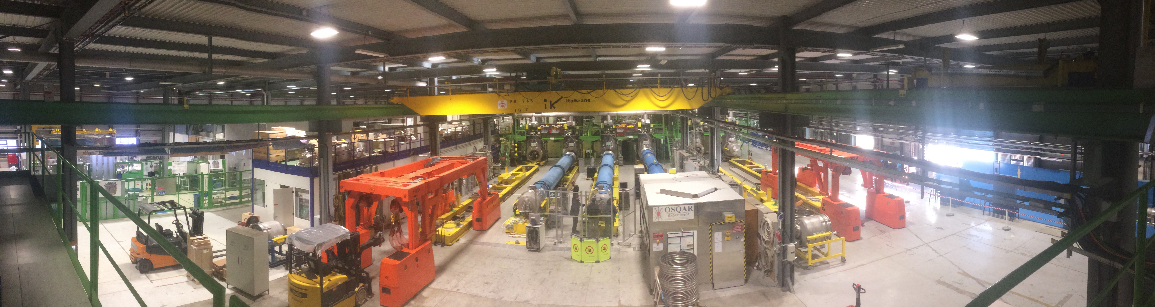
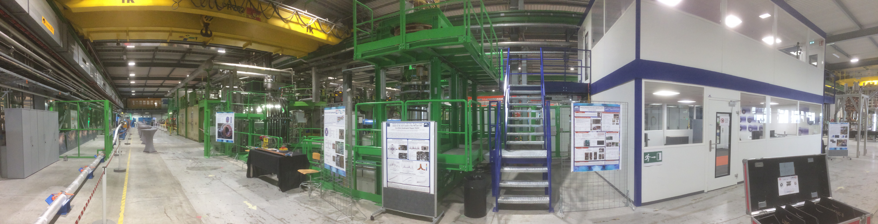
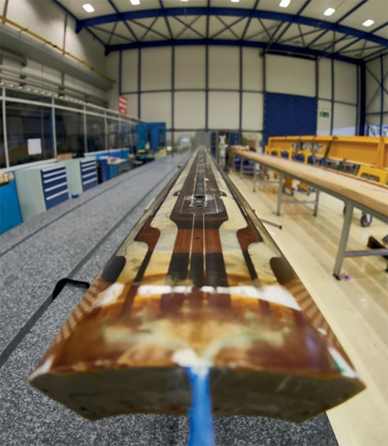
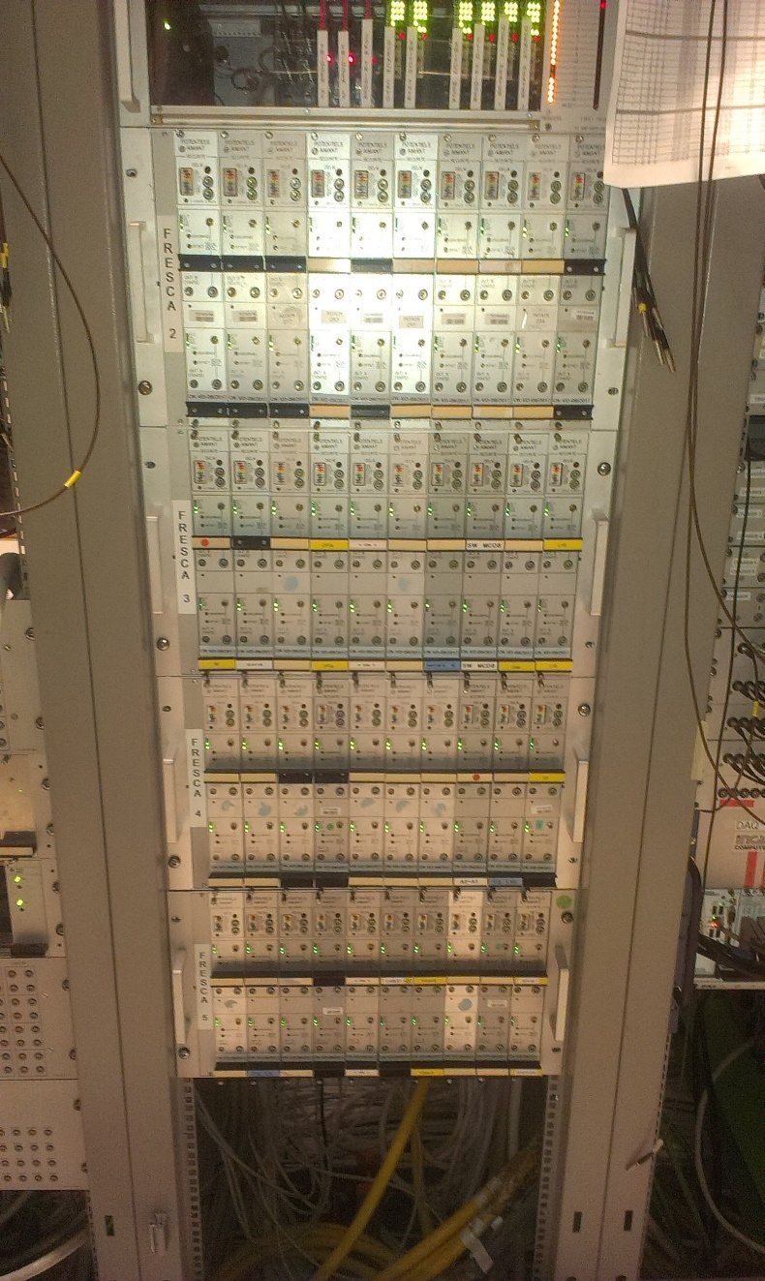
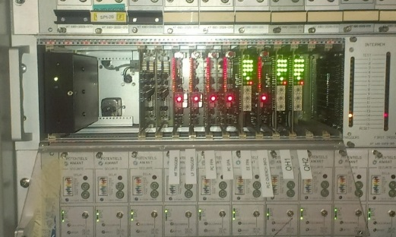
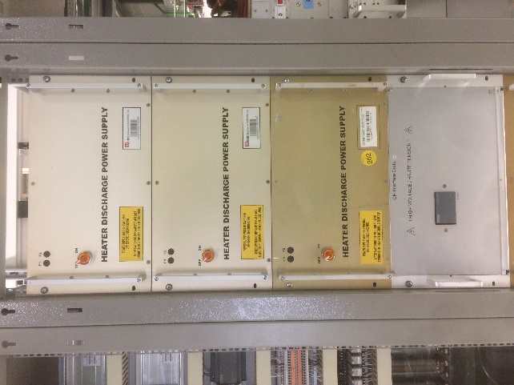
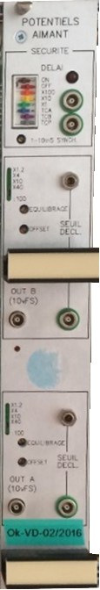
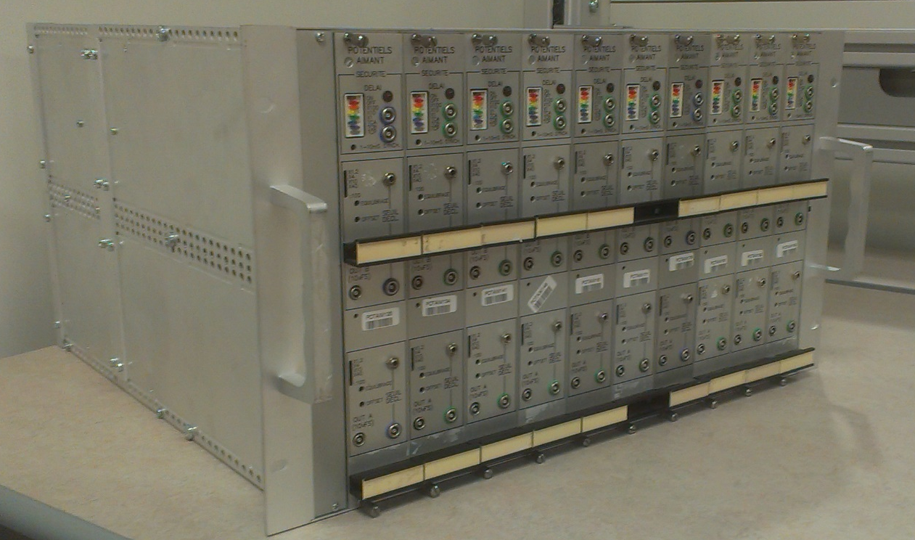
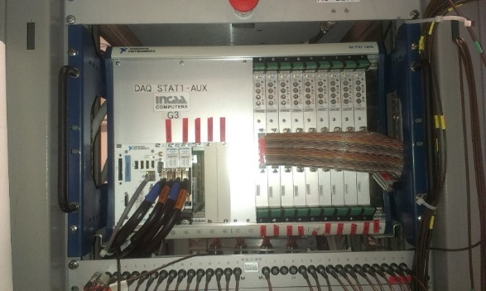
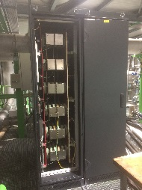
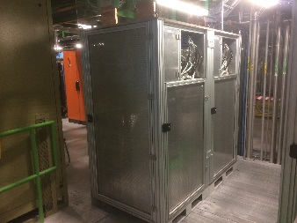
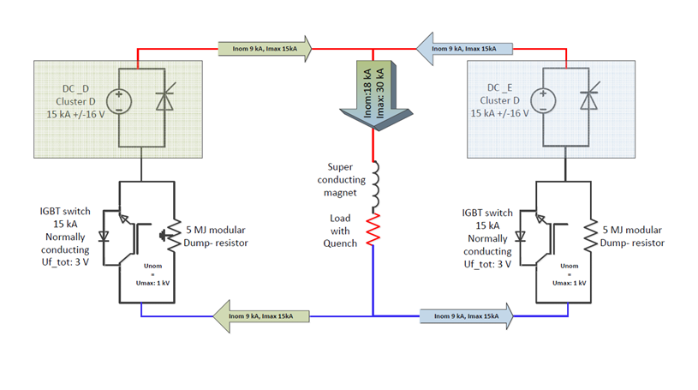
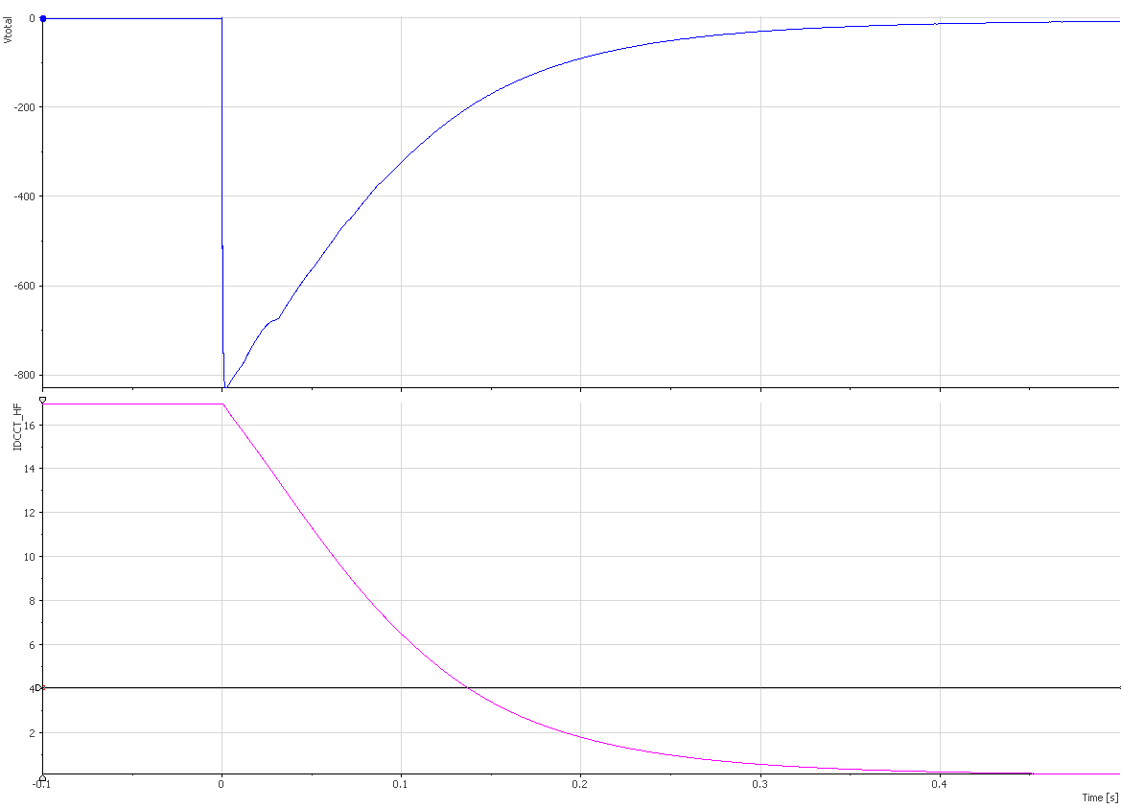
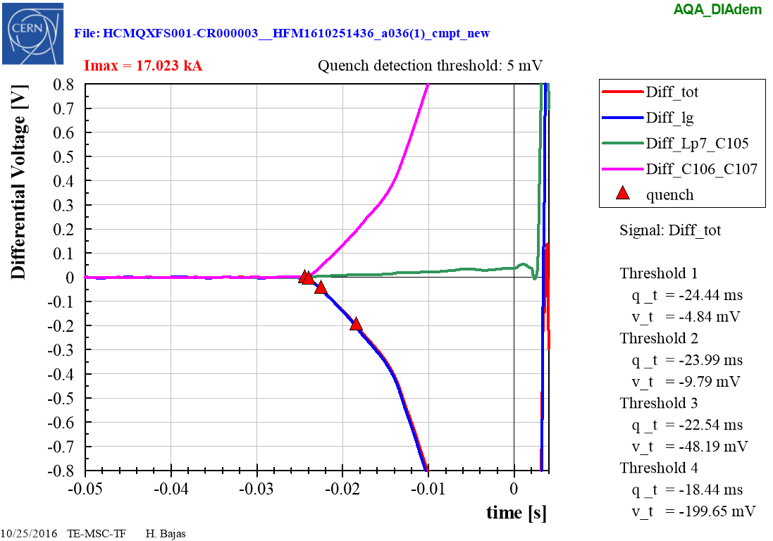
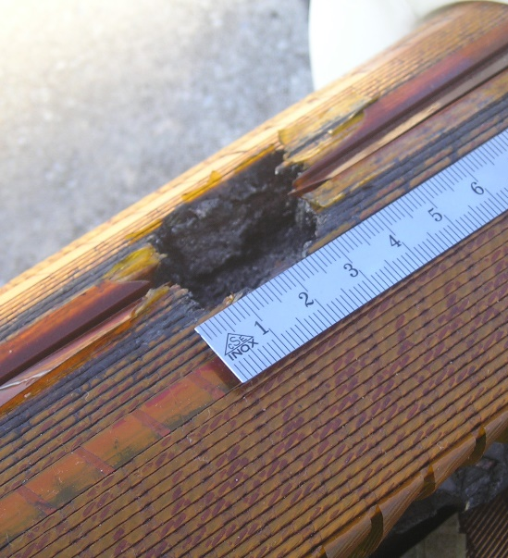
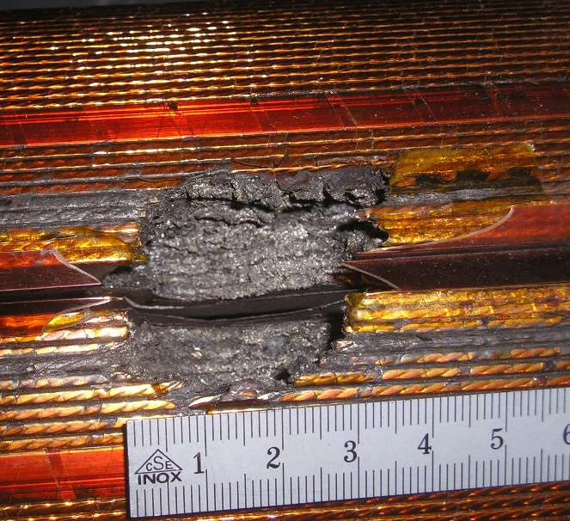
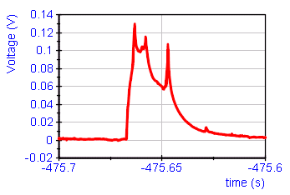
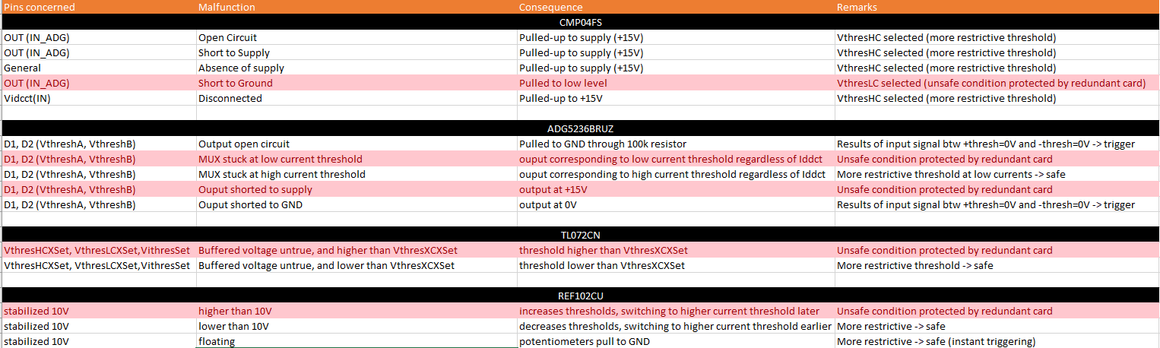
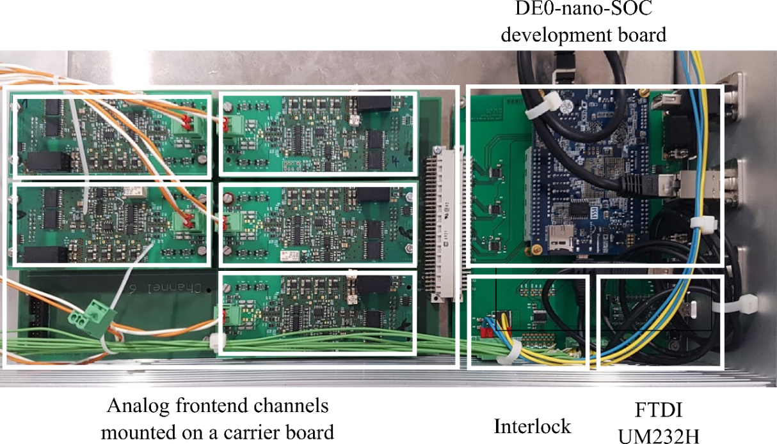
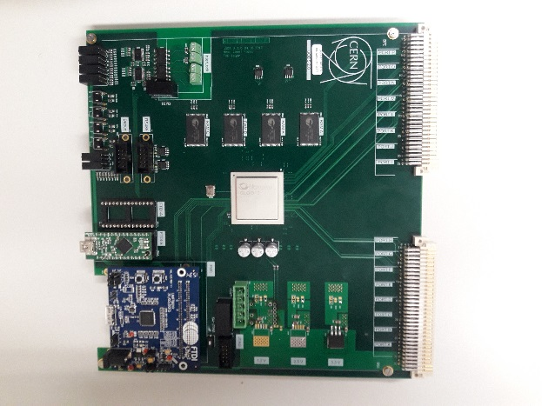
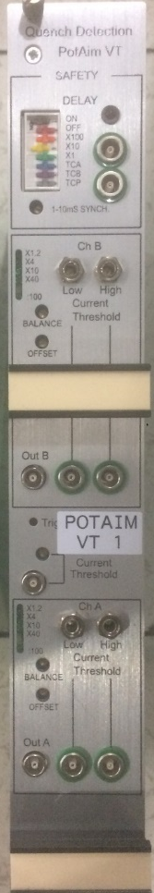
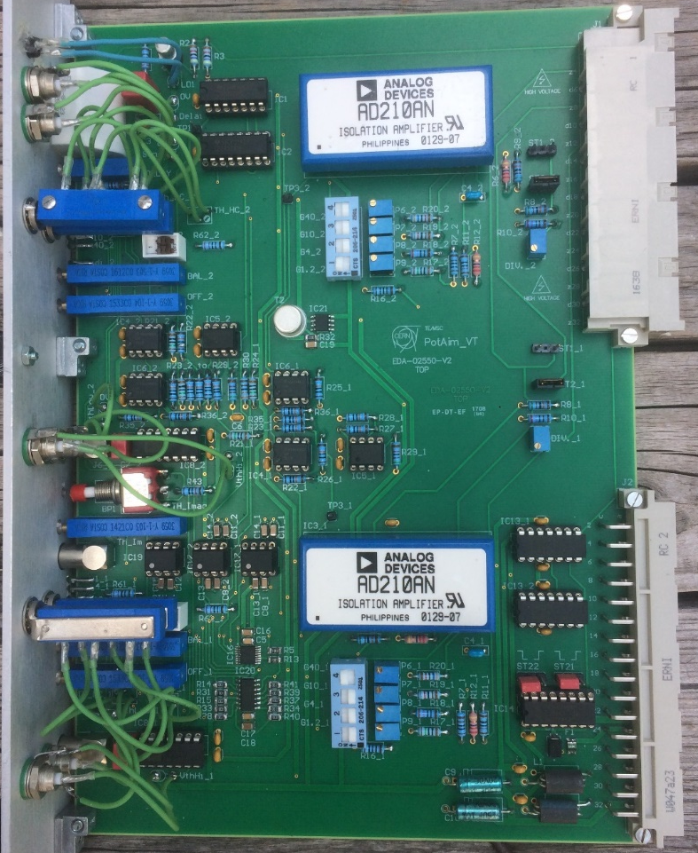
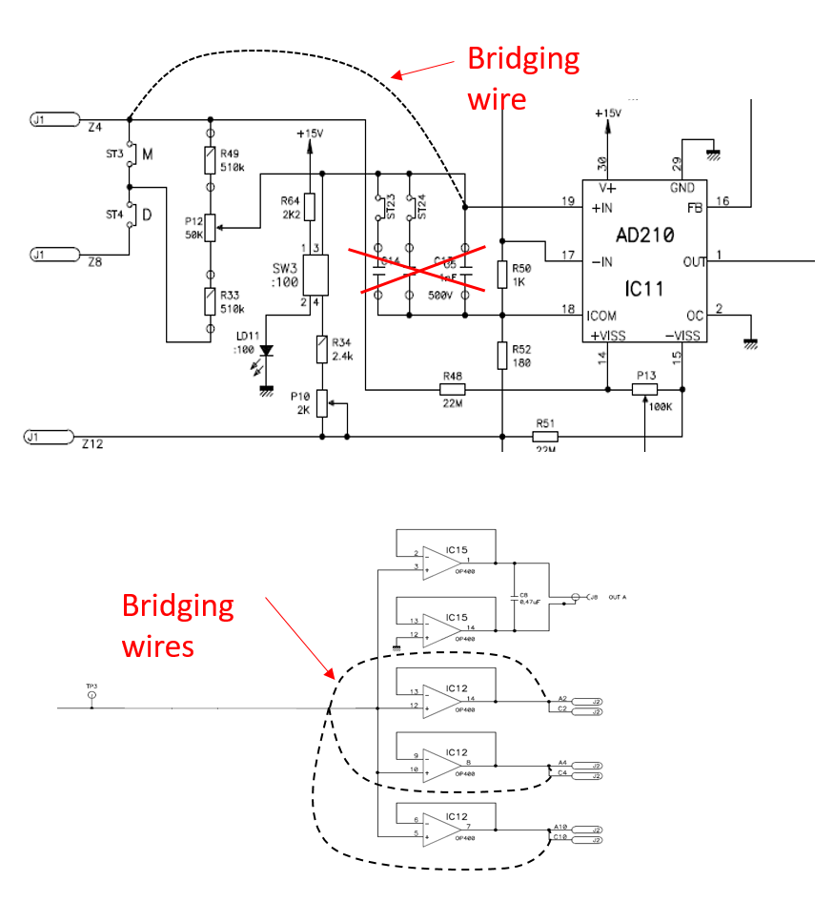
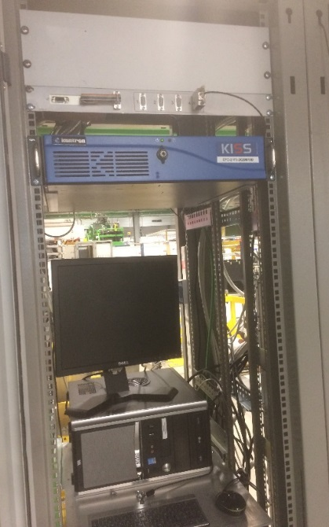
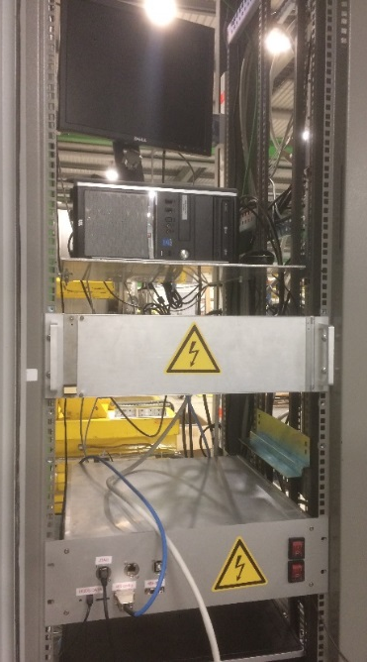
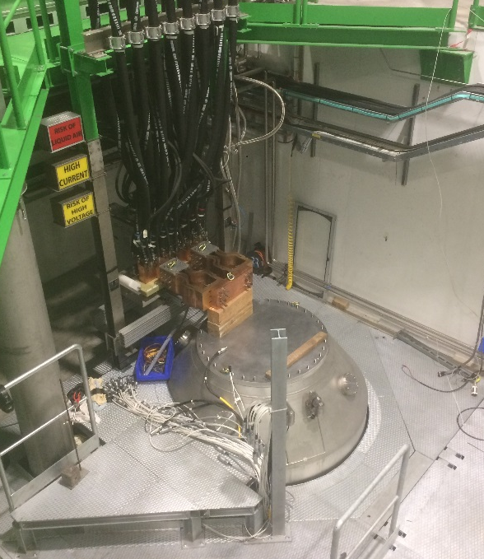
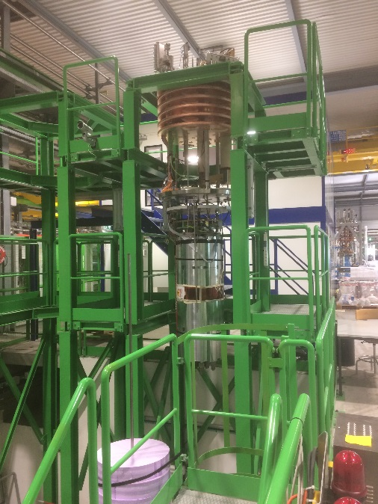
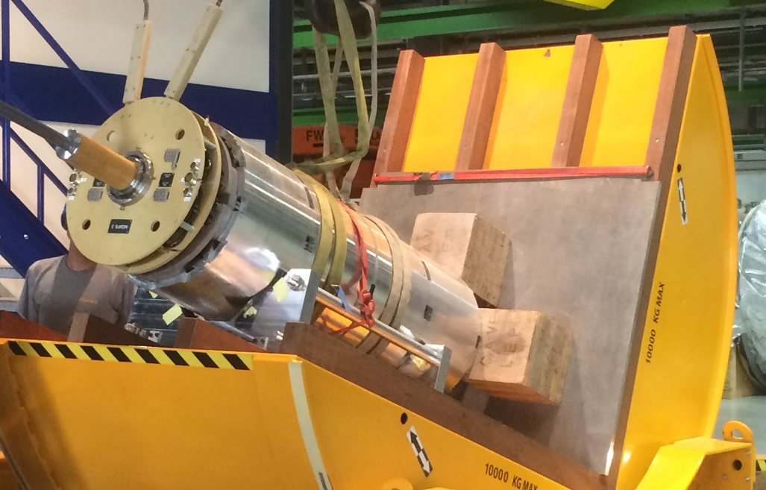
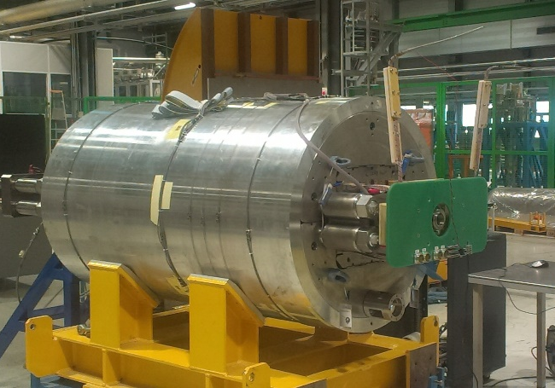
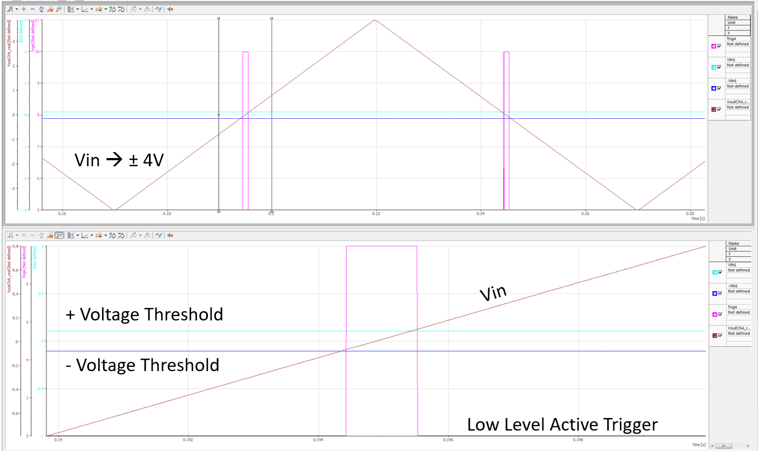
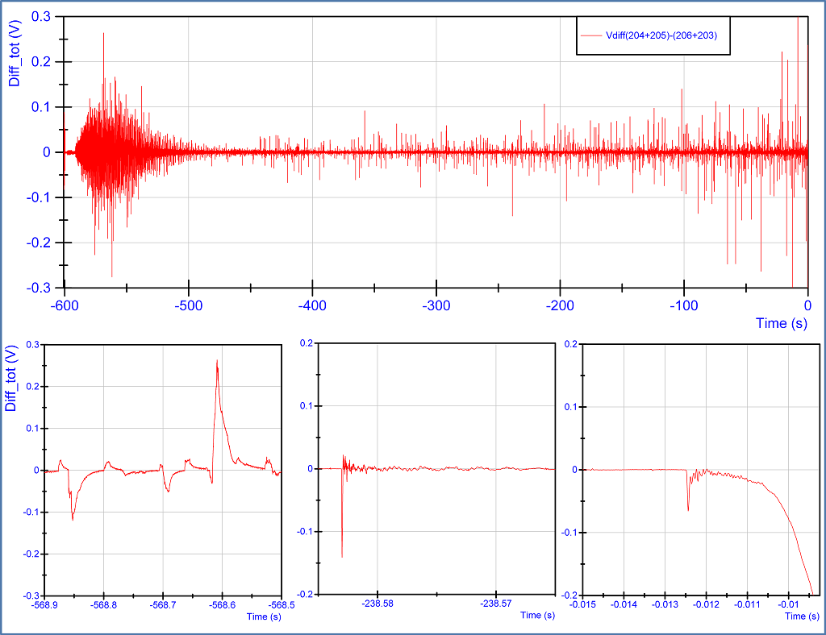
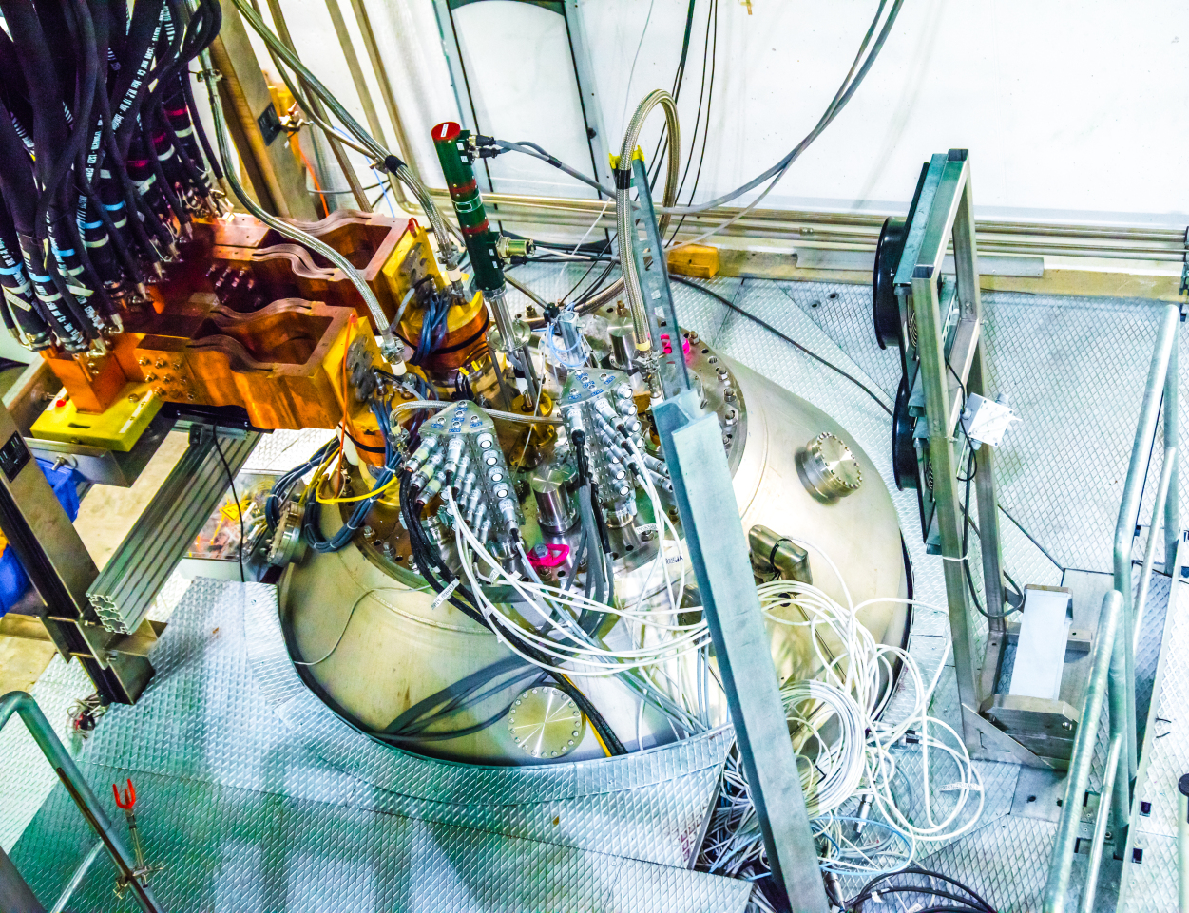
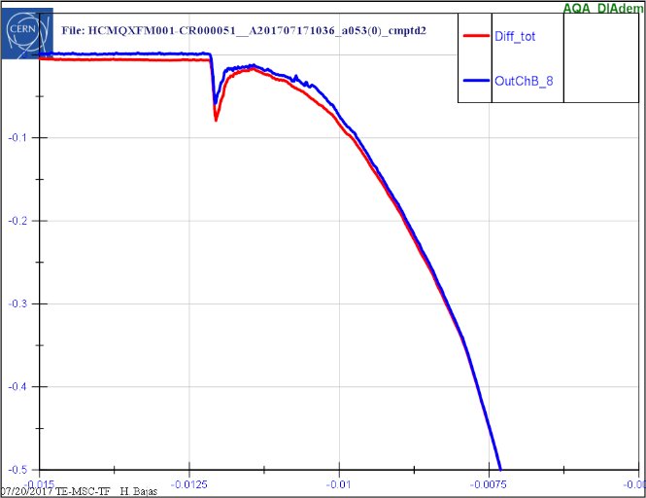
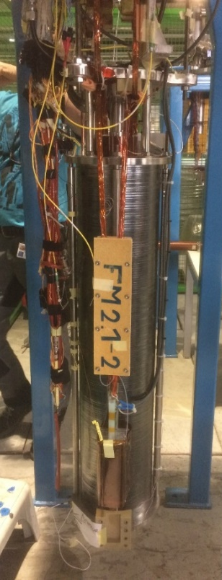
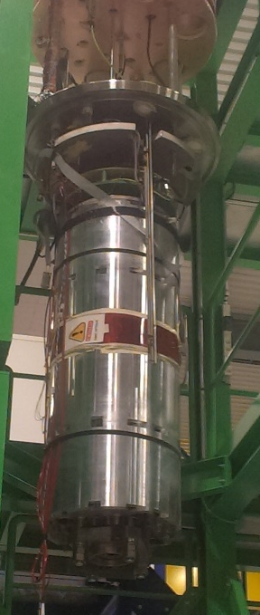
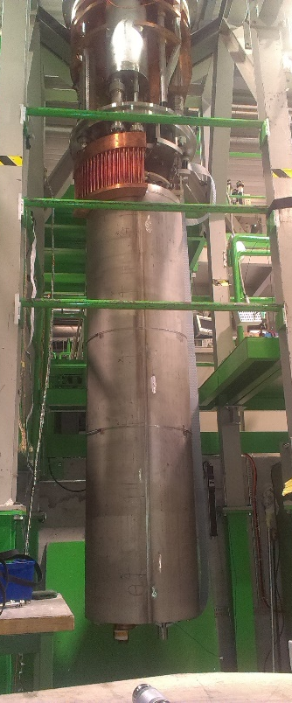
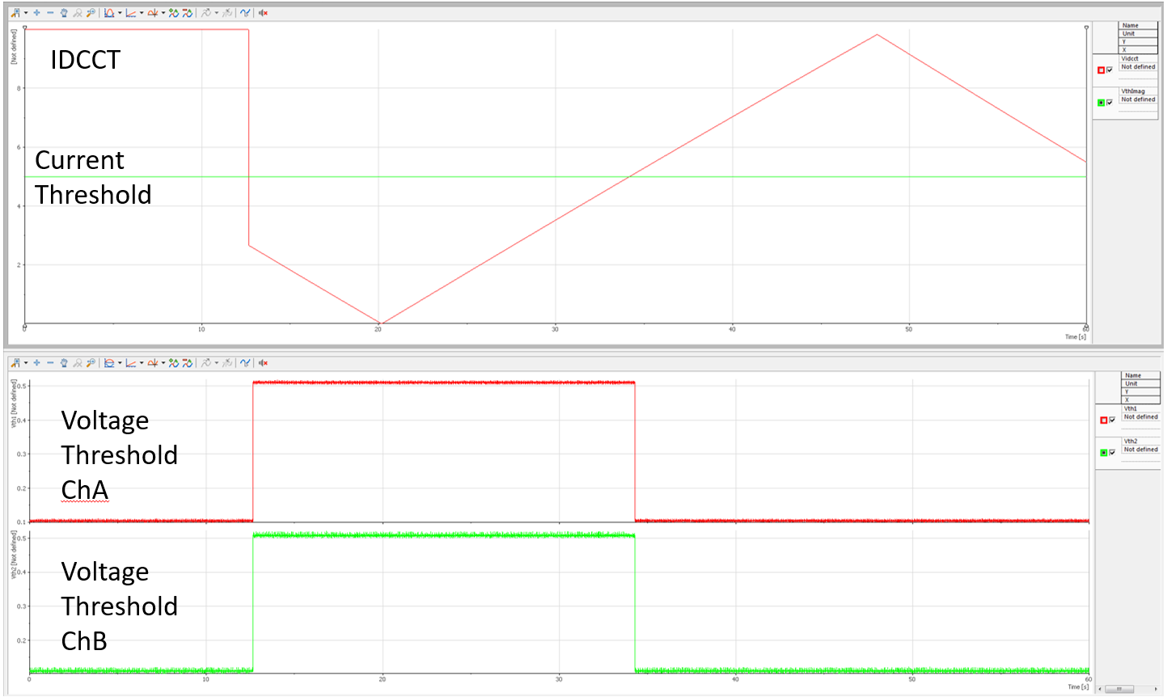


QUENCH DETECTION ELECTRONICS UPGRADE
Javier Villena Pulgar†, Daniel Turi, Max Pascal, Gerard Willering, Hugo Bajas
(Centro de Investigaciones Energéticas, Medioambientales y Tecnológicas – CERN)*
Abstract
Magnet Protection and DAQ System
With the advent of the Nb₃Sn magnets for the HL-LHC upgrade, new technical challenges have arisen in terms of flexibility, reliability and measurement quality in SM18 facilities. One of such challenges deals with the superconducting magnets quench detection system used during the cold powering tests of LHC present and future magnets. An upgrade of this quench detection system is presented here.
Trigger Distribution System
Electronics from the 80’s : PotAim
PotAim Crate
Potentiel Aimant (a.k.a. PotAim) is the system used in the SM18 to:
Sense and Amplify voltage in the magnet taps.
Two modes: Single and Differential
Detect Magnet Quench: An analog circuit compares the voltage in the output with a voltage threshold previously set in the card. If the output voltage surpass this threshold during a specific configurable time, the card sends a Quench Detection Signal to the Safety Matrix.
Isolate magnet electrical domain to electronics domain.
Quench Detection System
Quench Heaters Supply
Data Acquisition System
Energy Extraction System
This is what happens when protection system is not working … or even worst.
Cluster D Electrical Scheme:
Two 15kA Power Converters in Parallel plus Energy Extraction System
Energy Extraction Event during magnet testing
PotAim Upgrade
Variable Threshold Failures Mode Study
Future Implementations
Motivation
Some Nb₃Sn Magnets present flux jumps at currents far below the nominal current. (Right figure)
PotAim card presents a very low bandwidth (600Hz) which avoids flux jumps waveforms to be seen correctly.
Power Converters transients during initialization can trip accidentally the protections.
uQDS (Universal Quench Detection System), is proposed as a candidate to replace the current detection system in SM18 (PotAim Cards). TE-MPE-EP section at CERN develops this electronic system for Hi-Lumi upgrade.
Backwards compatibility
Minimal modification in PotAim crate. Only IDCCT signal has to be provided to PotAim Crate.
uQDS v1.5
uQDS v2
cerntsnew.cern.ch
PotAim Variable Threshold
cerntsnew.cern.ch
PotAim Extended Bandwidth
Image courtesy of MPE-EP section
Part of the development testing for uQDS have being carried out in SM18 test facilities
Tests
uQDS system installed in Cluster D
Cluster D Cryostat and MQXFS5 Magnet
Functional Tests
SC Magnet Tests
In the figure below, data acquired with uQDS v1.5.
All the plots show the total differential voltage during injecting current up to quench (about 18kA).
Five tests in real magnets have been done so far to compare PotAim VT performance vs PotAim.
They have shown good agreement between signals.
MQXFS-3C
Fresca2
Vertical cryostat in Cluster D during MQXFS-5 test
Voltage output comparison between old PotAim and PotAim Variable Threshold
Conclusions
FeatherM2
MQXFS-5
11T Dipole
Acknowledgements
Short-term solutions have been designed, manufactured and now they are in the final testing stage of validation to be used to protect Nb₃Sn magnets. However there are still some upgrades required for future tests in SM18. Digitization of the voltage reading at high frequency will increase the flexibility for smart filtering and processing the signals for quench detection, preventing false trips and more precise quench detection. It will also help to analyse the processes around the quench, especially precursors and cable movement that generate signals up to a few kHz. Finally, the remote control of protection system configuration settings will enhance and simplify magnet test operation.
To the whole SM18 team (Engineers, Operators, Mechanics, Logistics) for their constant support in the tests and study of the new PotAim Cards. Special thanks to G. Willering, H. Bajas, F. J. Mangiarotti, J. Feuvrier, V. Desbiolles, P. Viret, F. Rougemont, Y. Thuau, B. Mouches, A. Azarkan, F. Flamand for their valuable help during these last months. Also thanks to MPE-EP team for the photographs of uQDS displayed here.
  *This work has been funded by CERN and Ciemat
  †jav.villena@gmail.com

