Slide 1


Radiation hard electronics for ATLAS and CMS pixel detector upgrades
Luis Miguel Jara Casas
28/04/2016
EP-ESE-ME
Experimental Physics department, Electronics Systems for Experiments group, Microelectronics section.
Supervisor: Jorgen Christiansen

Slide 2
Outline
Introduction.
E-links for CMS pixel readout chip.
Test system for DRAD chip.
Challenges, conclusions and next steps.

Slide 3
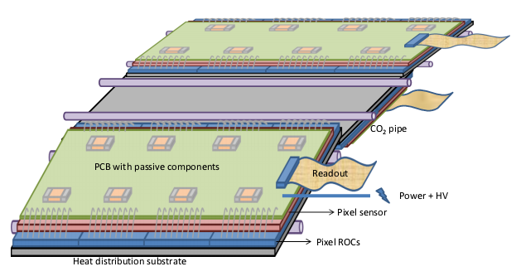
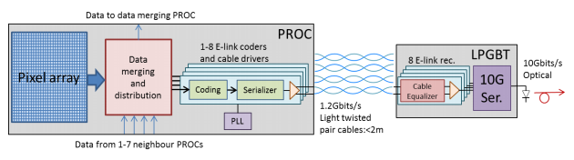
1.Introduction:
RD53 collaboration: working in the extrapolation of the hybrid pixel detector for the HL-LHC: major challenges for the pixel readout integrated circuits:
  Smaller pixels.
  Higher hit rates (1-3 GHz/cm²).
  Unprecedented radiation tolerance (10MGy)
    10.000 x space electronics.
  Higher output bandwidth.
  Mass and space constraints.
Readout cables for the chip.
Radiation effects in electronics at these levels.

Slide 4
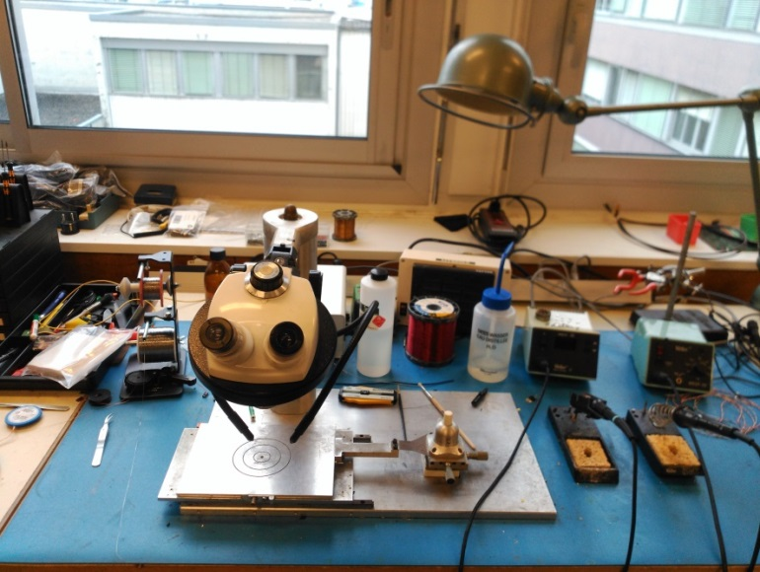
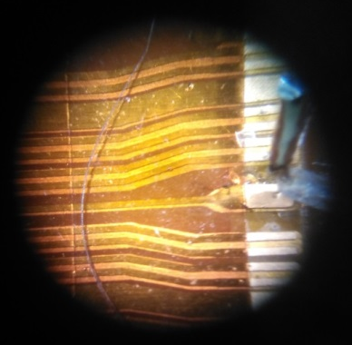
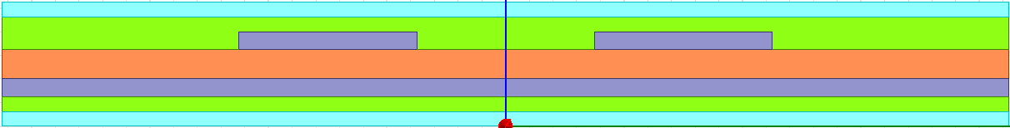
2.E-links for CMS pixel readout chip
  Target: development of s-parameters models for different cable cross sections and geometrical shapes.
  Optimization of the readout cables in terms of mass, signal integrity and radiation tolerance.
  Total of ≈6000 readout cables for all layers and ring disks, big contribution in material budget.
  Simulations were done for different cables.
eyelash
250μm
250μm
250μm
Isolator: 25 μm
Alu+Glue: 30+12.5 μm
Kapton: 55μm
Glue: 12.5 μm
Isolator: 25 μm

Slide 6
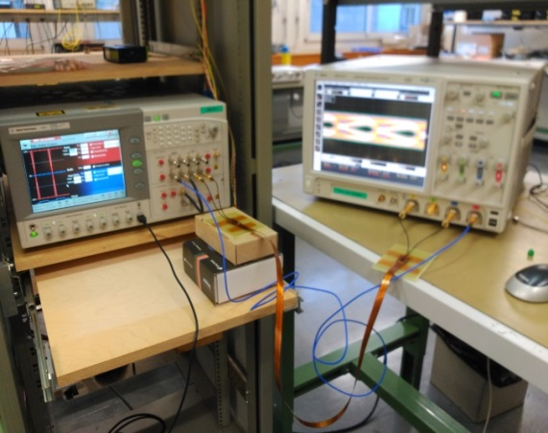
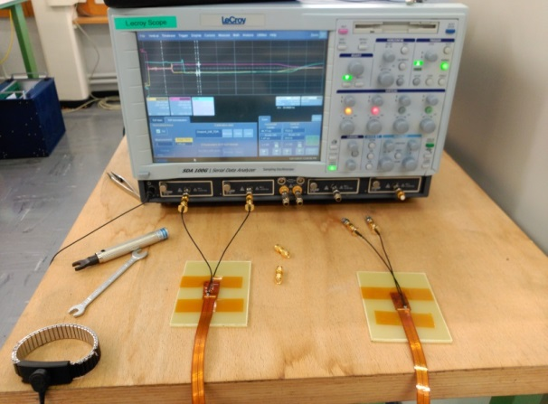
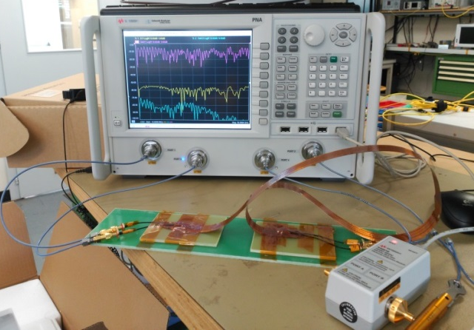
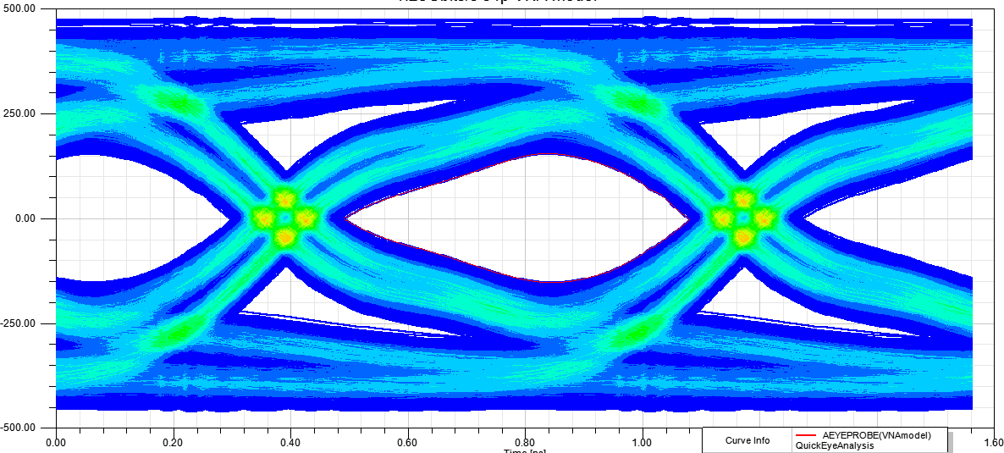
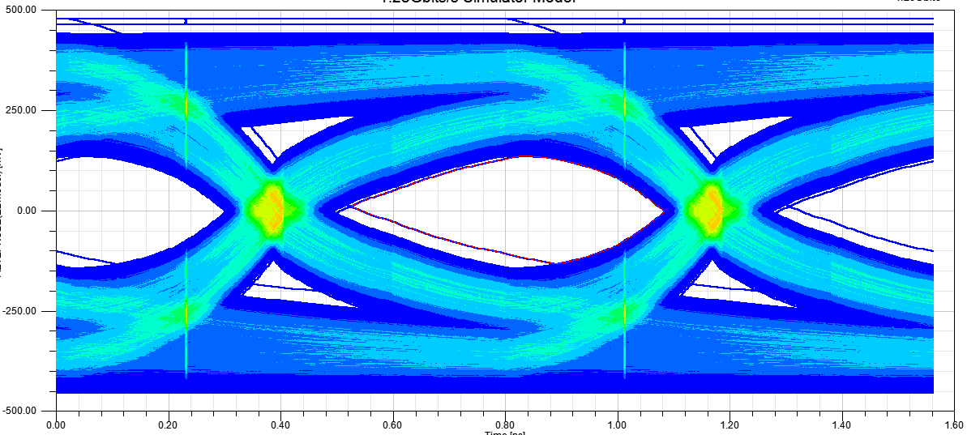
2.E-links for CMS pixel readout chip
Pulse generator and bit error test analyzer.
Time domain reflectometer
Vector network analyzer
MEASUREMENTS
SIMULATIONS
  Data rate:
  1.28Gbits/s

Slide 7
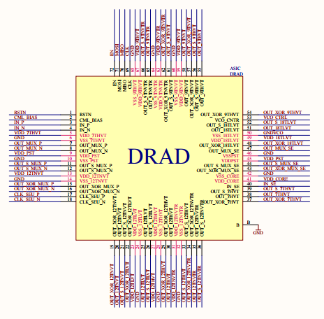
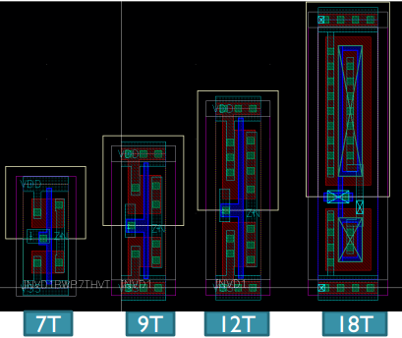
3. Test system for DRAD chip.
  Target: study of the radiation impact on digital standard cells. 65nm TSMC technology.
  DRAD (Digital-Radiation) chip: different test structures designed to measure delay degradation of standard cells on silicon.
  Every test structure is repeated with custom standard cell libraries:
    Increasing device dimensions.
    Different flavours.
    Different number of tracks.
CELL HEIGHT
7 Track: 1.4 μm
9 Track: 1.8μm
12 Track: 2.4 μm
18 Track: 3.6 μm

Slide 8

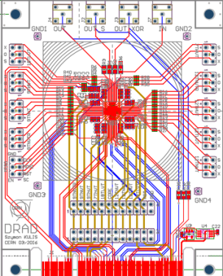
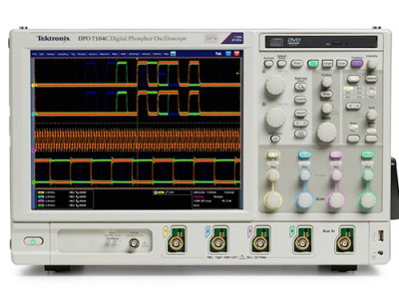
3. Test system for DRAD chip.
IP-Bus protocol
  Task: development of the test system for this chip.
  Hardware: Atlys-Spartan 6 FPGA, uASIC Board, chip board.
  Software: IP-Bus protocol to communicate with FPGA, scripts in Python for data saving and communication with oscilloscope.
  Firmware: developed in VHDL and Verilog
ATLYS Board
uASIC Board
New Chip Board
  Similar projects have been used as a starting point (software, firmware and hardware)
Python scripts and SCPI commands

Slide 9
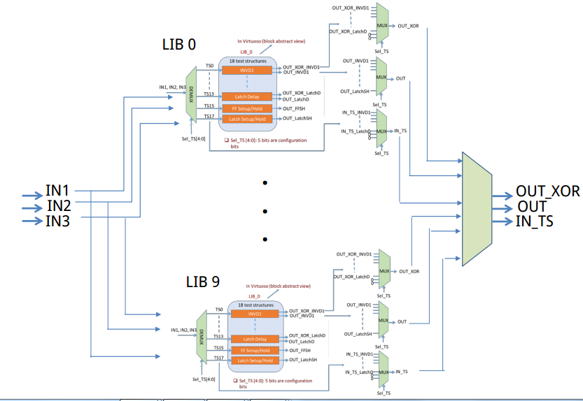
3. Test system for DRAD chip.
18 tests structures replicated in 9 different libraries

Slide 10
4.Challenges, conclusions and next steps:
We have simulated and measured different readout cables for CMS readout chip, obtaining S-parameter models of them.
I have been involved in the development of a test system for a chip which target is the study of radiation effects in electronics,.
Last challenges: get involved and learn how to develop a test system for a chip.
Next steps: DRAD chip will be delivered ≈23rd of May, I will be focused in the test system for the chip.

Slide 11
Thank you!

Slide 12
Backup slides

Slide 13
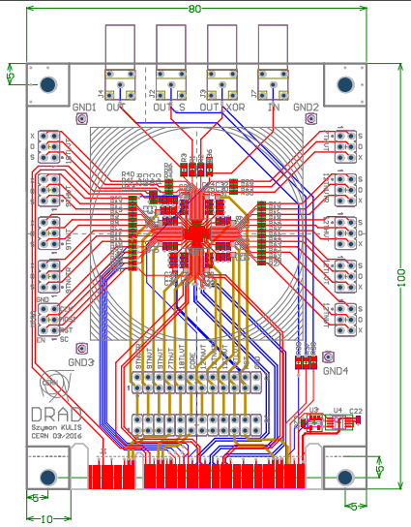
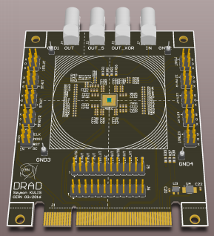

Slide 14
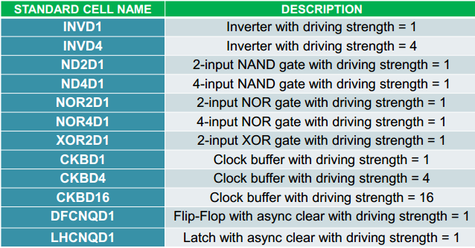
Standard cells:

Slide 15
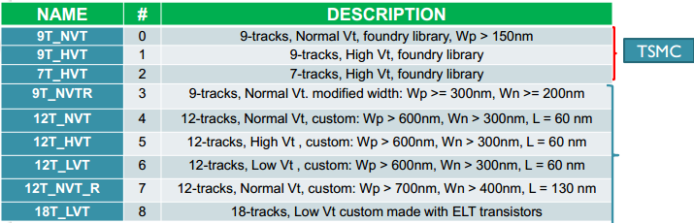
Libraries:

Slide 16
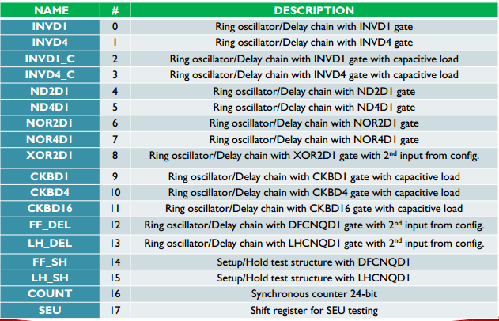
Test structures:

Slide 17
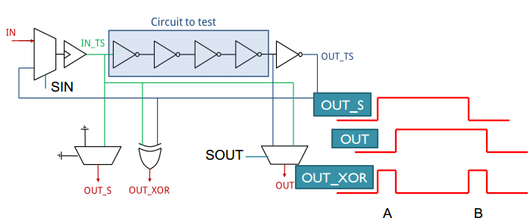
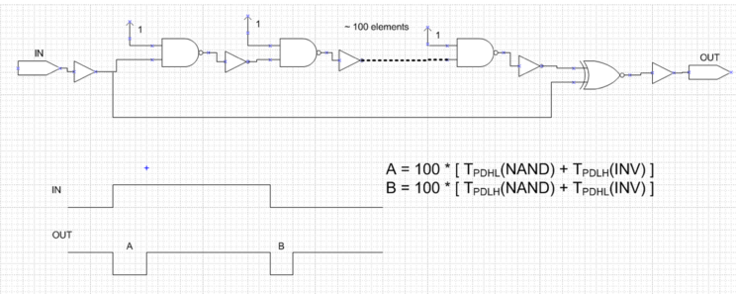
Ring oscillators/delay chains:

Slide 18
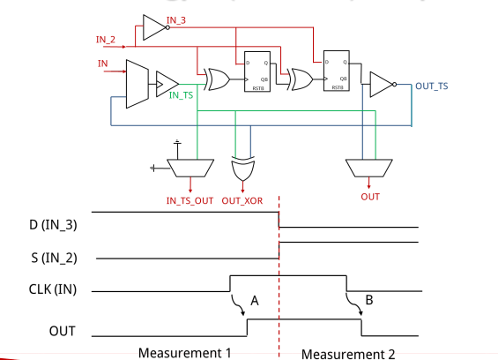
Ring oscillators/delay chains:

Slide 19
Ring oscillators/delay chains:

Slide 20
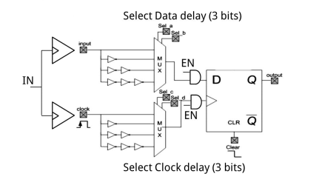
Setup/Hold measurements:

Slide 21
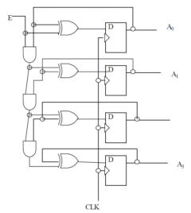
Synchronous Counter:

