Slide 2


Magnet Design and Construction
2nd Workshop of the Spanish Traineeship Programme FTEC 2015
José Luis Rudeiros Fernández
Supervisor: Frédéric Savary

Slide 3
Contents
Procurement of components
Laser measurement system
Analysis and Characterisation of the E-modulus of the 11T Dipole Coil
Summary & Short-Term Action Plan

Slide 4
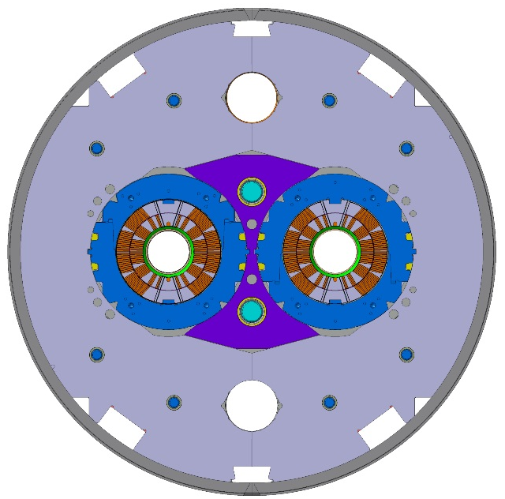
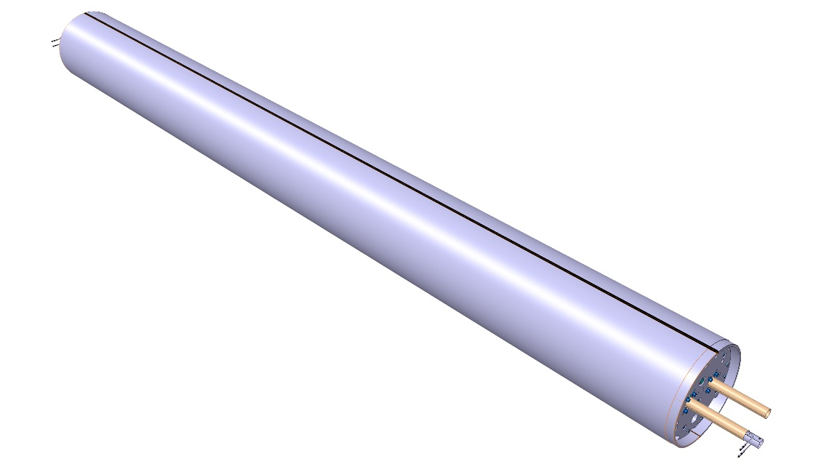
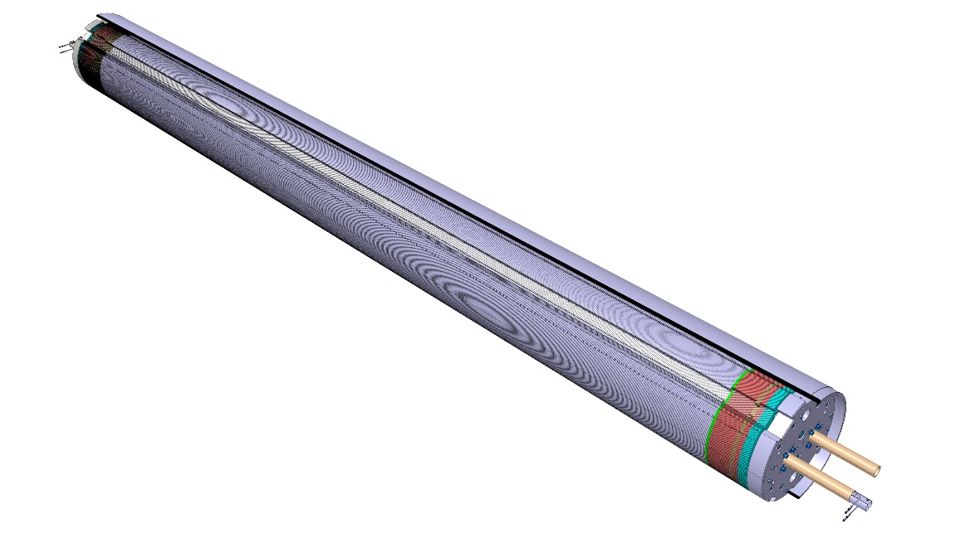
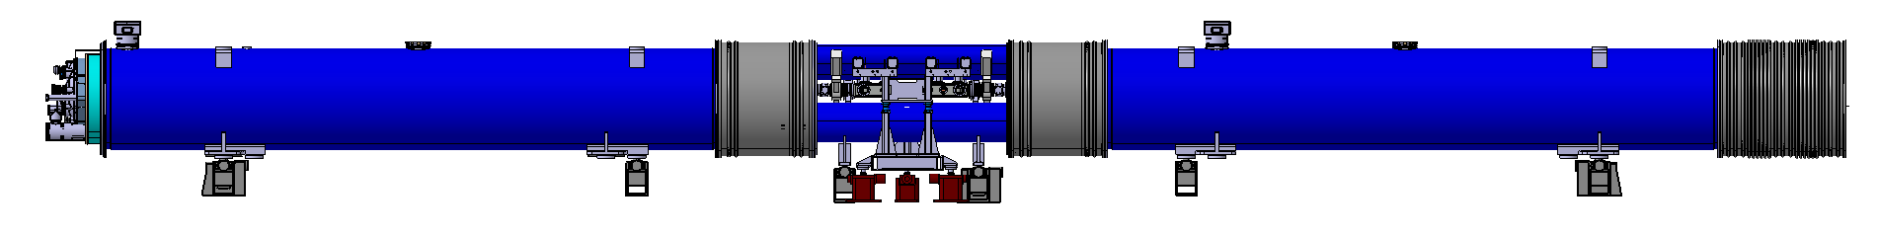
1. Procurement of components
Prototype of the 11T dipole (MBH) for HL-LHC
Shell
Yoke Lamination
6500 mm
Central Lamination
15660 mm
11 T dipole cold mass

Slide 5
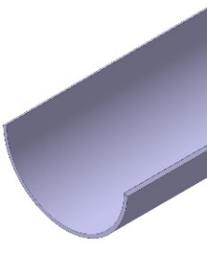


1. Procurement of components
Prototype of the 11T dipole (MBH) for HL-LHC
Announcement
Price Enquiry
Order
Follow-up
Discussions
Follow up
Technical specifications
Technical specifications
Sending to potential bidders
Bid opening
Technical evaluation
Bid assessment and negotiation
DAI
Departmental request
First draft sent to procurement team
Final version ready
Supplier requests a change in the DAI
15 Firms
Raw material needed
Technical annex to tender form
Tender form
Material request
Discussions
Technical specifications
Sending to potential bidders
Bid opening
DAI
Follow up
Technical specifications
Technical evaluation
Bid assessment and negotiation
Departmental request
Final version ready
First draft sent to procurement team
14 Firms
Technical visit
Technical annex to tender form
Tender form
06/08/2015
04/09/2015
05/10/2015
19/10/2015
27/10/2015
25/11/2015
30/11/2015
22/01/2016
12/02/2016
25/02/2016
07/03/2016

Slide 6
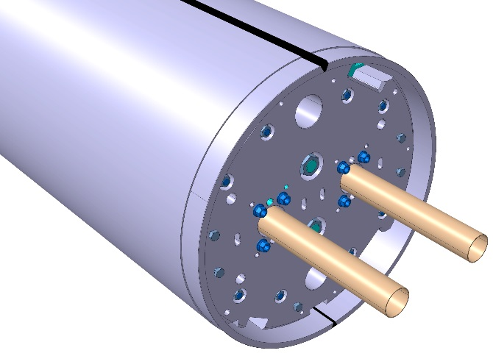
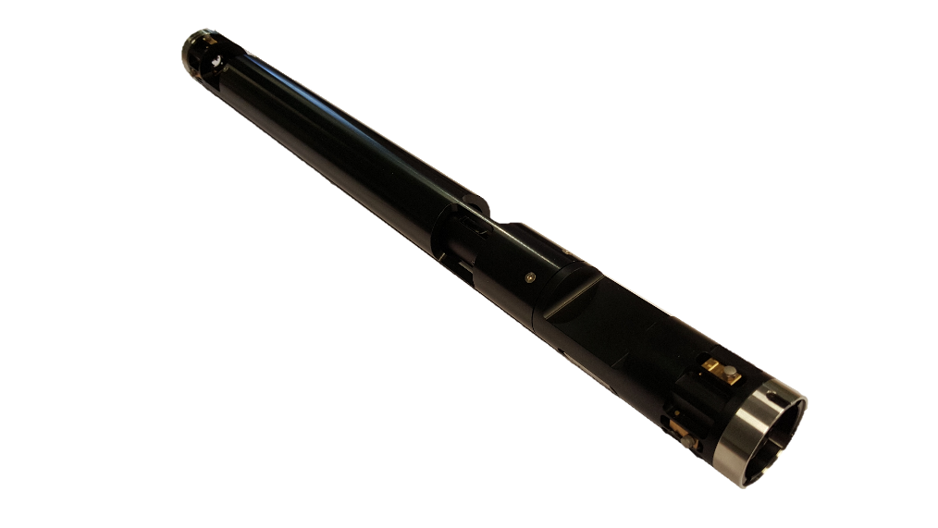
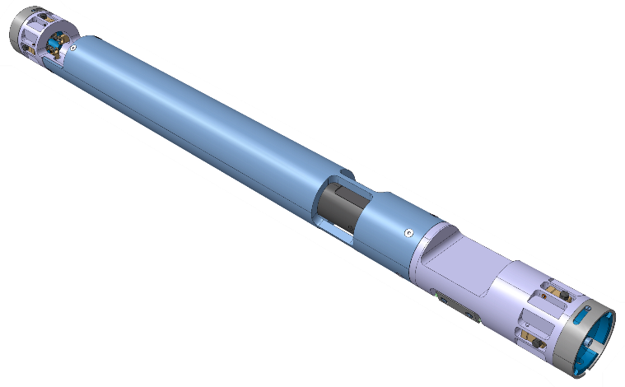
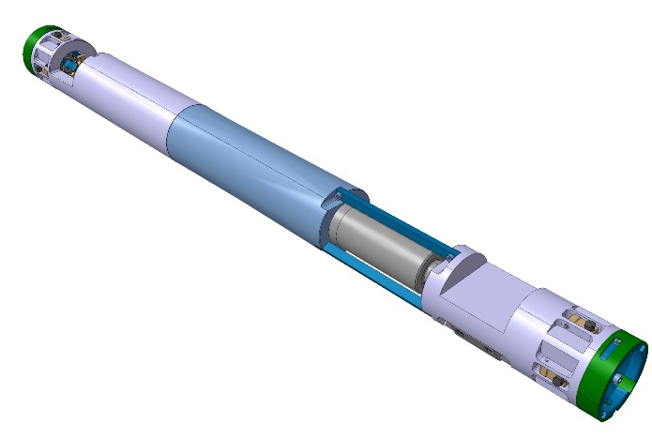
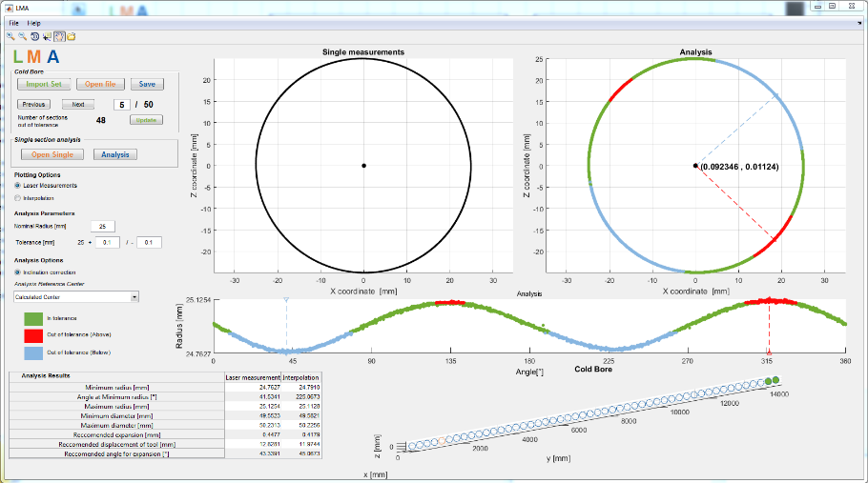
2. Laser Measurement System
Redesigned
Manufactured
z
y
x
y
[x₀,y₀]
x
LMA software
Redesigned UI
& Improved Functionality
Characterise any deformation in the cold bore

Slide 7
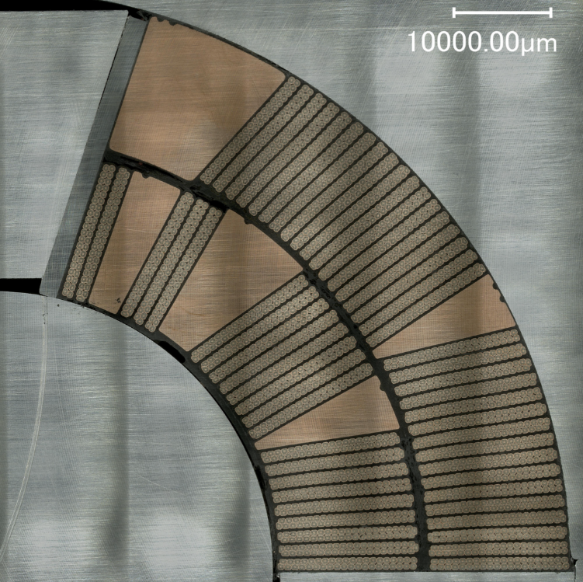
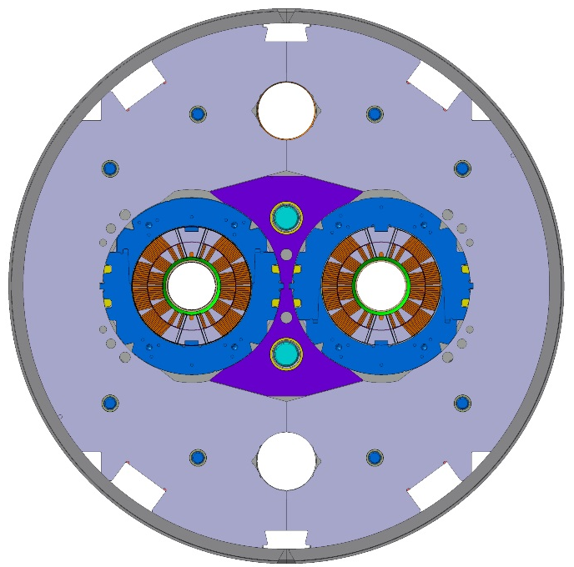
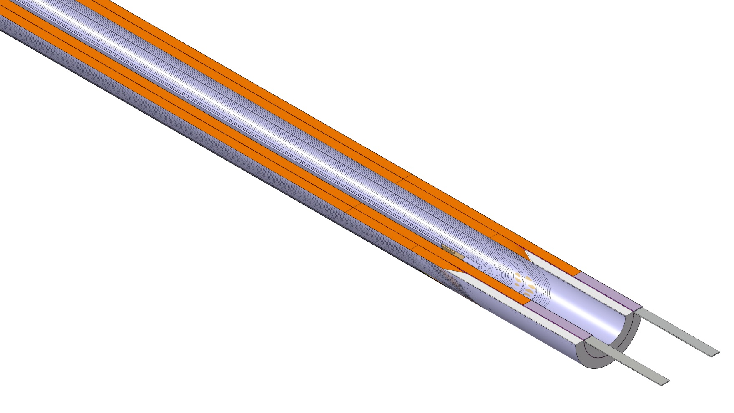
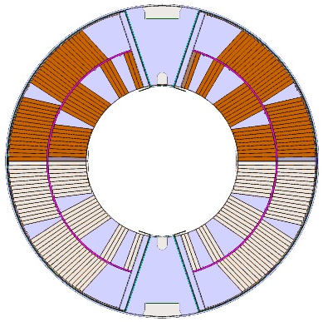
3. Analysis and Characterisation of the E-modulus of the 11T Dipole Coil
*
11T Paired Coils
11T Dipole
Cross Section
11T Coil
*Image from: Collaboration meeting on DS 11T Dipole grounds CERN technological choices: Cable insulation and coils - D. Smekens

Slide 8
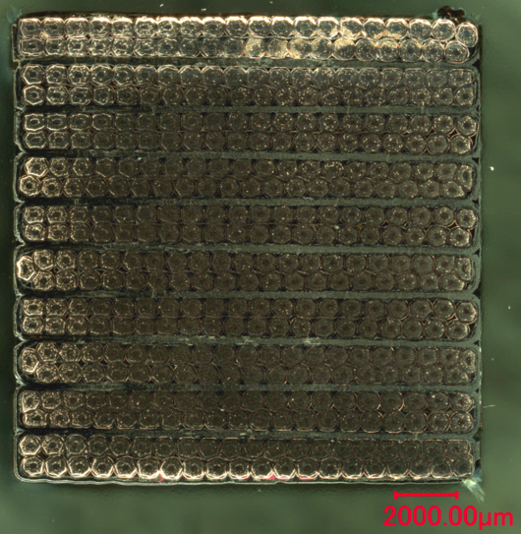
3. Analysis and Characterisation of the E-modulus of the 11T Dipole Coil
10-stack
*
Simplified model
*Image from: Collaboration meeting on DS 11T Dipole grounds CERN technological choices: Cable insulation and coils - D. Smekens

Slide 9
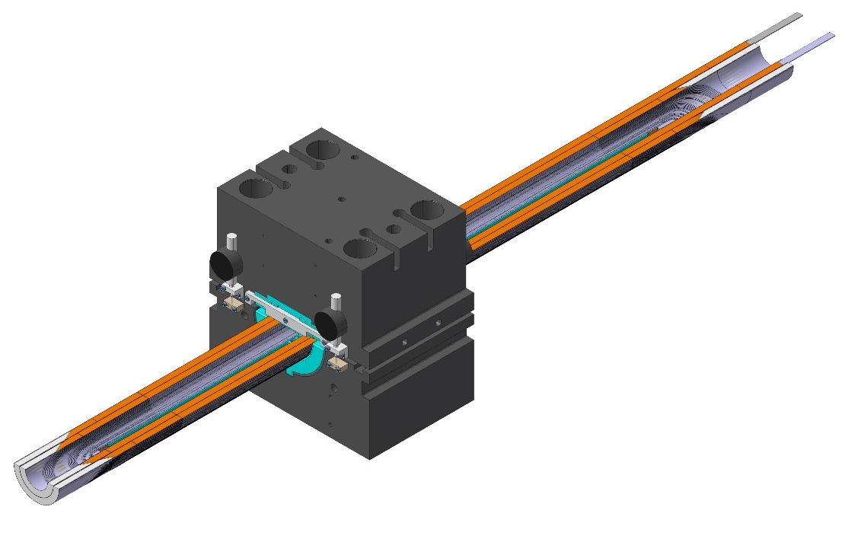
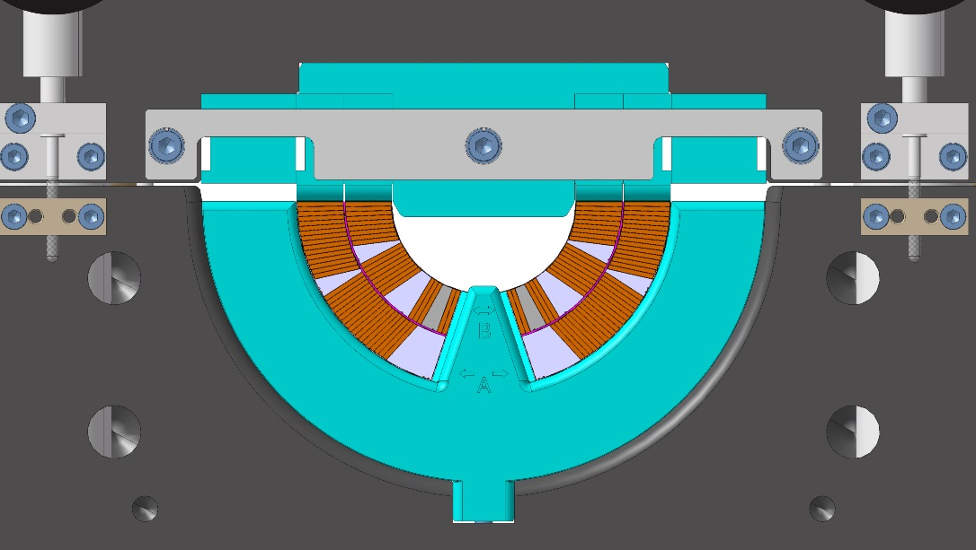
3. Analysis and Characterisation of the E-modulus of the 11T Dipole Coil
E-modulus Press
Modification of an existing press (used to measure MQXC coils).
Plan to characterise a real 11T dipole coil.
Measurements to be used as a reference to validate 10 stack measurements, FE and analytical models.

Slide 10
4. Summary & Short-Term Action Plan
Procurement of components for the 11T prototype is now in the follow-up stage.
Laser measurement system is ready for calibration and initial testing. Further development of LMA software is projected.
Initial development of a simplified model of the transverse behaviour of a 10 stack sample is ready. Further developments are expected.
First measurements with the E-modulus press expected for the end of the summer 2016.
Planned development of FE model to predict stresses in the 11T cold mass welds.

Slide 11
Thanks!

