Slide 1

TE-MSC-MDT

Slide 2


2nd FTEC WORKSHOP
Spanish Traineeship Program CIEMAT-CERN
28/04/2016
Juan Carlos Perez TE-MSC-MDT
Jose Ferradas TE-MSC-MDT

Slide 3
Outline
Description and status of the project
Project TE3536 at Laboratory 927
Magnet Design and Technology (MDT)
Model production
Main results

Slide 4
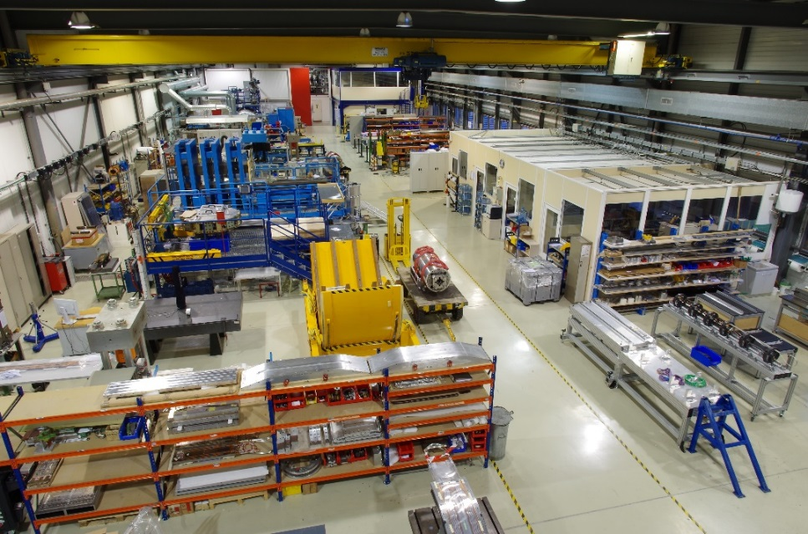
Description and status of the project
1. GENERAL
Project TE3536: Develop dimensional control techniques (using the FARO arm) for short and long Nb₃Sn coils
Mechanical Engineer position at Lab.927 (TE-MSC-MDT Section).
  From functional specifications to the construction of short models
2 main activities during these 10 months:
  TE3536 Main Project
  MCBXF Orbit Corrector collaboration// CIEMAT – CERN Project
Technology Department
Magnets, Superconductors and Cryostats Group
Magnet Design and Technology Section
Presentation pictures courtesy of N.Peray

Slide 5
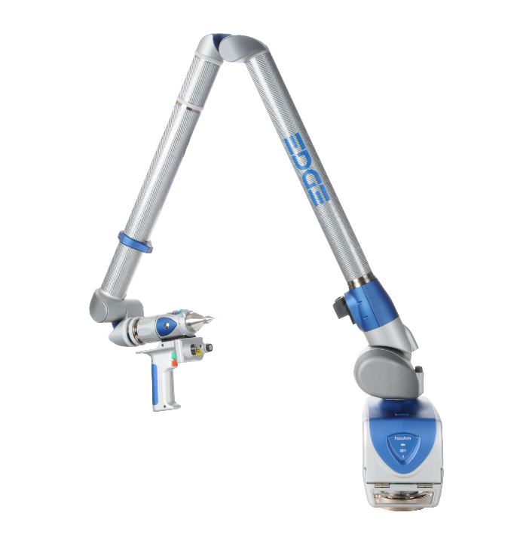
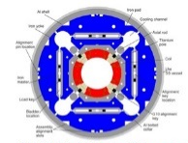
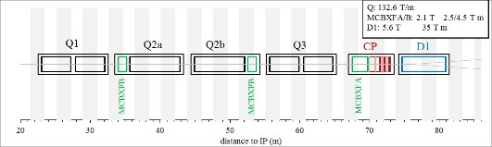

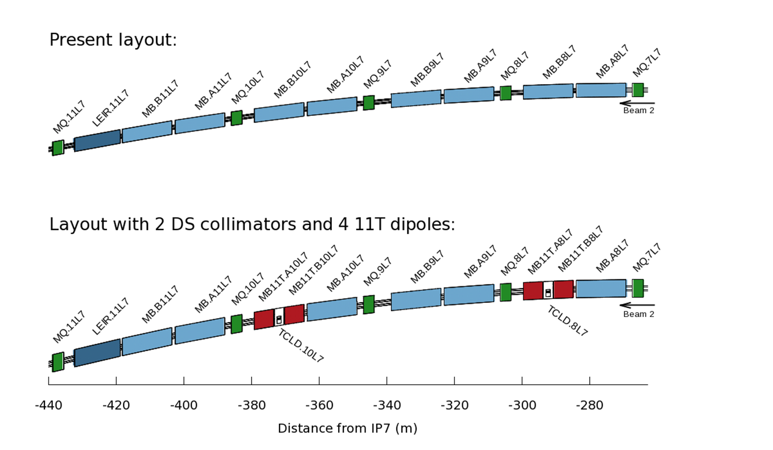
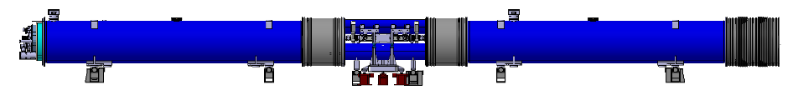
Project TE3536 at Laboratory 927
2. TE 3536
Supervisor: M. Juan Carlos Perez
Work developed:
  Mechanical measurements and its analysis
  Participation in most activities in the Lab
  Participation in meetings and workshops (CIEMAT, FERMILAB/BNL/LBNL (USA), CEA/SACLAY…)
  Contact with suppliers and collaborators
Projects:
  WP11.- 11T Dipole
  WP3.- Magnets for insertion regions: MQXF Project
  High Field Magnets R&D (FRESCA2, SMC, RMC…)
  HTS MAGNETS R&D (High Temperature Superconductors)

Slide 6
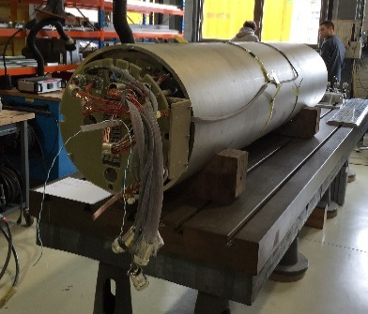
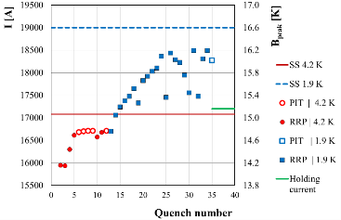
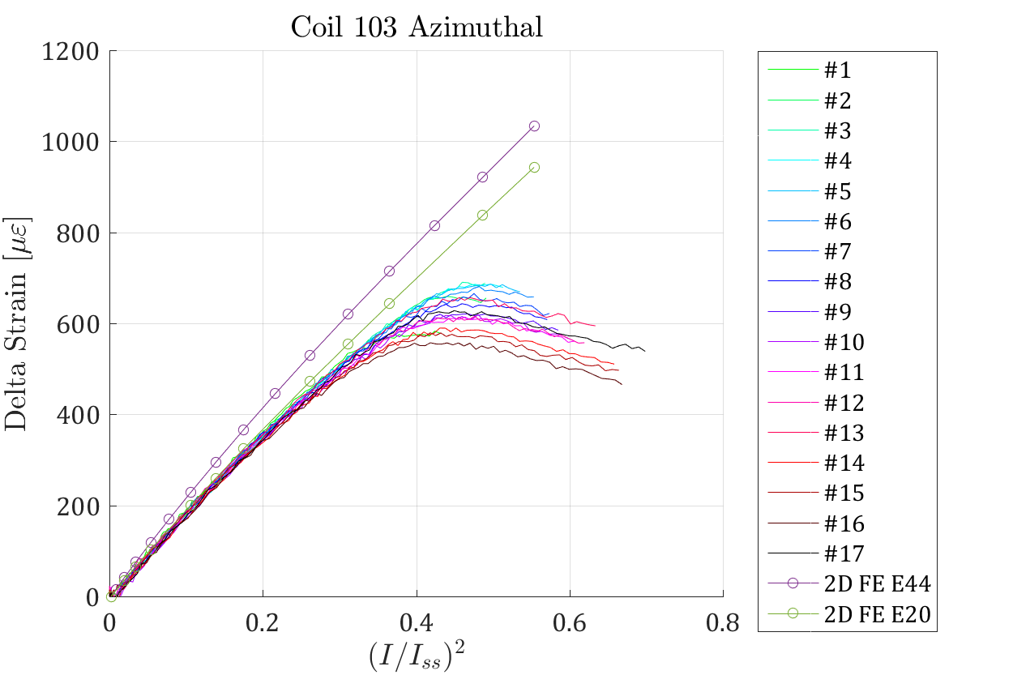
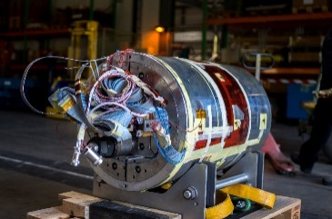
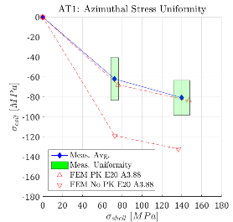
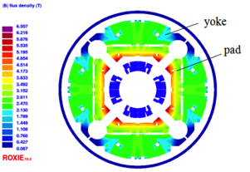
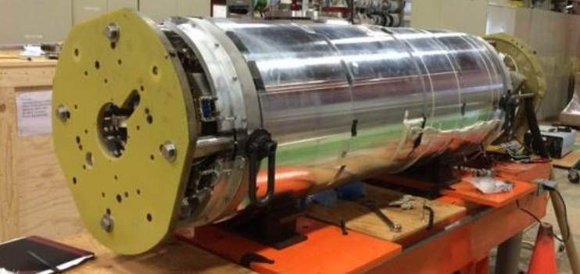
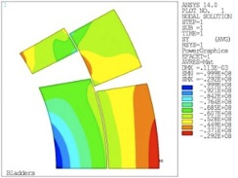
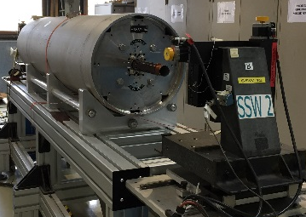
Magnet design and technology (MDT)
3. MDT
Prototype Production
Magnet Design
Model Production
Testing
Results analysis and implementation
Series production
Analytical Magnetic Analysis
Electro-magnetic optimization
Mechanical optimization
Protection
Inverse analysis of test results
Activities at Lab.927

Slide 7

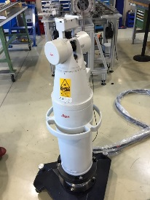
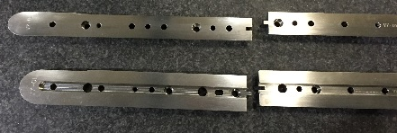
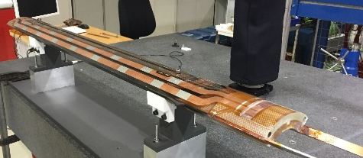
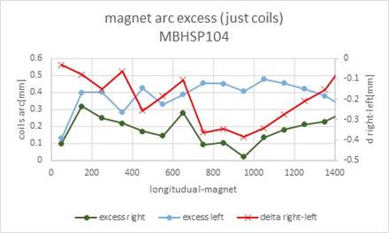
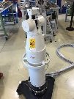
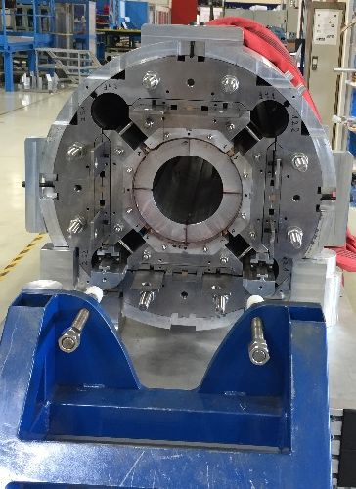
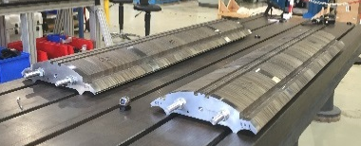
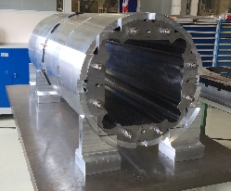
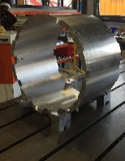
Model production
3. MDT
Coil components
Coil construction
Coil
Cable
Coil winding and curing
Reaction
Impregnation
Instrumentation
Mechanical Measurements
Necessary: Geometrical information
Magnet assembly
Geometry compensation (Shimming)
Magnet
Mechanical assembly
Magnet structure parts
Structure assembly
Mechanical measurements and analysis

Slide 8
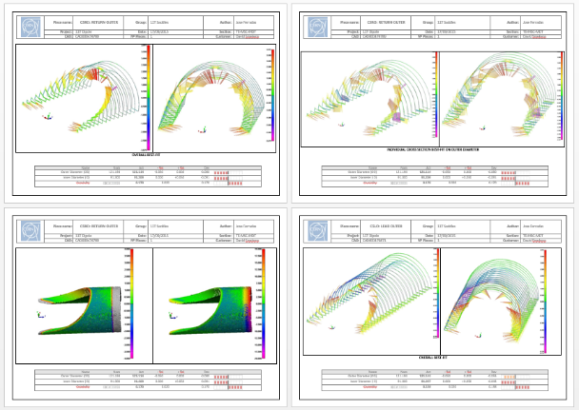
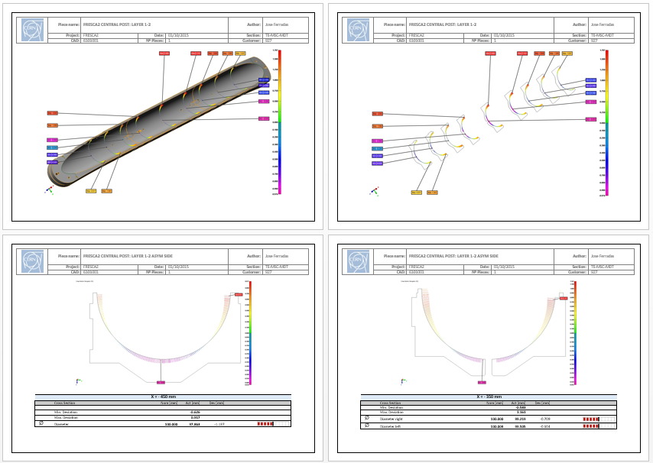
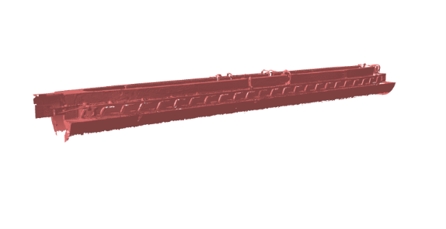
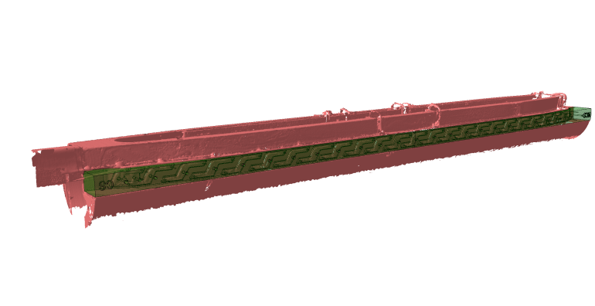
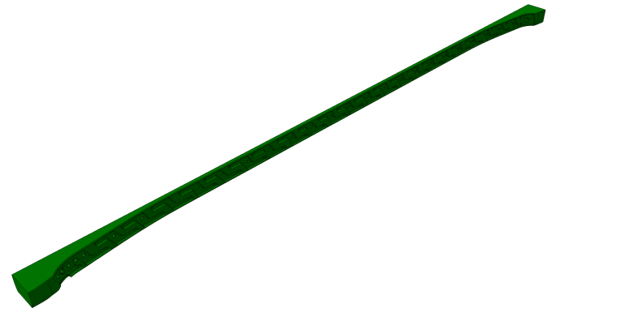
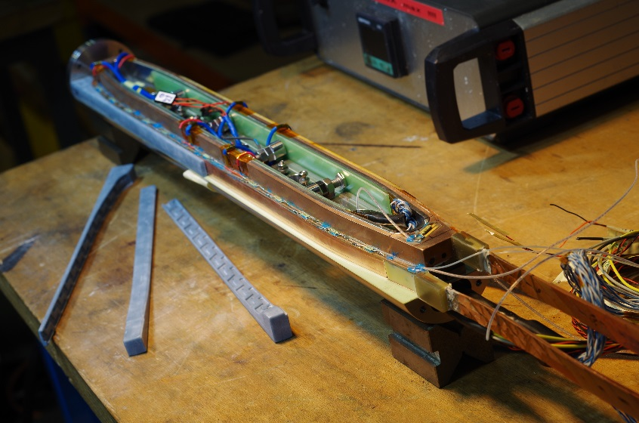
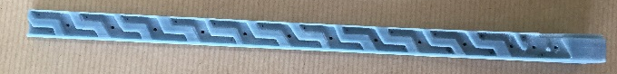
Main results
4.RESULTS
Knowledge acquisition:
  Superconducting Magnets Design and Technology
  Mechanical Engineering and analysis
  (CMM Coordinate Measurement Machine)
Mechanical measurements and analysis of their results
10-Stacks measurements for precise cable insulation thickness
Magnet assembly
Reverse engineering applications for high field magnets

Slide 9
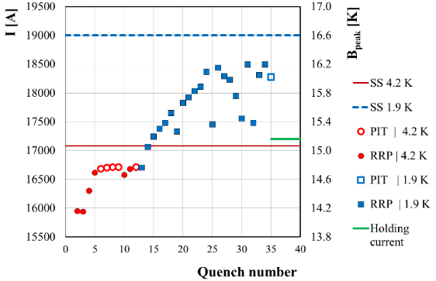

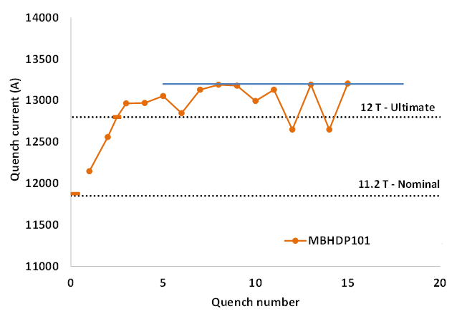
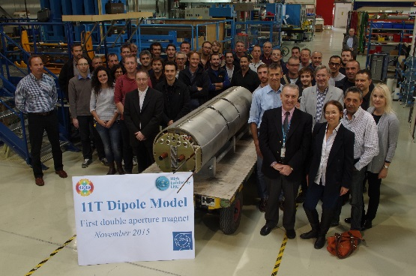
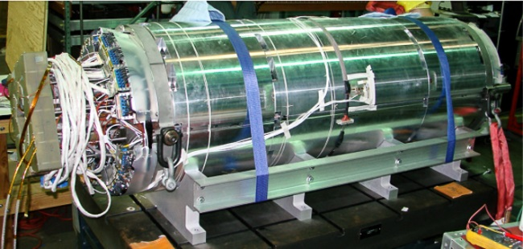
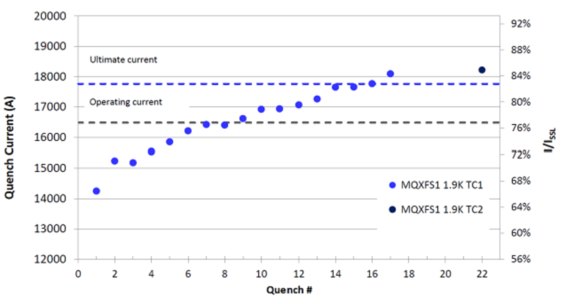
Main achievements
5.ACHIEVEMENTS
RMC Magnet reached a peak field of 16.2T.
  Corresponding to a current of 18.5kA
  Domain of record dipole type fields. Joining LBNL
First 11T Dipole double aperture model magnet assembled and tested at CERN
  Performance beyond design current (Over 12.5 T )
  No quenches up to nominal current (Coils previously tested)
First MQXF quadrupole model magnet assembled and tested at Fermilab
  Ultimate current reached
  Holding current test passed
  Quench memory successful after thermal cycle

Slide 10
Thank you
acknowledgment
Juan Carlos Perez TE-MSC-MDT
Jose Ferradas TE-MSC-MDT

